Slide 2
Schneider and Chambers 2008

Slide 3
Ferrandon et al. 2007

Slide 4
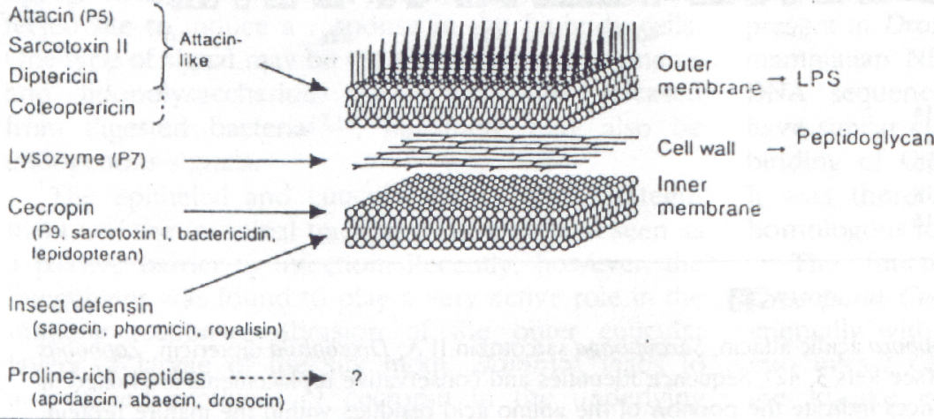
Obr. 1 : Navržené schema působení indukovaných antibakteriálních proteinů a peptidů na buněčnou stěnu bakterií (Hultmark 1993)
Notes:
The G- cell has an additional layer and from the external view of the cell the outside is convoluted. The G+ wall is much thicker then the G- and from its external view has a smoother appearance

