Slide 1
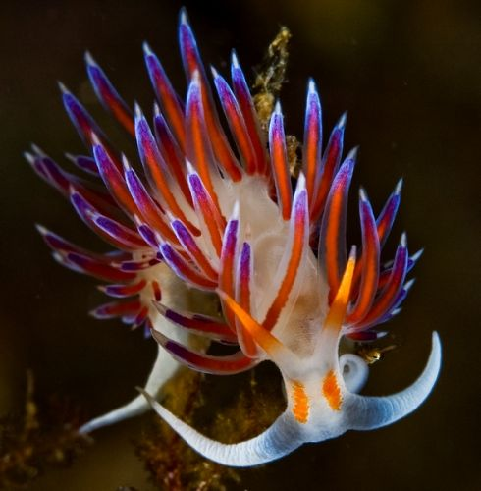
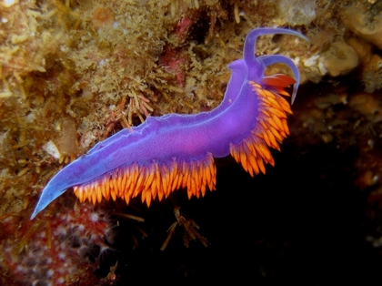
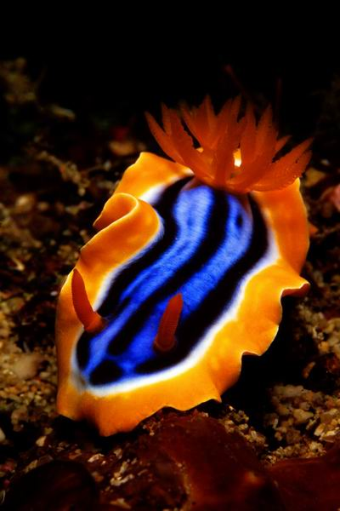

Molecular
Marine Biology
Symposium on the Latest Advances in Biology of Nudibranchia
Brno, May 4, 2016
Masaryk University, Faculty of Science
Central European Institute of Technology
Sections
I. Genomics, II. Proteomics, III. Metabolomics
IV. Lipidomics, V. Glycomics, VI. Secretomics
National Marine Institute
Cejc, Czech Republic
NaMaIn
v
v

