Slide 1
Mechanistic Studies of Plasma Polymerization of Allylamine
Andrei Choukourov, Hynek Biederman, Danka Slavinska, Luke Hanley, Andrey Grinevich, Hanna Boldyryeva and Anna Mackova
J. Phys. Chem. B, 2005, 109, 23086-23095

Slide 2
Content of publication
Analyses of amine-rich plasma polymers prepared in a glass tubular reactor with external ring electrodes and standard excitation frequency of 13.56 MHz from allylamine monomer (2.5 sccm) under working pressure 25 or 100 Pa.
For deposition were used pulsed-wave (PW) discharge mode and continuous (CW) mode (duty cycle 0.1 or 1), with average power in range 2-20 W
Used physical techniques for characterization of plasma polymers: IR spectroscopy, XPS, AFM, RBS
Chemical methods: derivatization.
Comparison of chemical composition for different depositions, stability of the surface in the air
Discussed polymerization mechanism=layer-by-layer growth: based on comparison of amine content for PW and CW plasma polymers and AFM study of ultrathin (1-10 nm) layers

Slide 3
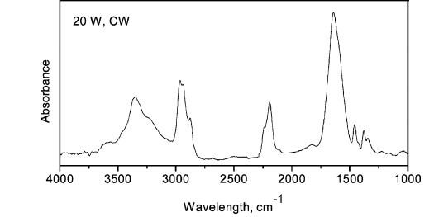
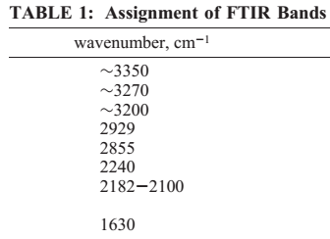
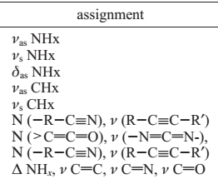
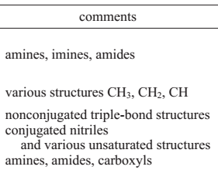
Published results: Infrared spectroscopy
Lambert-Beer law:
$log\frac{I_{0}}{I}=log\frac{1}{T}=A=αdC$
Results of IR spectroscopy in publication: description of absorption peaks and changes dependent on applied power (CW mode)
Problems: it is impossible to determine number of primary and secondary amines
What I miss in the text:
Details about data manipulation: problems with background
Quantitative analysis of IR spectra: comparison of the intensity of the paks or area under specific absorption region according to the thickness
No discussion about NH2 scissoring first overtone
No comparison of IR spectra of PW and CW layers

Slide 4
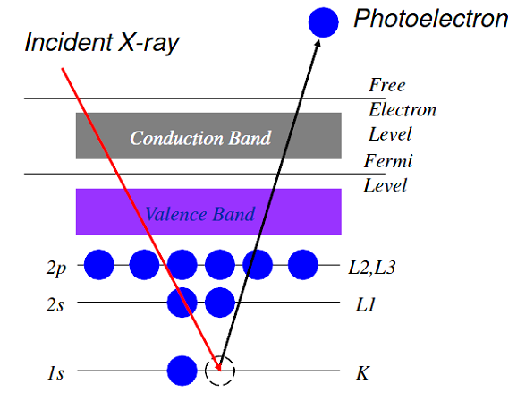
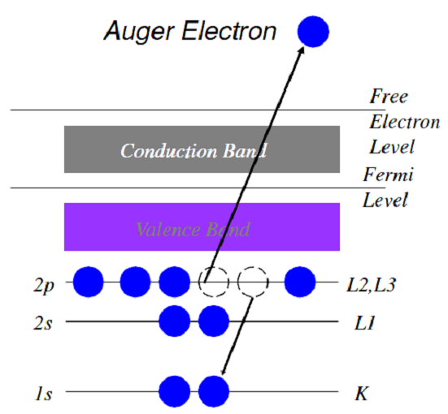
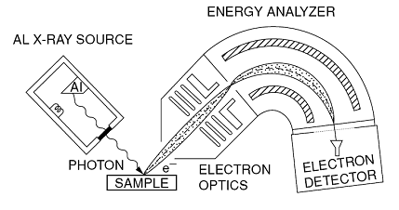
X-ray photoelectron spectroscopy
Measurement:
Wide scan survey spectrum: wide spectrum of binding energies (0-1300 eV) usually with lower resolution; identification of the elements and finding possible charging effect=) determination of elemental composition
Narrow scan survey spectrum: higher resolution measurement including area of concrete peak (C 1s) ; determination of chemical bonds (chemical shifts to higher binding energies)
XPS involves irradiating a sample with X-rays of a characteristic energy and measuring the flux of electrons leaving the surface.
XPS spectral lines are identified by the shell from which electron was ejected
Kinetic energy of photoelectron:
$E_{k}=hν−E_{b}−φ$
Following process : emission of Auger electron with specific kinetic energy

Slide 5
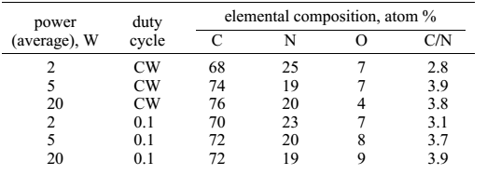
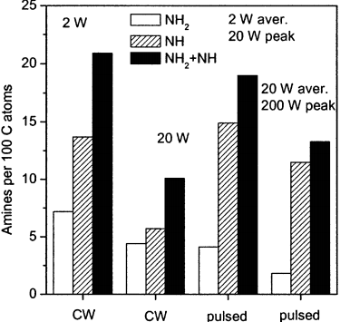
Chemical composition of the surface of allylamine polymers
Elemental composition : high resolution XPS
Primary and secondary amines: derivatization =) Binding energies of NH and NH2 are very close ~399.2 eV in N 1s environment .
Principle of derivatization: chemical reaction of amine group with specific compound. Used Trifluoromethyl benzaldehyde (TFBA) reacts only with NH2 . Trifluoroacetic anhydride (TFAA) was also used, however reacts with NH2, NH, and OH.
Discussion of the results:
higher supplied (peak) power results decrease of nitrogen content and amine content
For PW mode decreasing trend is not so strong
The overall increase in amine concentration in the pulsed mode compared to CW according to the supplied power (20 W) is attributed to secondary amines.

Slide 6
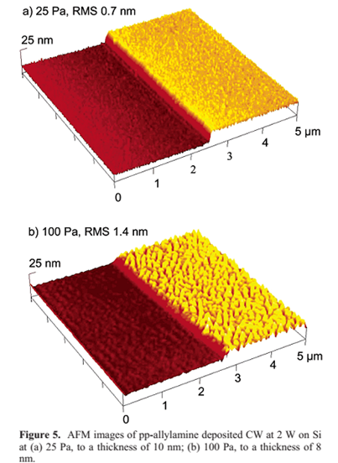
Rutherford backscattering
IR spectroscopy and XPS does not allow determination of hydrogen content
Thin films contain ~43 at. % =) about 20% less than in monomer (64%)
Atomic force microscopy
Usage of intermittent contact mode to eliminate artifacts induced by an AFM tip on a relatively soft plasma polymer surface
Scanned area: 1 x 1 μm and 5 x 5 μm; ultrathin layers (~10 nm)
comparison of the films deposited under 25 and 100 Pa
25 Pa: smooth layers, roughness does not change with thickness.
On the contrary, at 100 Pa, the film growth is more complex: roughness strongly dependent on thickness.
no indication of plasma polymer nucleation was observed within the AFM detection limit,=)the allylamine film formation occurs predominantly via a layer-by-layer mechanism

Slide 7
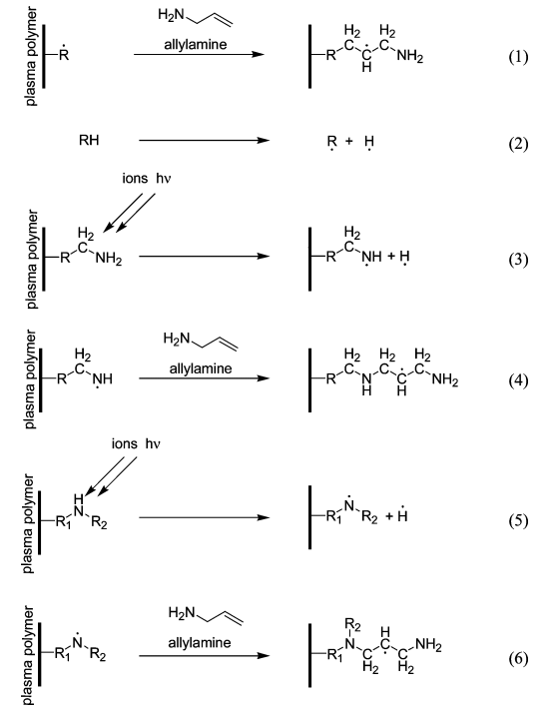
Possible reactions during plasma polymerization in PW mode Comparison with analyses of allylamine polymers
Plasma-off . Significant film formation (Yasuda studies). Plasma-induced polymerization of allylamine goes via the successive reactions of the monomer molecules with the surface radicals. The overall increase in amine concentration in the pulsed mode compared to CW (according to the supplied power) is attributed to secondary amines. This indicates that reaction 1 alone cannot account for all studied polymerization.
Plasma-on: in general, there is the hydrogen detachment in plasma polymerization=) lower hydrogen content in polymer in comparison with monomer-RBS
Reactions with ions and radiation=) radicals
The surface radicals participate in polymerization reactions with the gas-phase species or with each other to produce a highly cross-linked structure. The nitrogen radicals take part in chain propagation reactions forming the secondary amine structures (observed in IR, on the surface)
5), 6) The continuing loss of hydrogen with formation of non-amine nitrogen species

Slide 8
Conclusion
Positives:
It is possible to prepare smooth amine-rich coatings by plasma polymerization of allylamine =) possible usage for bioapplications
Good stability of polymers in the air (surface chemistry)
Discussion of plasma polymerization mechanism according to the
experimental results: amines and hydrogen content and AFM study of surface structure
previous researches focused on plasma polymerization: Yasuda H.: Plasma Polymerization;, Academic Press: New York, 1985; p 432;
Beck A. J., Candan S., Short R. D., Goodyear A., Braithwaite, N. St: J. Phys. Chem. B, 2001
Negatives:
Results of IR spectroscopy can be discussed in more detail, I miss comparison of PW and CW plasma polymers
Errors of chemical composition of the surface are not discussed
AFM study of surface includes plasma polymers prepared under different working pressure=) roughness comparison; however possible changes in chemistry are not mentioned

Slide 9
Thank you for your attention

