Slide 1
F7360 Characterization of thin films and surfaces
Katarína Bernátová Brno, 30.5.2016

Slide 2
Outline
Paper introduction
Experimental details and coatings
Characterization methods
Appropriateness of the methods
Achieved results

Slide 3
Introduction
Tribological behaviour of titanium carbide/amorphous carbon nanocomposite coatings: From macro to the micro-scale
J.C. Sánchez-López , D. Martínez-Martínez 1, C. López-Cartes, A. Fernández [1]
Motivation of the study – quality nanocomposite coatings (low friction and wear resistance, good toughness)

Slide 4
Experimental details and coatings
DC (graphite target) and RF (Ti target) magnetron sputtering
SPR (Sputtering power ratio) ~ P(C)/P(Ti)
Argon gas, total pressure = 0.75 Pa
TiC/a-C nanocomposite coatings

Slide 5
Characterization methods 1. X-ray diffraction
Atomic and molecular structure of crystal
Diffraction of X-ray beam on crystal lattice
Bragg´s law:
Structure factor [2]
d – spacing between diffracting planes
Θ – the incident angle (X-ray and planes)
n – integer
λ – wavelenght of the beam (0,01-10keV)
f_{n} - an atom´s structure factor
h, k, l - Millers index
u, v, w – coordinates of an atom

Slide 6
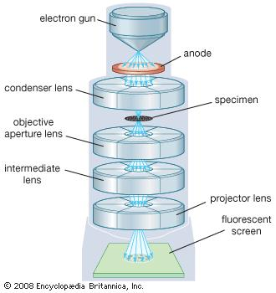
Characterization methods 2. Transmission electron microscopy (TEM)
Crystal structure, dislocations and grain boundaries in structure
High energy beam of electrons (keV)
Thin sample (nm)
Absorption of el. in material [3]

Slide 7
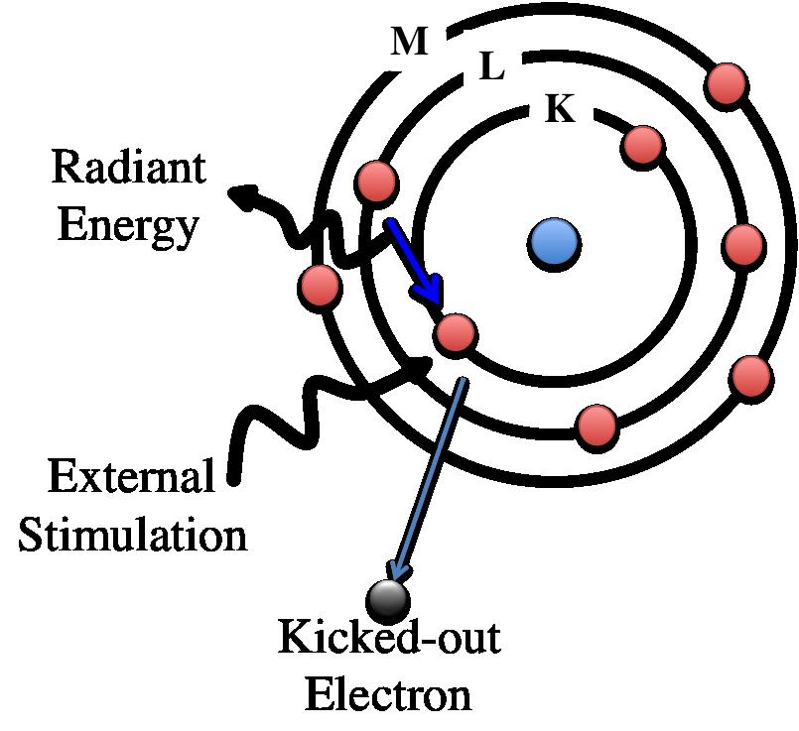
Characterization methods 3. Electron energy-loss spectroscopy (EELS)
Elemental compositions, chemical bonds
The study of the vibrational motion of atoms and molecules
On or near the surface
Interaction between the electron beam (0.1-10keV) and the specimen [4]

Slide 8
Characterization methods 4. Micro-Raman spectroscopy
The study of the interaction between light (inelastic scattered) and matter
Photons of a single wavelength
Stokes Raman scattering
Functional group, the structure of the molecules
Micro-Raman spectroscopy – microscopic samples [5]

Slide 9
Appropriateness of the methods
XRD – crystal structure of the films
EELS, Raman, XRD – a-C/TiC rates, chemical composition, phases proportion inside the film
Combination of TEM with EELS spectrometer
Pin-on-disk tribometer – tribological tests for friction coefficients, wear rates

Slide 10
Achieved results
Tribological properties
Film microstructure Phase composition

Slide 11
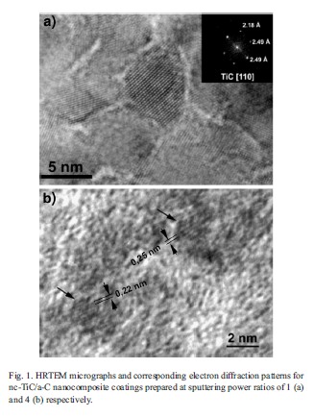
Achieved results 1)TEM
Fig.1: a) SPR = 1, TiC crystal (5-10nm) with random orientation
Fig.1: b) SPR = 4, 1 nm sparticles, amorphous matrix

Slide 12
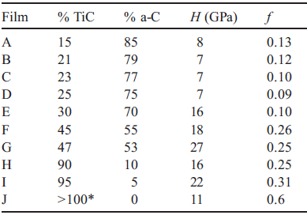
Achieved results 2) EELS
EELS spectra on the C K-edge core loss
Shape and position of the spectra changed gradually (from TiC to a-C phases)
The best tribological performance (low friction, low instabilities) – for the highest a-C contents
Table 1: Summary of samples, phase contents and tribomechanical properties

Slide 13
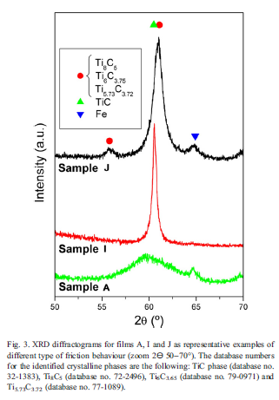
Achieved results 3) XRD
TiC phase – crystal size is strongly reduced as the carbon content increases (5% to 85%)
Sample J – non-stochiometric Ti-enriched TiC phases

Slide 14
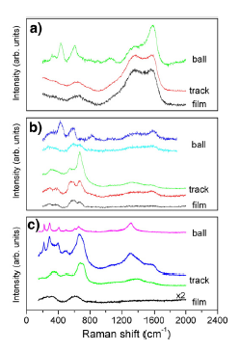
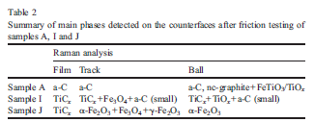
Achieved results 4) Raman spectroscopy
a) sample A: a-C content 85%
- two bands: 1370 cm⁻¹ and 1565 cm⁻¹ (sp2 content)
b) sample I: a-C content 5%
- understochiometric TiC (active due to carbon vacancies)
c) sample J: a-C content 0%
- Iron oxides formation by tribochemical reaction of the steel ball with the atmosphere

Slide 15
Conclusion
a-C content
> 60-65%
Surface prevention from
Mechanical wear and oxidation

Slide 16
References
[1] J.C. Sánchez-López ⁎, D. Martínez-Martínez 1, C. López-Cartes, A. Fernández, Surface & Coatings Technology 202 (2008) 4011–4018
[2] Rentgenová spektroskopie a difrakce [online]. Univerzita Karlova v Praze, [cit. 2012-5-5]. Dostupné na <http://physics.mff.cuni.cz/vyuka/zfp/>.
[3] http://www.britannica.com/technology/transmission-electron-microscope https://www2.warwick.ac.uk/fac/sci/physics/current/postgraduate/regs/mpags/ex5/techniques/structural/tem/
[4] http://iopscience.iop.org/article/10.1088/0034-4885/72/1/016502/pdf
http://tpm.amc.anl.gov/Lectures/EELSAEMShortCourse.pdf
[5] http://www.microspectra.com/support/technical-support/raman-science/35-technical-support/126-science-of-micro-raman-spectroscopy

Slide 17
Thank you for your attention!

