Slide 1
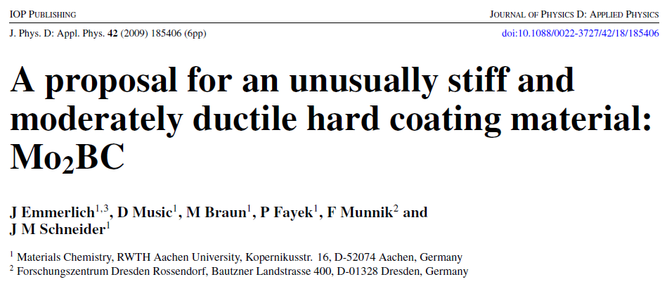

Slide 2
Introduction
Protection of tools – thin films
Most thin films – hard but brittle
Combination of hardness and moderate ductility to prevent formation and spreading of cracks
Nanolaminate Mo₂BC
Prepared by magnetron sputtering

Slide 3
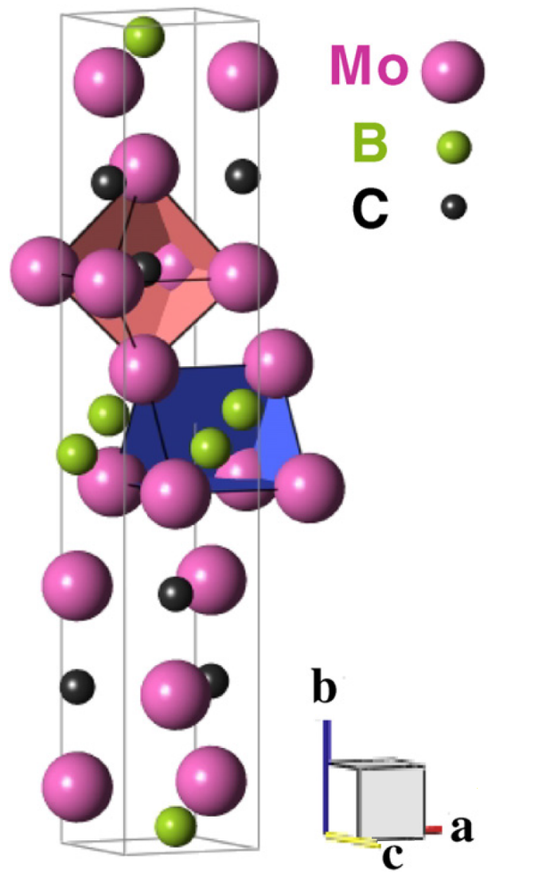
Mo₂BC coatings
Combination of great hardness and moderate ductility
Stiff Mo-B and Mo-C layers with metallic interlayer bonding
B – bulk modulus
G – shear modulus
B/G > 1,75 ductile materials
Mo₂BC thin films were synthesized using DC magnetron sputtering on Al₂O₃ at a substrate temperature of ∼900 °C
Material | B (GPa) | B/G
TiN | 295 | 1,39
Ti_{0,25}Al_{0,75}N | 178 | 1,44
c-BN | 376 | 0,98
Mo₂BC | 324 | 1,72

Slide 4
Used characterization methods
X-ray diffraction
Scanning electron microscopy
Electron recoil detection analysis

Slide 5
X-ray diffraction (XRD)
Information about the crystal structure
Uses the scattering of photons on the atoms of the lattice
The superposition of the scattered waves from individual atoms leads to classical reflection of light
The incident rays are reflected from the atomic planes and interfere with each other
Constructive interference occurs, when the Bragg condition is met

Slide 6
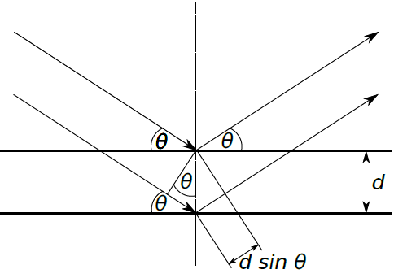
X-ray diffraction (XRD)
The Bragg equation:
2dsinθ = nλ
λ is the wavelength of the incident light, d is the distance between atomic planes, n is an integer and θ is the angle of incidence.

Slide 7
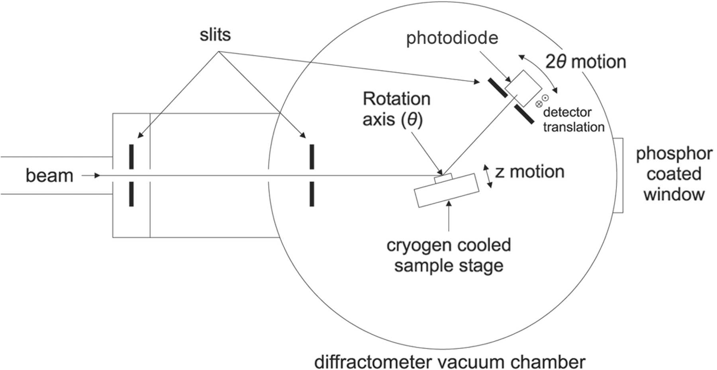
X-ray diffraction (XRD)

Slide 8
X-ray diffraction (XRD)
Three methods of measuring:
Debye-Scherer – monochromatic light and polycrystaline material
Laue – polychromatic light and monocrystaline material
Monochromatic light and monocrystaline material
The combination of polychromatic light and polycrystaline material creates too many diffractions

Slide 9
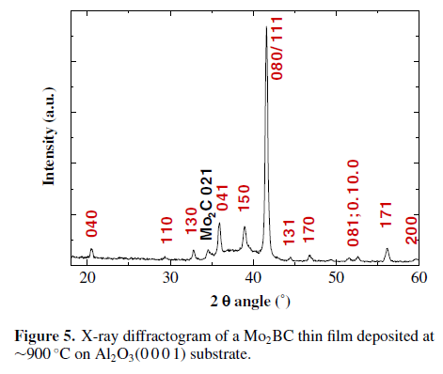
X-ray diffraction (XRD)
The sample consists predominantly of Mo₂BC
There is a minor contribution detected, stemming from Mo₂C
Good agreement between the measured peak positions and the reference values
The relative intensities of the diffractogram do not match due to the sample being textured

Slide 10
Scanning electron microscopy (SEM)
Used for imaging of surfaces
Focused beam of accelerated electrons
The beam is focused and directed by electromagnetic lenses and scanns the surface
High vacuum is necesary to prevent collisions of electrons with gas particles
Possibility to use with EDX or WDX to determine composition

Slide 11
Scanning electron microscopy (SEM)
Two basic kinds of signal:
Backscaterred electrons
Electrons with high energy reflected from the surface
Greater penetration depth but worse spatial resolution
Number of reflected electrons depends on the atomic number of the particle – greater mass – more reflected electrons – brighter spot
Secondary electrons
Electrons emitted from the surface due to inelastic scattering
Because of their low energy, only electrons created at the surface leave the sample
Mostly information about topography – electrons are emitted mostly from sharp edges

Slide 12
Scanning electron microscopy (SEM)

Slide 13
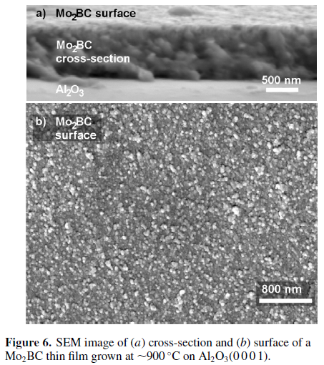
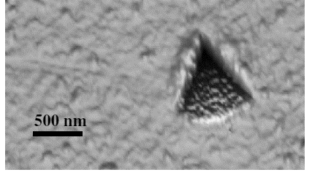
Scanning electron microscopy (SEM)
No formation of pores or cavities
Surface features with a diameter well below 100 nm
No crack formation observed around the indent

Slide 14
Energy recoil detection analysis (ERDA)
Detection of light elements in a heavy matrix
Analysis of forward scattered ions or atoms
A single collision
Particles can by identified by their kinetic energy
Analysis of particles: TOF, thin foil

Slide 15
Energy recoil detection analysis (ERDA)

Slide 16
Energy recoil detection analysis (ERDA)
The film consists of 49 at% Mo, 27 at% B and 24 at% C
The chemical formula Mo₂B_{1.1}C₁, which is very close to the nominal stoichiometry of Mo2BC.
O and H were not detected in the film.
The variation of B from stoichiometric Mo₂BC composition is within the expected measurement error.

Slide 17
Conclusion
Mo₂BC thin films were synthesized using DC magnetron sputtering on Al₂O₃ at a substrate temperature of ∼900 °C.
XRD measurements and ERDA confirmed that the grown film is almost phase pure and of near-stoichiometric composition
No formation of cracks was observed implying moderate ductility
Deformation experiments carried out with nanoindentation confirmed the high stiffness of Mo₂BC

Slide 18
Thank you for your attention!
J. Emmerlich, D.Music,M. Braun, P. Fayek, F. Munnik, J.M. Schneider, J. Phys. D: Appl. Phys. 42 (2009) 185406
Peter E.J. Flewitt, R.K. Wild: Physical Methods for Materials Characterisation, Series in Materials Science and Engineering
https://sites.google.com/a/lbl.gov/rbs-lab/ion-beam-analysis/elastic-recoil-detection-analysis-erda
http://journals.iucr.org/s/issues/2005/04/00/kv5008/kv5008fig1.html

