Slide 1

Building a Global Earth Observation System of Systems (GEOSS)
5th Jubilee International Conference
on Cartography & GIS
Barbara J. Ryan
Director, GEO Secretariat
16 June 2014
Varna, Bulgaria

Slide 2
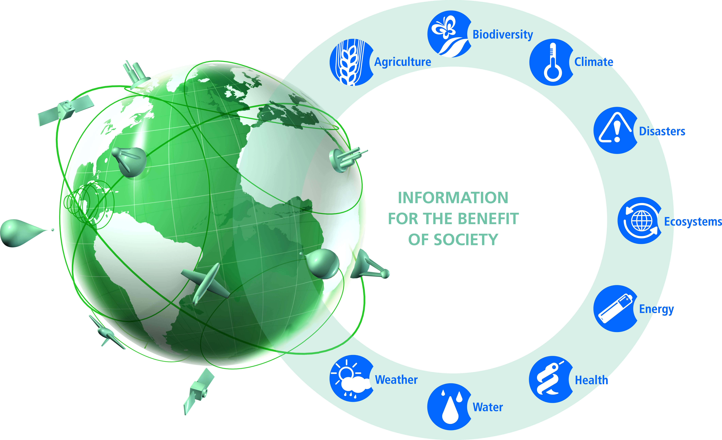
A Global, Coordinated, Comprehensive and Sustained System of Observing Systems
GEOSS

Slide 3
GEO Objectives
Improve and Coordinate Observation Systems
Advance Broad Open Data Policies/Practices
Foster Increased Use of EO Data and Information
Build Capacity

Slide 4
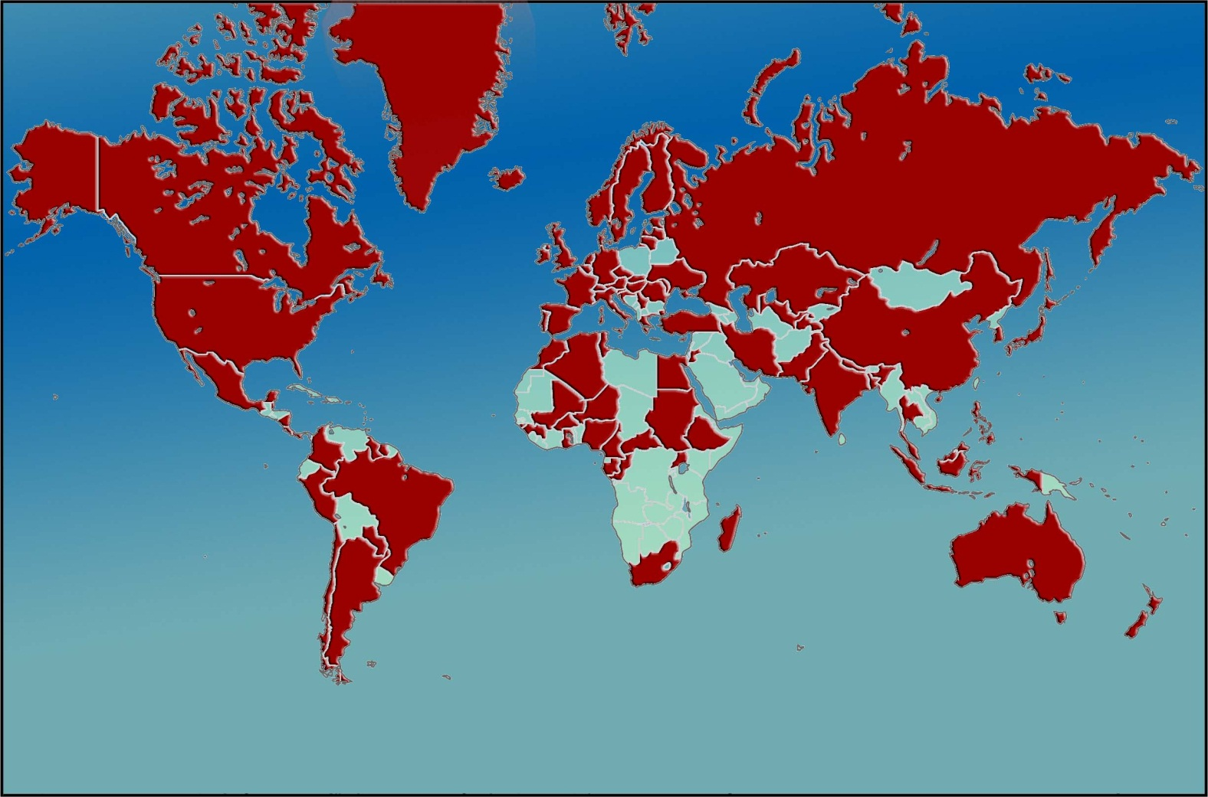
Created in 2005, to develop a coordinated and sustained Global Earth Observation System of Systems (GEOSS) to enhance decision making in nine Societal Benefit Areas (SBAs)
GEO today:
91 Members
77 Participating Organizations

Slide 5





































































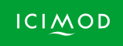




77 Participating Organizations

Slide 6
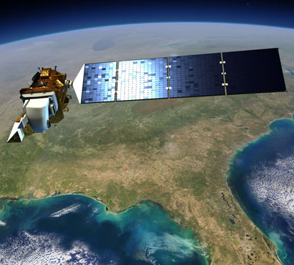
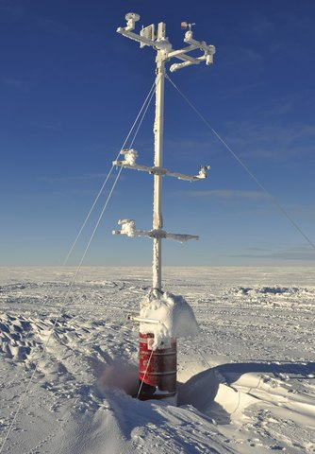
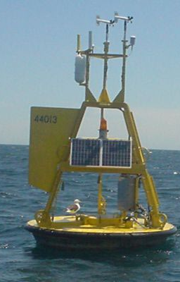
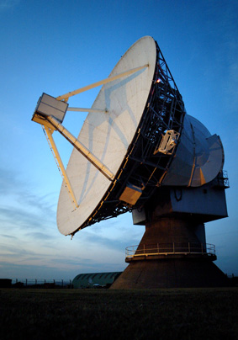
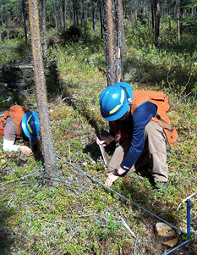
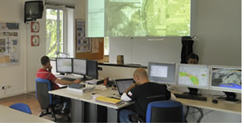
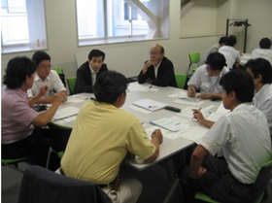
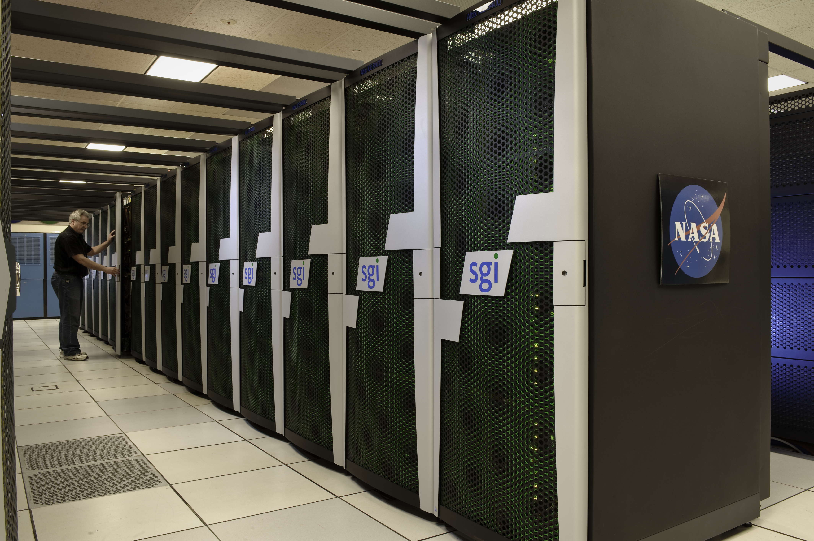
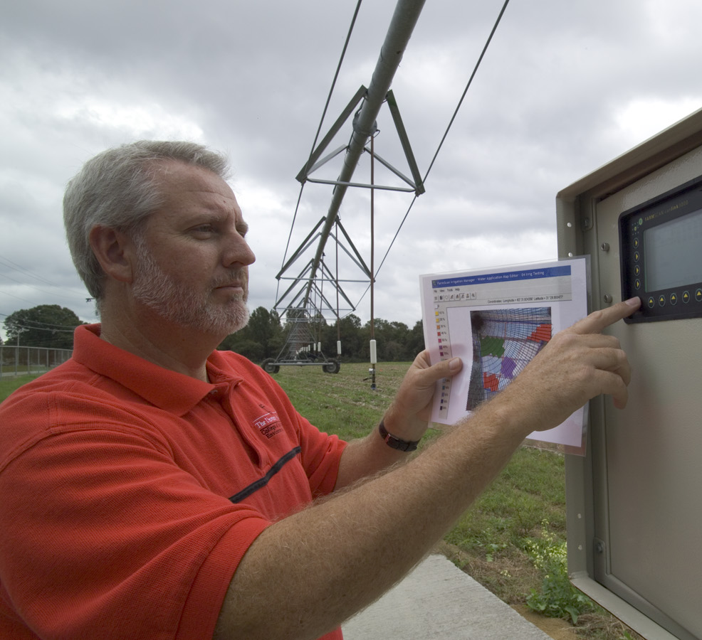
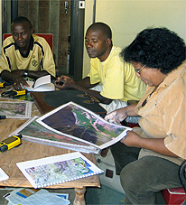
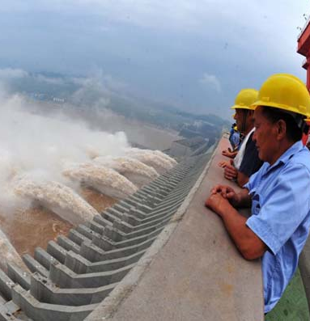
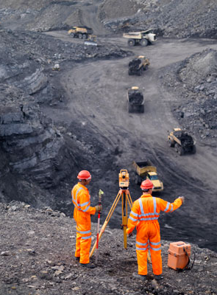
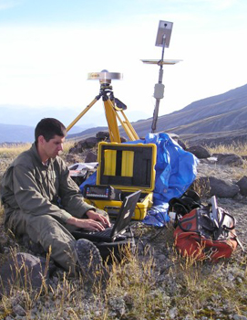
A broad Commercial Sector spans the entire information value chain
Data
providers
Value-Added providers
Downstream
users

Slide 7
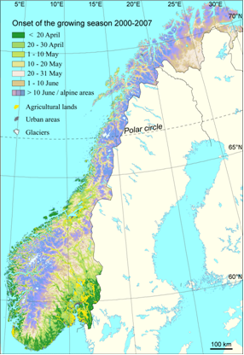
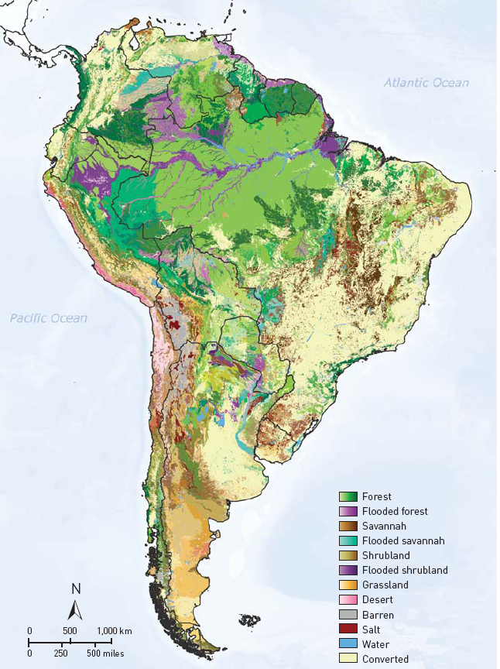

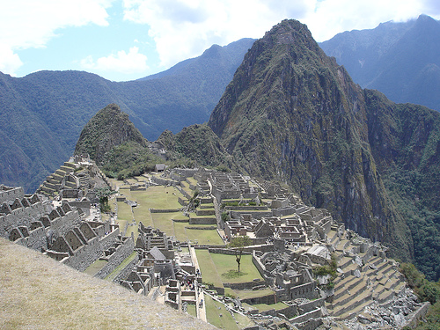
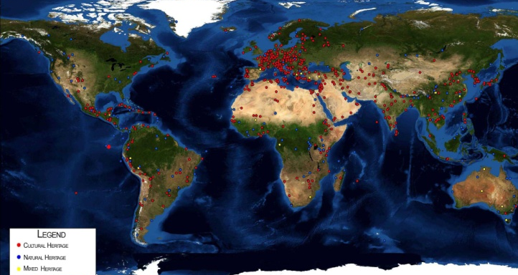




Ecosystem Classification & Mapping
(Australia, Austria, Brazil, Canada, China, EC,
Italy, Paraguay, USA, RCMRD, UNESCO)
* SHARE mountain stations
operational
* All ecosystem mapping
data available; DataCORE
* New maps of growing
season
* Atlas of 40 Chinese
World Heritage Sites
* Decision-making support:
ABCC program

Slide 8
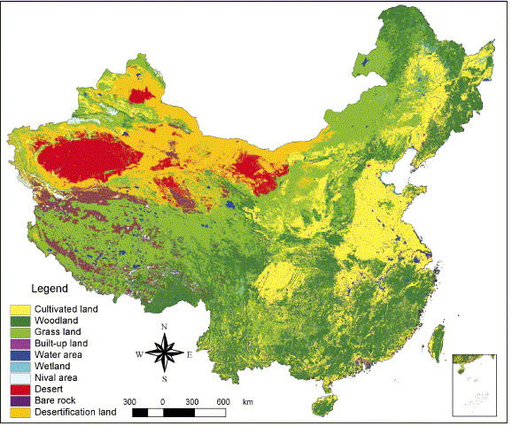
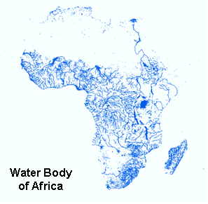
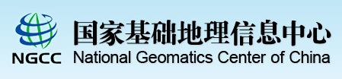
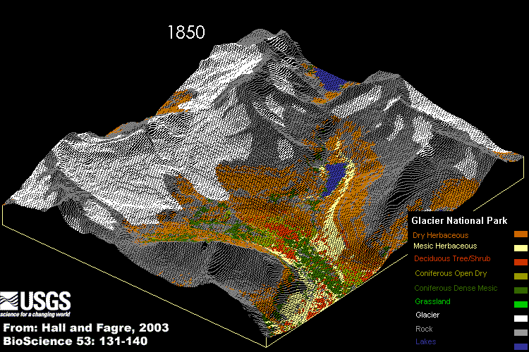
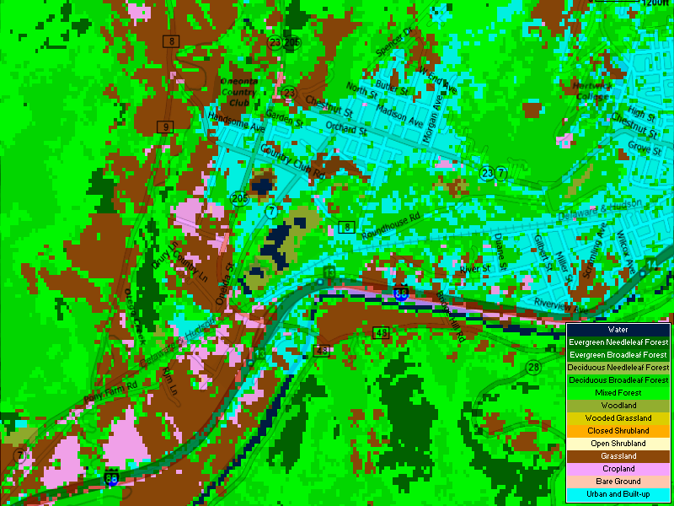
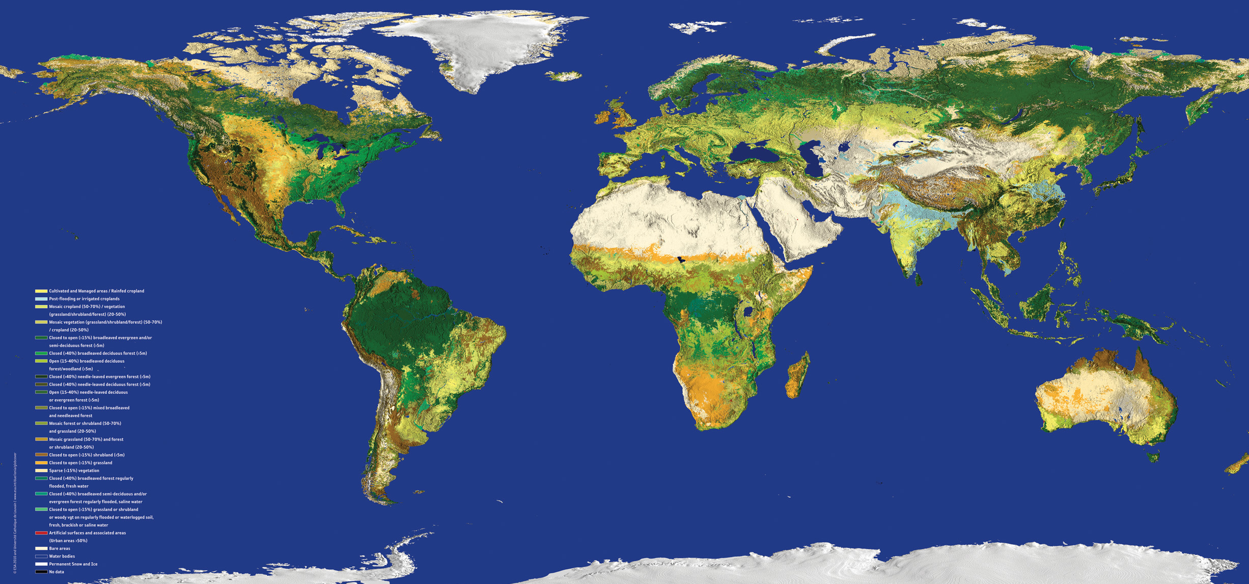

Advanced Land-Cover Products
(Canada, China, EC, Greece, Japan, Netherlands, Nigeria, Spain, Sweden, UK, USA, Spain, EEA, ESA, GTOS, ISPRS)
* Global 30m products
* Major land cover types
(eg. wetland)
* Independent validation
databases
* Global Land Cover Portal
* Growing int’l consensus

Slide 9
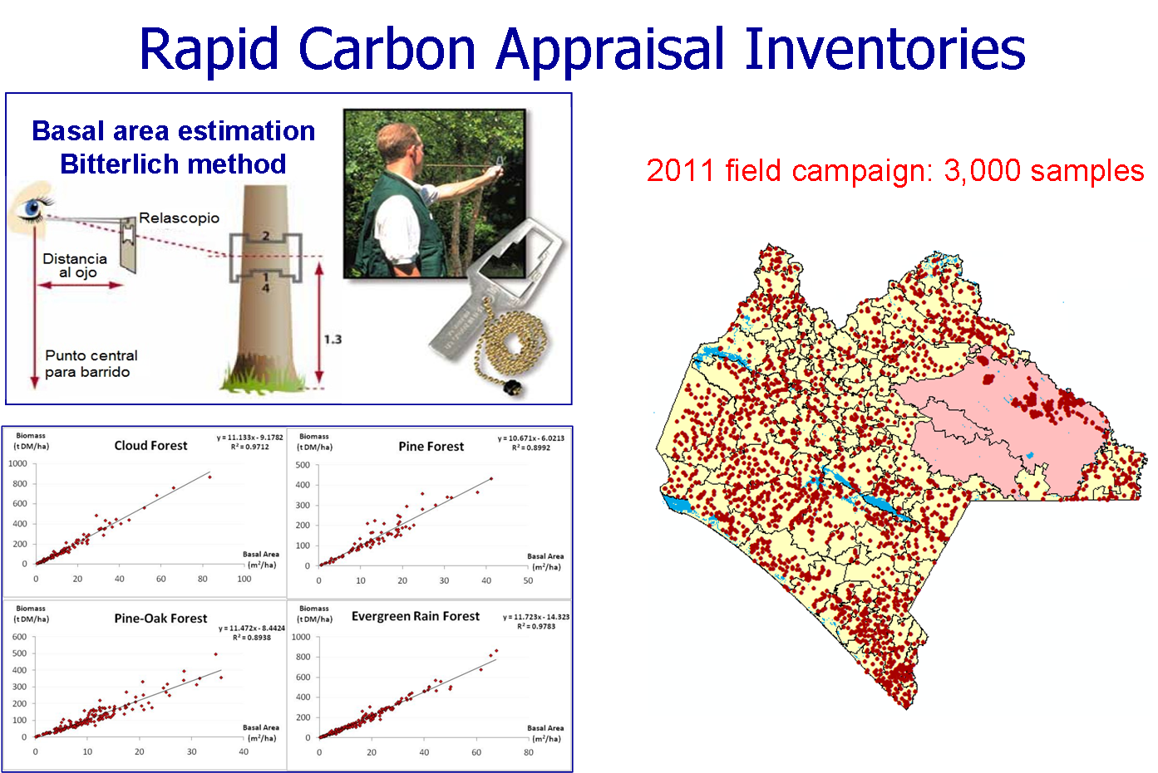
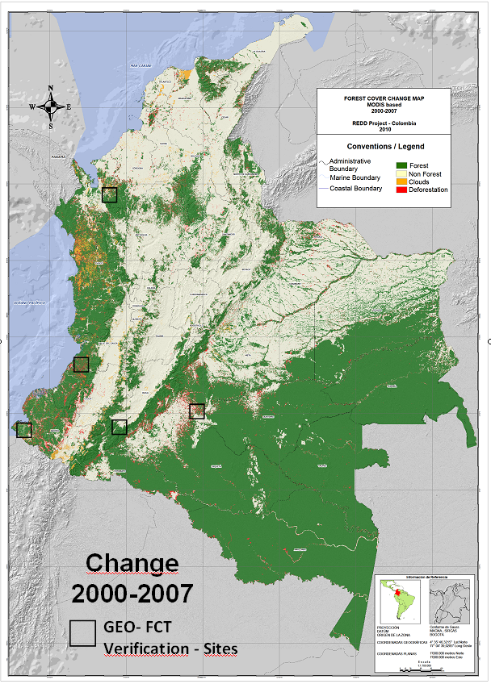
Global Forest Information System
(Australia, Canada, Japan, Norway, USA, CEOS, FAO)
* Forest Carbon
Tracking ongoing
* Demo in 12
countries (Congo)
* Coordinated space
data acquisition
* In-situ validation
* Regional capacity
building growing
(US Silvacarbon)
Mexico
Columbia
In-situ forest measurements

Slide 10
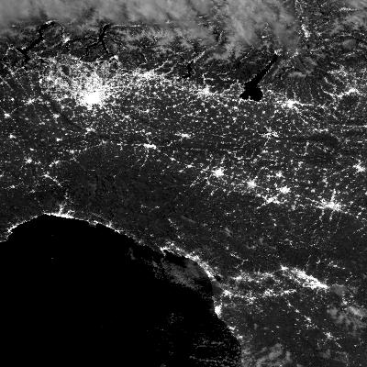
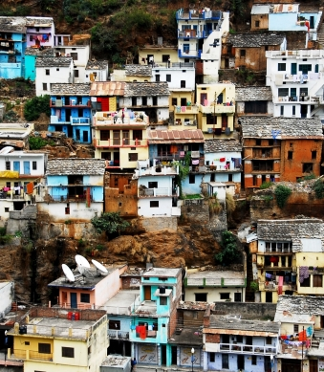

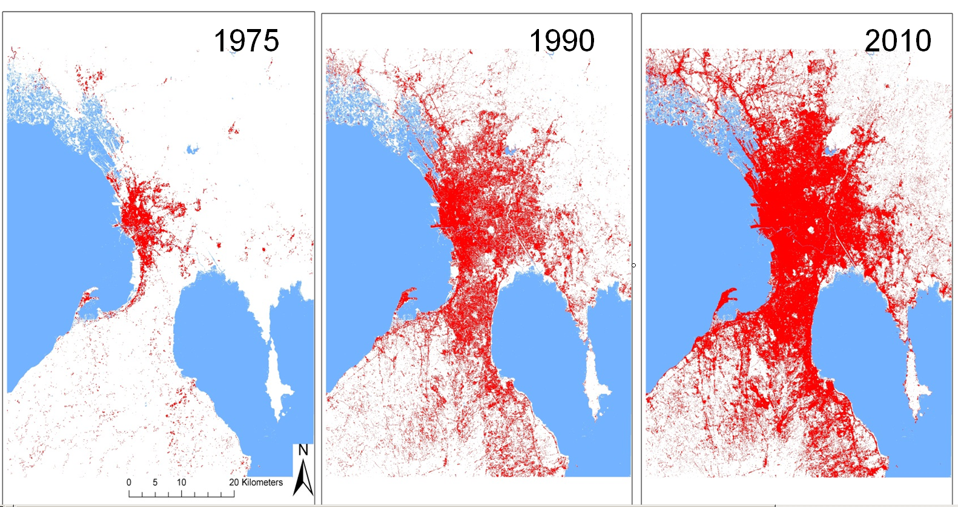
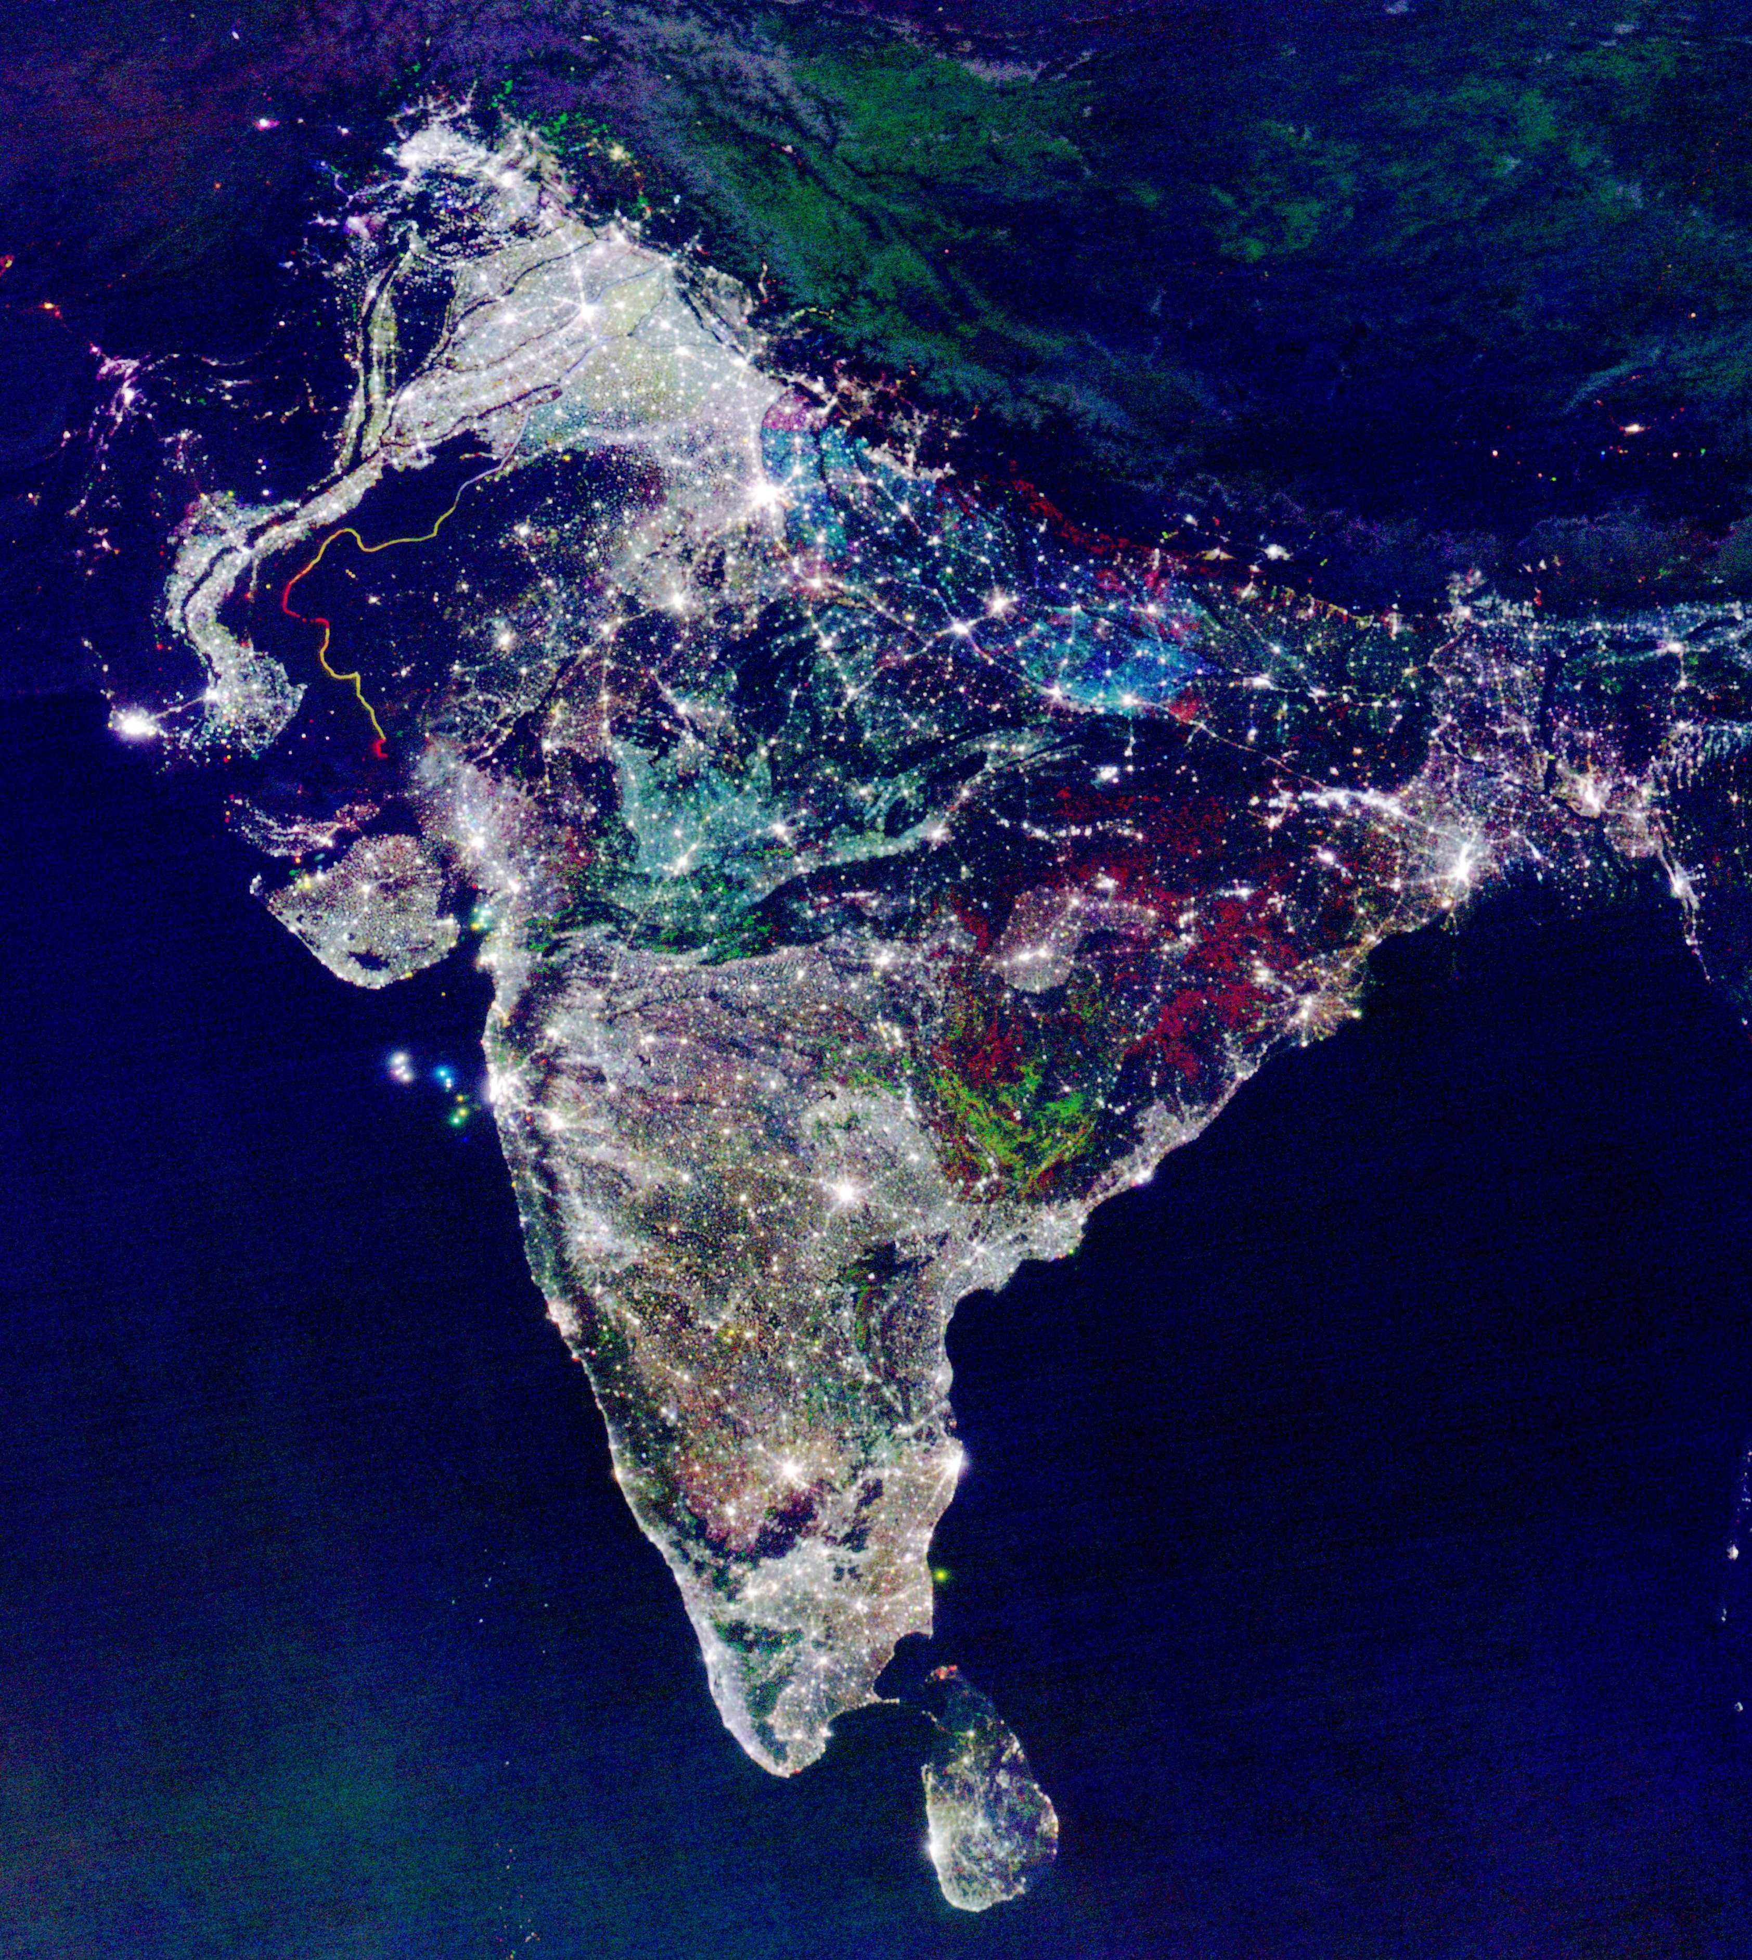


Global & Local Urban Footprints
(China, EC, Germany, Greece, Italy, Pakistan, USA)
* 35-yr evolution of
26 mega-cities
* Global night-time
lights for 2012
* Urban Heat Island
patterns
* Over 3’700 cities
mapped using
ASTER (15m)
Manila

Slide 11
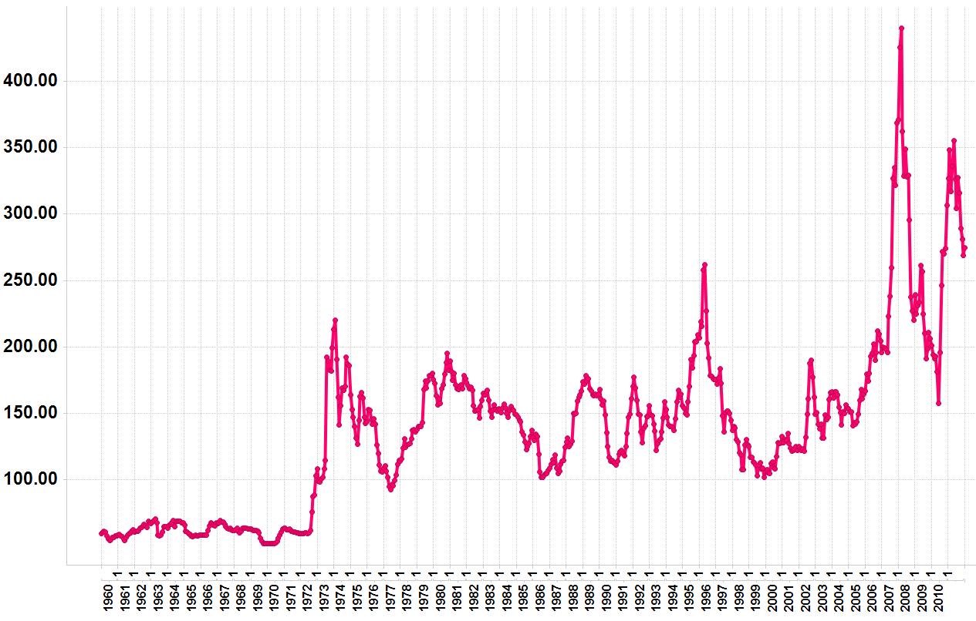
2008 Price hikes
Droughts:
Australia & Ukraine
Monthly Wheat Prices
1960-2011
Today
2010/11 Price hikes
Drought:
Russia
1971/2’s price hike
3x
Landsat 1 Launched (1972)
Nominal wheat price in US $/Metric Ton
Source: World Bank

Slide 12

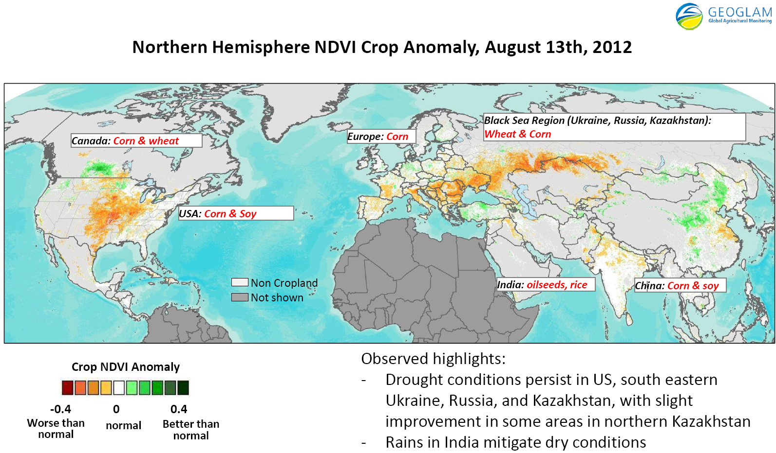


Crop Information for Decision-Making
(Canada, China, EC, France, Japan, Kazakhstan, India, Mexico, Russia, USA, CEOS, FAO)
* GEOGLAM part
of G20 Action
Plan on Food
Price Volatility
* New crop outlook
* Rice crop
monitoring
* Draft space
strategy
Notes:
12
NASS,
China crop watch system
Use of Multi-spatial resolution data for crop rotation mapping at varying scales and coverage in Indo-Gangetic Plains Region of India.
250 m Argentina – crop group map (summer/winter crops, perennial crops)
1km – 56 m Brazil – crop group map (summer/winter crops, perennial crops)
1 km MARS-FOOD - arable land mask for growth monitoring
56 m – 25 m US–NAS – crop type map supported by field survey
1- 5 m + 60 m FEWS – national area estimate for major crops
250 m NASA/USDA/SDSU – croplands area likelihood map

Slide 13
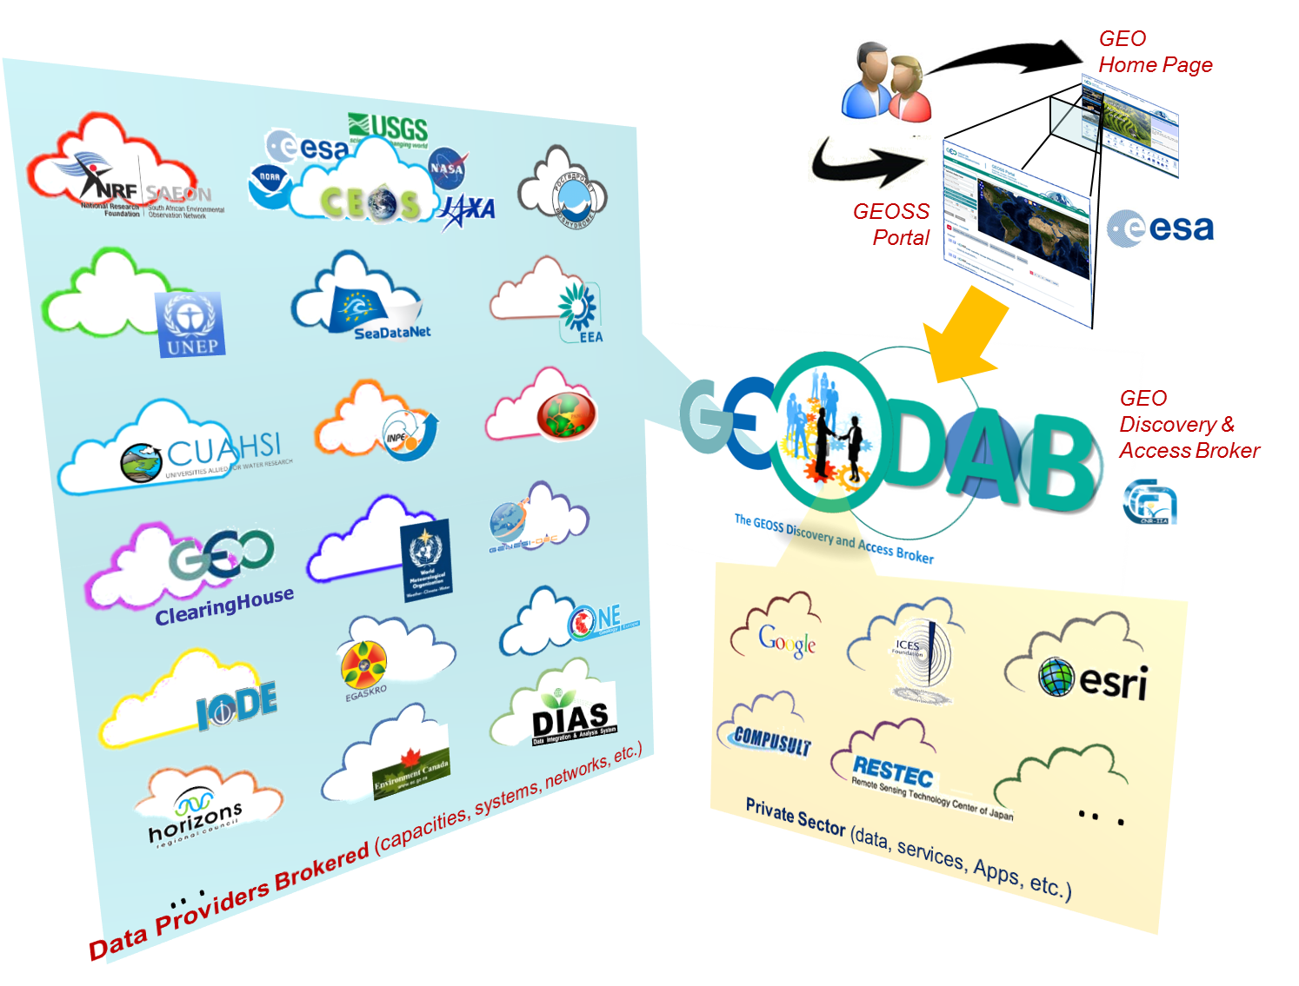
GEOSS Common Infrastructure

Slide 14
Introduction of the Brokering approach

Slide 15
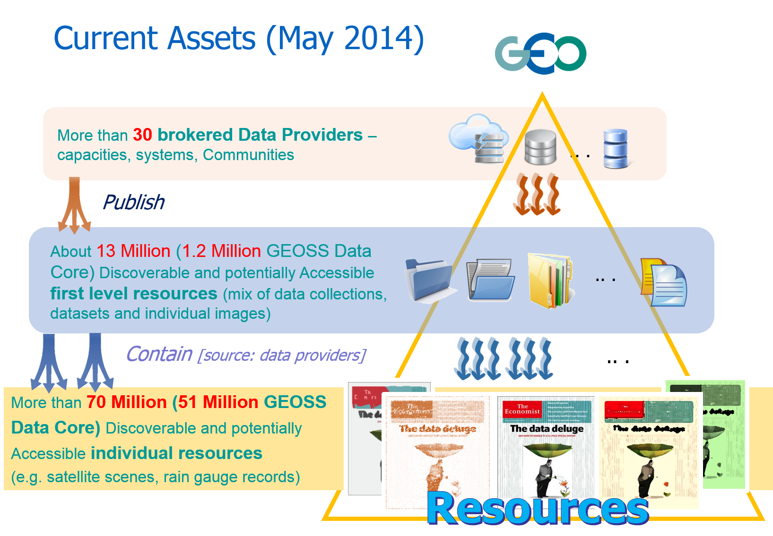
GEOSS Current Assets (May 2014)

Slide 16
Space
GEOSS
GEOSS
Hypercube
Time
Themes

Slide 17
GEOSS Targeted Gaps
Large spatial and temporal gaps in specific data sets
Space
Time
Precipitation in Greece
(1946-2013)
Themes

Slide 18
GEOSS Targeted Gaps
Uncertainty over continuity of observations
Large spatial and temporal gaps in specific data sets
Space
East Africa drought observations
(2010 – 2012)
Time
Themes
West Africa drought observations
(1995–2013)

Slide 19
GEOSS Targeted Gaps
Large spatial and temporal gaps in specific data sets
Space
Time
Themes
West Africa Land Use (1990-2005)
West Africa crop prediction
(2014-2015)

Slide 20
GEOSS Targeted Gaps
Large spatial and temporal gaps in specific data sets
Space
Time
Themes
Precipitation in Africa
(1992-2012)

Slide 21
GEOSS should be making this cube as dense and transparent as possible GCI
Ecosystems mapping in Europe (1987-2010)
Major disasters in South Asia (1992-2005)
Space
Global water bodies (1998-2005)
Faults monitoring in South America (1980-2014)
Crops obs. Asia (2005-2010)
Global Climate predictions (2012-2032)
West Africa Land Use (SB)
(1990-2005)
Precipitation in Africa (
Time
GCI Searches
Themes

Slide 22

GEOSS Implementation Requires:
Data Sharing Principles
Full and Open Exchange of Data
Data and Products at Minimum Time Delay and at Minimum Cost
Free of Charge or Cost of Reproduction
Notes:
See slide text

Slide 23
Increasing Demand for Free Landsat Data
Data delivered to 186 countries
User shift to multi-year scenes at same location
Exceeded 11 million scenes to date
11,898,738 Landsat Scenes distributed as of June 2013
Scenes in Millions
Free data policy
October 1, 2008
Daily Average = 53 scenes best year of sales (2001)
Daily Average ≅ 5,700 scenes web-enabled data delivered

Slide 24
Canada’s Experience
Radarsat-2

Slide 26
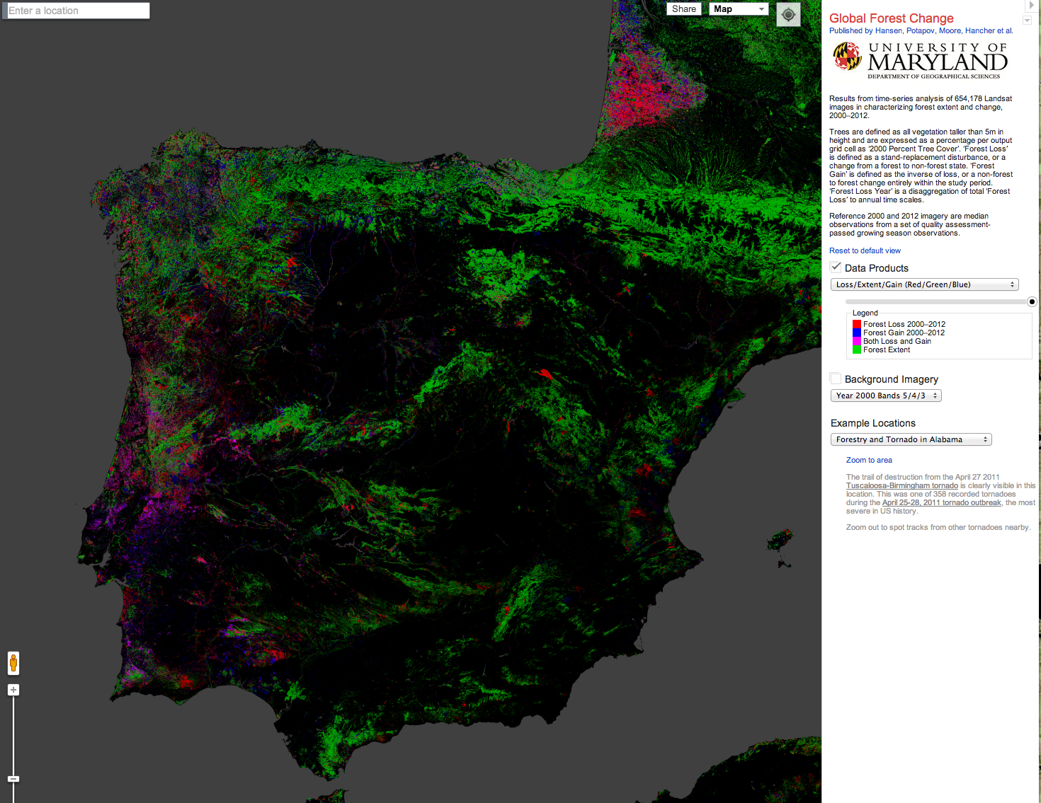

Slide 28
Ministerial Guidance
Continue improving Earth observations worldwide
Urge the adoption and implementation of data sharing principles globally
Advance the GEOSS information system
Develop a comprehensive interdisciplinary knowledge base
Cultivate global initiatives

Slide 29
Summary
Broad open data policies/practices essential for publically funded collections & must be strengthened
Economic value in downstream elements – value-added products and services
Broader stakeholder engagement needed, including the private sector
Strengthen policy linkages/mandates
National, Regional and International collaboration is essential

Slide 30


Open worldwide to any non-commercial entity, individual or team (students, scientists and developers) wanting to unleash the power of Earth Observation data
to allow us all to make smarter decisions.
Be inspired, unleash the power and win cash prizes ($20,000 USD).
Register by Thursday, 31 July 2014 and submit Apps by Sunday, August 31 2014.
Join in www.geoappathon.org
@geosec2025 #geoappathon

Slide 31

GEO-XI Plenary
13-14 November 2014
Libreville, Gabon
Barbara J. Ryan
bryan@geosec.org
http://www.earthobservations.org

