Slide 1
"From Geodesy and Mapping
to Geospatial Information Management
- the Future of Geoinformation"
by
Gottfried Konecny
Emeritus Professor
Leibniz University Hannover, Germany

Slide 2
1. Geodesy is the art and science to determine
size and shape of the earth
(C.F. Helmert, 1880)
2. and to map the
earth´s surface
3.…. and to manage it for sustainable development

Slide 3
1. Geodesy

Slide 4
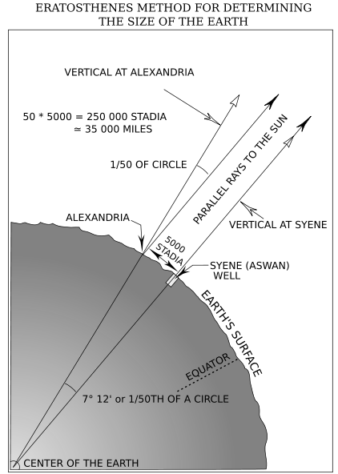
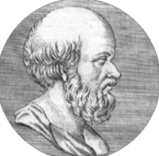
Eratosthenes
born 276 B.C. in Cyrene
died 194 B.C. im Alexandria
first determination of the
size of a sherical earth

Slide 5
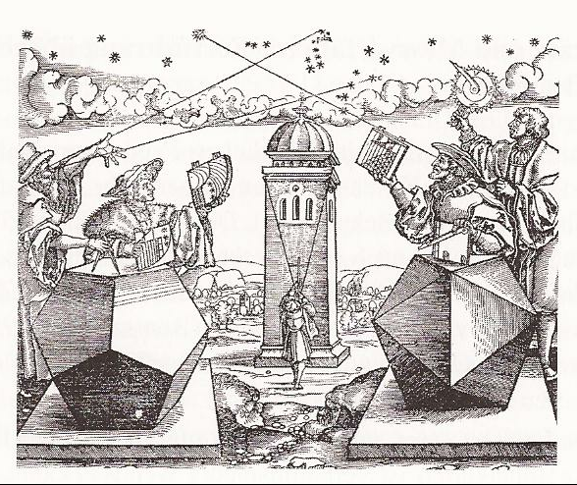
Astronomic Positioning at sea and on land in the age of exploration

Slide 6
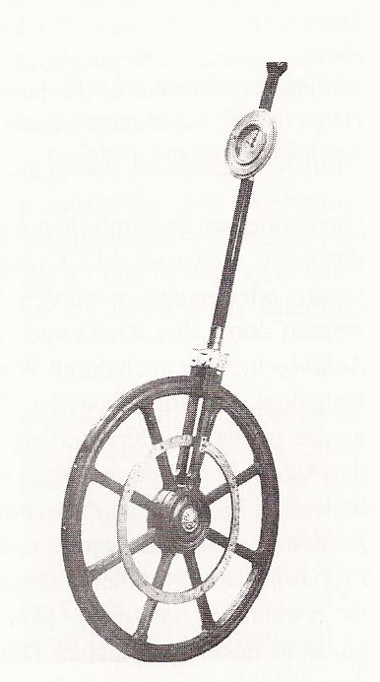
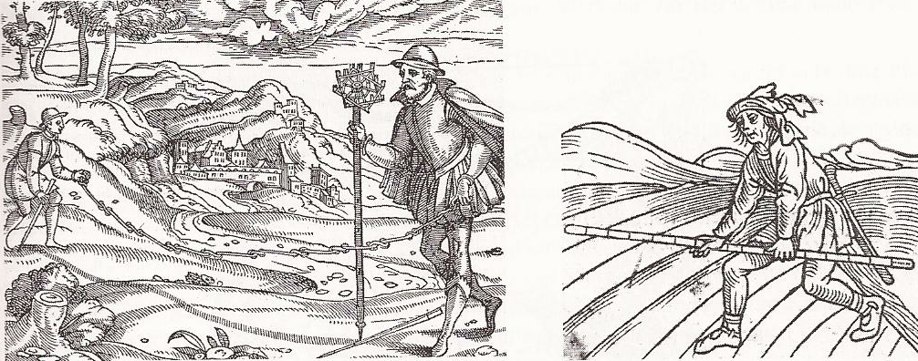
time consuming measurement of distances

Slide 7
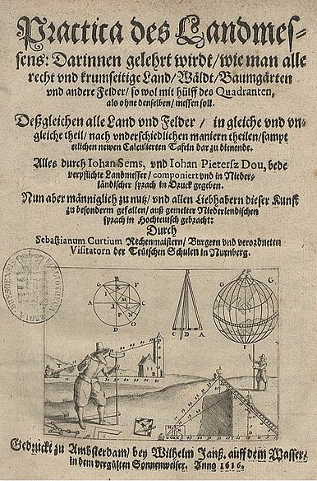
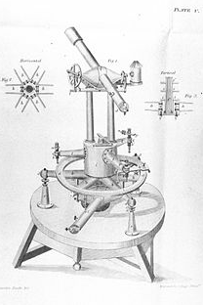
New tools: measurement of angles
the theodolite
Gemma Frisius
principle of triangulation
Willebrord Snellius
first triangulation in Holland

Slide 8
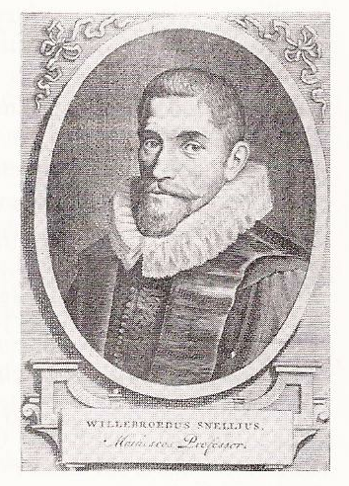
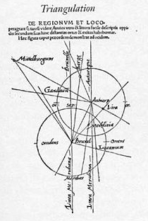
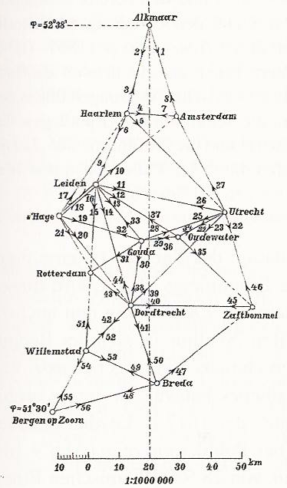
Explanation of Technology Willebrord Snellius
by Gemma Frisius 1533 1615
First triangulation
network

Slide 9
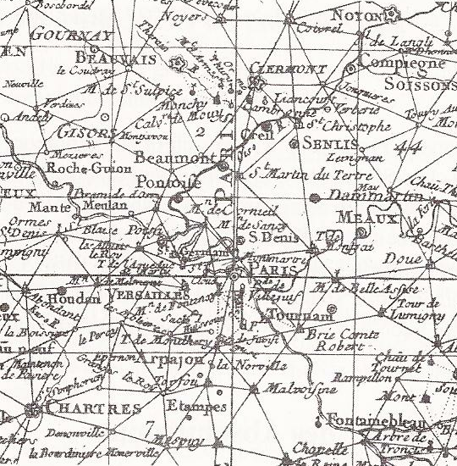
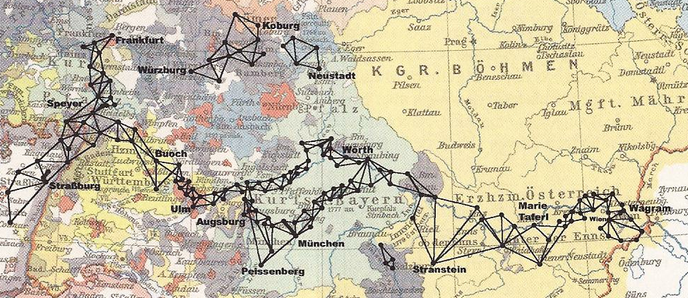
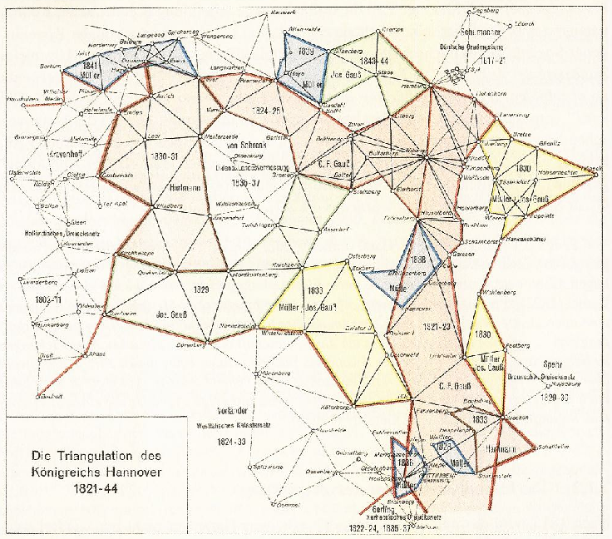
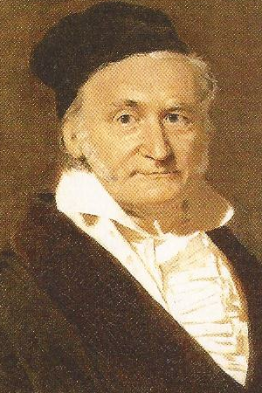
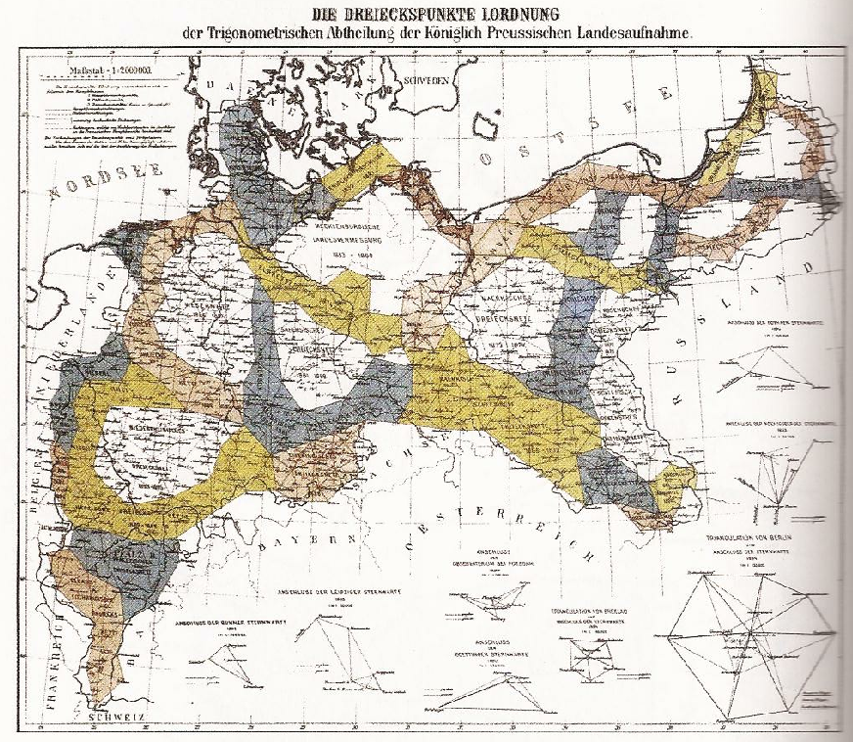
French triangulation 1744 French- Austrian triangulation chain 1761 – 1762
C.F.Gauss triangulation of the Kingdom of Hannover Prussian triangulation network
first triangulation net adjusted by least squares 1828 - 1844 completed 1899

Slide 10
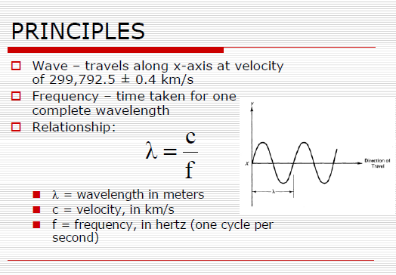
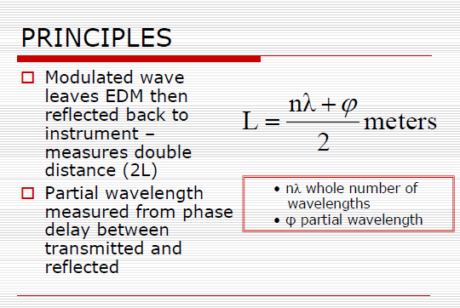
Electronic Distance Measurement

Slide 11
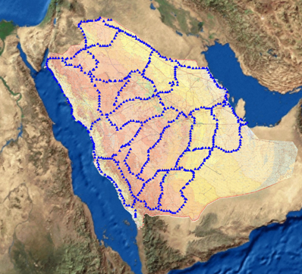
In the late 1950´s
Electronic
Distance
Measurement
permitted to
extend control
over large areas

Slide 12
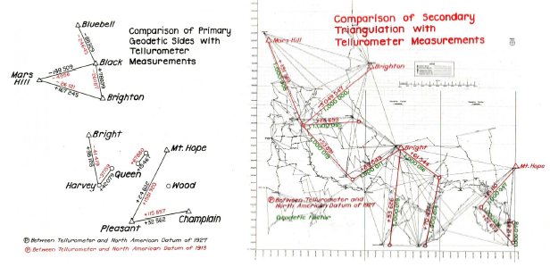
The more efficient and more accurate EDM
began to be a new survey tool in the 1960´s

Slide 13
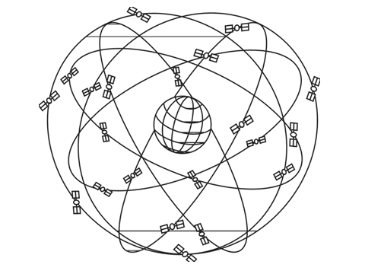
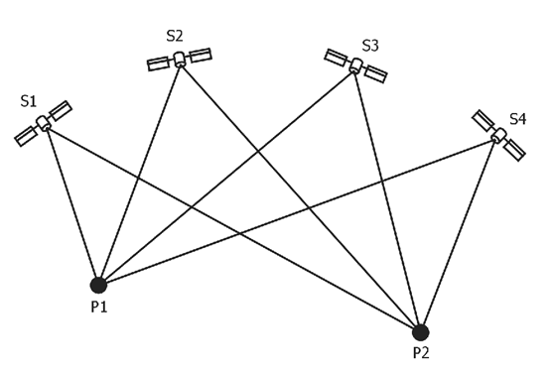
GNSS
became a new
revolution
in the 1990´s

Slide 14
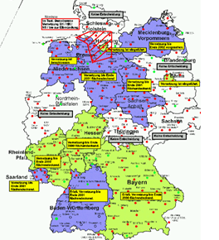
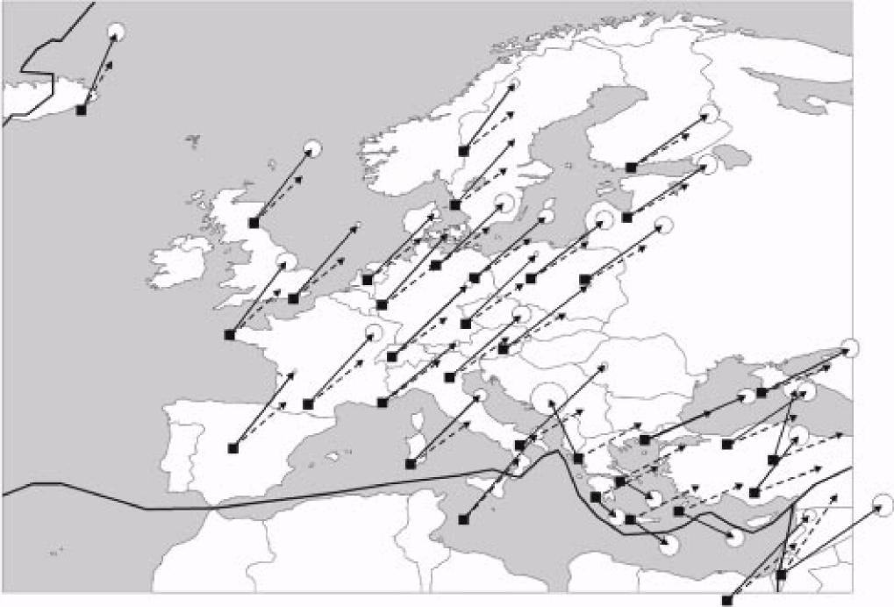
With GNSS geodesy became an indispensable earth science tool
CORS IREF

Slide 15
2. Mapping

Slide 16
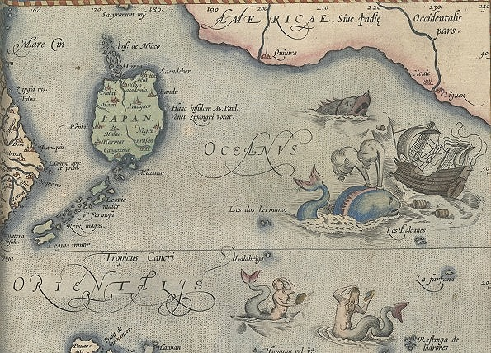
Explorer Maps around 1500 were descriptions
and described relative geographic locations
determined by astronomic positions

Slide 17
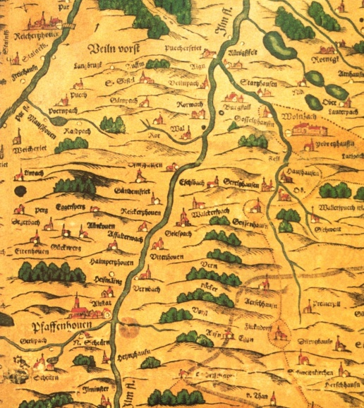
The first map series based on astronomic positioning was
Apian´s Map of Bavaria of 1570
Napoleon used it to conquer Bavaria from the Habsburgs in 1810

Slide 18
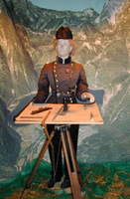
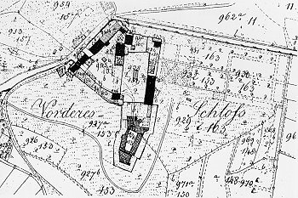
In the early 19th century Topographic Mapping was based on
Triangulation Networks and Plane Table Surveying

Slide 19
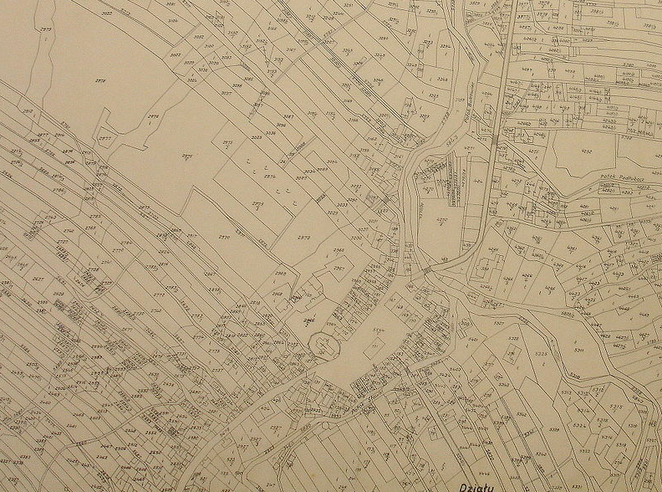
Starting with Emperor Joseph of Austria in 1770 most mapping
at larger scale was introduced for property taxation at the scale 1:2880

Slide 20
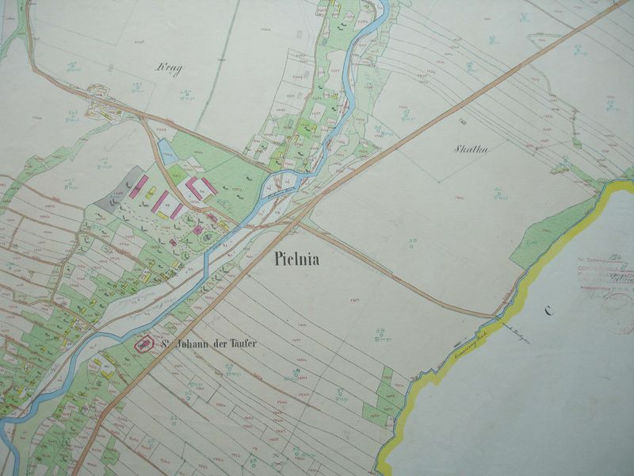
The Tax Cadastre also permitted to base some topographic objects
on the property map (buildings, pastures, creeks, forests)

Slide 21
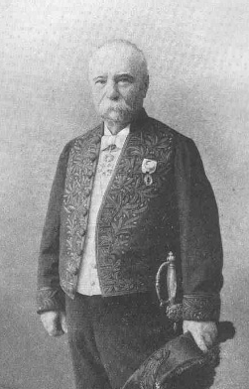
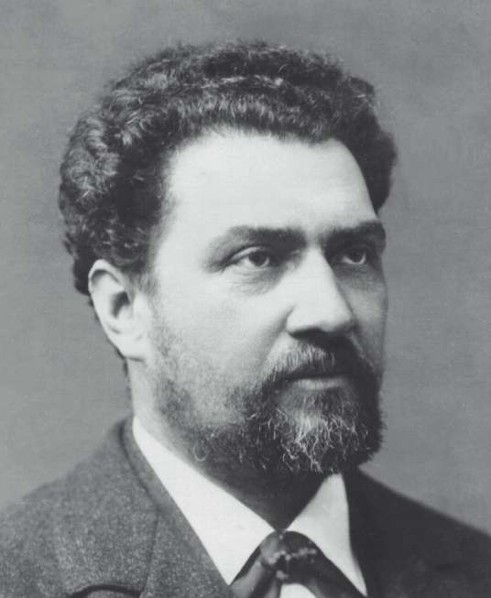
Aimé Laussedat
1819/1907 Paris Mapping
Albrecht Meydenbauer
1858/1865 Architectural Documentation
Iconometry Photogrammetry
the use of photographs became a tool for the survey of all objects
with the start in the 1850´s and with a global impact in the 1950´s

Slide 22
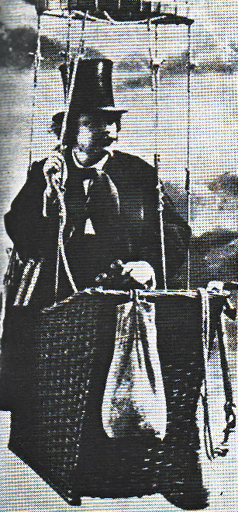
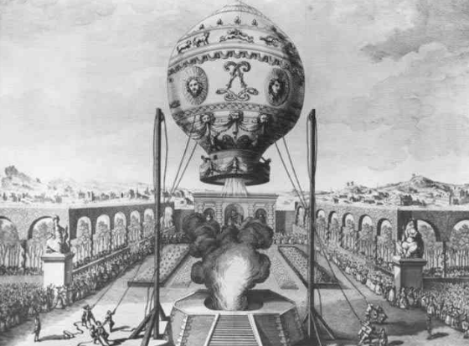
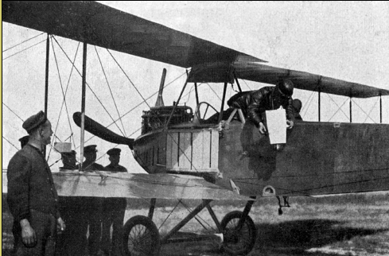
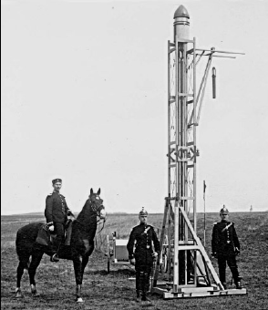
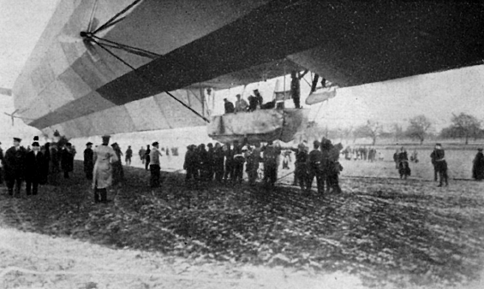
Fundamentals of Photogrammetry
Aerial Platforms
Gaspard-Felix Tournachon (Nadar)
balloon photography 1863
Jacques Etiene & Joseph Michel Montgolfier 1783
Rockets 1906
Zeppelin 1909
Aircraft 1914

Slide 23
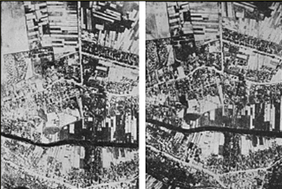
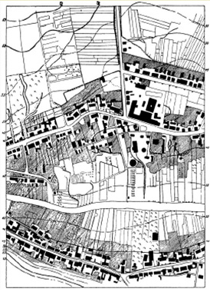
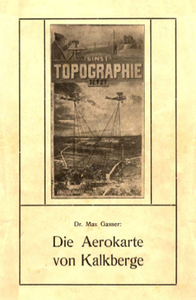
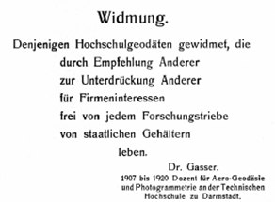
Max Gasser invented the
Gasser Projector (Multiplex)
in 1915, for which he obtained
a war patent.
1925 the Zeiss Company
made the Stereoplanigraph
Gasser made a restitution of
two stereo images taken
from the Zeppelin over
Kalkberge.
He published a book and
dedicated it to those
„University Geodesists, who
by recommendation of
others, for oppression of
others, for company interests,
free from research motivation,
live from salaries of the
Government“

Slide 24
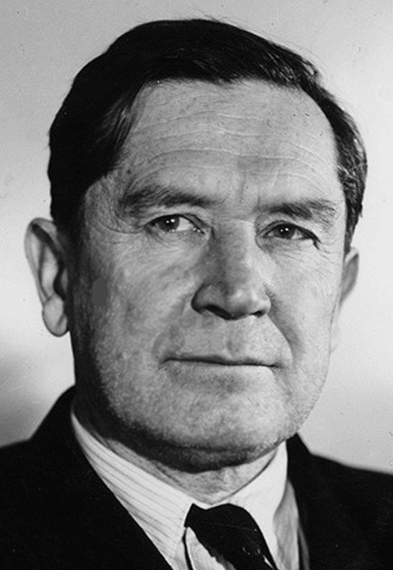
F. V. Drobyshev
1894 - 1986
Professor of Photogrammetry
MIIGAIK 1941 – 1971
MIIGAiK was responsible for
developing mapping technology
in the socialist
Countries, the USSR and China

Slide 25
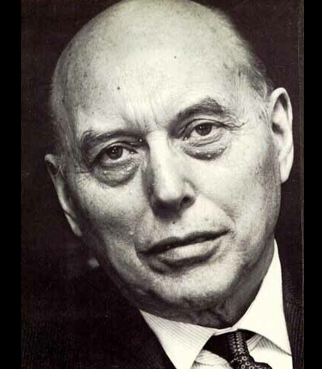
Willem Schermerhorn
Professor, Technical University Delft
President ISP 1938-1948
Prime Minister of the Netherlands
1946 – 1947
Founder of the ITC
spread the use of Photogrammetry
to the developing world
A

Slide 26
Status of Topographic Mapping 1990
1:25 000 green , 1:50 000 yellow
1:100 000 violet , 1:200 000 red
Source: U.N.Cartographic Conference, Beijing 1993

Slide 27
Map Updating Source: U.N. Cartographic Conference Bangkok, 1990

Slide 28
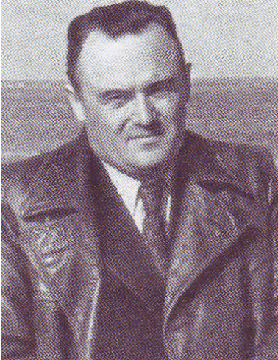
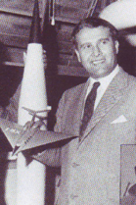
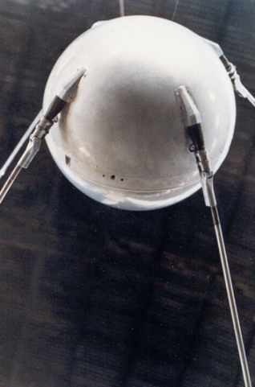
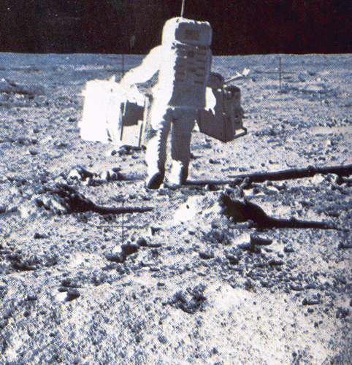
Koroljov Wernher von Braun
Space Platforms
Sputnik 1957 Man on the Moon 1969

Slide 29
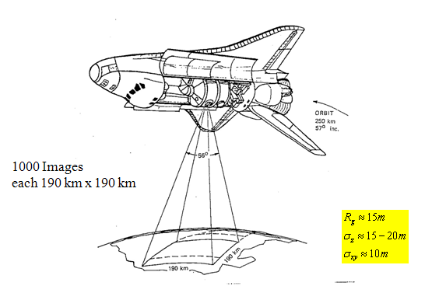
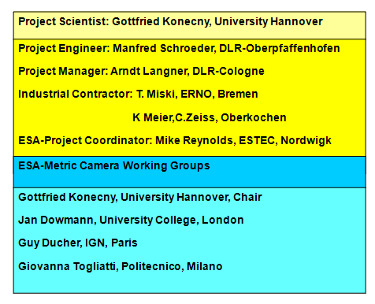
Before the 1980´s
high resolution images from
Space were
Considered secret
in 1983 the German Government
and ESA financed the
„Metric Camera Experiment“
from Space Shuttle
10% of the earth´s land mass
was covered in stereo in the
9 day mission

Slide 30
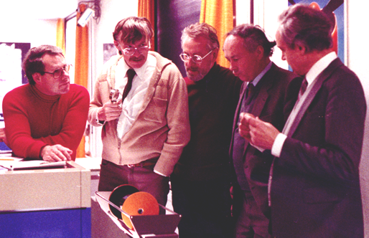
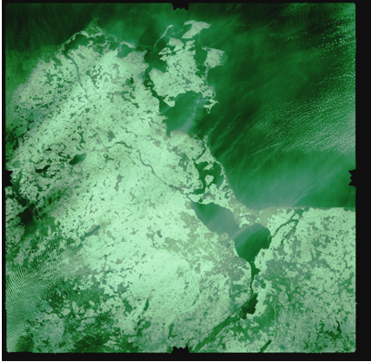
the film was developed at
DLR or IGN. A beautiful
strip was taken over the
GDR. The Government, not
wanting to admit that
imagery had been taken
0ver a socialist country,
did not include the images
in the catalogue.
Instead, copies of these
images were taken
informally to our ISPRS
friends in the GDR by car
.

Slide 31

the favourable response came later in 1987, when
ISPRS was brought to Leipzig for a meeting, where
the collegues of the Sovjet Union (Kienko and
Drazhniuk) openly showed us their KFA 1000 images.

Slide 32

Stereo Image Collection from Space as it is practised today

Slide 33




Current Status of Satellite Imaging
GeoEye 1 0.5m GSD WorldView 2 0.5m GSD
Pleiades 1
0.5m GSD
TerraSar X
1m GSD

Slide 34
3. Databases

Slide 35

Exponential Growth of Computer Technology

Slide 36

Exponential Growth in Network Performance

Slide 37

6. GIS and Database Technology an example: ArcGIS
Software components in ArcGIS (1)
Introduction
Objectives
Materials & Methods
Results
Conclusions / Outlook
Overview:
ArcGIS components.

Slide 38
Test Plots - Level 1 Map
Introduction
Objectives
Materials & Methods
Results
Conclusions / Outlook
Result of import into ArcGIS/ArcInfo and automated polygon closure & attribute allocation.

Slide 39
Test Plots - Level 2 Map
Introduction
Objectives
Materials & Methods
Results
Conclusions / Outlook
Result of import into ArcGIS/ArcInfo and manual polygon closure & attribute allocation.

Slide 40

The geodatabase data model
(3rd generation)

Slide 41


Slide 42


Slide 43


Slide 44


Slide 45


VISION
‘To design, implement and manage a comprehensive and sustainable GEOPORTAL, which serves as an “One Stop” source of land information and services in an integrated, efficient and cost effective manner.’
GEOPORTAL
Conveyance
Spatial Catalogue
Information Search
  Attribute
  Coordinate
Value Added
Services
Land
Dispute
Survey and
Mapping
Municipal
Properties
Land
Grants
Cadastral
Registration
Citizen
Web Based
Business
Integrated Land Information
Repository
Front
Office
Government

Slide 46

STRUCTURE

Slide 47



HIGH LEVEL OVERVIEW
User
e-Services
Regional Office
Central Office
www
Geo-Portal

Slide 48
ARCHITECTURE

Slide 49
FUNCTIOINAL REQUIRMENTS
Functional Requirements
Multiple Service Delivery Channel and Integration
User services
Management Services
Map Viewer
Document Management System
Information Access and Search
e-Acceptance of Transaction Documents
Information Security
Bilingual Language Support (Arabic and English)
MIS and Reports
Integration with other entities

Slide 50
DESIGN
Functional View
Users
ILIS Sub-system
ILIS Security
Work Flow Management Engine
Web Interface
User Registration
User Authentication
Personalization Service
Business Rules
User Repository
User Management
Document Management
Search Engine
Core Application Modules
Map Viewer
Electronic Fund Transfer
Survey
Management
Utilities
Management
Planning and
Land use
Title / Deed Management
Management Information System
Spatial Data & Aspatial Data
Data Store
Systems Administration
History Management
Security Management
Data Storage Management
Supporting Infrastructure
Management

Slide 51






8. Smart Phones permit GIS to become mobile
Apple
I Pod I Pad I Phone I Phone G3
Blackberry Samsung Omni

Slide 52

Versatility
lies in the
downloadable
„Apps“
making the
Smartphone
a Navigation Device
(Google Maps, Navtech, Tom Tom)
an Internet Browser
a phone
a data base
Versatility
lies in the
downloadable
„Apps“
making the
Smartphone
a Navigation Device
(Google Maps, Navtech, Tom Tom)
an Internet Browser
a phone
a data base

