Slide 1
New Developments in Geoinformation
Technology and their Impacts on
Photogrammetry and Remote Sensing
FIG & SSGA Workshop
Ulan Baatar, Mongolia, Sept 4 - 8, 2011
Presentation by
Gottfried Konecny
Emeritus Prof. Leibniz University Hannover

Slide 2
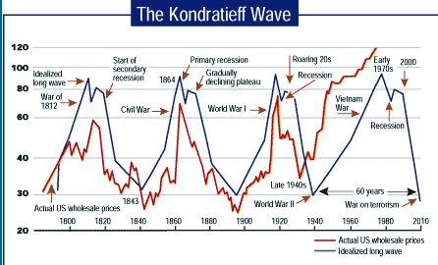

Slide 3

The Kondratjev Cycles
Steam Engine Railway Electricity Automobile Information Health
Textile Industry Steel Chemistry Petrochemistry Technology
Clothing Transport Mass Individual Globalization Wellness
Consumption Mobility Communication
1 st Cycle 2nd Cycle 3rd Cycle 4th Cycle 5th Cycle 6th Cycle
1800 1850 1900 1950 1990 20xx

Slide 4
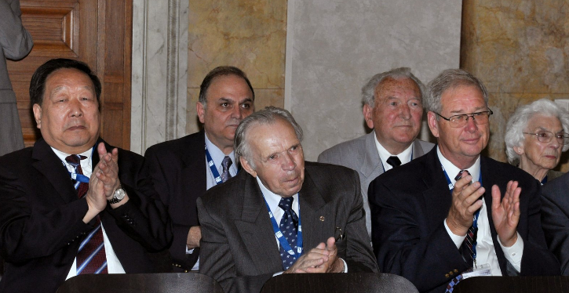
100 year Anniversary of ISPRS in Vienna 2010
Election of Honorary Fellows of the Society:
Li Deren, China; Costas Armanakis, Canada; Ivan Antipov, Russian Federation;
George Zarzicky, Canada; Stan Morain, USA

Slide 5
New Technology made it possible,
that tasks, which were not affordable before,
are available now,
they can be used for partial automation:
Satellite Positioning to cm accuracy (GNSS-GPS)
2. Imaging by digital aerial photography (ortho mapping)
3. Satellite Imagery covering the Globe (Google Earth)
4. Laser Scanning
5. Computer Technology Advances (Moore´s Law)
6. Database Technology (Object Relational Data Bases)
7. Web Applications (Geoportals, Crowd Sourcing)
8. Mobile Technology Applications (Smart Phones)

Slide 6
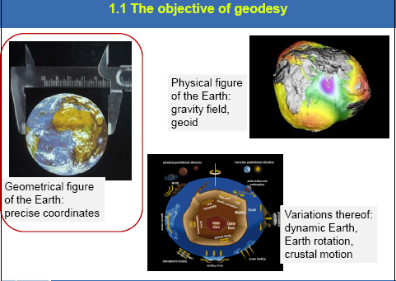
1. Satellite Positioning GNSS-GPS

Slide 7
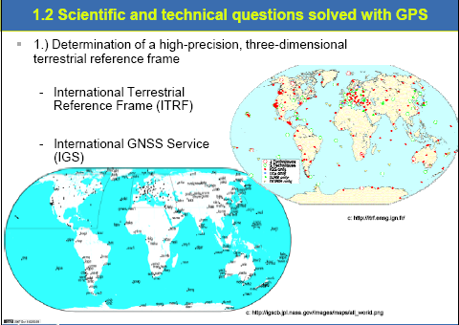

Slide 8
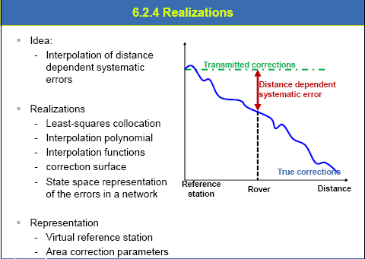

Slide 9
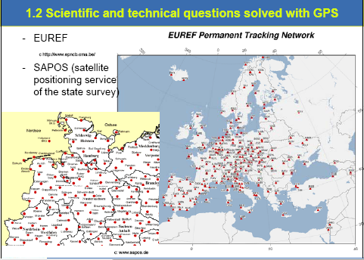

Slide 10
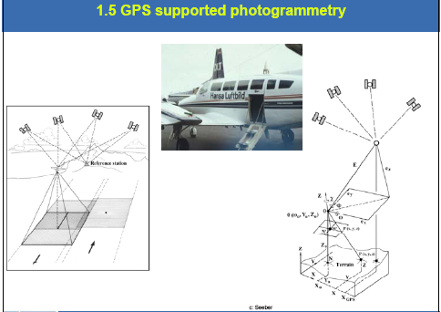

Slide 11
Result:
1. Augmented Accuracy Systems such as
EGNOS, WAAS, NTRIP and Omnistar permit
static geolocation anywhere on the globe with
+/- 50cm accuracy with inexpensive code receivers
2. Phase receivers operating in RTK mode at a range of 10km
or in CORS networks with station up to 50km range
permit +/- 1cm accuracy
Mobile applications with RTK or CORS reference permit
+/- 1 dm accuracy

Slide 12
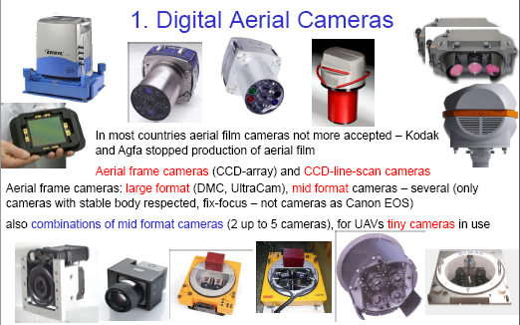
2. Digital Aerial Photography

Slide 13
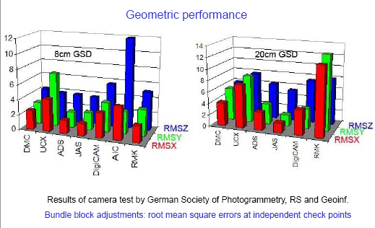

Slide 14
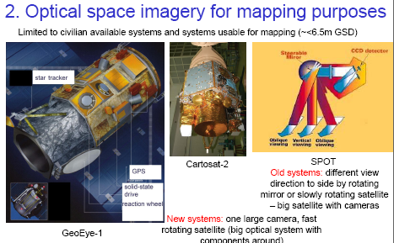
3. High Resolution Satellites

Slide 15
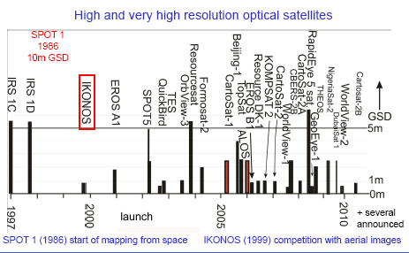

Slide 16
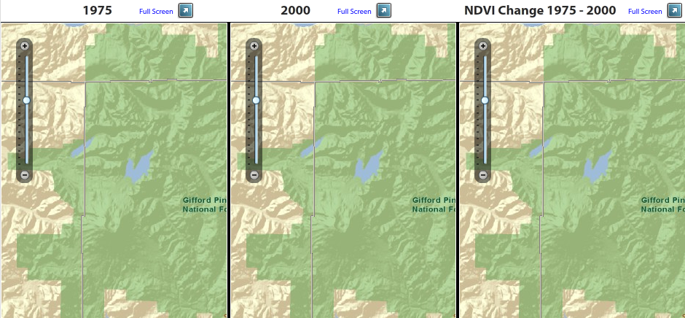
ESRI Viewer for Change Detection of Landsat Images

Slide 17
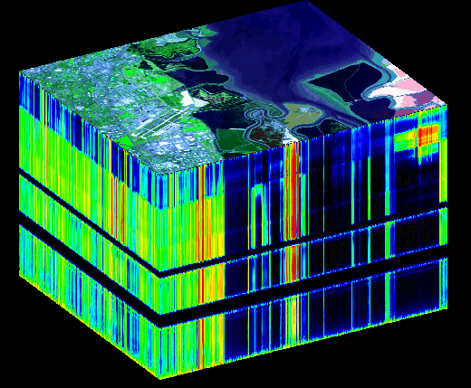
Hyperspectral Cube (AVIRIS Data)

Slide 18
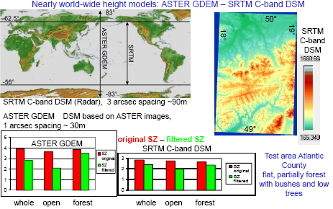
Competition between Optical and Radar Systems

Slide 19
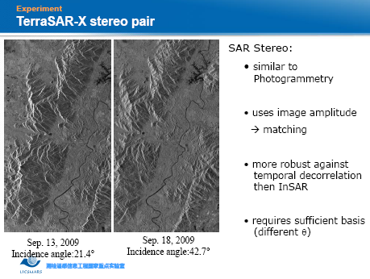

Slide 20
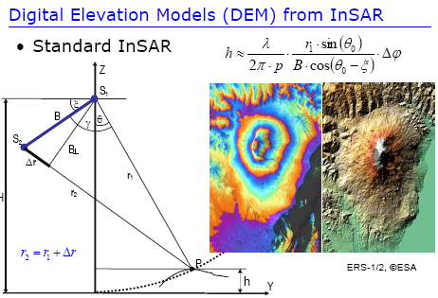

Slide 21
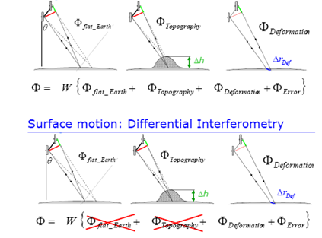
Surface motion: Interferometry

Slide 22
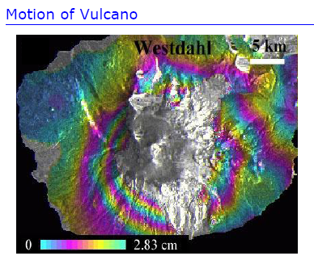

Slide 23
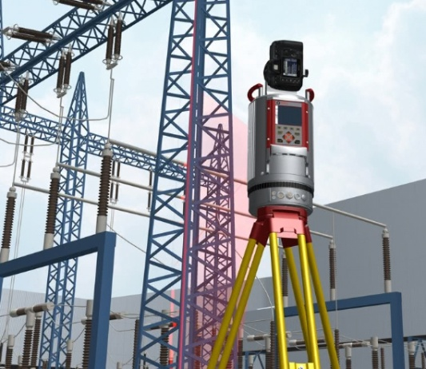
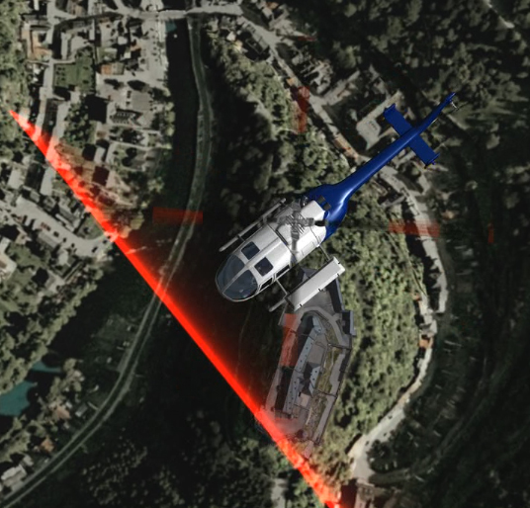
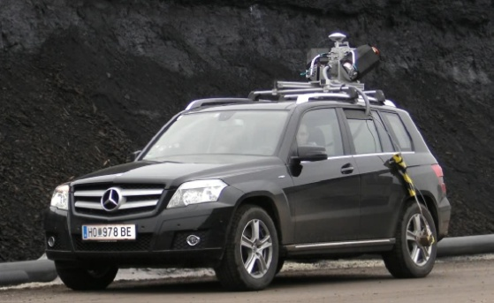
4. Laser Scanning
TLS Terrestrial Laser Scanning
ALS Airborne Laser Scanning
MLS Mobile Laser Scanning

Slide 24
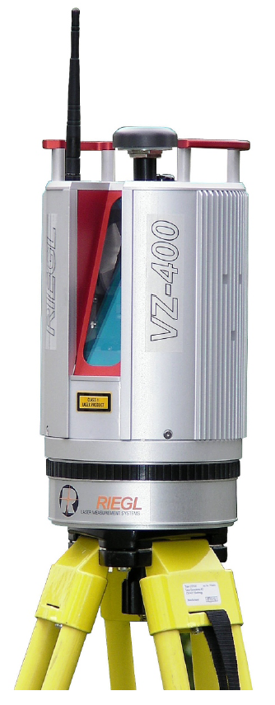
TLS Terrestrial Laser Scanning
Scanner and Camera
Properties of 3D Laserscanners
Model RIEGL LMS VZ400
Distance up to 500 m
for Laser Class I
Scan range horizontal total 100° (+60° / -40°)
Scan range vertical max. 360°
Distance accuracy ± 5 mm
Data rate 125 000 points/sec.
Measurement Interference

Slide 25

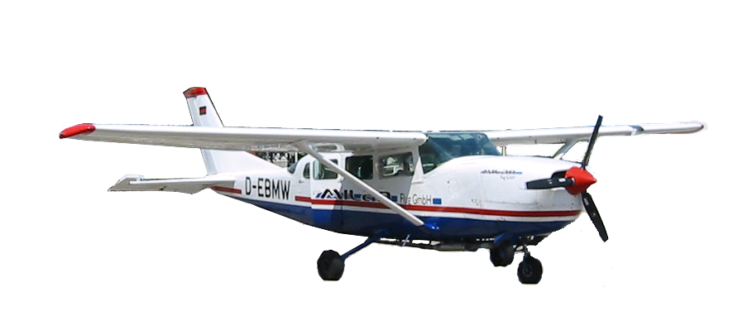
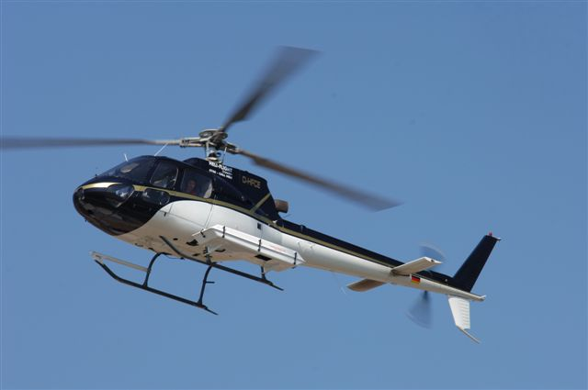
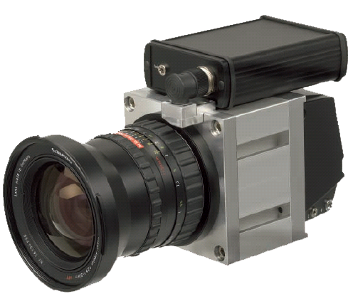
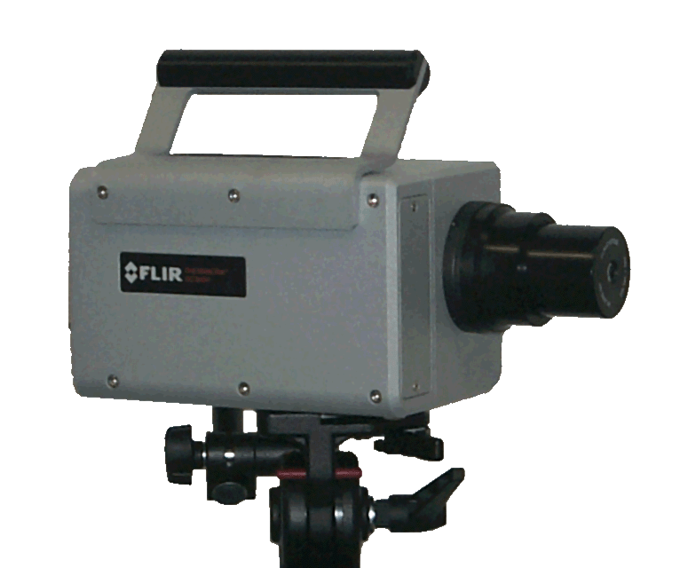
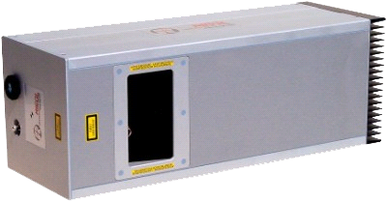
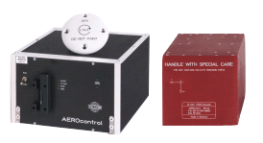
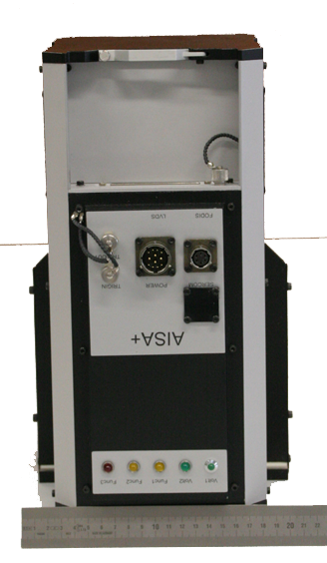
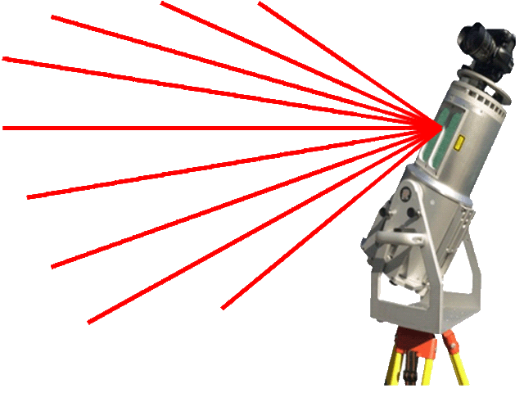
ALS Airborne Laser Scanning
Aero-Complex-Monitoring
Universal Data Collection System
with
- Airborene Laser Scanning
- Infrared Thermography
- Terrestrisches Laser Scanning
Digital RGB Images
Imaging Spectrometer

Slide 26

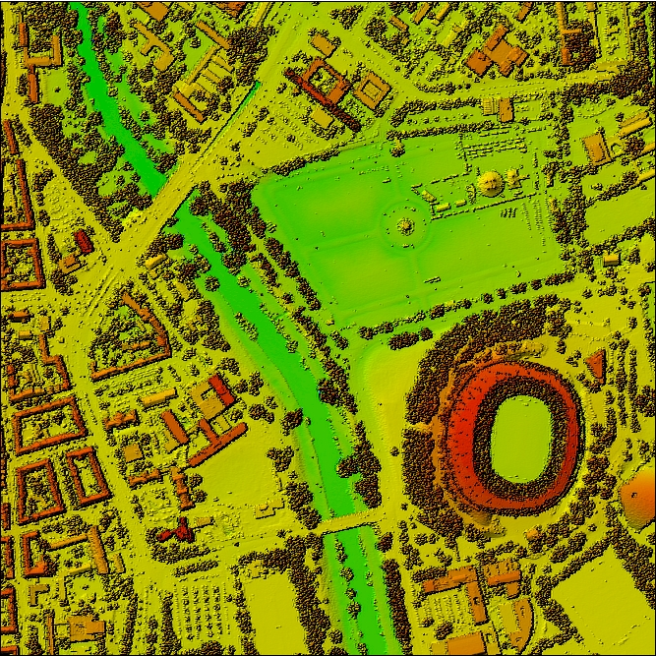
DHM erzeugt mittels ALS
DSM Shaded Relief
AWD – Arena
90 m
© Stadt Hannover
Notes:
26

Slide 27
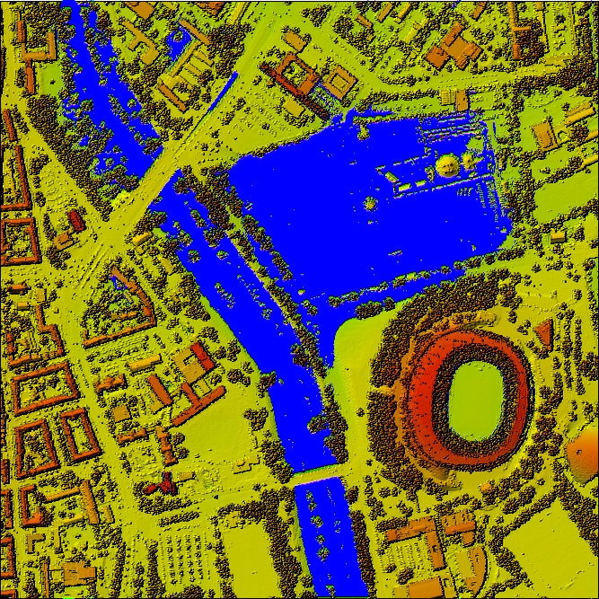
DHM erzeugt mittels ALS
DSM Shaded Relief
AWD – Arena
94 m
© Stadt Hannover
Notes:
27

Slide 28
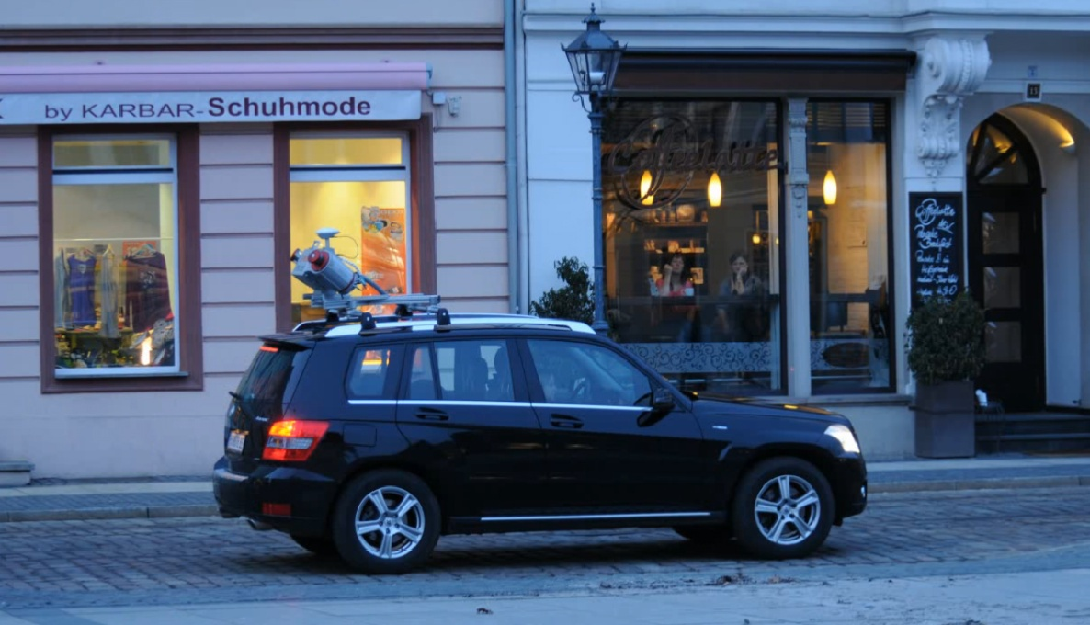

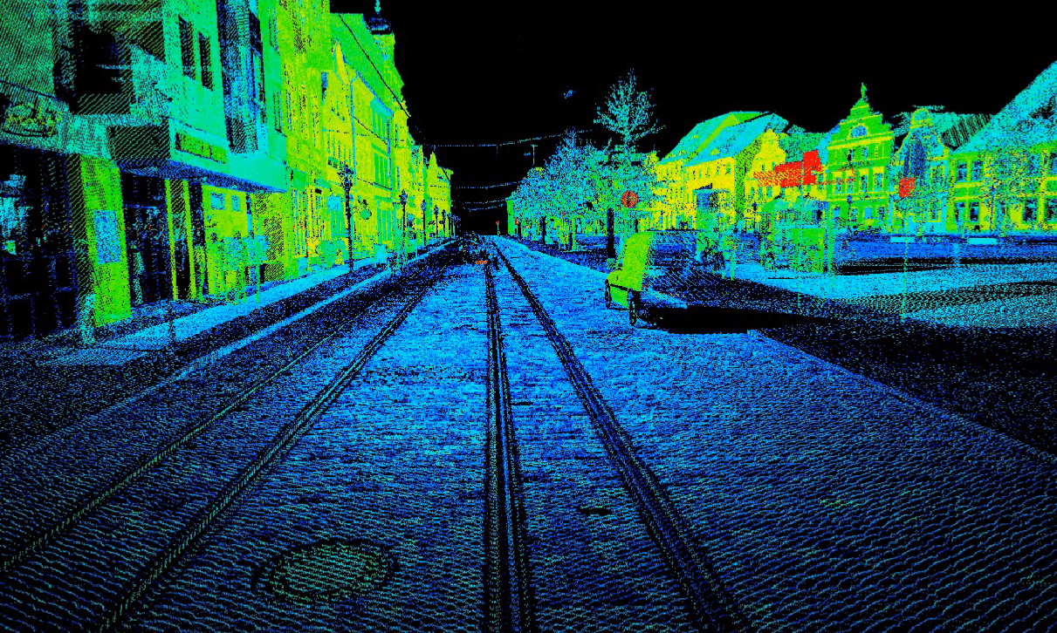
MLS - Mobile Laser Scanning
Stadt Cottbus

Slide 29
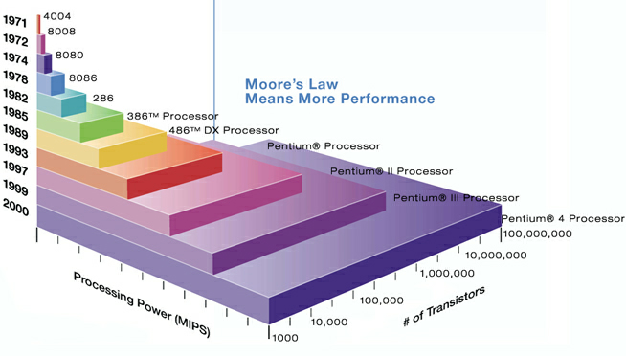
5. Exponential Growth of Computer Technology

Slide 30
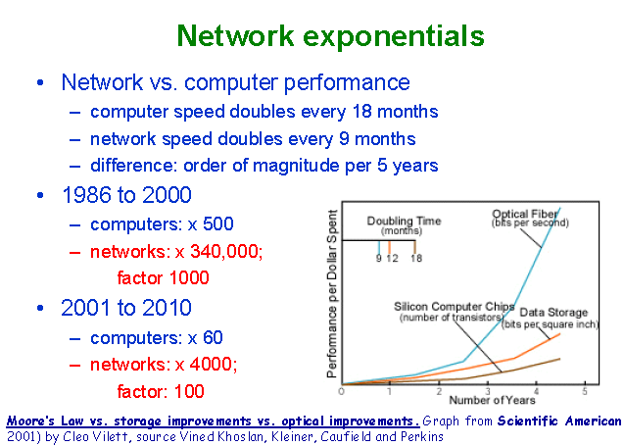
Exponential Growth in Network Performance

Slide 31
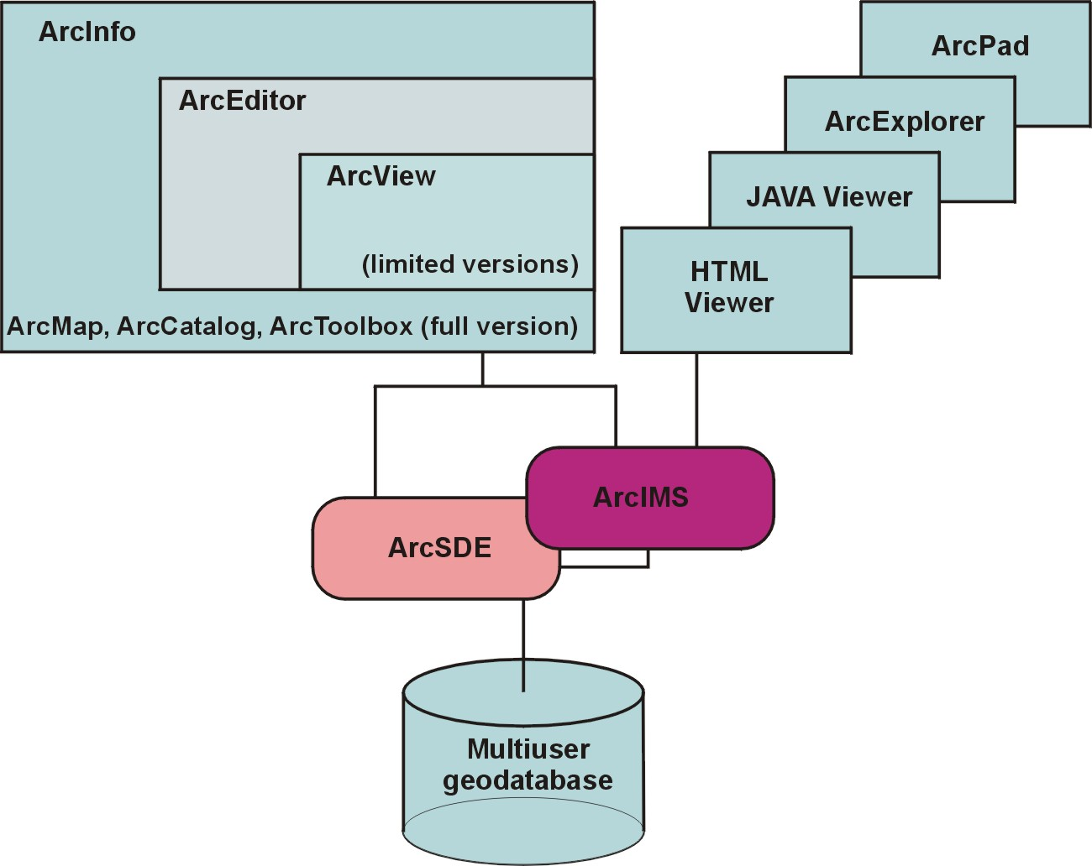
6. GIS and Database Technology an example: ArcGIS
Software components in ArcGIS (1)
Introduction
Objectives
Materials & Methods
Results
Conclusions / Outlook
Overview:
ArcGIS components.

Slide 32
Test Plots - Level 1 Map
Introduction
Objectives
Materials & Methods
Results
Conclusions / Outlook
Result of import into ArcGIS/ArcInfo and automated polygon closure & attribute allocation.

Slide 33
Test Plots - Level 2 Map
Introduction
Objectives
Materials & Methods
Results
Conclusions / Outlook
Result of import into ArcGIS/ArcInfo and manual polygon closure & attribute allocation.

Slide 34
Image or Raster Data and the Geodatabase (3)
1. Storage of raster data in database tables
Introduction
Objectives
Materials & Methods
Results
Conclusions / Outlook
Image pyramid.
The geographical extent remains
identical in every pyramid layer.

Slide 35
Test Plots - Level 2 Map
Introduction
Objectives
Materials & Methods
Results
Conclusions / Outlook
DEM from elevation information with automatically generated contours.

Slide 36
Software components in ArcGIS (11)
Components of ArcGIS desktop software (6):
Extensions (additional components):
ArcGIS Spatial Analyst for processing and modelling surface information in grids
ArcGIS 3D Analyst for processing surface information in TINs
ArcGIS Geostatistical Analyst
ArcGIS Survey Analyst
ArcPress for printing
etc.
Introduction
Objectives
Materials & Methods
Results
Conclusions / Outlook

Slide 37
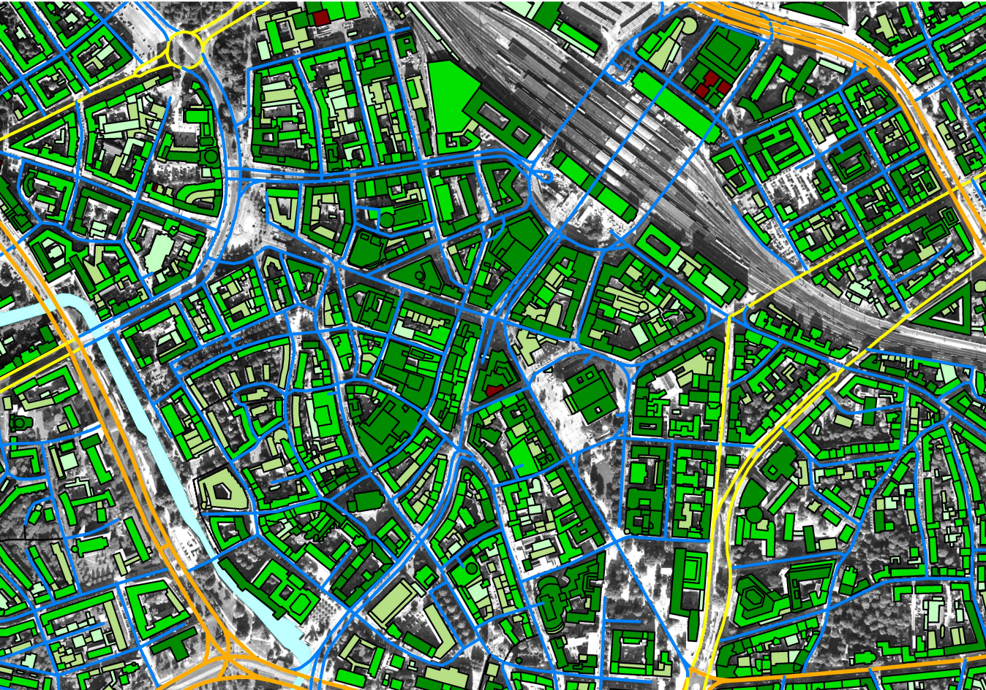
City models: Vector data
StreetMap Address + Orthophoto und Vector Data

Slide 38
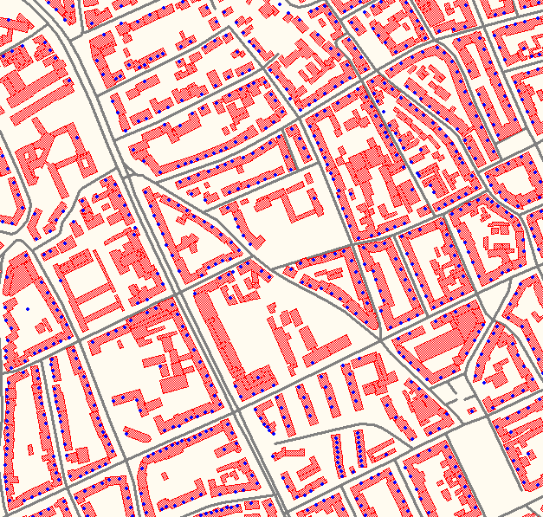
City models: Address information
Point: address information
Polygon of the building
Road network

Slide 39
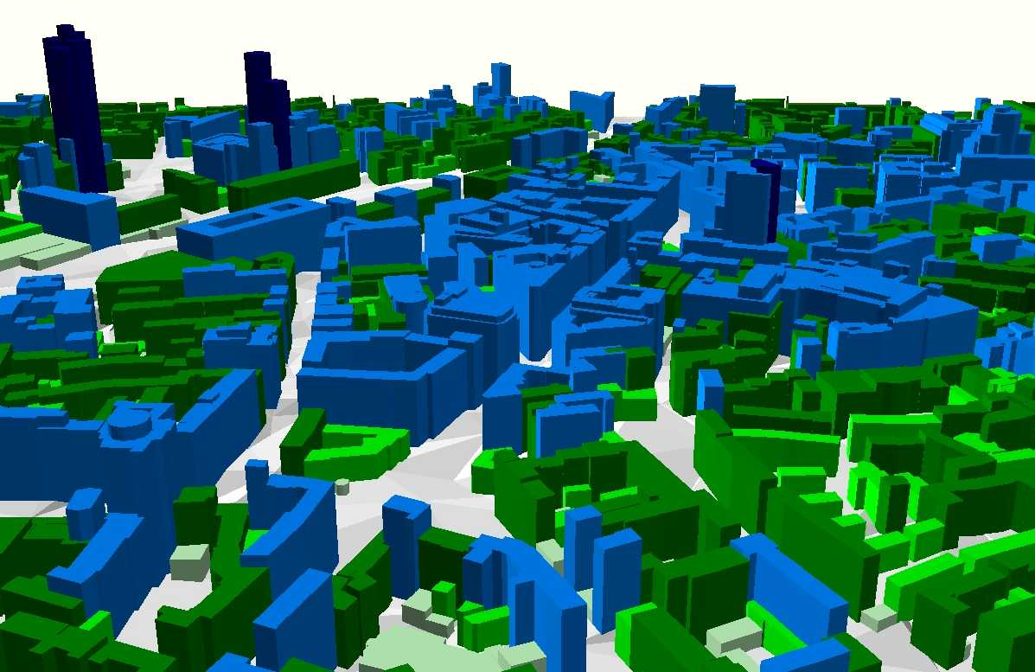
City models: Vector data
Building model: 3D presentation

Slide 40
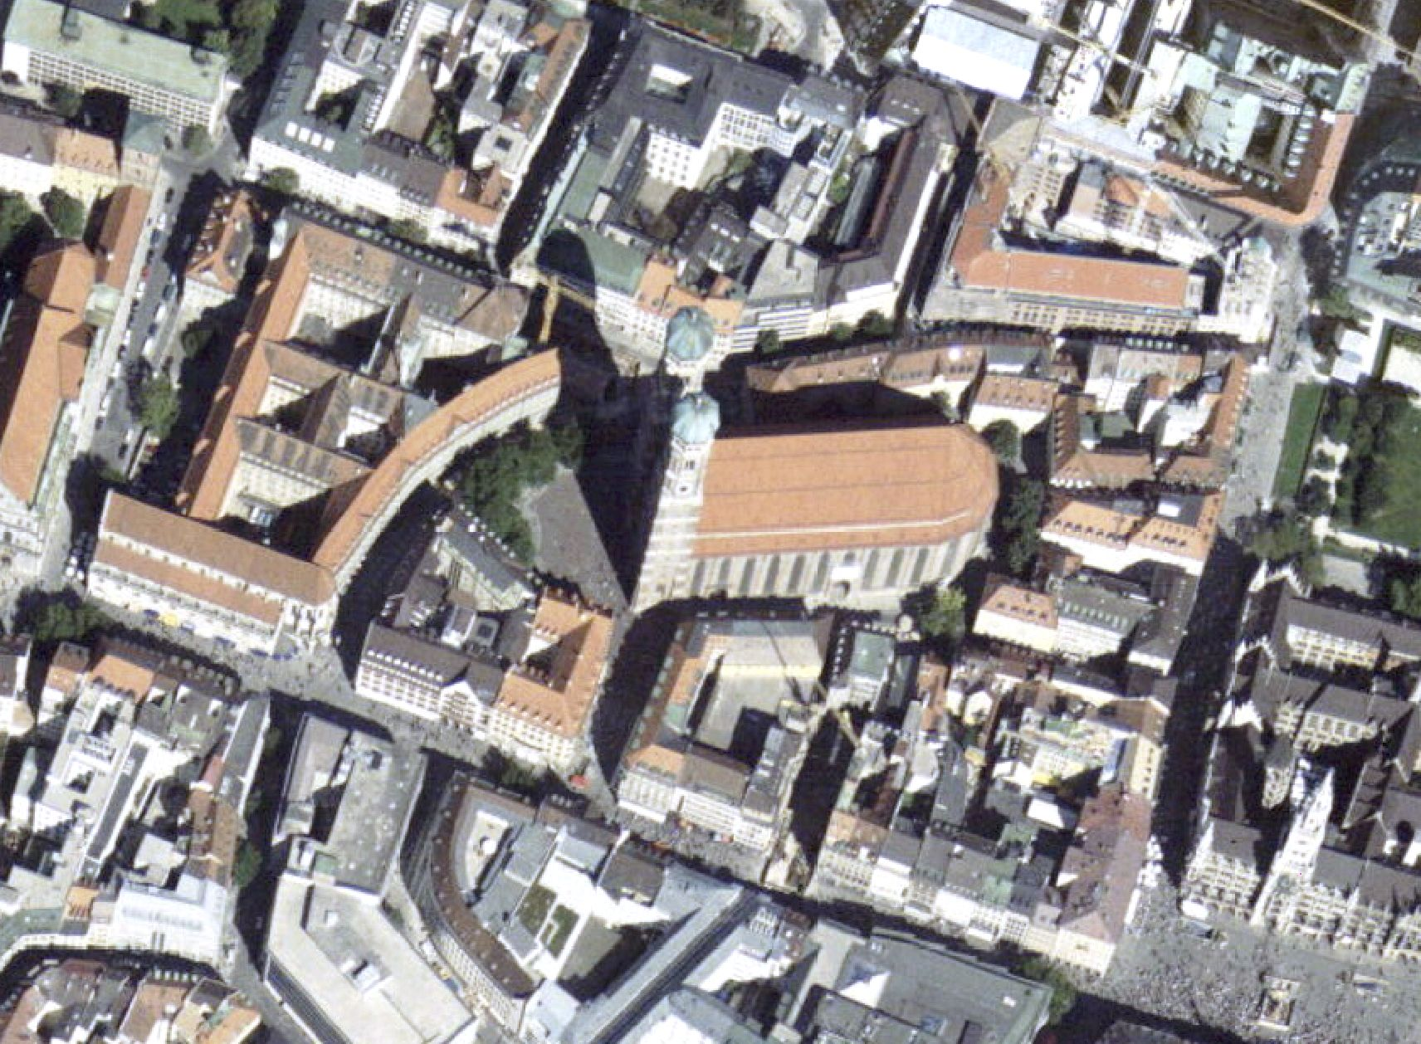
City models: Orthophoto
Orthophoto Final - colour

Slide 41
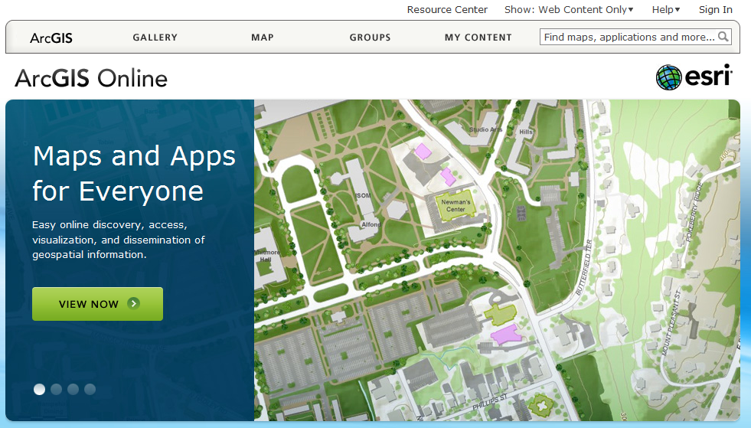

Slide 42
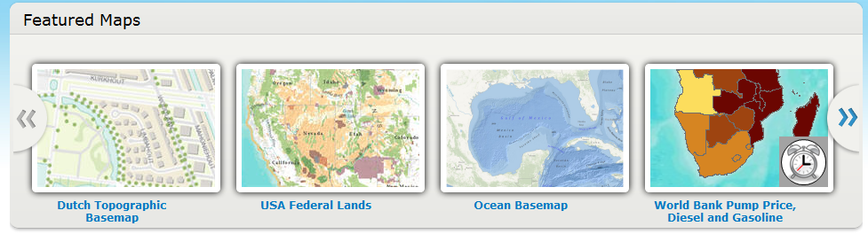
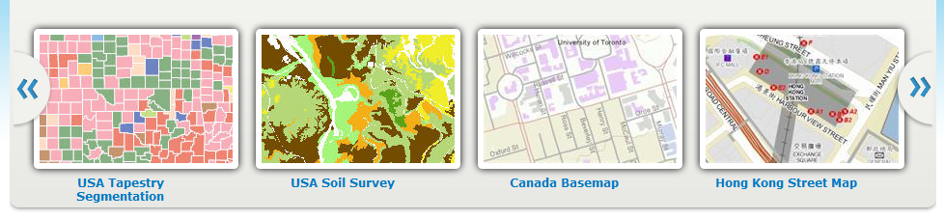
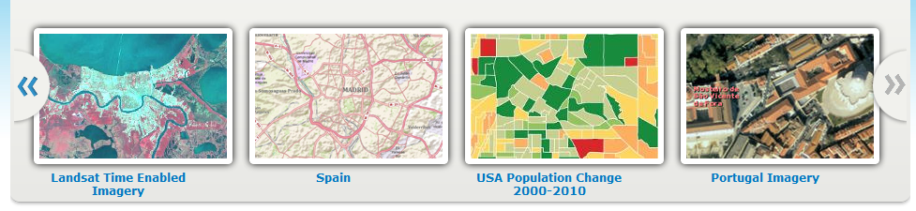

Slide 43
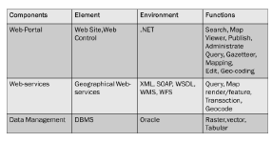
7. Web Portal, Web Services, Data Management

Slide 44
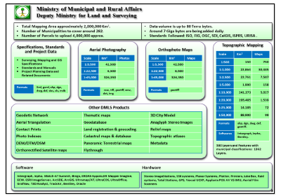
Data to be distributed through the Portal

Slide 45
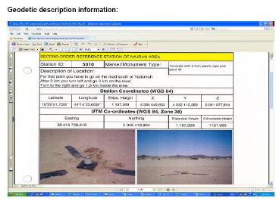

Slide 46
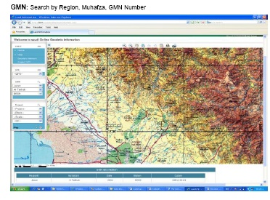

Slide 47
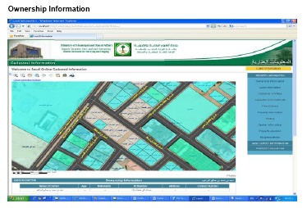

Slide 48






8. Smart Phones
Apple
I Pod I Pad I Phone I Phone G3
Blackberry Samsung Omni

Slide 49

Versatility
lies in the
downloadable
„Apps“
making the
Smartphone
a Navigation Device
(Google Maps, Navtech, Tom Tom)
an Internet Browser
a phone
a data base
Versatility
lies in the
downloadable
„Apps“
making the
Smartphone
a Navigation Device
(Google Maps, Navtech, Tom Tom)
an Internet Browser
a phone
a data base

Slide 50

Google Earth Images

Slide 51

Google Maps and Address Search

Slide 52

Google Street View

Slide 53

Google Maps Navigation

Slide 54

Bing Maps 3D View

Slide 55
GIS has integrated aerial and satellite images
It is able to display available and augmented maps
It can incorporate address searches with street views
It has become a navigation device
It can incorporate 3D views (3D city models)

Slide 56
What are then the problems our disciplines are facing?
The problems are sociological in nature:
1. do we have political support?
2. do the laws sufficiently protect our professional interests?
3. what is the esteem scientists and engineers have in society?
If we are not sufficiently heard, what are the alternatives for us?
1. to get engaged in social, economic, political and ultimately
ethical issues issues
2. who can give us guidance in our approach to solve problems
in integrating photogrammetry and remote sensing into a
greater context?

