Slide 1
3a – HYDROLOGIE

Slide 2
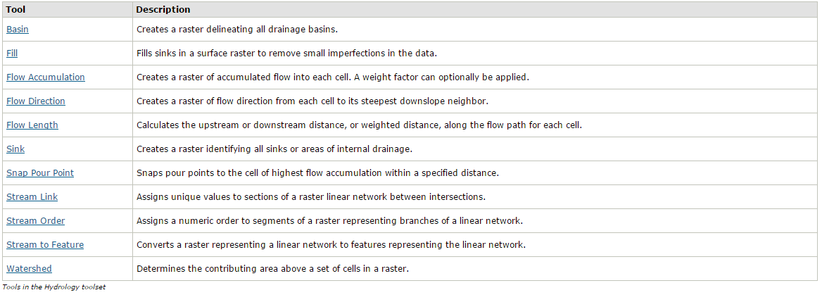
I. Analysis Tools

Slide 3
I.A Fill

Slide 4
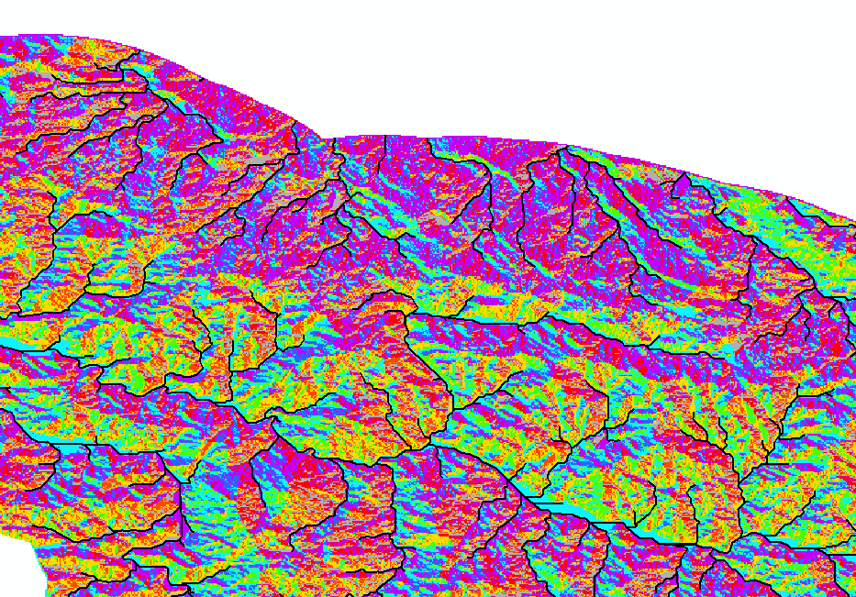
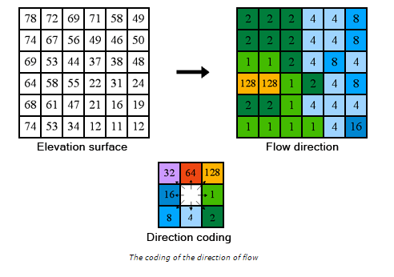
I.B Flow direction

Slide 5
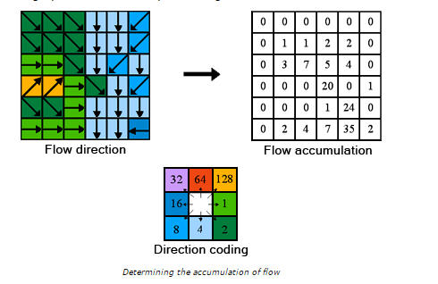
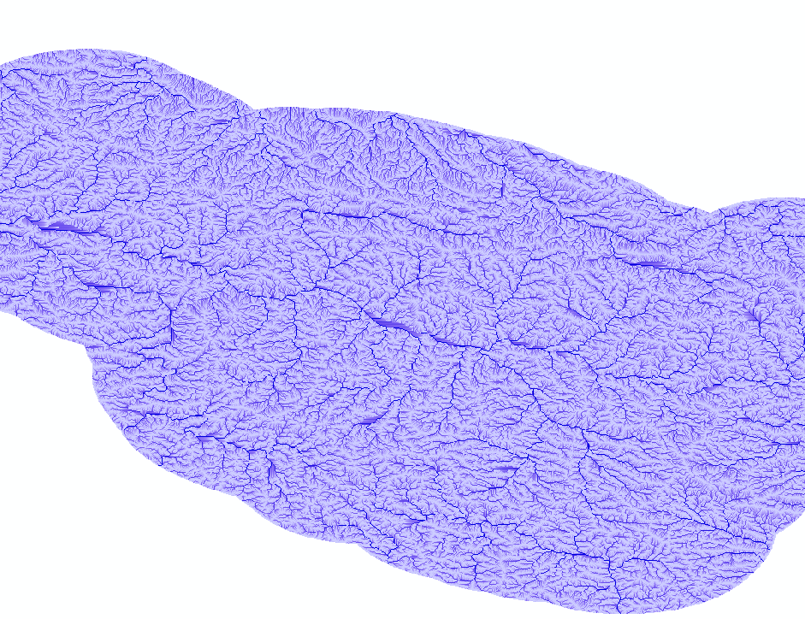
I.C Flow Accumulation
Vstup
in_flow_direction_raster
Flow direction raster

Slide 6
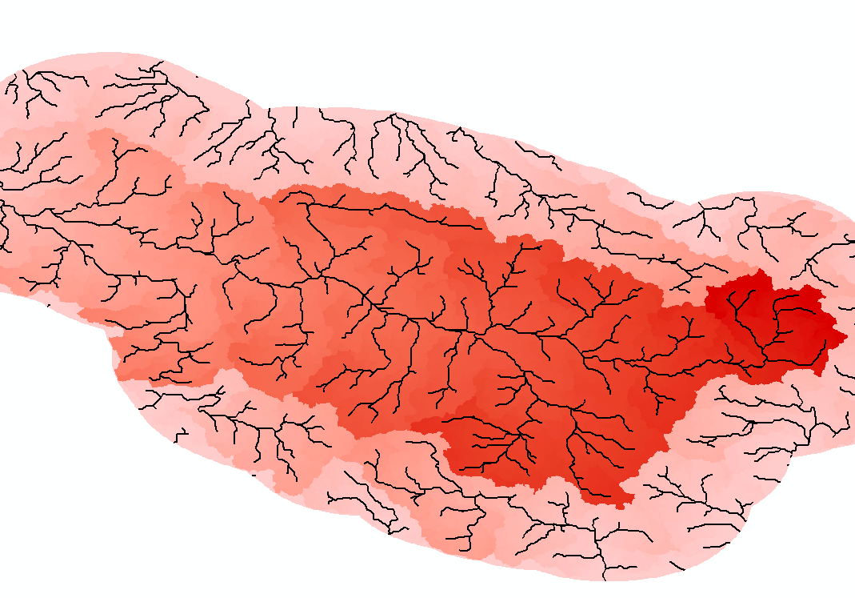
I.D Flow lenght
Vstup
in_flow_direction_raster
Flow direction raster
direction_measurement
Upstream/downstream
in_weight_raster

Slide 7
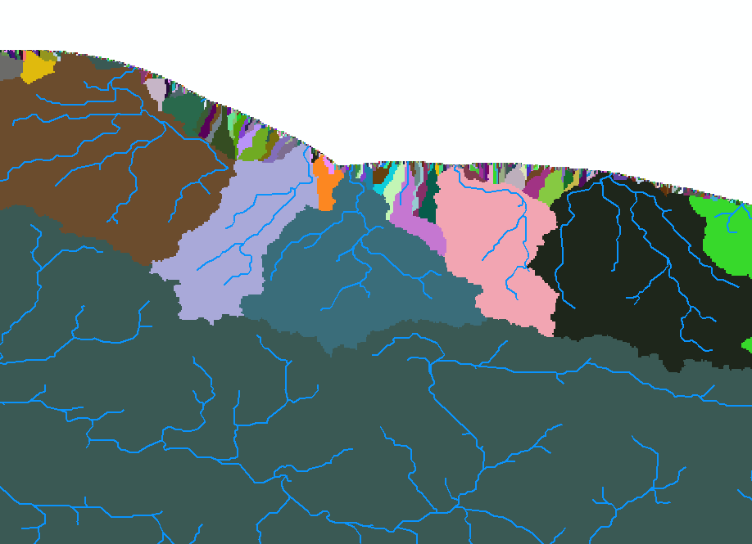
I.E Basin
Vstup
Flow direction raster

Slide 8
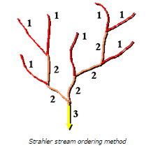
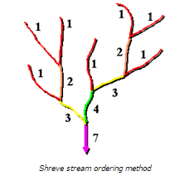
I.F Stream Order

Slide 9
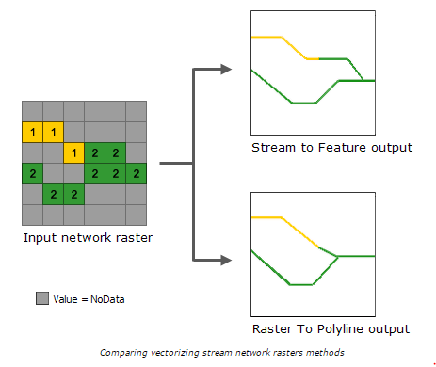
I.G Stream to Feature
Alternativa k Raster to Polyline

