Slide 1
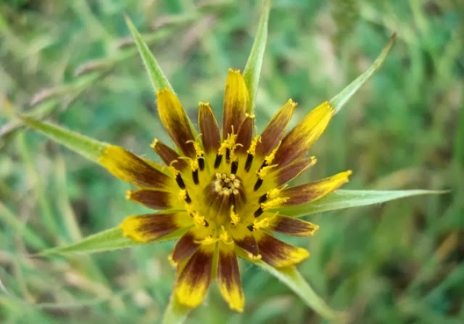
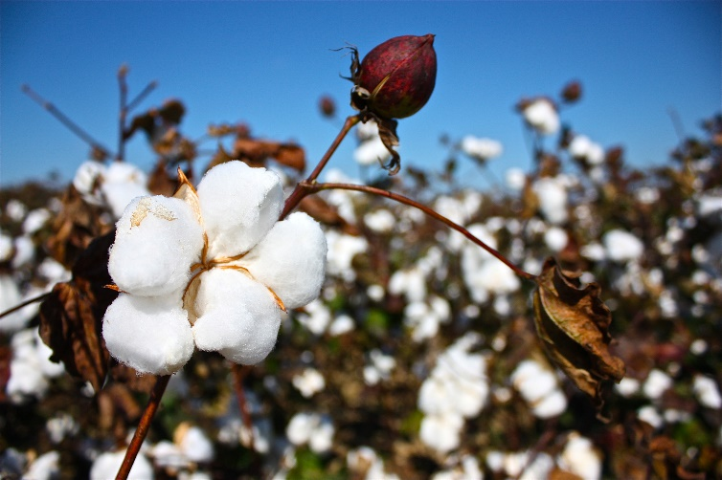
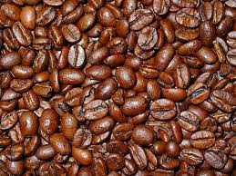
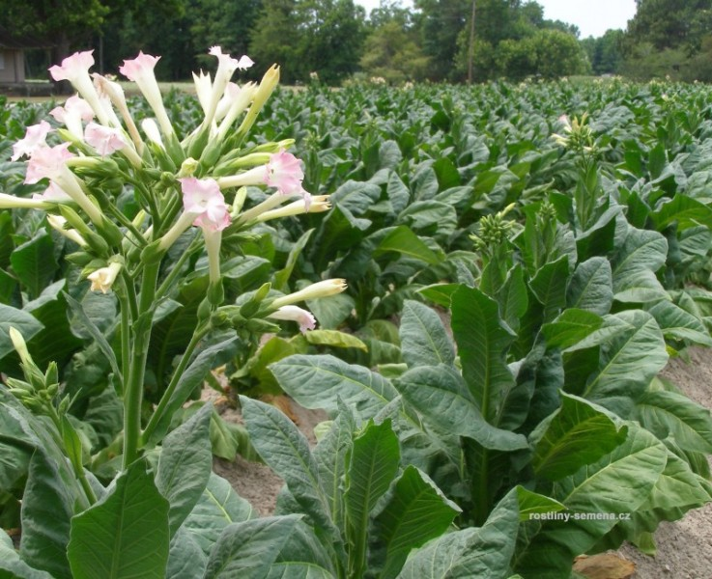
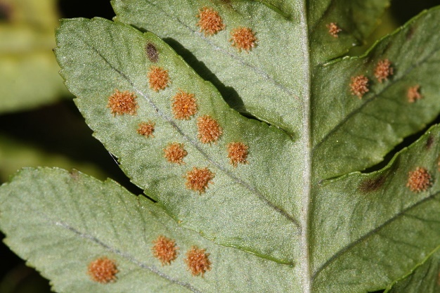
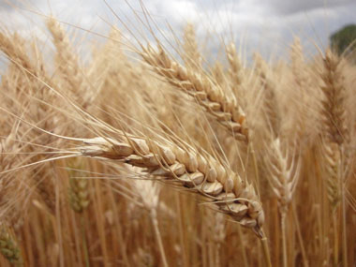
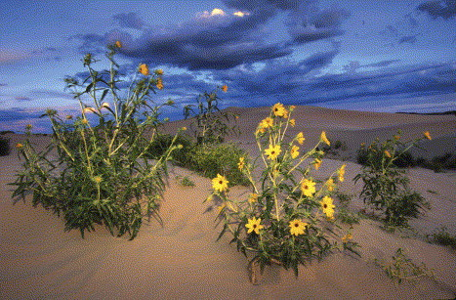
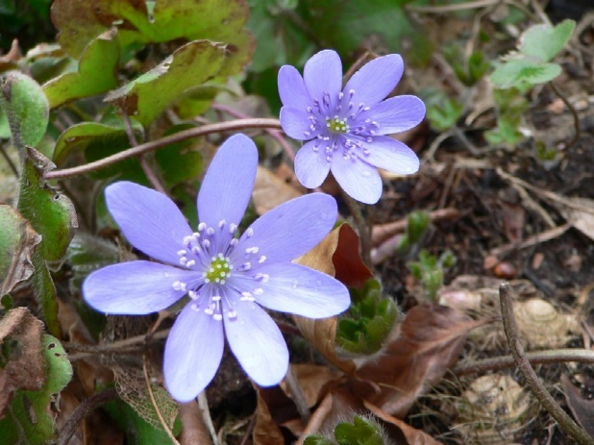
Hybrid speciation
Homoploid and Polyploid

Slide 2
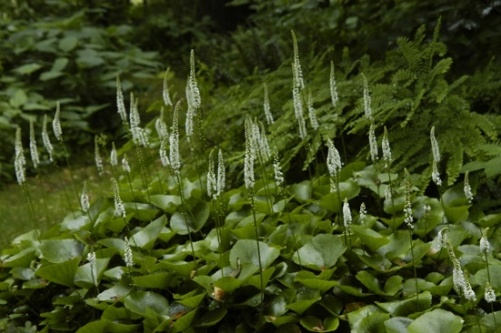
Homoploid vs Polyploid hybrid speciation
Helianthus anomalus (Asteraceae)
Triticum aestivum (Poaceae)
Galax ucreolata (Diapensiaceae)
Soltis & Soltis (2009) The Role of Hybridization in Plant Speciation. Ann Rev 60: 561-588.
Otto (2007) The Evolutionary Consequences of Polyploidy. Cell 131: 452-462.

Slide 3
Senecio squalidus = S. chrysanthemifolius x S. aethnensis

Slide 4
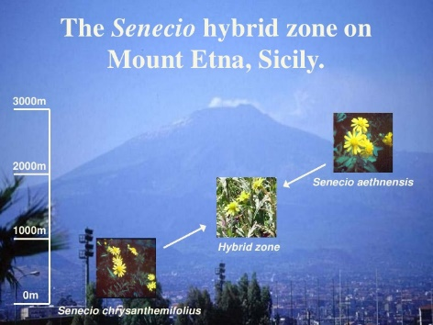
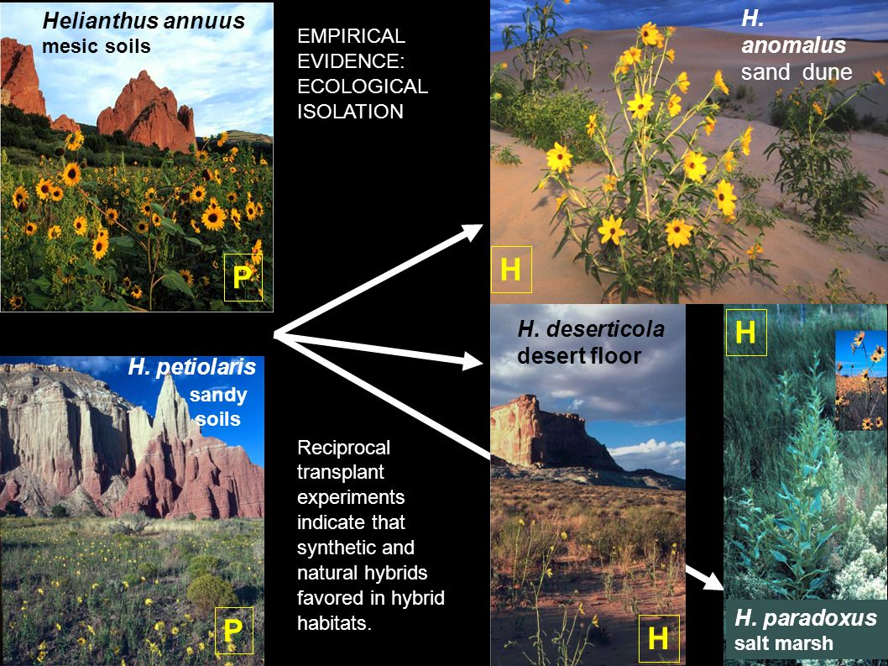
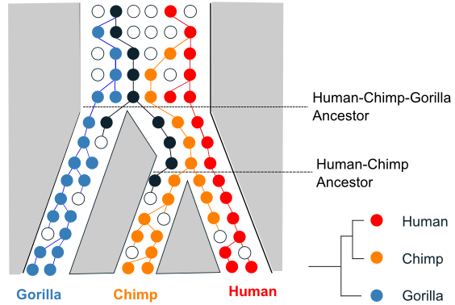
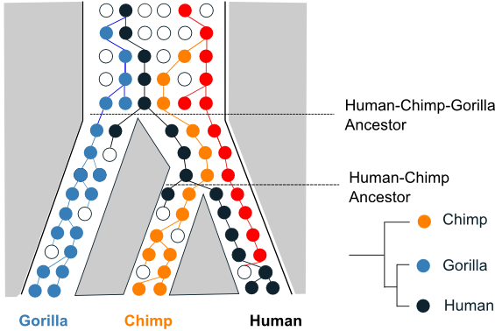
Homoploid hybrid speciation – how do we recognize a homoploid hybrid species?
Schumer et al. (2014) How common is homoploid hybrid speciation. Evolution 68: 1553–1560.
Gross and Riesberg (2005) The Ecological Genetics of Homoploid Hybrid Speciation. J Hered 96: 241–252.

Slide 5
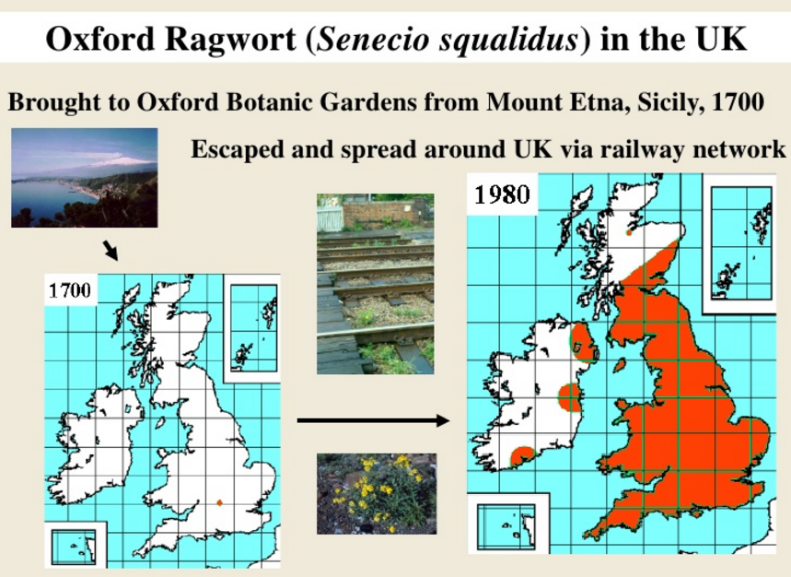

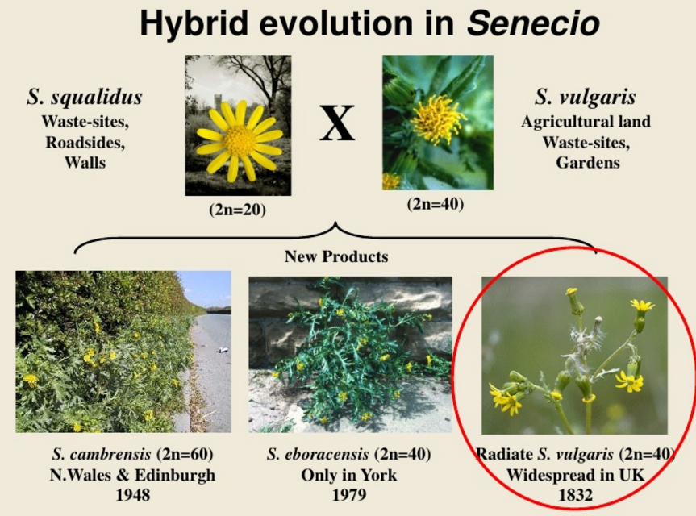
Homoploid hybrid speciation in allopatry – Senecio squalidus
Abbott et al. (2010) Homoploid hybrid speciation in action. Taxon 59: 1375–1386.

Slide 6
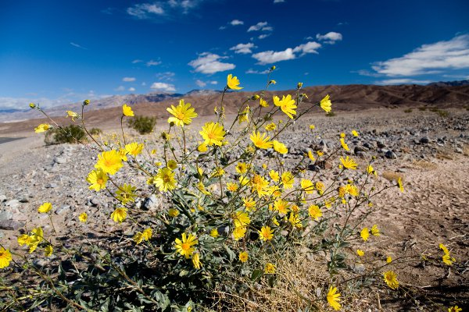

Homoploid hybrid speciation – recombinational (chromosomal) model
selection
drift
Hegarty & Hiscock (2005) Hybrid speciation in plants: new insights from molecular studies. New Phytol 165: 411–423.
Buerkle & Riesberg (2008) The rate of genome stabilization in homoploid hybrid species. Evolution 62: 266–275.

Slide 7
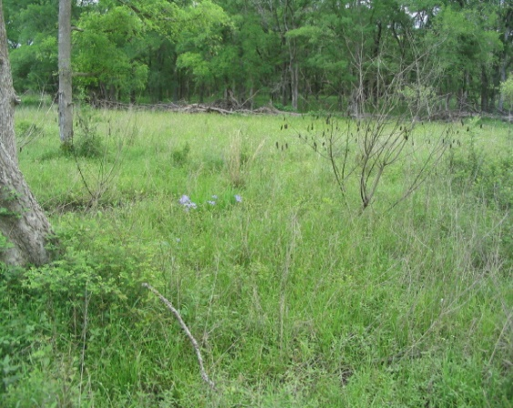
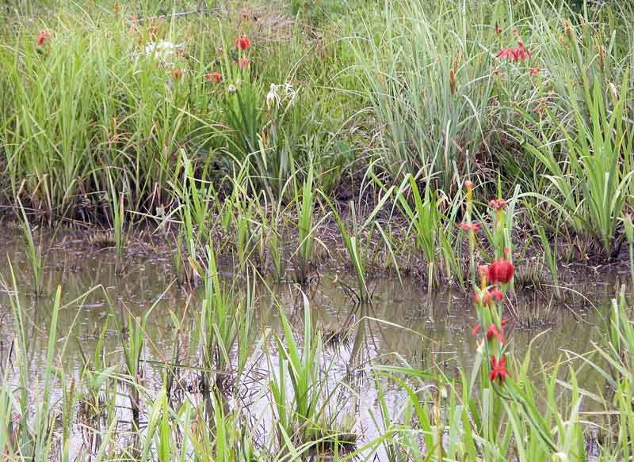
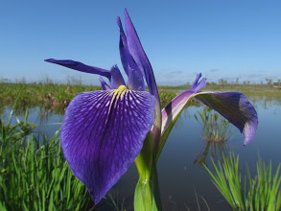
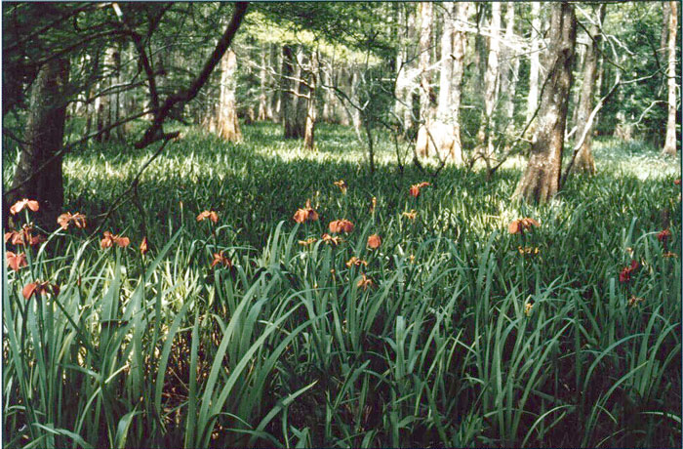
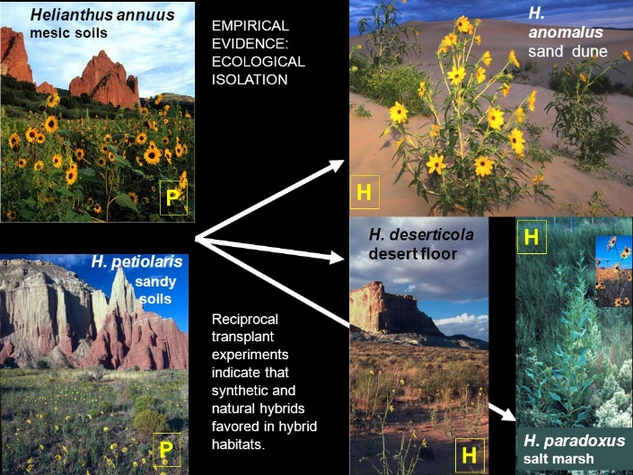
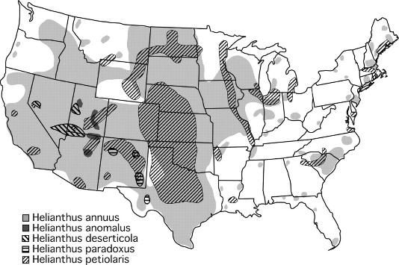
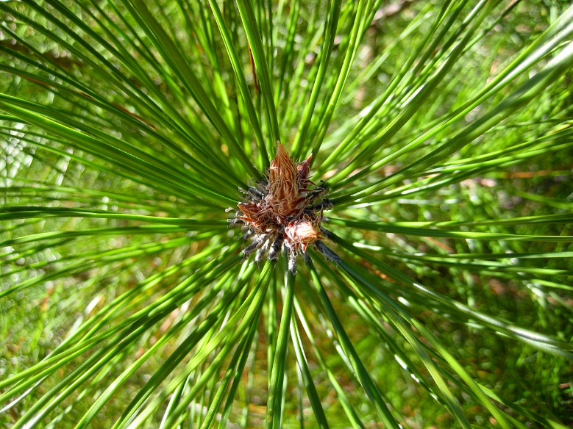
Homoploid hybrid speciation – ecological divergence
X
X
=
Iris brevicaulis
Iris fulva
Iris hexagona
Iris nelsonii
Pinus densata
Gross & Riesberg (2005) The Ecological Genetics of Homoploid Hybrid Speciation. J Hered 96: 241–252.
Nolte & Tautz (2009) Understanding the onset of hybrid speciation. Trends in Genetics 26: 54–58.

Slide 8
Polyploid hybrid speciation
homoploid hybrid
allopolyploid hybrid
Tolmiea diplomenziesii (2n=14), T. menziesii (2n=28)
Soltis & Soltis (2009) The Role of Hybridization in Plant Speciation. Ann Rev 60: 561-588.
Paun et al. (2009) Hybrid speciation in angiosperms: Parental divergence drives ploidy. New Phytol 182: 507-518.
Otto (2007) The Evolutionary Consequences of Polyploidy. Cell 131: 452-462.
Ramsey & Schemske (1998) Pathways, mechanisms and rates of polyploid formation in flowering plants. Ann Rev 29: 467-501

Slide 9
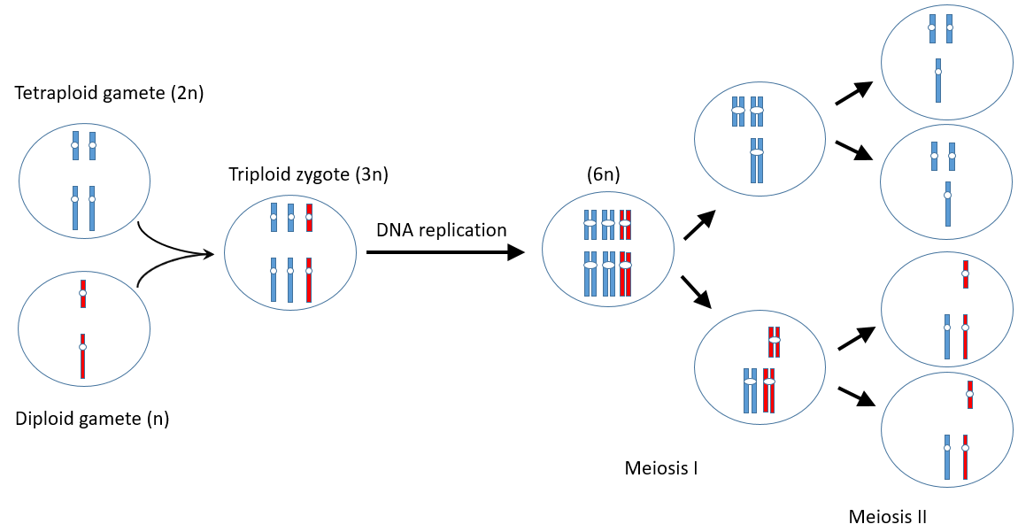
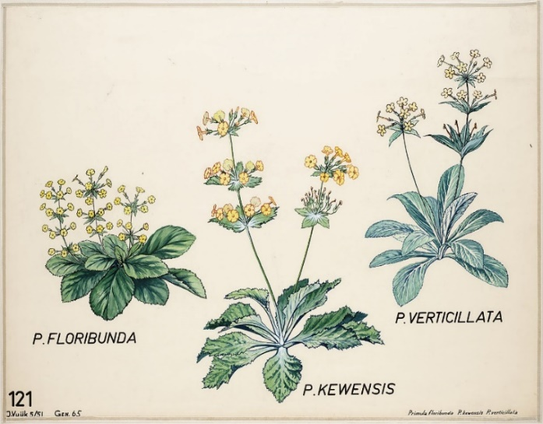
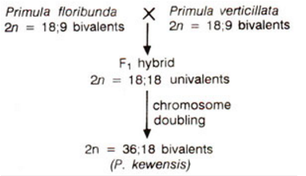
Polyploid hybrid speciation - origin, reproductive isolation
Soltis & Soltis (2009) The Role of Hybridization in Plant Speciation. Ann Rev 60: 561-588.
Riesberg & Willis (2007) Plant Speciation. Science 317: 910-914.
Ramsey & Schemske (1998) Pathways, mechanisms and rates of polyploid formation in flowering plants. Ann Rev 29: 467-501.

Slide 10
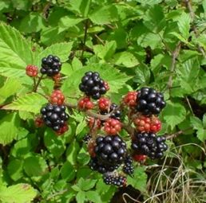

Polyploid hybrid speciation – disadvantages and advantages
Silene acaulis
Soltis & Soltis (2009) The Role of Hybridization in Plant Speciation. Ann Rev 60: 561-588.
Barringer (2007) Polyploidy nd self-fertilization in flowering plants. Am J Bot 94: 1527-1533.
Comai (2005) The advantages and disadvantages of being polyploid. Nature Reviews 6: 837-846.

Slide 11
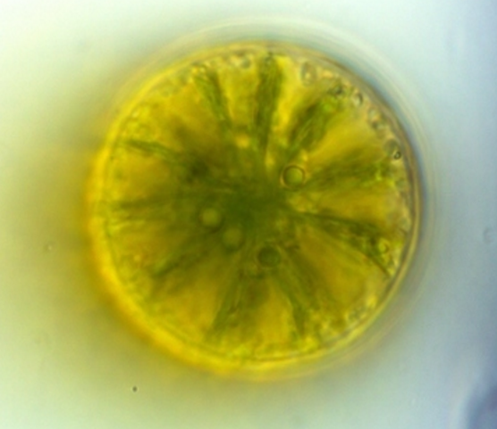
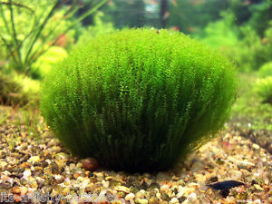
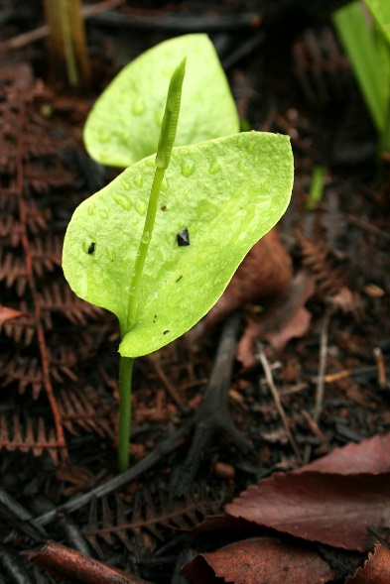
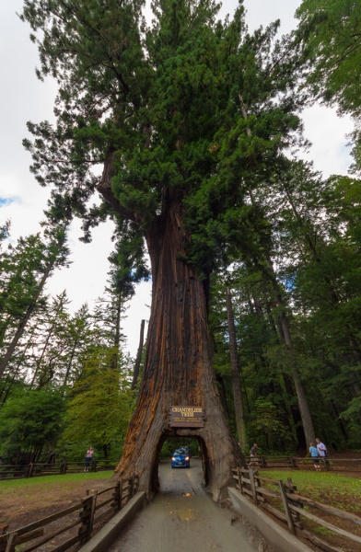
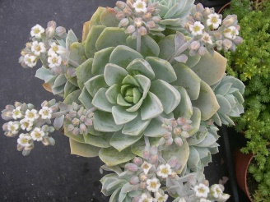
Netrium digitans
Leptodictyum riparium
Ophioglossum
reticulatum
Sequia
sempervirens
Sedum suaveolens
Husband et al. (2013) The Incidence of Polyploidy in Natural Plant Populations: Major Patterns and Evolutionary Processes. In: Plant Genome Diversity Vol. 2, Springer, pp 255-276.

Slide 12
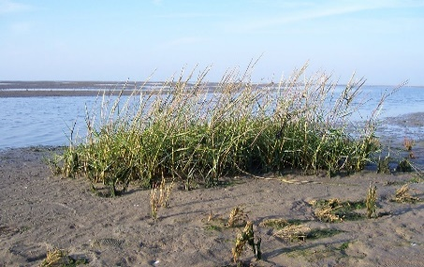
Polyploid hybrid speciation – recent and ancient polyploid speciation
Soltis & Soltis (2009) The Role of Hybridization in Plant Speciation. Ann Rev 60: 561-588.
Wood et al. (2009) The frequency of polyploid speciation in vascular plants. PNAS 106: 13875-13879.

