Slide 1
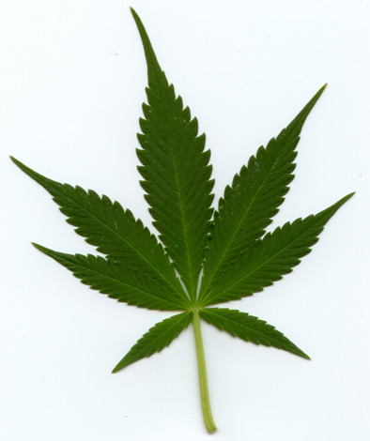
Task A
Anni
Alžbeta
Gianmaria

Slide 3
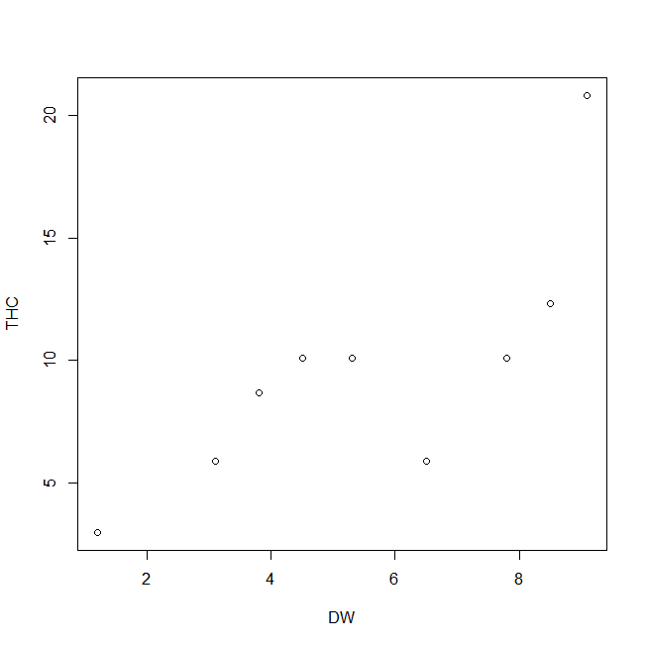
> summary(thc)
THC DW
Min. : 3.00 Min. :1.200
1st Qu.: 6.60 1st Qu.:3.975
Median :10.10 Median :5.900
Mean : 9.92 Mean :5.830
3rd Qu.:11.75 3rd Qu.:8.325
Max. :20.80 Max. :9.100

Slide 4
> lm.thc<-lm(THC~DW, data=thc)
> anova(lm.thc)
Analysis of Variance Table
Response: THC
Df Sum Sq Mean Sq F value Pr(>F)
DW 1 128.999 128.999 12.509 0.007655 **
Residuals 8 82.497 10.312
---
Signif. codes: 0 ‘***’ 0.001 ‘**’ 0.01 ‘*’ 0.05 ‘.’ 0.1 ‘ ’ 1

Slide 5
> summary(lm.thc)
Call:
lm(formula = THC ~ DW, data = thc)
Residuals:
Min 1Q Median 3Q Max
-4.9687 -1.4006 -0.2593 1.4734 6.2498
Coefficients:
Estimate Std. Error t value Pr(>|t|)
(Intercept) 1.6650 2.5453 0.654 0.53138
DW 1.4160 0.4003 3.537 0.00765 **
---
Signif. codes: 0 ‘***’ 0.001 ‘**’ 0.01 ‘*’ 0.05 ‘.’ 0.1 ‘ ’ 1
Residual standard error: 3.211 on 8 degrees of freedom
Multiple R-squared: 0.6099, Adjusted R-squared: 0.5612
F-statistic: 12.51 on 1 and 8 DF, p-value: 0.007655
formula: THC=1,6650+1,4160*DW

Slide 6
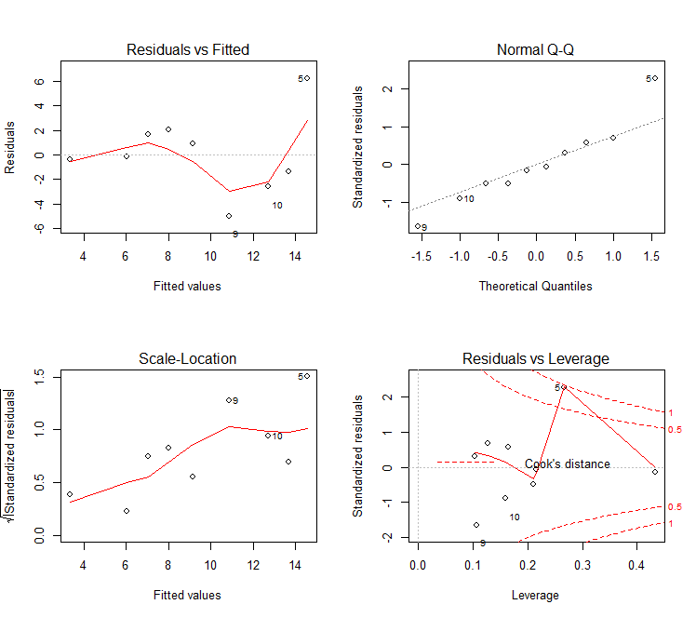

Slide 7
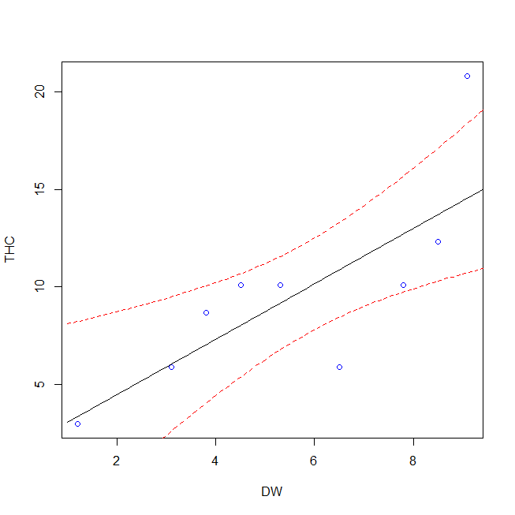
Multiple R-squared: 0.6099
Adjusted R-squared: 0.5612
F_{(1,8)}=12.51, p-value: 0.007655
windows()
> plot(THC~DW, data=thc, col="blue")
> pr<-predict(lm.thc, data.frame(DW= seq(1,10,0.1)), se.fit = T)
> lines(seq(1,10,0.1), pr$fit)
> lines(seq(1,10,0.1), pr$fit-(qt(0.975,8))*pr$se.fit,lty=2, col="red”)
> lines(seq(1,10,0.1), pr$fit+(qt(0.975,8))*pr$se.fit,lty=2,col="red")

