Slide 1
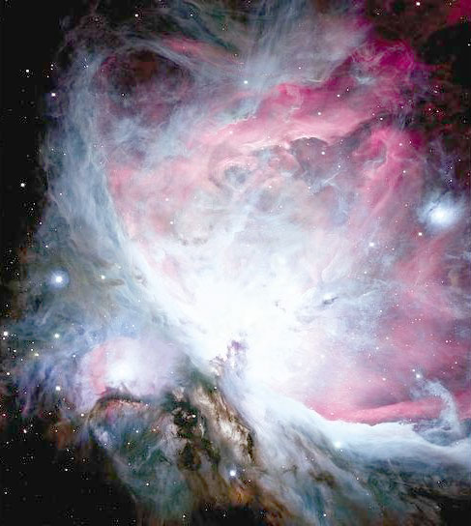
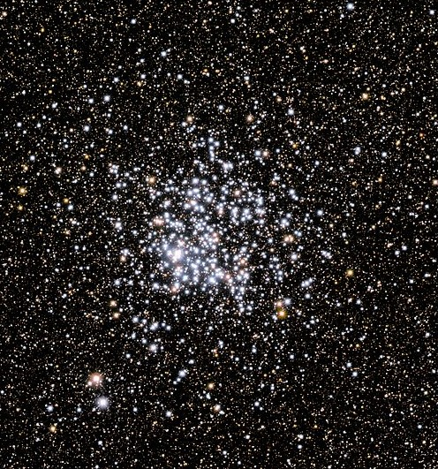
M11, NGC 6705: Total Mass
About 10000 M(sun), 200 Myr
Orion Nebula, Distance about
450 pc, Total Mass about
5000 M(sun), Diameter about 3 pc

Slide 2
Cluster formation
Observations versus Models
Important parameters
Time scale
Total mass
Initial Mass Function
Velocity distribution
Binary fraction
Diameter
Density distribution

Slide 3
Heuristic Approach
We know of 14 Open Clusters which are younger than 10 Myrs within 1000 pc around the Sun (Source: WEBDA)
There are also five star forming regions
Open Clusters still have to form within the solar vicinity
Total masses: up to 40 000 M(sun)
Stable for some Gyrs
Evolutionary theory has to explain these facts

Slide 4
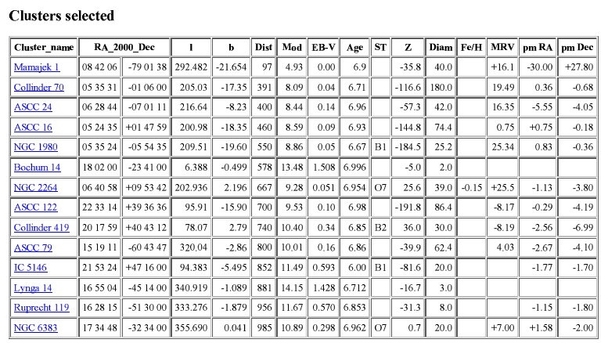
Several spurious entries like the “ASCC clusters”

Slide 5
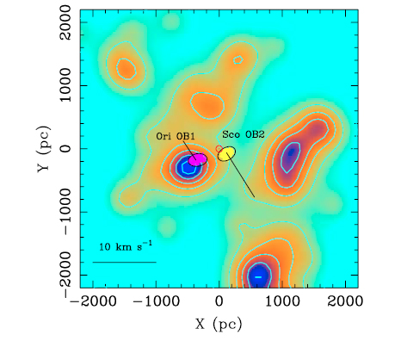
Distribution of young open clusters and star forming regions from Alfaro et al., 2009, Ap&SS, 324, 141

Slide 6
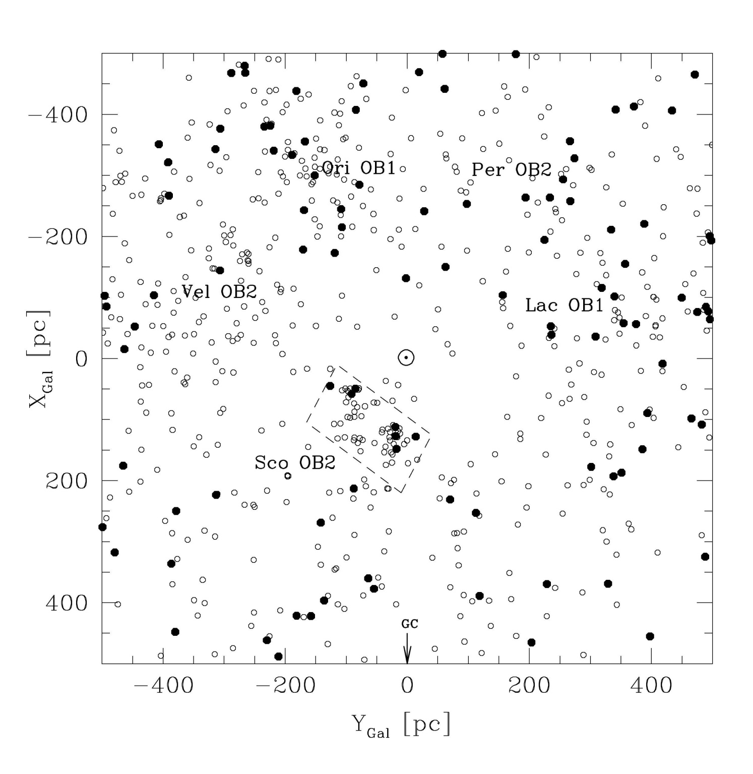
Stars hotter
than B0 and
B0 to B2
Distribution of star forming regions from Preibisch & Mamajek, 2008, Handbook of Star Forming Regions, Volume II

Slide 7
Giant Molecular Clouds
Star Clusters can only form within „Giant Molecular Clouds“ (GMC) with a high enough initial mass
The stellar formation rate in the solar neighborhood is very low
But still there have to exist several GMCs to form Star Clusters
Is the formation process the same for all observed Galaxy types?

Slide 8
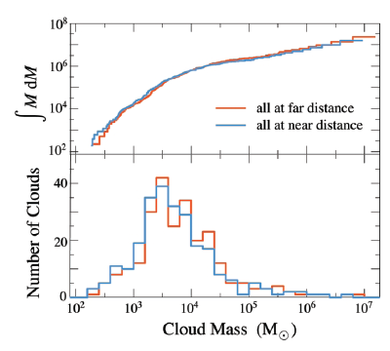
Giant Molecular Clouds
Stark & Lee, 2006, ApJ, 641, L116
Recent investigation of the
¹³CO Gas within 2000 pc
around the Sun
The number of young
OCLs can be very well
explained
Formation rate of 0.45
OCLs per kpc⁻² Myr⁻¹ in
the galactic disk within
2 kpc around the Sun
Battinelli &
Capuzzo-Dolcetta, 1991,
MNRAS, 248, 76
Single + Binaries
Star
Clusters

Slide 9
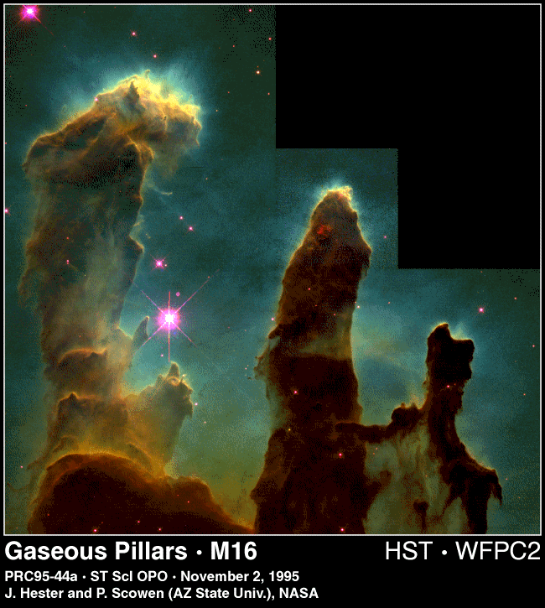
NGC 6611 (M16)
d = 1750 pc
t = 8 Myr
Star formation
„live“

Slide 10
Initial Mass Function
The „Initial Mass Function“ (IMF) describes the mass distribution for a population of stars when they are formed together
Relevant astrophysics:
Size, total mass and metallicity of the initial GMC
Fragmentation of the GMC
Conservation of the angular momentum
Local and global magnetic fields
Accretion in the Pre-Main Sequence phase
The only observational parameter for the test of stellar formation and evolution models
We observe a luminosity function which has to be transformed to the IMF

Slide 11
Initial Mass Function
Several most important questions are still not solved
Is the IMF homogeneous within the Milky Way?
Is the IMF constant throughout time?
What is the influence of the local and global magnetic field on the IMF?
What is the influence of the local and global metallicity on the IMF?

Slide 12
Initial Mass Function
The IMF θ(m), often called „Present-Day Mass Function“ (PDMF), is defined as:
dN = θ(m) dm
dN is the number of all stars per cubic parsec on the main sequence with a mass between M and (M + dm).
But we observe not the masses of stars but their magnitudes (relative and absolute) or luminosities.
So we have to define the luminosity function and transform it into the IMF.

Slide 13
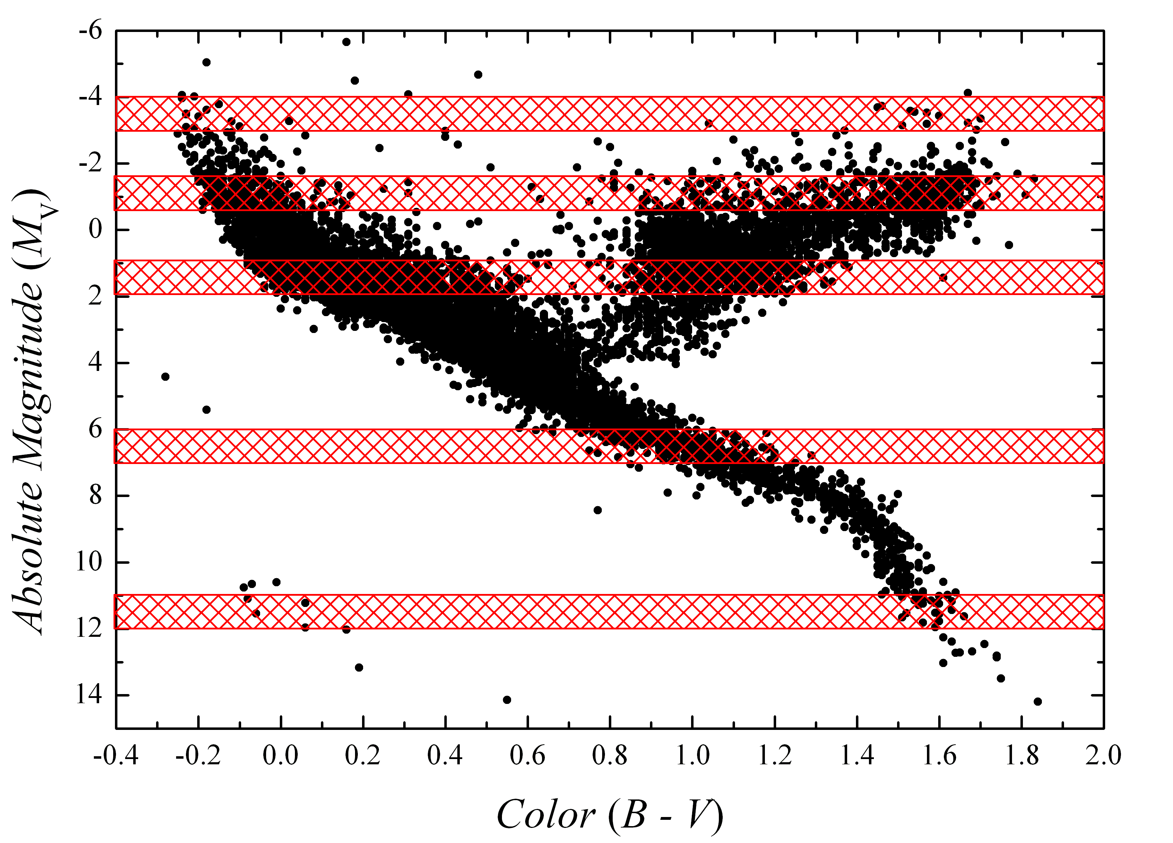
Evolved stars
Evolved stars
In each row (M_{V} + dM) there is a mixture of main sequence and evolved objects. For the IMF, we need the main sequence only.

Slide 14
Luminosity function
The luminosity function Ψ(M_{V}), is defined as:
dN = -Ψ(M_{V}) dM_{V}
dN is is the number of all stars per cubic parsec on the main sequence with an absolute magnitude between M_{V} and (M_{V} + dM_{V}). The transformation to the IMF is given as:
θ(m) = -Ψ(M_{V})[dm(M_{V})/dM_{V}]⁻¹
The second term is the derivation of the Mass-Luminosity function m(M_{V}). It is depending on the age (t), metallicity (Z) and rotation (v_{rot})
m(M_{V}) = m(M_{V}, Z, t, v_{rot})

Slide 15
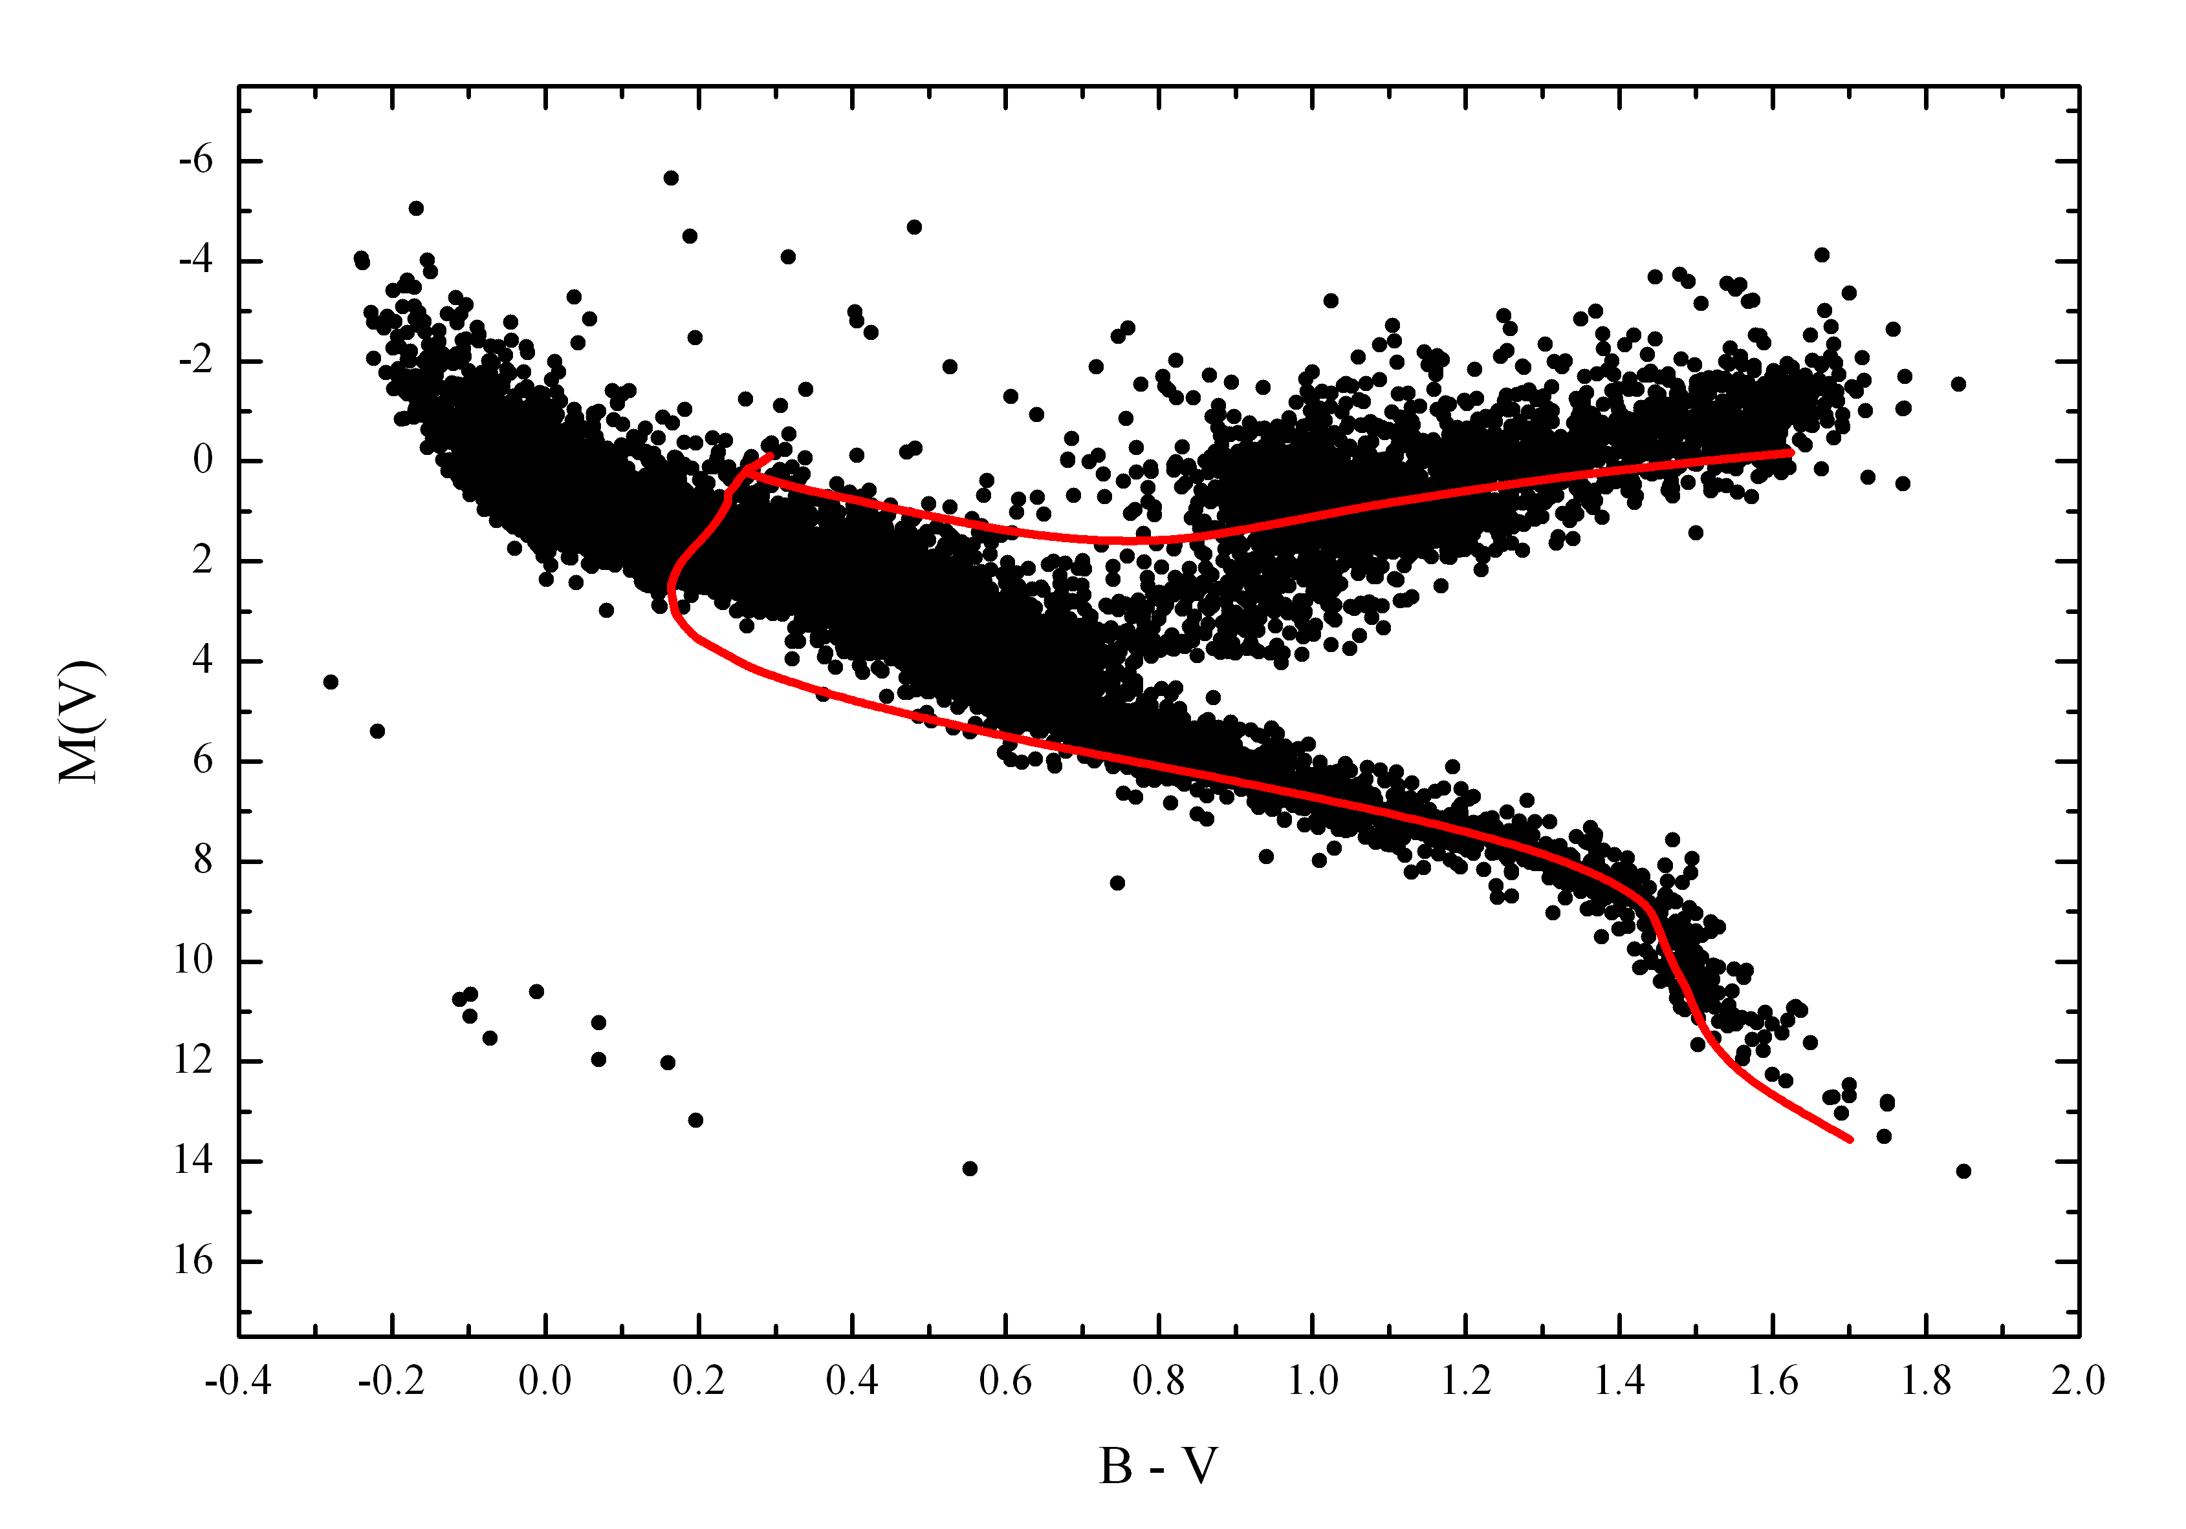
With which masses
are these giants
born?

Slide 16
Correction of the observations
We have to correct the complete observations for the evolved objects. There are three possibilities:
Take a statistical sample with a well known luminosity function (clusters)
Take a statistical sample with well known photometric magnitudes and distances
Take isochrones = theoretical star evolution = models based on observations = circular argument
All these methods are not self consistent and always introduce an unknown error to the analysis

Slide 17
Salpeter, 1955, ApJ, 121, 161
Results of classical spectral classification, only 10%
of stars with M_{V} = -4.5 mag are on the main sequence!
These values are depending on the chosen sample for the
spectral classification and which classification scheme
is applied.
The errors are rather large.

Slide 18
Salpeter, 1955, ApJ, 121, 161
Results of classical spectral classification, only 10%
of stars with M_{V} = -4.5 mag are on the main sequence!
These values are depending on the chosen sample for the
spectral classification and which classification scheme
is applied.
The errors are rather large.

Slide 19
All observations have to be normalized to one “standard system” which means essentially to one “time scale”.
The observations show, that this heuristic law describes them very well
θ(m) ≈ m^{-Γ} Salpeter law (1955)
Star cluster are one of the most important observational test for the IMF because they, normally, have well defined ages, distances and metallicities. However, the errors are still quiet large.
But there is still no homogeneous IMF determination for open clusters taking into account the available data.

Slide 20
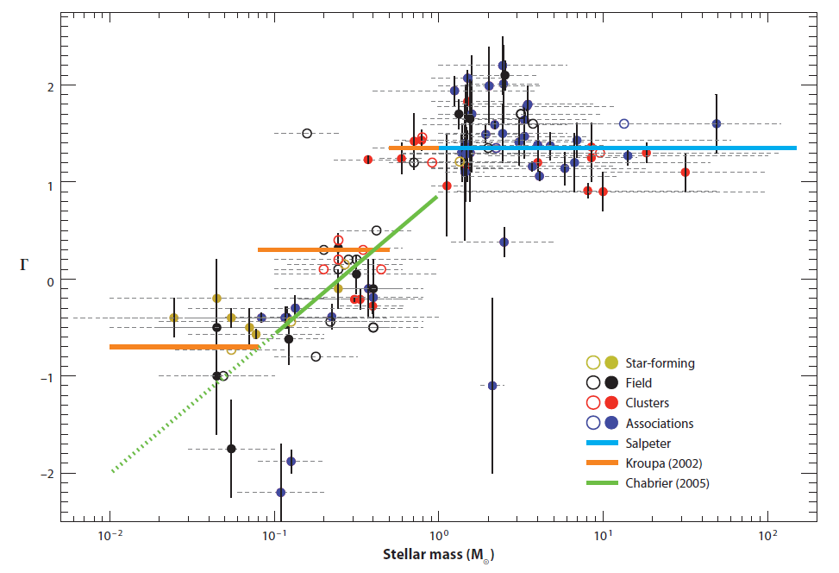
Kroupa (2002)
Bastian et al, 2010, Annual Review of Astronomy and Astrophysics, 48, 339

Slide 21
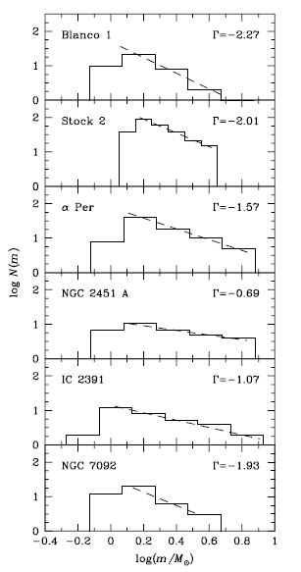
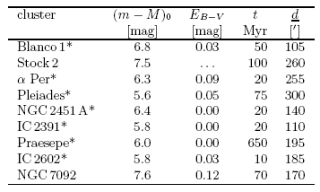
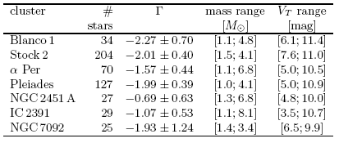
TYCHO2 data
Sanner & Geffert, 2001, A&A, 370, 87

Slide 22
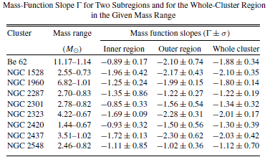
Saurabh et al., 2008, AJ, 135, 1934
Typical values and errors

Slide 23
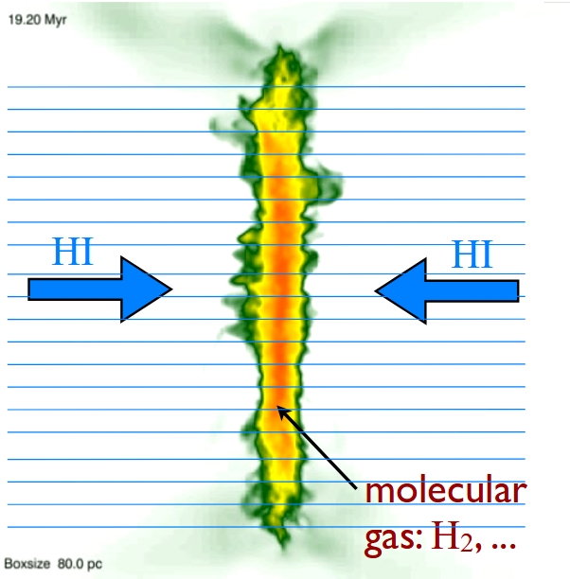
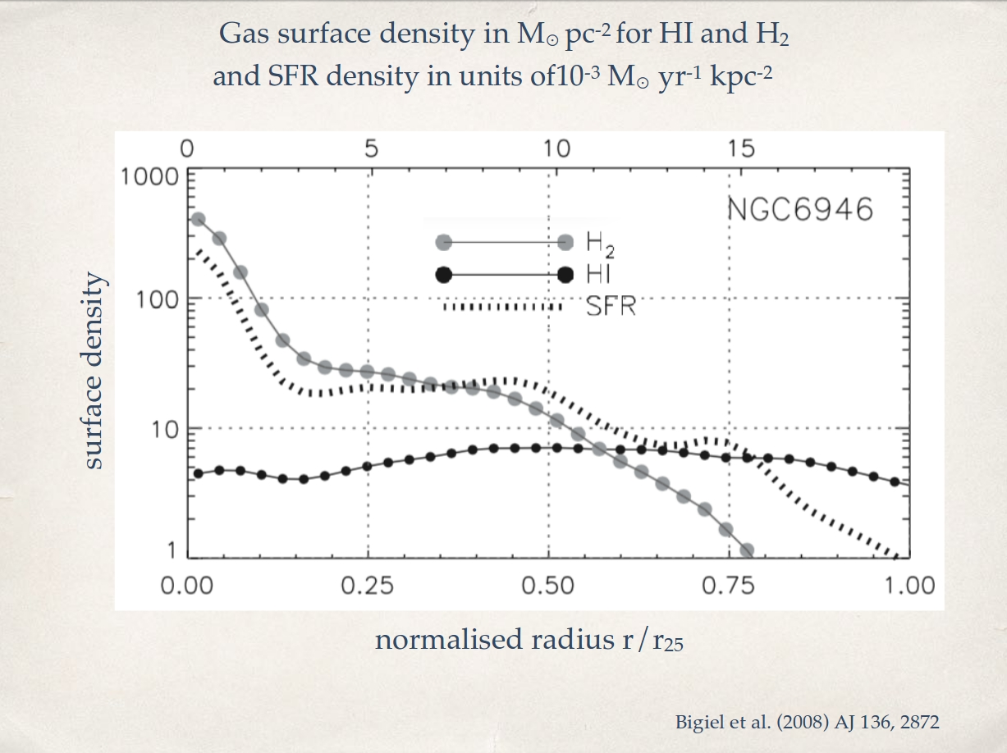
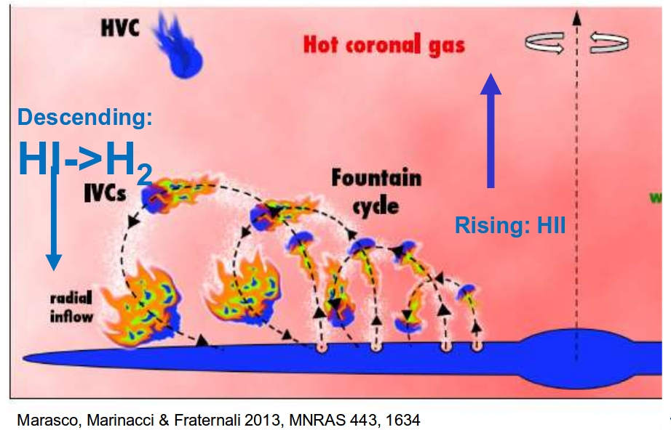
Molecular clouds - formation
Colliding flows – colliding HI streams (only low-mass cloud formation – 10⁴-10⁵ M_{sol})
Cloud collisions – in spiral arms (can yield rather massive clouds - 10⁶ M_{sol})
Various instabilities ? - can yield massive clouds
Subsequent supernova explosions – sweeping up the local ISM
In all cases, HII formation is needed

Slide 24
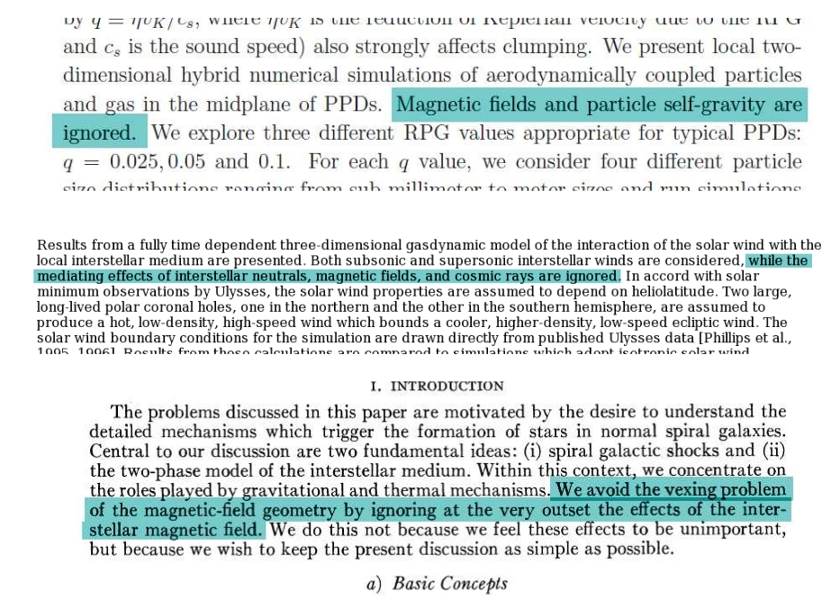
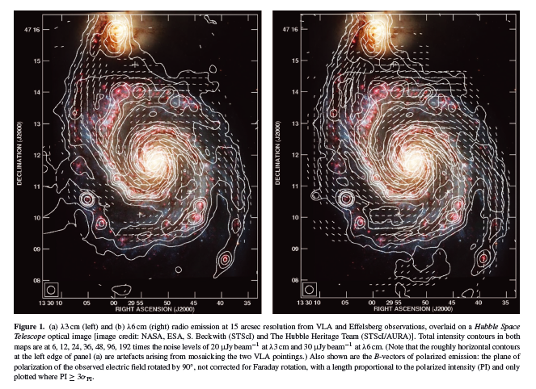
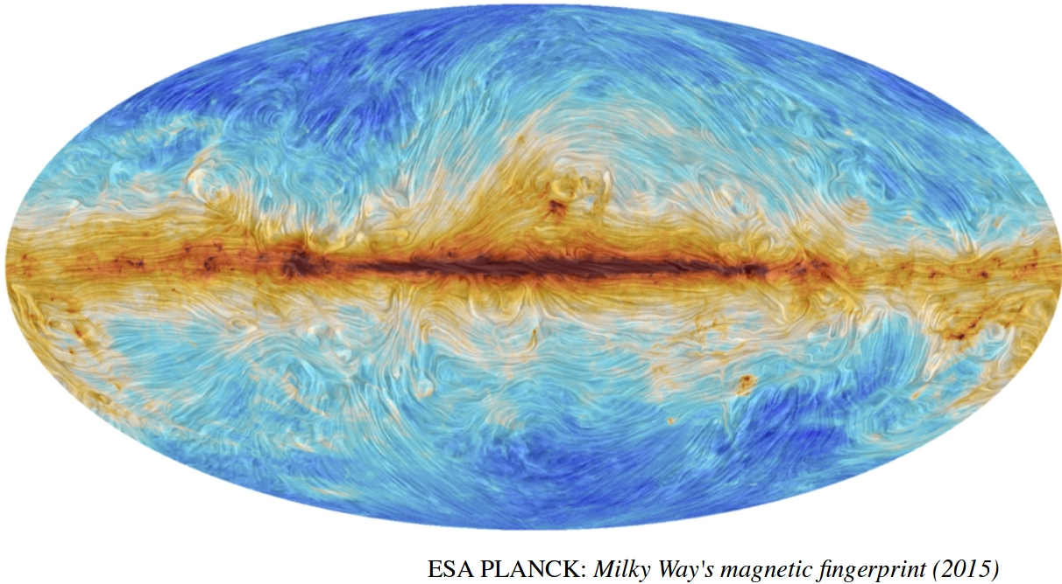
Magnetic fields
Slide credit: Kothes (2018)
M51, Fletcher+ (2011)
Magnetic field of the Milky way from dust polarization

Slide 25
Magnetic field – star formation
Price & Bate, 2009, MNRAS, 398, 33
Effects of magnetic pressure on fragmentation
Increasing magnetic field strength

Slide 26
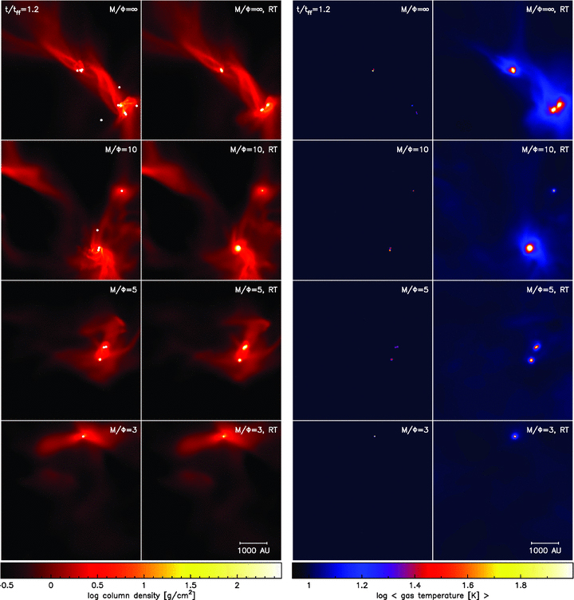
Increasing magnetic field strength

Slide 27
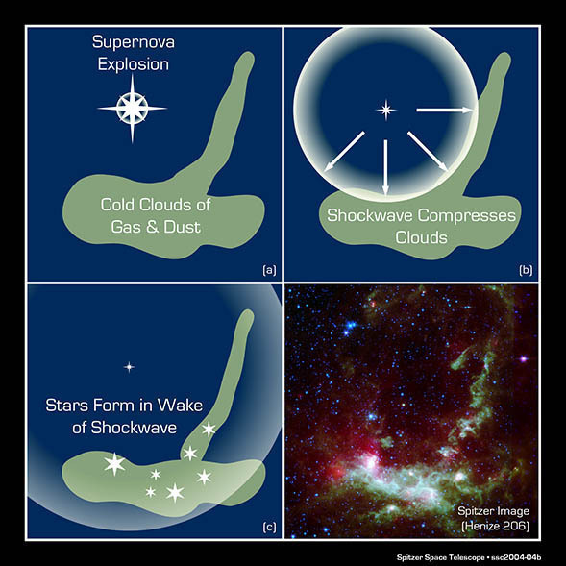
Star formation physics
Inertia – turbulence effects
Inertia – centrifugal force
Fission – break-up of the collapsing cloud
Heat pressure – warm gas tends to expand under its own pressure
Magnetic pressure – mag. field amplified when compressed, changes the dynamics of the system and resists collapse
Constituent | Roles | Produced by | Destroyed by
Dense gas clouds | Form stars | Gravitational collapse; supernova explosions? | Ultraviolet starlight; stellar winds, supernovae
Dust grains | Catalyze molecule formation; stop ultraviolet starlight | Red giant stars | Supernovae
Molecules | Radiate heat from gas clouds, permitting collapse | Grain catalysis | Ultraviolet starlight
Stars | Produce supernovae, red giants, dust, ultraviolet light | Gravitational collapse | Stellar evolution

Slide 28
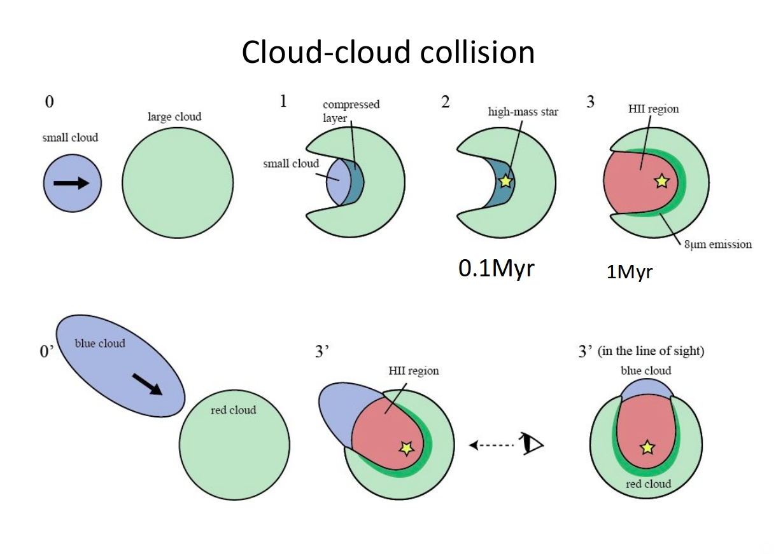
Credit: Fukui (2018)

Slide 29
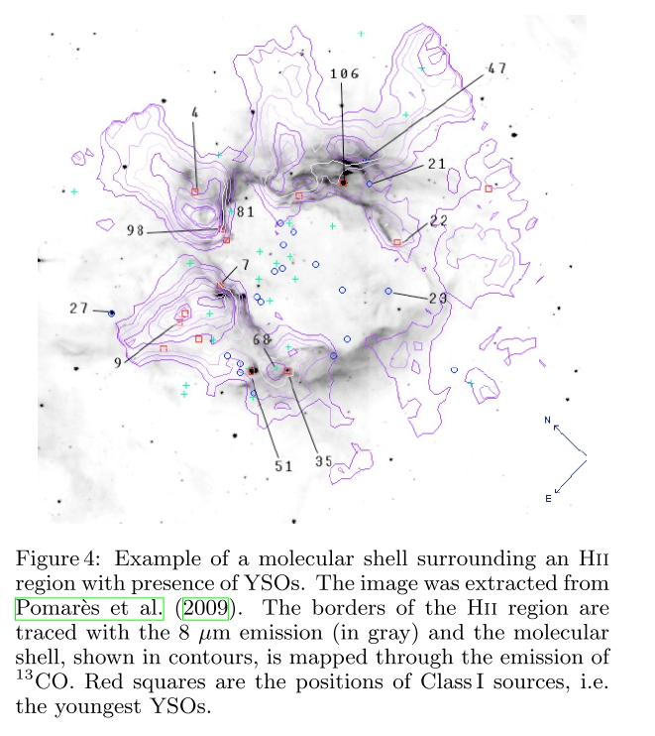
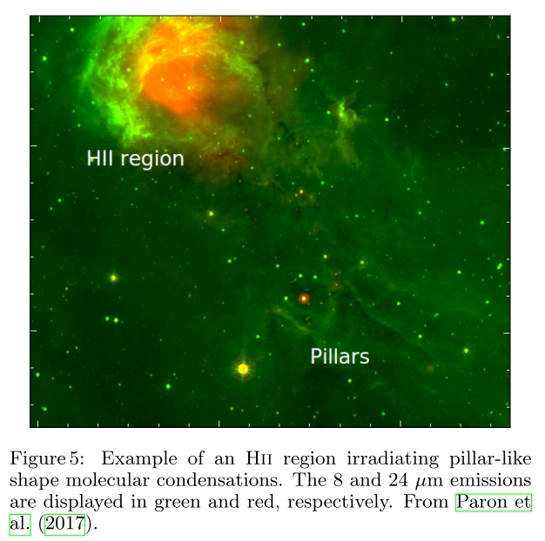
Collect & collapse
Radiatively-driven implosion
During a supersonic expansion of HII region, enough of ISM can be swept up to initialize SF
Ionization from from a HII region moves over a molecular condensation and generates a dense outer shell of ionized gas. This shell is over-pressured with respect to the interior of the condenstation and shocks are driven into it, compressing the interior until the pressure is balanced

Slide 30
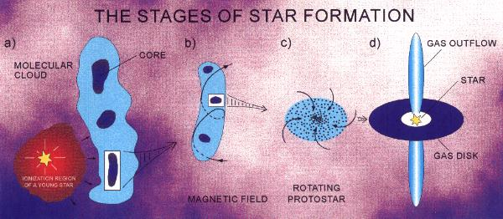
Star formation
Gravitation „wins“ Magnetic field, Shock wave Protostar
FREE GAS NO FREE GAS

Slide 31
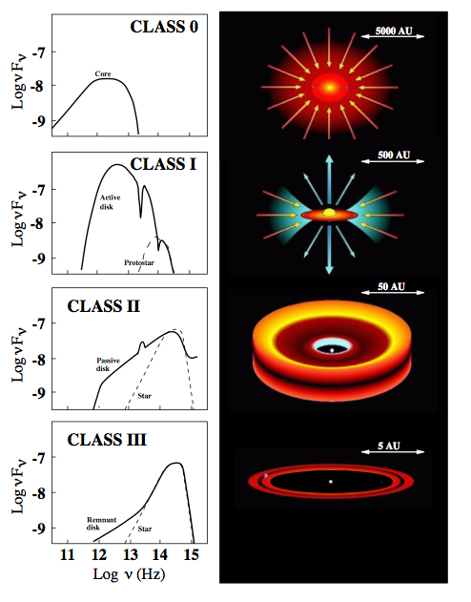
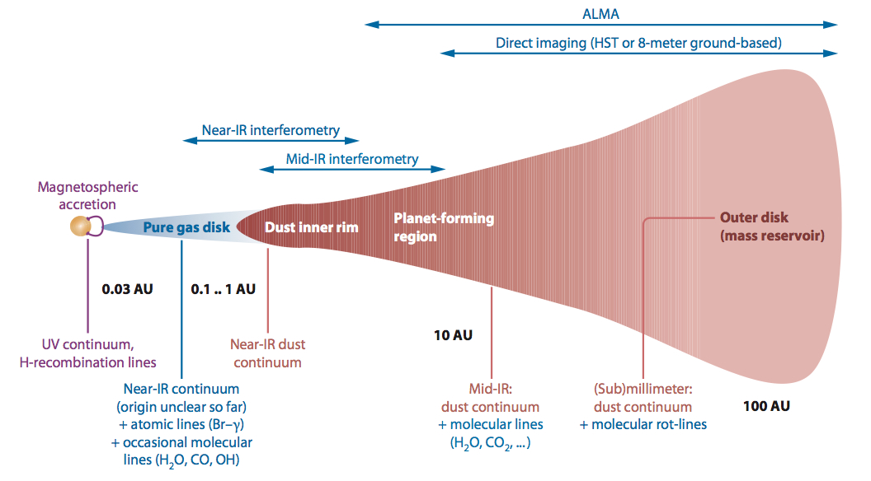
Protostars
Dullemond & Monnier (2010)
Relatively young field of study (advent of advanced infrared mission and radio astronomy)
IR photometry can be used to distinguish between the protostar classes
High mass/low mass stars form the same way?
Various timescales for different stellar masses
Isella (2006)

Slide 32
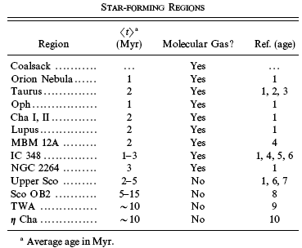
Star formation
The detection of free Gas in a Star Cluster is an excellent indicator for the time scale of continuous stellar formation
Star formation lasts
3 to 4 Myrs and is
continuous
This is also the
“intrinsic” error of an
age determination
Hartmann et al., 2001, ApJ, 562, 852

Slide 33
Numerical simulation of star formation in Giant Molecular Clouds
Hypothesis: the formation of all members of a star cluster is continuous for 3 to 4 Myrs within one GMCs
Is this a realistic approach?
Is it possible to simulation the formation of star clusters and compare the results with observational data within the solar vicinity?

Slide 34
Numerical simulation of star formation in Giant Molecular Clouds
Detailed paper by Bate & Bonnell, 2005, MNRAS, 356, 1201
Basis: Orion Nebula and Taurus star forming region
“Complete” astrophysical numerical simulation including Shock Waves, dynamical parameters and 3D-Hydrodynamics, Jeans Mass < 1 M(sun)
The numerical simulations are astonishing close to the observations

Slide 35
Numerical simulation of star formation in Giant Molecular Clouds
Input parameter:
Mass (GMC) = 50 M(sun), limited by CPU time
Diameter = 0.375 pc, limited by CPU time
Time for the gravitational collapse: 19000 years
Random turbulence field with a 3D Gaussian distribution

Slide 36
„Stars“: Mass > 0.084 M(sun)
Brown Dwarfs: Mass < 0.084 M(sun), no Hydrogen burning
More low mass stars formed due to the IMF
For star clusters it is essential to know the internal
velocity distribution because of their evolution
(see later)

Slide 37
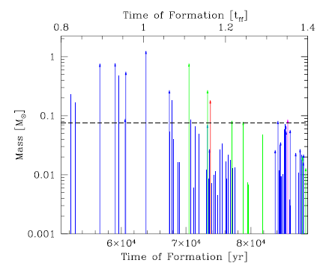
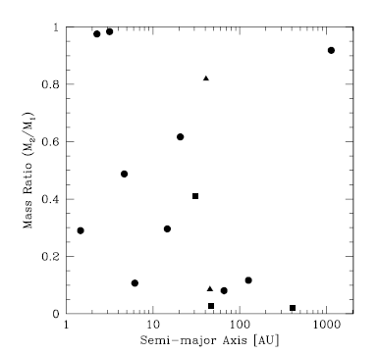
Continuous star formation
in time
The formation of
Binary systems

Slide 38
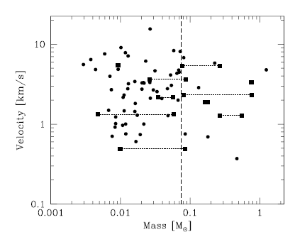
Binaries are
connected with
a line
The rms velocity dispersion of the simulations is 4.3 km s⁻¹
Such observational data for d > 500 pc are still not available => Gaia satellite mission

Slide 39
Evolution of Star Clusters
Star Clusters form with the following characteristics
Total Mass: IMF
Metallicity
Kinematics of the Cluster center: location within the Galaxy
Internal velocity dispersion
How does a Star Cluster evolve with these starting parameters?

Slide 40
Each member (= star) evolve “as an individual”, some important topics
Binary Evolution
Mass Loss (hot stars)
AGB Evolution
Planetary Nebula (cool stars)
Supernovae explosions
In Star Clusters, collisions are very uncommon (see later), almost no new multiple (binary) systems form during the later evolution
Star Clusters, normally, follow Galactic Rotation

Slide 41
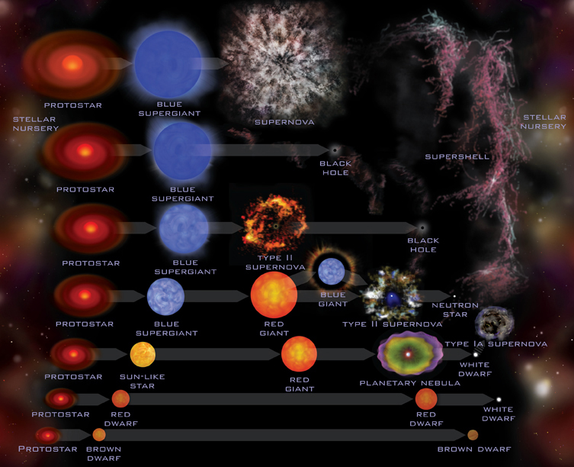

Slide 42
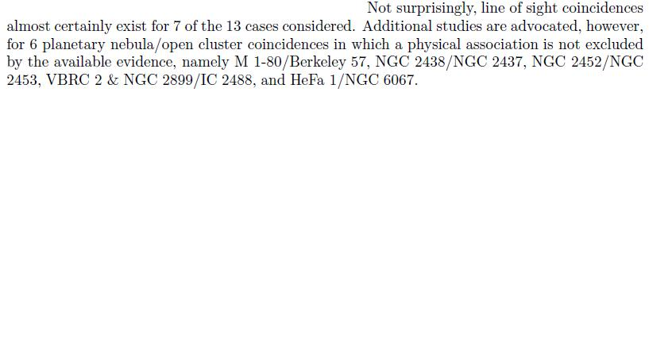
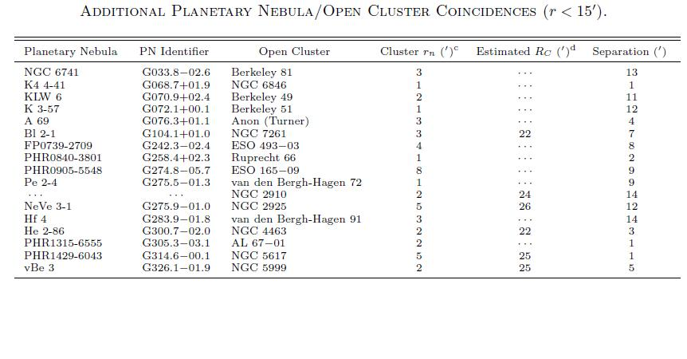
Planetary Nebulae
Majaess et al., 2007, PASP, 119, 1349
PNs exist in Open Clusters

Slide 43
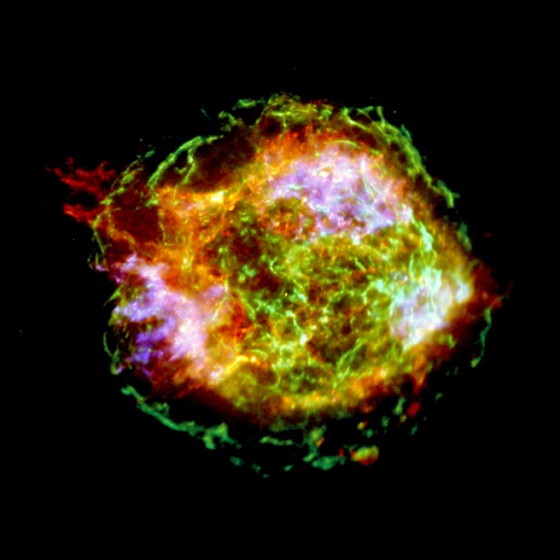
Important topic
of how SN
explosions affect
the cluster
evolution
Shockwaves
Mass flow
Statistically, SN
explosions are
rather common
From Chandra, Diameter 4 pc

Slide 44
SN Remnants
Catalogue of galactic SNRs: http://www.mrao.cam.ac.uk/surveys/snrs/
274 entries
Complete list of papers for Open Clusters
Pauls, 1977, A&A, 59, L13: NGC 559?
Kumar, 1978, ApJ, 219, L13: Tr 18 and 21?
Peterson et al., 1988, MNRAS, 235, 1439: Lynga 1, Pismis 20, Stock 14, and Trumpler 21, none conclusive

Slide 45
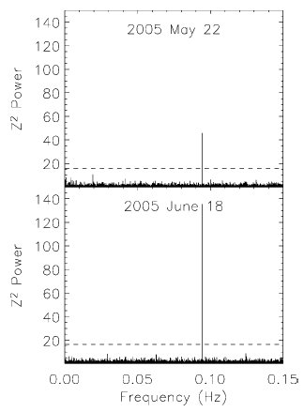
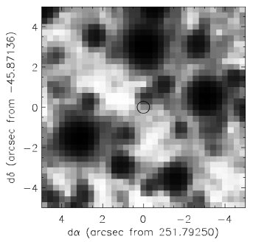
Muno et al., 2006, ApJ, 636, L41: Westerlund 1
d = 5200 pc, log t < 6.4
Pulsar, V fainter than 25th mag

Slide 46
White Dwarfs were detected in Open Clusters
The number is compatible with a common stellar evolution scenario, but the membership determination is very difficult
The absolute magnitude of WDs is about 10 magnitudes fainter than the corresponding Main Sequence

Slide 47
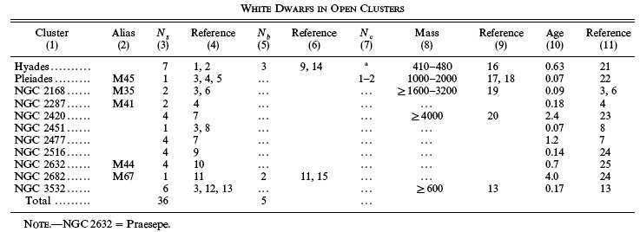
von Hippel, 1998, AJ, 115, 1536
Single Multiple
In total, 41 WDs until 1998 found, no firm
improvement after that

Slide 48
Why do Star Clusters dissipate?
Virial Theorem:
Kinetic Energy:
Potential Energy:
yielding:

Slide 49
Escape Velocity:
Collisions:
Density ρ and cross section σ:
Example of a typical Open Cluster:
t_{coll} = 10²⁵s => Collisions play no role

Slide 50
Even in the most inner core parts, collisions are highly improper, but could occur
Conclusions:
Binary and Multiple systems are not results of collisions in later stages but form already at the very beginning
Members do, in general, not escape due to collisions (swing-by effect), but their peculiar velocity component is part of the cluster formation or due to a SN

Slide 51
Crossing Time:
Members can escape from a Star
Cluster on a relatively short time scale
Reason: Velocity dispersion caused by
the cluster formation and SN events

Slide 52
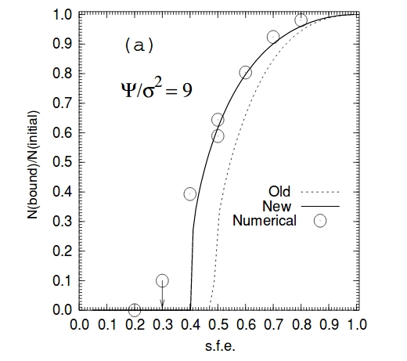
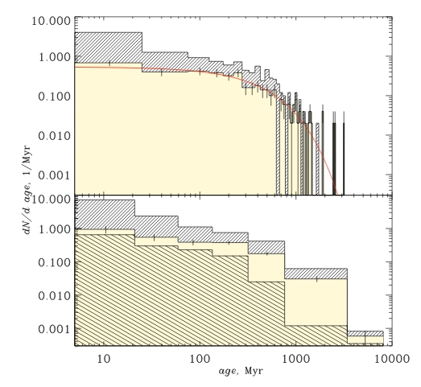
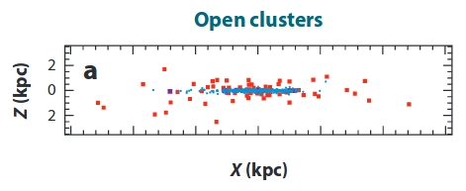
Infant mortality problem
Boily & Kroupa (2003)
Piskunov+ (2006)
Portegies Zwart+ (2010)

Slide 53
Tidal Forces due to Differential Galactic Rotation
Total Mass of the Milky Way: M_{G} = 2x10¹¹ M(Sun)
Gravitational acceleration of the complete star
cluster g_{G} and the individual member g* :
The difference of these two values, is the
force, of which “the Galaxy” tries to pull away
a star from the cluster

Slide 54
On the other side we have the gravitational force of the open cluster. The stability radius r_{S} is defined as:
For 1000 M(Sun) => Diameter 20 pc

Slide 55
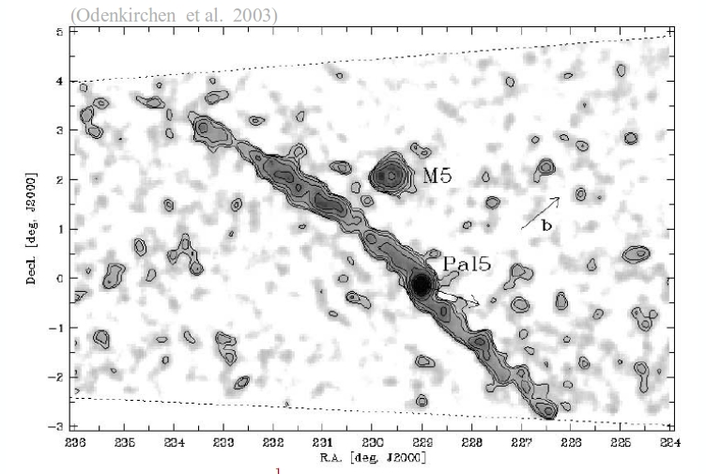

Slide 56
Summary
Star Cluster dissipate because of
Differential Galactic Rotation
Internal Velocity Dispersion
Collisions in the first few Myrs
SN Explosions and corresponding Shock Waves
( Collisions with “Field Stars”)
Explains the existence of Globular Clusters
Valid for all Spiral Galaxies

