Slide 1
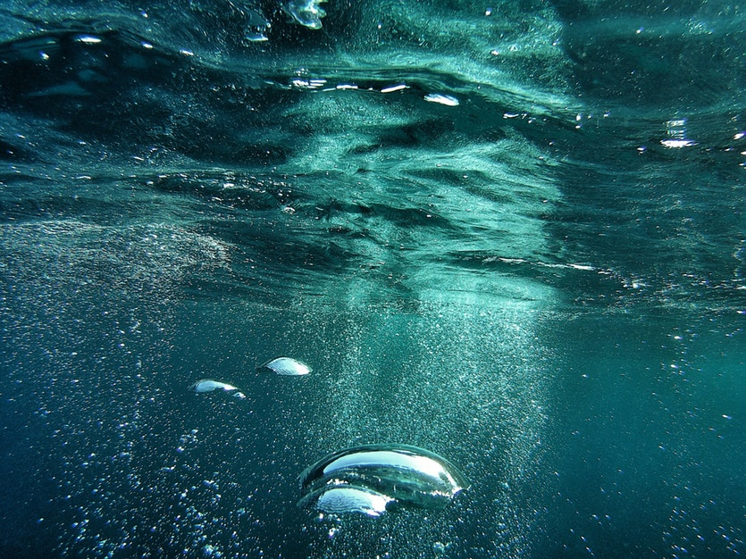
10 Water

Slide 2
In this lesson we are going to
give a feedback and learn from it
revise nominalization
describe hydrologic cycle
talk about ground water and its pollution
learn how to express obligation, possibility, probability, etc.

Slide 3
Discuss the world distribution of water (%)
Ocean
Glaciers and other ice
Ground water
Lakes
fresh
saline
Soil moisture
Atmosphere
Rivers

Slide 4
Discuss the world distribution of water (%)
Ocean
97.2
Glaciers and other ice 2.15
Ground water
0.61
Lakes
Fresh
0.009
Saline
0.008
Soil moisture
0.005
Atmosphere
0.0001
Rivers
0.001

Slide 5
The Hydrologic cycle
Water is drained away to the ocean or river. (runoff)
Clouds are formed.
Water vapor is advected (transfered in the atmosphere).
Water evaporates from the land.
It rains or snows.
Water moves from the soil into plant roots and passes through their leaves. (transpiration)
Water evaporates from the ocean.

Slide 6
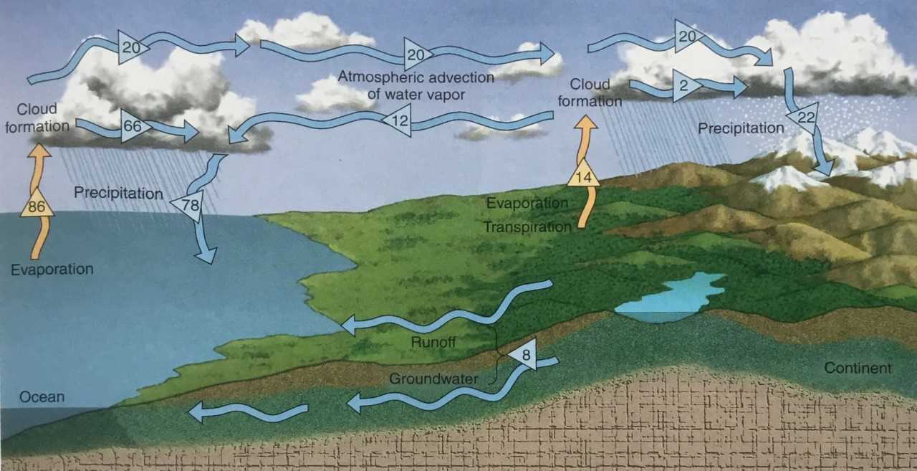
Process description: while, when, during, as, the following step, result in, until, initially, in the last stage, cause, lead to, after, subsequently, eventually, moreover, besides, due to, interact, be interrelated, apart from, interfere, the impact

Slide 7
READ THE TEXT AND DISCUSS
What are the most dangerous pollutants mentioned in the text? Why?
Why are underlined expressions used in the sentences? What do they mean?

Slide 8
Discuss the pollution of ground water in the Czech republic
What may happen in the future?
What must be done?
What should our government do?
Is it right that people in some parts of the world don‘t have to save water? Should something be done with that?
What mustn‘t people do?
What should have been done in the past?
What can all people do to protect the water?
What will we be able to do in the future?

Slide 9
sources
http://modalsinnature.weebly.com/summary-of-modal-functions.html
Evans and Dooley. Grammaryway. Express Publishing 1999
Christopherson, Robert W. Elemental Geosystems. Pearson. New Jersey 2007

