Slide 1
Development potential of the area
Jan Ambrož, Jakub Kura
Brno, 2017

Slide 2
Content
Development documents
Development Principles of Jihočeský kraj
MAS
Euroregions

Slide 3
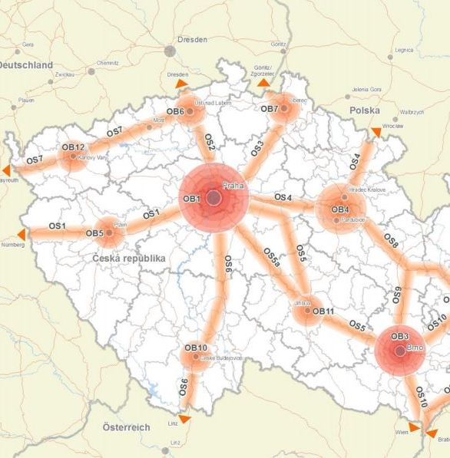
Development documents
NUTS 3 - Jihočeský kraj in Development policy of Czech republic
  České Budějovice – development area – OB10
    Concentration of huge number of inhabitants and economic aktivity with importance on national level
  Development axis OS6 from Prague to Austria
    Transportation – highway - D3, railway

Slide 4
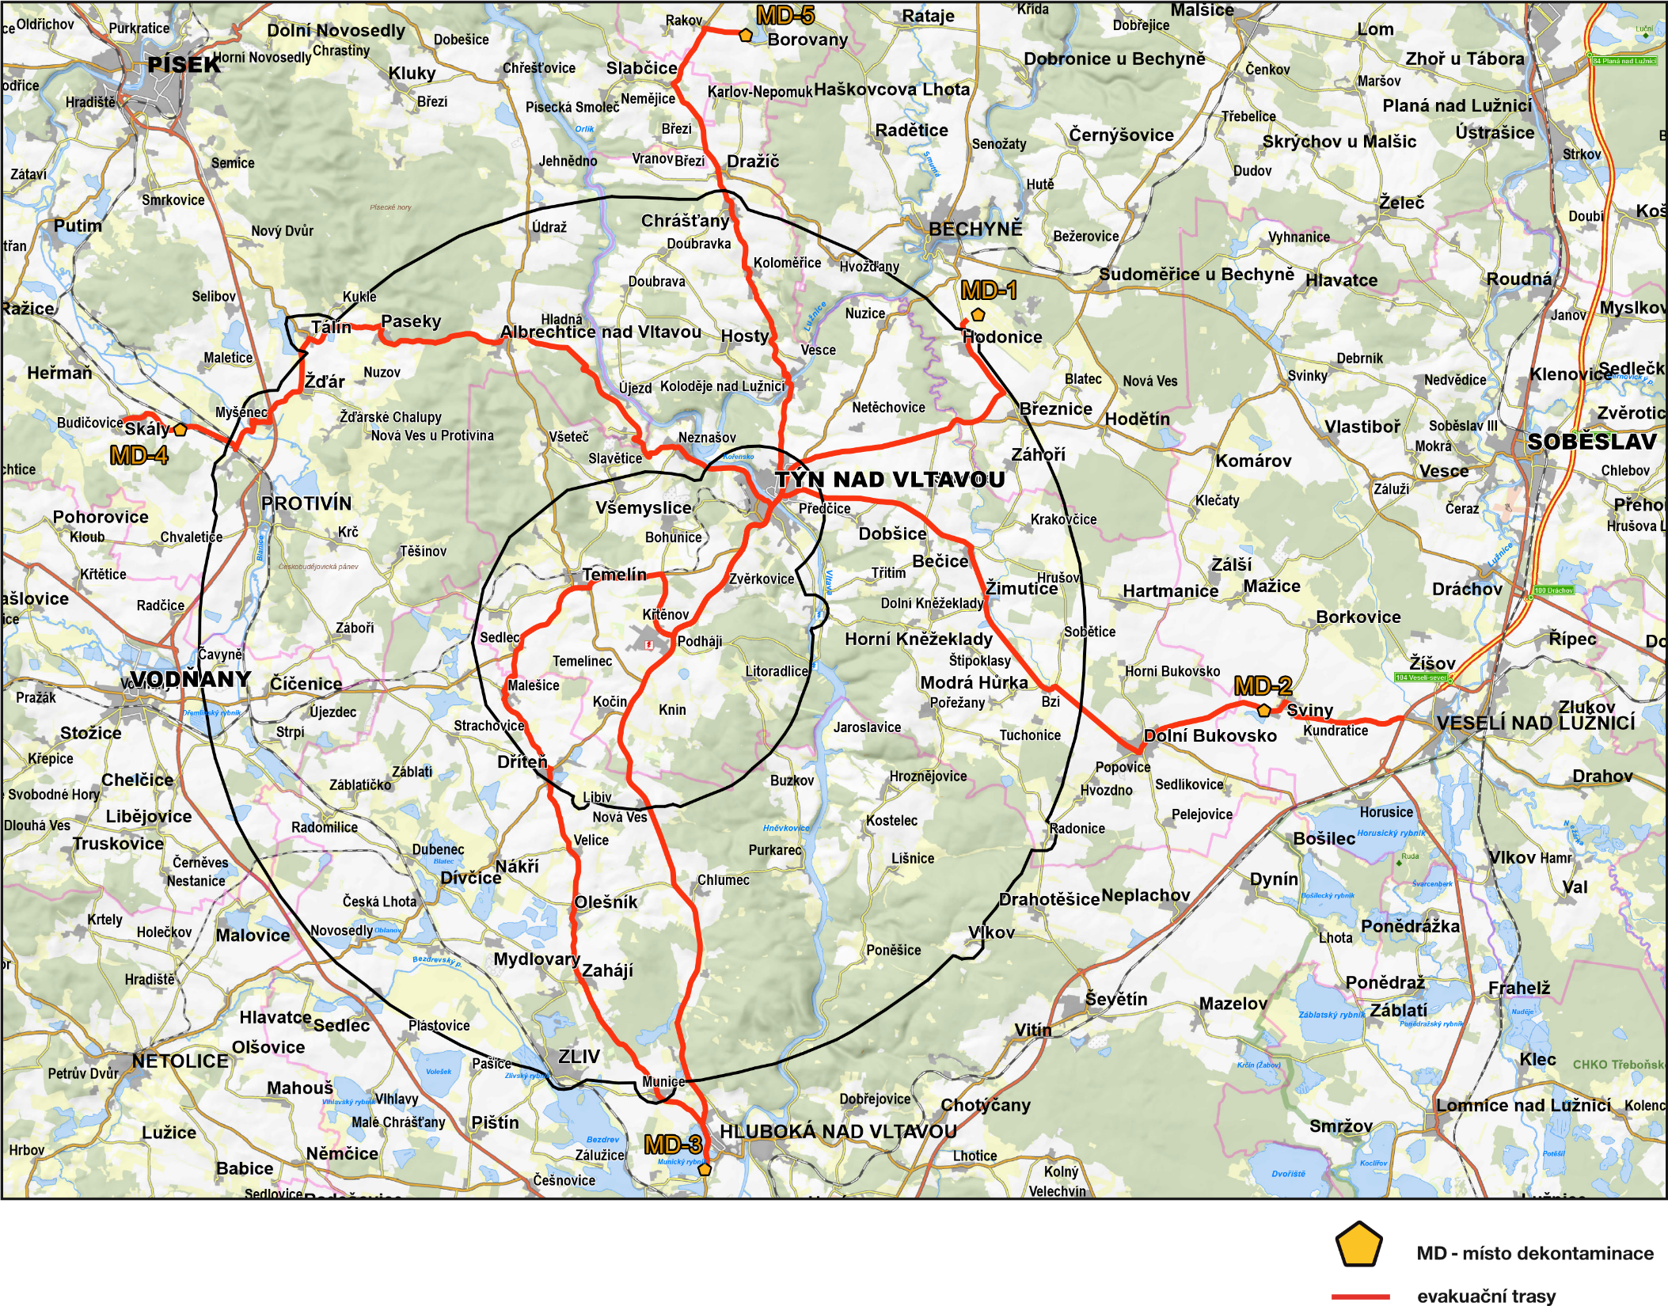
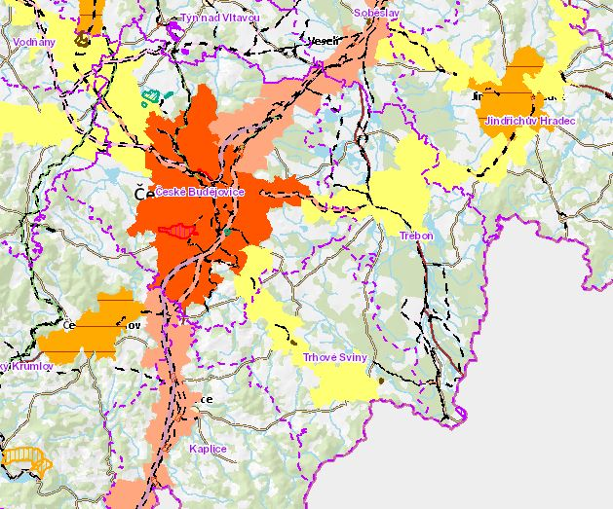
Development Principles of Jihočeský kraj
Specifies Development policy of Czech republic and also creates new development areas and axis of subnational importance
  F.e. area for expansion of Temelín nuclear power plant
  Areas for housing – no exact places, vague definition
  Areas for sport and leisure – Lipno
  Areas for mining and quarrying – gravel, building stone
  Few axises for transportation development

Slide 5
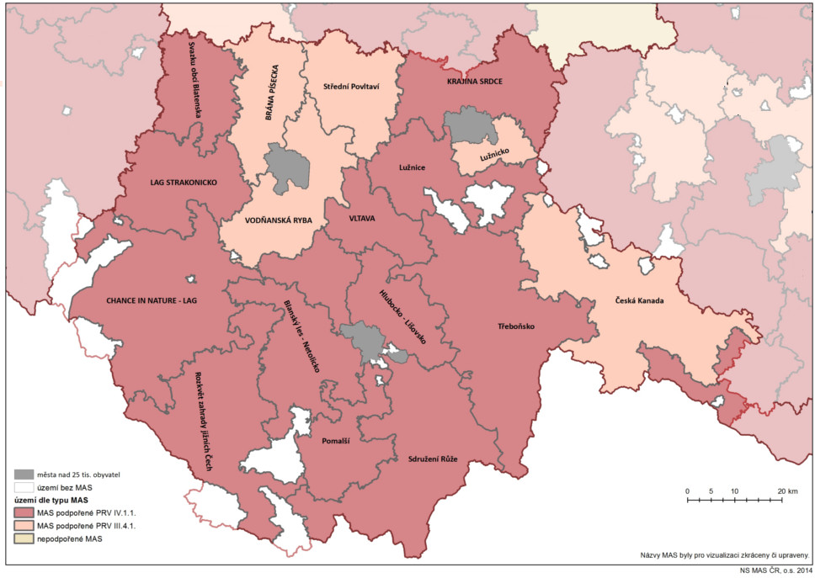
MAS
MAS = partnership of public administration, business and a non-profit organizations
8 subjects in our area
Selected development projects of MAS
  International project „Linecká stezka“ – reflextion of historical ties between south Bohemia and Linz area
  Support of mutual Czech-Austrian border hipotourism – transborder cooperation in promoting horse tourism
  Other projects don´t have any Czech-Austrian partnership and focuses solely on area of MAS – Rural traditions in landscape, Rural market and local products…

Slide 6
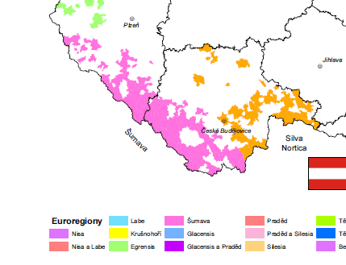
Euroregions
Šumava – Bayerischer wald – Mühlviertlel
  Euroregional governance a networks – strenghtening crossborder cooperation at communal level in Czech-Bavarian borderland
  Disposition Fund in the region Bavorský les – Šumava – funding for meeting between inhabitants, institutions and organizations in border area
Silva Nortica
  Interegional mobility – mobility without borders – various topics related with mobility
  European Region Danube – Vltava – strenghtening of relationships between CZ – AT- DE and supporting crossborder cooperation

Slide 7


