Slide 1

Ecotoxicology
Part 1 - Introduction
Ludek Blaha + ecotox colleagues

Slide 2
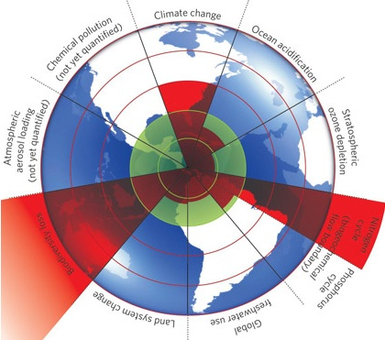
Global anthropogenic threats ?
A safe operating space for humanity
& the nine planetary boundaries
Rockstrom et al. 2009
(Ecology and Society 14(2): 32; Nature 461, 472-475)

Slide 3
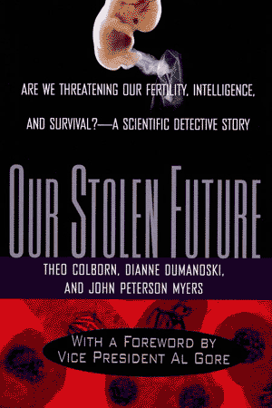
1996 - Chemicals in the environment
Do you believe that chemicals in products sold to consumers have been proven safe?
Think again
most chemicals in modern use have simply not been tested for their impacts on
human, even very basic effects.
… what about the effects in nature, then ?
How we stand 20 years later?

Slide 4
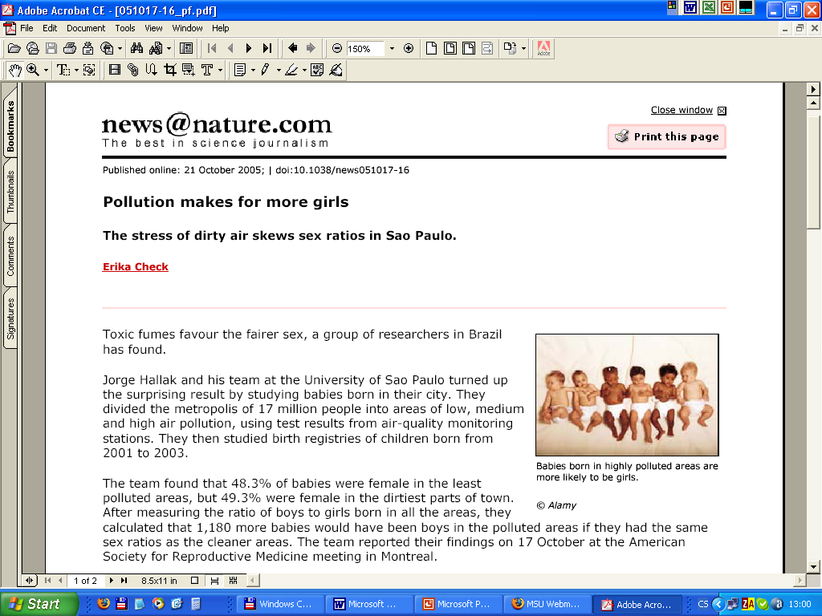

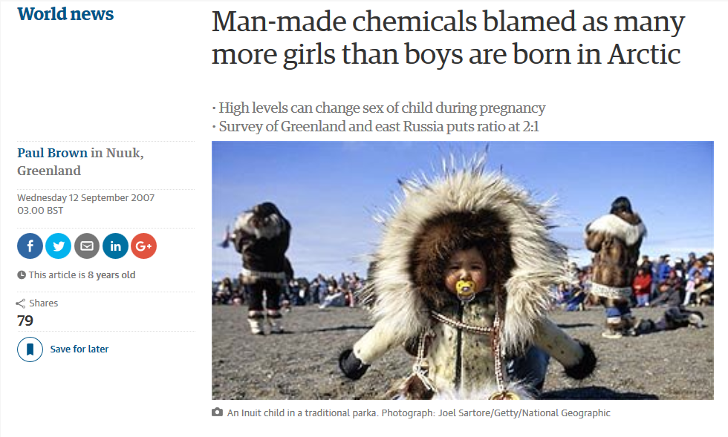

Slide 5
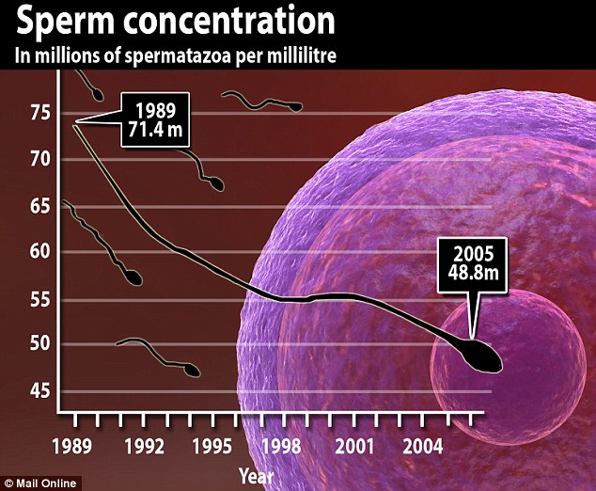
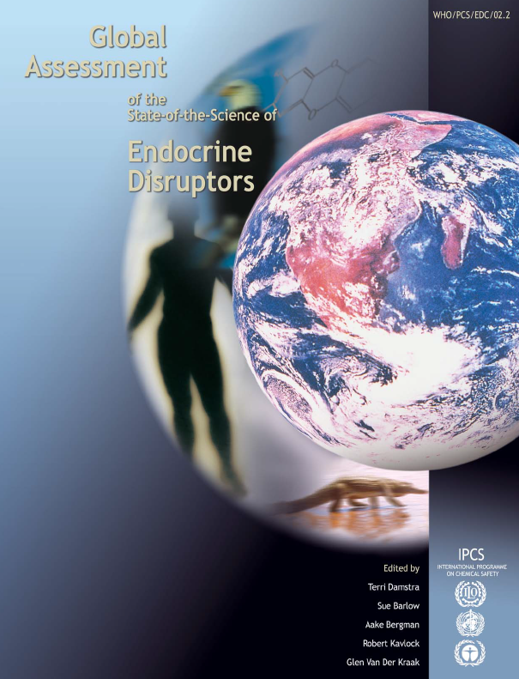

Slide 6
Environmental pollution
Examples and ecological cosequences

Slide 7
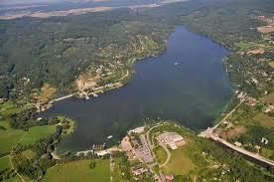
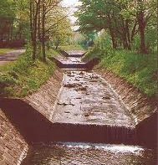
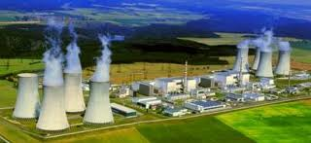
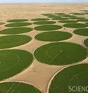
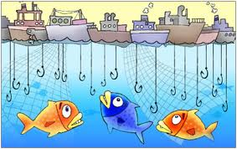
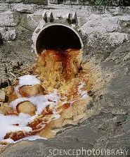
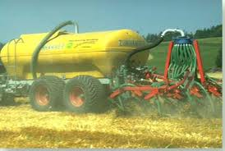
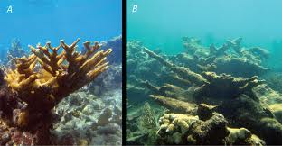
Major anthropogenic threats – example: waters
Direct
Impacts
Indirect

Slide 8
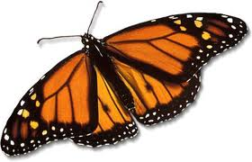
Major impacts
Loss of biodiversity

Slide 9
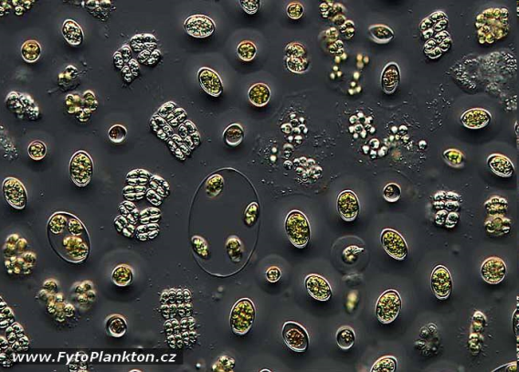
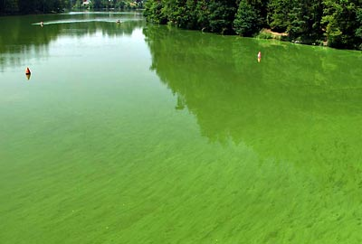
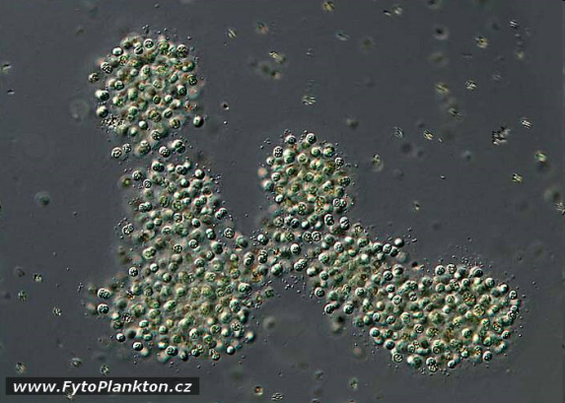
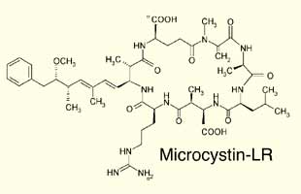
Changes in biodiversity

Slide 10
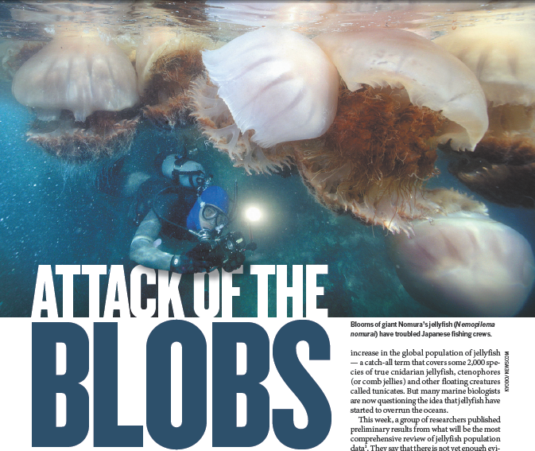
Changes in biodiversity
NATURE (2012) 482: 20

Slide 11
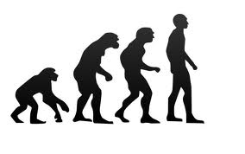
Major impacts
Loss of biodiversity
Impairment of ecosystem services
  Unbalanced water cycles
    Water scarcity
    Draughts/floods
  Impaired water quality
    Drinking waters
    Bathing waters
    Toxicants in food chain
  Shrinking of food supplies
    Direct → lowering fish amounts
    Indirect → crop yield

Slide 12
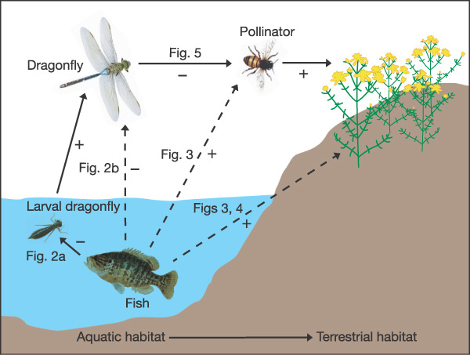
Impacts on fish → decreased crop yields
NATURE (2005) 437: 880

Slide 13
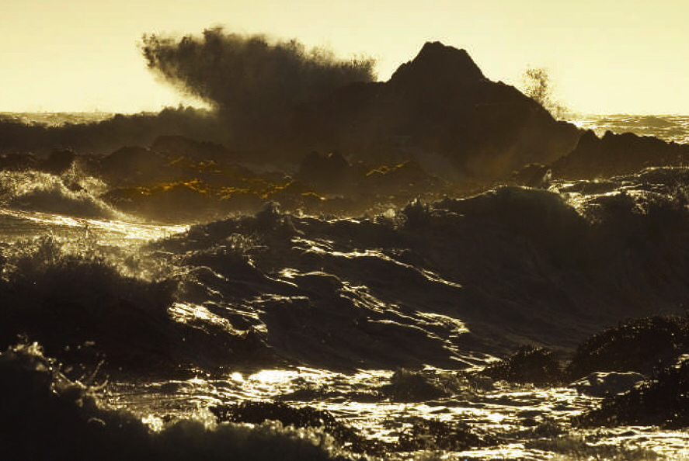
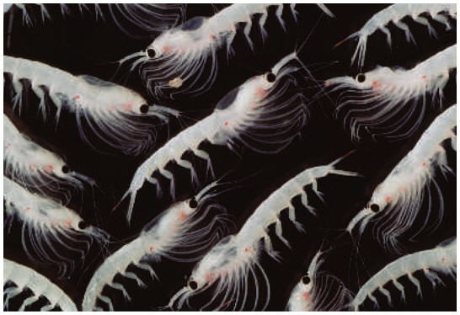
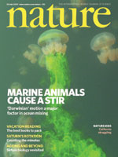
Impacts on biota → global effects
Mixing oceans
→ cooling the atmosphere
[Nature 447, p.522, May 31, 2007]
Marine life supplies up to 50% of the mechanical energy required worldwide to mix waters from the surface to deeper cool layers
[Dewar, Marine Res 64:541 (2006)]
[Katija a Dabiri, Nature 460:624 (2009)]

Slide 14
Ecotoxicology
assessment o hazards
and risks of chemicals in ecosystems

Slide 15
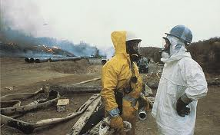
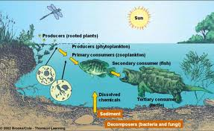
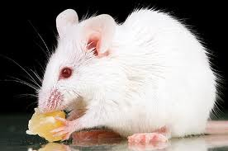
Assessment of chemical hazards
…to…
Humans Other organisms
(TOXICOLOGY) (ECOtoxicology)

Slide 16
ECOTOXICOLOGY by definition
Aim: to maintain the natural structure and function of ecosystems
Definitions:
  ecotoxicology is concerned with the toxic effects of chemical and physical agents on living organisms, especially on populations and communities within defined ecosystems; it includes the transfer pathways and their interactions with the environment
  science of contaminants in the biosphere and their effect on constituents of the biosphere, including humans’ (Newman & Unger, 2002)
  science that provides critical information on effects of toxic compounds on living organisms which SERVE various practical aims (environmental protection)

Slide 17
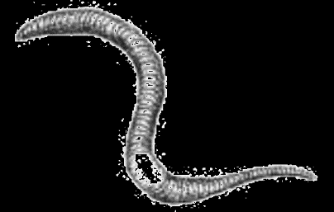
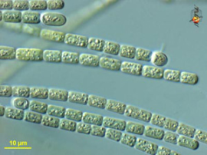
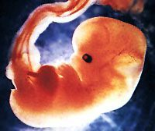
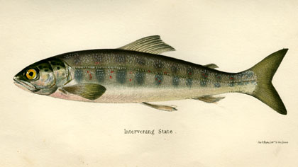
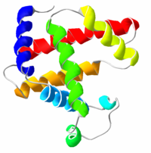
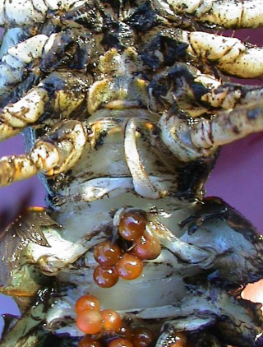
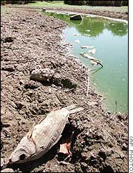

CHEMICAL ENTERS THE ENVIRONMENT
CHEMICAL ENTERS THE ORGANISM
biomonitoring
LEVELS, FATE, PROCESSES
Toxicokinetics
biotransformation
bioactivation
excretion / sequestration
Bioavailable fraction
Target site
“EFFECT”
toxicodynamics
“EXPOSURE”
acute
chronic

Slide 18
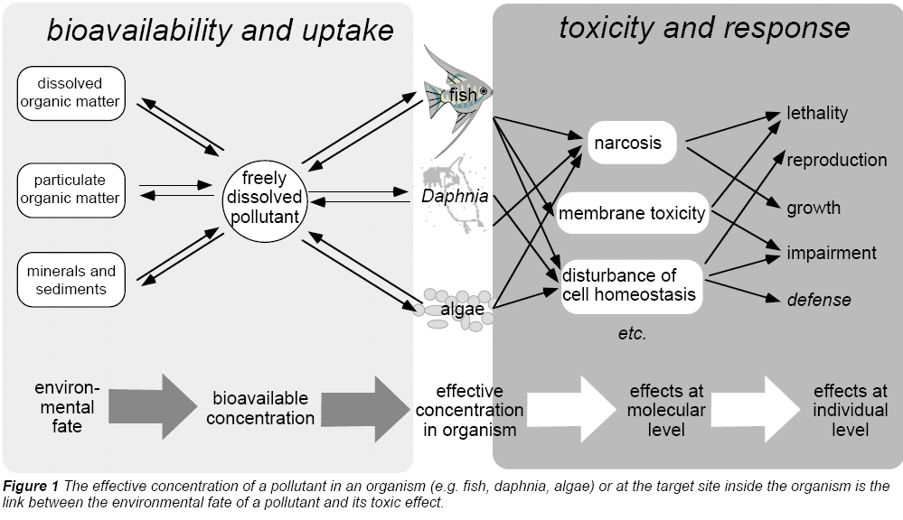
Ecotoxic effects
Escher, B. I., Behra, R., Eggen, R. I. L., Fent, K. (1997), "Molecular mechanisms in ecotoxicology:
an interplay between environmental chemistry and biology", Chimia, 51, 915-921.

Slide 19
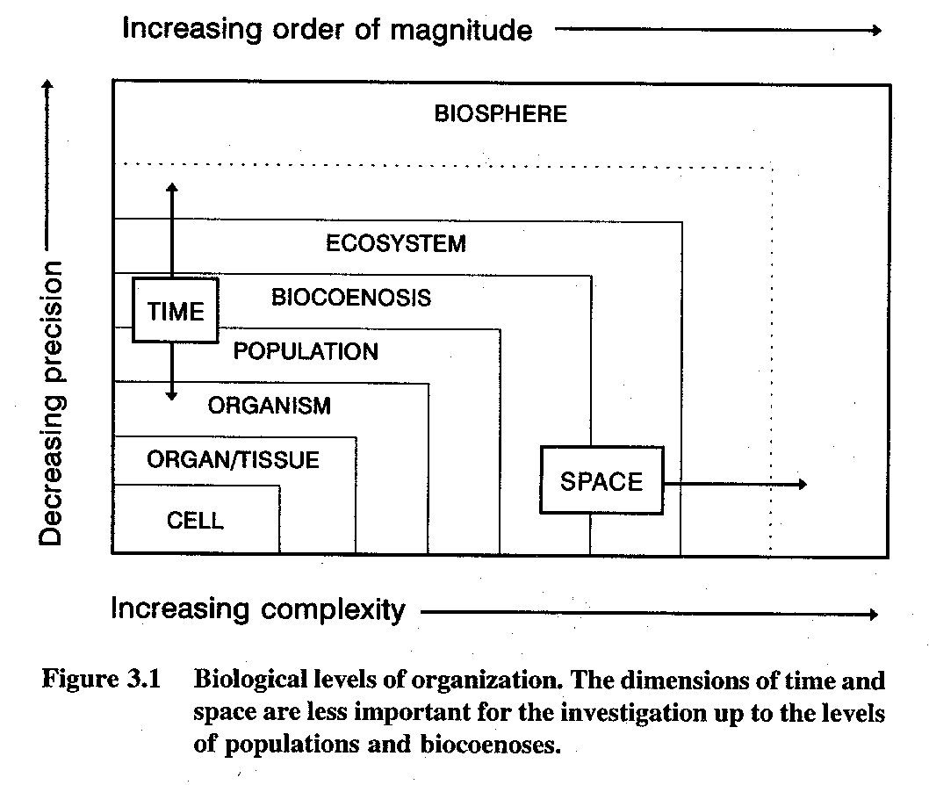
Ecotoxicology - from molecules to ecosystems
… and backwards

Slide 20
From ecosystems
→
down the mechanisms
OR
?
From mechanisms (molecules)
→
up to effects and ecosystems

Slide 21

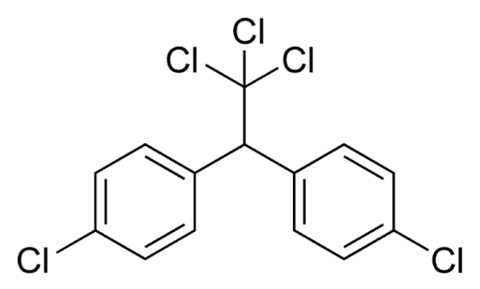
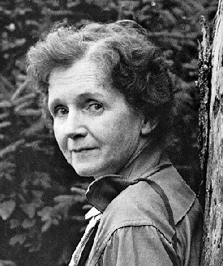
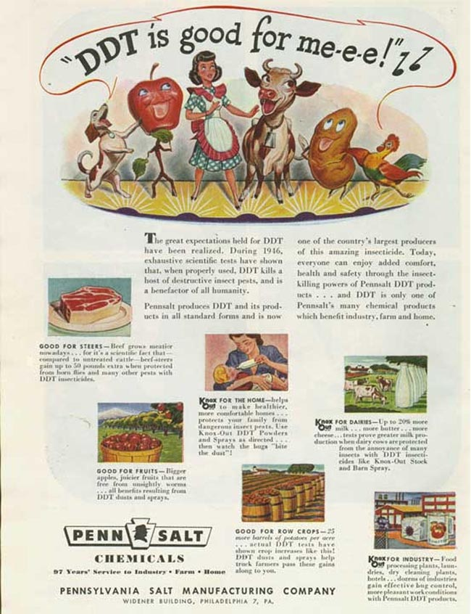
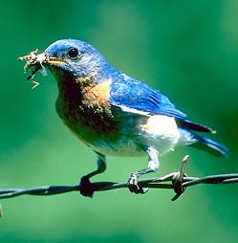
1962
© Patuxent Wildlife
Refuge, MA, USA
http://www2.ucsc.edu/scpbrg/

Slide 22
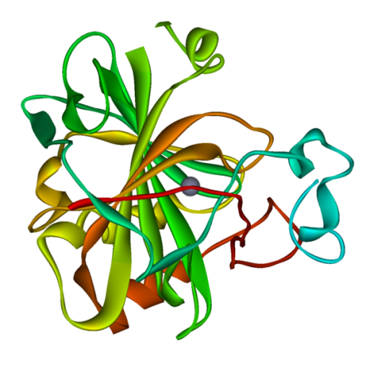

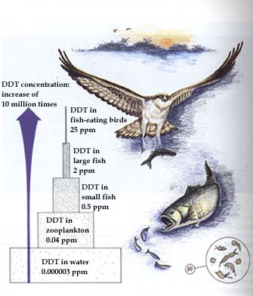
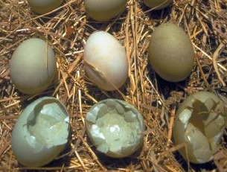
Bitman et al. Science 1970, 168(3931): 594
Biochemistry
bird carbonate dehydratase
In situ: bioaccumulation
-> bird population decline
In vivo: shell thinning

Slide 23
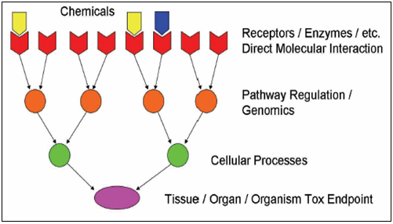
1) From molecules to individuals
MECHANISMS OF TOXICITY

Slide 24
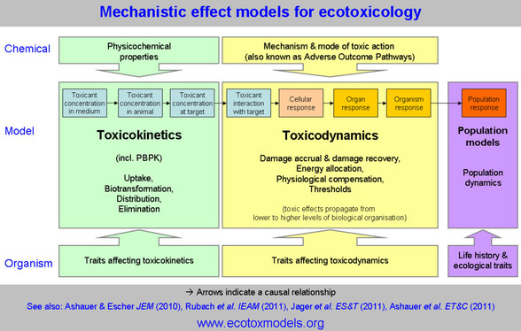
2) From molecules to individuals - AOPs
ADVERSE OUTCOME PATHWAYS

Slide 25
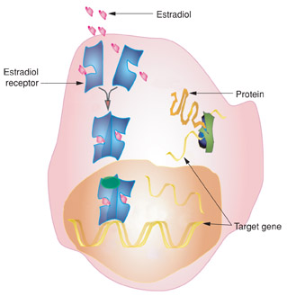
AOP Example: ethinylestradiol
Ethinylestradiol
Binds to
ESTROGEN
RECEPTOR
Target genes
Proliferation/Apoptosis (sexual organs)
Synthesis of egg yolk (fish, amphibia)
Effects
Females: reproduction regulation
Males: feminization
(+ e.g. cancer promotion, development,
immunomodulation)

Slide 26
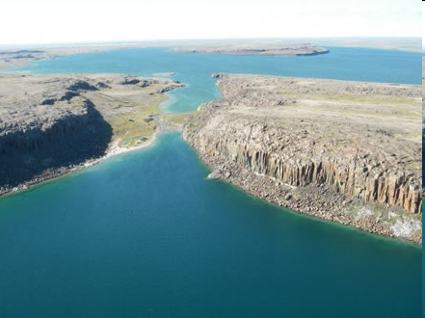
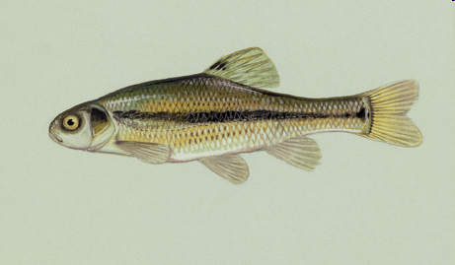
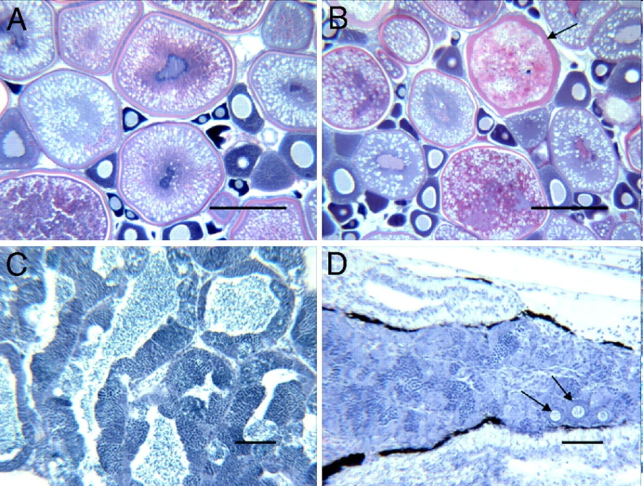

Kidd, K.A. et al. 2007. Collapse of a fish population following exposure to a synthetic estrogen. Proceedings of the National Academy of Sciences 104(21):8897-8901
5 ng/L (!)
7 years
Controls +Ethinylestradiol

Slide 27

Effects at different levels - molecular
Molecular
  Nonspecific effects
    Hydrophobic interactions with phospholipid membranes
    (baseline = narcotic toxicity)
    Direct reactivity: electrophilic compounds → nucleophilic organism
    (e.g. oxidation of PROTEINS, lipids (membranes), DNA …)
  Specific effects
    Activation of ER, AR and other „nuclear receptors“
    Inhibition of enzymes (e.g. CN- inhibits hemes in mitochondria/hemoglobin, insecticides …)

Slide 28

Effects at different levels - cellular
Cellular
  Effects on structure
  Effects on metabolism (maintenance)
  Effects on regulation
    Changes in functions (e.g. Ethinylestradiol)
    Repair, survival, growth
    Death (apoptosis or necrosis)
    Proliferation
    Differentiation

Slide 29

Effects at different levels - ORGANISM
Organism level – important in ecotoxicology (see Bioassays)
  Effects on structure
  Effects on metabolism (maintenance)
  Effects on regulation
    Changes in functions (e.g. Ethinylestradiol)
    Repair, survival, growth
    Death
    Proliferation = Reproduction
3 key apical endpoints
(reflected e.g. in regulations)

Slide 30



Energy
hv
food
Losses
heat
faeces
Life
(maintenance)
Metabolism
Control,
Interactions
with environment
Defence
against pathogens
predators …
Defence against
toxicants
Growth
to sexual
maturity
Reproduction
Chemical
stress

Slide 31
Chemical stress
→ energy re-allocation
→ „insufficient“ resourses elsewhere
Energy
hv
food
Losses
heat
faeces
Life
(maintenance)
Metabolism
Control,
Interactions
with environment
Defence
against pathogens
predators …
Defence against
toxicants
Growth
to sexual
maturity
Reproduction
Chemical
stress

Slide 32
Chemical stress
+ ... another stress
(food scarcity)
Energy
hv
food
Losses
heat
faeces
Life
(maintenance)
Metabolism
Control,
Interactions
with environment
Defence
against pathogens
predators …
Defence against
toxicants
Growth
to sexual
maturity
Reproduction
Chemical
stress

Slide 33

Effects at different levels
Population
  (… all the organisms that both belong to the same group or species (i.e. can sexually reproduce) and live in the same time within the same geographical area)
  Effects on structure
    elderly vs. young, males vs. females
  Effects on maintenance & growth
    Natality, mortality, reproduction fitness

Slide 34

Effects at different levels
Community & Ecosystem
  (… a group of interacting living organisms sharing a populated environment)
  Effects on structure
    Loss of species, loss of biodiversity
  Effects on functioning
    (including „ecosystem
    functions“)

Slide 35
WRAP UP … take home message
Ecotoxicology as a science with close links to practical environmental protection
  Understand the importance and links between
  ECOTOXICITY --- BIODIVERSITY --- ECOSYSTEM SERVICES
From molecular events to higher levels
  Be aware of different biological levels - from molecules to communities
  Know examples of effects at these different levels
  Know example(s) of „Adverse Outcome Pathway(s)“
Understand keywords such as
  Exposure - Bioavailability
  Toxicokinetics – Toxicodynamics
  Apical endpoints in ecotoxicology … and interaction among them

