Slide 1

Ecotoxicology
Current issues in
Research vs Regulation
Ludek Blaha + ecotox colleagues

Slide 2
When
Where
the assessment of toxicity is needed?
What
to assess for toxicity?

Slide 3


When & where the toxicity assessment is needed?
View of the researcher
View of the regulator
Anytime!
… depending on researcher’s
budget
As the law says!
… what are the
law(s)? →

Slide 4
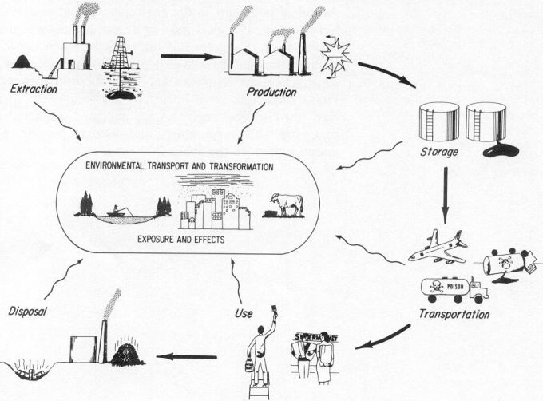

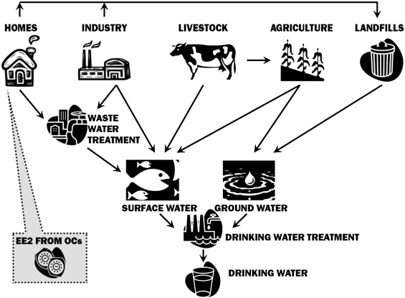
Chemical laws („bulk“)
§§
Industrial chemicals
Cosmetics
PPP (pesticides)
Biocides
Human
pharmaceuticals
Veterinary
pharmaceuticals
REACH
(ECHA)
PPP
(EFSA)
nano nano nano nano
MPs
(EMA)
MIXTURES!
§§
AIR
Two §§ approaches:
Prospective
(chemicals…)
Retrospective
(mixtures …)
WFD – surface w.
GWD – ground w.
Air quality
Food and feed
Soil & Sediments
Wastes
SOIL
WATER

Slide 5
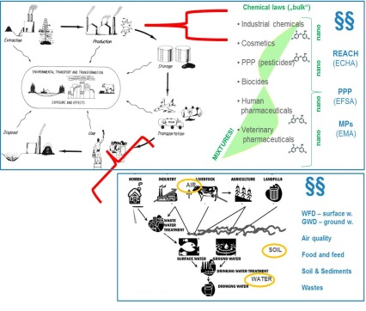




What to assess for toxicity?
 | Current research topics | As required by law
Individual chemicals (prospective) | Engineered nanomaterials/particles Ecological effects (e.g. of pharmaceuticals) Endocrine disruption & chronic diseases | Industry & biocides (REACH) PPPs = pesticides Pharmaceuticals Cosmetics
Mixtures (prospective) | Multistressors +T°C, salinity, pathogens, irradiation, food Exposome
Contaminated samples (retrospective) | Can analyzed chemicals explain observed effects ? | Chemical analyses & limits Effect testing rare: Remediation, dredged sediments (CZ), effluents (DE)

Slide 6
What to assess for toxicity?
 | Current research topics | As required by law
Individual chemicals (prospective) | Engineered nanomaterials/particles Ecological effects (e.g. of pharmaceuticals) Endocrine disruption & chronic diseases | Industry & biocides (REACH) PPPs = pesticides Pharmaceuticals Cosmetics
Mixtures (prospective) | Multistressors +T°C, salinity, pathogens, irradiation, food Exposome
Contaminated samples (retrospective) | Can analyzed chemicals explain observed effects ? | Chemical analyses & limits Effect testing rare: Remediation, dredged sediments (CZ), effluents (DE)

Slide 7
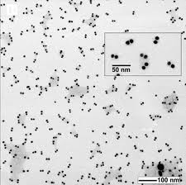
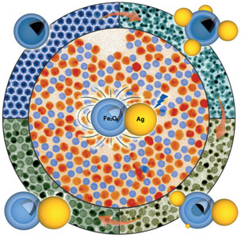
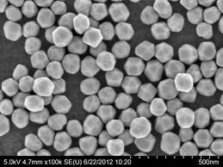
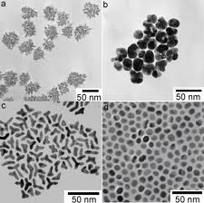
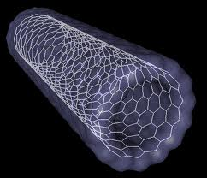
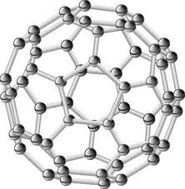
Nanoparticles - examples

Slide 8
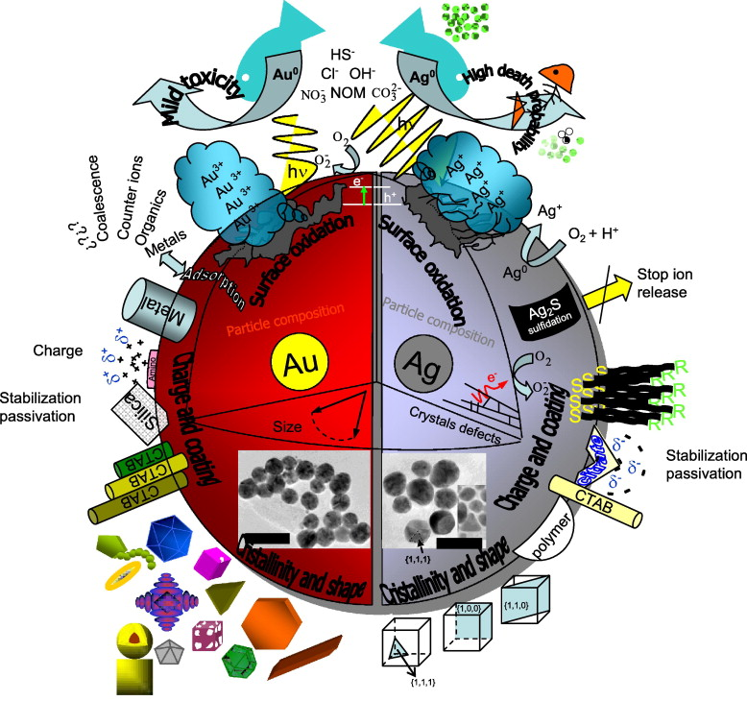
Toxicity of nanoparticles …
(Mostly unknown)
Parameters may
Affect ecotoxicity
Composition (chemical)
Surface (size, area)
Charge
Reactivity
Interactions with ions,
other chemicals…
➔ Effects on
environmental Fate
and toxicity

Slide 9
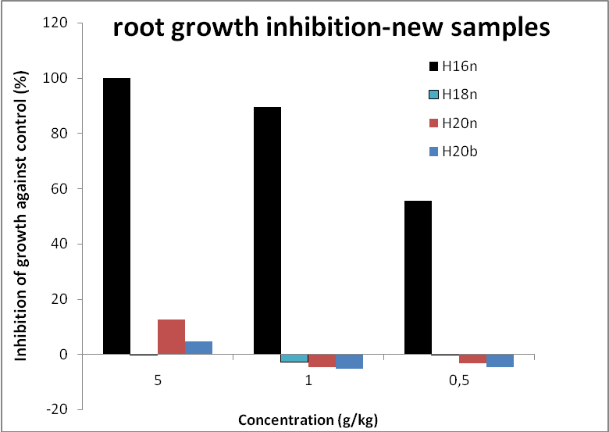
Ecotoxicity of nanoparticles – RECETOX example
Comparison of toxicity - 4 „appeared to be the same“ particles
(one producer – 4 different lots)
(zerovalent iron – ZVI – Fe⁰)
?? Why is H16 so toxic ??
… despite of detailed investigation never revealed

Slide 10
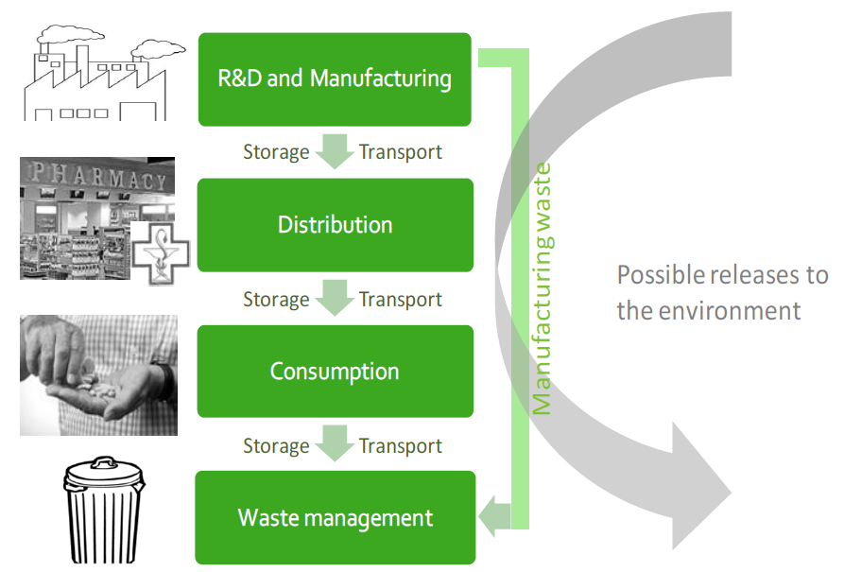
PHARMACEUTICALS

Slide 11
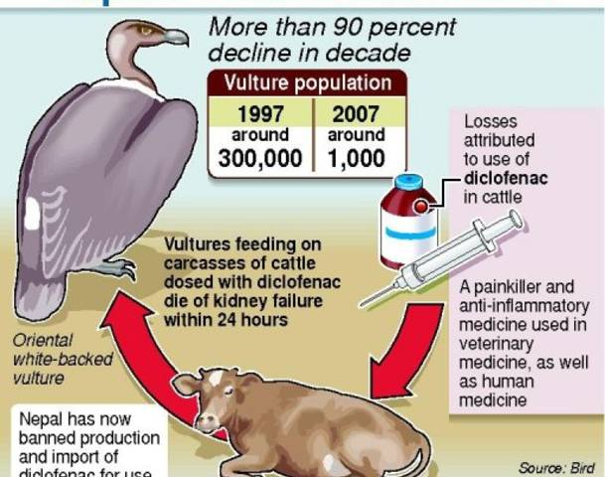
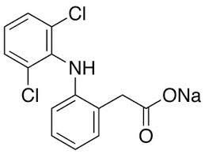
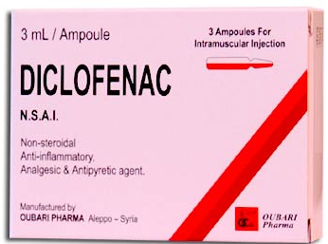
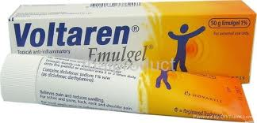
Example 1 - DICLOFENAC
Unexpected effects at NON-TARGET species
- nephrotoxicity at vultures
- Relevant also in EU
(ESP, EL,CY)

Slide 12
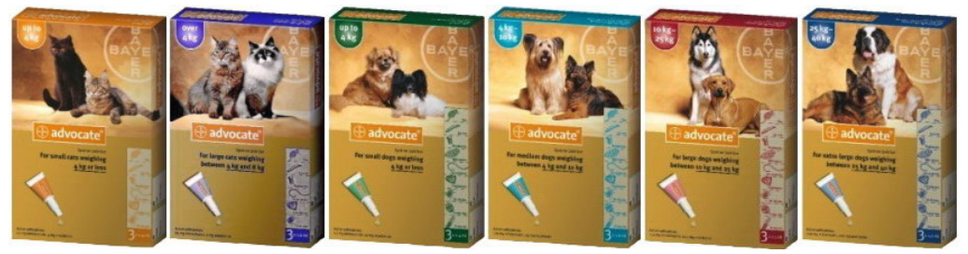
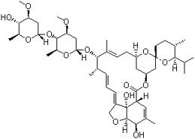
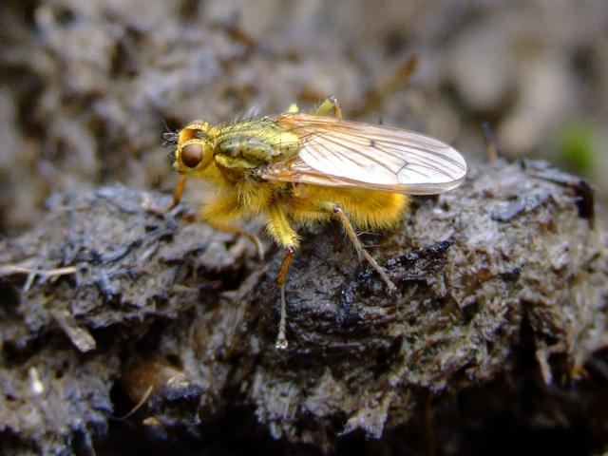
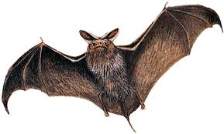
Example 2 – AVERMEKTIN-like antiparasitics
Moxidectin – used e.g. in home
„spot on” products
Ivermectin – antiparasitics in large herds
    Used 2-times per season per sheep/cow
    Kills 100% parasites in sheep
    Released in dung - kills 80-90% larvae of dung flies
    High concentrations in dung (released 2 days post application)
    Persistent in the soil (half-life 30 days)
    Can be washed into adjacent streams (highly toxic to water insects)
?

Slide 13
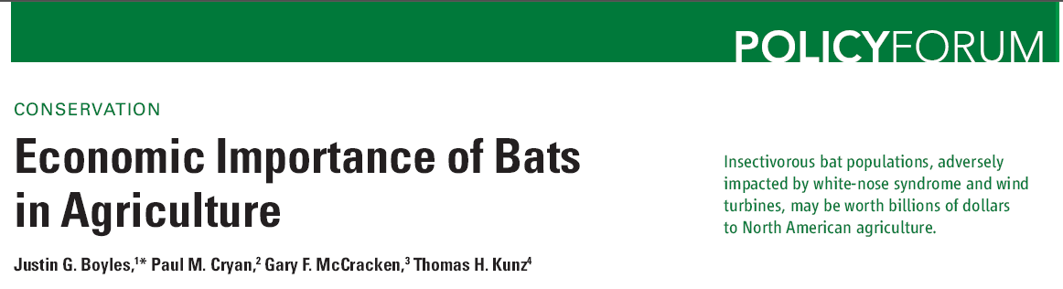

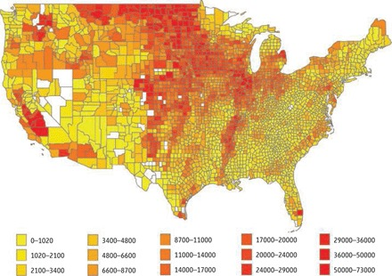
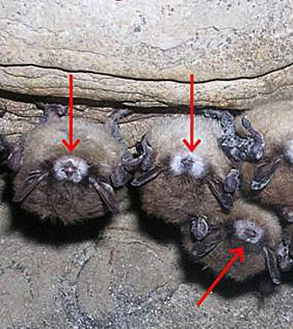
Boyles et al. (2011) Science 332 (60251) 41-42

Slide 14

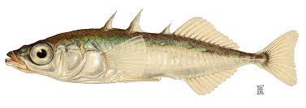
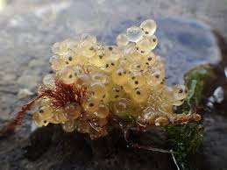
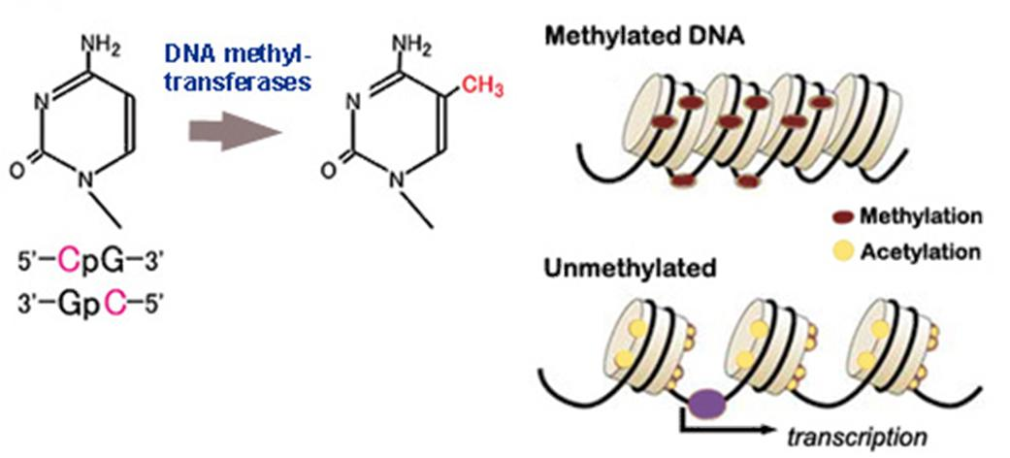
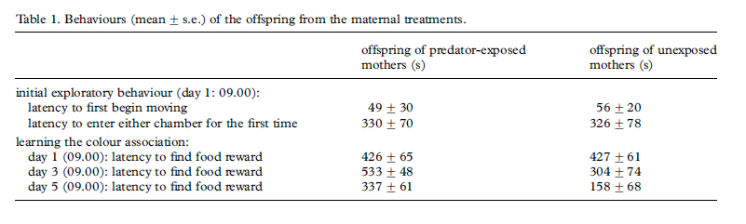
Stress → multigeneration effects
Epigenetics → DNA methylations
2x difference

Slide 15
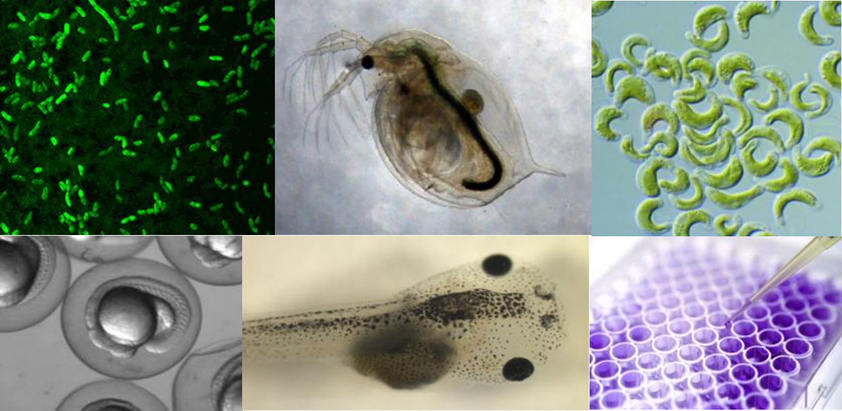
MIXTURE TOXICITY EU interlaboratory test
Testing comparability of existing and innovative bioassays for water quality assessment
Main questions:
Are current limits (for individual compounds) safe?
Relevance of “Something from Nothing” phenomenon ?
3 samples
→ 12 European laboratories – different bioassays
→ ČR – RECETOX: 11 bioassays
Carvalho, R. et al. (2014) Mixtures of chemical pollutants at European legislation safety concentrations: how safe are they? Toxicol Sci 141(1): 218-233

Slide 16
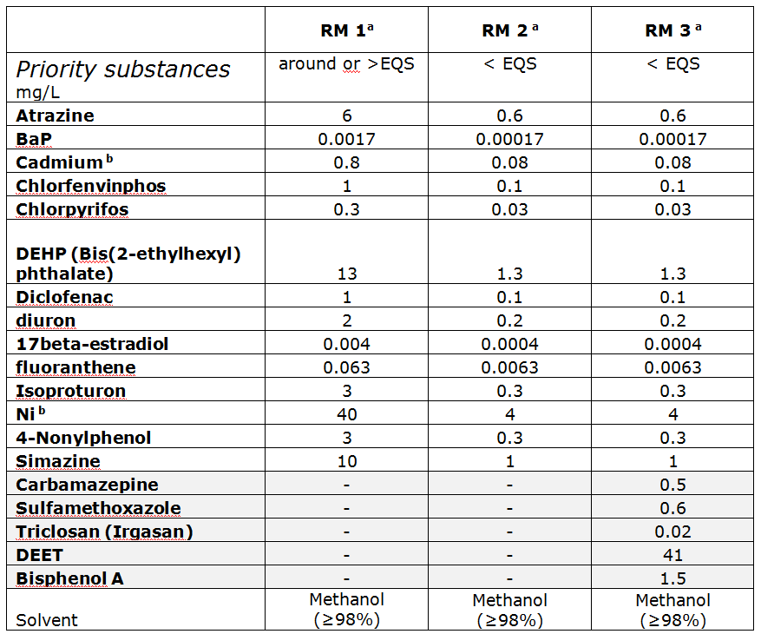
MIXTURE TOXICITY EU interlaboratory test
Testing comparability of existing and innovative bioassays for water quality assessment
EU WFD
priority
substances
Different
concentrations
EQS
= limit
(Environmental
Quality
Standard)

Slide 17
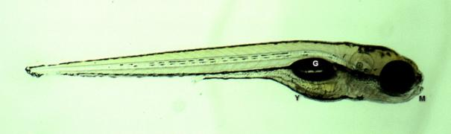
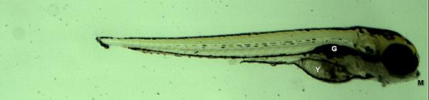
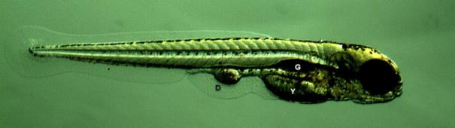
MIXTURE TOXICITY EU interlaboratory test
Testing comparability of existing and innovative bioassays for water quality assessment
Example: Effects of mixtures on D. rerio fish embryos
Control
Effects of RM 3 (i.e. safe)
mixtures
Carvalho, R. et al. (2014) Mixtures of chemical pollutants at European legislation safety concentrations: how safe are they? Toxicol Sci 141(1): 218-233

Slide 18
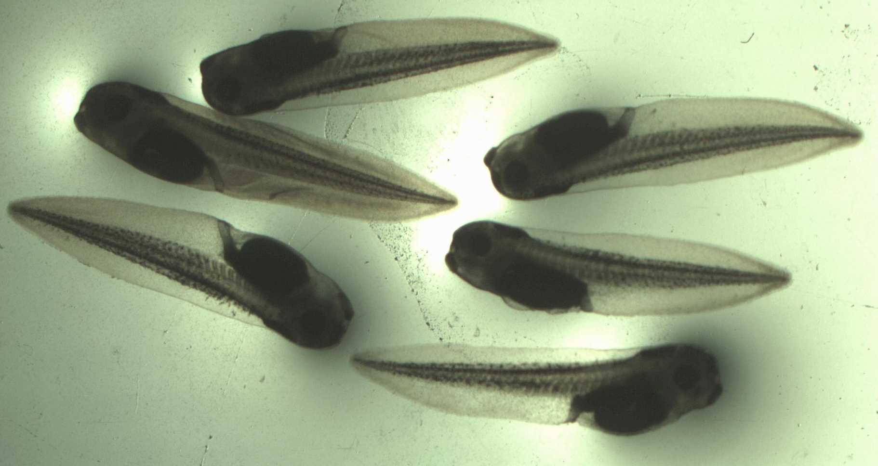
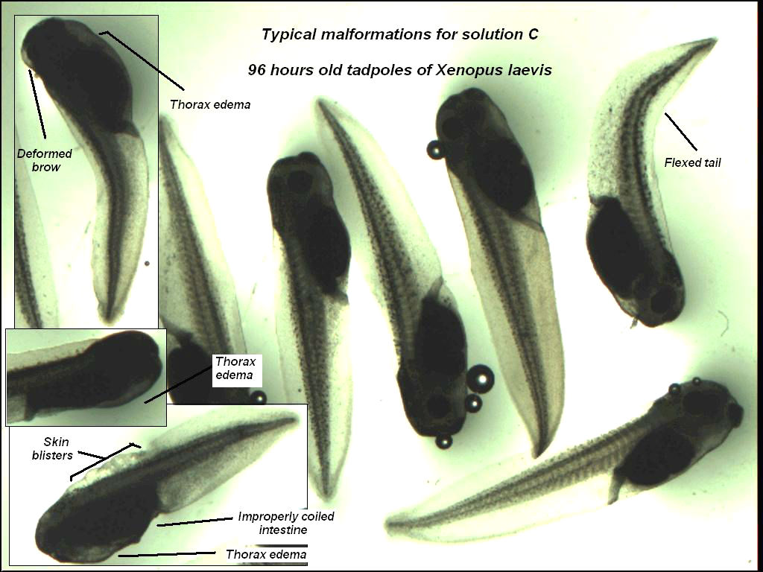
MIXTURE TOXICITY EU interlaboratory test
Testing comparability of existing and innovative bioassays for water quality assessment
Example: Effects of mixtures on X. laevis frog embryos
Effects of RM 3 (i.e. safe)
mixtures
Controls
Carvalho, R. et al. (2014) Mixtures of chemical pollutants at European legislation safety concentrations: how safe are they? Toxicol Sci 141(1): 218-233

Slide 20
What to assess for toxicity?
 | Current research topics | As required by law
Individual chemicals (prospective) | Engineered nanomaterials/particles Ecological effects (e.g. of pharmaceuticals) Endocrine disruption & chronic diseases | Industry & biocides (REACH) PPPs = pesticides Pharmaceuticals Cosmetics
Mixtures (prospective) | Multistressors +T°C, salinity, pathogens, irradiation, food Exposome
Contaminated samples (retrospective) | Can analyzed chemicals explain observed effects ? | Chemical analyses & limits Effect testing rare: Remediation, dredged sediments (CZ), effluents (DE)

Slide 21
What to assess for toxicity?
 | Current research topics | As required by law
Individual chemicals (prospective) | Engineered nanomaterials/particles Ecological effects (e.g. of pharmaceuticals) Endocrine disruption & chronic diseases | Industry & biocides (REACH) PPPs = pesticides Pharmaceuticals Cosmetics
Mixtures (prospective) | Multistressors +T°C, salinity, pathogens, irradiation, food Exposome
Contaminated samples (retrospective) | Can analyzed chemicals explain observed effects ? | Chemical analyses & limits (see lectures: RISK ASSESSMENT part) Effect testing rare: Remediation, dredged sediments (CZ), effluents (DE)

Slide 22
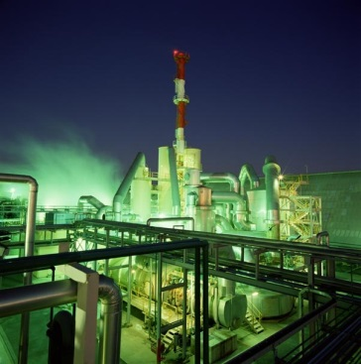
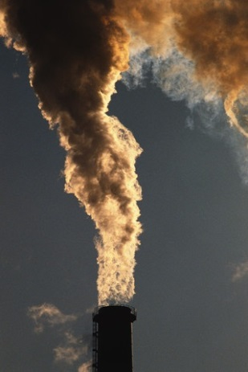
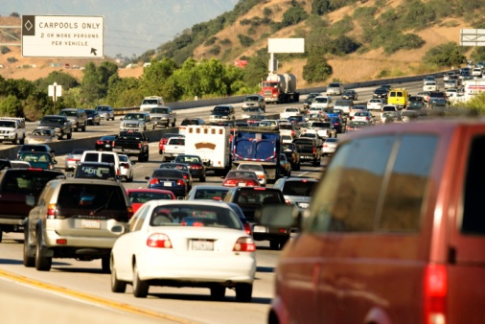
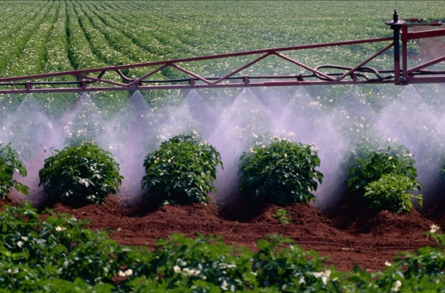
Contaminated samples? Case study “air“
Active sampling
particles vs gaseous phase
Reference locality – agriculture (Košetice observatory)
Region A – industrial
(historically OCPs production)
Region B – combined: industry, agriculture, traffic
Novák et al. (2009) Environment International

Slide 23
Chemical
analyses

Slide 24
Dioxin-like effects
Difference B>A
Difference B vs A – particles vs gas

Slide 25
Antiandrogenic effects
    Quantitative – comparable
    Clear differences in patterns … no effects on particles in „B“ (?)

Slide 26

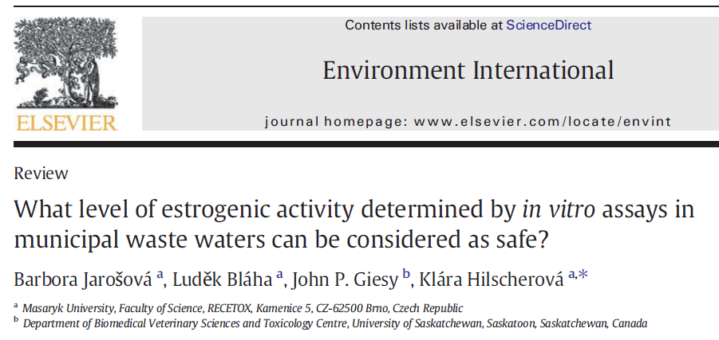
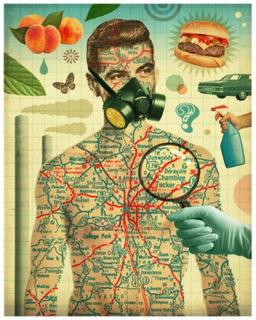
Summary on When, Where, What
Regulatory world
  Assessment of „chemicals“!
Contaminated samples
- effects rarely tested
  Great value of bioassays
  in assessment of contaminated samples
      Effects observed (!)
      How to set the „limits“?
Research issues and questions
  Nanomaterials, Pharmaceuticals, EDCs
  Mixtures!
  Exposome

