Slide 1




Laboratory of Functional Genomics and Proteomics
National Centre for Biomolecular Research
Faculty of Science, Masaryk University
Methods in Genomics and Proteomics
Mass Spectrometry in Proteomics
CG980
Zbyněk Zdráhal
RG Proteomics, CEITEC-MU
Proteomics CF , CEITEC-MU
NCBR, FS MU
zdrahal@sci.muni.cz

Slide 2

Introduction
Úvod

Slide 3
CG980
Sample preparation is a base of good results
GIGO
garbage in garbage out

Slide 4
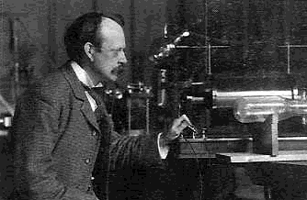
CG980
Main applications of mass spectrometry in proteomics
Intact mass measurements
Protein identification (incl. protein complexes, de novo sequencing)
Analysis of protein modifications
Protein quantification
MS imaging
Protein structure elucidation (complementary to NMR)
J.J. Thomson - father of mass spectrometry, Nobel prize for physics, 1906

Slide 5

Mass Spectrometry Basics

Slide 6
Mass Spectrometry (MS)
CG980
Method principle:
    measurement of m/z ion ratio of analyte
m – ion mass
z – charge number
Basic steps of MS analysis:
    ionization of analyte molecules (fragments)
    ion separation according to their m/z
    ion detection
vacuum
vacuum
Ion
source
Mass
analyzer
Detector
Analysis outcome:
    mass spectrum – dependence of ion intensity on their m/z
  allowing determination of ion mass
  in case of molecular ion
  mass of the whole molecule
a.i.
2955
m/z
Note: Apart from selected types of ionization, all steps of MS analysis take place in vacuum to prevent ions from unwanted collisions during their way from ion source to detector (mean free path of molecules)

Slide 7


CG980
Landmark in MS of biomolecules
New „soft“ ionization techniques (in the middle of 80s in the 20th century)
basic prerequisite for wide use of MS in biomolecule analysis, mainly proteins
(Nobel prize 2002)
Koichi Tanaka
Shimadzu Corp., Kyoto, Japan
MALDI
Matrix Assisted Laser Desorption/Ionization
KARAS M., HILLENKAMP F.
Laser Desorption Ionization of Proteins with Molecular Masses
Exceeding 10000 Daltons
Anal. Chem., 60 (20): 2299-2301 (1988)
John B. Fenn
Virginia Commonwealth University,
Richmond, USA
ESI
ElectroSpray Ionization

Slide 8
CG980
Mass spectrometry of proteins
Most widely used technique in proteomics
MALDI
Most often in combination with Time-of- Flight analyzer TOF
(matrix-assisted laser desorption/ionization time-of-flight mass spectrometry)
MALDI - TOF MS
MALDI – TOF/TOF MS
ESI
In combination with several different analyzer types
Ion trap – IT
triple quadruple and its variants - QQQ, Q-TOF, Q-LIT,
Ion Cyclotron Resonance - ICR
Orbitrap and its combinations – e.g. IT-Orbitrap

Slide 9
CG980
MALDI-TOF MS analysis
matrix is low mass compound capable to absorb laser radiation
e.g. Dihydroxybenzoic acid (for UV laser)
Příprava vzorku:
sample is mixed with excess of matrix (in solution)
mixture is deposited on a sample target and is allowed to dry
sample co-crystallize with matrix during drying
MS analysis
H⁺
Result:
Soft ionization without unwanted fragmentation
Simple spectra
Saving of sample on the sample target
(for additional analysis)
Laser pulse („shot“)

Slide 10
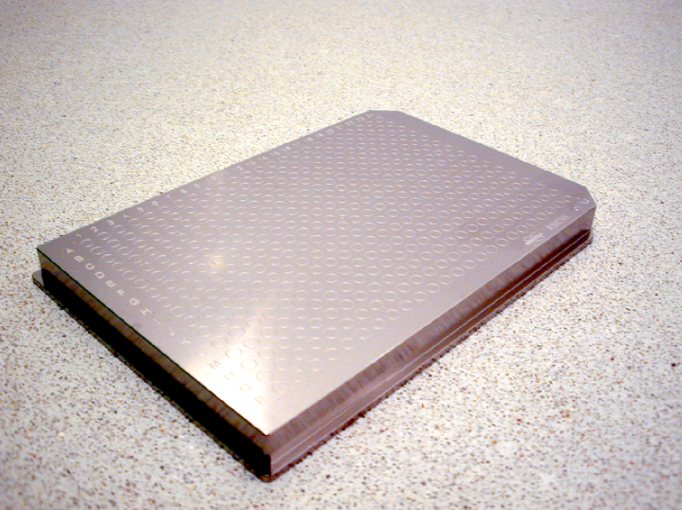
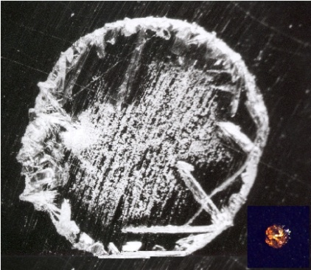
CG980
Target for sample deposition prior MALDI-MS
384 positions
Detail of sample cocrystallized with matrix (DHB) prepared for analysis

Slide 11
CG980
Desorption-ionization process
pictures by courtesy of Dr. Sauerland (Bruker)

Slide 12
CG980
Time-of-Flight Analyzer (TOF)
Separation of ions according to time of flight in the analyzer, time is recalculated to mass
E= ½ mv²
V= s/t
E – ion energy
m – ion mass
v – ion velocity
s – flight path
t – ion flight time
Prerequisite: Ions have to receive the same kinetic energy before entering analyzer drift zone which they enter simultaneously and their flight time is measured in a detector
m₁< m₂ < m₃
MALDI
ion
source
1
3
Detector
2
Start
Finish

Slide 13
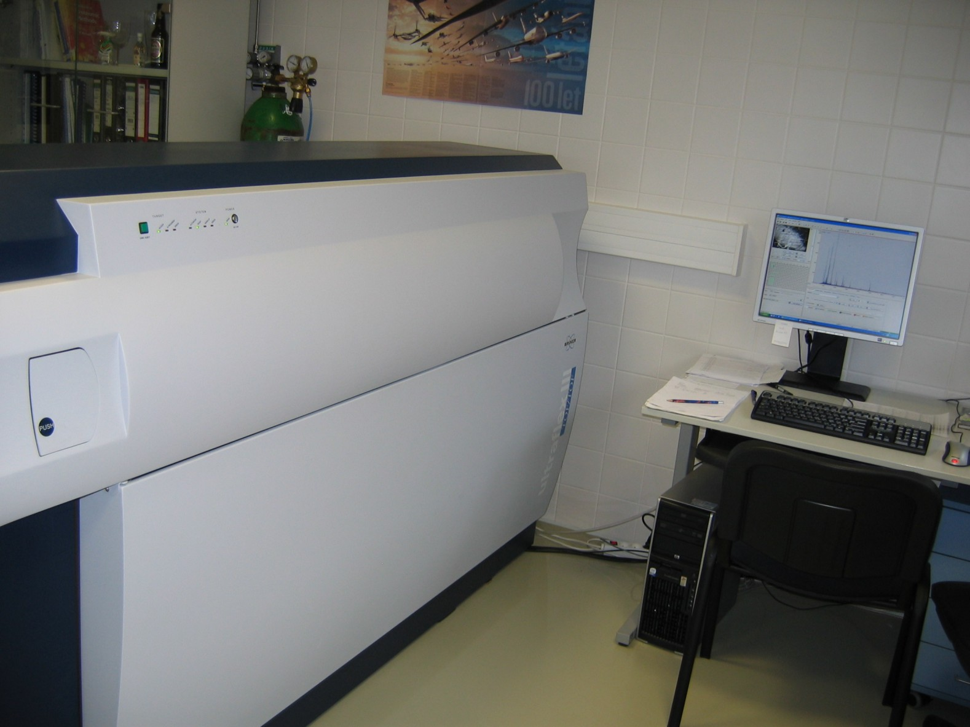
CG980
MALDI - MS/MS instrument
MALDI-TOF/TOF mass spectrometer Ultraflex III (Bruker)

Slide 14

CG980
MALDI – TOF MS animation
Task: find out more about MALDI-TOF MS basics on web
use expression „time-of-flight mass spectrometry“

Slide 15
CG980
MALDI-MS spectrum of protein (IgG)
1+
1+
2+
dimer

Slide 16
CG980
MALDI-MS spectrum of a peptide (~ fmol)
R ~ 18 000
[M+H]⁺
[M+Na]⁺

Slide 17
MALDI-MS profiling
CG980
microorganism identification
In clinical practice for clinical pathogens
sample
peptide/protein
extraction
MALDI MS
(3 – 20 kDa)
Microorganism identification
taxonomic studies
PCA analysis
database of MALDI MS profiles
The identification is based on comparison of the measured profile with profiles in database

Slide 18
MALDI-MS profiling
CG980
MALDI-MS spectra (profiles) of selected bacteria species
a.i.
a.i.
Sphingomonas paucimobilis
2500
2500
2000
2000
Aeromonas hydrophila
1500
1500
Pseudomonas aeruginosa
1000
1000
500
Alcaligenes faecalis
500
0
0
5000
5000
7000
7000
9000
9000
11000
11000
m/z
m/z

Slide 19
MALDI-MS profiling
CG980
Method limitation
Staphylococcus saprophyticus CCM 3317 CCM
Staphylococcus epidermidis CCM 7221 CCM
distinquished strains
Staphylococcus epidermidis CCM 2446 CCM
Staphylococcus epidermidis CCM 2124 CCM
Peptostreptococcus anaerobius CCM 3790 CCM
Serratia rubidaea CCM 3412 CCM
Streptococcus mitis CCM 7411 CCM
Finegoldia magna CCM 3785 CCM
Corynebacterium urealyticum CCM 4186 CCM
Corynebacterium urealyticum CCM 3976 CCM
Corynebacterium urealyticum CCM 3975 CCM
Corynebacterium pilosum CCM 6140 CCM
Campylobacter jejuni ssp jejuni CCM 7212 CCM
Campylobacter jejuni CCM 6214 CCM
Campylobacter jejuni ssp jejuni CCM 6191 CCM
Campylobacter jejuni ssp jejuni CCM 6189 CCM
indistinguishable strains
Campylobacter coli CCM 6211 CCM
Campylobacter fetus subsp fetus CCM 5682 CCM
Campylobacter fetus subsp fetus CCM 6210 CCM
Campylobacter fetus subsp fetus CCM 5683 CCM
1000
900
800
700
600
500
400
300
200
100
0
Distance Level
In general, the method can not discriminate bacteria at strain level

Slide 20
CG980
ESI ionization
Sample preparation:
sample has to be in solution
sample solution is introduced into the ion source by spray needle
Sample ionization:
sample solution is sprayed by spray needle in ion source chamber
under atmospheric pressure
ionization proceeds within the spray of liquid droplets by applying
strong electric field
charged liquid droplets are formed, which are transformed to multiply-
charged ions during evaporation
ions are transported into vacuum part of the instrument via transfer line
and subjected to MS analysis
Result:
Soft ionization without unwanted fragmentation
Multiply charged ions
Easy on-line connection with separation techniques (LC, CE)
LC - liquid chromatography; CE - capillary electrophoresis

Slide 21

CG980
Ion trap operation
MS scan
measurement of m/z ratio of analyzed compounds
ion capture in an ion trap
sequential ejecting of ions from the trap according to m/z
ion detection
MS/MS scan
targeted fragmentation of selected ions (precursors)
ion capture in an ion trap
ejecting of all ions except ions with selected m/z
excitation and fragmentation of selected ions
detection of formed fragment ions (product ions)
Notes:
Linearni past, citlivost

Slide 22
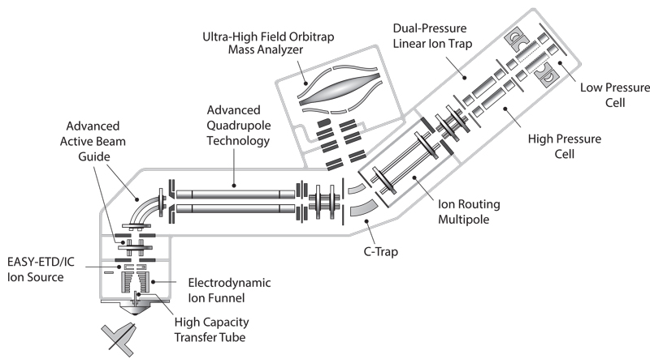
CG980
Orbitrap Fusion™ Lumos Tribrid
example of hybrid mass spectrometer
Precursor fragmentation techniques:
CID – ion trap
ETD – ion trap
HCD – ion-routing multipole
EThcD – ion trap/ion-routing multi pole
Ion separation/detection:
Ion trap – low resolution
Orbitrap – high resolution
ETD HD – high dynamic range ETD providing significantly increased
fragment ion coverage
Resolution Orbitrap
15,000–500,000 (FWHM) at m/z 200

Slide 23
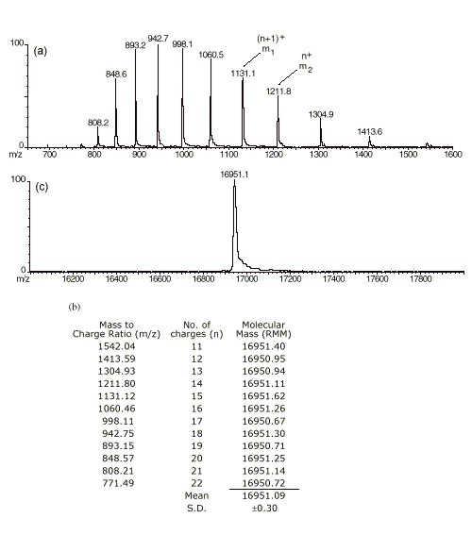
CG980
ESI–MS spectrum of protein
myoglobin (MW 16 951)
+ 21
+ 12
transformed spectrum
Serie of multiply-charged ions is formed differing in number of charges

Slide 24
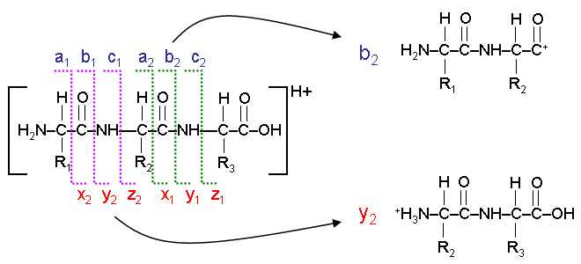
CG980
MS/MS fragmentation of peptides
peptides consist of individual aminoacids which are connected by peptide bond
during fragmentation (CID), peptide is fragmented preferentially at peptide bond
and thus:
all peptide bonds might be fragmented (in each precursor molecule different ones)
forming set of fragments with various number of aminoacids
differences in m/z (or mass) of „neighbouring fragments“ determines type of
terminal aminoacid in the longer fragment
serie of fragment ions are formed (b – y, a – x, c – z) which can be used for de novo
primary structure elucidation; moreover they are predictable and they can be used for
database search based protein identification even if they are not complete
Outline of tripeptide fragmentation
Roepstorff P. and Fohlman, J., Biomed. Mass Spectrom., 11 (11), 601 (1984)

Slide 25
MS vs MS/MS of peptides (CID)
CG980
MS
[M+H]⁺
CID – collision induced dissociation
MS/MS
+
N-terminus
C-terminus
ΔM AA
b- ion serie
y- ion serie
+
+
b₁
y₁
+
+
b₂
y₂
+
+
b₃
y₃
+
+
b₄
y₄
fragmentation maps for individual peptides

Slide 26
CG980
ESI-MS a MS/MS spectra of a peptide (MW 1148.5)
MS analysis
mass determination
Doubly-charged ion of the peptide
selected for MS/MS by intensity
MS/MS analysis
data for protein identification or primary structure elucidation
E
T
V
E
N

Slide 27

LC-MS systems
On-line

Slide 28
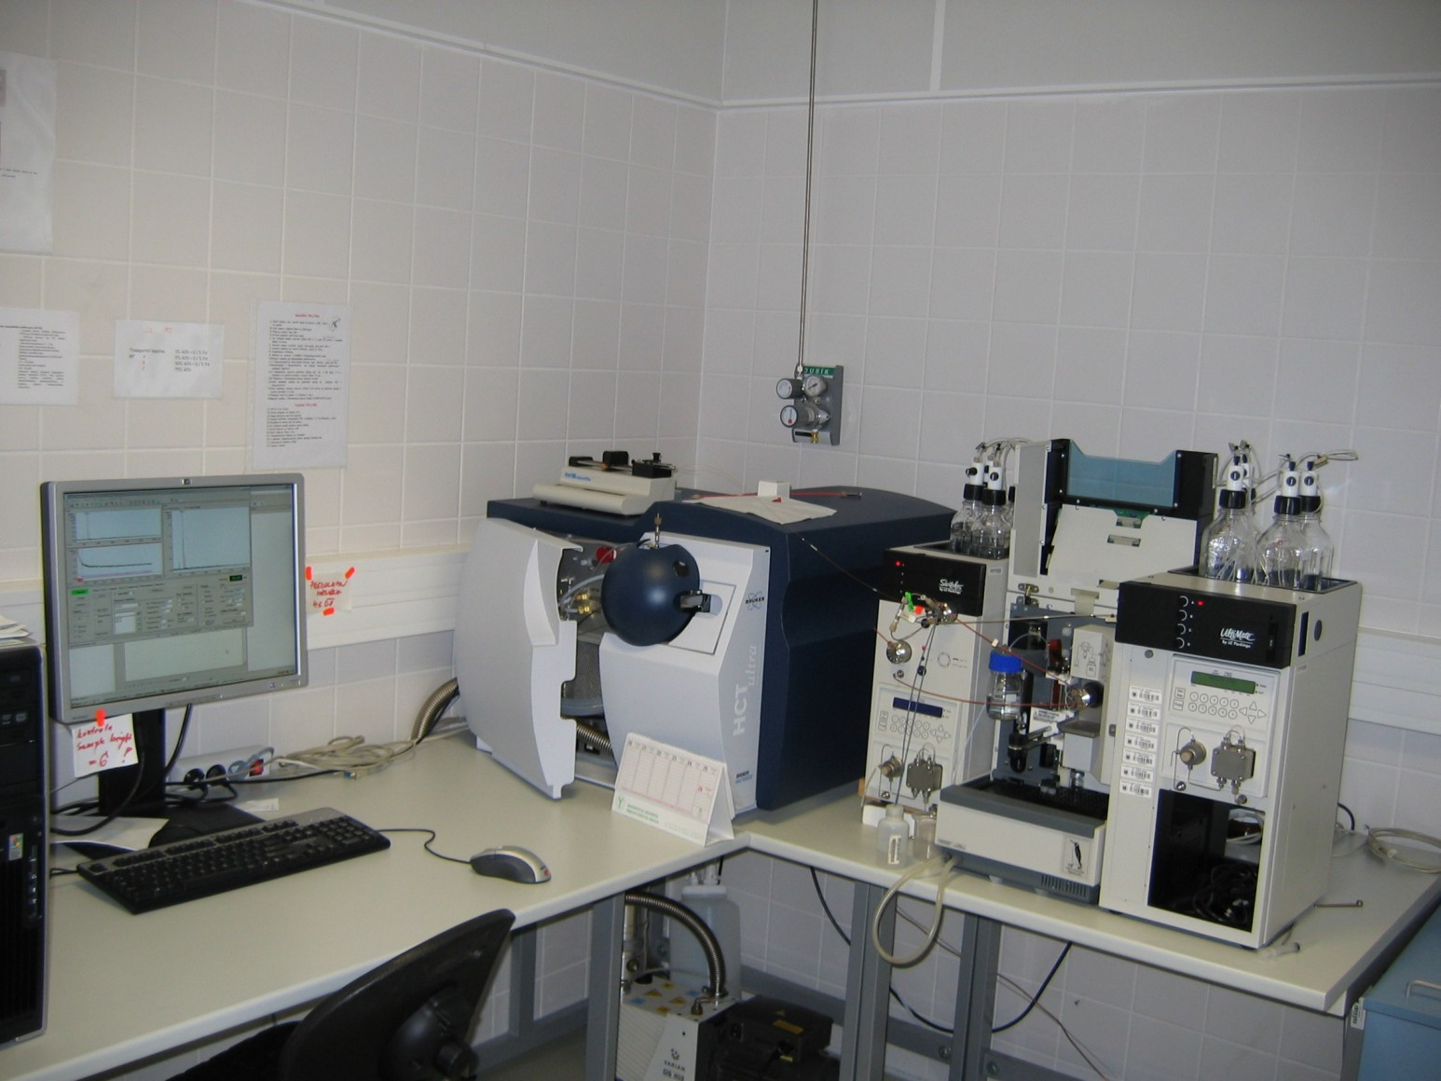
CG980
LC-MS system
fused-silica transfer line
MS
HPLC system
ESI
ESI-IT mass spectrometer HCT Ultra (Bruker) connected on-line to capillary liquid chromatograph Ultimate (LC Packings)

Slide 29
CG980
Protein
or
mix
2-D GE
Basic LC-MS/MS separation schemes
separation (optional)
1-D LC
digestion
MS/MS
1D - RP
peptide separation
Protein mix
2-D LC
MudPit
digestion
MS/MS
1D - SCX
2D - RP
step by step fractionation

Slide 30
Blood plasma
(3500 – 9000 proteins ??)
example of multidimensional separation
CG980
depletion
0. dimension
2 fractions
IEF (liq)
1. dimension
20 fractions
LC (RP)
2. dimension
1600 fractions
GE (1D/2D)
3/4. dimension
∞ fractions
from H. Wang, Molecular & Cellular Proteomics, 2005, 4, 618–625.

Slide 31

Protein Identification using Mass Spectrometry

Slide 32
CG980
Protein identification using mass spectrometric data
bottom up
top down
protein
(mix)
protein
(mix)
separation
digestion
(specific protease)
separation
MS
MS/MS
analysis
MS/MS
analysis
Identification (DB search, de novo)

Slide 33
CG980
Protein identification using MS
bottom up
proteins with known primary sequence
Common approaches:
peptide mapping
protein
separation
specific
digestion
MS
peptides
comparison of
obtained peptide map
with sequence database
gel electrophoresis
liquid chromatography
isoelectric focusation
MALDI-TOF MS
MS/MS Ion Search
Separation of
digested
peptides
comparison of
fragmentation maps
of individual peptides with
sequence database
specific
digestion
MS/MS
peptides
liquid chromatography
capillary electrophoresis
ESI-MS

Slide 34
Protein identification by peptide mapping
(peptide mass fingerprinting)
Blue approach

Slide 35
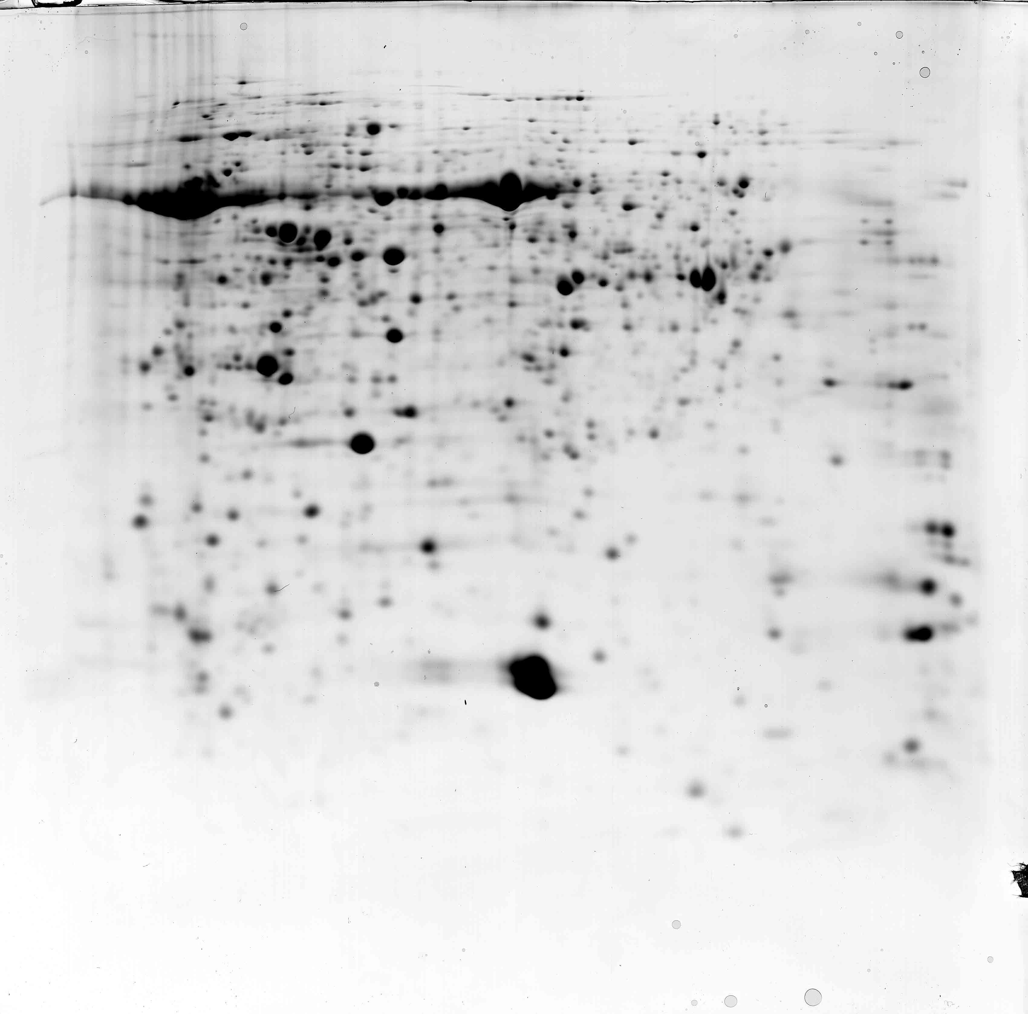
CG980
Separation of protein mixture by two-dimensional gel electrophoresis
1. dimension Isoelectric point
protein
separation
2. dimension Mass

Slide 36
CG980
Digestion
enzymatic digestion of protein results in set of peptides
specific protease is preferred
Trypsin
cleaves after lysine (K) and arginine (R), if proline does not follow
QNGVQMLSPSEIPQRDWFPSDFTFGAATSAYQIEGAWNEDGKGESNWDHFCHNHPERILD GSNSDIGANSYHMYKTDVRLLKEMGMDAYRFSISWPRILPKGTKEGGINPDGIKYYRNLI NLLLENGIEP
QNGVQMLSPSEIPQR 1-15 1683.848 Da
DWFPSDFTFGAATSAYQIEGAWNEDGK 16-42 3010.317 Da
GESNWDHFCHNHPER 43-57 1864.757 Da
ILDGSNSDIGANSYHMYK 58-75 1984.907 Da
TDVR 76-79 490.262 Da
...
Set of masses of these formed peptides (i.e. peptide map) is characteristic for given protein similarly as fingerprint for human individual.
Specific
digestion

Slide 37
CG980
MALDI - TOF MS spectrum of peptides after protein digestion
MS
peptides
MS spectrum contains masses of peptides formed by digestion of selected protein

Slide 38
CG980
Protein identification– peptide mapping
database searching
Measured peptide map (set of masses (or m/z) of peptides formed by digestion of analysed protein) is searched against database of protein sequences using database search engines.
Database search engine calculates theoretical peptide map for each protein sequence in database (applying cleavage rules for selected protease) and stepwise compares experimentally obtained peptide map of our analysed protein with in-silico calculated peptide maps.
Searching results in a list of proteins with most similar peptide maps. Similarity extent is given by score, all protein candidates with score value higher than the limit significant value (calculated by software) are considered as identified by search engine.
comparison of
obtained peptide map
with sequence database

Slide 39
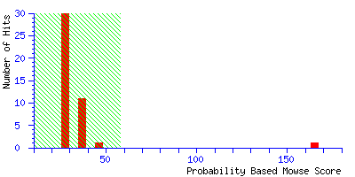
CG980
Result of database searching
peptide mapping
Mascot Search Results
Database : MSDB 20021127 (1019653 sequences)
Timestamp : 26 Jan 2003 at 10:36:50 GMT
Top Score : 165 for S18600, glutamate-ammonia ligase ....
Limitní skore = 58
Score
1. S18600 Mass: 47780 Total score: 165 Peptides matched: 12
glutamate-ammonia ligase (EC 6.3.1.2) precursor, chloroplast (clone lambdaAtgsl1) - Arabidopsis thaliana
2. S32228 Mass: 47714 Total score: 76 Peptides matched: 7
glutamate-ammonia ligase (EC 6.3.1.2) precursor - rape - Brassica napus
Sequence Coverage: 44%
1 MAQILAASPT CQMRVPKHSS VIASSSKLWS SVVLKQKKQS NNKVRGFRVL
51 ALQSDNSTVN RVETLLNLDT KPYSDRIIAE YIWIGGSGID LRSKSRTIEK
101 PVEDPSELPK WNYDGSSTGQ APGEDSEVIL YPQAIFRDPF RGGNNILVIC
151 DTWTPAGEPI PTNKRAKAAE IFSNKKVSGE VPWFGIEQEY TLLQQNVKWP
201 LGWPVGAFPG PQGPYYCGVG ADKIWGRDIS DAHYKACLYA GINISGTNGE
251 VMPGQWEFQV GPSVGIDAGD HVWCARYLLE RITEQAGVVL TLDPKPIEGD
301 WNGAGCHTNY STKSMREEGG FEVIKKAILN LSLRHKEHIS AYGEGNERRL
351 TGKHETASID QFSWGVANRG CSIRVGRDTE AKGKGYLEDR RPASNMDPYI
401 VTSLLAETTL LWEPTLEAEA LAAQKLSLNV
comparison of
obtained peptide map
with sequence database
www.matrixscience.com
Sequence regions in red corresponds to assigned peptides from measured peptide map

Slide 40
Protein identification based on MS data vs MS/MS data
CG980
MALDI MS/MS – fragmentation map of peptide - [M+H]⁺ 1675.9
4
x10
MALDI MS – peptide map
Intens. [a.u.]
1.0
0.8
1799.96
1675.87
1287.59
0.6
0.4
2539.17
1117.50
1458.85
1502.76
0.2
1012.50
1877.89
1576.71
2161.02
2638.21
3156.32
0.0
1000
1250
1500
1750
2000
2250
2500
2750
3000
m/z

Slide 41
Protein identification by LC-MS/MS
Green approach

Slide 42
CG980
Protein digestion
specific
digestion
In difference of „blue approach“ this time whole complex protein mixture is digested altogether, again using specific protease (usually trypsin).
This peptide mixture is separated (frequently multidimensionally depending on sample complexity) and subjected to MS/MS analysis.

Slide 43
CG980
Separation of tryptic peptides formed by digestion of protein mixture
Separation of
digested
peptides
Digest of human blood plasma sample separated by liquid chromatography (1D separation) connected to mass spectrometer (LC-MS/MS)

Slide 44
CG980
MS/MS spectrum of tryptic peptide (m/z 608.3, 2+)
MS/MS
peptides
MS/MS spectrum contains the peptide fragments formed by collision induced dissociation in ion trap.
These fragments carry specific information about peptide sequence and allow identification.

Slide 45
CG980
Protein identification based on – MS/MS data
database searching
Measured fragmentation maps (i.e. sets of masses (or m/z) of fragments formed during MS/MS of individual peptides) are searched against database of protein sequences by search engine.
At first, database search engine prepares theoretical peptide map for a protein sequence in database, subsequently, it calculates theoretical fragmentation map for each peptide of corresponding peptide map (according to given fragmentation rules) and then these in-silico prepared fragmentation maps are compared with our experimentally obtained fragmentation maps of analyzed peptides. The engine performs this operation for each protein sequence in database.
Software calculates individual score for each peptide, score value higher than limit score determines signifikant similarity between theoretical and measured fragmentation map – significant peptide identification.
In final, search engine assort peptides to corresponding protein sequences (the more peptides with significant score per protein – the more reliable protein identification). The software also calculate protein score which is derived from individual peptide score as a tool for setting up results.
comparison of
fragmentation maps
of individual peptides with
sequence database

Slide 46
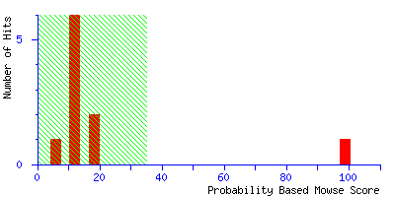
CG980
Result of database searching
MS/MS data
Mascot Search Results
Database : SwissProt 51.2 (243975 sequences; 89639744 residues)
Taxonomy : Homo sapiens (human) (15175 sequences)
Timestamp : 16 Dec 2006 at 16:05:59 GMT
Significant hits: AACT_HUMAN Alpha-1-antichymotrypsin precursor (ACT) –
Homo sapiens
comparison of
fragmentation maps
of individual peptides with
sequence database
Limitní skore = 35
Protein score
Peptide Summary Report
1. AACT_HUMAN Mass: 47621 Score: 99 Queries matched: 1
Alpha-1-antichymotrypsin precursor (ACT) Homo sapiens (Human)
Query Observed Mr(expt) Mr(calc) Delta Miss Score Expect Rank Peptide
1 608.3000 1214.5854 1214.7234 -0.1380 0 99 2.2e-08 1 K.ITLLSALVETR.T
Individual peptide score
Thanks to variability of primary protein structure it is possible to determine identity of protein based on fragments (MS/MS spectrum) of a single peptide.

Slide 47
CG980
Processed MS/MS spectrum
Aminoacid order derived from fragments of y-serie
Differences in m/z (resp. masses) of neighbouring fragment ions of corresponding serie (b, y) enables to determine individual aminoacids and their place in sequence.

Slide 48
CG980
Protein identification – database searching
comparison of
fragmentation maps
of individual peptides with
sequence database
MS
protein is identified
(protein with its sequence in database)
+
database
searching
m/z
-
unknown protein
(sequence is not available,
de novo sequencing)
other reasons of unsuccessful identification:
low protein concentration, unspecific digestion, unknown modification, low quality of MS data, ...

Slide 49

Characterization
of Posttranslational Modifications

Slide 50
CG980
Characterization of protein modifications
mutations (protein isoforms)
chemical (oxidation, deamidation, etc.)
posttranslational (e.g. phosphorylations, glycosylations)
MS in analysis of protein modifications
modification type
localozation
site occupancy
List of modifications and tools:
DeltaMass - https://abrf.org/delta-mass
ExPASy - http://www.expasy.org/proteomics/post-translational_modification

Slide 51

CG980
Difficulties in PTMs analysis
low abundance of modified proteins
protein occurs frequently in several modification forms
protein modification status can change during sample preparation
signal suppresion of modified peptides in MS
(preferential ionization of unmodified peptides)
To improve success of PTMs analysis
specific sample preparation procedures
(enrichment techniques, enzyme treatment etc.)
specific MS/MS operation modes

Slide 52
CG980
Phosphorylations
sample treatment
phosphatase inhibitors, denaturation (as soon as possible)
enrichment of phosphopeptides (proteins)
- TiO₂ (MOAC – „metal oxide affinity chromatography“)
- IMAC („immobilized metal affinity chromatography“)
- SCX resp. SAX or HILIC („ion exchange or hydrophilic interaction chromatography“)
- immunoprecipitation pomocí specifické protilátky
I.L. Batalha, Trends in Biotechnology 30 (2), 100-110 (2012)
Maldi-MS
w/o enrichment
Maldi-MS
TiO₂ enrichment
phosphopeptides
phosphopeptides
Proteomics Core Facility
52/30

Slide 53
CG980
Phosphorylations
MS analysis
dedicated MS/MS fragmentation techniques preserving phosphogroup at aminoacid residue
CID (limited) ETD (ECD)
electron transfer (capture) dissociation
HCD
higher-energy collision dissociation
EThcD
electron-transfer/higher-energy collision dissociation
Frese at al., J. Proteome Res., 12, 1520−1525 (2013)

Slide 54
CG980
Phosphorylations
how MS see modifications
MALDI-MS
a.i.
2500
shift in peptide mass in MS spectrum corresponding to modification mass indicates presence of given type of PTM
2000
1500
80 Da
1000
500
Intens.
Intens.
x10
7
7
x10
1070
1120
1170
m/z
2.5
578.3
538.3
40 Da
ESI-MS
1.25
2.0
1.00
1.5
0.75
1.0
0.50
0.5
0.25
487.7
668.3
408.2
447.7
528.2
615.6
1155.4
334.7
408.0
569.3
661.3
325.7
380.1
640.4
1076.4
226.8
285.1
873.5
920.9
165.0
495.0
916.9
0.0
165.0
221.9
0.00
200
400
600
800
1000
m/z
200
400
600
800
1000
1200
1200
m/z

Slide 55
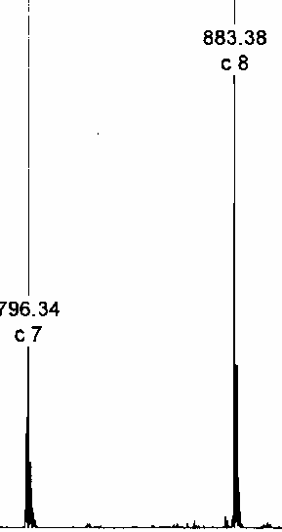
CG980
Phosphorylations
how MS see modifications
shift in fragment mass in MS/MS spectrum corresponding to modification mass indentifies and localizes given type of PTM
ESI-MS/MS (ETD)
S
Δ m/z = 87
S_{phos}
Δ m/z = 167
m/z
m/z

Slide 56
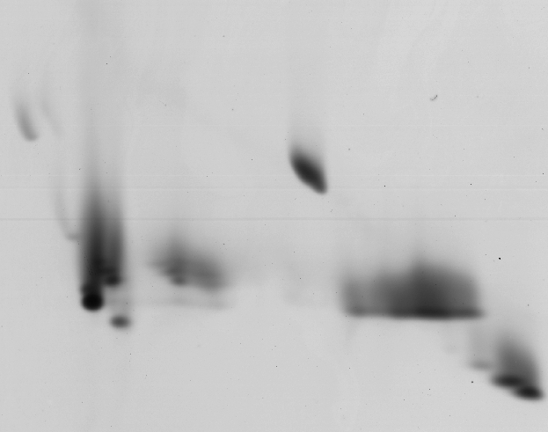
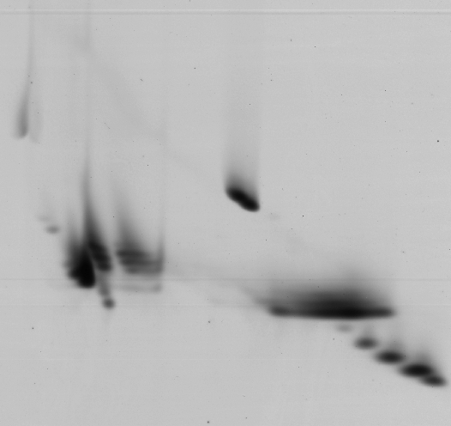
CG980
Histone acetylations
2-D gel electrophoresis (AUT-AU) histone extracts
w/o deacetyase inhibitors
with deacetylase inhibitor
H1
H1
H2B
H2B
H3
H3
H2A
H2A
e
d
c
b
a
e
d
c
b
a
H4
H4

Slide 57
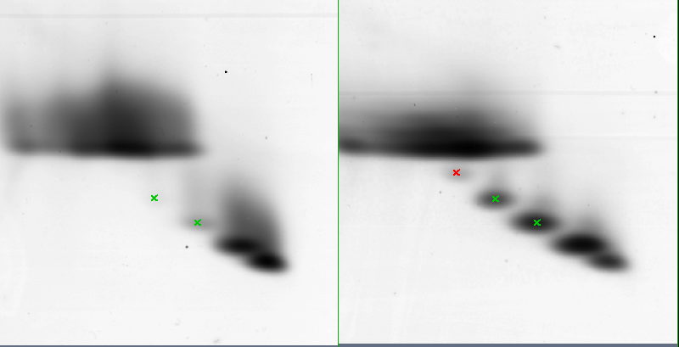
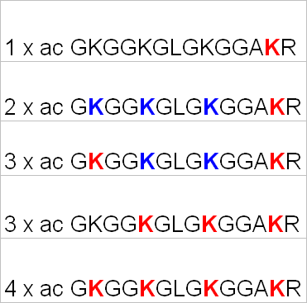
Histone acetylations
LC-MS/MS analysis results
CG980
w/o deacetyase inhibitors
with deacetylase inhibitor
E
4x Ac
3x Ac
2x Ac
1x Ac
0
D
D
C
C
B
B
A
A
1 MSGRGKGGKG LGKGGAKRHR KVLRDNIQGI TKPAIRRLAR RGGVKRISGL
51 IYEETRGVLK VFLENVIRDA VTYTEHAKRK TVTAMDVVYA LKRQGRTLYG
101 FGG
dimetyl

Slide 58
CG980
Histone acetylations
distinquishing modification site in peptide GKGGKG LGKGGAKR (3x Ac)
detail of MS/MS (ETD) spectrum
128
unmodified K
128+42
acetylated K

Slide 59

Protein quantification

Slide 60
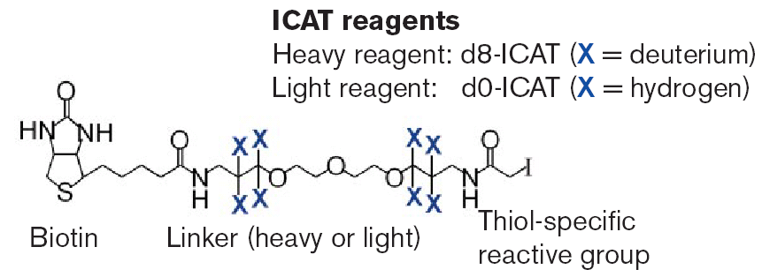
CG980
Protein quantification by MS
general approaches
methods based on application of isotopic labels
absolute quantification
(determination of amount/concentration of given protein using additon of internal standard with known concentration)
relative quantification
(comparison of changes in protein levels between two or more samples)
Isotopic labels are introduced to proteins at different stages of experiment: during cell cultivation or by chemical reaction after protein isolation or after digestion (peptides).
label free methods based on advanced processing of MS (MS/MS) data

Slide 61

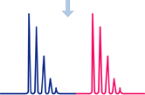



CG980
Protein quantification by MS
absolute quantification
AQUA Peptide Selection
Order selected peptide isotopically labeled (¹⁵N, ¹³C)
Adding labeled peptide to protein mix
Digest
Analyze by LC-MS/MS to quantitate protein of interest
Select an optimal tryptic peptide and stable isotope amino acid from the sequence of your protein of interest
Optimize LC-MS/MS separation protocol for quantitation
Price !!!
AQUA
only for protein(s) selected in advance

Slide 62
Protein quantification by MS
relative quantification
CG980
Protein sample A
Protein sample B
SILAC, in-vivo
100%
individual protein isolation
pooling
common
purification/fractionation
common digestion of pooled samples
LC-MS
the same peptide distinguished by isotopic label
(different label mass)

Slide 63
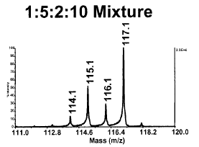
Protein quantification by MS
relative quantification
CG980
Protein sample A
Protein sample B
individual protein isolation
individual
purification/fractionation
reporter ions are released bringing quantitation info
Individual sample digestion
individual labeling
iTRAQ, TMT
MS/MS
common
LC-MS/MS
The same peptides are not distinguished in MS mode

Slide 64
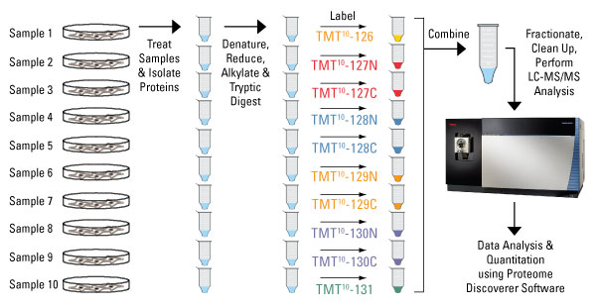
Protein quantification by MS
relative quantification – TMT labeling
CG980
Thermo Fischer Scientific

Slide 65
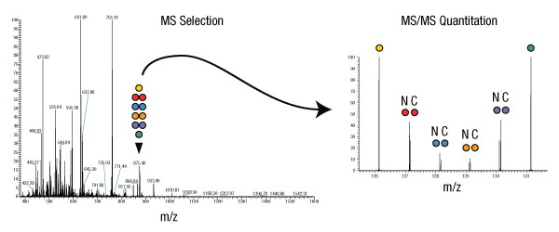
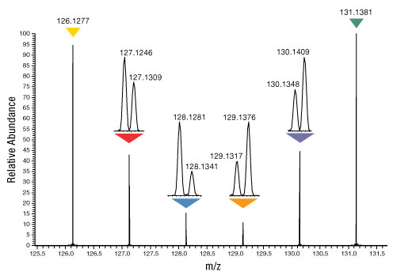
Protein quantification by MS
relative quantification – TMT labeling
CG980
Reagents contain different numbers and combinations of 13C and 15N isotopes in the mass reporter. The different isotopes result in a 10-plex set of tags that have mass differences in the reporter that can be detected using high resolution Orbitrap MS instruments.
Thermo Fischer Scientific

Slide 66
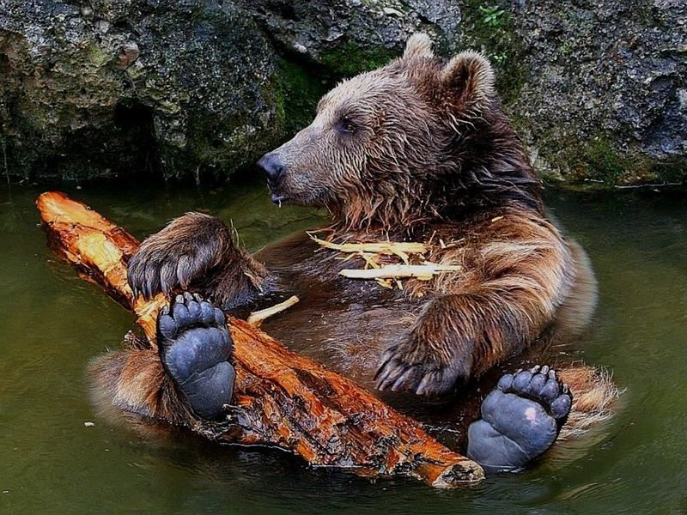
… and this is the end

