Slide 1
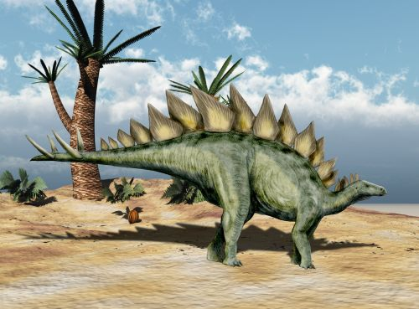
4. Paleontology

Slide 2
In this lesson we are going to:
revise the vocabulary
practise reading and listening skills
learn how to use passive voice (revise selected tenses)
learn how to write a formal e-mail
discuss questions which might be asked by paleontologists

Slide 3
LET‘S REVISE SOME GRAMMAR BEFORE WE LEARN SOMETHING NEW!
Scientists have attributed those extinctions to climate changes.
This generated a gigantic dust cloud.
They pointed out that the dinosaurs had been on the decline for milions of years.
We do know that climates were changing toward the end of the Cretaceous and dinosaur species were decreasing.
They evolved into the many mammal species that populate the earth today, including humans.

Slide 4
PASSIVE VOICE
Who should find the crater? Who could „date“ it?
„A large meteorite crater should be found someplace on earth that could be dated as having formed around 66 million years ago.“

Slide 5
PASSIVE VOICE
Use the passive voice
when „what is done“ (object) is more important than „who did it“ (subject)
in formal texts when you want to show that „what is done“ is more important than „who did it“.
if you do not want to mention „who did it“ (it is not important, polite or we do not know who/what it is)

Slide 6
STRUCTURE
They found the crater. x The crater was found.
They have found the crater. x________________.
They are analysing the crater. x_______________.
They should find the crater. x_________________.
_____________________ x The crater had been found.
______________________ x The crater was being analysed.
______________________x The crater will be found.
Subject + (be – correct form!) + past participle + (by + subject).

Slide 7
TASK
Professor Carr is coming to Masaryk University to have several lectures on the extinction of dinosaurs. You are currently writing an article related to this topic. You would like to meet him and ask some questions about it. Write a formal e-mail in which you will explain why you want to meet him, show your interest and ask if it would be possible to meet during his visit.

Slide 8
Discuss if the following expressions are formal or informal and where exactly you would use them (salutation, body paragraphs or closing?)
I miss you so much!
Hi!
Dear Professor Johnson,
Love ya!
Best regards
Sincerely
Thank you for your time and look forward to hearing back from you.
Please feel free to call or email me if you have any questions.
To Whom it May Concern,
Dear Mr./Ms. Smith
I am sorry to inform you that I will not be able to attend class today because I am ill.

Slide 9
SOURCES
https://www.menlo.edu/wp-content/uploads/2015/03/writing-a-formal-email.pdf (formal x informal emails – self-study)
https://www.youtube.com/watch?v=tjhDV_GzTM8 (video)
https://www.newdinosaurs.com/24_stegosaurus_nobu_tamura (pictures - dinosaurs :-))
https://www.perfect-english-grammar.com/passive.html (grammar – more information)
https://www.flo-joe.co.uk/fce/students/strategy/transfrm/passive2.htm (grammar - practice)

