Slide 1
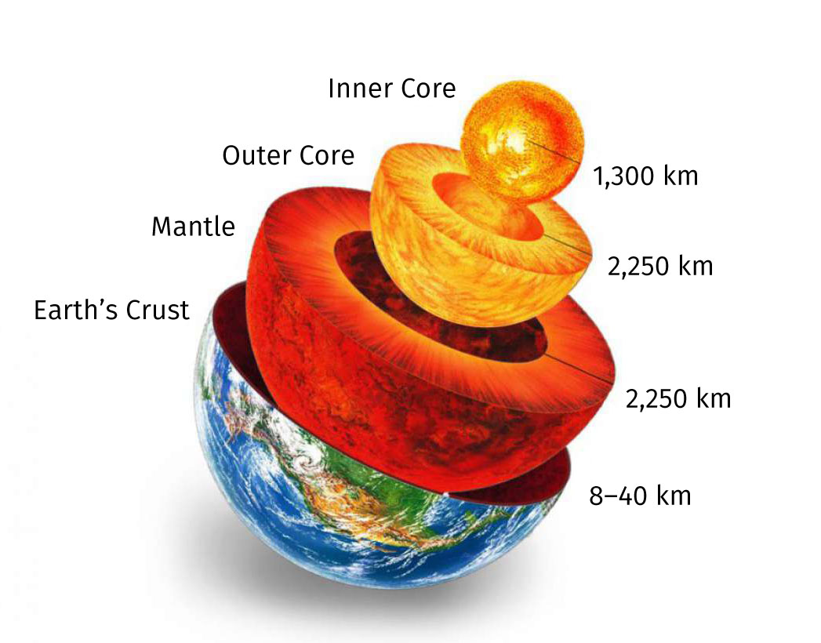
5 Dynamic planet

Slide 2
In this lesson we are going to:
revise the vocabulary from the previous lesson
revise the grammar (passive voice)
learn how to describe our planet and its processes
learn how to use conditionals
discuss hypothetical situations

Slide 3
Which associations do you have with the following:
Crust ____________________________________
Mantle __________________________________
Core ____________________________________

Slide 4
conditionals
Is the following sentence related to the past/present/future?
If there was a tunnel all the way to the core, how long would it take a skydiver to fall to the centre of the Earth?

Slide 5
When and how to use them?
How do these sentences differ in the meaning and structure?
If you melt a rock, it becomes liquid. Zero conditional
If you touch this liquid rock, you will get hurt. First conditional
If I were you, I wouldn‘t touch it. Second conditional („were“ instead of „was“ should be used in all cases in formal English. „Was“ with „he/she/it/there“ sounds more natural in a spoken language but it‘s not a mistake to use both forms. In a formal context use „were“ all the time and you can‘t make a mistake. Only the phrase: „If I were you…“ requires always „were“ instead of „was“, even in a spoken language.)
If you had listened to me, you wouldn‘t have had to go to hospital. Third conditional
If you had listened to me, you wouldn‘t suffer so much now! Mixed conditional

Slide 6
Structure
Zero conditional – If + present tense, present tense (fact)
First conditional – If + present tense, will + infinitive (specific real situation)
Second conditional – If + past tense, would + infinitive (hypothetical situation, unreal present)
Third conditional – If + past perfect, would + present perfect (unreal past)
What is the difference?
Talk to him when you see him.
Talk to him if you see him.
Wishes
I have a lot of work. – I wish I didn‘t have so much work!
I sent that e-mail without correcting the mistakes. – I wish I hadn‘t sent the e-mail! I wish I had checked it!

Slide 7
Discuss
What would happen if …
What will happen if …
What happens if …
magnetic field/disappear
heat/iron
enter/the core
the mantle/not exist
no nickel in the core
the crust/thicker than the mantle
the Sun/further from the Earth
only salt water on the Earth
no pressure in the core
the Earth/stop moving
Other topics for more creative minds ☺
diversification
desertification
extinction
geology
scientific research
fossilization

Slide 8
sources
http://the-dialogue.com/en/en66-how-plate-tectonics-is-connected-with-life-on-the-planet/ (picture)
https://www.youtube.com/watch?v=1f-duh6frmo (video)
https://www.perfect-english-grammar.com/conditionals.html (grammar)
https://www.ego4u.com/en/cram-up/grammar/conditional-sentences (more grammar :-)
https://www.flo-joe.co.uk/fce/students/strategy/transfrm/conditn.htm (more grammar - including all conditional structures)
Kelly, K. Science. Macmillan Publishers Limited, Oxford 2008 (The layers of the Earth - vocabulary)

