Slide 1
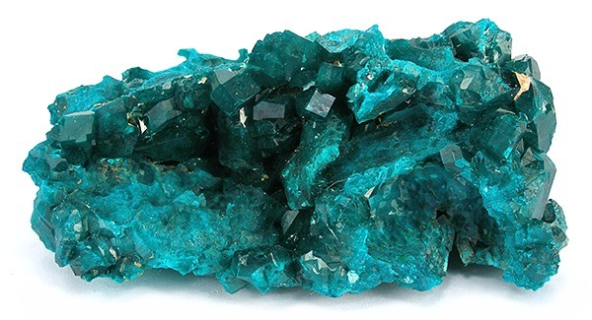
7 MINERALS

Slide 2
In this lesson we are going to:
revise some vocabulary and grammar from the previous lessons
learn how to give a feedback and how to learn from the feedback (poster presentation)
learn how to describe minerals and distinguish between them
learn new vocabulary
revise classifying

Slide 3
Discuss
Which conditions must be satisfied for a substance to be a mineral?
Which physical properties do we distinguish when we want to identify the mineral?
What is Mohs‘ hardness scale?

Slide 4
classifying
Use the Internet where necessary to finish the following sentences:
We classify minerals according to …
We divide minerals into …
Calcite belongs to …
Minerals consist of …
Gypsum is significantly different from…
Diamond is much … than …
Quartz contains …

Slide 5
discuss
What is cleavage? How is it different from fracture?
How do smooth crystal faces differ from cleavage surfaces?
What is harder? Calcite or topaz?
Could a fingernail leave marks on gypsum?
Which minerals have metallic luster?
What would happen if you rubbed a diamond against porcelain?
Is color important in the process of mineral identification? Why/not?

Slide 6
Task
Describe physical properties of some sample minerals
This mineral breaks along one cleavage direction, it is quite a soft mineral, it can be dark brown to dark black, it has a light tan streak and glassy luster. It forms flakes and sheets.
Biotite mica

Slide 7
Sources
https://www.tes.com/lessons/CYvuVc7DjOo-3Q/earth-s-minerals (picture)
https://www.youtube.com/watch?v=7MvXv66b5h4 (video)
  McGeary, David. Physical Geology. 4th Edition. McGraw-Hill. New York 2001

