Slide 1
Ecotoxic effects
- Cellular and organisms levels -
Luděk Bláha, PřF MU

Slide 2
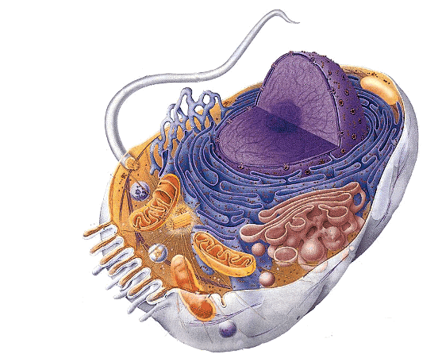
Toxicity at cellular level
Molecular mechanisms
(effects on proteins, membranes, DNA) manifest at cellular level

Slide 3
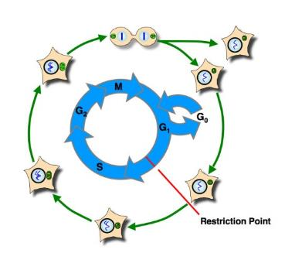
Life trajectories of the cell
Regular pathways of cell life
  Cycling (cell cycle, proliferation)
  Due to limited proliferation → senescence or
  or terminal differentiation
  or cell death (controlled) – apoptosis
Homeostasis assured through careful check of key processes, i.e.
Cell membrane integrity
Aerobic respiration (mitochondria)
Proteosynthesis (ribozomes)
DNA integrity
…. Effects on these processes → toxicity

Slide 4
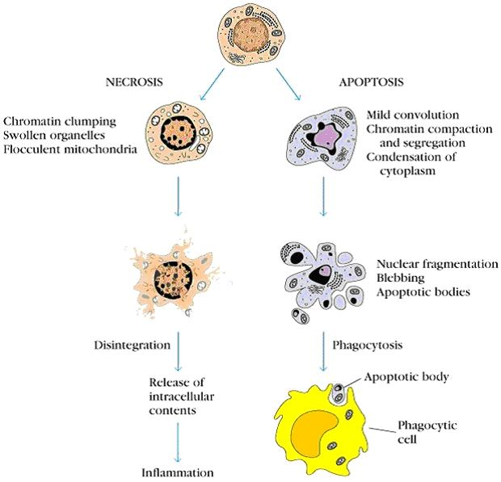

Slide 5
IMPACTS and manifestation of toxicity at cell level
Disruption of cell proliferation
Tumors, cancer
Immune system disruption (proliferation in many processes)
Disruptions of differentiation
Important for early development (embryotoxicity, teratogenicity)
Tumors (cells often NOT differentiated)
Immune systém
Disruptions of apoptosis
Tumors (cells escape apoptosis)
Effects on immune system
  (TCDD induced activation of AhR → apoptosis in thymus → loss of functional immune reactions

Slide 6
The cellular effects further propate
→ level of the ORGANISM

Slide 7
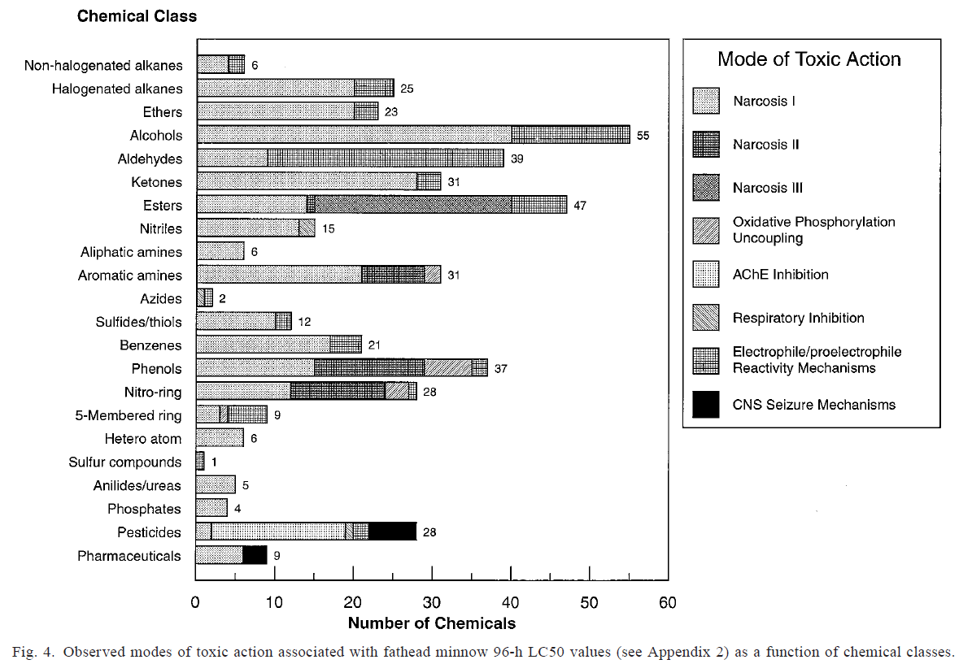
Acute lethal toxicity (fish) & relevant toxicity mechanisms
Russom et al. Environmental Toxicology and Chemistry, Vol. 16, No. 5, pp. 948–967, 1997

Slide 8
CHRONIC and DELAYED TOXICITY
„Chronic“ mechanisms less explored
  Usually not tested in ecotoxicity assays
  Slow manifestation and effects in ecosystems
Various effects:
  growth inhibition (~ lower food uptake)
  diseases such as carcinogenicity
  teratogenicity and embryotoxicity,
  developmental toxicity
  Reproduction toxicity
  Organ-specific types of toxicity
  → Imunotoxicity
    Neurotoxicity
    Nefrotoxicity etc.
„Systemic“
effects

Slide 9
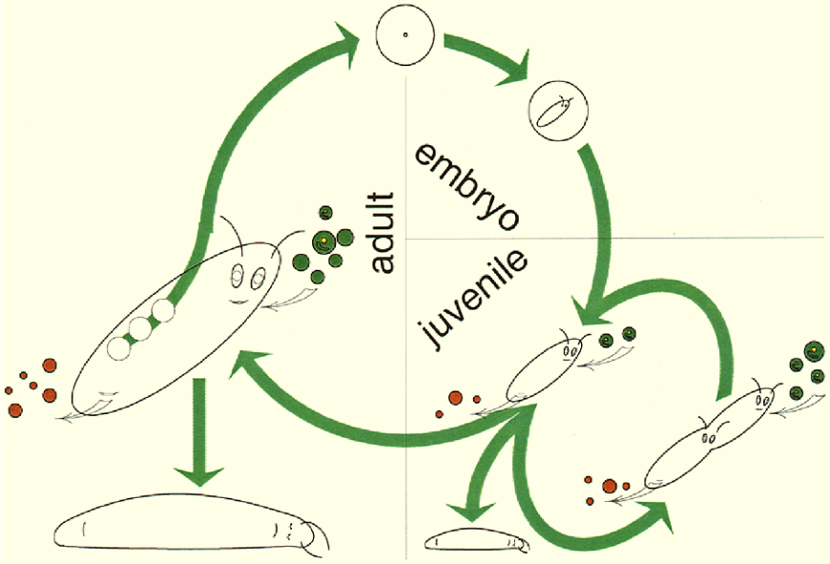
Effects at different levels - ORGANISM
Organism level – important in ecotoxicology (see Bioassays)
  Effects on structure
  Effects on metabolism (maintenance)
  Effects on regulation
    Changes in functions (e.g. Ethinylestradiol)
    Repair, survival, growth
    Death (lethality)
    Proliferation = Reproduction
3 key apical endpoints
(reflected e.g. in regulations)

Slide 10
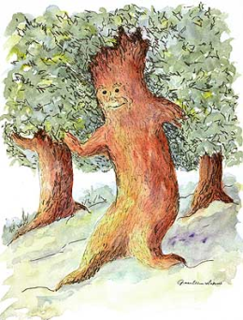


Energy
hv
food
Losses
heat
faeces
Life
(maintenance)
Metabolism
Control,
Interactions
with environment
Defence
against pathogens
predators …
Defence against
toxicants
Growth
to sexual
maturity
Reproduction
Chemical
stress

Slide 11
Chemical stress
→ energy re-allocation
→ „insufficient“ resourses elsewhere
Energy
hv
food
Losses
heat
faeces
Life
(maintenance)
Metabolism
Control,
Interactions
with environment
Defence
against pathogens
predators …
Defence against
toxicants
Growth
to sexual
maturity
Reproduction
Chemical
stress

Slide 12
Chemical stress
+ ... another stress
(food scarcity)
Energy
hv
food
Losses
heat
faeces
Life
(maintenance)
Metabolism
Control,
Interactions
with environment
Defence
against pathogens
predators …
Defence against
toxicants
Growth
to sexual
maturity
Reproduction
Chemical
stress

Slide 13
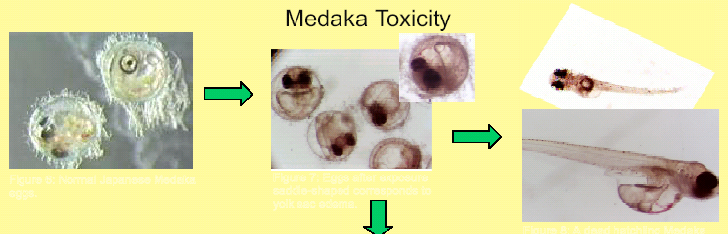
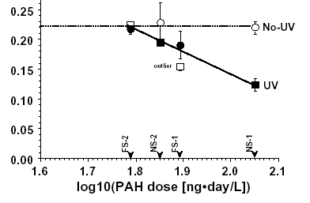
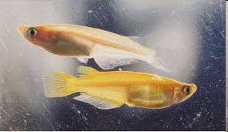
Example - GROWTH inhibition in fish
Exposures to PAHs +/- UV (phototoxicity)
Model fish = Japanese medaka
Growth is proportional to food/feed consumption
(measuring of food consumption answers how toxicant affects the growth)

Slide 14
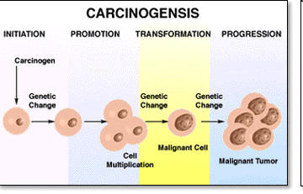
Carcinogenicity
Complex process with four main phases/steps:
initiation (DNA changes) = mutagenesis
promotion (changes fixed in genome, cell proliferation etc)
- transformation (formation of malignant cells)
- progression (neoplasia, metastasing)
RELEVANT mostly
for HUMAN
toxicology but
tumors observed
also in wild
biota

Slide 15
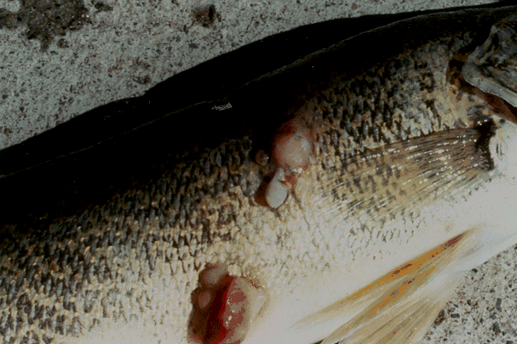
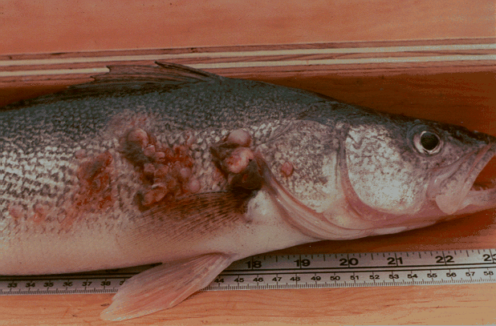
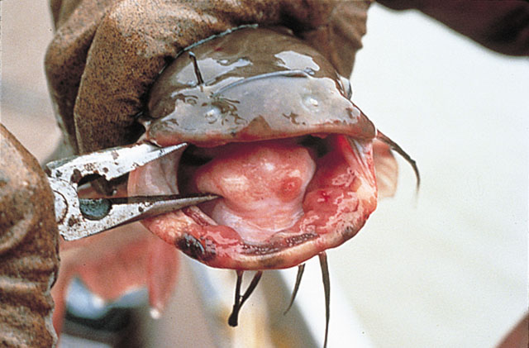

Slide 16
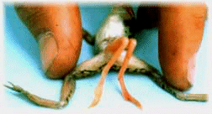
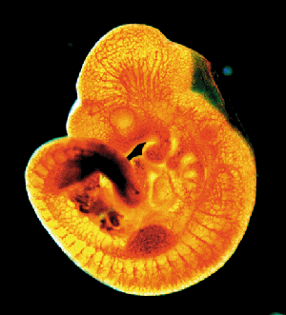
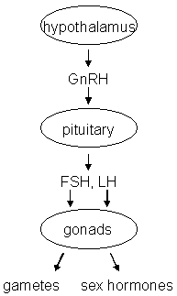
Endocrine disruption
Interference of xenobiotics with normal functioning of hormonal system
Known consequences
→ Disruption of homeostasis, reproduction, development, and/or behavior (and other hormone-controlled processes), such as
  Shift in sex ratio, defective sexual development
  Low fecundity/fertility
  Hypo-immunity, carcinogenesis
  Developmental processes - malformations
  etc.

Slide 17
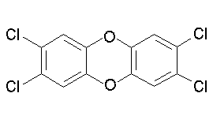
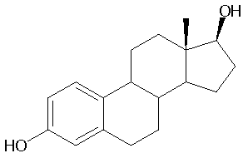
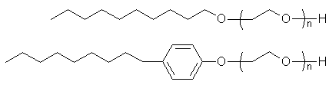
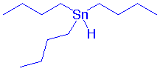
Endocrine disrupters in the environment?
2,3,7,8-TCDD
EDCs...
  Persistent Organic Compounds
  (POPs and their metabolites)
  steroid hormones and their
  derivatives from contraception pills
  alkylphenols
  organometallics (butyltins)
  pharmaceuticals
  Pesticides
  + number of unknowns …
estradiol
alkylphenols
Tributyl-tin

Slide 18
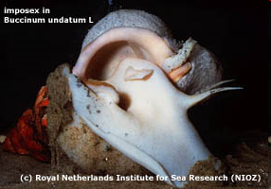
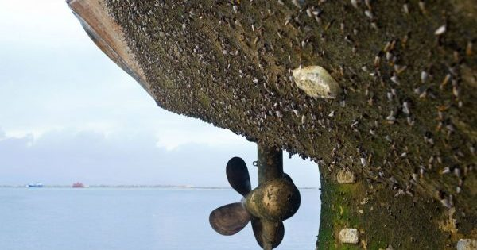
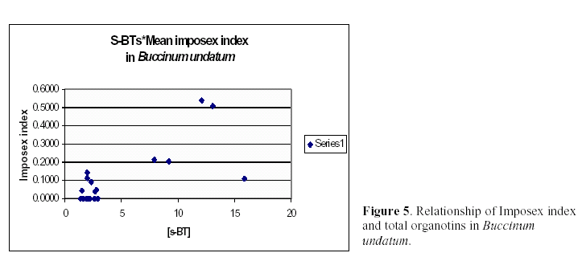
Effects of EDs in
invertebrates
(molluscs)
One of the first EDC effects: = imposex
Development of male sexual characteristic in
females
Effects of alkyltins (e.g. Tributyl tin)
– anti-fouling agents
BIOFOULING

Slide 19
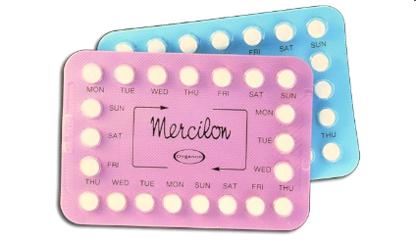
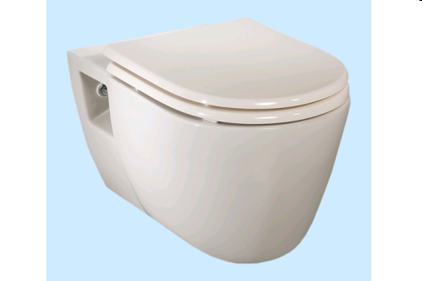
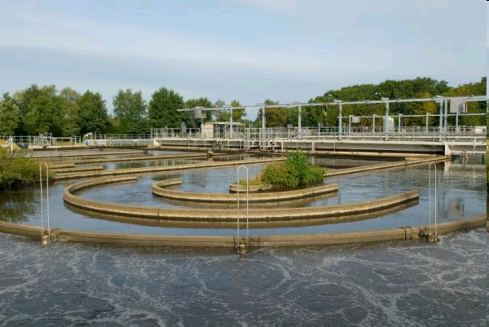
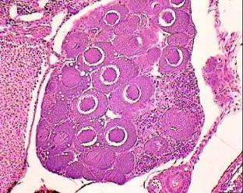
Female estrogens and contraception pills
Feminization
Intersex
Female eggs (oocytes) formed in male testes
Reproduction
disruption
Decline in fish populations

Slide 20
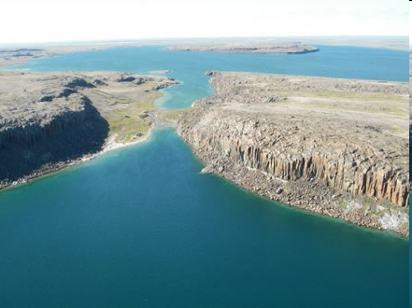
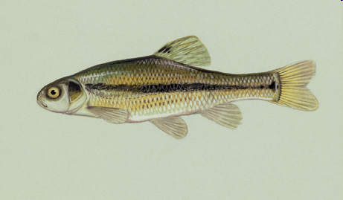
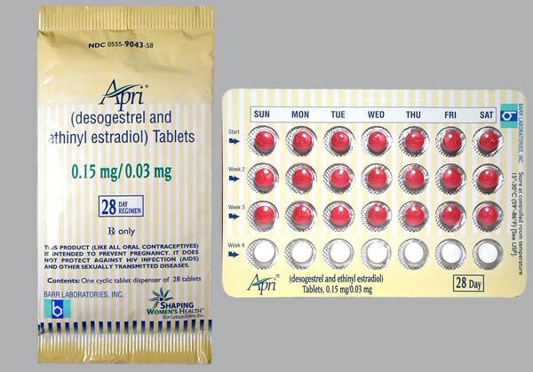
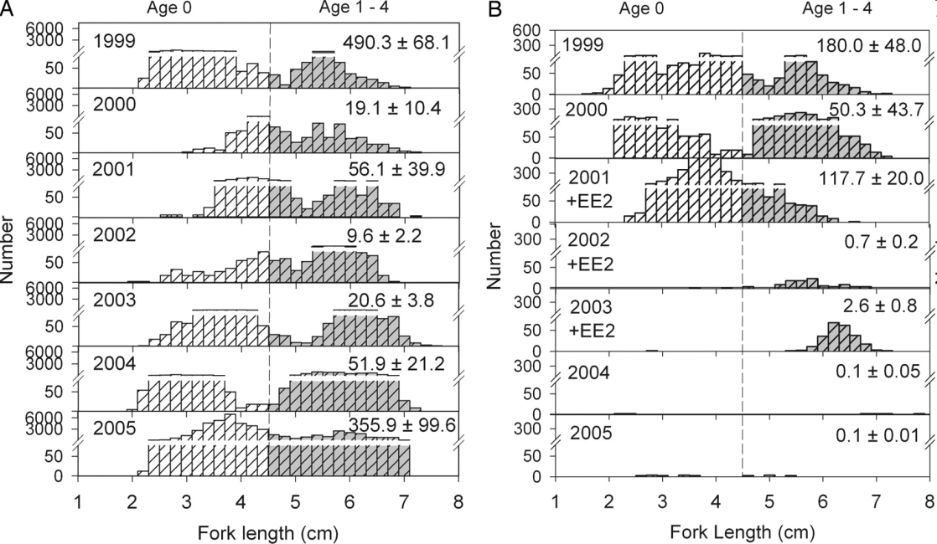
Kidd, K.A. et al. 2007. Collapse of a fish population following exposure to a synthetic estrogen. PNAS 104(21):8897-8901
Control lake lake with EE2
EE2 - 5 ng/L (!)

Slide 21
Reproduction toxicity, developmental toxicity, embryotoxicity and teratogenicity

Slide 22
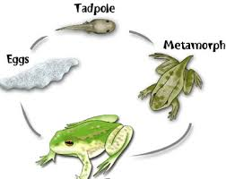
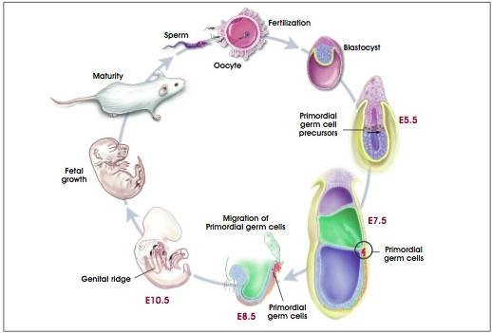
Reproduction and development are closely related
Reprod
Reprod

Slide 23
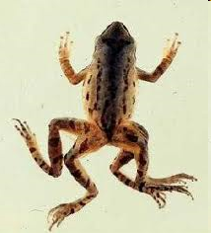
DEVELOPMENTAL TOXICITY
Embryotoxicity
= general term – toxicity to embryo
Teratogenicity
= morphological developmental effects
  Malformations, missing organs etc.
well characterized in aquatic vertebrates
  ecotoxicity tests - Danio rerio, Xenopus laevis

Slide 24
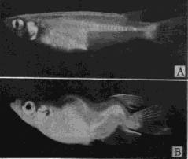
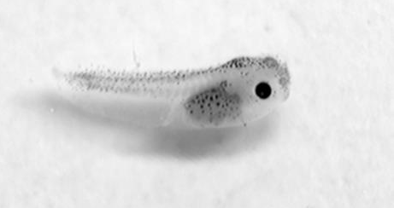
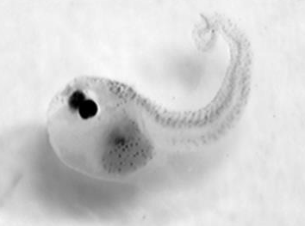
Teratogenicity effects
Examples of teratogens
- organochlorine compounds (DDT, DDE)
- new types of pesticides ATRAZIN
- PCBs and compounds with dioxin-like mechanims
- toxic metals
- natural toxins (e.g. From cyanobacteria)
Japanese medaka
teratogenicity of PCBs
Embryos of frogs X. laevis
Controls exposure to cyanotoxins

Slide 25
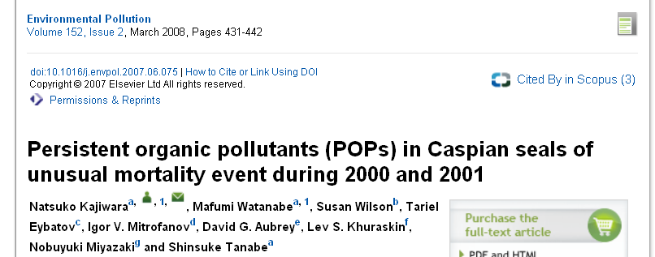
IMMUNOTOXIC EFFECTS OF ECOTOXICANTS
Examples
- Mortalities of seals, dolfins – morbillivirus infections / PCBs, PCDDs
- Elevated skin lesions (fungi, bacteria) in fish from contaminated sites
- Arsenic → direct toxicity to natural killer cells in immune system (responsible for removal of tumors → increased carcinogenicity)
- Prenatal exposures to DIOXINS → complete „apoptosis“ (convolusion) of thymus → not immune system in offsprings (no T-cells)

Slide 26
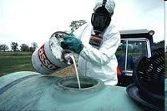
NEUROTOXIC EFFECTS (e.g. Insecticides)
1] Acute toxicity
- spasms, effects on CNS, suffocation, death
2] Chronic effects
→ effects on behaviour, learning etc..
  Behavioral changes – critical for survival of individuals and populations
  - male-female attraction / reproduction, foraging, hiding from predators
Loss of synchronization in release of gametes
(aquatic invertebrates and vertebrates)
- Complex reproduction behaviour (birds and mammals)
- Slower burrying of molluscs into sediments ← fast predation
→ lower fitness and lower reproduction success

Slide 27
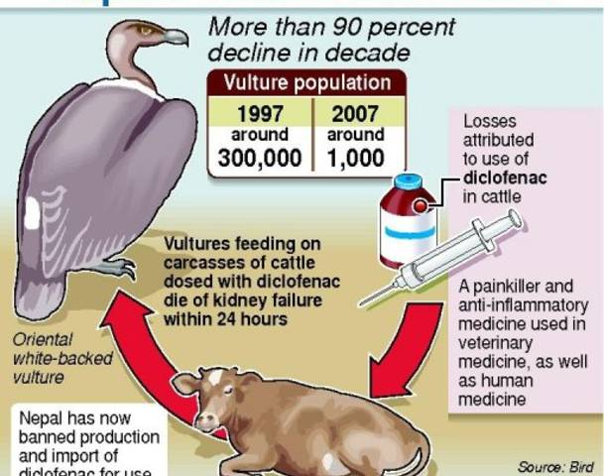
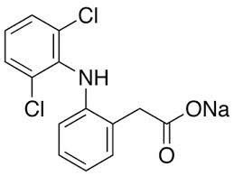
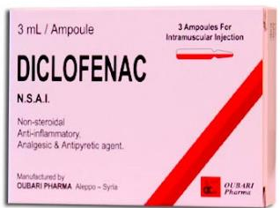
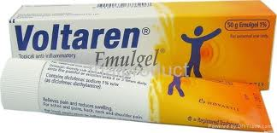
NEFROTOXICITY IN VULTURES
- Damaging effects of veterinary pharmaceuticals on vulture populations
- primary effect → kidney in vultures = nephrotoxicity

Slide 28
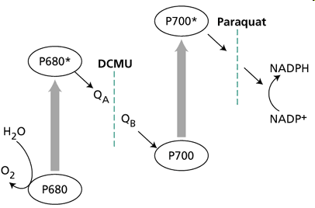
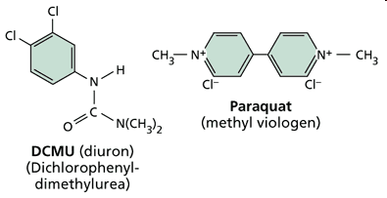
TOXIC EFFECTS TO PRODUCERS (plants, algae)
Unique process of PHOTOSYNTHESIS
Target to many herbicidies – e.g. Diuron (DCMU) and Paraquat

Slide 29
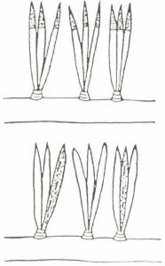

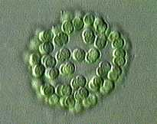
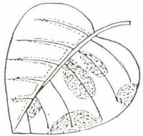
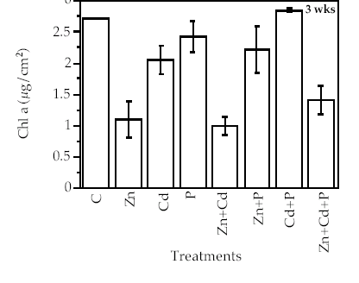
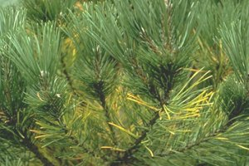
Acute effects in producers
Damage to photosynthetic pigments
cell and plant death
Example:
Effects of metals on chlorophyll-a
content in algae

Slide 30


EFFECTS on DECOMPOSERS
bacteria, microorganisms
Key component for global GEO-BIO-CHEMICAL CYCLES

Slide 31

Specific notes on ecotoxicity to microorganisms
1) Unicellular (or small in general)
large specific surface – easy uptake of chemicals
2) Relativelly good protection (cell wall)
3) Fast division and proliferation
  generally good ADAPTATION of populations
  (antimicrobial resistencies)

Slide 32


Slide 33

Therapeutic antibiotics … and resistance

Slide 34


Spread of ARG
(antibiotic resistence genes)
… also at waste
water treatment plants

Slide 36

WHO Report:
The Review of Antimicrobial Resistance, Chaired by Jim O’Neil, UK, 2014

Slide 37

Total 10 million deaths per year

