Slide 1
SYNTHETIC ROUTE DESIGN AND SELECTION
Petr Beňovský

Slide 2
GENERAL ISSUES
Academia vs. Industry (even more coordinated approach involving large numbers of chemists and supporting personnel towards a common goal);
Moreover, “in the meantime“, under high time pressure and stress, process people need to continually improve their expertise and capability for the effective design of new synthetic routes;
Plan → Do → Audit cycle → → → Select
Understand sources, available time, limitations, priorities, risks, quality, quantity, budget, …

Slide 3
SELECT CRITERIA
S
E
L
E
C
T
Butters, M. et al Chem. Rev. 106, 3002 (2006)

Slide 4
SELECT CRITERIA
Criteria | Subcriteria | Potential Issues
SAFETY | Process, health | Thermal risk, carcinogens, sensitisers
ENVIRONMENTAL | Waste, environmental hazard | Inceneration of solvents, aquatic toxins, ozone depleting chemicals
LEGAL | Intellectual property | Indication, compound protection, process
ECONOMICS | Cost of goods, production cost, concentration | Length of the synthesis, cost of operations
CONTROL | Control of quality parameters, P-CH parameters | Meeting specifications, GMP requirements
THROUGHPUT | Time scale of manufacture | Continuity of steps, operations, transfer, availability of chemicals
S
E
L
E
C
T
Butters, M. et al Chem. Rev. 106, 3002 (2006)

Slide 5
SELECT CRITERIA
S A F E T Y
E
L
E
C
T

Slide 6
SELECT CRITERIA
S
E N V I R O N M E N T A L
L
E
C
T
Very difficult to develop totally sustainable process with a low environmental impact
Always depends on the production volume and particular hazard

Slide 7
SELECT CRITERIA
S
E
L E G A L
E
C
T
In civilized countries the development and commercialisation of API must be performed without breaking laws or infringing valid intellectual property;
Legal issues can arise any time and patent litigations are pretty common;
Regulated or banned substances
Using unacceptable quantities
Transportation of hazardous materials
Materials with third-party restrictions
Patent infrigment

Slide 8
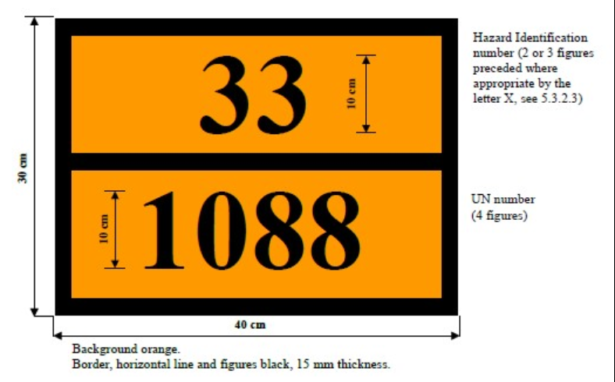
SELECT CRITERIA
S
E
L E G A L
E
C
T
ADR

Slide 9
SELECT CRITERIA
S
E
L E G A L
E
C
T

Slide 10
SELECT CRITERIA
S
E
L
E C O N O M I C S
C
T
The key factors determining the economic viability:
Cost of goods (CoG)
Price of the product
Marketing costs
Product and/or technology licensing
Investment
CoG – the total cost involved in manufacture of a drug product (API manufacturing, formulation, packaging) expressed as a percentage of the selling price of the drug

Slide 11
SELECT CRITERIA
S
E
L
E
C O N T R O L
T
Compliance with valid guidelines of authorities for particular region (FDA, EMEA, ASEAN, ICH)
Specification that defines the acceptable quality – a must for the registration process;
Impurities – known, unknown
Mutagenic impurities – ICH M7 guideline
Solvates, stability (DVS, TGA)
Stability tests, enforced degradation studies
Polymorphism, Heavy metals
DoE, QbD, PAT

Slide 12
SELECT CRITERIA
S
E
L
E
C
T H R O U G H P U T
The amount of material that can be manufactured in unit time;
Usually identified in the late stage of development for already established procedure;
Chemical yield
Number, capacity and availability of vessels
Reaction, work-up time
Limiting concentration
Number of steps
Convergency
Usage of special equipment

Slide 13
SELECT CRITERIA
S
E
L
E
C
T H R O U G H P U T
Chemical yield often can be improved through a deeper undestanding of kinetics and mechanism;
Reducing the number or the length of the most time consuming operations will improve throughput – telescoping;
Poor solubility could be a problem;
Protecting – deprotecting sequences;

Slide 14
SELECT CRITERIA - THROUGHPUT

Slide 15
SELECT CRITERIA - THROUGHPUT

Slide 16
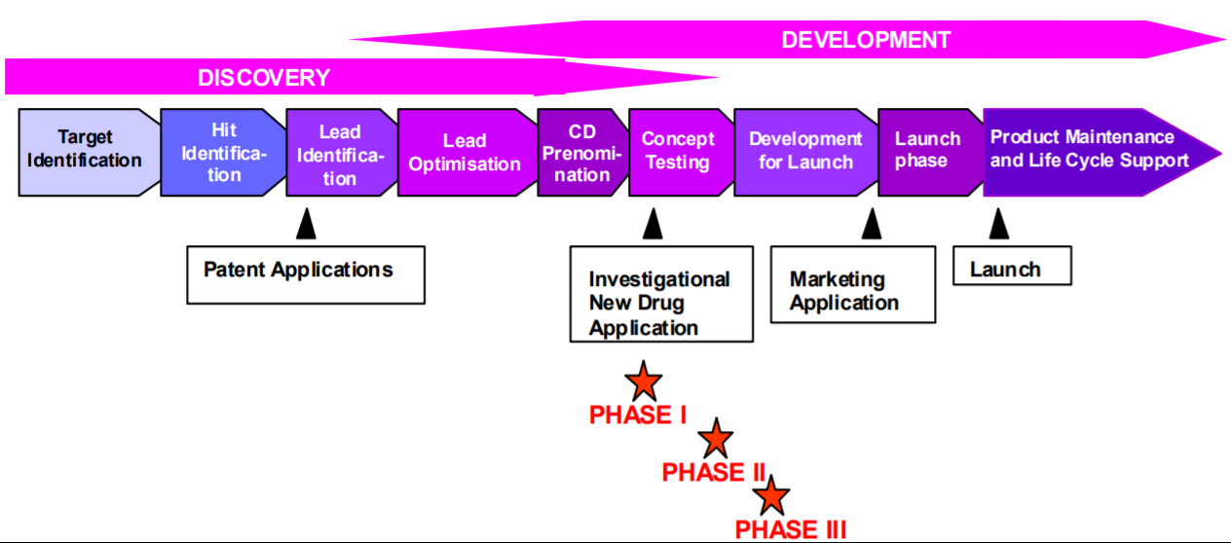
DEVELOPMENT PHASES

Slide 17
CLINICAL PHASES
Phase 1 – safety screening (20-80 healthy volunteers) – safe dosing is determined and possible side effects identified;
Phase 2 – testing protocol is formulated (100-300 patients) – efficacy determination and further details about safety ;
Phase 3 – Final testing (1000-3000 patients) – desired effect confirmed, monitoring of side effects, comparison with known similar drugs; after successful completion of this phase a drug is usually approved and registered.
Phase 4 – Following studies after approval – gathering further pieces of information about risks, advantages and optimal dosing

Slide 18
A PRACTICAL SYNTHESIS OF IFETROBAN SODIUM
Bristol-Myers Squibb
Highly selective thromboxane A2 receptor antagonist (antithrombotic and anti-ischemic properties)
Mueller, R.H. Process Chemistry in the Pharmaceutical Industry, p.37, Marcel Dekker Inc. 1999, ISBN 0-8247-1981-6

Slide 19
A PRACTICAL SYNTHESIS OF IFETROBAN SODIUM
Potential new drug candidates:

Slide 20
A PRACTICAL SYNTHESIS OF IFETROBAN SODIUM

Slide 21
A PRACTICAL SYNTHESIS OF IFETROBAN SODIUM
Large supply of the product made in Kilo Lab, but at the same time first candidate SQ-28668 failed in the clinical studies;
Next drug candidate was chosen (SQ-30741) – but exhibited extensive first-pass metabolism in clinic and further work was halted;
17 kg of the product still remained unutilized;
Finally, BMS-180291 selected as promising drug candidate (the product proved very useful for the start in Kilo Lab campaign).

Slide 22
A PRACTICAL SYNTHESIS OF IFETROBAN SODIUM

Slide 24
A PRACTICAL SYNTHESIS OF IFETROBAN SODIUM
SUMMARY (so far):
23 steps, synthesis is convergent but the longest linear sequence consists of 16 steps;
Overall yield < 3%
10 steps involve oxidation stage adjustment
Resolution process
BMS-18029 seemed to be promising drug candidate in preliminary tests
„Quick-fixes“ in original route to get more material (20 kg by a combination of Kilo Lab and Pilot Plant efforts);
In the meantime Process Research activities started to identify a better route

Slide 25
A PRACTICAL SYNTHESIS OF IFETROBAN SODIUM
Model alternative Diels-Alder approach:
Would require synthetic approach to starting propargylic derivative

Slide 26
A PRACTICAL SYNTHESIS OF IFETROBAN SODIUM
Stereoselective approaches (to avoid resolution):

Slide 27
A PRACTICAL SYNTHESIS OF IFETROBAN SODIUM
More efficient than the original synthetic pathway;
Safety concerns;
The yield in the Grignard to lactone conversion was lower than practical

Slide 28
A PRACTICAL SYNTHESIS OF IFETROBAN SODIUM
With S-valinol or S-phenylglycinol auxiliaries 65% yield; 72% ee;
Relatively inexpensive chiral auxiliary S-methylbenzylamine provided selectivity 94 : 6 (>99 : 1 after crystallization) in 89% yield.
Serine derived chiral auxiliaries gave lower yields and stereoselectivity.

Slide 29
A PRACTICAL SYNTHESIS OF IFETROBAN SODIUM
Improved efficiency:

Slide 30
A PRACTICAL SYNTHESIS OF IFETROBAN SODIUM
Still improving efficiency:

Slide 31
A PRACTICAL SYNTHESIS OF IFETROBAN SODIUM
SUMMARY:
12 convergent steps; 3 oxidation-reduction reactions left from 10;
83 researchers.
Overall yield 28%;

