Slide 1
NMR-based Structural Biology for Studying Biomolecular Interactions
Karel Kubíček

Slide 2
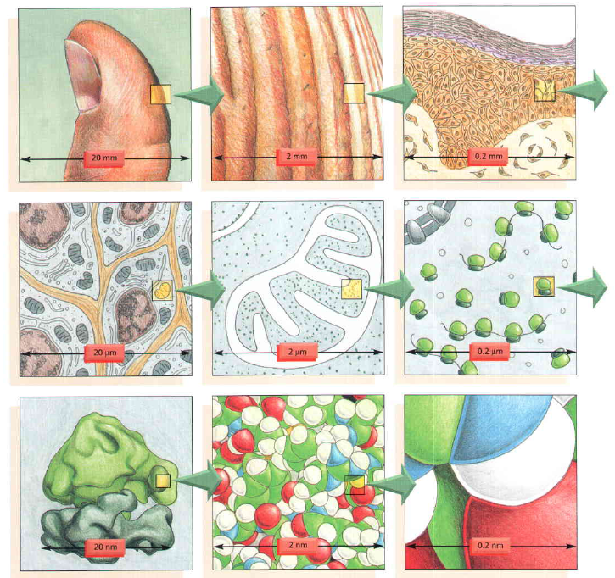

Slide 3
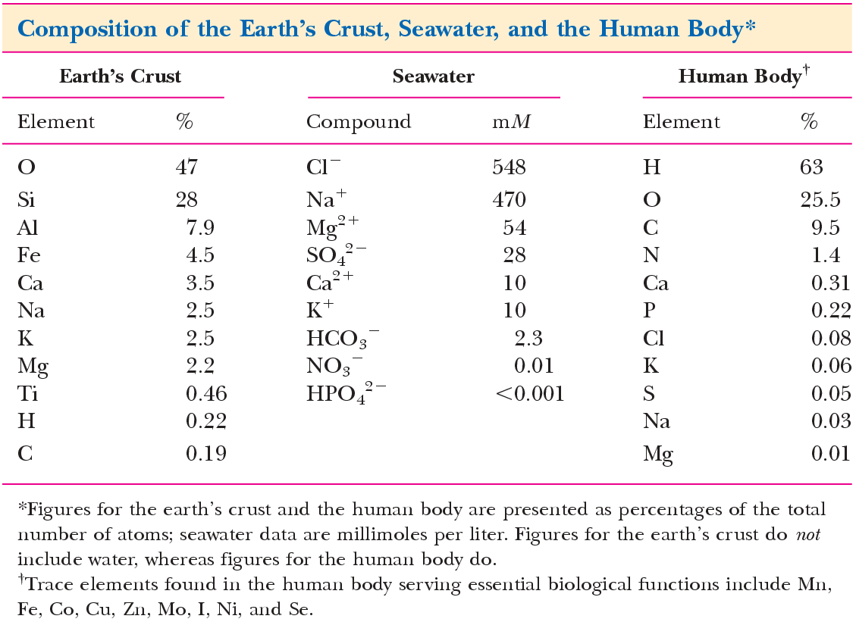

Slide 4
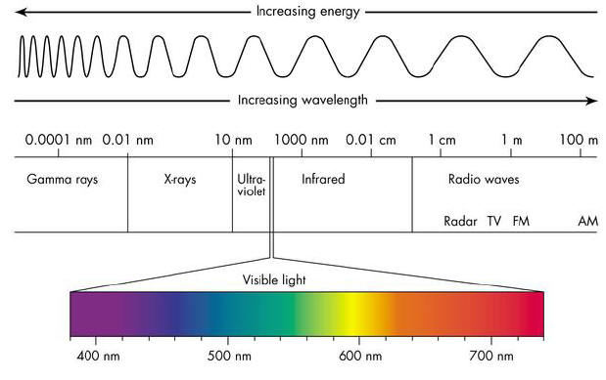
NMR

Slide 5
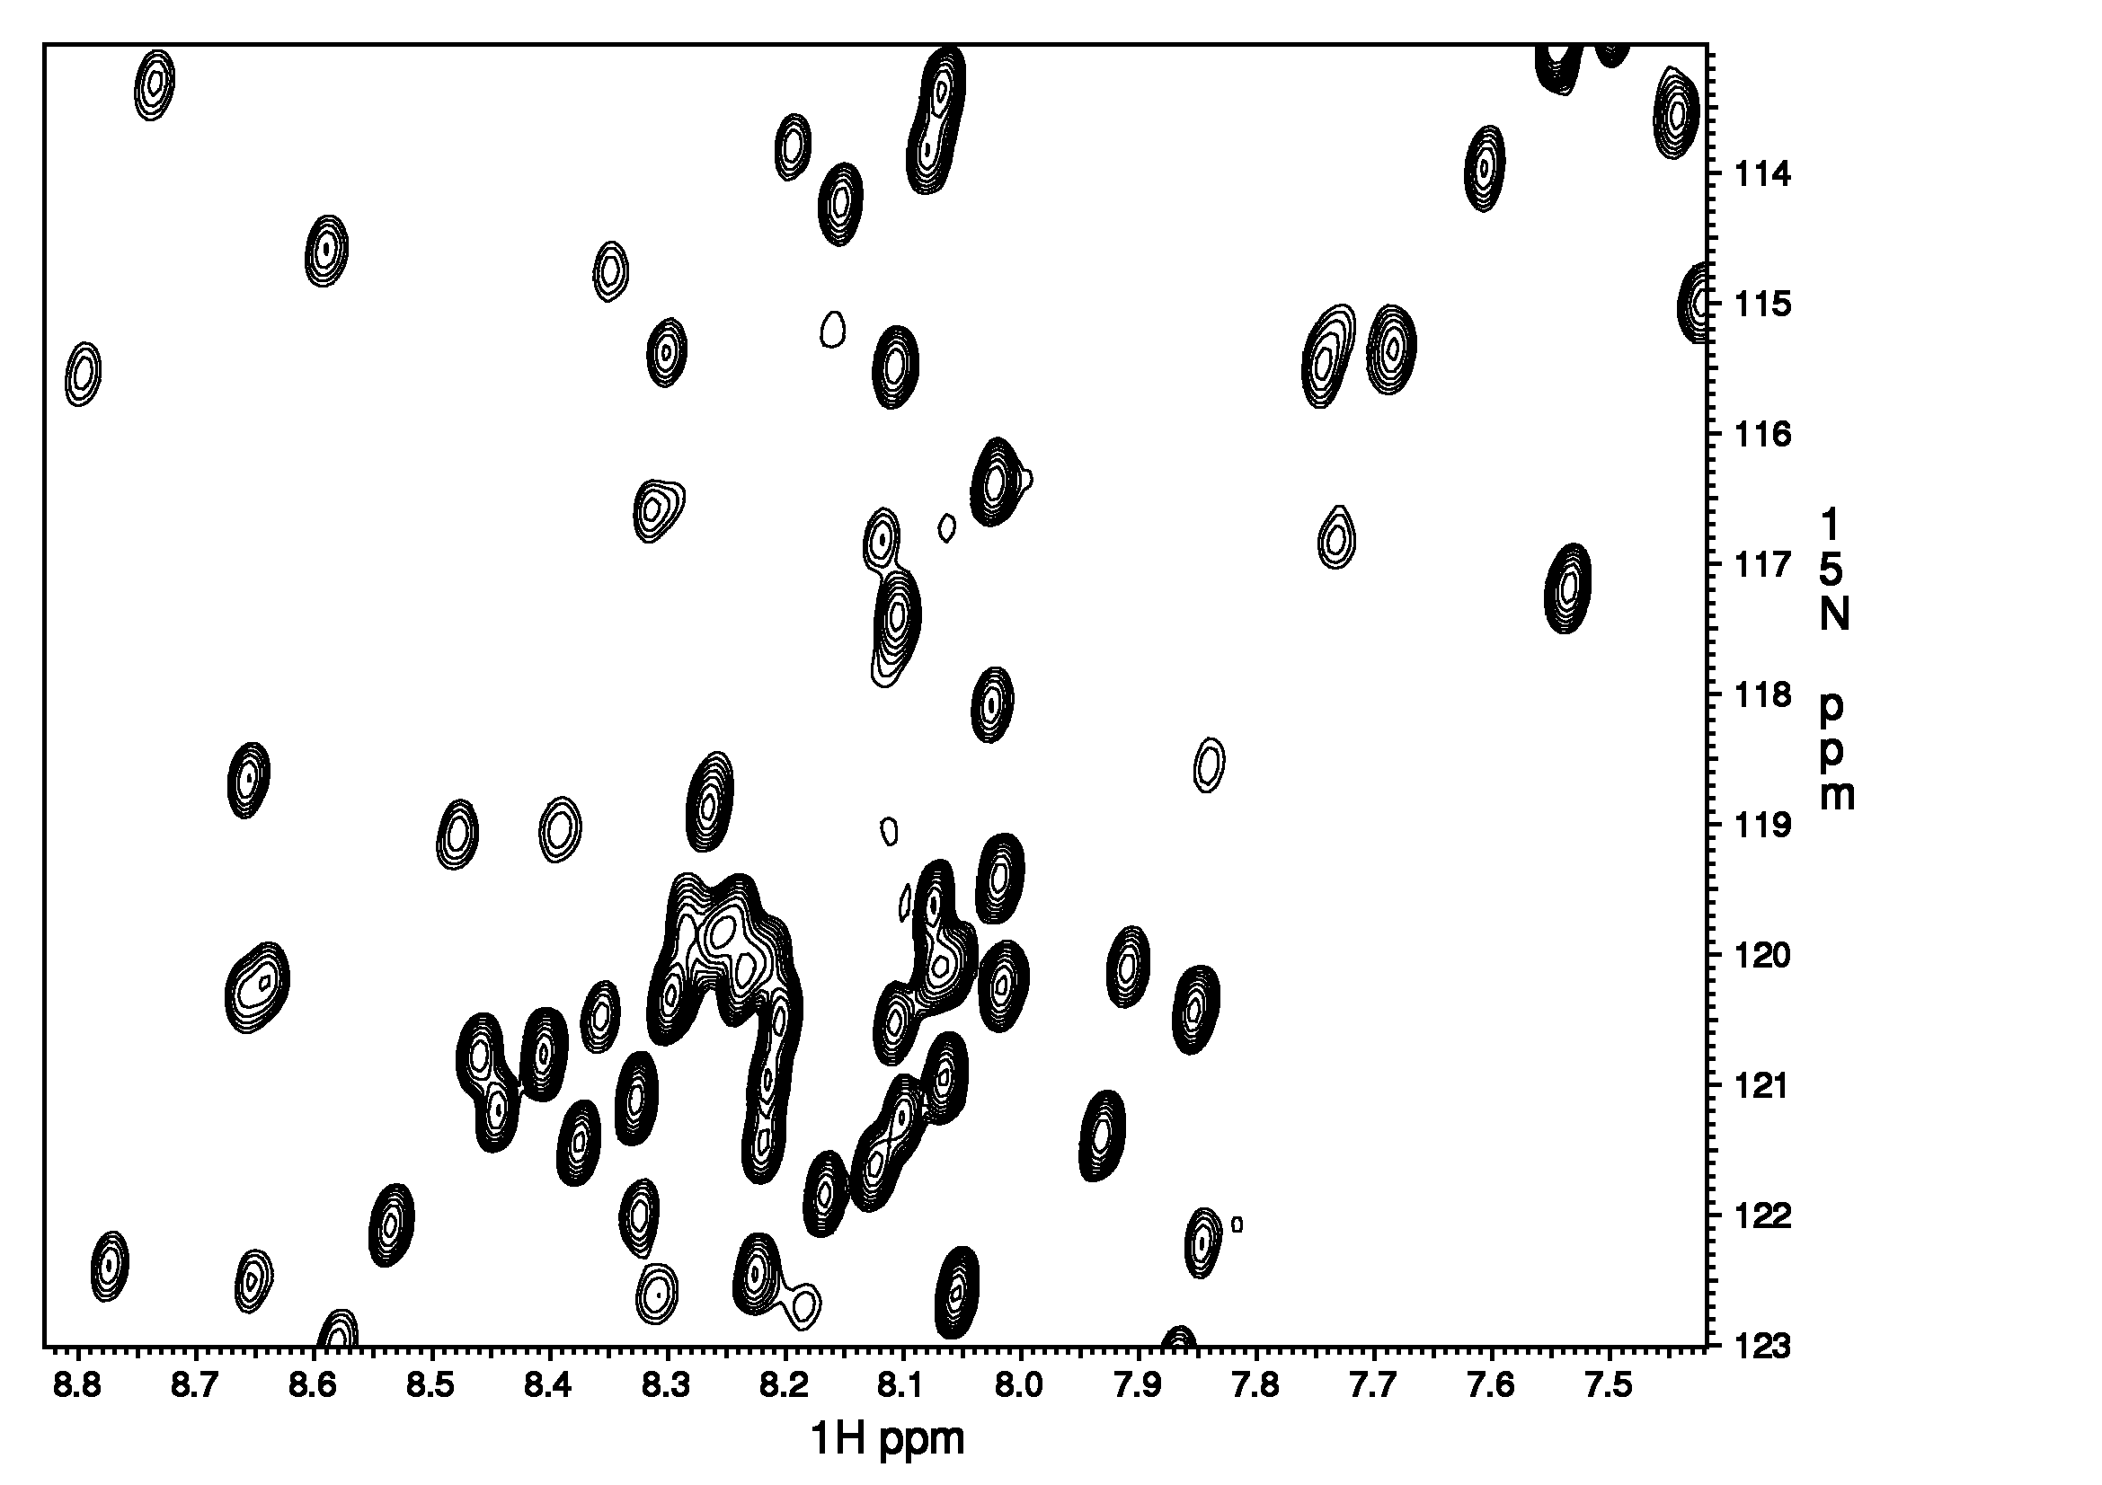
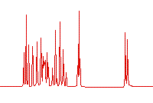
200-500 μl of
100-1000 μM compound
Method of choice
Data to be analyzed
Results
Structure
Relaxation properties
Interaction at atomic level resolution
Analysis
Image
sample
spectrum
NMR

Slide 6
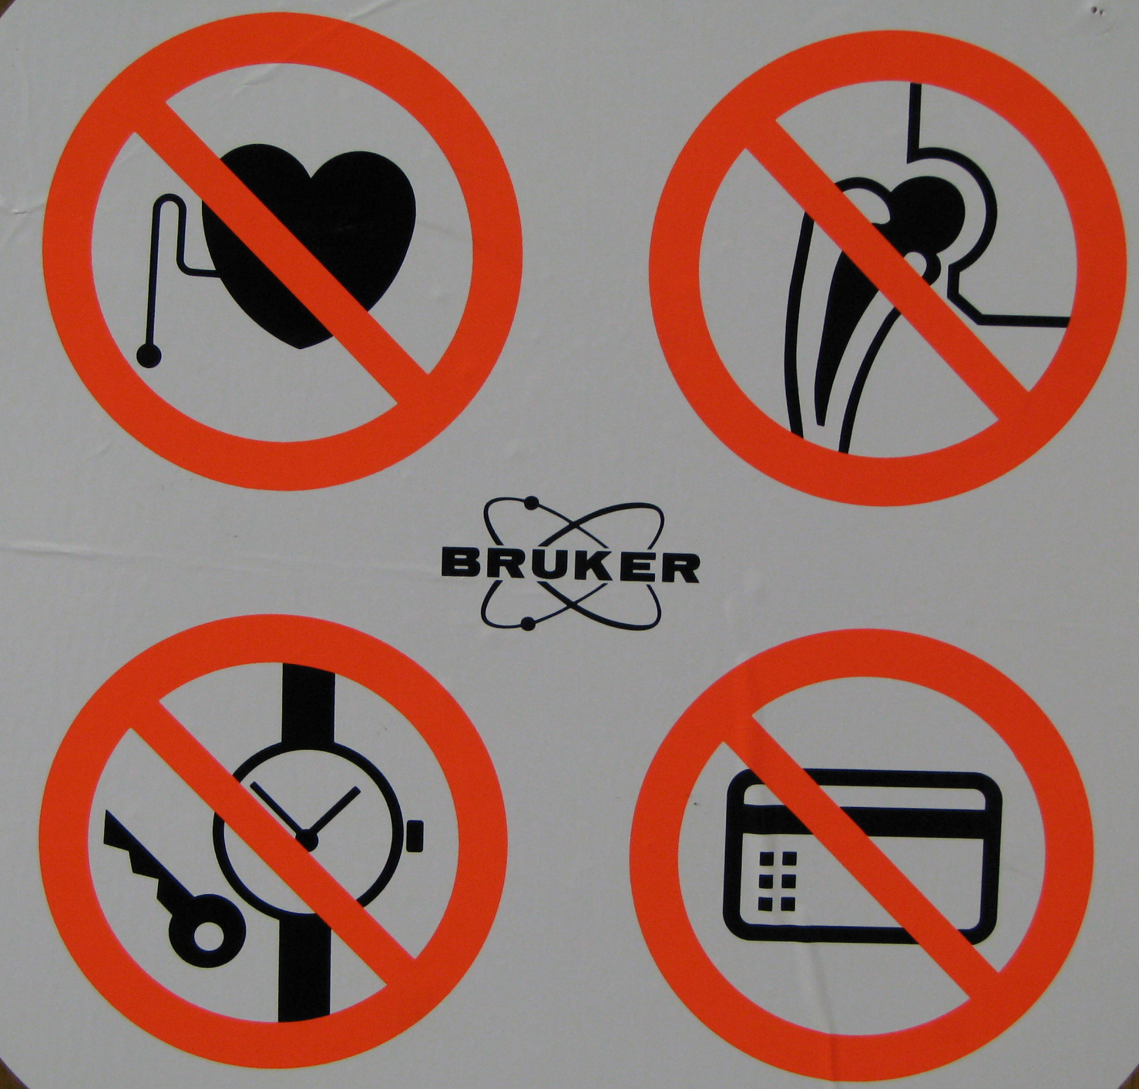
NMR hardware
Magnet
Spectrometer
Control units

Slide 7
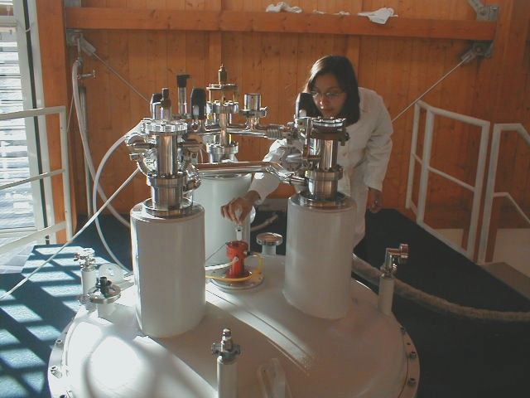
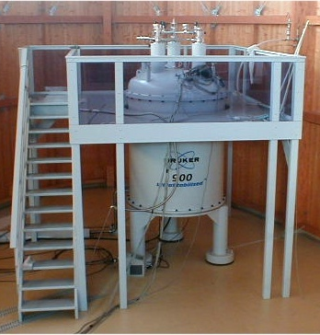
NMR spectrometer
Earth’s Magnetic Field
~ 50μT

Slide 8
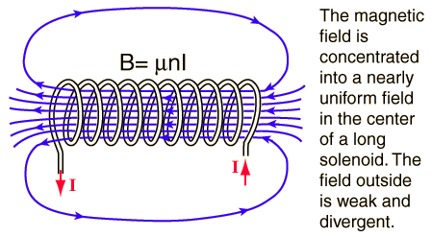
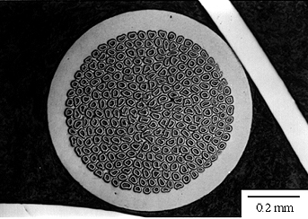
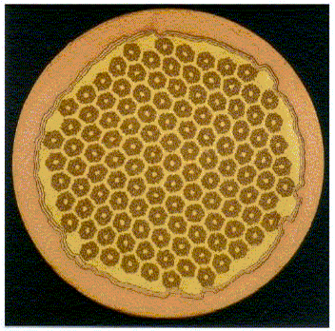
Ampere’s law & solenoid
Magnet
superconducting solenoids immersed into He bath
He-bath ~4 K further improved to ~2.1 K with J-T pump
field strength 25-28 Tesla
(Nb, Ta)₃Sn superconductor of 0.81 mm with ~271 filaments
buried in OFHC copper matrix

Slide 9
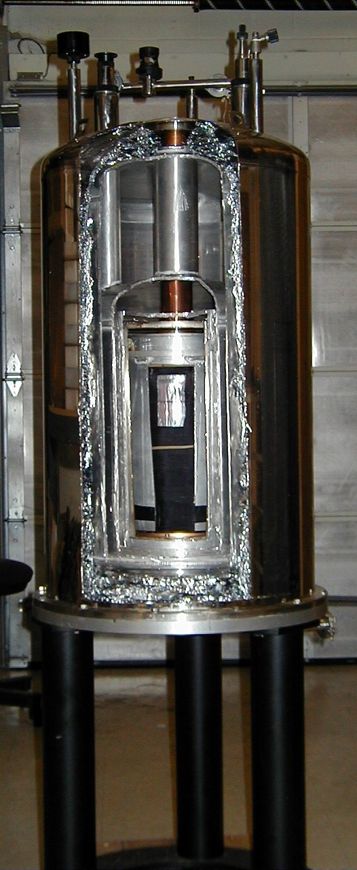
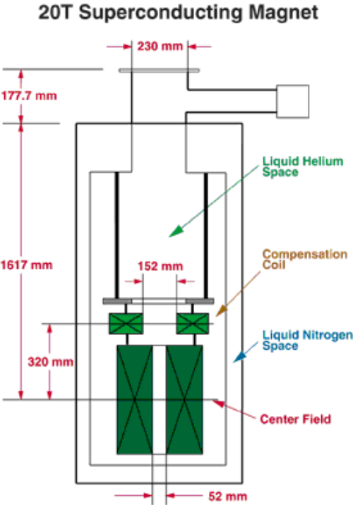

Slide 10
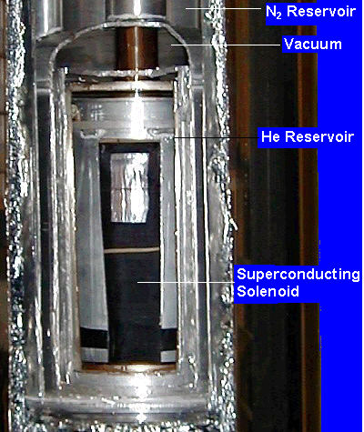
Bore cca 55 mm
N₂-refill
He-refill

Slide 11
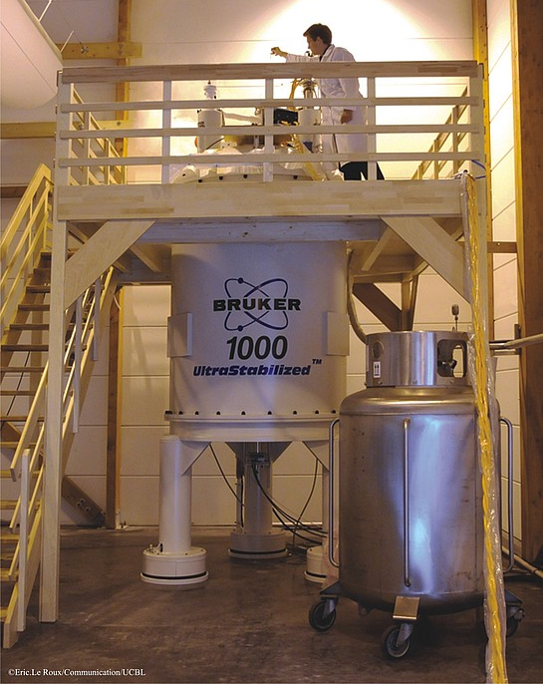
Improvement of sensitivity, resolution and signal-to-noise ratio
Of NMR magnets
decoupling
TROSY
1000
DNP in high
fields
750
600
decoupling
500
Spectrometer Frequency [Hz]
FT and nD
360
220
60
J. Emsley &
R. Feeney,
Progr.. NMR
Spectroscopy 1995, 28, 1
1945
1961
‘65
‘68
1973
1979
1987
‘92
‘97
2000
‘10
Time [year]

Slide 12
Quench
an abnormal termination of magnet operation
Occurs when part of the superconducting coil enters the normal (resistive) state.
This can occur
because the field inside the magnet is too large
the rate of change of field is too large (causing eddy currents and resultant heating in the copper support matrix)
or a combination of the two.
a defect in the magnet can cause a quench.
MOVIE: https://www.youtube.com/watch?v=d-G3Kg-7n_M

Slide 13
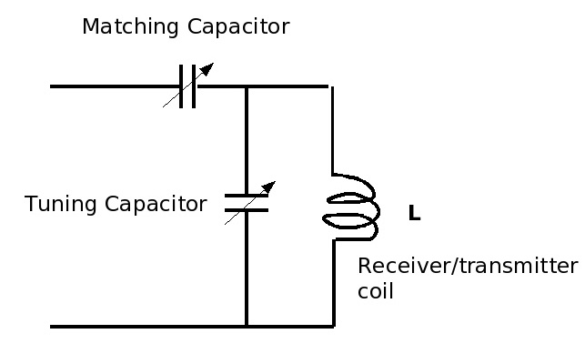
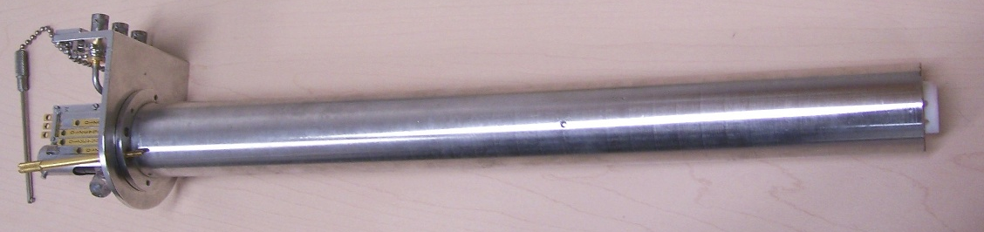
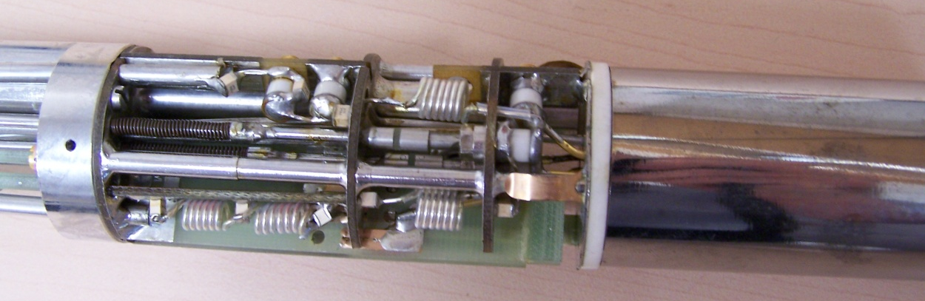
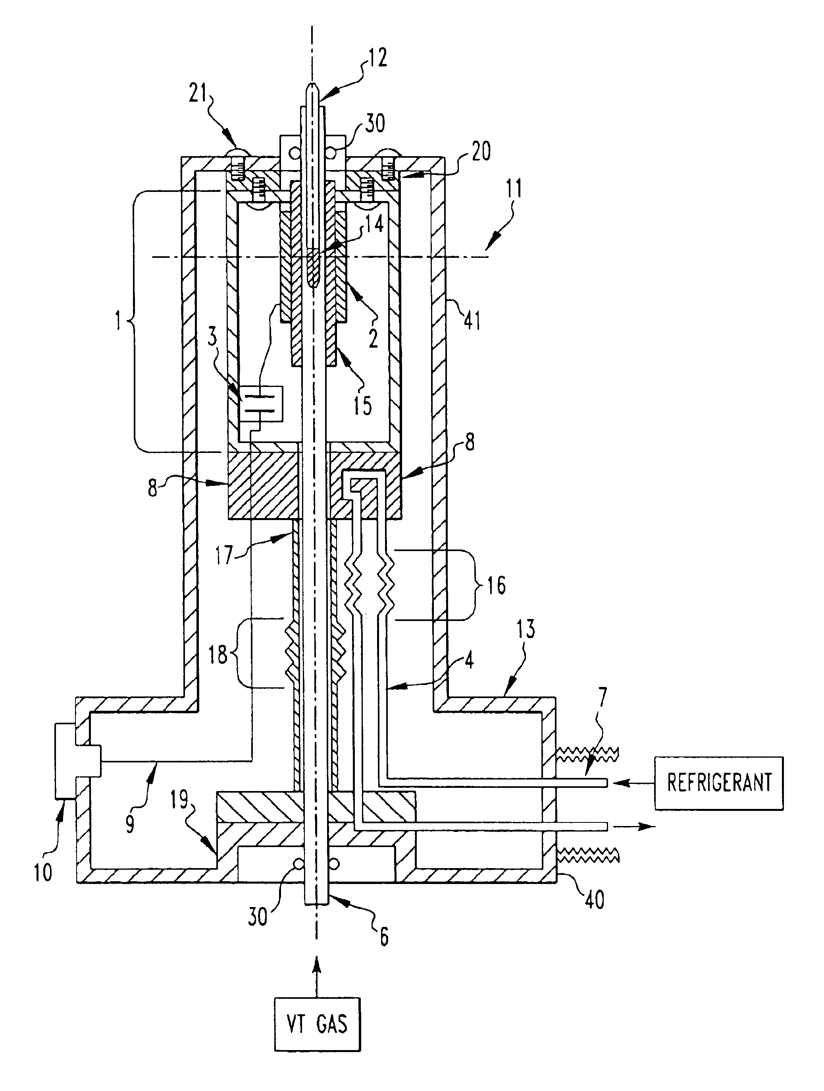
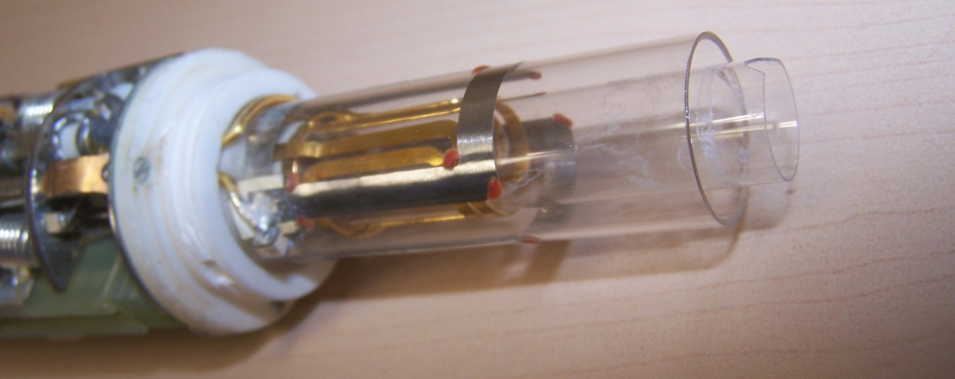
NMR Probe(head)

Slide 14
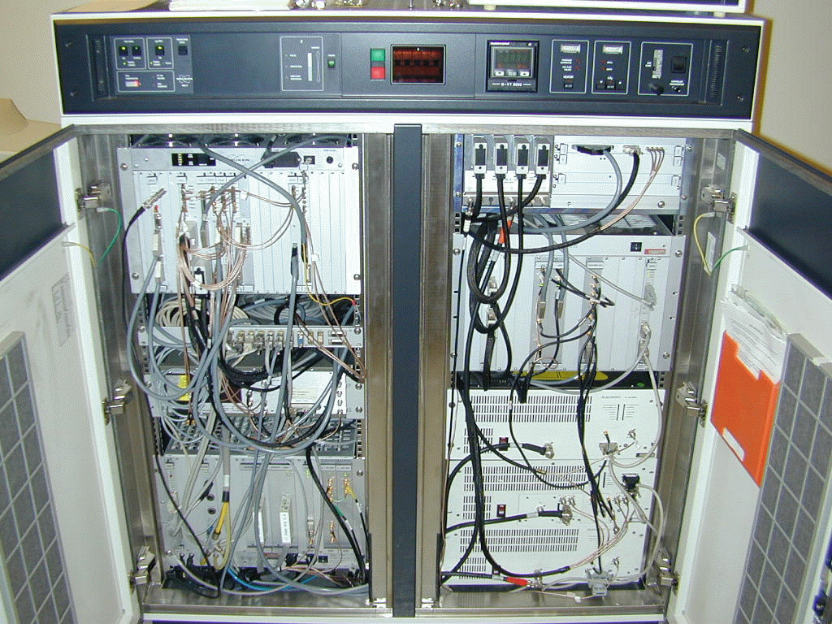
Spectrometer
Temperature Unit
CBU
Control board unit
AcquisitionControler
FGU
Frequency gen. u.
Transmitter
Shimms

Slide 15
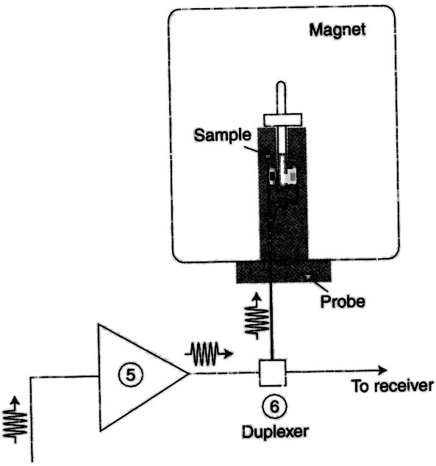
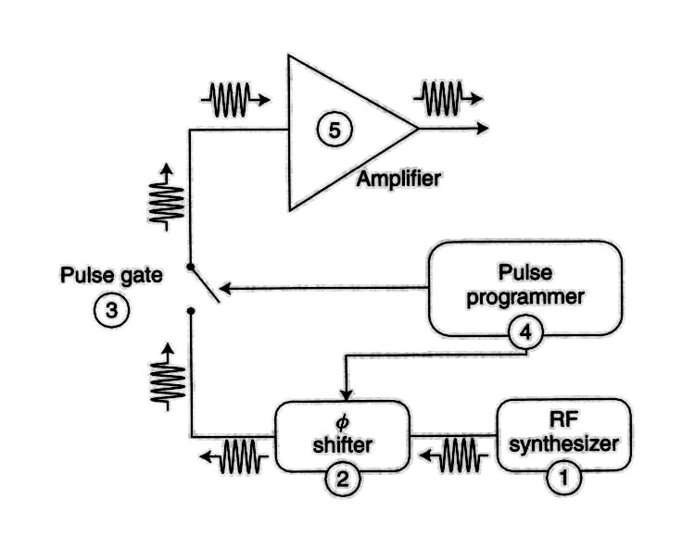
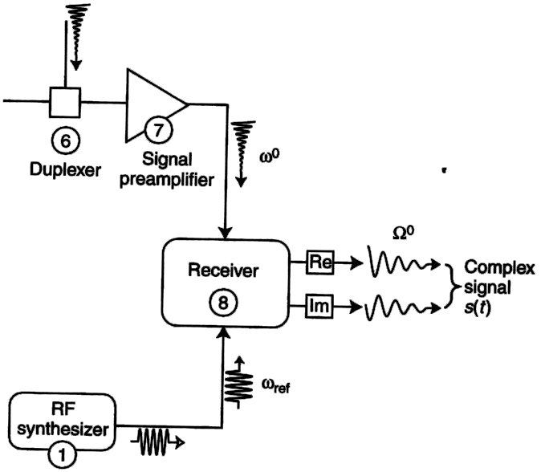
NMR Spectrometer - Overview
Signal - s_{l}(t)=Σ s_{l}(t)
_{l}

Slide 16
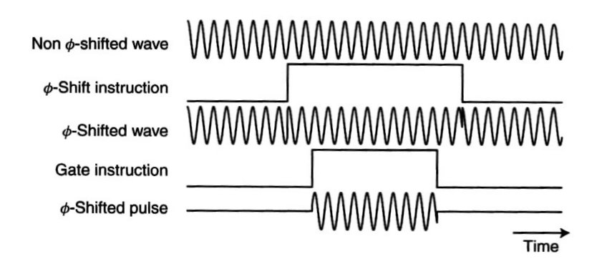
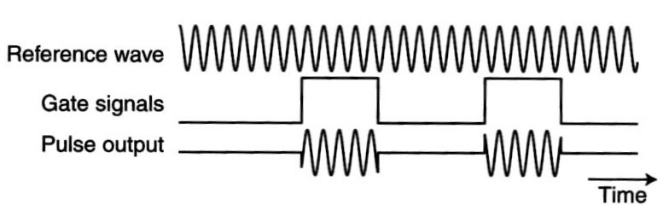
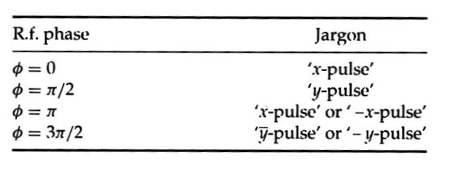
NMR radiofrequency pulse
Pulzy:
tvrdé – 7-30 μs@-3~+3dB
selektivní – ms~s@>30db
adiabatické

Slide 17
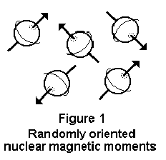
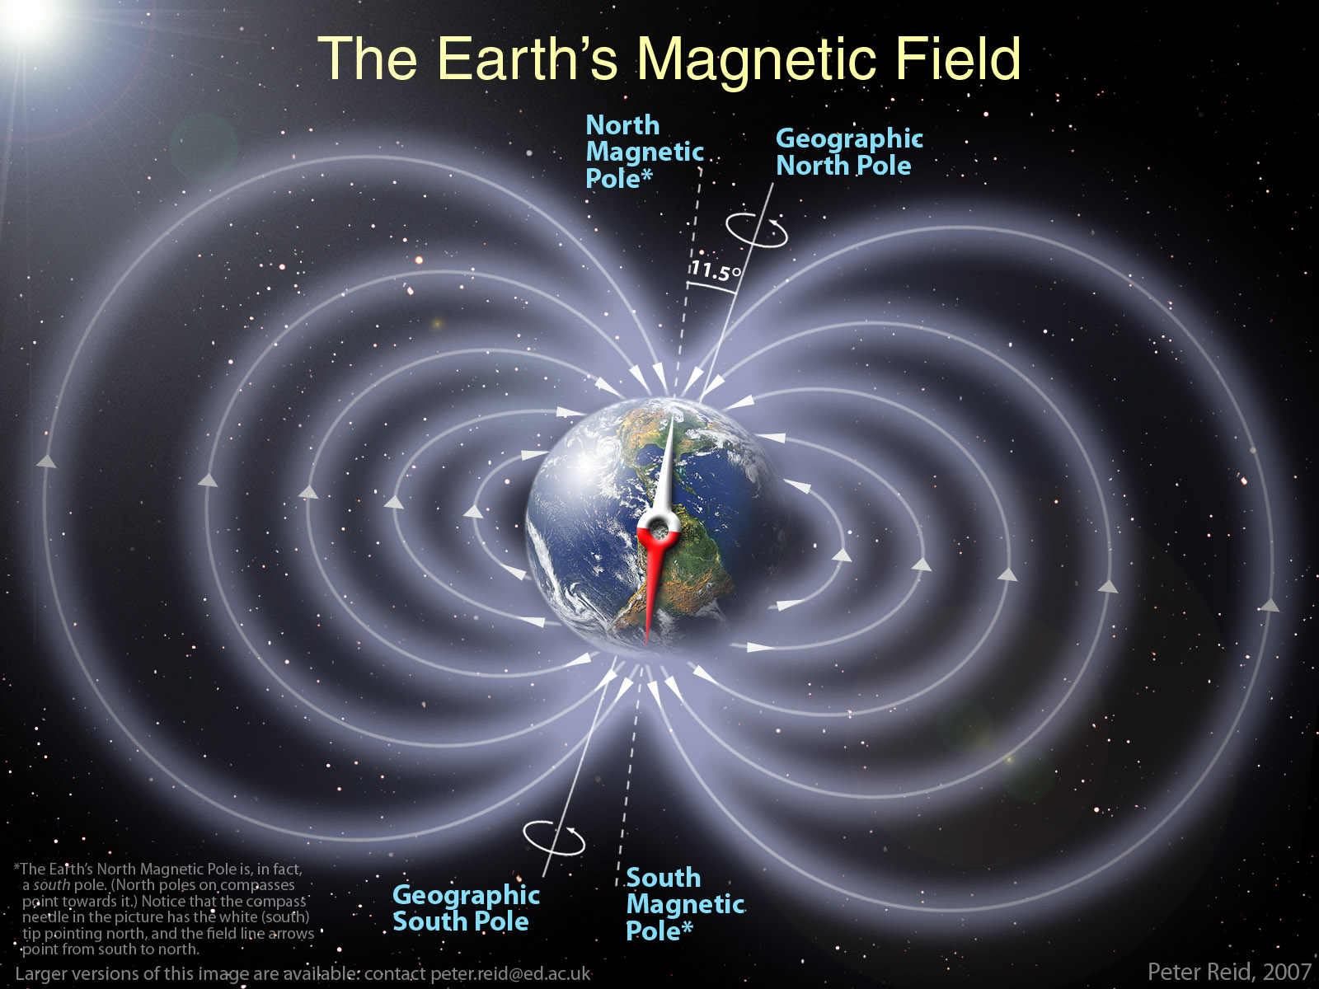
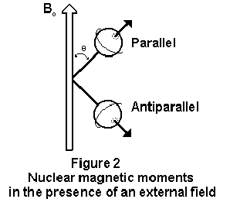
For NMR, nuclear spin is needed!!!
Spin analogy to a compass needle
magnetic field = 0
magnetic field > 0

Slide 18
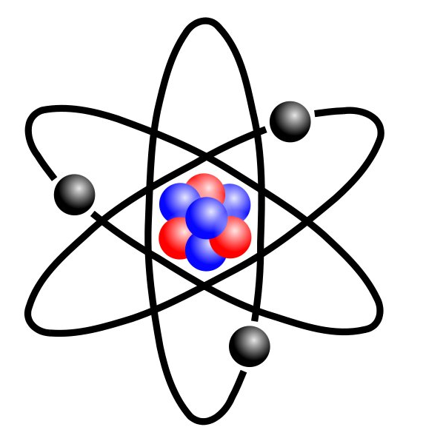
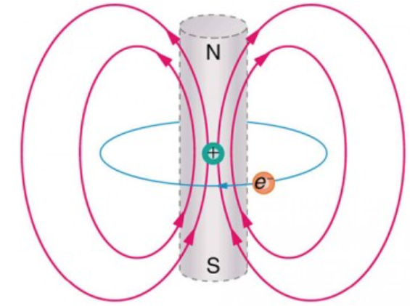
Atom
In the planetary model of the atom, an electron orbits a nucleus, forming a closed-current loop and producing a magnetic field with a north pole and a south pole.
Electron
=
Proton
Neutron
Molecule is hence a group of small magnetic fields and each atom within the molecule experiences different local magnetic field.

Slide 19
NMR - Refresh
nuclear spin ≠ 0 (¹H, ¹³C, ¹⁵N, ³¹P) - number of neutrons and the number of protons both even ⇒ NO nuclear spin - number of neutrons plus the number of protons odd ⇒ half-integer spin (i.e. ½, 3/2, 5/2) - number of neutrons and the number of protons both odd ⇒ integer spin (i.e. 1, 2, 3)
ν=γ*B (1) - when placed in a magnetic field of strength B, a nuclei with a net spin can absorb a photon, of frequency ν. The frequency ν depends on the gyromagnetic ratio, γ of the nuclei
from quantum mechanics we know that nucleus with spin I can have 2I +1 orientations ⇒ nuclei with a spin ½ can have two orientations in an external magnetic field– low / high energy
N
S
E=h ν (2)
N
N
S
S

Slide 20
Nuclear Magnetic Resonance
Refresh
From (1) and (2): E=h γ B
N
S
Energy
S
N
Magnetic Field

Slide 21
N
S
change field
Energy
change frequency
S
N
Magnetic Field
Abs. E.
Magnetic Field

Slide 22
CW vs. Fourier transform NMR
Problem of NMR
the magnitude of the energy changes in NMR spectroscopy small ⇒ sensitivity is a major limitation
Solution I.
increase sensitivity by recording many spectra, and then add them together; because noise is random, it adds as the square root of the number of spectra recorded.
For example, if 100 spectra of a compound were recorded and summed, then the noise would increase by a factor of 10,
but the signal would increase in magnitude by a factor of 100
⇒ large increase in sensitivity.
However, if this is done using a CW-NMR, the time needed to collect the spectra is very large (one scan takes 2 - 8 minutes).

Slide 23
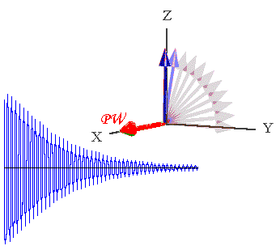
CW vs. Fourier transform NMR
Solution II.
FT-NMR ⇒ all frequencies in a spectrum are irradiated
simultaneously with a radio frequency pulse.
Following the pulse, the nuclei return to thermal equilibrium.
A time domain emission signal is recorded by the instrument as
the nuclei relax.
A frequency domain spectrum is obtained by Fourier transformation.
RF pulse 90°
FT
frequency domain
time domain (FID – free induction decay)

Slide 24
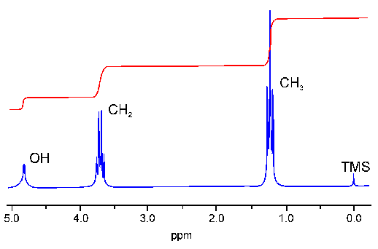
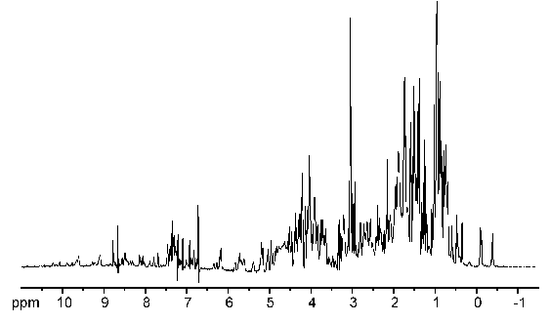
Each proton = 1 NMR signal
EtOH
protein

Slide 25
Each (non-exchangeable) proton = 1 NMR signal
Wε
-NH
-NH/-NH₂/arom
Hα
Hβ
-CH₃
H₂O

Slide 26
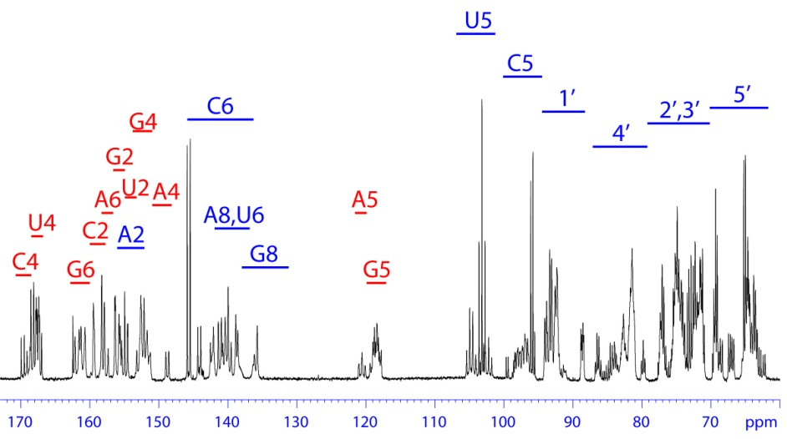
Each (non-exchangeable) proton = 1 NMR signal

Slide 27
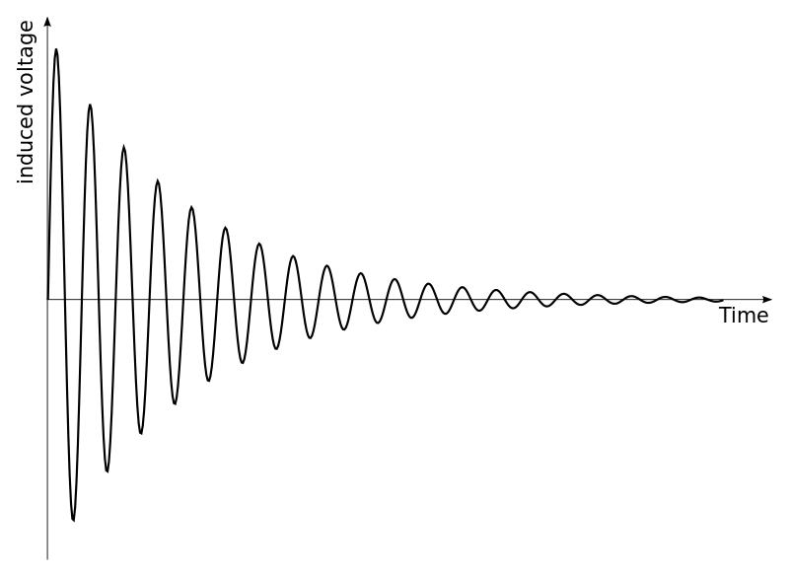


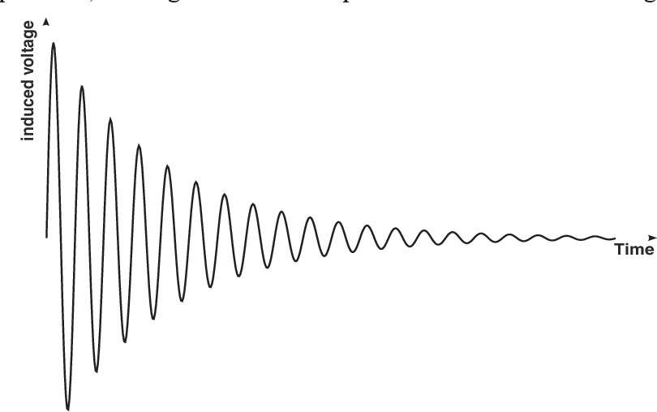

Size Relaxation FID NMR line(width) after FT
slow (i.e. long t₂ time)
medium
fast
Hz
Induced voltage
Time
Hz
Induced voltage
Time
Hz

Slide 28
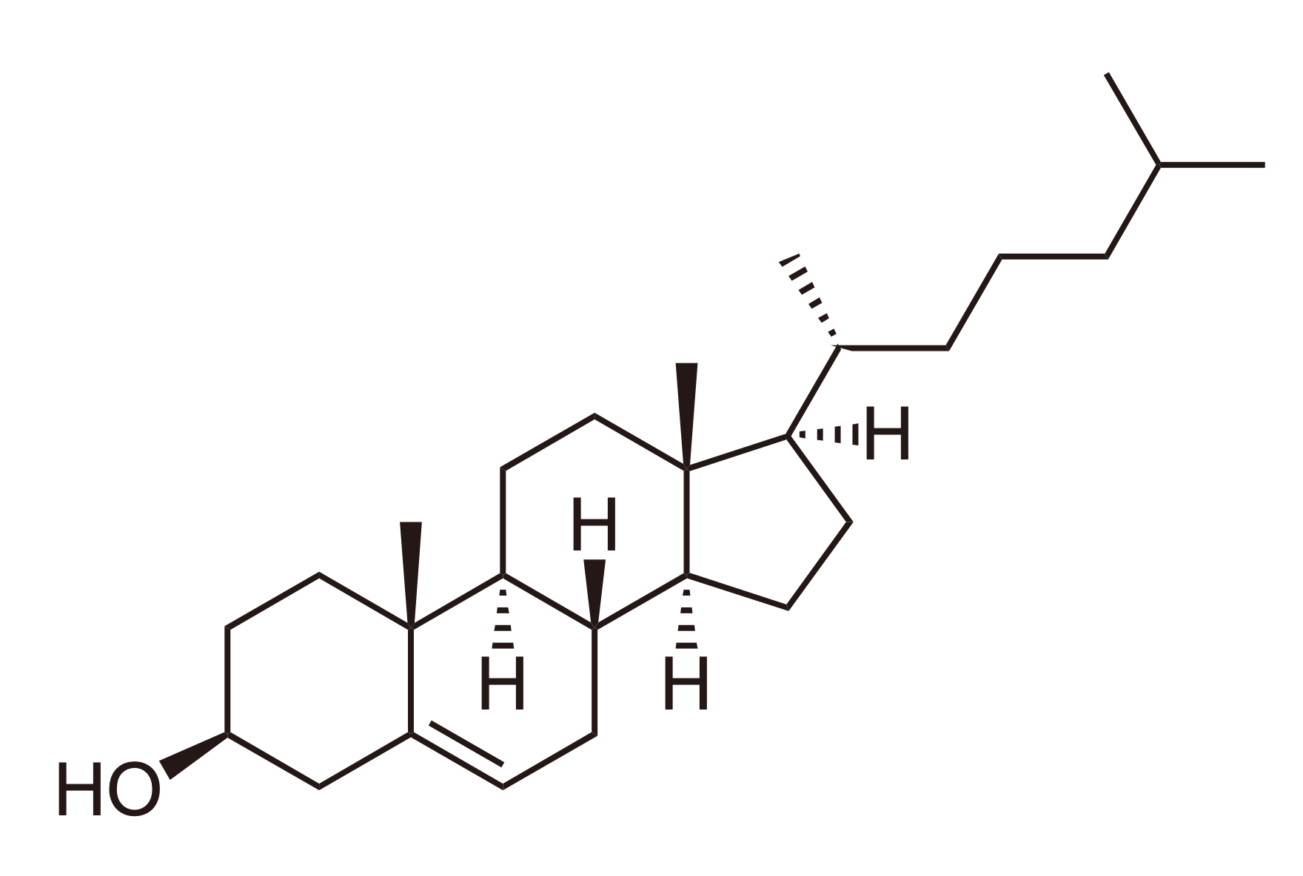
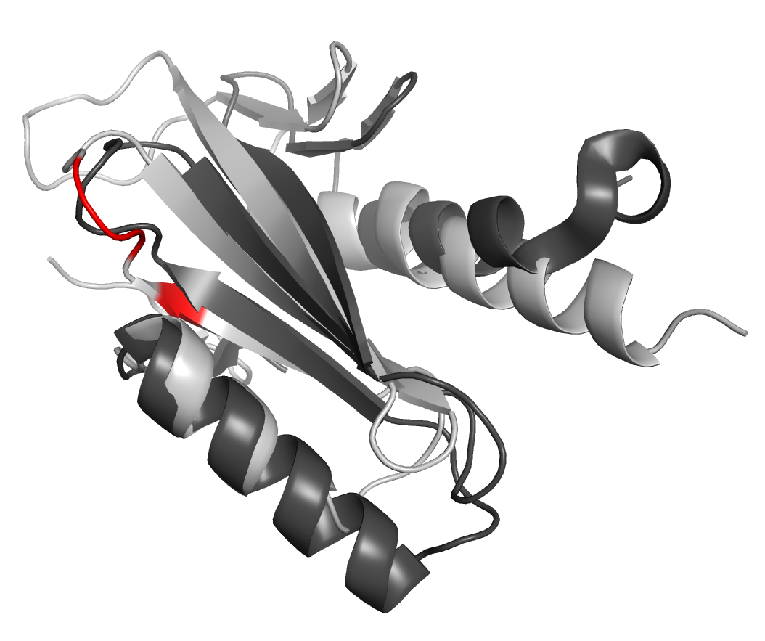
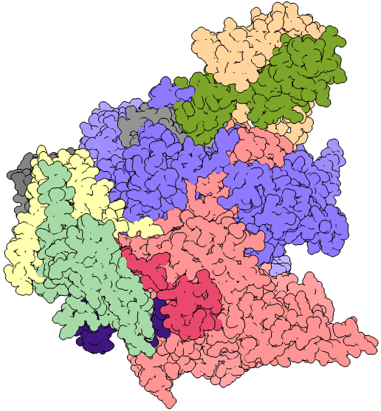
Size Relaxation FID NMR line(width) after FT
slow (i.e. long t₂ time)
medium
fast
e.g. Cholesterol
Hz
Induced voltage
Time
Biomolecules 5-30 kDa
Hz
Induced voltage
Time
Large molecules 50+ kDa
Hz

Slide 29
NMR data processing

Slide 30
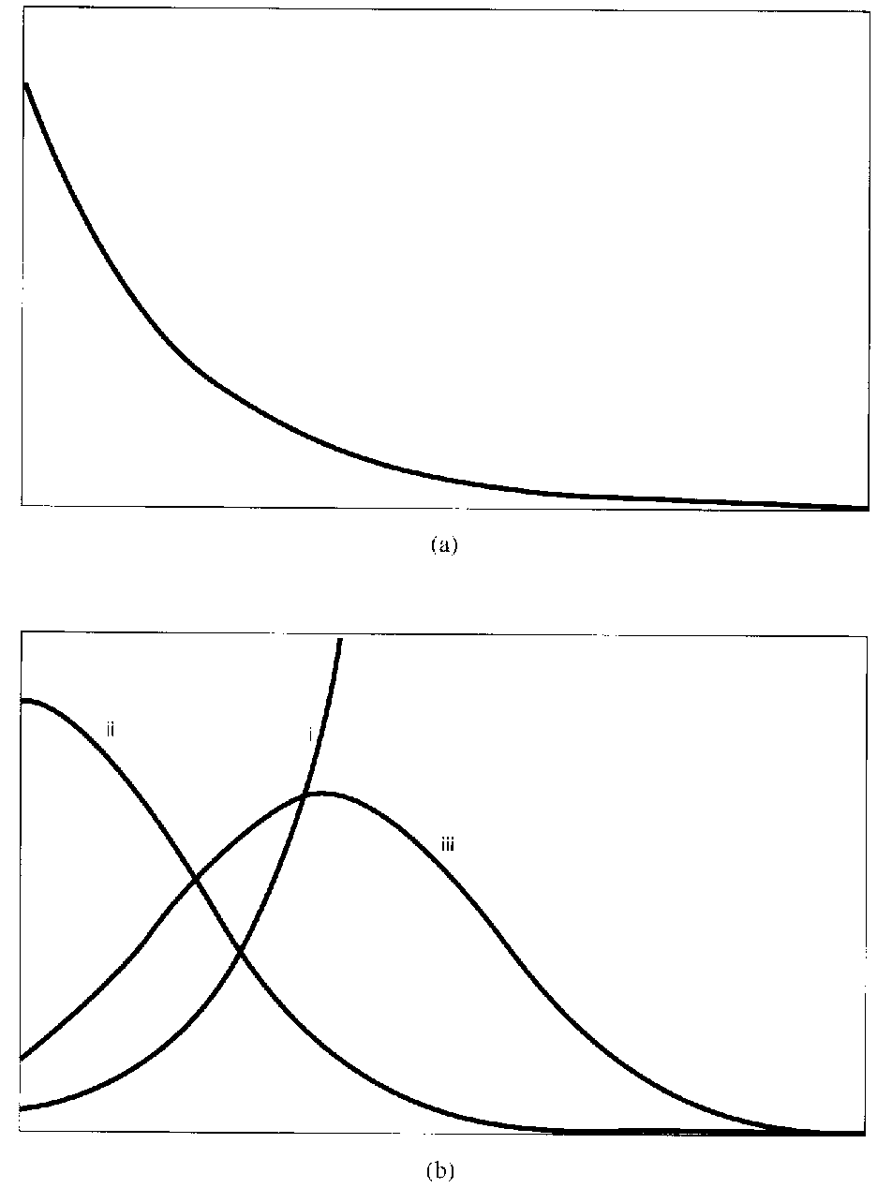
NMR data processing
Window functions:
1) improvements od S/N ratio
2) increasing resolution

Slide 31
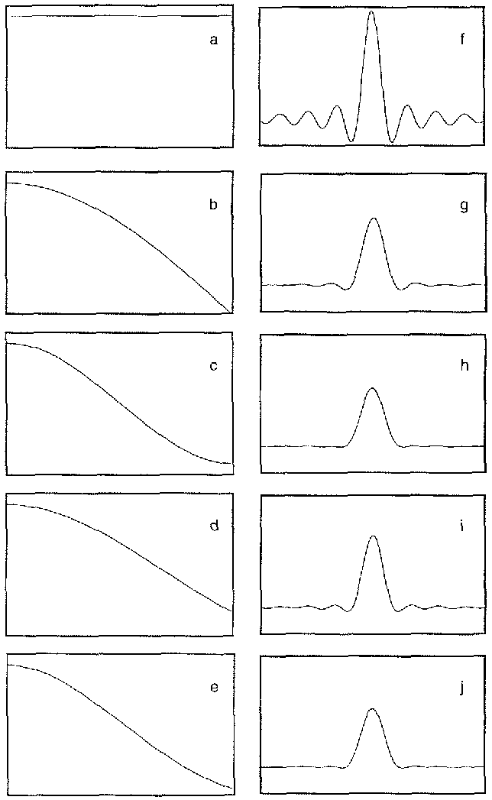
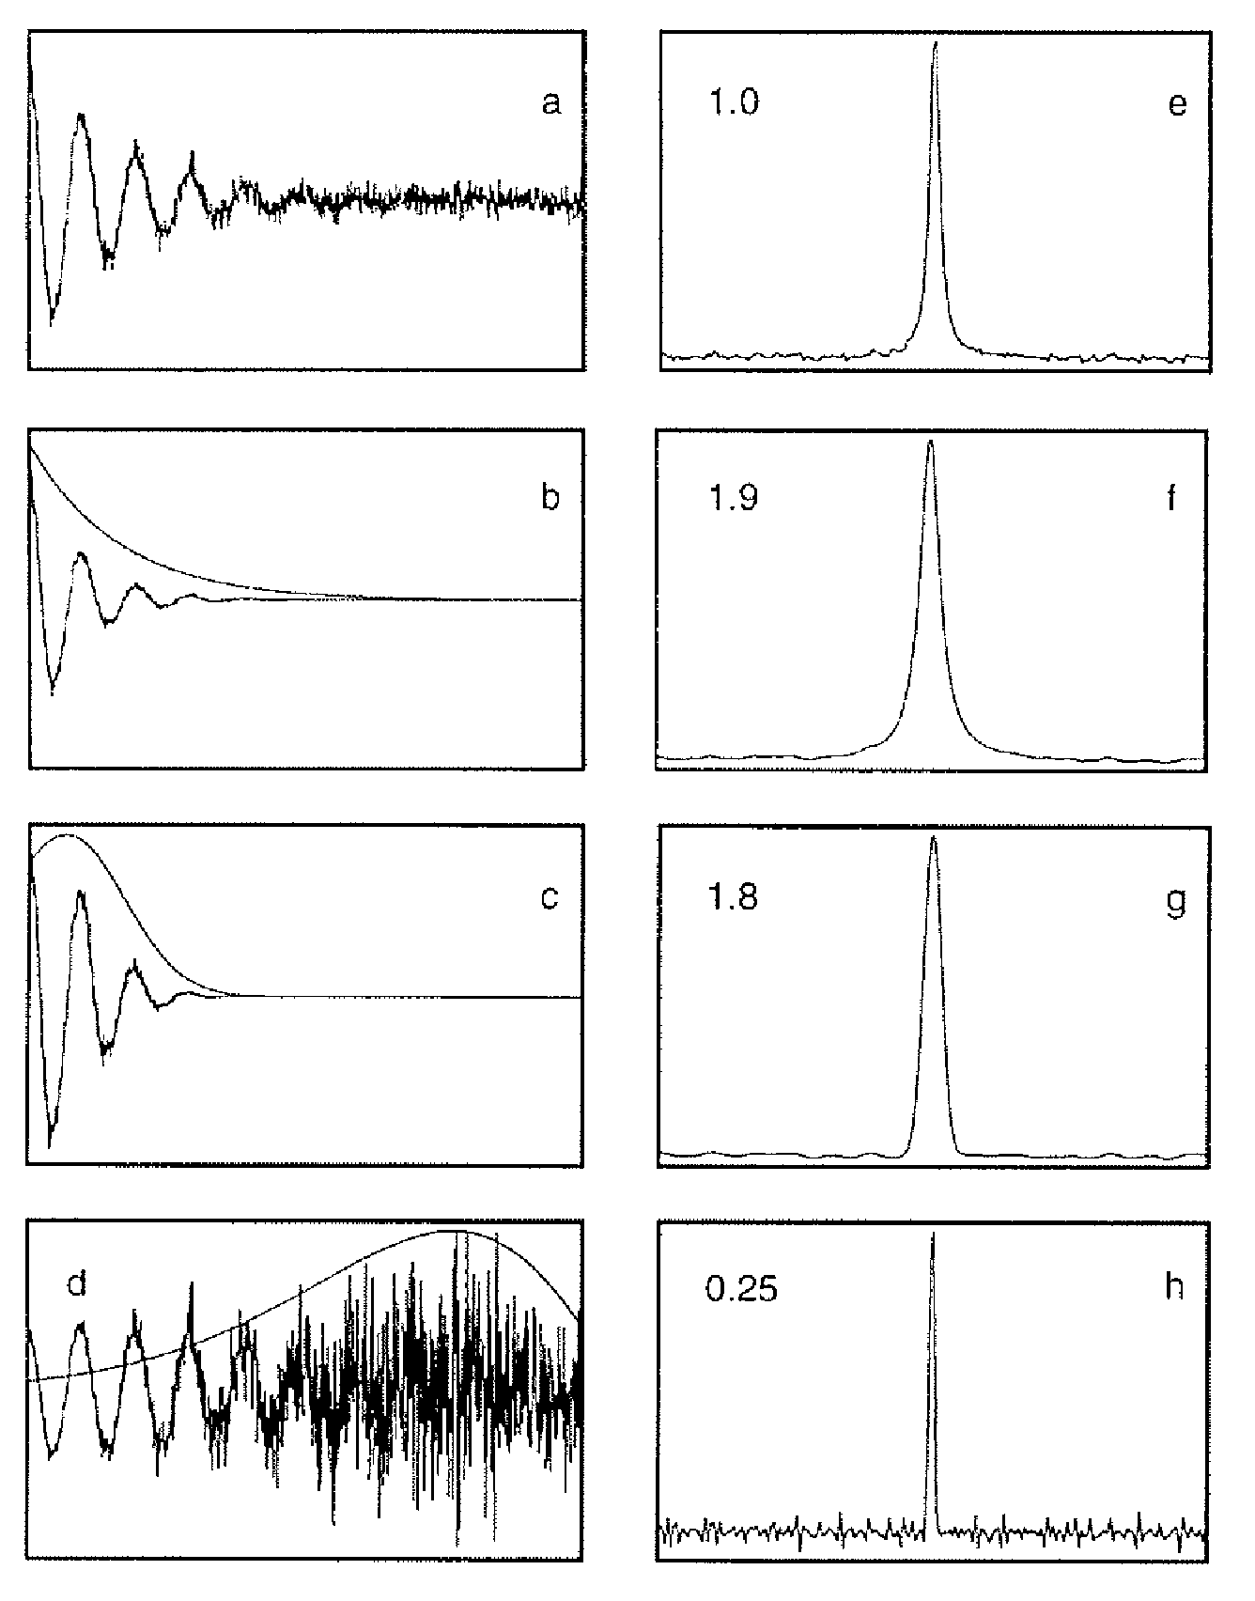
NMR data processing – window functions – apodization
Exp
Lor.-Gauss
Kaiser w. function

Slide 32
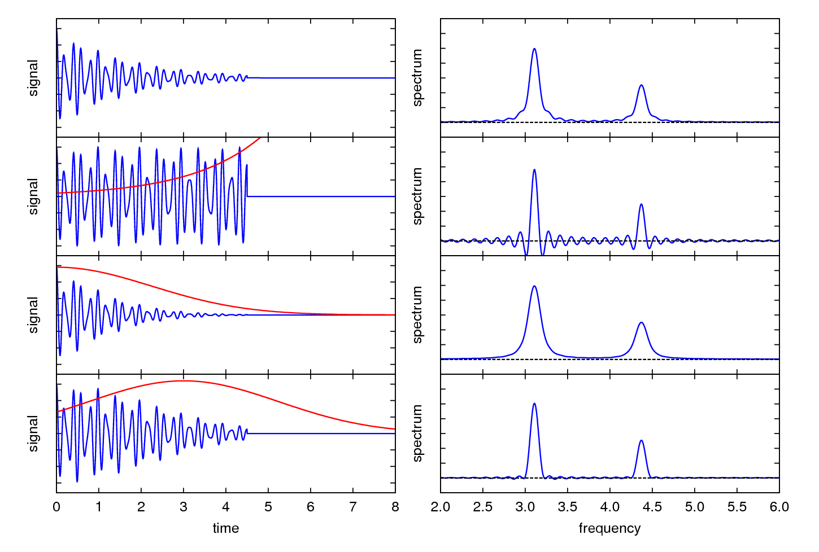

Slide 33
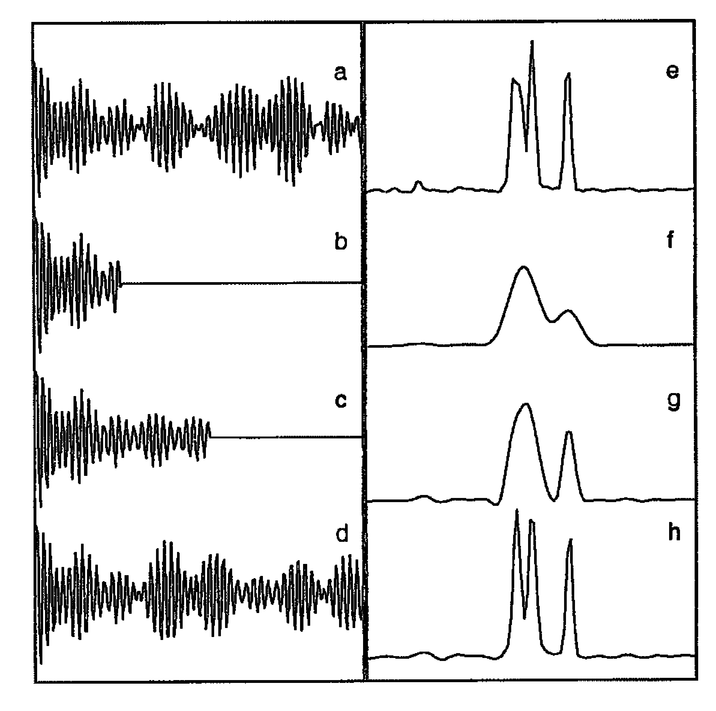
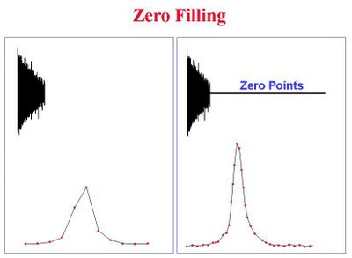
NMR data processing – Zero Filling, Linear prediction
Linear prediction
240 points
Zero filling
64 pts
LP to 128 pts
LP to 240 pts

Slide 34
NMR data processing - summary
Solvent suppression
Window function
Zero-filling
FT
Transpose (in case of multidimensional spectra)
|nmrPipe -fn POLY -time \
|nmrPipe -fn SP -off 0.33 -end 0.98 -pow 2 -c 1.0 \
|nmrPipe -fn ZF -size 2048 \
|nmrPipe -fn FT -auto \
|nmrPipe -fn PS -p0 -76.0 -p1 0.0 -di \
|nmrPipe -fn EXT -x1 11.0ppm -xn 6.0ppm -sw \
|nmrPipe -fn POLY -ord 3 -auto \
|nmrPipe -fn TP \
F2

Slide 35
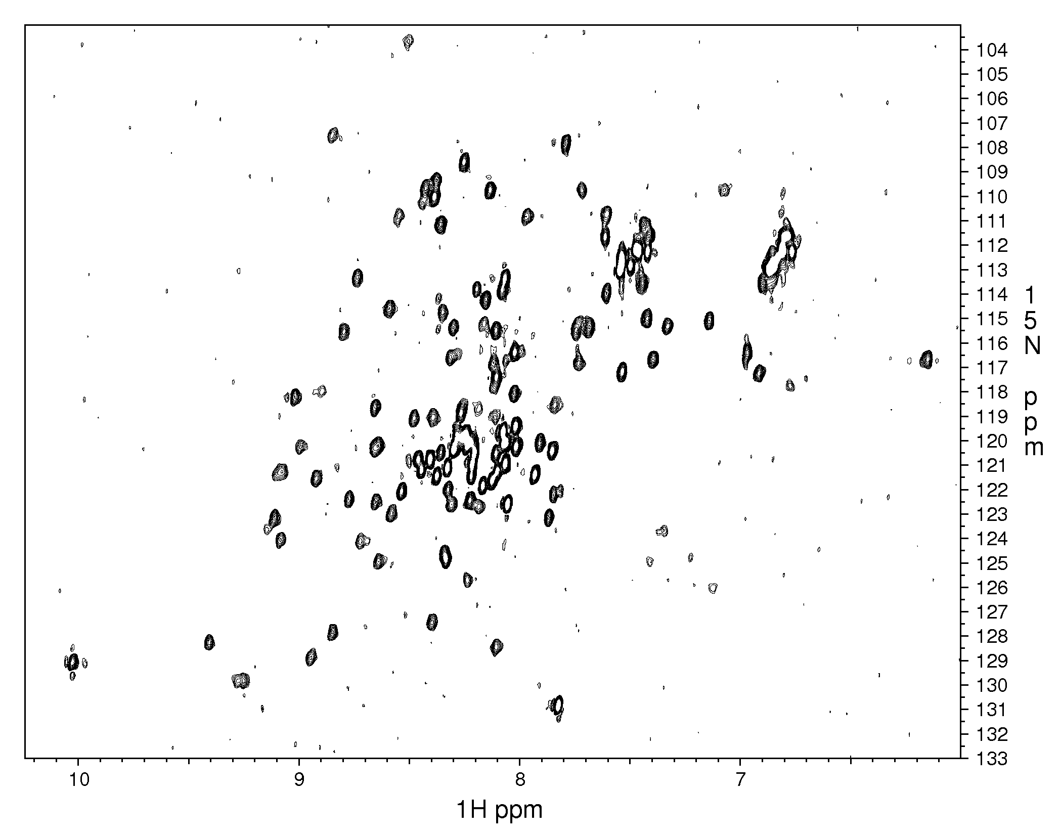
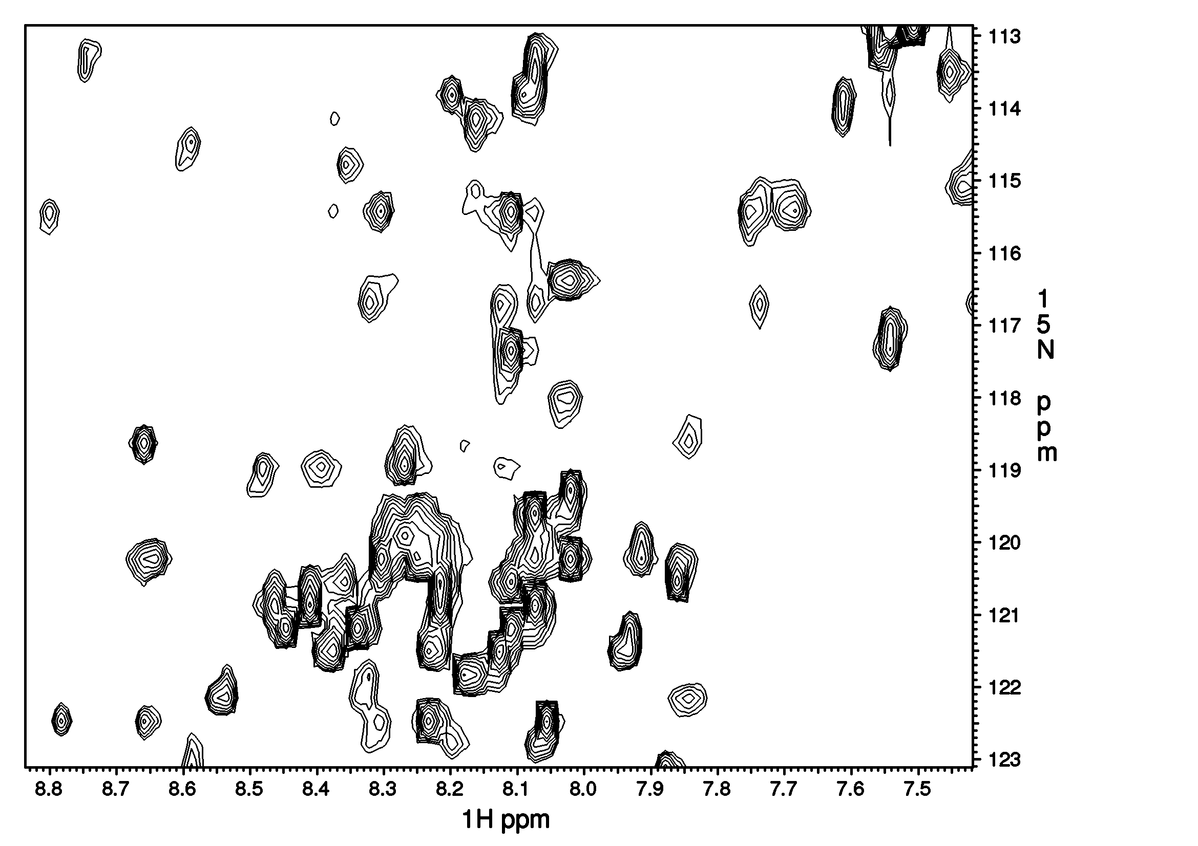
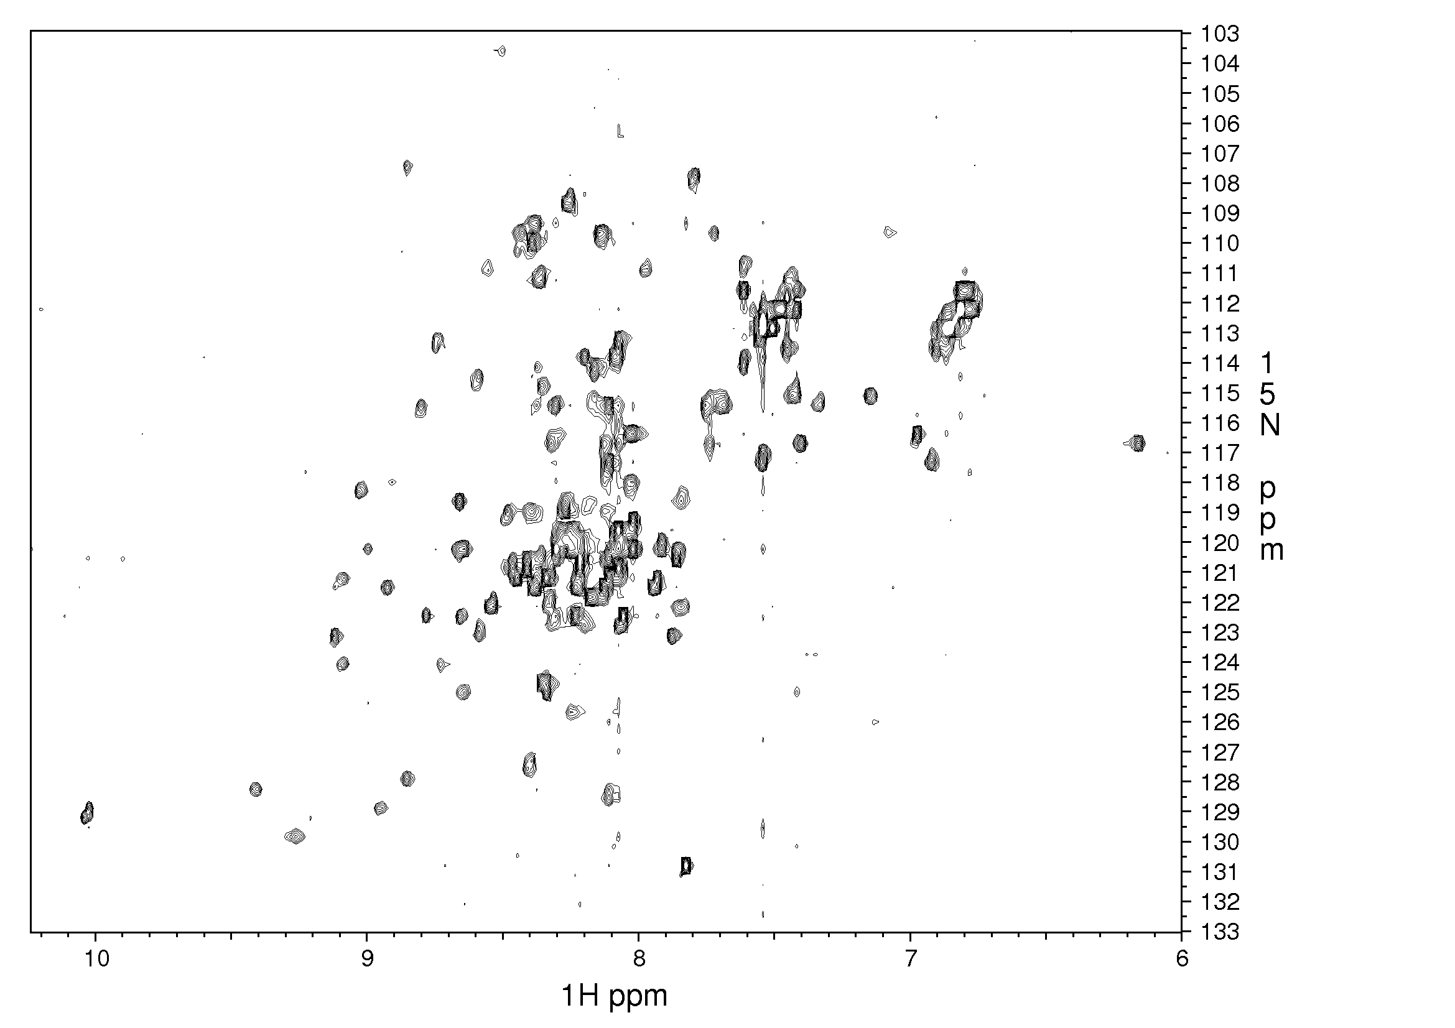

Slide 36
NMR as a tool for study structure, dynamics and interactions of biomolecules
Structure determination of NAs and proteins
Protein – metal interaction
Protein – ligand interaction
For most of the modern applications, enrichment by ¹³C, ¹⁵N and often ²H needed!
Isotope | Ground state spin | Natural abundance [%] |  | Rel. Sensitivity
¹H | ½ | ~100__ |  | 1.00x10⁺⁰
¹³C | ½ | 1.10 |  | 1.59x10⁻²
¹⁵N | ½ | 0.37 |  | 1.04x10⁻³
¹⁹F | ½ | 100__ |  | 8.30x10⁻¹
³¹P | ½ | ~100__ |  | 6.63x10⁻²
¹²C | 0 | 98.90 |  | -
¹⁶O | 0 | ~100__ |  | -

Slide 37


NMR as a tool for study structure, dynamics and interactions of biomolecules
0) AA/NA sequence, resonance assignment, standard chemical shifts
Structure determination of proteins/NAs
NMR can provide detailed information about the structure at the atomic level resolution relying on the spatial proximity of two interacting protons – nuclear Overhauser enhancement (NOE)
Additional structural information can be obtained (residual dipolar couplings – RDCs, J-couplings, backbone chemical shifts - CSI)
NOE:
r_{1,2}
r_{1,2;} r_{1,3;} r_{2,3}≤ 6 Å
1Å=1.10⁻¹⁰m

Slide 38


Iterative procedure of structure determination by NMR
Structure calculation
Final structure
Uncertainty of the final structure represented as a family of 10-20 structures with deviation among individual members indicated by RMSD (typically <1.5 Å²)
N
Nrd1 CID
PDB ID: 2LO6
C
http://www.fbreagents.com/basics_nmr/9proteins.htm

Slide 39
Studying interactions by NMR titration
Slow exch. regime (on the NMR timescale) – individual peaks for each of the studied states (e.g. free / complexed forms of a protein), peak intensity representing population of a given state
Intermediate exchange regime
Fast exchange regime – single peak whose chemical shift position is given by the molar ratio of the states present in solution
Slow (K_{D}<1 μM)
Free Bound
100% 0%
50% 50%
0% 100%
Intermediate (K_{D} ~1-10 μM)
Free Bound
100% 0%
50% 50%
0% 100%
Fast exchange regime (K_{D}>10 μM)
Free Bound
100% 0%
50% 50%
0% 100%
¹⁵N / ppm
¹H / ppm

Slide 40

¹⁵N-¹H HSQC – Heteronuclear Single Quantum Coherence
1 peak ≅ 1 amino acid
good estimate of the protein folding status
no information about sequential assignment (which peak is which amino acid)
for sequential assignment third dimension needed (¹³C)
once assignment of the peaks known – HSQC is optimal tool for monitoring interactions by NMR through titrations (i.e. stepwise addition of small amounts of ligand to the nearly constant volume solution with the isotopically enriched molecule)
¹H-¹⁵N HSQC, cca 155 aa, well folded, 600MHz, 293K

Slide 41

¹H 1D, Cavanagh et al., 2007
water
¹H-¹⁵N HSQC, cca 155 aa, well folded, 600MHz, 293K

Slide 42

Interaction of Nrd1-CID with C-terminal domain (CTD)
NMR Titration - ¹⁵N enriched CID + unlabeled CTD-Ser5P in n-steps, n=6 in our case
- peaks corresponding to the interacting residues of CID change their chemical shift (position in the spectrum)
=> interaction surface, binding constant, stoichiometry
Notes:
We studied the interaction between CTD and CID by monitoring the chemical shift changes of the CID residues – one peak represents one amino acid in this spectra - upon addition of the CTD. In this way, we indentified the interacting surface of the Nrd1-CID

Slide 43

Nrd1 CID interaction surface – CID residues experiencing the largest chemical shift variations upon the interaction with 5-phospho-Ser CTD shown in blue with side-chains in stick representation
Notes:
… that are located on three helices of the CID.

Slide 44


CTD-CID interaction with mutants studied by fluorescence anisotropy
Notes:
Additionally, still analyzing the chemical shift perturbations, we have selected the residues crucial for the interaction and have mutated them to observe a dramatic drop in the affinity as measured by fluorescence anisotropy.

Slide 45

Interligand NOEs between CID and CTD – 900MHz, 150ms, 293K
CID resonances
CTD resonances
Notes:
Next, we determined the NMR structure of the complex between Nrd1-CID and Ser5P-CTD by measuring intermolecular contacts that are defined by these NOEs, where in one frequency domain, we acquired the resonances of the protein and in the second dimension the resonances of the ligand.

Slide 46
Transferred-NOE
NOE = p_{bound}.NOE_{bound} + p_{free}.NOE_{free}
τ_{c,bound} >> τ_{c,free} (and p_{L,free} >> p_{L,bound})
NOE_{bound} > NOE_{free}
Notes:
The correlation time is roughly defined as the time taken for a molecule to rotate one radian or move a distance of the order of its own dimension. Usually it is assumed that the correlation time depend on temperature according to an Arrhenius type of function;
Correlation time - The characteristic time between significant fluctuations in the local magnetic field experienced by a spin due to molecular motions.

Slide 47


Transferred NOE Experiments
tr-NOESY~600μM Discodermolide without and with ~12μM tubulin
800MHz,
mixing time=80ms
8 7 6 ppm
disco w/o tub
disco:tub 50:1
8 7 6 ppm

Slide 48




protein
Magnetization to be transferred
ligand1
ligand2
Transferred magnetization
Note the weak “signal”
They “compete” for same place but never “meet”

Slide 49

interligand NOE Experiments .

Slide 50


interligand NOE Experiments .
(50)EpoA + (1)Tub
(50)Tbs + (1)Tub

Slide 51

interligand NOE Experiments .
(50)EpoA + (1)Tub
(50)Tbs+(50)EpoA+(1)Tub
(50)Tbs + (1)Tub
interligand x-peaks, 100-450ms, 900MHz

Slide 52
interligand NOE Experiments .
(50)EpoA + (1)Tub
(50)Tbs+(50)EpoA+(1)Tub
(50)Tbs + (1)Tub
interligand x-peaks, 100-450ms, 900MHz

