Slide 1
Structural Biology – a concept
structure & dynamics
In vivo
function

Slide 2
Where the structural information comes from ….
PDB Statistics – by method

Slide 3
In vitro structure & dynamics
buffered solutions, crystalline state, or deposited isolated molecules on the surface
In vivo
function
X
In vivo structure & dynamics
Complex environment of living cells

Slide 4
approximation
X-ray diffraction
Complex heterogenous aqueous env.
Simple homogenous anhydrous env.
vs.
-180 ºC
37 ºC

Slide 5
approximation
NMR spectroscopy
Complex heterogenous aqueous env.
Simple homogenous aqueous env.
vs.
20 ºC
37 ºC

Slide 6
approximation
Electron microscopy
Complex heterogenous aqueous env.
Simple homogenous aqueous env.
vs.
-180 ºC
37 ºC

Slide 7
… underlying assumptions in STRUCTURAL BIOLOGY
The use of these techniques imposes …
structure is independent of environmental conditions
thermodynamically NOT kinetically preferred conformation is responsible for biological activity.
biologically active specie = lowest (free) energy structure

Slide 8
…not entirely true, particularly for DNA
structure is independent of environmental conditions
(Δ pH, Δ ion strengh, ion type, MC, hydration)

Slide 9
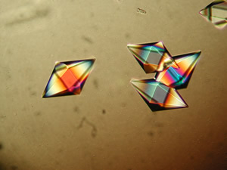
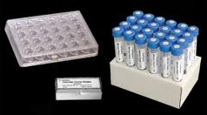
…monocrystal production
X-ray – particularly prone to env. artifacts

Slide 10
… not generally true
thermodynamically NOT kinetically preferred conformation is responsible for biological activity.
Biological processes (folding, interactions) t < sec, min
Only H2 would be observed in conventional X-ray, NMR experiment
Bessi et al. Angew Chem Int Ed Engl. 2015 Jul 13;54(29):8444-8.

Slide 11
…not entirely true
biologically active specie = lowest (free) energy structure
…number of processes happens via conformational selection
(from excited/non-visible states)
Kinetically preferred state
Thermodynamically preferred state
Free energy
Exited state
U
Folding coordinate
Lowest energy state

Slide 12

…X-ray, NMR, cryoEM structures
Summary
…are biased
Towards thermodynamically preferred (lowest energy) conformation, which
is not necessarily biologically active; the bias is a function of T [ºC]
Towards conformation specific to selected environmental conditions
Parameters used to assess structure quality refers
only to precision not accuracy

Slide 13
…in addition, NMR
Summary
…is biased by averaging
Exited state
Multiple states populated
at physiological temperatures
Lowest energy state
We observe ensemble average

Slide 14
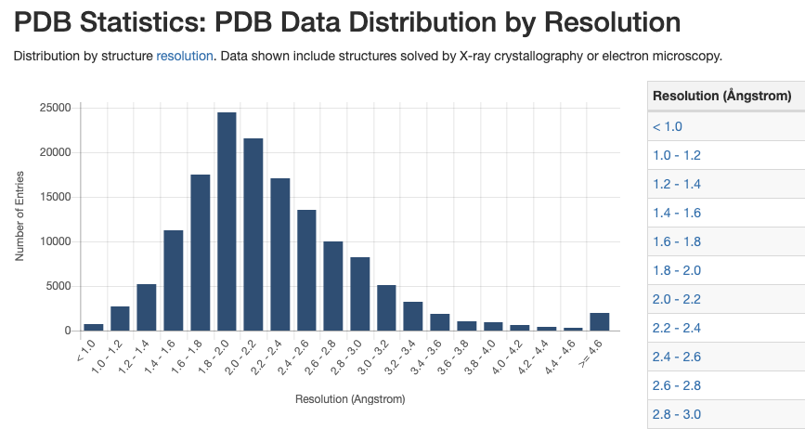
Bias from external information on local structure
NMR
cryoEM
X-ray

Slide 15
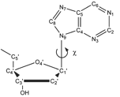
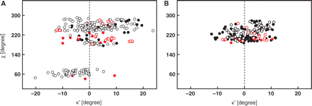
Bias from external information on local structure
Example: Implicitly used assumption of planarity of nucleic acid bases
However, NA bases are planar only when isolated and
when at 0 K.
Data from ultra-high resolution structures of nucleotides
Nucleic Acids Res, Volume 37, Issue 21, 1 November 2009, Pages 7321–7331
During structure determination we presume planarity
… source of the artefact in NMR – affects interpretation of NOEs, Js, RDCs

Slide 16
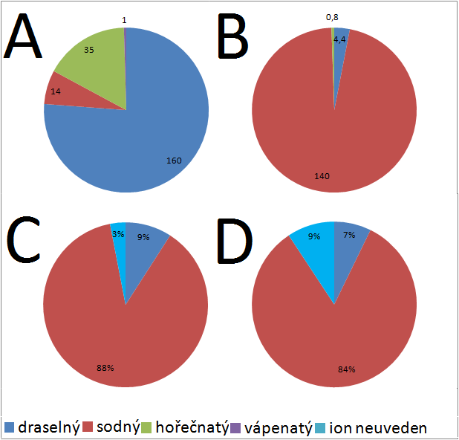
… which can be easily fixed
Historically based artifacts
Ionic composition of:
Intracellular space
Extracellular space
potassium
sodium
magnesium
calcium
ion not specified
Ionic composition of buffers used for NMR studies of:
DNA
RNA
Statistics based on PDB data

Slide 17
How to recognize physiologically relevant (accurate) structure?
Structural Biology – an issue
… assessment of structural accuracy presumes knowledge of reference structure

Slide 18
… characterization of structures at physiologically relevant env. conditions
Cellular Structural Biology – a concept
X
In vitro structure & dynamics
buffered solutions or crystalline state
In vivo
function
In vivo structure & dynamics
Complex environment of living cells

Slide 19
Cellular structural biology
in vivo function
in cell structure
DNA
Cell nucleus
cryoEM
NMR
RNA
analysis
cytosol
protein
Homework – mandatory self-reading
Plitzko et al. Structural Biology Outside the Box-Inside the Cell.
Curr Opin Struct Biol. 2017 Oct;46:110-121
Notes:
Conservation of repetitive sequences suggest their importance for function. Their distribution in genome then provide hints on the function.

Slide 20
EXAM by homework
Model a 3D complex between TBA aptamer and FGF2 presuming that the
TBA binds to the heparin binding site via electrostatic interactions.
Consider visualization of charge distribution on structural models of FGF2 and TBA.
e.g., Raček et al. Atomic Charge Calculator II: Web-Based Tool for the Calculation of
Partial Atomic Charges. Nucleic Acids Res. 2020 May 13;gkaa367. doi: 10.1093/nar/gkaa367
Notes:
Conservation of repetitive sequences suggest their importance for function. Their distribution in genome then provide hints on the function.

