Slide 1
English for Physicists IV
Week 8

Slide 2
Presentation Skills
Efficient ending?

Slide 3
ENDING = final impression ☺
traditional structure
I-N-A-G-L-S O-T D-E-N
M-M-R-A-U-S-Y
C-C-O-O-N-N-S-L-U-I
E-S-O-C-L
I-N-T-I-V-A-T-O-I-N F-R-O S-Q-U-E-T-S-N-I-O

Slide 4
ENDING = final impression ☺
traditional structure
SIGNAL TO END
SUMMARY
CONCLUSION
CLOSE
INVITATION FOR QUESTIONS

Slide 5
SUMMARY X CONCLUSION
summary – repeating the main points (no details, no new things)
conclusion – a commentary, the lessons learned, recommendations, suggestions or the next steps

Slide 6
Dealing with questions

Slide 7
Dealing with questions – TRACK technique
T
R
A
C
K

Slide 8
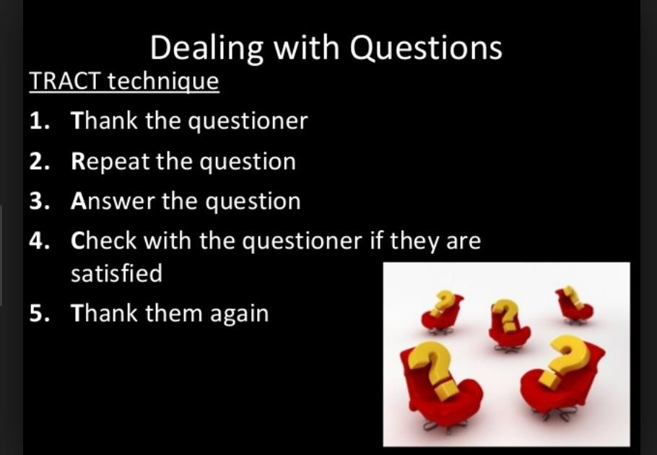

Slide 9
2. Watch and decide whether the speaker does (✓) or does not (x) carry out each stage
version 1
1x 2x 3x
1 2 3
1 2 3
1 2 3
1 2 3
version 2
welcomes the question
1 ✓ 2 ✓
3x phrases………………………..
takes time to think before answering
1
clarifies the question
1
replies positively
1
2 3 …………………………………
2 3 ………………………………….
2 3 ……………………………………
checks the questioner is satisfied
1 2 3 …………………………………..

Slide 10
2. Watch and decide whether the speaker does (✓) or does not (x) carry out each stage
version 1
1x 2x 3x
1 2 ✓ 3
1 2
1 2 ✓ 3
1 2
version 2
welcomes the question
1 ✓ 2 ✓
3x phrases………………………..
takes time to think before answering
1
clarifies the question
1 ✓
replies positively
1 ✓
2 ✓ 3 ✓ …………………………………
2 3 ………………………………….
2 ✓ 3 ……………………………………
3
checks the questioner is satisfied
1 2 3 ✓…………………………………..
3

Slide 11
3. Listen, write each question a-f and choose the best response
a
1 No, of course not. 2 Please do.
3 No, that’s a problem.
b
1 Well, actually, it’s confidential. 2 Yes, I do.
3 Certainly.
c
1 You could say so. 2 That’s right.
3 I’d prefer not to.
d
I need a break.
I don’t need a break. 3 That’s a good idea.
e
1 No, they aren’t. 2 You’re wrong.
3 Actually, some are at headquarters.
Any moment.
That’s a difficult question. 3 That’s interesting.
f

Slide 12
Don´t you think we need to take a break?
Do you mind telling me where you got those figures?
All the job losses are in the plant, aren´t they?
May I ask you a question?
Could I ask you when you´re going to leave?
I suppose you´re in town for a week. Is that right?

Slide 13
KEY
d (3)
b (1)
e (3)
a (2)
f (1)
c (2)

Slide 14
4. Handling questions
I’m afraid I don’t see the connection.
Sorry, I don’t follow you.
Good questions 4, 8 Difficult questions 7,9 Unnecessary questions 3, 6 Irrelevant questions 2, 1, 5
I think I answered that earlier.
Good point.
Interesting. What do you think?
Well, as I said/mentioned earlier…
I’m afraid I don’t have that information
That’s a very good question.
I don’t know that off the top of my head.

Slide 15
5. What would you say?
Instead of asking a question, the person strongly, rather angrily, disagrees with you.
Instead of asking a question, the person states his/her viewpoint that agrees with yours.
The person says that some of your information is inaccurate, but you are absolutely sure that you are correct.
The person says that some of your information is inaccurate, and you are not sure whether your information was correct or not.
The person asks a question that will require a very long, complicated answer.

Slide 16
1. Instead of asking a question, the person strongly, rather angrily, disagrees with you.
Instead of asking a question, the person states his/her viewpoint that agrees with yours.
The person says that some of your information is inaccurate, but you are absolutely sure that you are correct.
The person says that some of your information is inaccurate, and you are not sure whether your information was correct or not.
The person asks a question that will require a very long, complicated answer.
  Do not regard this as an attack. You can say: I appreciate your bringing this to my attention. I will have to recheck my sources to see what is correct.
  If possible, give your source of information. If you cannot do so, you can say: I believe that my information is correct, but I will certainly recheck my facts.
  You can say: That is an interesting question, but it would take much too long to answer it. Perhaps we can discuss it later.
  Listen politely, then restate your point of view, with additional evidence, if possible. Do not argue with the person. If he/she repeat their position, you can say: Well, we will have to agree to disagree on this point. or Unfortunately, there is no time to go into this more deeply right now.
  Show how this person’s ideas support your own point of view. You can say: Yes, that fits exactly with
what I was saying.

Slide 17
1. Instead of asking a question, the person strongly, rather angrily, disagrees with you. d
Instead of asking a question, the person states his/her viewpoint that agrees with yours. e
The person says that some of your information is inaccurate, but you are absolutely sure that you are correct. b
The person says that some of your information is inaccurate, and you are not sure whether your information was correct or not. a
The person asks a question that will require a very long, complicated answer. c
  Do not regard this as an attack. You can say: I appreciate your bringing this to my attention. I will have to recheck my sources to see what is correct.
  If possible, give your source of information. If you cannot do so, you can say: I believe that my information is correct, but I will certainly recheck my facts.
  You can say: That is an interesting question, but it would take much too long to answer it. Perhaps we can discuss it later.
  Listen politely, then restate your point of view, with additional evidence, if possible. Do not argue with the person. If he/she repeat their position, you can say: Well, we will have to agree to disagree on this point. or Unfortunately, there is no time to go into this more deeply right now.
  Show how this person’s ideas support your own point of view. You can say: Yes, that fits exactly with
what I was saying.

Slide 18
6. How would you ask?
Ask for repetition | Ask for details | Ask for simplification
Ask for clarification | Ask for additional information | Give your opinion
Agree | Ask for sources | Ask for evidence
Ask for examples | Interrupt the speaker | Ask for opinion
Follow up a question. You are not satisfied with the answer | Express doubt and reservation | Disagree
Ask for methods | Ask for a take-home message

Slide 19
7. Grammar focus – indirect questions.
Do you know…?
Can you tell me….?
I have no idea…
I would like to know…..
I wonder / was wondering … Do you happen to know…?
I am not sure……………. Have you any idea………. ?
Do you know where the author comes from?
Where does the author come from?
Is this the only solution? Can you tell me if/whether this is the only solution?
Who proved that?
I have no idea who proved that.
Did you have a control group?
I would like to know if/whether you had a control group.
Why have you chosen this topic?
I wonder why you have chosen this topic.

