Slide 1
English for Mathematicians II
Week 8 – Conic Sections

Slide 2
Unit 8 – Conic Sections
TED Talk task
Conic sections
  vocab
  description
  ellipse - listening

Slide 3
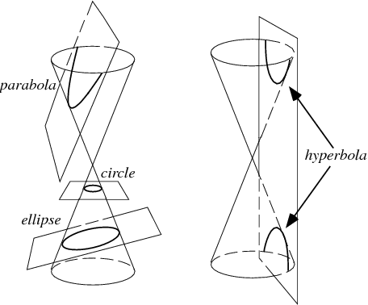
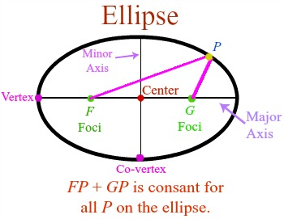
Conic Sections - vocabulary

Slide 4
Conic Sections – vocabulary
circle, ellipse, parabola, hyperbola

Slide 5
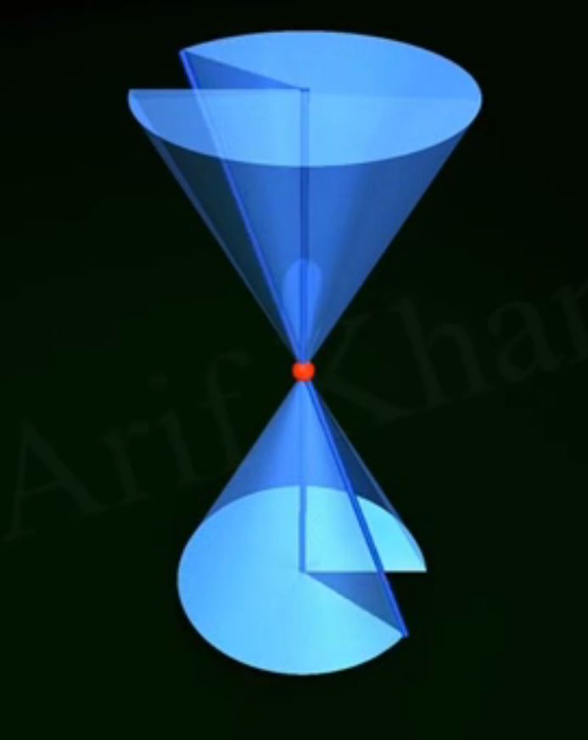
Conic Sections – vocabulary

Slide 6
Conic Sections – pair work describe & write down 2 sentences

Slide 7
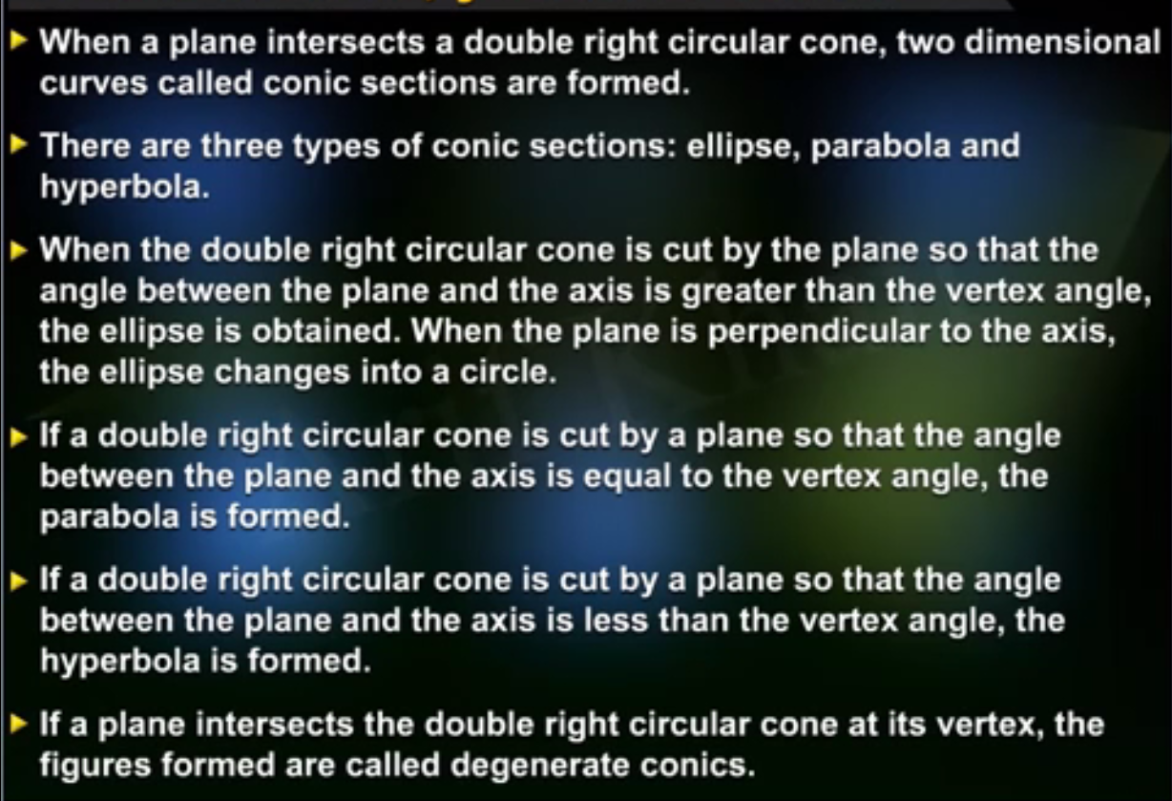

Slide 8
Conic Sections - ellipse

Slide 9
Irregular plurals
Focus ……
Axis ………
Radius ….
Vertex……
Locus …….
Directrix …
Foci
Axes
Radii
Vertices
Loci
Directices

Slide 10
Video
an oval
Which synonym for the term „ellipse“ does the speaker use?
How is the concept of being equidistant different for a circle and for an ellipse?
Which tools does the speaker use to draw an ellipse?
Which two different arrangements of an ellipse does he mention?
What is the difference between the major and minor axis?
Where can vertices of an ellipse be found?
Where are the co-vertices?
What does x (and y) radius denote?
How are the equations for horizontal and vertical ellipses different?
What does a letter b denote?
What are the foci of an ellipse?
equal distance from the centre vs. the sum of the distances from two points being equal
2 pins, a string, a piece of paper,
a box, a marker
vertical and horizontal
major … longer diameter
Endpoints of axes (where the ellipse intersects the vertices)
Endpoints of minor axis
horizontal (vertical) axis
a and b are switched
the distance from the centre to a co-vertix
two points where he placed the pins/attached the string

Slide 11
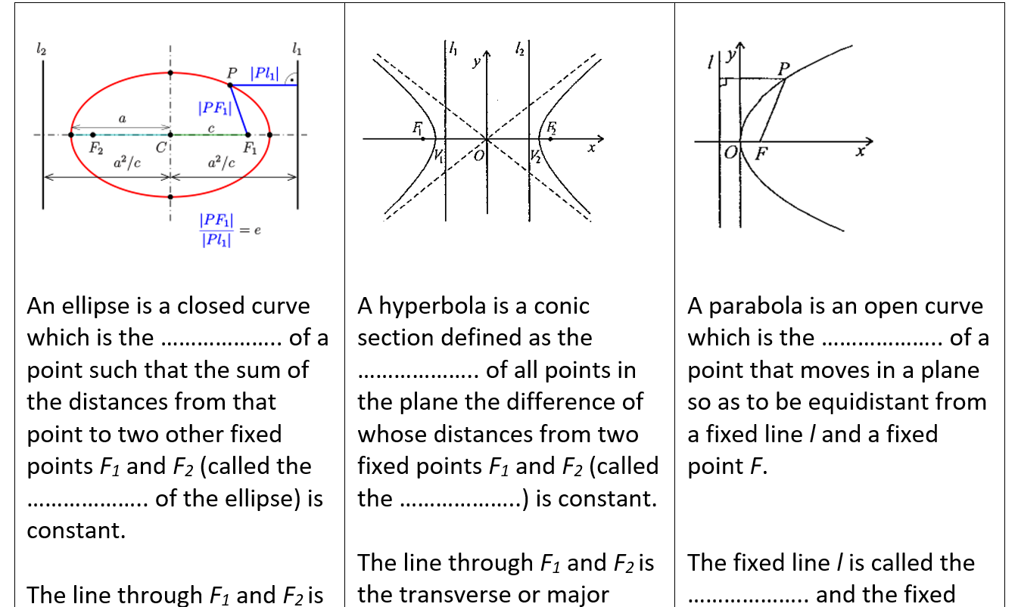
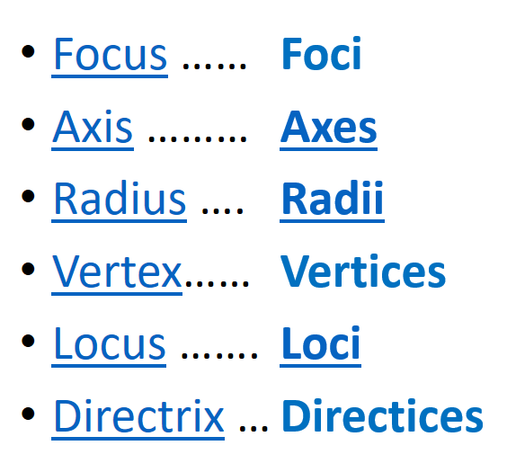
Read the text and fill in the information
The conic sections are curves obtained by the intersection of a right circular cone and a plane. According to the angle of intersection, the conic is an ellipse, a parabola and a hyperbola. A circle is also a conic, it is a special case of an ellipse.
3 groups

Slide 12
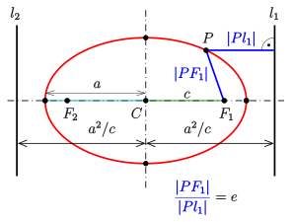
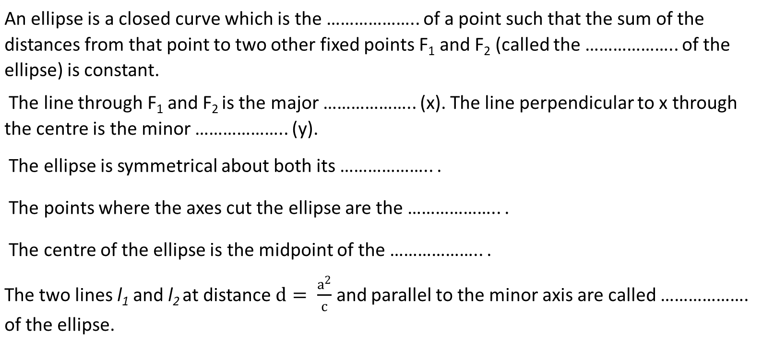
locus
An ellipse is a closed curve which is the ……………….. of a point such that the sum of the distances from that point to two other fixed points F₁ and F₂ (called the ……………….. of the ellipse) is constant.
The line through F₁ and F₂ is the major ……………….. (x). The line perpendicular to x through the centre is the minor ……………….. (y).
The ellipse is symmetrical about both its ……………….. .
The points where the axes cut the ellipse are the ……………….. .
The centre of the ellipse is the midpoint of the ……………….. .
The two lines l₁ and l₂ at distance $d= \frac{a^{2}}{c}$ and parallel to the minor axis are called ………………. of the ellipse.
foci
axis
axis
axes
vertices
vertices/ axes
directices

Slide 13
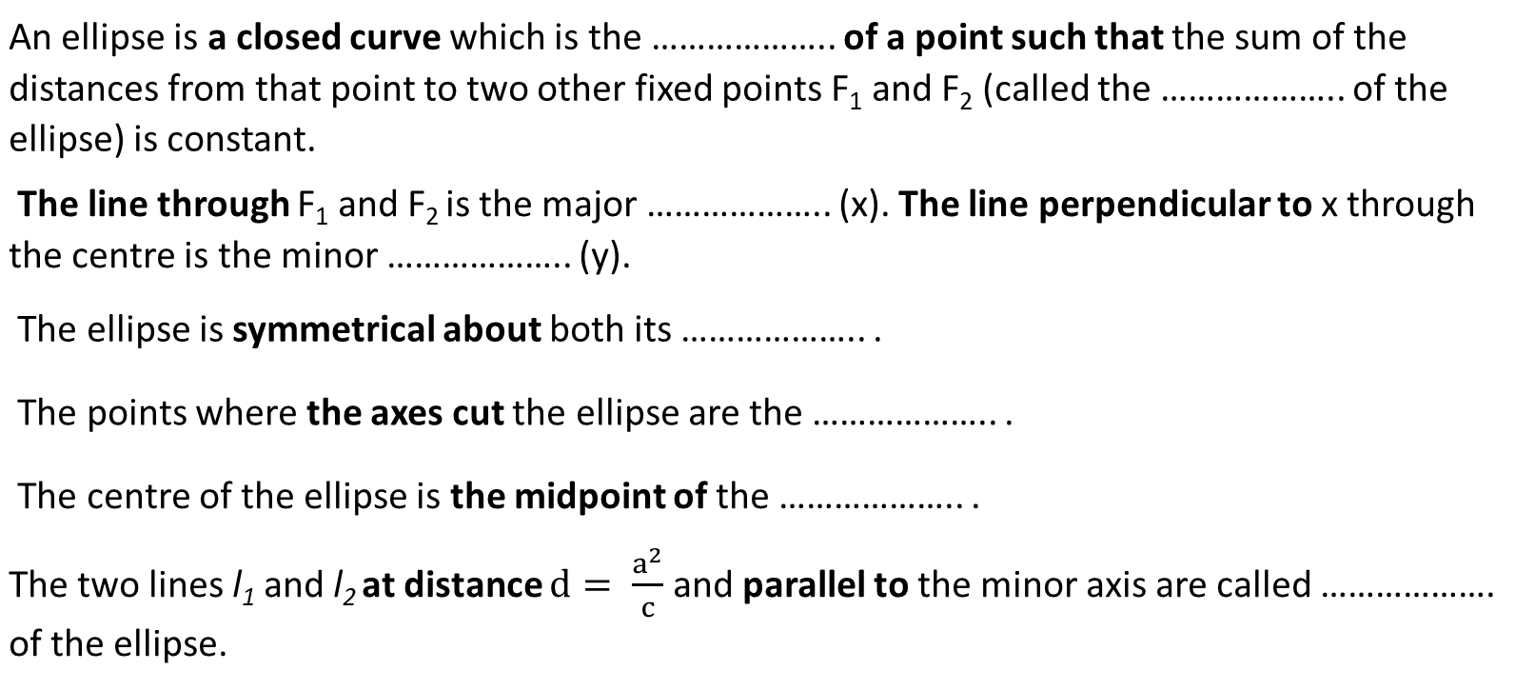
locus
An ellipse is a closed curve which is the ……………….. of a point such that the sum of the distances from that point to two other fixed points F₁ and F₂ (called the ……………….. of the ellipse) is constant.
The line through F₁ and F₂ is the major ……………….. (x). The line perpendicular to x through the centre is the minor ……………….. (y).
The ellipse is symmetrical about both its ……………….. .
The points where the axes cut the ellipse are the ……………….. .
The centre of the ellipse is the midpoint of the ……………….. .
The two lines l₁ and l₂ at distance $d= \frac{a^{2}}{c}$ and parallel to the minor axis are called ………………. of the ellipse.
foci
axis
axis
axes
vertices
vertices/ axes
directices

Slide 14
locus
A hyperbola is a conic section defined as the ……………….. of all points in the plane the difference of whose distances from two fixed points F₁ and F₂ (called the ………………..) is constant.
The line through F₁ and F₂ is the transverse or major ……………….. (x). The line perpendicular to x through the centre is the conjugate or minor ……………….. (y).
The points where the transverse axis cuts the hyperbola are the ……………….. .
The centre of the hyperbola is the midpoint of the ……………….. .
The hyperbola is a two-branched open curve. The branches of the hyperbola approach two straight lines which are called the asymptotes.
Two fixed lines l₁ and l₂ situated at the opposite side of vertices are ……………….. . The ratio of distance of a point on hyperbola from a focus and the corresponding directrix are in the same ratio.
foci
axis
axis
vertices
vertices/ axis
directices

Slide 15
locus
A hyperbola is a conic section defined as the ……………….. of all points in the plane the difference of whose distances from two fixed points F₁ and F₂ (called the ………………..) is constant.
The line through F₁ and F₂ is the transverse or major ……………….. (x). The line perpendicular to x through the centre is the conjugate or minor ……………….. (y).
The points where the transverse axis cuts the hyperbola are the ……………….. .
The centre of the hyperbola is the midpoint of the ……………….. .
The hyperbola is a two-branched open curve. The branches of the hyperbola approach two straight lines which are called the asymptotes.
Two fixed lines l₁ and l₂ situated at the opposite side of vertices are ……………….. . The ratio of distance of a point on hyperbola from a focus and the corresponding directrix are in the same ratio.
foci
axis
axis
vertices
vertices/ axes
directices

Slide 16
locus
A parabola is an open curve which is the ……………….. of a point that moves in a plane so as to be equidistant from a fixed line l and a fixed point F.
The fixed line l is called the ……………….. and the fixed point F is called the ……………….. .
The line through the focus perpendicular to the to the directrix is the ……………….. of the parabola.
The point where the axis cuts the parabola is the ……………….. .
directrix
focus
axis
vertex

Slide 17
locus
A parabola is an open curve which is the ……………….. of a point that moves in a plane so as to be equidistant from a fixed line l and a fixed point F.
The fixed line l is called the ……………….. and the fixed point F is called the ……………….. .
The line through the focus perpendicular to the to the directrix is the ……………….. of the parabola.
The point where the axis cuts the parabola is the ……………….. .
directrix
focus
axis
vertex

Slide 18
True/false?
An ellipse is an open curve.
A transverse axis is a straight line through the foci.
The fixed points of conics are called the vertices.
A circle is a special case of a group of curves known as conic sections.
A parabola has two foci.
A parabola is a two-branched open curve.
False (… a closed curve)
True
False (… the foci)
True
False (… one focus)
False (a one-branch open curve)

Slide 19
