Slide 1
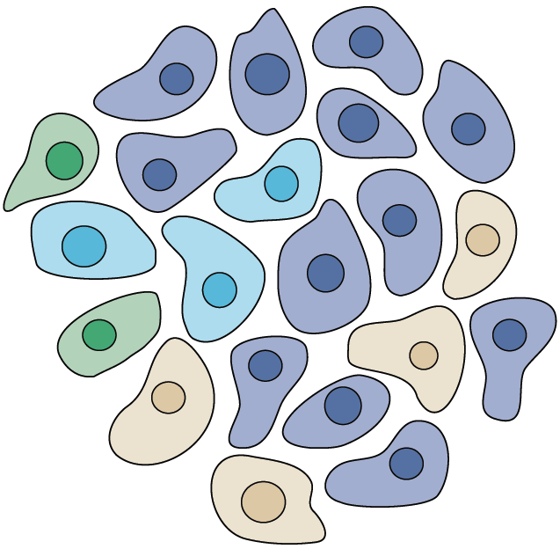


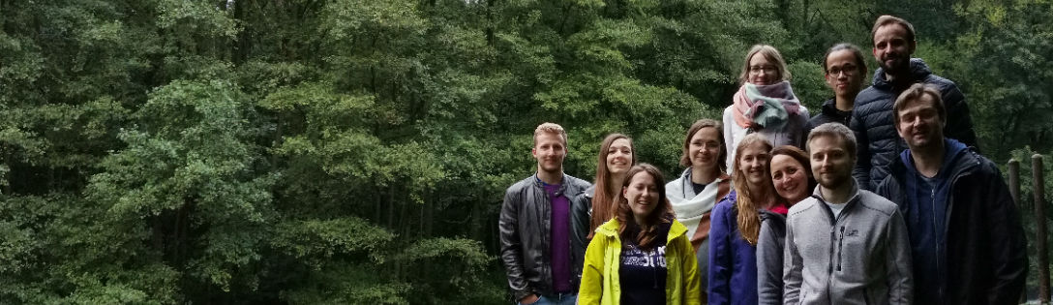

Speciální metody FŽ
Cancer Plasticity
Karel SOUČEK
Department of Cytokinetics
Institute of Biophysics AS CR
Kralovopolska 135
612 65 Brno , Czech Republic
Tel: + 420 541 517 166
ksoucek@ibp.cz
@souceklab

Slide 2

Typické znaky nádorové buňky
podpůrné proliferační signály
deregulace supresorů růstu/proliferace
odolnost k buněčné smrti
neomezená replikace
neoangiogeneze
invaze a metastázování
mutace a genomická nestabilita
zánět
přestavba energetického metabolismu
únik před zničením imunitním systémem
Douglas Hanahan & Robert A. Weinberg: Hallmarks of Cancer: Next Generation, Cell, 2011

Slide 3
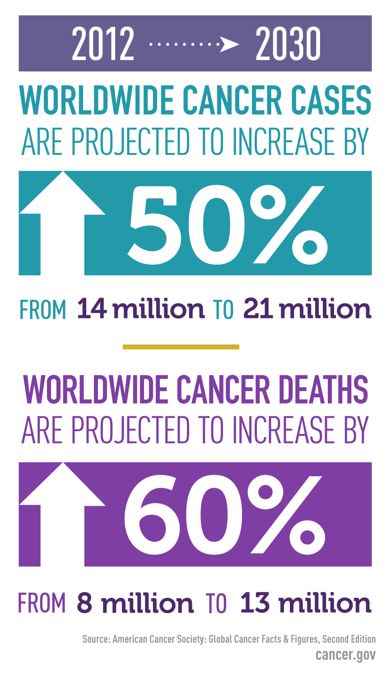
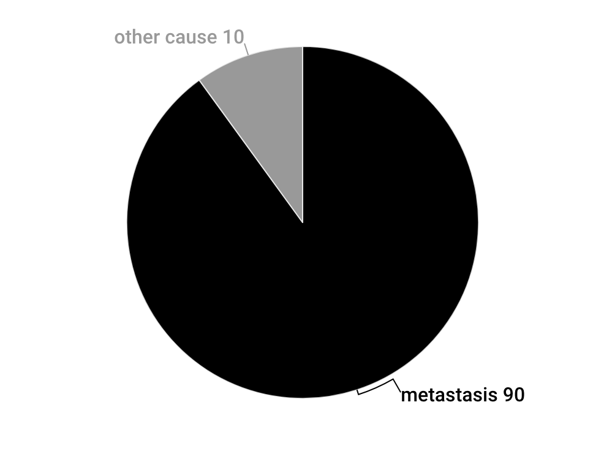
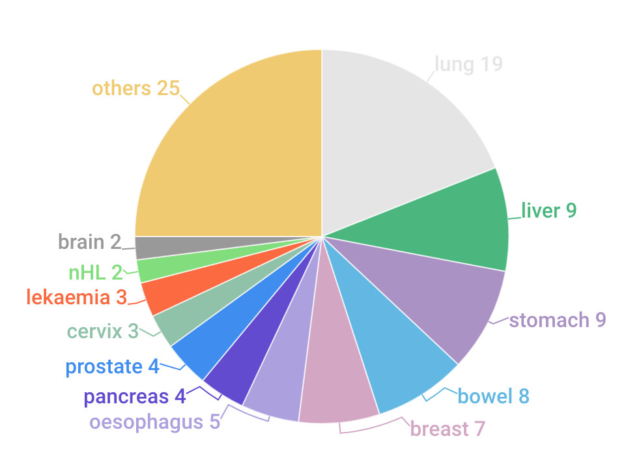
Why is cancer so devastating?
cancer death portion per cancer type
cancer-related death cause estimate

Slide 4
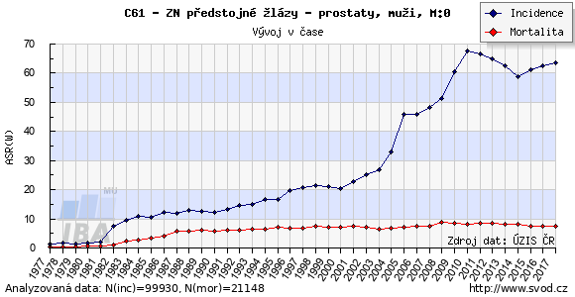
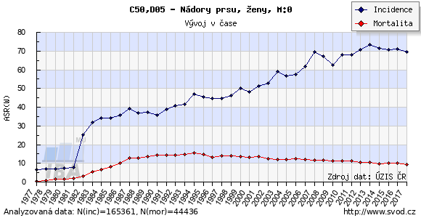
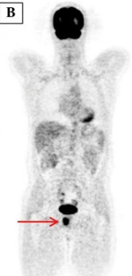
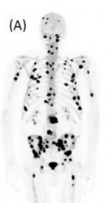
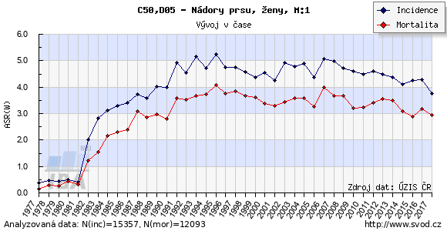
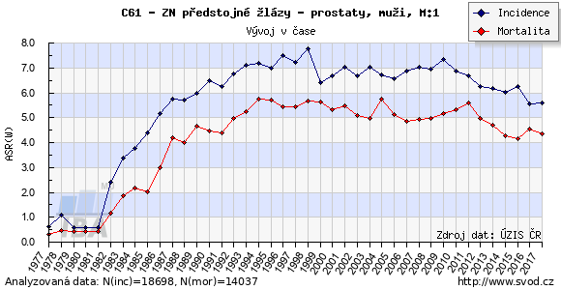
Why is cancer so devastating?
Prostate cancer
Breast cancer

Slide 5
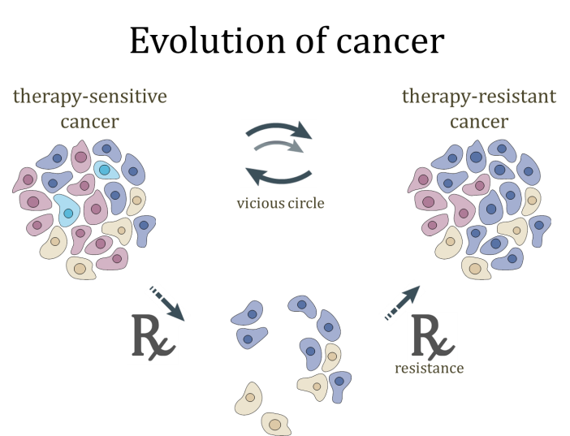
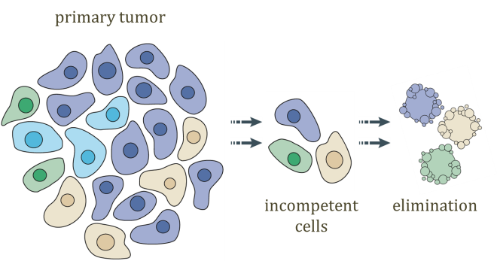
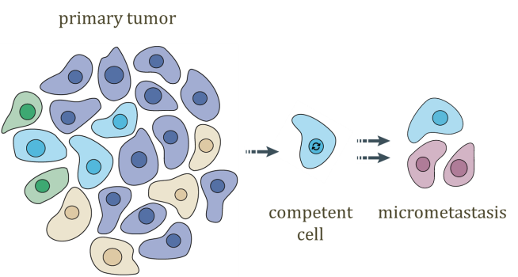
Overview of current research
What kind of cells drives metastasis and how we can target them?
Cancer is heterogeneous and not single cell disease.
Complex and dynamic, NOT static “ecosystem”.
Diversity inside tumors is clinical problem limiting the efficacy of targeted therapies and compromising treatment outcomes
90% of cancer related deaths are due to metastasis

Slide 6
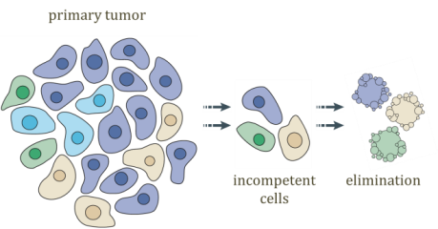
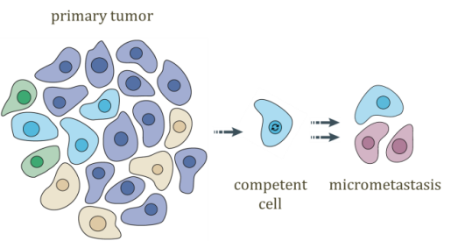
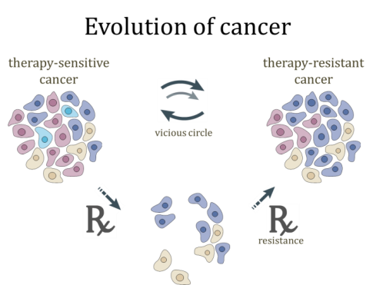
Overview of current research
Does EMT & chemoresistance regulates cell surface phenotype?
  EMT & metastatic signature of selected cancer subpopulations
    British Journal Cancer, 2018 - > Follow up(s) in docetaxel resistant PCa and TNBC
    What kind of cells and mechanisms drive metastasis and chemoresistance?
  Trop-2 associates with epithelial phenotype of breast and prostate cancer cells
    Carcinogenesis, 2018 -> Follow up(s) in functional role of TSPN, Trop-2
    Is there a cure for advanced cancer?
  Toll-like receptors in chemoresistant prostate cancer
    AZV project (ICRC, IBP CAS, UPOL – Z. Culig, K. Souček, V. Študent)
  Synthetic lethality as a concept for treatment drug resistant cancer
    Molecular Cancer Therapeutics, 2017-> Follow up – Molecular Oncology, 2020, Haspin(i)

Slide 7
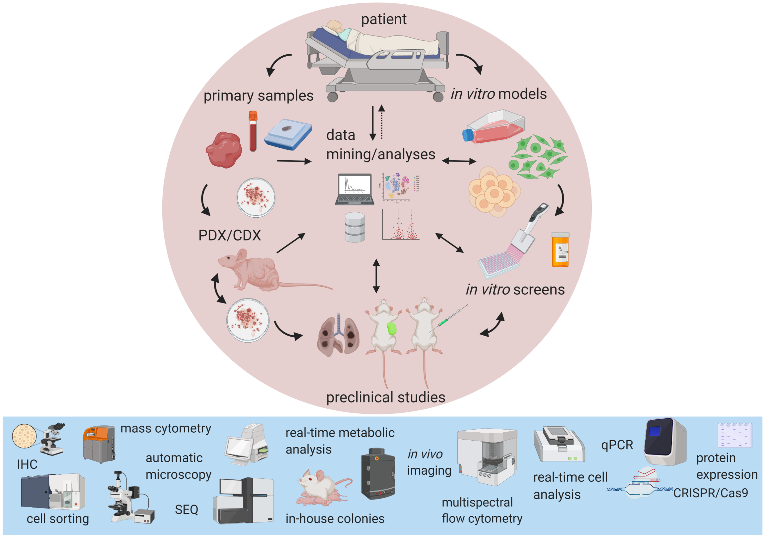
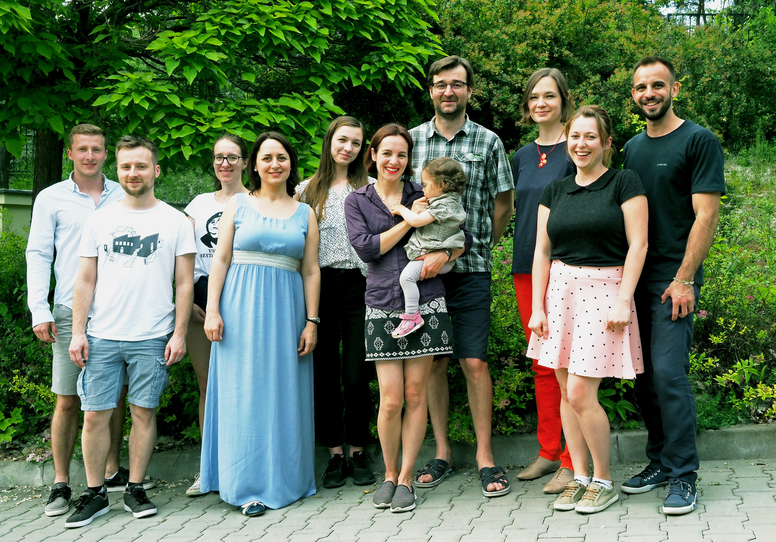
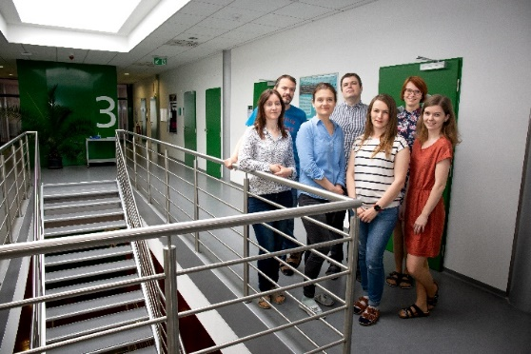


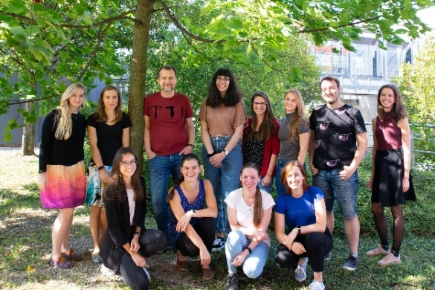
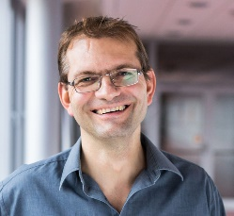
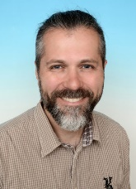


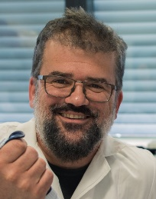
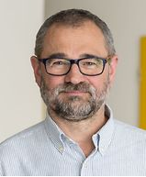

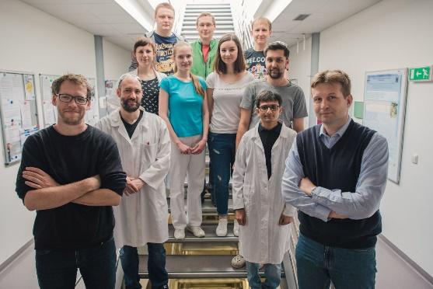


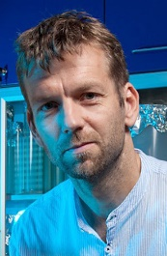
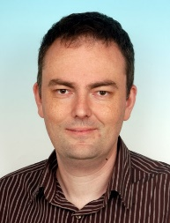


Partners
Team & Collaborators
Methodology

Slide 8

  Does Epithelial-to-Mesenchymal Transition (EMT) & chemoresistance regulates cell surface phenotype?
epithelial
surface signature
mesenchymal
surface signature

Slide 9


Slide 10
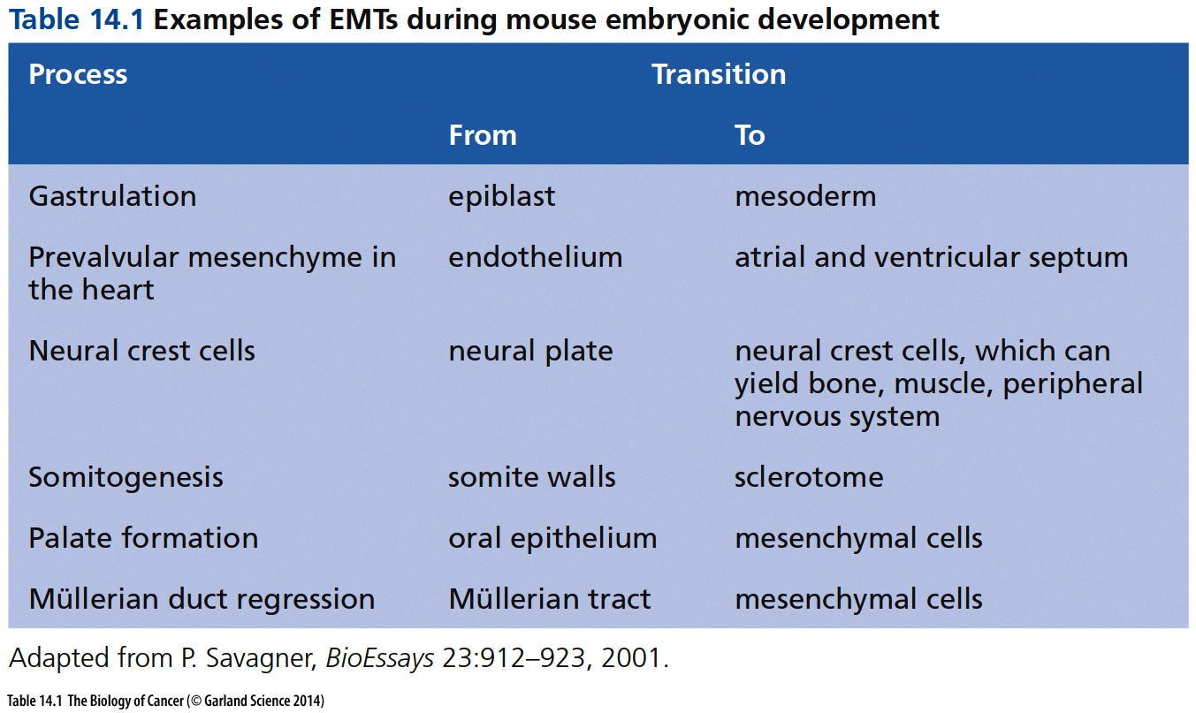
Epithelial-Mesenchymal Transition (EMT)
Změna buněčného fenotypu spojená se ztrátou adheze a zvýšením motility

Slide 11
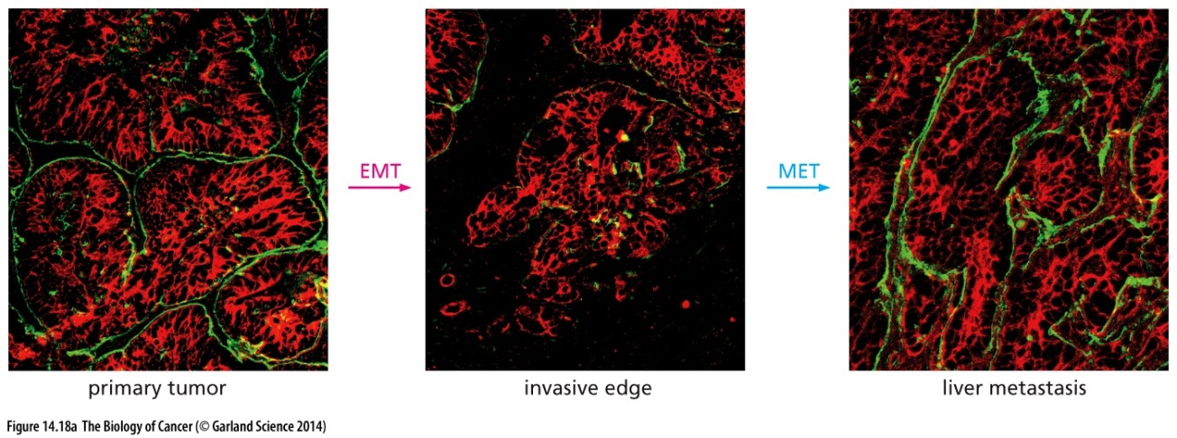
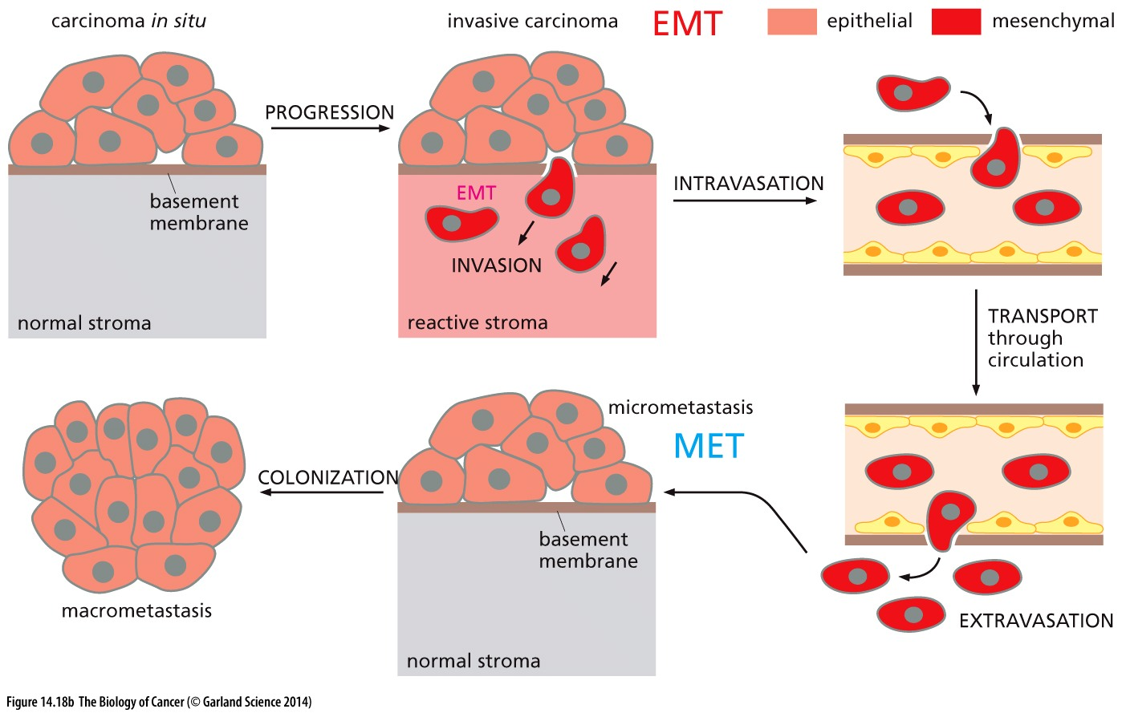
EMT & nádory

Slide 12
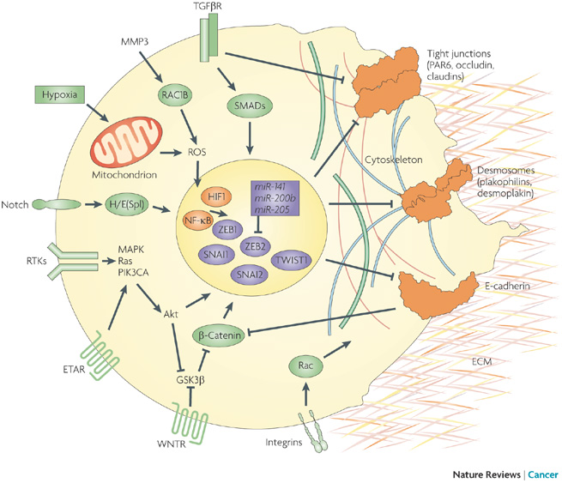
Znaky a regulátory EMT
Kornelia Polyak & Robert A. Weinberg
Nature Reviews Cancer 9, 265-273 (April 2009)

Slide 13
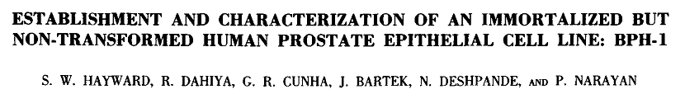

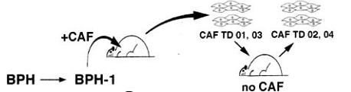
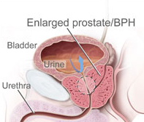
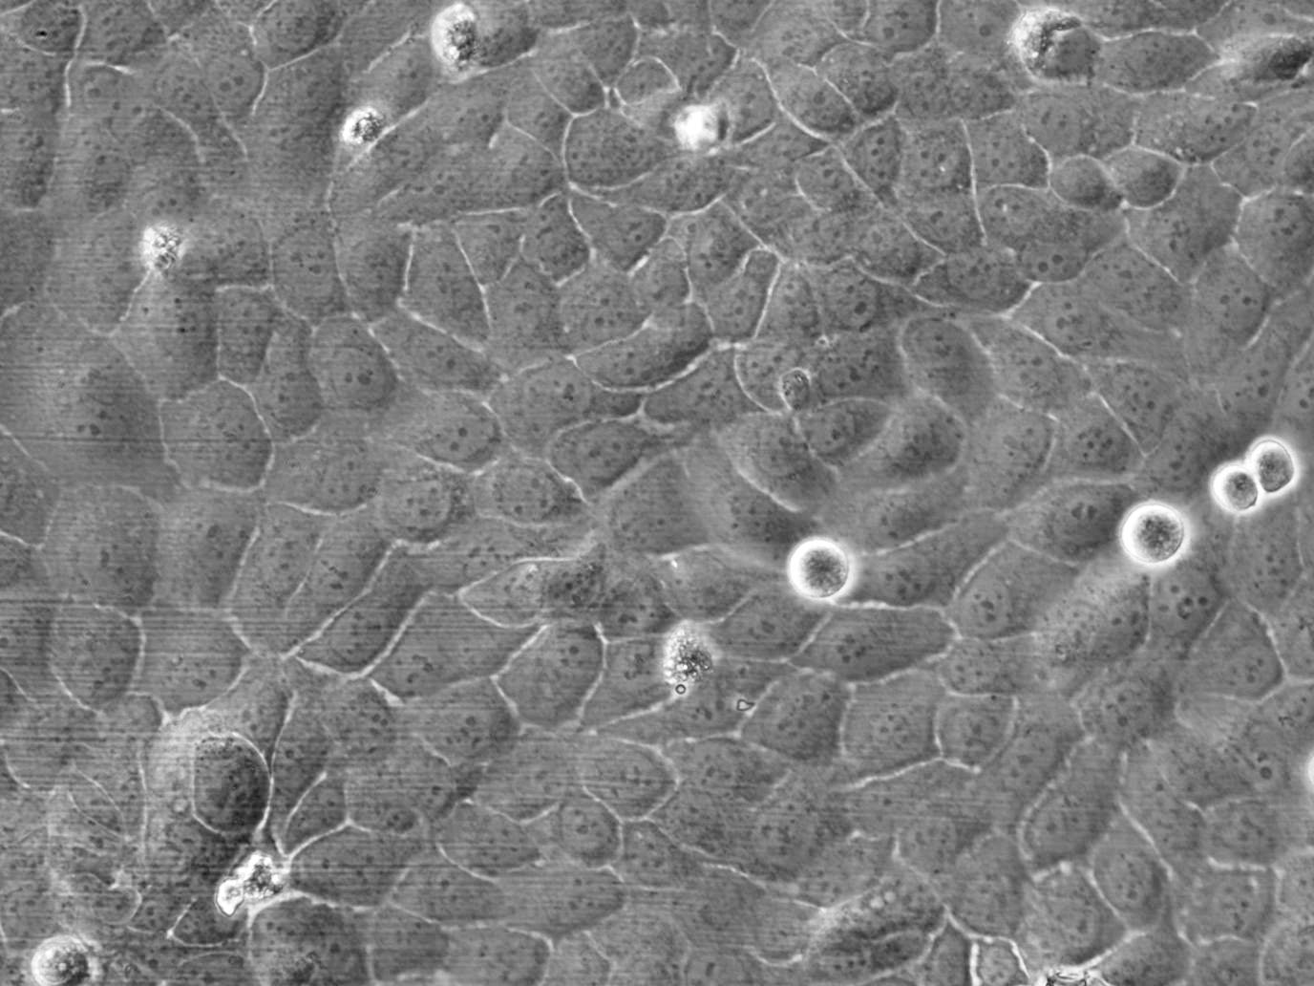
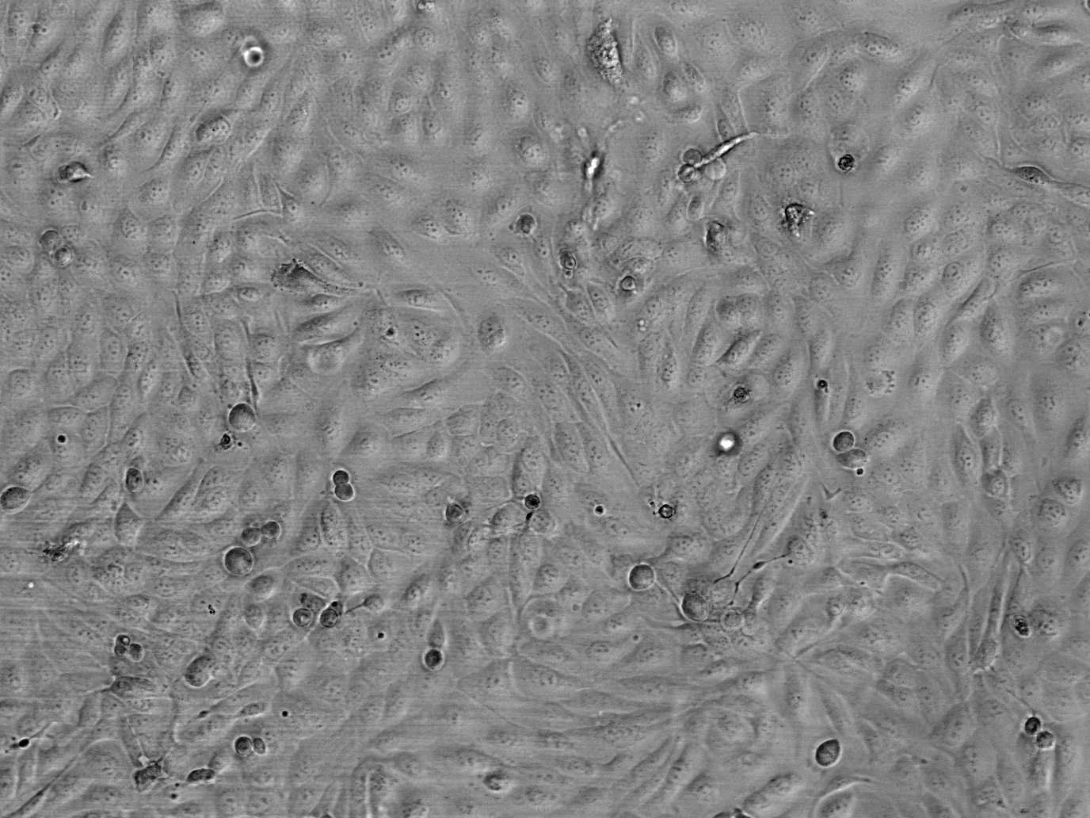
Experimentální přístupy
Benign (BPH-1)
EMT
Cancer associated fibroblast - tumor derived (CAFTD)
EMT markers
EMT regulators
Cell shape and behavior
TGF-β
TGF-β
EMT
EMT

Slide 14
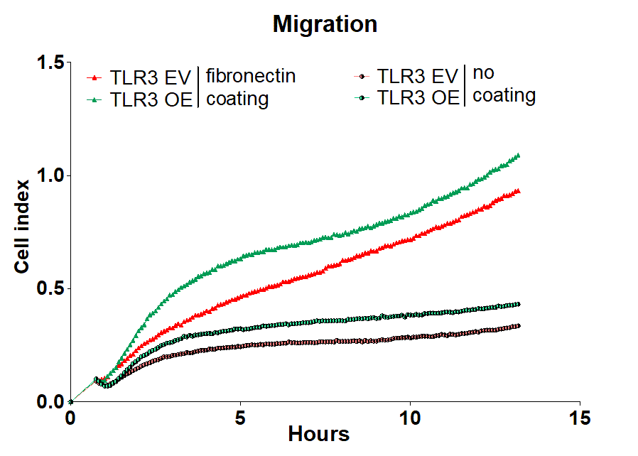
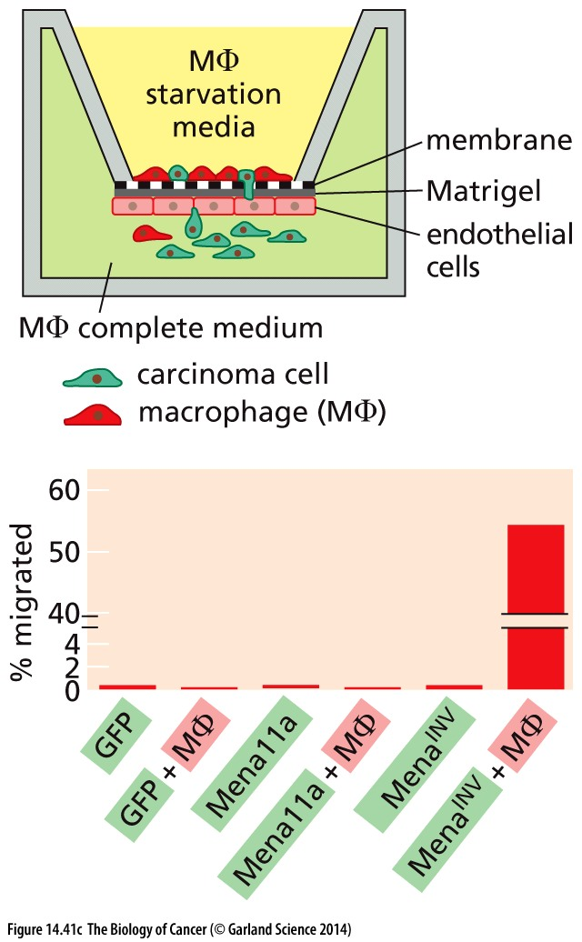
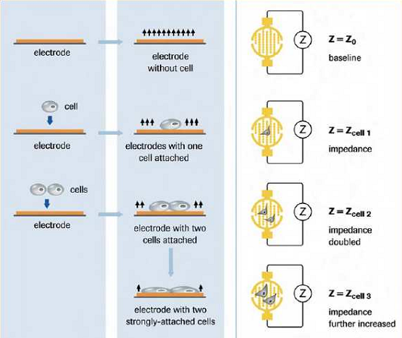
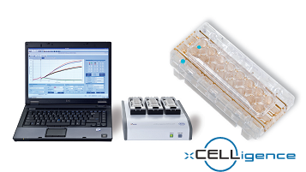
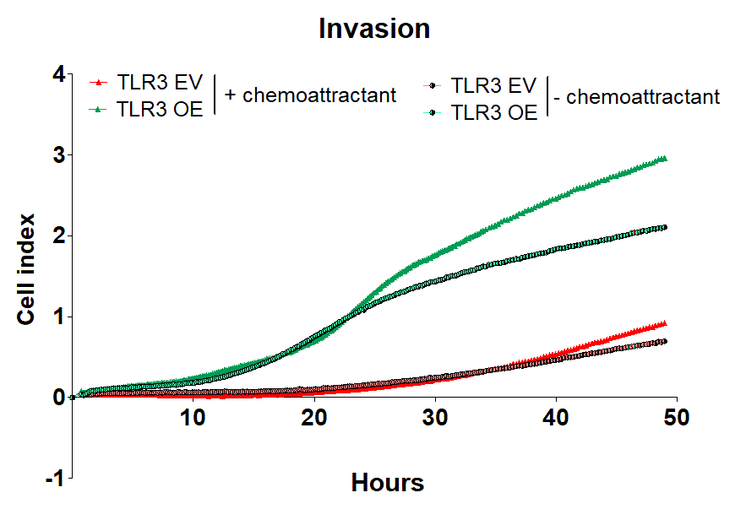
Analýza migračního potenciálu
Floating cell
Protect ring
Attached cell
Matrix
Electrodes
Invading cell

Slide 15
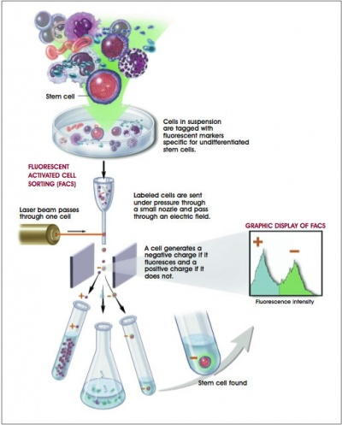
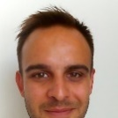
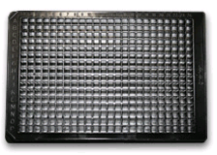
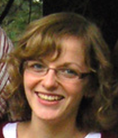



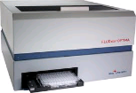
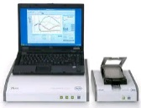
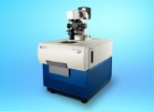
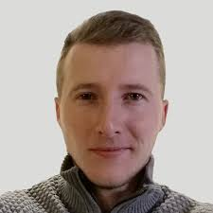











  Flow cytometry as a tool for understanding of cell phenotype and function
Fedr, R., Pernicova, Z., Slabakova, E., Strakova, N., Bouchal, J., Grepl, M., Kozubik, A. & Soucek, K. Automatic cell cloning assay for determining the clonogenic capacity of cancer and cancer stem-like cells. Cytometry A 83, 472-482, (2013).
Kahounova, Z., Kurfurstova, D., Bouchal, J., Kharaishvili, G., Navratil, J., Remsik, J., Simeckova, S., Student, V., Kozubik, A. & Soucek, K. The fibroblast surface markers FAP, anti-fibroblast, and FSP are expressed by cells of epithelial origin and may be altered during epithelial-to-mesenchymal transition. Cytometry A 93, 941-951, (2018).
Simeckova, S., Fedr, R., Remsik, J., Kahounova, Z., Slabakova, E. & Soucek, K. Multiparameter cytometric analysis of complex cellular response. Cytometry A 93, 239-248, (2018).
Drápela, S., Fedr, R., Remšík, J., Souček, K., High-throughput, parallel flow cytometry screening of hundreds of cell surface antigens using fluorescent barcoding. Methods in Molecular Biology, under review, (2021)
Radek
Fedr
single cell/well
up to 384 well plate
Zuzana Kahounová
re-culture after sorting (2D, 3D)
Šárka Šimečková
Stanislav Drápela
analysis: CyQuant, ATP, xCelligence, images, SEQ
lineage
surface
plasticity
manifestation

Slide 16



Cell phenotypes associate with distinct surface antigens in vitro
Epithelial cells | Mesenchymal cells | EMT induced by:
HMLE | HMLE-EMT | stem cell state
MCF10A | MCF10A-V12 | oncogene (KRas^{V12})
BPH-1 | CAFTD03 | microenvironment

Slide 17

High-throughput cell surface screen identified epithelial- and mesenchymal-like surface signature
Remsik, J. et al. Br. J. Cancer 118, 813-819, (2018).

Slide 18

Cell phenotypes associate with distinct surface antigens in vitro
Hypothesis: The 10-molecule signature associates with plasticity of cancer cells
12-color cytometric panel for analysis of tumor heterogeneity
Remsik, J. et al. Br. J. Cancer 118, 813-819, (2018).

Slide 19







Six-molecular surface fingerprint predicts docetaxel resistance in prostate cancer patients
Stanislav Drápela
Taxane resistance = serious obstacle in the therapy of advanced prostate cancer
In vivo models – docetaxel-resistant patient derived xenografts
Docetaxel-resistant
cell surface profile
↓EpCAM
epi cell adhesion
molecule
docetaxel
(33 mg kg⁻¹)
Data from Cancer Facts & Figures, ACS, 2018
↓CD9
tetraspanin
TURP
engrafted s.c.
van Weerden et al., Br J Cancer, 2009
Aim: To determine unique surface fingerprint of docetaxel-resistant (DR) cells
↑CD44
homing cell adhesion molecule
    i. “personalized“ prediction of docetaxel
    effectiveness prior therapy
↑CD59
glycoprotein
protectin
    ii. identification of druggable targets
    for the targeting of DR cells
↑CD95
Fas receptor
    iii. description of the mechanism of
    docetaxel resistance
↑SSEA-4
stage-specific embryonic antigen-4
Drápela, S., et al., Pre-existing cell subpopulations in primary prostate cancer tumors display the surface fingerprint of docetaxel-resistant cells. Under revision.

Slide 20







Future plans
1. IHC-based validation of selected biomarkers – e.g. SSEA-4
2. Functional validation – CRISPR knock-out models
  Output: stratification of the patients for docetaxel therapy
  Output: clinical relevance of selected biomarkers
3. Deciphering molecular mechanism of docetaxel resistance – sorting & RNAseq
  Output: complex genomic, transcriptomic and proteomic profile of docetaxel-resistant cells
sorting
RNA-seq
analysis
Applying transcriptomic profile of “DOC resistant“ cells to already published advanced PCa & PCa metastasis signatures.

Slide 21















Analyses with applied artificial intelligence
Radek
Fedr
Jiřina Procházková
Increased amount of parameters = necessity to employ AI in data computation
Aim: To apply machine learning and dimension reduction algorithms in search and recognition of populations
with specific or unknown fingerprint
  Process implementation
Expert-driven machine learning/
Dimensionality reduction maps
Cell classification/
Clustering algorithms
Original parameters translation/Sorting
Microscopy
Flow cytometry
Local structure
Global structure
Sequencing
Created with BioRender.com
  Output: To reveal unique populations and compare genomic, transcriptomic and proteomic profiles

Slide 22







Plasticity and intratumoral heterogeneity in triple-negative breast cancer
Barbora Kvokačková
Complex analysis of tumor and microenvironmental compartments in TNBC samples by mass cytometry
Analysis of epithelial-to-mesenchymal plasticity (EMT) in TNBC patient samples
Identification of new clinically valuable biomarkers
EMT surface fingerprint in clinical specimens
Complex heterogeneity in TNBC tissues (36 markers)
Stromal
Immune
Tumor
collaboration with
Remsik, J. et al. Plasticity and intratumoural heterogeneity of cell surface antigen expression in breast cancer Br. J. Cancer 118, 813-819, (2018).

Slide 23



Future outlook
Description of intratumoral and stromal heterogeneity in TNBC patient cohort by mass cytometry – advanced data analysis
Identification of genetic signatures in selected subpopulations and their association with clinical observations
Validation of identified biomarkers by IHC on retrospective cohort of TNBC patients
sorting
RNAseq
Analysis
pop2
pop1

Slide 24

What kind of cells and mechanisms drive metastasis and chemoresistance?
primary tumor
competent
cell
micrometastasis

Slide 25

Metastatická kaskáda
Cirkulující nádorové buňky (CNB) – klíčová úloha
Francia et al., Nat. Rev. Cancer (2011)

Slide 26

Proč se cirkulujícími nádorovými buňkami zabývat?
90% úmrtí spojených se solidními nádory – metastáze
  Šíření primárně krví
Klinicky významné
  „Liquid biopsy“
  Průběh terapie
  Prognostický znak
  Specifické mutace → cíle terapie
Schilling, et al., Nat. Rev. Urol. (2012)

Slide 27

Vlastnosti cirkulujících nádorových buněk
Překonání anoikis
Změna fenotypu
1g (10⁹ buněk) tumor – uvolnění 10⁶ buněk/24 h
  1 CNB na 100 mil krevních buněk
Poločas života: 1 – 2 hod
Velikost a deformovatelnost
Exprese povrchových znaků
  Možnosti detekce
Hayes et al., Science (2010)

Slide 28


Metody detekce nádorových cirkulujících buněk
Vojtěch Dvořák, BP, MU, 2016

Slide 29

Detekce nádorových cirkulujících buněk

Slide 30

Příklad: Filtrace
CNB: epiteliální původ → větší velikost
Platformy: MetaCell, CellSieve, Celsee,…
Výhody – nezávislost na povrchových znacích
  Heterogenní populace
  Není nutná aktivace receptorů
  Nativní stav
Nevýhody
  Možný překryv s leukocyty
  Nutné využít dalších znaků (CD45)
  Různá velikost CNB?

Slide 31




Příklad: Filtrace
polycarbonate membrane with 8 μm pores (CTCs over 20 μm)
capilary force-driven filtration

Slide 32

Příklad: mikrofluidní separace

Slide 33

Příklad: mikrofluidní separace

Slide 34



Příklad: mikrofluidní separace

Slide 35


Izolace CTC pomocí deplece CD45+ buněk krve

Slide 36
Klinické využití detekce cirkulujících nádorových buněk
Odhad prognózy pacienta
Monitoring průběhu onemocnění
Včasná detekce
Metastázující karcinomy prsu a prostaty – hranice 5 CNB/7,5ml
Metastázující karcinom tlustého střeva – hranice 3 CNB/7,5 ml
CellSearch system Veridex – schváleno FDA
www.cellsearchctc.com

Slide 37


Množství cirkulujících nádorových buněk korelují s prognózou

Slide 38

Molekulární charakterizace CNB → cílená terapie
Biopsie – identifikace mutací – zacílení terapie
Uvolňovány i z metastáz → komplexita
Vývoj onemocnění → chemorezistence, identifikace nových cílů
Využití v budoucnu?
Krebs et al., Nat. Rev. Clin. Onc., (2014)

Slide 39

Plasticita cirkulujících nádorových buněk
Tvorbu metastáz ovlivňuje řada faktorů – mj. plasticita CNB
Epiteliálně-mezenchymální přechod
  Podíl na vzniku CNB
  Vyšší motilita a invazivita
  Vznik chemorezistence
  Detailní mechanismy stále předmětem výzkumu
  Význam popsán u řady karcinomů (prsu, prostaty, plic, tlustého střeva, vaječníků, atd.)
Tsai et al., Cancer Cell, (2012) - upraveno

Slide 40


Epiteliálně-mezenchymální přechod
U CNB popsán epiteliální i mezenchymální fenotyp
M+ buňky – spojeny s progresí onemocnění
Dynamické změny

Slide 41








Multicentric invasive ductal carcinoma of the right breast, G2, pT3 pN1a(2/9) M0 L1 V0, ER 100%, PR 0-80%, KI67 59%, Her-2 neg., dg. 5/2011, age 32
MUDr. J. Navrátil, Ph.D.
MUDr. P. Fabián, Ph.D.
Prof. MUDr. M. Svoboda, Ph.D.
Progress of the disease:
Adjuvant RT
& tamoxifen
Capecitabin
Paclitaxel w
Markéta Pícková
Stanislav Drápela
Surgery
Navelbin
Adjuvant
CHT TAC
Letrozol
Faslodex
Gemzar
Carboplatin
CDX surface profiling
5/2020
exitus
11/2019
5/2011
7/2011
11/2011
4/2016
Relapse in skeleton
6/2017
3/2018
9/2018
6/2019
9/2019
12/2019
3/2020
Mets in CNS
Blood collection
histology
CTC-derived tumor
Xenograft establishment
RTG
Implantation
CTCs isolation

Slide 42



Preclinical models for isolation of circulating tumor cells
Markéta Pícková
Circulating tumor cells are promissing tool for analysis of cancer heterogenity and therapy response
Aims: Prepare suitable in vivo preclinical models of cancer progression to study the cancer heterogenity refflected in circulating tumor cells (CTCs) and utilize the models for translational research to support development of personalized medicine of patients with metastatic disease.
Model of human melanoma
CTC-derived colonies
Syngeneic model of breast cancer
Flow cytometric detection and in vitro isolation of viable CTCs
In vivo progression of A375 IV luc GFP melanoma and 4T1 breast cancer
Characterization of EMT-surface markers signature in CTCs and corresponding primary tumor

Slide 43
Is there a cure for advanced cancer?

Slide 44


Protein kinases: promising targets for anticancer therapy
> 500 enzymes (approx. 1.7% of human genome)
Pharmacokinetics
Kinases = phosphotransferases
regulation of multiple cell processes
DNA damage response, DNA repair, mitosis
MU380 = better pharmacokinetic profile
Protein kinase inhibitors = hot topic in pharmacology
(> 30 compounds in clinical trials)
Checkpoint kinase 1 (CHK1)
implemented in DNA damage response and DNA repair
until 2014 unknown pharmacophore
promising therapeutic target
novel CHK1i – MU380
SCH900776
CHK1 IC₅₀ = 0.005 mM
phase II clinical trials (with cytarabine)
MU379
potential metabolite
less selective than SCH900776
MU380
CHK1 IC₅₀ = 0.002 mM
more potent than SCH900776 in vitro
synthetic lethality (gemcitabine, cytarabine)
Kamil Paruch

Slide 45







CHK1 inhibition in multiple preclinical models
T. Suchánková
S. Drápela
Ovarian cancer - survival
Pancreatic cancer
Chronic lymphocytic leukaemia (CLL)
Docetaxel-resistant prostate cancer (PCa)
in vivo robust pharmacophore
highly efficicent in combination with antimetabolites on various preclinical models
bypasses chemoresistance in prostate cancer
effective as monotherapy in CLL
Kamil Paruch, Lumír Krejčí, Martin Trbušek

Slide 46






Haspin kinase – new target for preclinical development of highly selective inhibitors
Jan Novotný
Tereza Suchánková
Aims
synthesis of a small library of potent compounds
profiling the activity in a panel (400+) of kinases
testing for the activity in the cancer cell models
HASPIN
Atypical human kinase that associates with chromosome and phosphorylates threonine 3 of histone 3 during mitosis
MU1464 is highly selective haspin inhibitor with a new central pharmacophore
  HeLa Fucci2 reporter system suitable for single cell tracking and analysis of cell division and morphology

Slide 47


Future plans
Jan Novotný
Tereza Suchánková
1. Optimization and preclinical progression of our new highly selective inhibitors of the kinase Haspin and identification of compounds suitable for early phase clinical evaluation.
2. Development of new tools for description of complex response to new inhibitors at cellular level
  single cell tracking - Fucci4 system
  flow cytometric multiparametric assay for haspin inhibitor screen
  Proximity-dependent Biotin Identification (BioID)
Bajar et al. Nature Methods. 2016
3. Linking haspin biology to intratumor heterogeneity, cancer plasticity, metastasis and acquiring the resistance in response to therapy
Sony SP6800 Spectral Analyzer

Slide 48



The Nobel Prize in Chemistry 2008
"for the discovery and development of the green fluorescent protein, GFP"
http://nobelprize.org/nobel_prizes/chemistry/laureates/2008/

Slide 49



Fluorescent proteins
bioluminescence resonance energy transfer (BRET)
  Aequorea victoria - jellyfish
  Blue bioluminescence. Ca²⁺ interacts with aequorin photoprotein.
  Blue light excites green fluorescent protein.
  Renilla reniformis – coral
  luminescence appears after degradation of coelenterazine in the presence of luciferase enzyme.
  Blue light excites green fluorescent protein
Aequorea victoria “Crystal jelly “
Renilla reniformis "Sea Pansy"
http://www.mbayaq.org/efc/living_species/default.asp?hOri=1&inhab=440
http://www.whitney.ufl.edu/species/seapansy.htm

Slide 50


Fluorescent proteins
Osamu Shimomura
  1961 discovered GFP and aequorin
http://www.conncoll.edu/ccacad/zimmer/GFP-ww/GFP2.htm

Slide 51



Fluorescent proteins
Douglas Prasher
Martin Chalfie
Science. 1994 Feb 11;263(5148):
Green fluorescent protein as a marker for gene expression.
Chalfie M, Tu Y, Euskirchen G, Ward WW, Prasher DC.
Department of Biological Sciences, Columbia University, New York, NY 10027.
A complementary DNA for the Aequorea victoria green fluorescent protein (GFP) produces a fluorescent product when expressed in prokaryotic (Escherichia coli) or eukaryotic (Caenorhabditis elegans) cells. Because exogenous substrates and cofactors are not required for this fluorescence, GFP expression can be used to monitor gene expression and protein localization in living organisms.

Slide 52


Fluorescent proteins
http://www.conncoll.edu/ccacad/zimmer/GFP-ww/GFP2.htm

Slide 53





Roger Tsien
~ 2002 – mutated FP = wide spectrum of colors
http://www.tsienlab.ucsd.edu/

Slide 54
Analysis of synchronized cells

Slide 55

Licensing control by Cdt1 and geminin
J Cell Sci 2012 125: 2436-2445; doi: 10.1242/jcs.100883

Slide 56


Fucci
(fluorescent ubiquitination-based cell cycle indicator) cells
Ubiquitin E3 ligase complexes
G1 - APC^{Cdh1}
^{substrate:} Geminin, inhibitor of DNA replication inhibits Cdt1
S, G2, M- SCF^{Skp2}
substrate: DNA replication factor Cdt1 – key licensing factor
Fucci sensors - 1st generation, coral FP
monomeric Kusabira orange 2 – hCdt1 (30/120)
Monomeric Azami-Green – hGeminin (1/110)
Fucci sensors – 2nd generation, Aequorea FP
red monomeric fluorescent protein - mCherry -hCdt1 (30/120)
yellowish green monomeric variant of GFP –mVenus – hGeminin (1/110)

Slide 57


Fucci
http://cfds.brain.riken.jp/Fucci.html

Slide 58




Slide 59






CONTROL
SCH900776
MU380
VEHICLE
GEMCITABINE

Slide 60
…lot of questions, but how to answer them?
How many times cells divided?
What is a length of cell cycle phases?
Is there a difference in time between first and second division?
How it is all affected by my drugs?

Slide 61

Branches (dvisions) analysis
02_02_01_01

Slide 62


02_02_01_01
Median 14 hours

Slide 63


Slide 64
Partners
Team & Collaborators
Methodology

Slide 65







SELECTED ALUMNI (2016 – 2020/2021)
Ján Remšík
PhD in CAP – > postdoc at MSKCC, NYC, USA, cancer spread into cerebrospinal fluid
Vojtěch Dvořák
MSc in CAP –> PhD student at Ce-M-M, Vienna, drug resistance
Stanislav Drápela
PhD in CAP – > postdoc at Moffitt, FL, USA, from 5/2021, cancer metabolism

Slide 66

Acknowledgement
Souček lab
Kamil Paruch – Medicinal Chemistry
Jiří Damborský – Protein Engineering
Lumír Krejčí – Genome Integrity
Aleš Hampl – Cells and Tissue Regeneration
Lukáš Kubala – Molecular Control of Immune response
Vladimír Rotrekl – Stem Cells and Disease Modeling
Pavel Krejčí – Cell Signaling
Jiří Navrátil, Pavel Fabian, Marek Svoboda – Masaryk Memorial Cancer Institute
Vladimír Študent – FN Olomouc
Jan Bouchal – Palacky University
Medical University Innsbruck
Erasmus University
Institute of Biophysics of the Czech Academy of Science
Masarykova univerzita
FNUSA-ICRC
Grant agencies and all patients!
THANK YOU FOR YOUR ATTENTION

