Slide 1
C8953
NMR structural analysis seminar
Information about classes + 1D ¹H-NMR
Michal Knor
437395@mail.muni.cz
March 10, 2021

Slide 2
Information about classes
Credit:
3 homework tests + final exercise
Study materials:
https://is.muni.cz/auth/el/1431/jaro2021/C8953/um
E-tests:
https://is.muni.cz/auth/el/1431/jaro2021/C8953/odp

Slide 3
Energy levels splitting
s=1/2
B₀
m_{s}=+1/2
α
E
β
ΔE
α
B₀
m_{s}=‐1/2
β
N_{α}>N_{β}

Slide 4
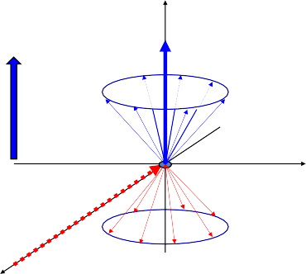



Behavior of nuclear spin after irradiation by RF pulse
z
M_{z}
B₀
B₀
y
^{B}loc
RF pulse
B₀ induces local mag. field
B_{loc}, which affects against B₀
x
Nuclear shielding
Precession frequency:
Precession frequency affected by nuclear shielding: Chemical shift:
Definition of th relative scale of the chemical shift:
ω = ‐γB₀
ω = ‐(1+σ)B ₀
δ = ω ‐ ω_{ref}
6
δ = (ω ‐ ω_{ref})/ω_{ref}.10 ppm

Slide 5
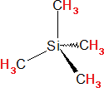
Characteristic intervals of chemical shifts values
H
H
H
H
H
O
H
R
H
O
H
O
O
H
N
H
H H
R H
R Cl
H
O
R
R1
R2
R
R
H
H
12
Higherω
10
8
4
2
0
ppm ⁶
Lowerω
Increase of chemical shift
Increase of shielding

Slide 6
Trends in chemical shifts
Electronegativity, inductive and mesomeric effects of substituents
Hybridisation
Relative position towards the ring, double bond
3,1 ppm H H
H Cl H OR H NO₂
2,1 ppm 2,3 ppm 3 ppm H H H H H H
I H Br
4,5 ppm H H
Substituents with ‐I effect
=N⁺R >‐N⁺R >‐NO >‐NR
2 3 2 2
‐SO₂R>‐SO₃>‐SOR>‐SR
‐F>‐OR>‐NR₂>‐CR₃
‐F>‐Cl>‐Br>‐I
H
H H
5,3 ppm
⁼N>=NR>‐NR
2
Cl
Cl
‐C⁼CH>‐CH=CH₂>‐CH₂‐CH₃
Substituents with +I effects
‐N‐R>‐O‐>S‐
‐C(CH₃)₃>‐CH(CH₃)₂>‐CH₂CH₃>‐CH₃
metals
Cl H
7,3 ppm
Cl
Cl

Slide 7
Mesomeric effect
7,24
5,29
5,29
6,11
3,74
6,52
6,55
8,15
3,93
7,08
7,55
‐M
+M
6,70
+M
7,70
‐M
Substituents with ‐M effects
‐F, ‐Cl, ‐Br, ‐I, ‐OH, ‐OR, ‐NH₂, ‐NHR, ‐NR₂, ‐SH, ‐SR
Substituents with +M effect
‐CH=O, ‐RC=O, ‐C(OH)=O, ‐C(OR)=O, ‐C(NH₂)=O, ‐NO₂, ‐SO₃H, ‐C=N

Slide 8













Spin-spin interaction, J-coupling
H
H
R
R
R
R
^{B}loc
H H
Nucleus H: spin α ‐B_{n}
spin β +B_{n}
B₀ ‐ B_{loc} + B_{n}
H
^{B}0 ^{‐ B}loc
B ‐ B ‐ B
0 loc n

Slide 9





Interaction constant J
B₀
ω_{b}
=ω_{a}+1/2J
ω_{a}
ω_{c}
=ω_{a}‐1/2J
J=ω_{b}‐ω_{c}

Slide 10
Interaction constant J
– CH₂ – CH₃
Multiplicity of the nucleus I with the spin 1/2 is given by: m = n + 1, n = number of interacting nuclei with nucleus I
Intensity of lines in multiplet follows Pascal’s triangle
1 | 1 | 1
1 | 2 |  | 1
1 3 |  | 3 | 1
1 4 | 6 |  | 4 1
1 5 10 |  | 10 | 5 1

Slide 11

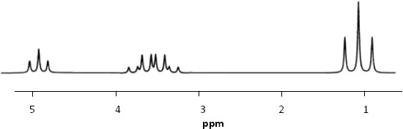
1D ¹H NMR spectrum
3_{J1} 3_{J2}
HO – CH₂ – CH₃
3_{J1}
3_{J2}
3_{J}
2
3_{J2}
3_{J2}
3_{J1}
3_{J1}
3_{J2}
3_{J2}
3_{J2} 3_{J2}
3_{J2}
3_{J1} 3_{J1}
3_{J1} 3_{J1}

Slide 12

Values of J-constants - trends
H
R2
HO
13_{C}
O
NH₂
R1
R1
H
R2
H
H C
N
3
H
H
H
O
N H
H
H
²J_{CH}= 3.1 Hz
³J_{HH}= 12 Hz
³J_{HH} = 13 ‐ 18 Hz
⁵J_{HH} = 7 ‐ 12 Hz
H
H
13_{C}
13_{C}
H
13_{C}
H
H
²J_{HH}= ‐12,5 Hz
⁵J_{HH}= 2 ‐ 3 Hz
¹J_{CH} = 125 Hz
¹J_{CH} = 160 Hz
¹J_{CH} = 250 Hz

Slide 13
Values of J-constants - trends
H
H
H
A
H A
A
B
B
H B
H
³J_{HH} = 7,5 Hz
⁴J_{HH} = 1,5 Hz
⁵J_{HH} = 0,7 Hz
X= Li H Cl OMe F
²J_{HH} (Hz) 7,1 2,5 ‐1,4 ‐2,0 ‐3,2

Slide 14
1D ¹H NMR spectroscopy
the fastest measuring, the highest sensitivity
complicated interpretation in case of more complex systems
We are looking for:
position of the signal (ppm)
multiplicity (²J, ³J, ⁴J)
intensity (integral)
halfwidth
We are considering:
chemical/magnetic equivalence
enantiotopicity/diastereotopicity
averaging of signals (dynamics, chemical exchange)

Slide 15
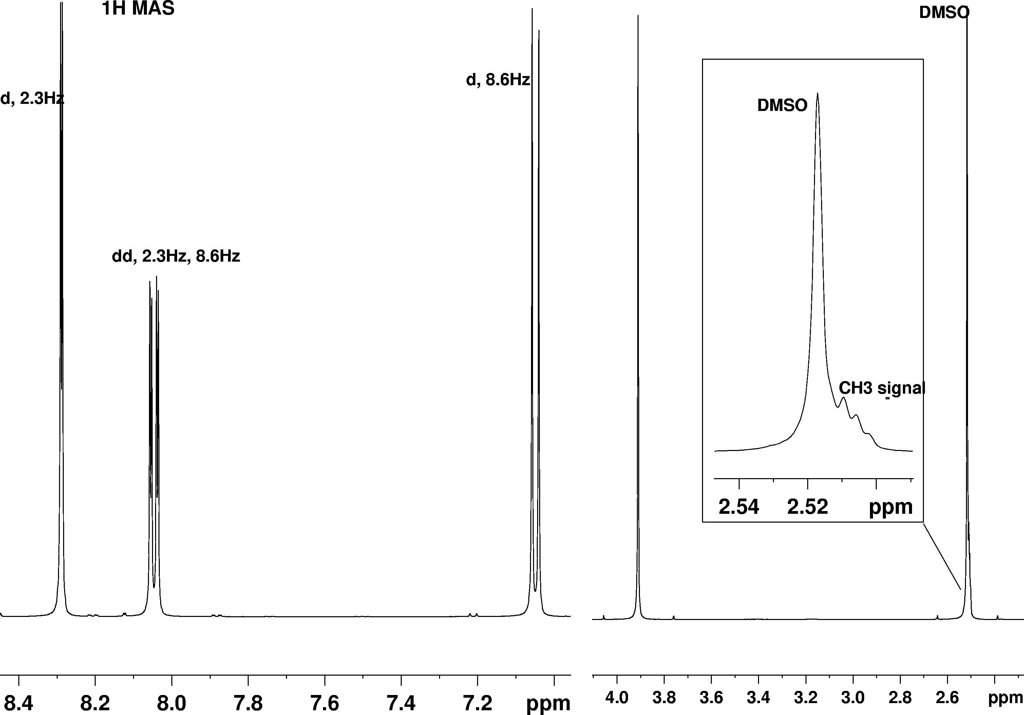
1D ¹H NMR spectrum of methyl-5-acetylsalicylate
O O
6
CH
5 1
H C 7
9
O 10
3
3 ₈
2
4
OH
3

Slide 16
1D ¹H NMR spectrum of methyl-5-acetylsalicylate
O O
5
H C 7
6
1 CH
3
3 ₈
9
O 10
4
2
OH
10
6
3
Notes:
3
two singlets in the spectrum - two isolated groups in the structure - CH₃ groups; Met-8 neighboring carbonyl has lowest shift than ester Met-10
doublet of doublets (cca 8.0 ppm) - proton signal splitted by two neighbors - H-4
two doublets in interaction with H-4 - based on the J-interaction: doublet with larger J-constant belongs to close proton - H-3, smaller
J-constant - more distant proton -
H-6
4
8

Slide 17
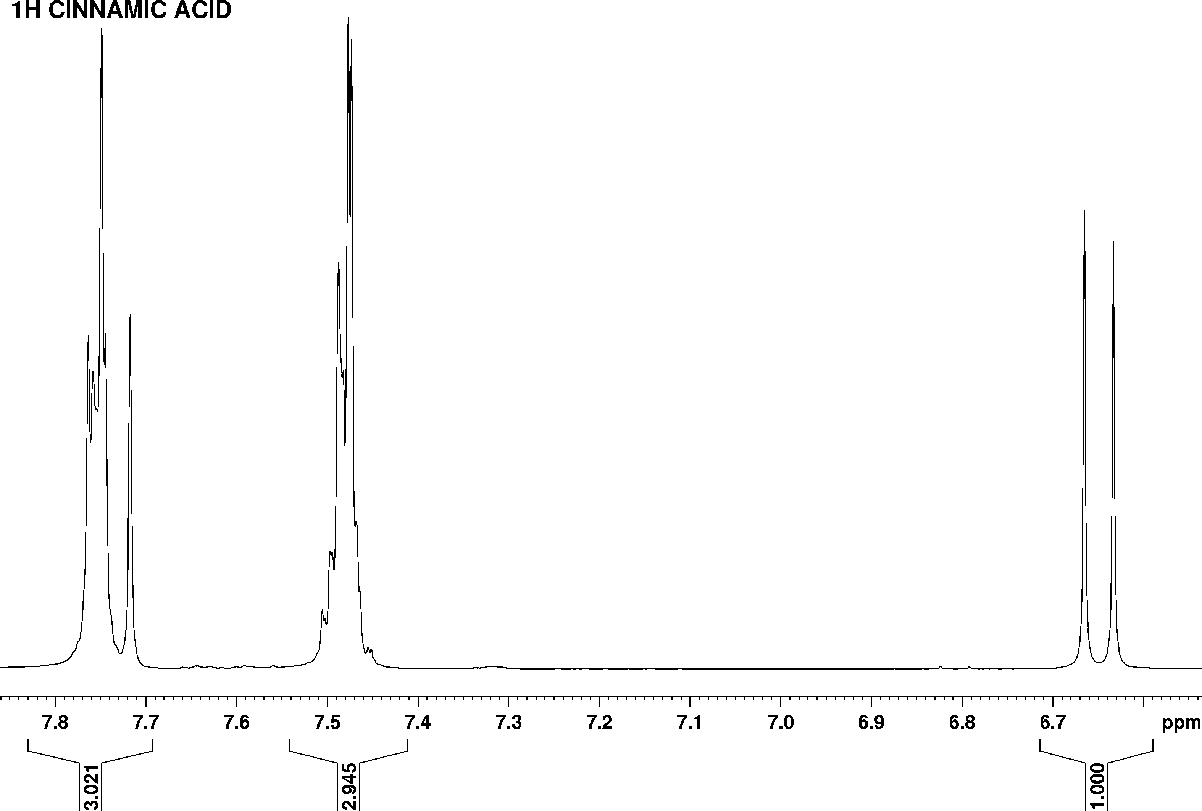
1D ¹H NMR spectrum of cinnamic acid
H O
1 8
7 9 OH
6
5
4 2
3
H

Slide 18

1D ¹H NMR spectrum of cinnamic acid
H O
8
2,6
3,5
6
1
Notes:
H-8 - doublet with large coupling, in range of shifts of protons on double bond, integral = 1
H-7 - doublet with the same coupling like doublet H-8, deshielded due to
-M effect of carboxyl and due to
nearby aromatic ring
more intensive signal between 7.7 and 7.8 ppm has integral: 3-1=2 protons - H-2,6, symmetrical, highest shift due to -M effect of substituent in ortho position on aromatic ring
signal with integral = 3 around 7.5 ppm - less intensive signal - only one proton, highest shift due to -M effect of substituent in para position - H-4; more intensive signal with highest shift - H-3,5
5
7
9 OH
4
₂ H
3
8
7
4

Slide 19
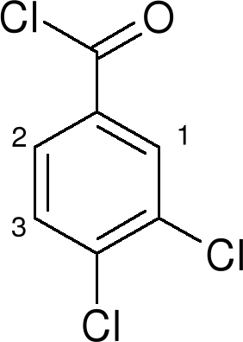
Draw approximate 1D ¹H NMR spectrum of the following compound

Slide 20
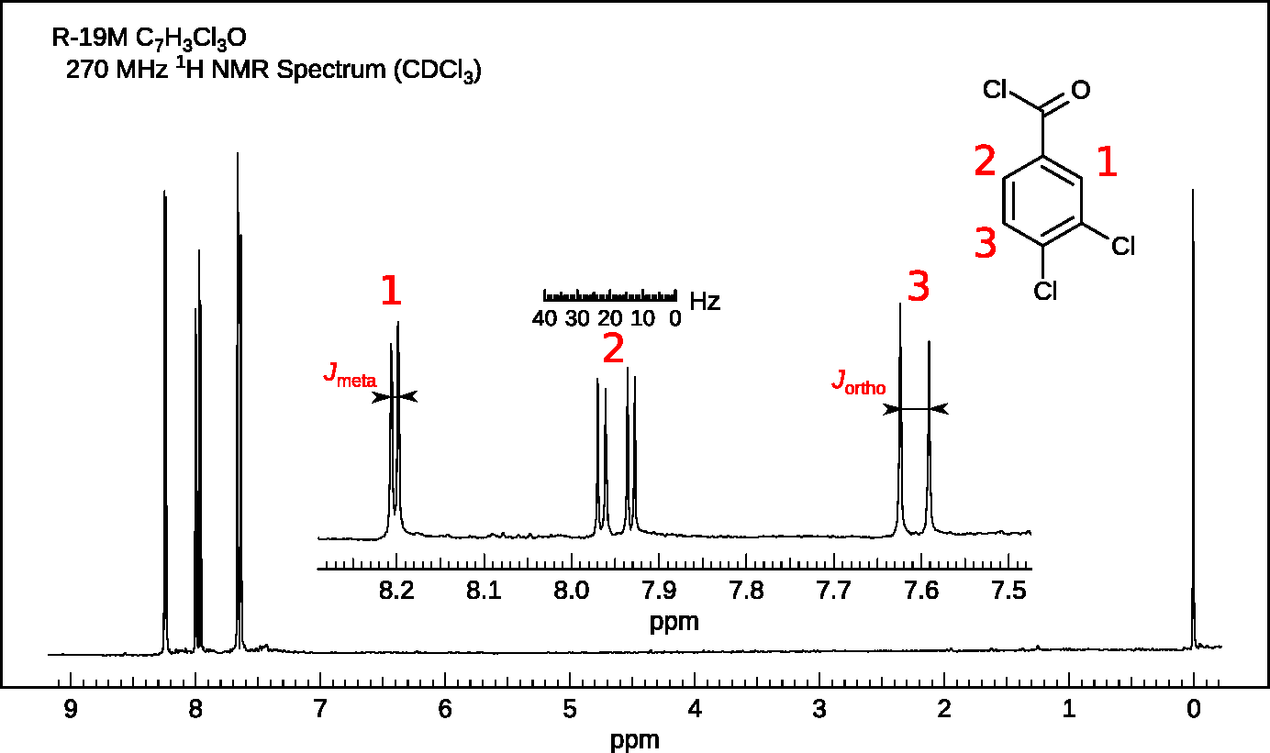
Draw approximate 1D ¹H NMR spectrum of the following compound
Notes:
H-2 - meta- and ortho- interaction with H-1 a H-3 - doublet of doublets
H-1 - only meta- interaction with H-2
- smaller coupling than H-3 in ortho-
interaction with H-2
chemical shifts are result of overall effects of substituents on the aromatic ring

Slide 21
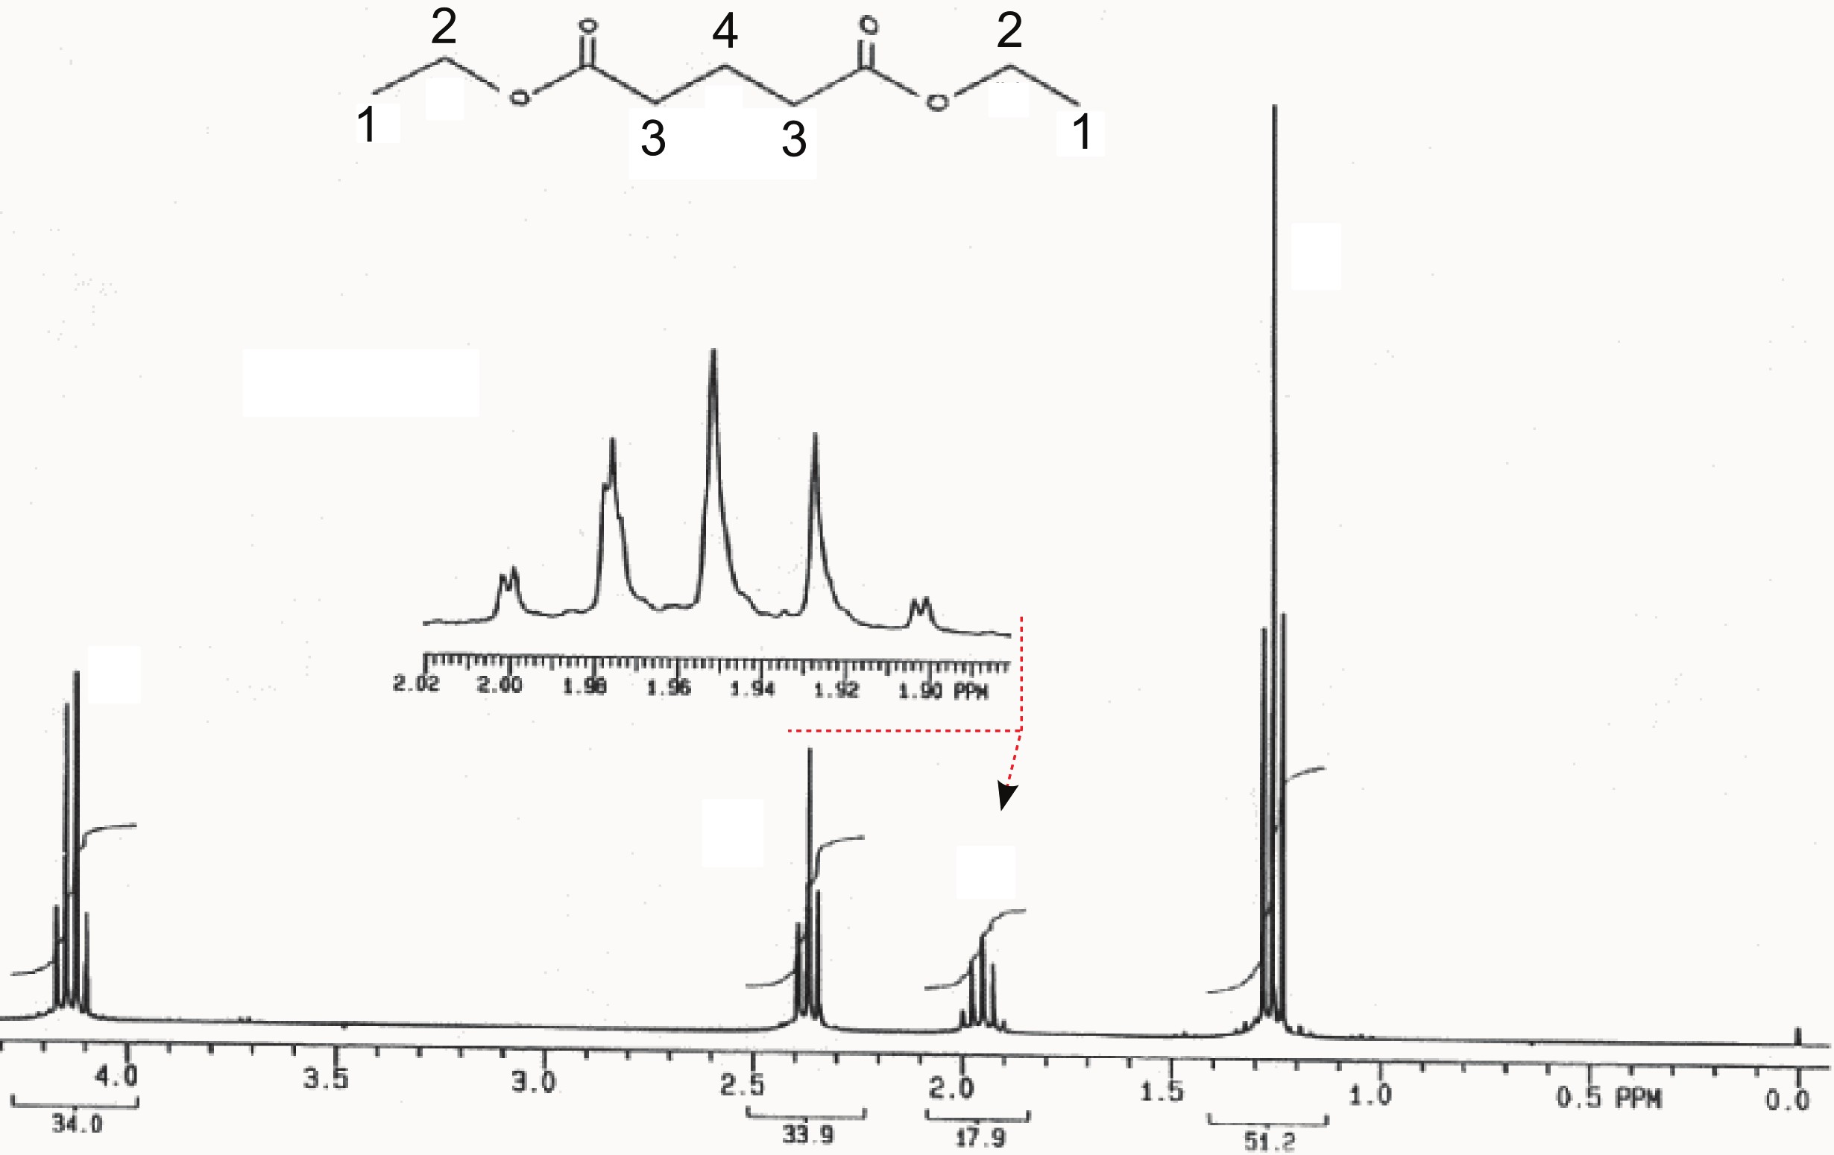
1D ¹H NMR spectrum of ethyl glutarate

Slide 22
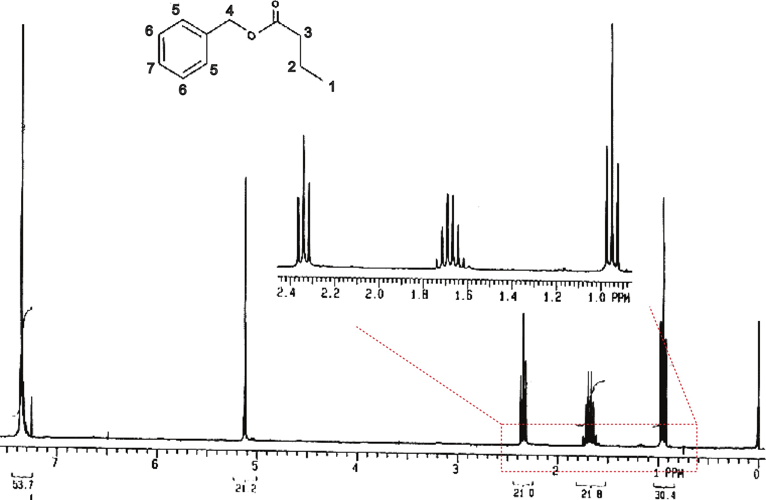
1D ¹H NMR spectrum of benzyl butyrate

Slide 23
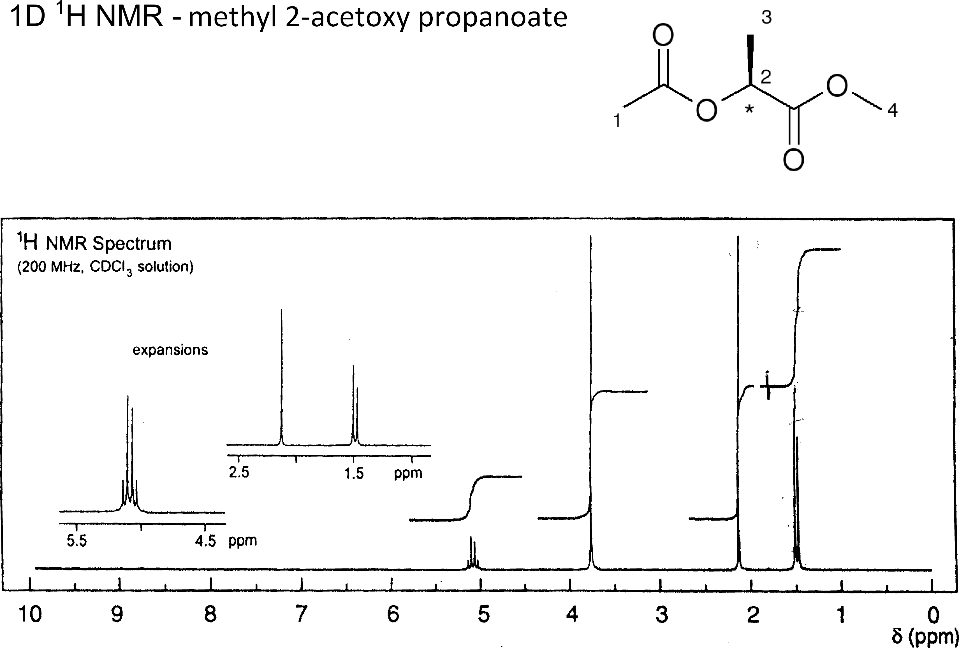
1D ¹H NMR spectrum of methyl 2-acetoxy propanoate

Slide 24
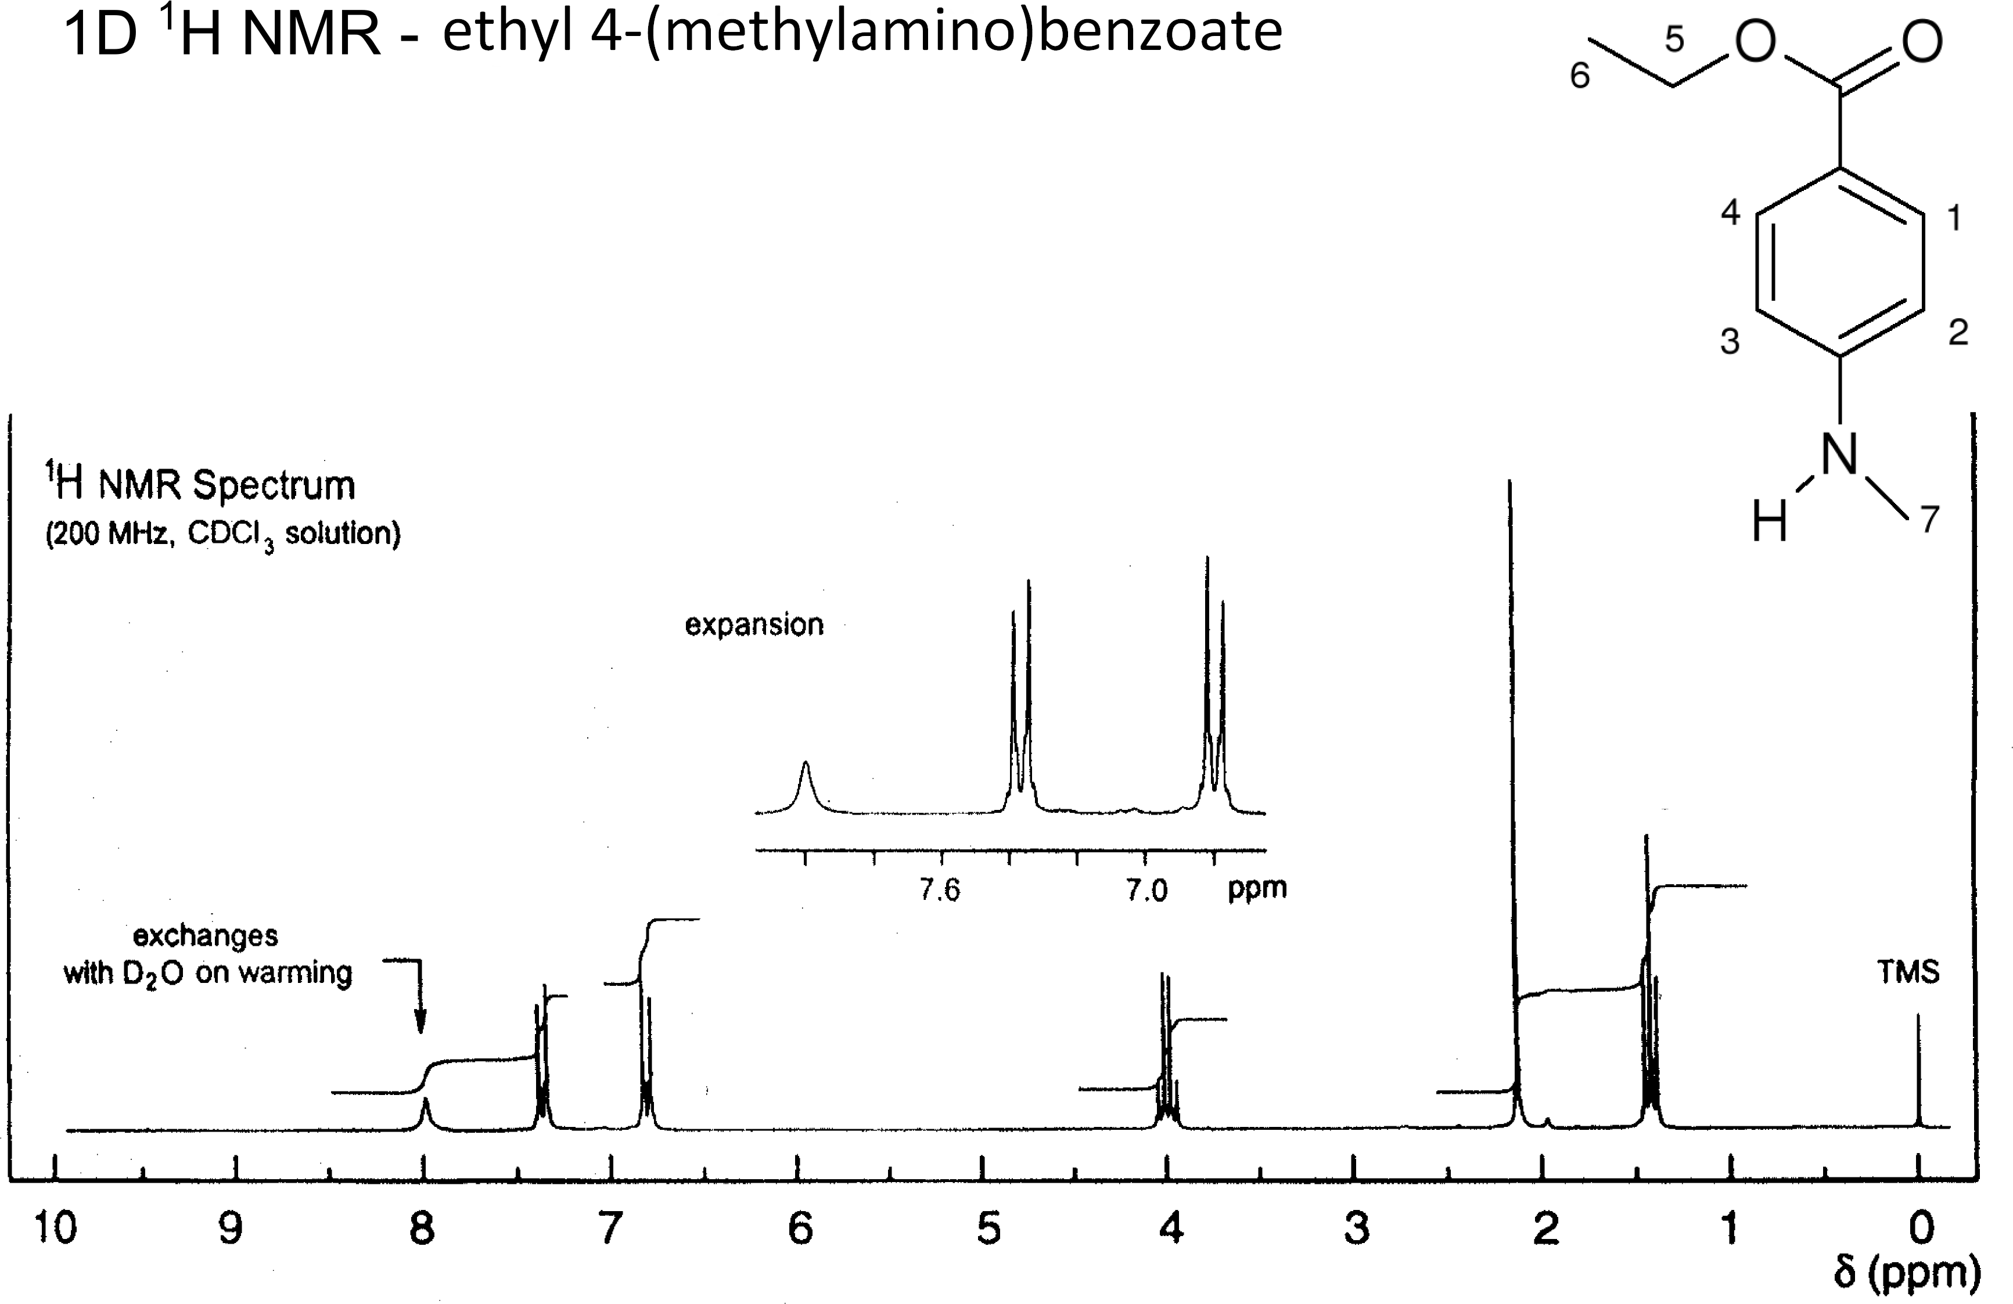
1D ¹H NMR spectrum of ethyl 4-(methylamino)benzoate

Slide 25
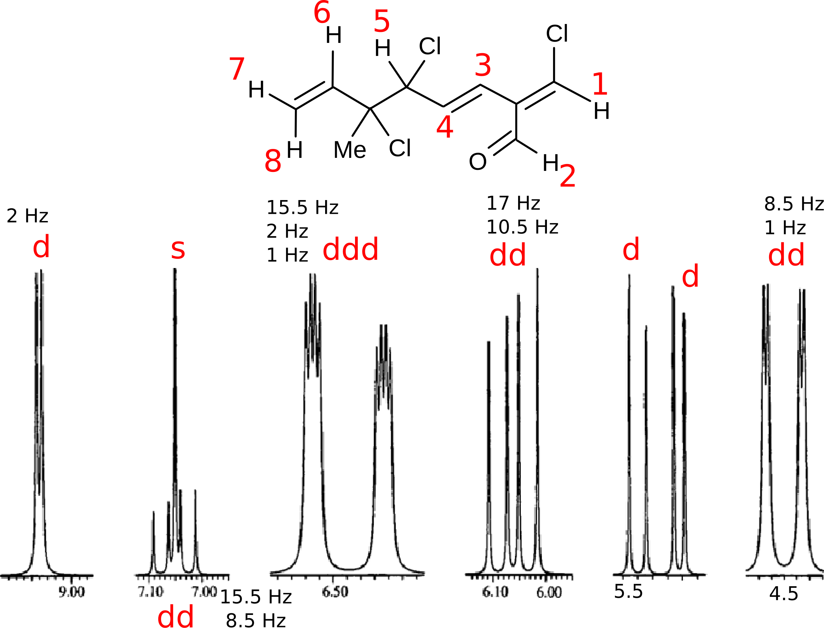
1D ¹H NMR spectrum of cartilagineal

Slide 26
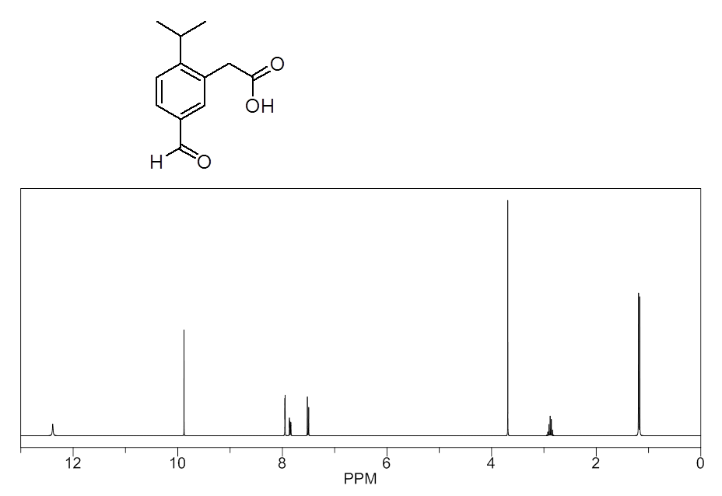
1D ¹H NMR spectrum

Slide 27
Next session:
1D ¹³C-NMR spectra

