Slide 1
C8953
NMR structural analysis - seminar
1D ¹³C-NMR
Michal Knor
437395@mail.muni.cz
March 17, 2021

Slide 2
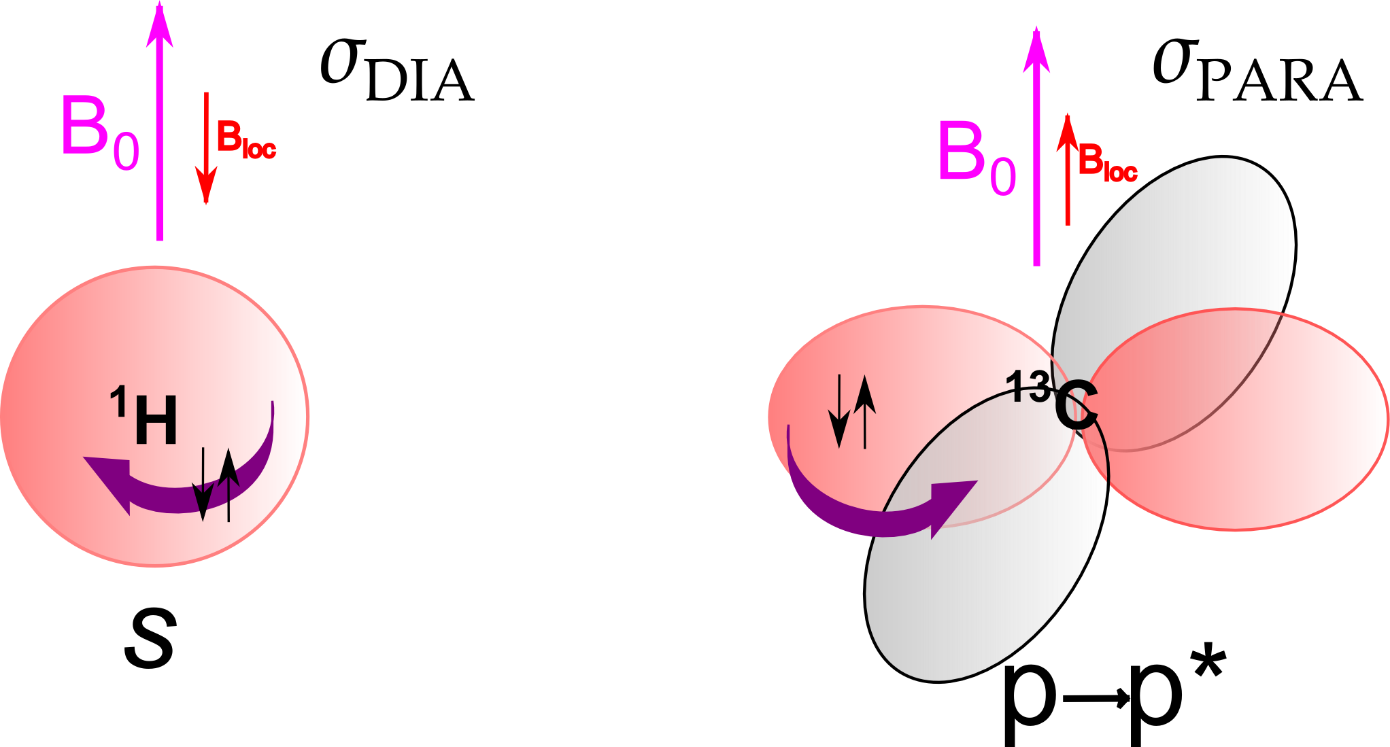
¹H vs ¹³C NMR
1_{H}
13_{C}
Spin number
1
1 2
13
1 12
H: s= × H: s=1
C: s= × C: s=0
2
2
Abundance [%] | 99.98 | 1.1
Gyromagnetic ratio [10⁷ rad.T⁻¹.s⁻¹] | 26.8 | 6.7
Chemical shift range [ppm] | 0 - 15 | 0 - 200
Nuclear shielding | σdia | σdia + σpara
Integration of signals | C | ×
T1 relaxation [s] | 1-20 | 1-40
Homonuclear J-interaction | C | ×
H↔C J-interaction (∼ 100-250 Hz) | carbon satellites | (n + 1) splitting × decoupling

Slide 3
¹H vs ¹³C NMR
1_{H}
13_{C}
Spin number
1
1 2
13
1 12
H: s= × H: s=1
C: s= × C: s=0
2
2
Abundance [%] | 99.98 | 1.1
Gyromagnetic ratio [10⁷ rad.T⁻¹.s⁻¹] | 26.8 | 6.7
Chemical shift range [ppm] | 0 - 15 | 0 - 200
Nuclear shielding | σdia | σdia + σpara
Integration of signals | C | ×
T1 relaxation [s] | 1-20 | 1-40
Homonuclear J-interaction | C | ×
H↔C J-interaction (∼ 100-250 Hz) | carbon satellites | (n + 1) splitting × decoupling
1D ¹H NMR
1D ¹³C NMR
ω_{C}+0.5¹J_{HC}
ω_{C}-0.5¹J_{HC}
^{1J}HC
^{1J}HC
¹H-¹³Cα
¹H-¹³Cβ
¹Hα-¹³C ¹Hβ-¹³C
¹H decoupled
1_{H-}12_{C}

Slide 4
Important regions of ¹³C chemical shifts
Aldehydes RCH=O
R₂C=CH₂
C-F
C-Cl
C-I
Ketones R₁R₂C=O
RHC=CHR
C-Br
Alkenes
C-NO₂
C-H Saturated Hydrocarbons
R₂C=CH₂
Aromatics
C-NH₂
Heteroaromatics
C-OH
C-SR
Carboxylic acids R-CO₂H
RC N
C-OR
C-Ar
Esters R-CO₂R'
C-SO₂ R
C-C=C
Amines R-CONR₂'
Alkynes
C CR
C-CO R
200
150
100
ppm(δ)
50
0.0

Slide 5
¹J_{CH} depends on the bond order ( hybridization ⇔
haracter )
-C-H ¹J_{CH} ≈ 125 Hz
► =C-H ¹J_{CH} ≈ 160 Hz
≡C-H ¹J_{CH} ≈ 250 Hz
X-C-H
⁾ X = N, O, S, F, Cl, . . . ¹J_{CH} ⇑
⁾ X = Li, Mg, . . . ¹J_{CH} ⇓
²J_{CH} < 0 or close to zero (<3 Hz)
often not observable
in 1D ¹³C H-C interaction suppressed by DECOUPLING
⇒ simplification of spectra (splitting removed, sensitivity)
saturation of ¹H energy levels during decoupling enhances relatively intensity of ¹³C signals because of heteronuclear nOe ⇒ quaternary carbons usually less intensive.

Slide 6
Values of chemical shift of important solvents
Abbr. Formula ¹H |  |  | 13_{C}
ACN | CH₃CN | 1.9 | 118
Benzene | C₆H₆ | 7.2 | 128
 | CHCl₃ | 7.2 | 77
DCM | CH₂Cl₂ | 5.3 | 54
DMF | (CH₃)₂NCHO | 2.9, 8.0 | 32, 163
DMSO | (CH₃)₂SO | 2.5 | 40
MeOH | CH₃OH | 3.3, 4.8 | 49
Water | H₂O | 4.8 | -
EXPLAIN effect of solvent on the position of residual ¹H water signal:
CHCl₃ - 1.6, ACN - 2.1, DMSO - 3.3, MeOH - 4.9

Slide 7
How many ¹³C signal would you expect in the NMR spectrum?
N
N
N
N
Cl
N
Ru
N₊ H
Cl
O
Cl CH
CH₃
S
3

Slide 8
How many ¹³C signal would you expect in the NMR spectrum? 7
N
N
N
N
Cl
N
Ru
N₊ H
Cl
O
Cl CH
CH₃
S
3

Slide 9
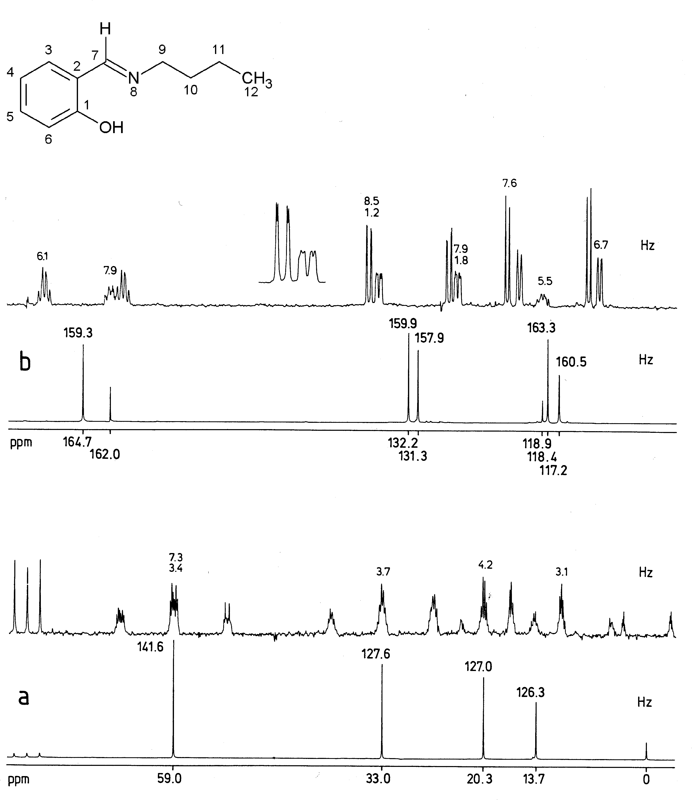
1D ¹³C-NMR 1, bottom without CPD

Slide 10
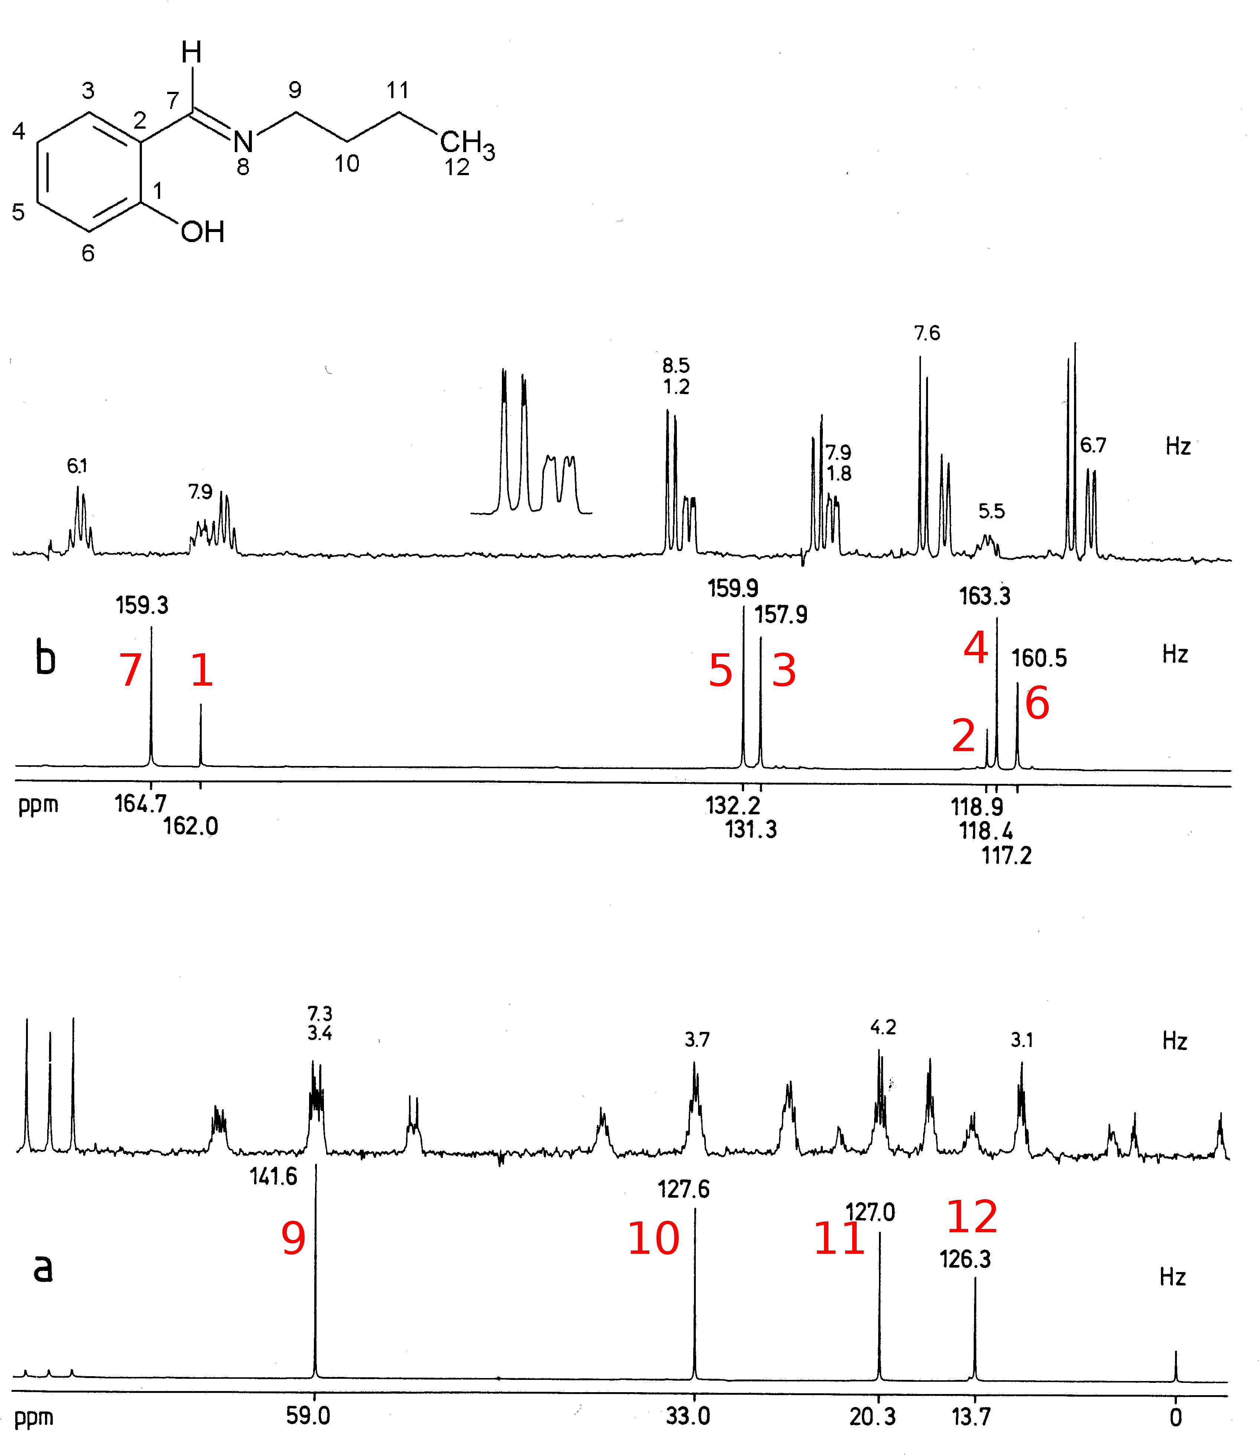
1D ¹³C-NMR 1, bottom without CPD
Notes:
numbers at top of peaks refers to values J_{HC} constants
C1+C7 connected to electronegative groups (C1 quaternary)
C2 ipso aromatic, C4+C6
shielded by M+ of OH
C5+C4 NOE-enhanced in bit larger extend by close H
C9→C12: decaying effect of N8

Slide 11
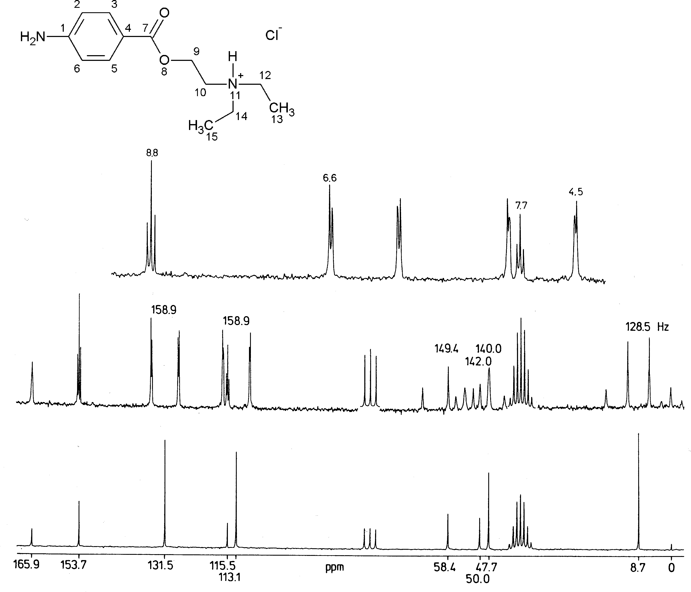
1D ¹³C-NMR 2
ZOOM of coupled region of most deshielded signals
coupled spectrum
spectrum with decoupling

Slide 12
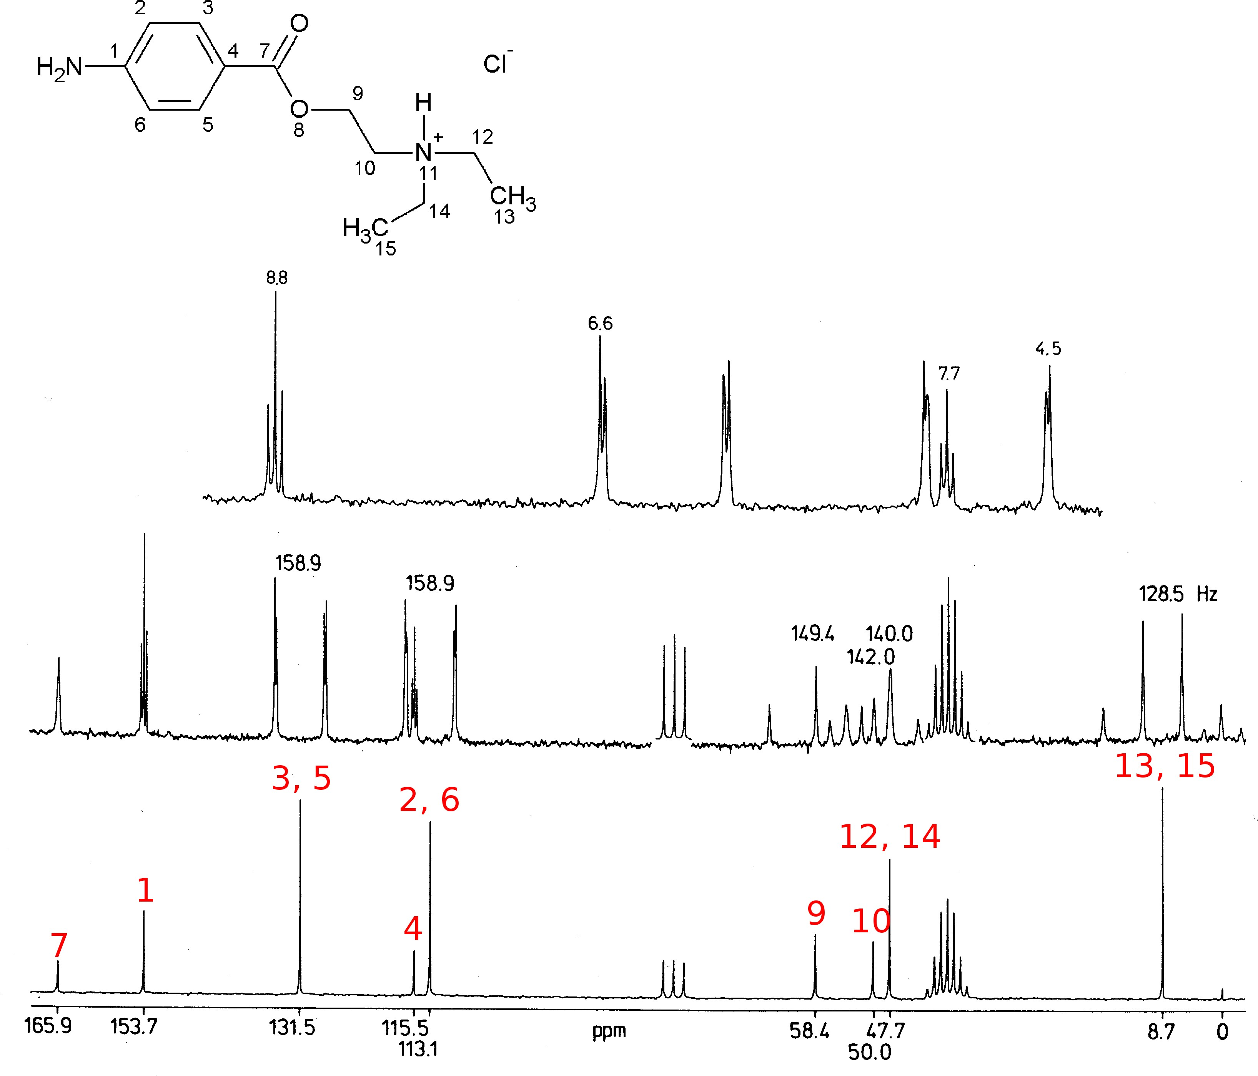
1D ¹³C-NMR 2
Notes:
C7 carbonyl, C1 attached to N
C3/5 deshielded by M- CO, C2/6 shielded by M+ of NH₂
C4 last quaternary aromatic signal (most isolated from H nuclei)
C9 effect of esteric group,
? C10 affected by NH exchange
C12/C14 + C13/C15
decaying effect of N+

Slide 13
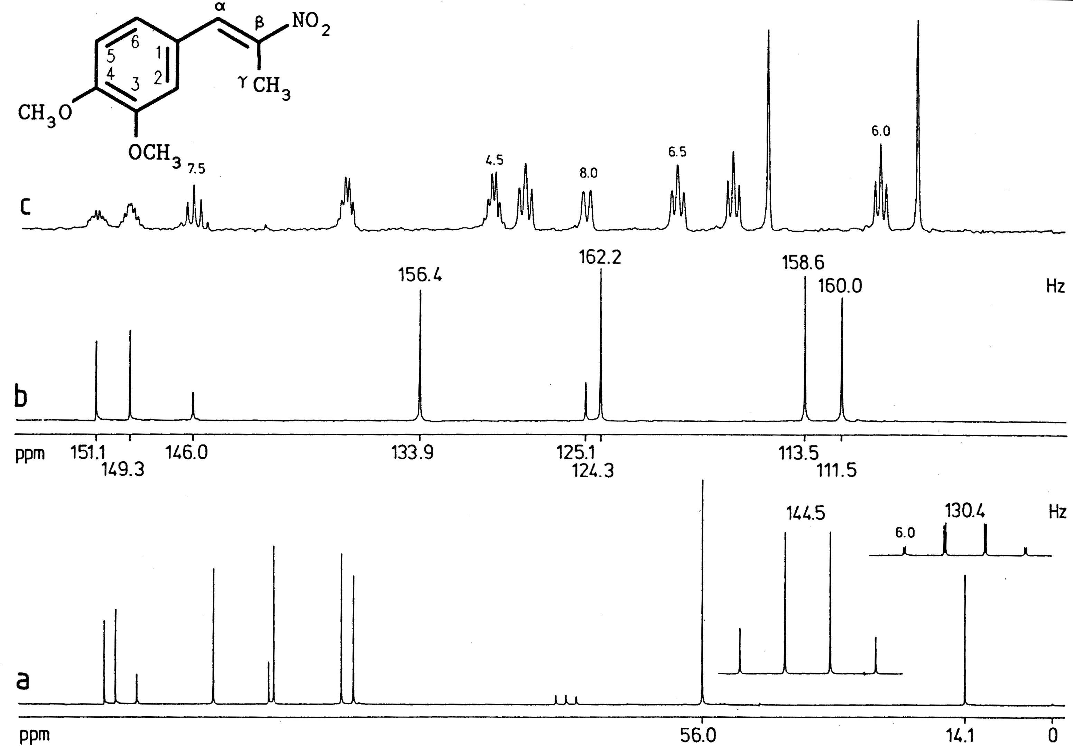
1D ¹³C-NMR 3, b - zoom of right region, a - full decoupled spectrum

Slide 14
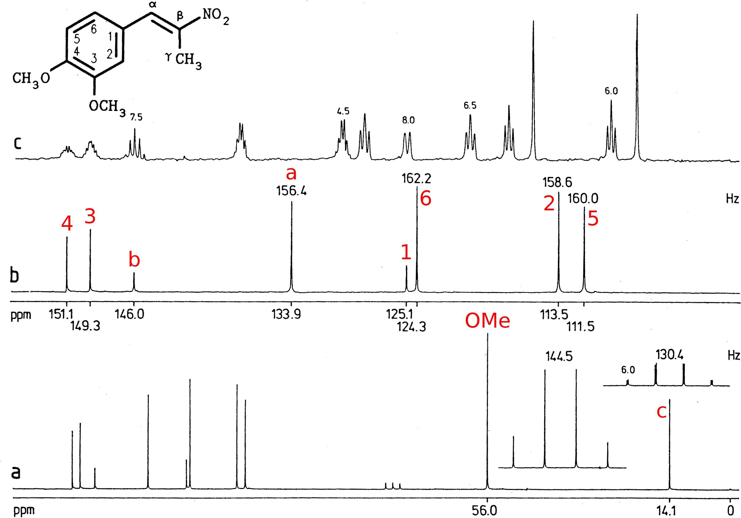
1D ¹³C-NMR 3, b - zoom of right region, a - full decoupled spectrum
Notes:
C3/C4 quaternary aromatic deshielded by O, Cβ quaternary coupled by CH₃ and CαH
Cα deshielded by NO₂
C1 last quaternary aromatic signal
C2/C6 coupled mutually and with Cα, C5 isolated (contraintuitive)
quartets OMe, Cγ

Slide 15
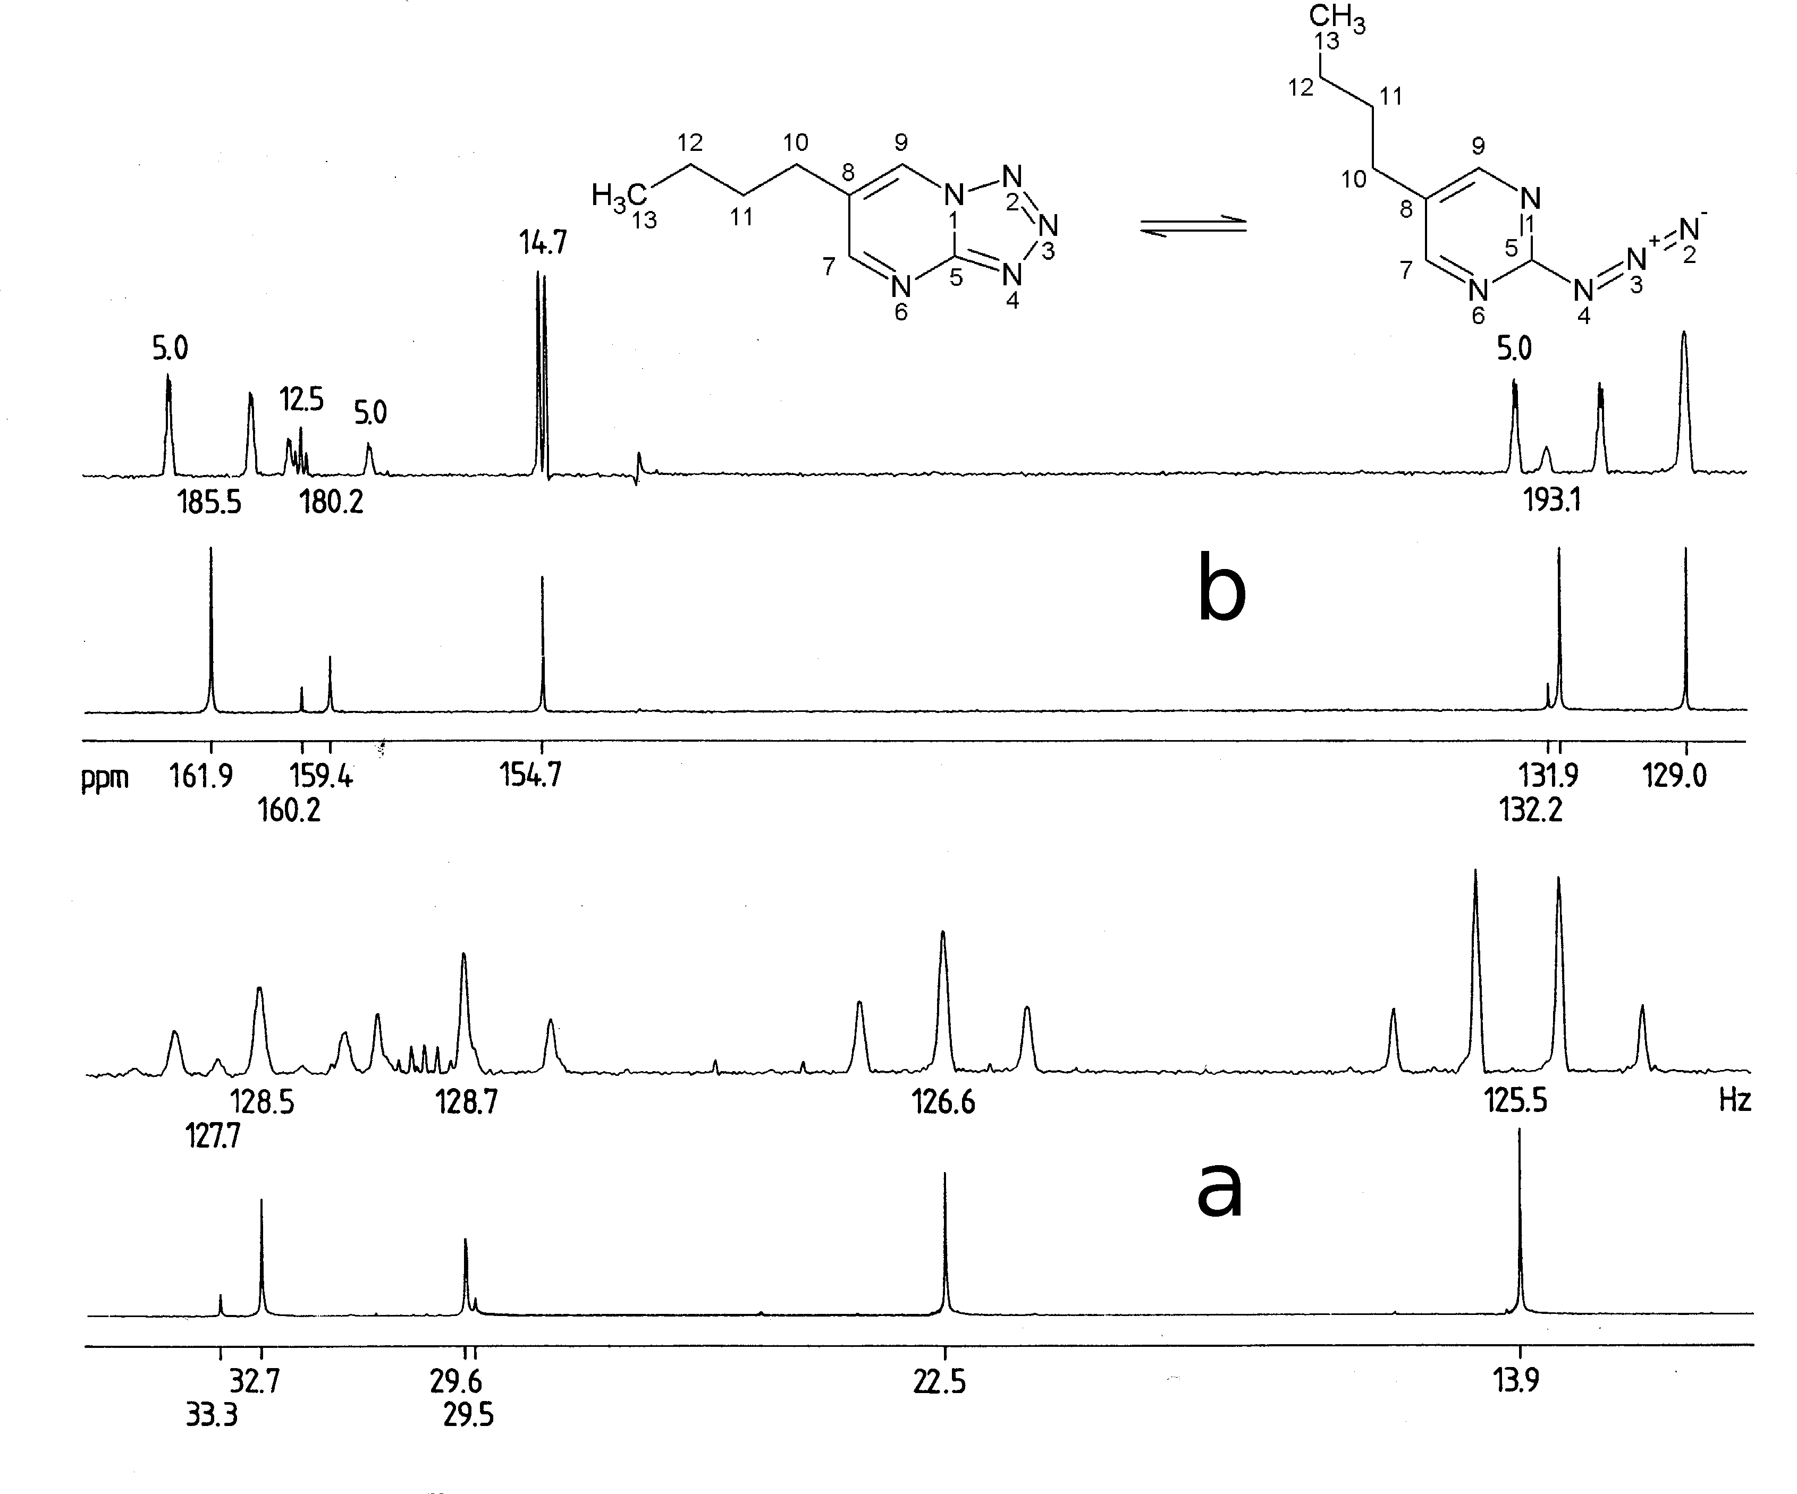
1D ¹³C-NMR 4, consider equilibrium minor-major form
Which form dominates and why?

Slide 16
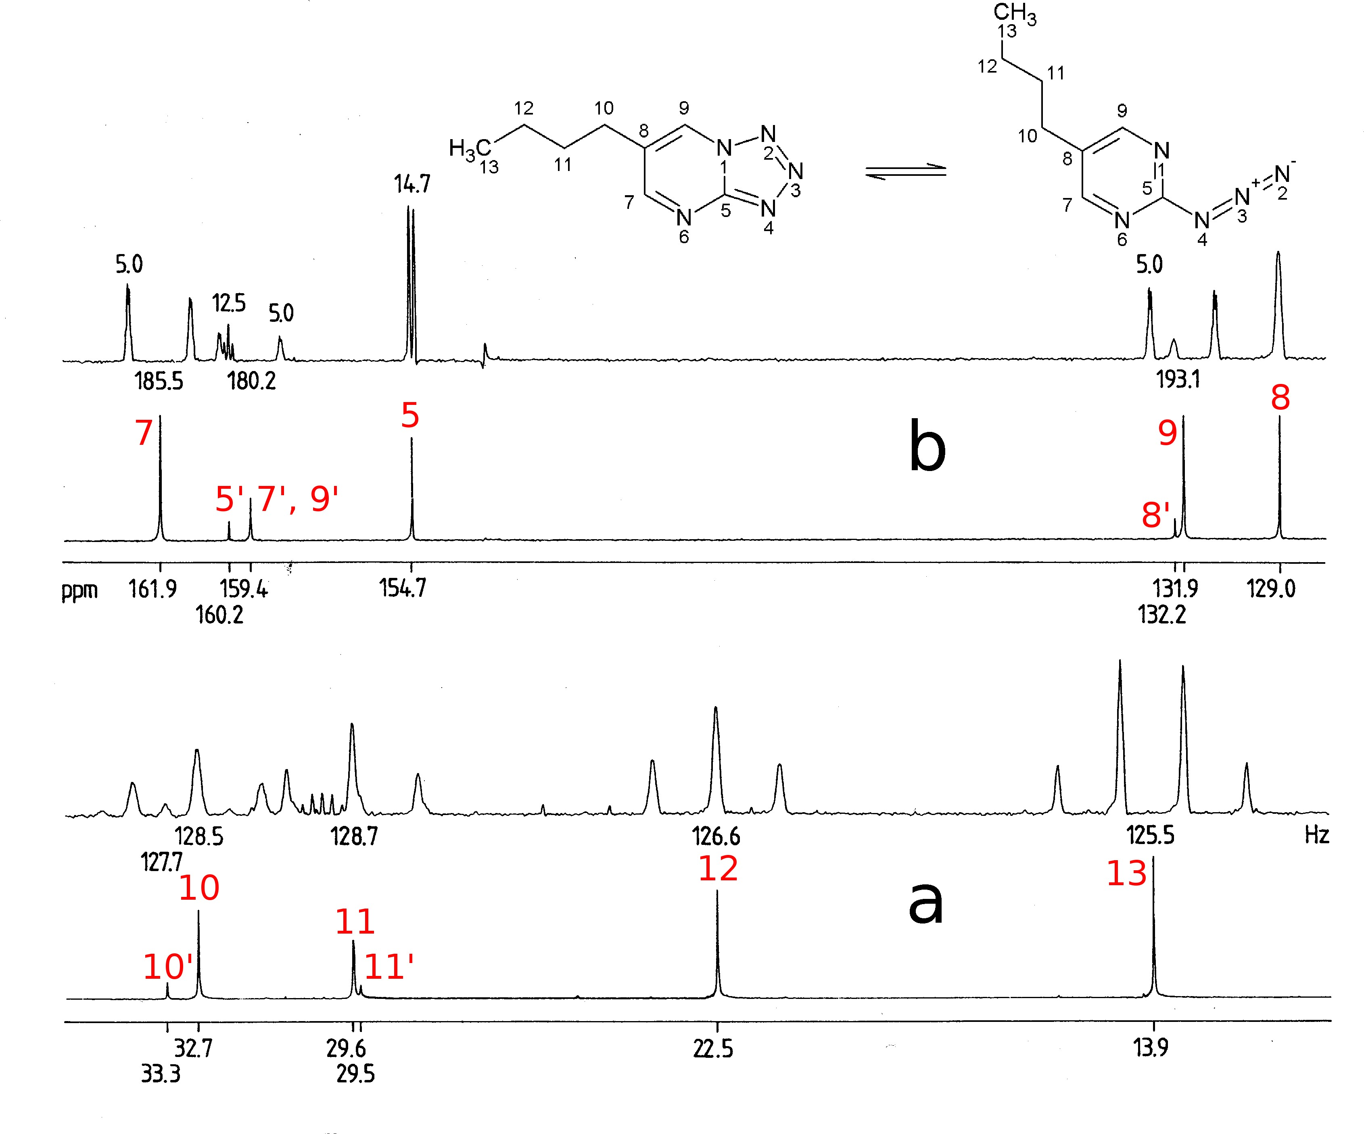
1D ¹³C-NMR 4, consider equilibrium minor-major form
Which form dominates and why?

Slide 17
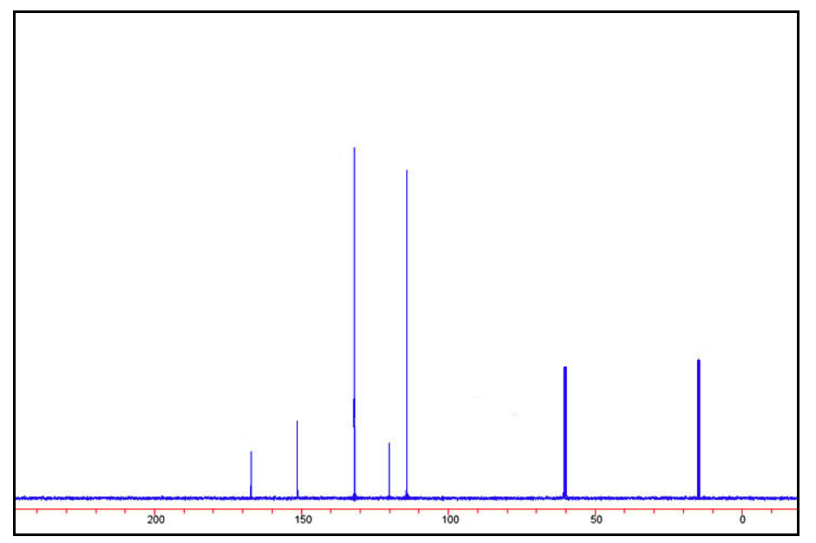
Draw structural formula of compound with summary formula C₉H₁₁NO₂ (use 1D ¹³C NMR spectrum to find the right structure)

Slide 18
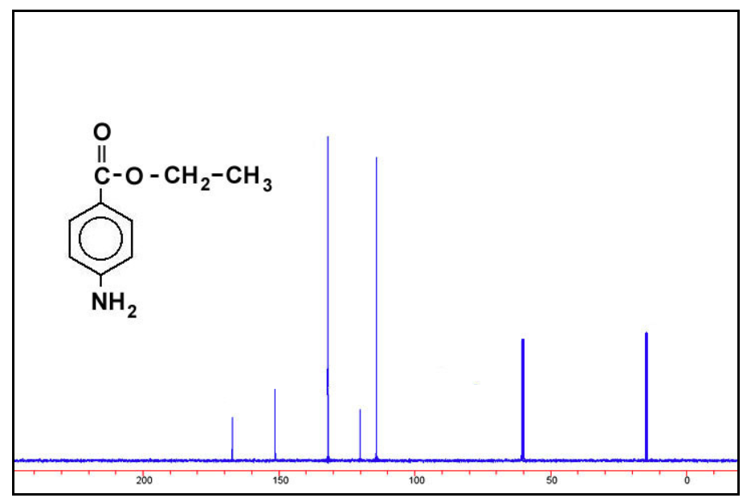
Draw structural formula of compound with summary formula C₉H₁₁NO₂ (use 1D ¹³C NMR spectrum to find the right structure)
Notes:
C1 quaternary carbonyl, C7 attached to N
C5 aromatic,deshielded by NH₂, shielded by carbonyl group, C6 opposite effects
C2/C3 decreasing effect of O
C4 last quarternaty carbon
5
2
3
6
1
4
5
6
7
2
3
7
4
1

Slide 19
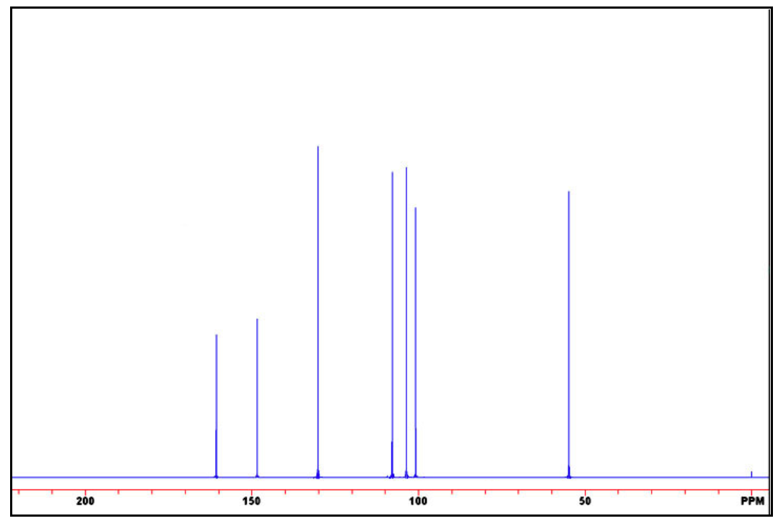
Draw structural formula of compound with summary formula C₇H₉NO (use 1D ¹³C NMR spectrum to find the right structure)

Slide 20
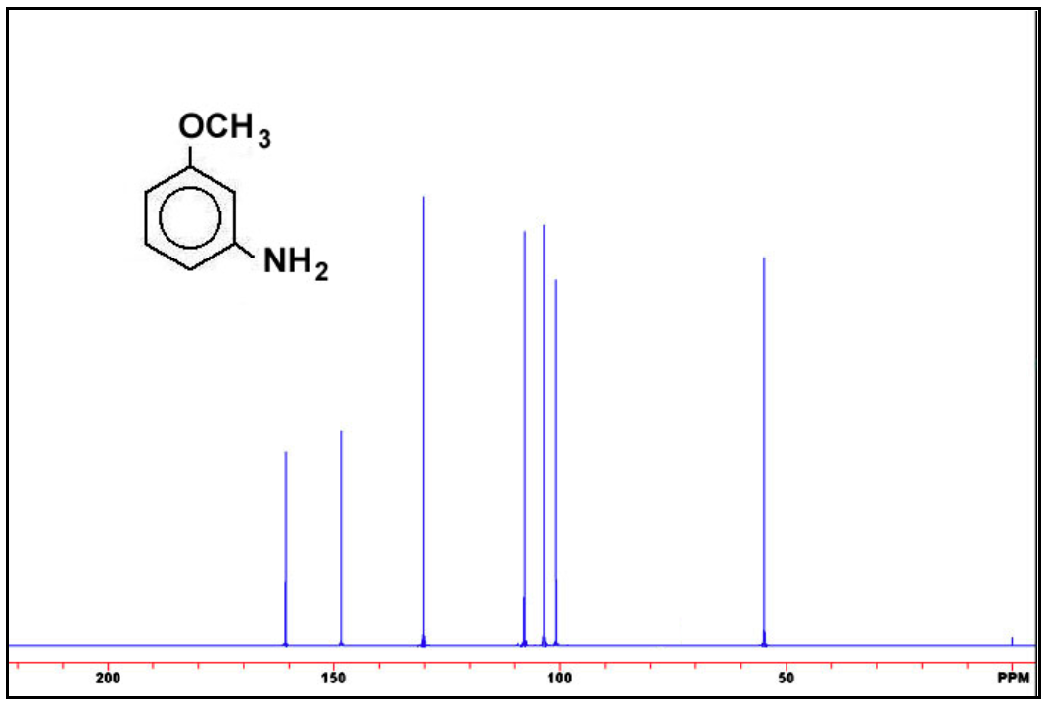
Draw structural formula of compound with summary formula C₇H₉NO (use 1D ¹³C NMR spectrum to find the right structure)
Notes:
C1 quaternary deshilded by O, 5 quarternary deshilded by N
C3 aromatic,deshielded by OCH₃ and NH₂
C2/C4 shielded by OCH₃ and NH₂ ,OCH₃ shielding effect stronger
C6 shielded by both OCH₃ and NH₂
C7 isolated CH₃ carbon
7
1
2
6
3
4
2
5
7
3
6
4
1
5

Slide 21
Next topic
Vector Model + ¹³C APT experiment

