Slide 1
ENVIRONMENTAL ASPECTS
Petr Beňovský

Slide 2
GREEN CHEMISTRY, SUSTAINABLE CHEMISTRY
The design of chemical products and processes that reduce or eliminate the use or generation of hazardous substancese;
Systematically pursued from the 90s of the 20th century;
1952 – Upjohn – the synthesis of cortisone – just 10 step synthesis of cortisone using fermentation for a key hydroxylation reaction at position 11 of progesterone

Slide 3
GREEN CHEMISTRY METRICS
Atom Economy
Characterizes the “greeness“ of a synthetic process by calculating the number of atoms from all of the reactants that make it into the final product;
Does not address the hazard, reaction yield, stoichiometry, the amount of solvent, …
% Atom Economy = Molecular weight of the product / Molecular weight of all products x 100
Trost, B. Science 254, 1471 (1991)

Slide 4
GREEN CHEMISTRY METRICS
Environmental Factor, E-Factor
The ratio of waste over product
It is usual to calculate E-factor without process water
E-Factor = the amount of waste (kg) / the amount of the product (kg)
Industry Segment | Volume (t/y) | E-Factor
Oil Refining | 10⁶ - 10⁸ | < 0.1
Bulk Chemicals | 10⁴ - 10⁶ | < 1 - 5
Fine Chemicals | 10² - 10⁴ | 5 - 50
Pharmaceuticals | 10 - 10² | 25 - 100

Slide 5
GREEN CHEMISTRY METRICS
Reaction Mass Efficiency (RME)
The idea is to keep the simplicity of the atom economy concept, but avoid the high impact of solvents which are found in the E-factor;
RME takes into account reaction yield, stoichiometry and the use of catalysts or other reagents;
% Reaction Mass Efficiency = Mass of desired product / Mass of all reactants x 100

Slide 6
GREEN CHEMISTRY METRICS
Process Mass Intensity (PMI)
PMI measures the mass of materials used to make 1 kg of the API
% Process Mass Intensity = Mass of all material used to make the product (kg) / Mass of product (kg) x100
Allows companies to benchmark and quantify improvements to the efficiency and sustainability of their production
Reasonable target of a single synthetic step is any value between 10 and 40

Slide 7
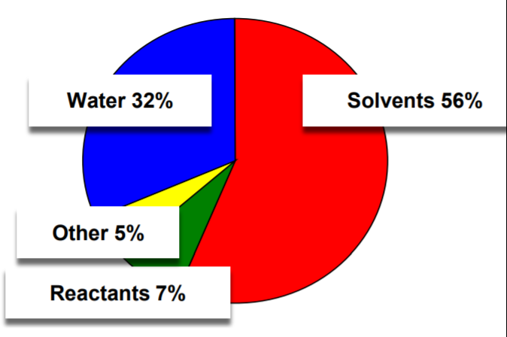
GREEN CHEMISTRY METRICS
Process Mass Intensity (PMI)

Slide 8
IBUPROFEN EXAMPLE
Originator – Boots Group (1960s)
Original name – Brufen (Aspro, Panadol, Nurofen)
Generic names – Motrin, Advil, Nuprin, Ibalgin
Sold as the racemate despite the fact that (S)-(+)-Ibuprofen is the active form;
Fast epimerization in vivo

Slide 9
IBUPROFEN EXAMPLE
Original synthesis – overall yield 40%
Annual production in Great Britain 3000 tones

Slide 10
IBUPROFEN EXAMPLE
New synthesis – BHC company (1990)
Overall yield 77%
Presidential Green Chemistry Challenge Greener Synthetic Pathways Award v roce 1997

Slide 11
BIOCATALYSIS
Myths of biocatalysis:
Expensive
Unstable
Not readily available
Sensitive to reaction conditions
Not good enough or wrong selectivity
Give poor volumetric productivity
Difficult work-up
Nowadays, all of them are mostly wrong

Slide 12
BIOCATALYSIS
2018 – Nobel Prize for directed evolution of enzymes (Frances H. Arnold, George P. Smith)
Iterative change of amino acids in the enzyme until the desired property (acitivity, stability, selectivity) is achieved;
Directed evolution mimics the processes of Darwinian evolution in a test tube

Slide 13
BIOCATALYSIS
Bornscheuer, U.T. et al Angew.Chem.Int.Ed. 43, 6032 (2004)

Slide 14
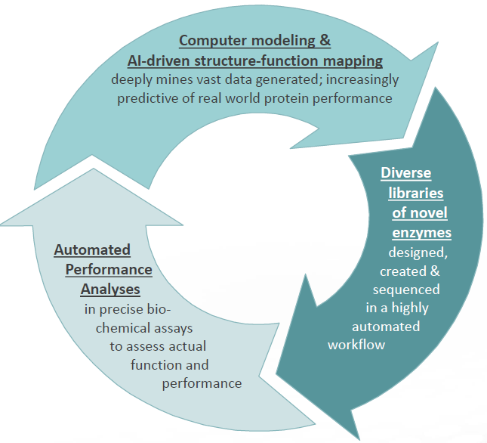
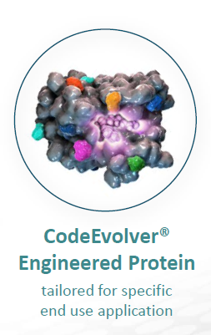
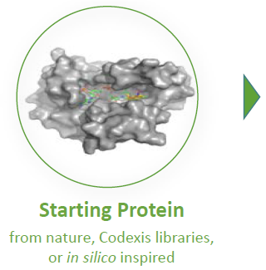
BIOCATALYSIS
CODEXIS
https://www.youtube.com/watch?v=up5QUdTLsBU&feature=youtu.be

Slide 15
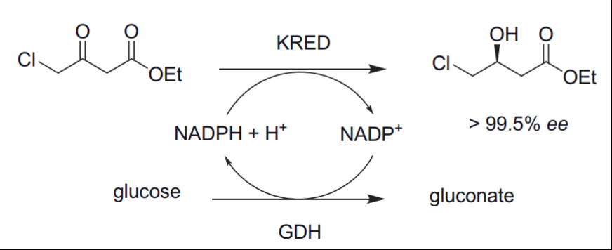
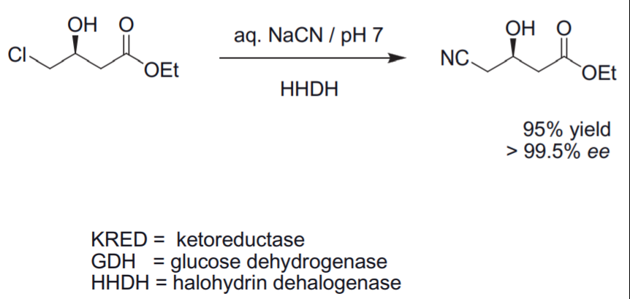
BIOCATALYSIS
CODEXIS

Slide 16
BIOCATALYSIS
CODEXIS
Atorvastatin (Lipitor®)
2006 – Presidential Green Chemistry Challenge Award
Substantial waste reduction
Overall yield > 90%
Purity > 98%
ee > 99.9%
Low loading of enzymes
Solvent recycling
E-Factor is 5.8 (without used water)
E-Factor is 18 (with used water)

Slide 17
GREEN CHEMISTRY, SUSTAINABLE CHEMISTRY
Ryoji Noyori
“Green chemistry is not just a mere catch phrase;
it is the key to the survival of mankind“

