Slide 1
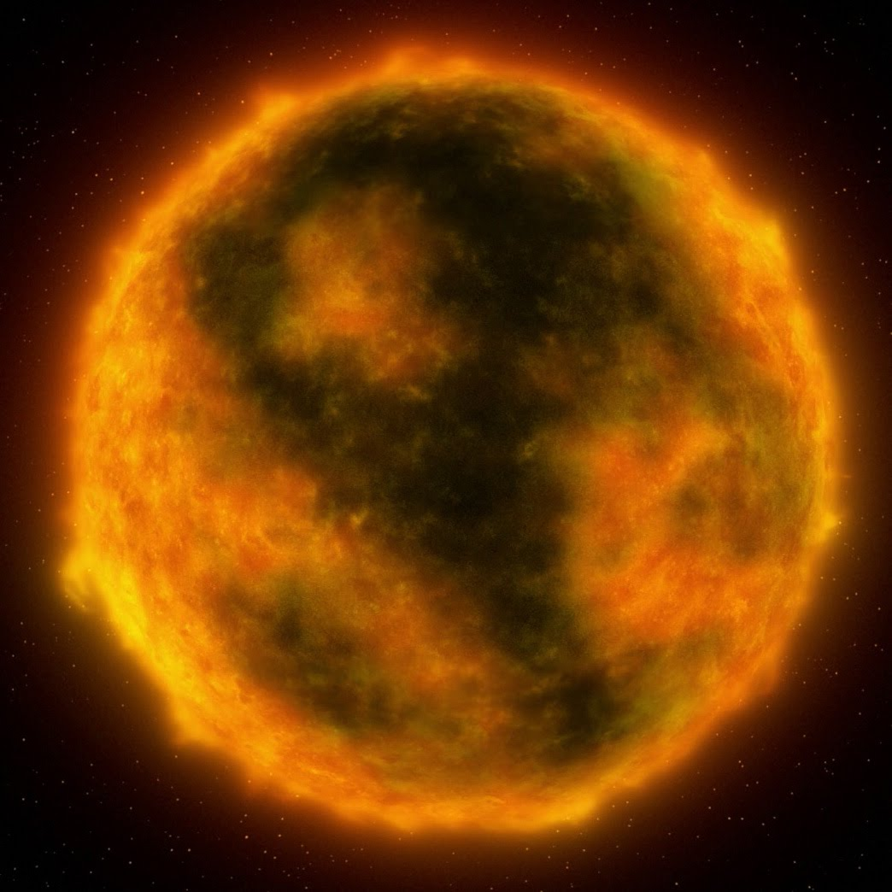

Red supergiants
Jacco van Loon
Keele University
Brno 2021

Slide 2
Plan for this seminar:
What are red supergiants… and what are not?
Why should we care about red supergiants?
Mass loss from red supergiants
The peculiar (or typical?) case of Betelgeuse
Red supergiants as progenitors of supernovae
My favourite red supergiant
Feel free to interrupt! We can discuss binary evolution…

Slide 3
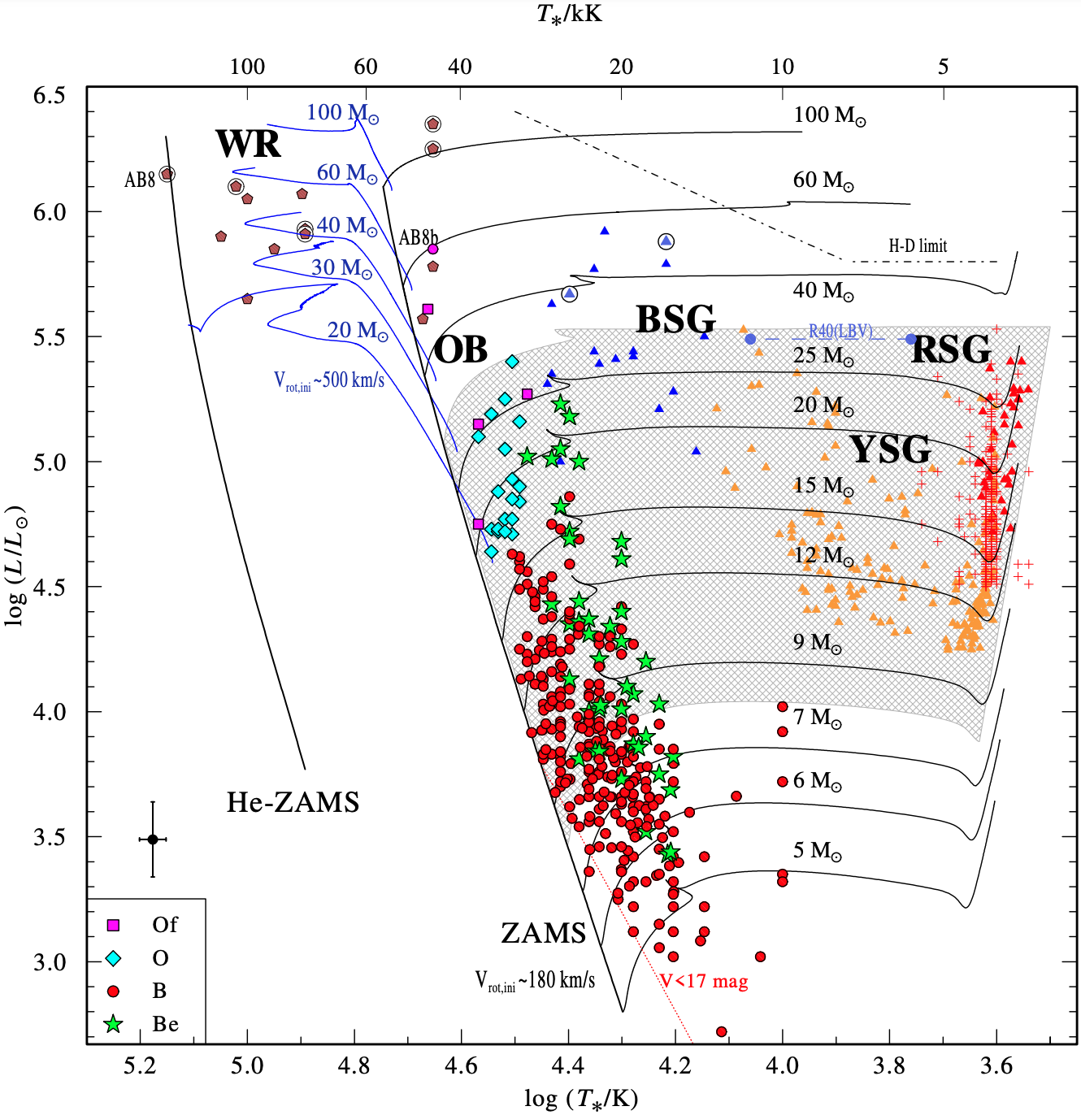
What are red supergiants?
Ramachandran + 2019
Post-OB evolution (“inverse Henyey”), core He burning, convective mantle (“inverse Hayashi”)
… and what are not?
Yellow SuperGiants (Blue Loop stars ⇒ post-YSG RSGs?)
Super-AGB
(shell-burning) AGB or super-AGB stars
Cepheids
AGB
complications
rotation
overshoot
binary interaction
SMC

Slide 4
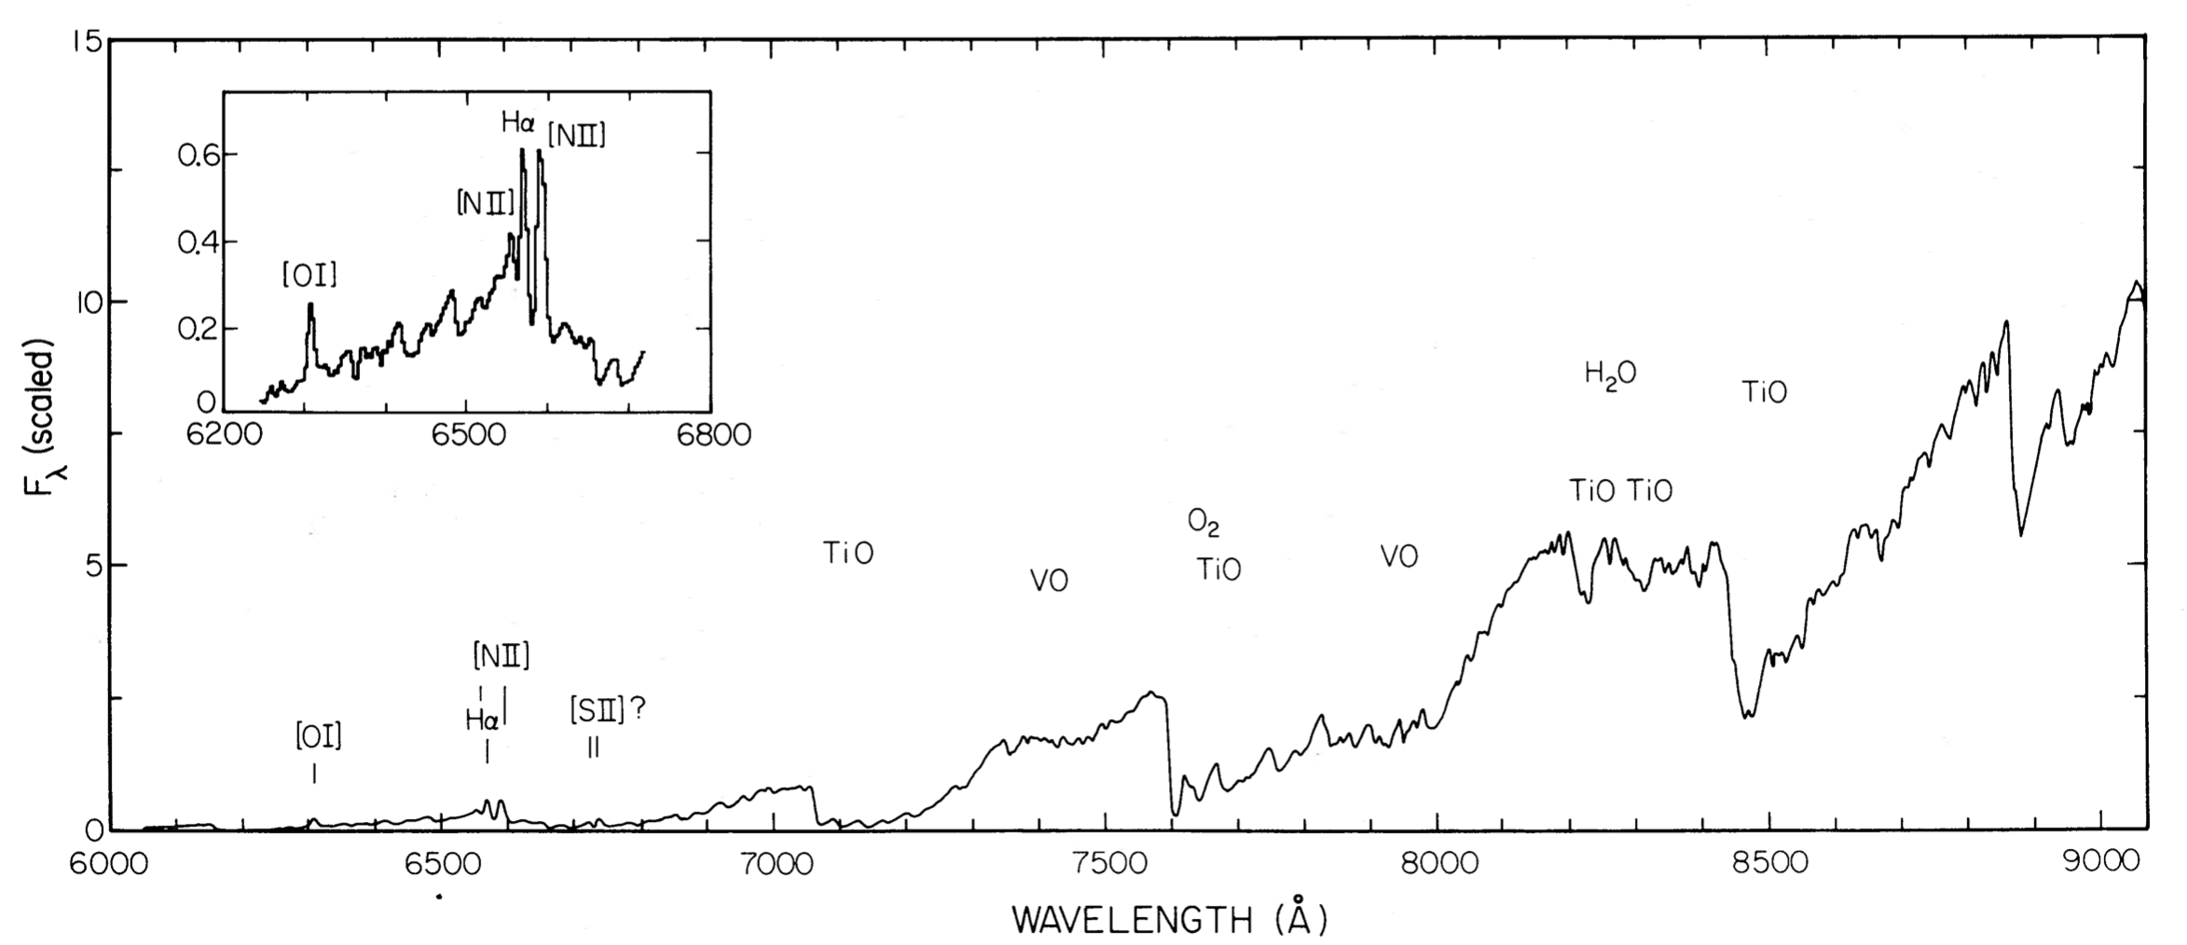
red ⇔ low surface temperature
supergiant ⇔ low surface gravity
Elias, Frogel & Schwering 1986
(WOH G64 in the LMC)
Earth’s orbit
motions of few–tens km/s
dynamical timescales year(s)
rotation, convection, pulsation, collapse, binary motion, wind…
Main sequence

Slide 5




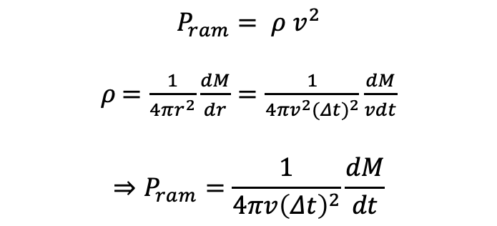

Why should we care about red supergiants?
Why? | pro | con
Tracers of stellar populations | Luminous Peak around 1 µm | Rare (lifetime few % of main sequence) Complicated analysis (spectrum, variability)
Feedback on ISM | Mass return Dust production | Energetically unimportant (radiation, mechanical) Relatively little dust ( < 1 % M⊙) may not survive
Supernovae Neutron stars Black holes | Proven link to SNe Probable link to NSs Possible link to BHs | Limited to < 30–40 M⊙ No warning of imminent SN (?) Link to black holes unproven
$$P_{ram}= ρ v^{2}$$
𝜌$=\frac{1}{4πr^{2}}\frac{dM}{dr}=\frac{1}{4{πv}^{2}{(Δt)}^{2}}\frac{dM}{vdt}$
$$⇒P_{ram}=\frac{1}{4πv{\left(Δt\right)}^{2}}\frac{dM}{dt}$$
free expansion: 1 kpc
reality: sweep up ISM: 10 pc
post-RSG BSG
1 pc
axisymmetric
BSG: 10⁻⁶ M ⊙ /yr, 10⁶ yr, 1000 km/s
RSG: 10⁻⁵ M ⊙ /yr, 10⁵ yr, 10 km/s
$$⇒P_{RSG (pc)}={10}^{5}P_{BSG (kpc)}$$

Slide 6
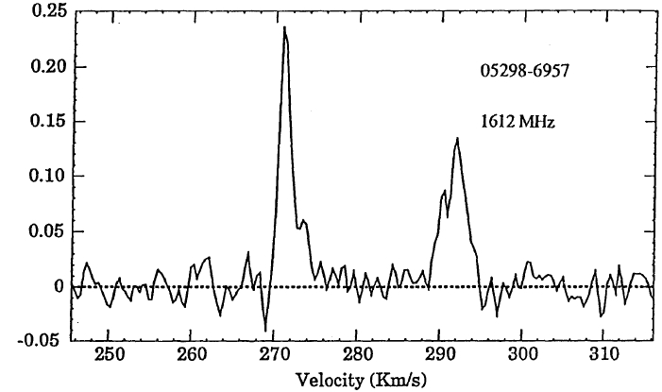
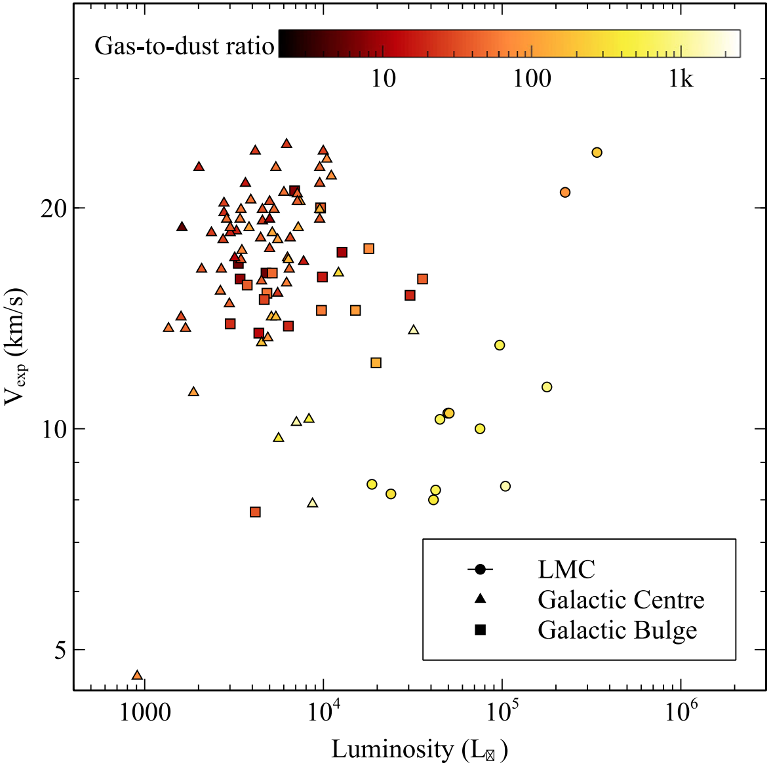

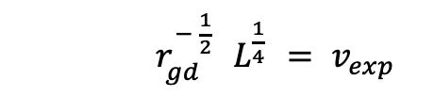
Mass loss from red supergiants – method
$r_{gd}^{− \frac{1}{2}}{ L}^{\frac{1}{4}} = v_{exp}$
Wood + 1992
if dusty !
if opacities known
if geometry known
alternatively model atomic line profiles
Marshall + 2004
$\frac{dM}{dt} = τ\left(λ\right){ r}_{gd}{ v}_{exp}{ L}^{\frac{1}{2}}$
Goldman + 2017
⦿

Slide 7
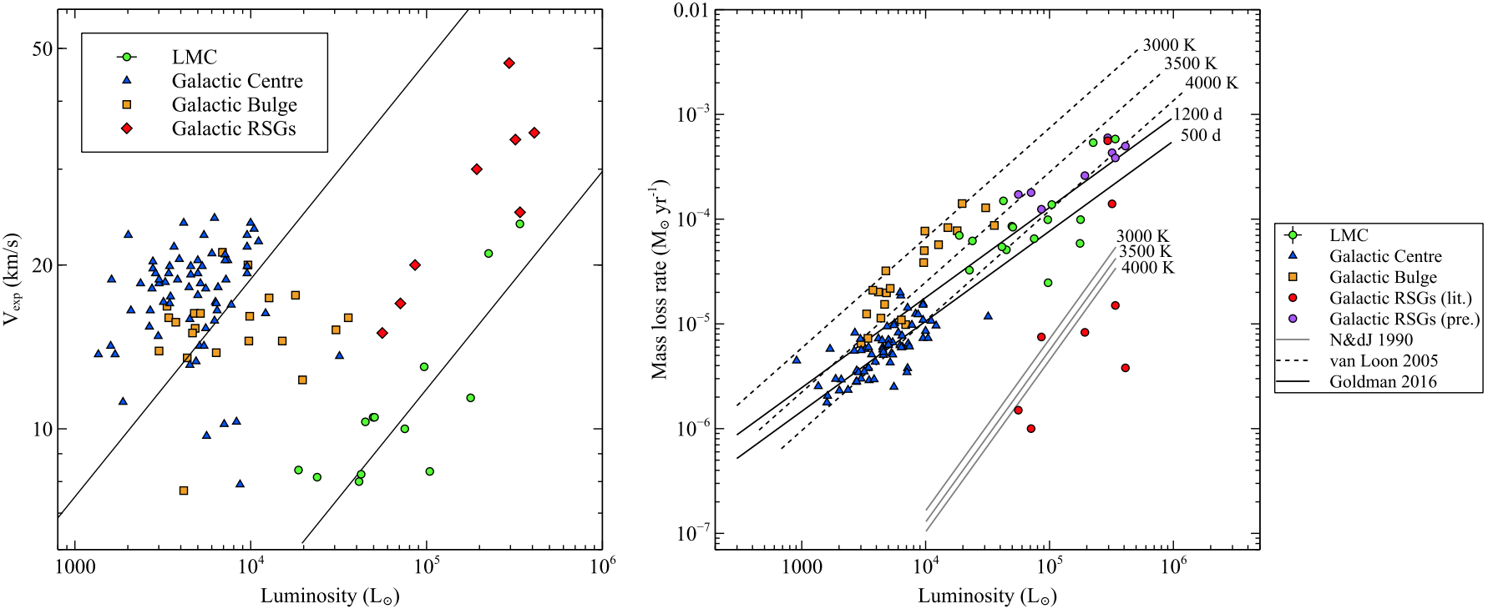
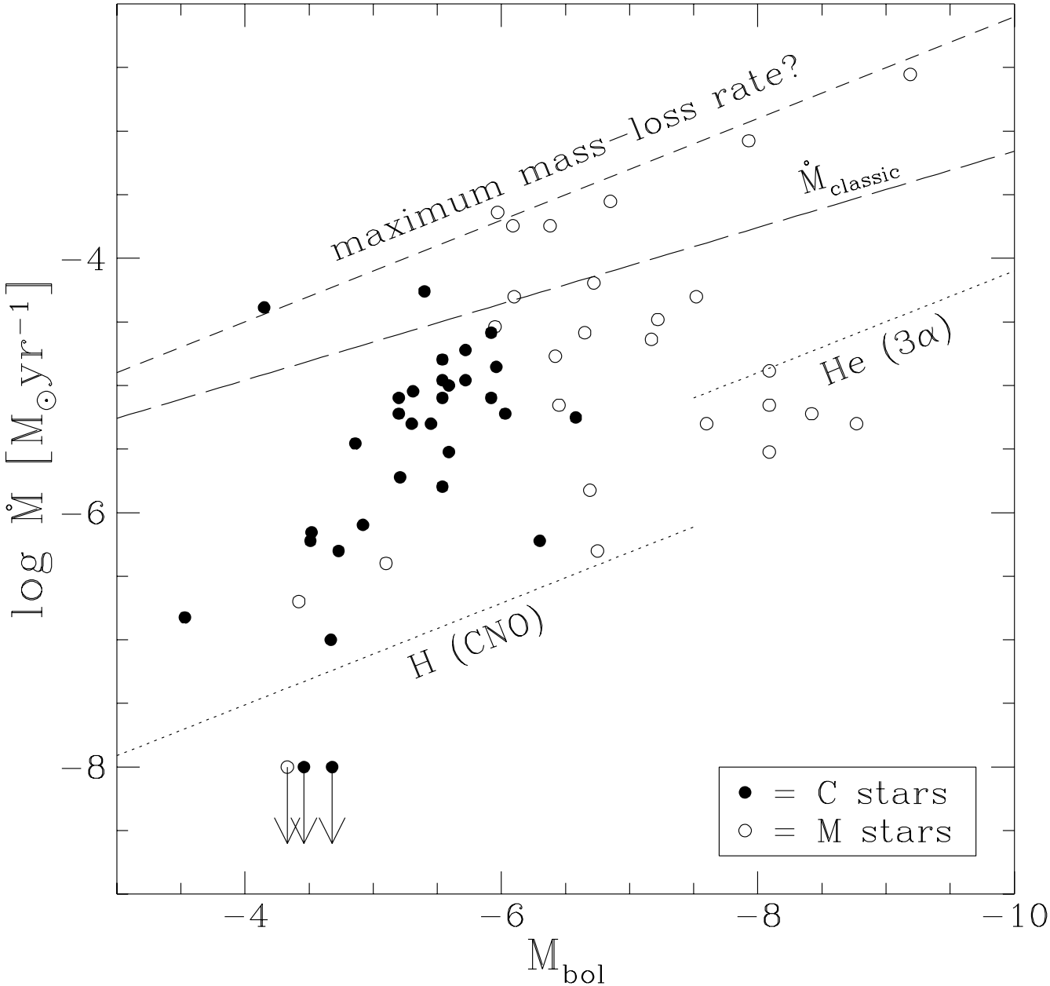
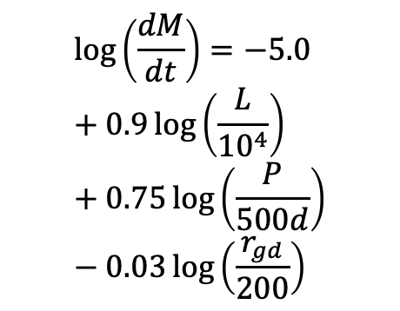
Mass loss from red supergiants – results
Goldman + 2017
7
van Loon + 1999
$$\log\left(\frac{dM}{dt}\right)=−5.0+0.9\log\left(\frac{L}{{10}^{4}}\right)+0.75\log\left(\frac{P}{500d}\right)−0.03\log\left(\frac{r_{gd}}{200}\right)$$
no direct metallicity dependence
RSG mass loss generally at nuclear burning rate
+ possible superwind

Slide 8
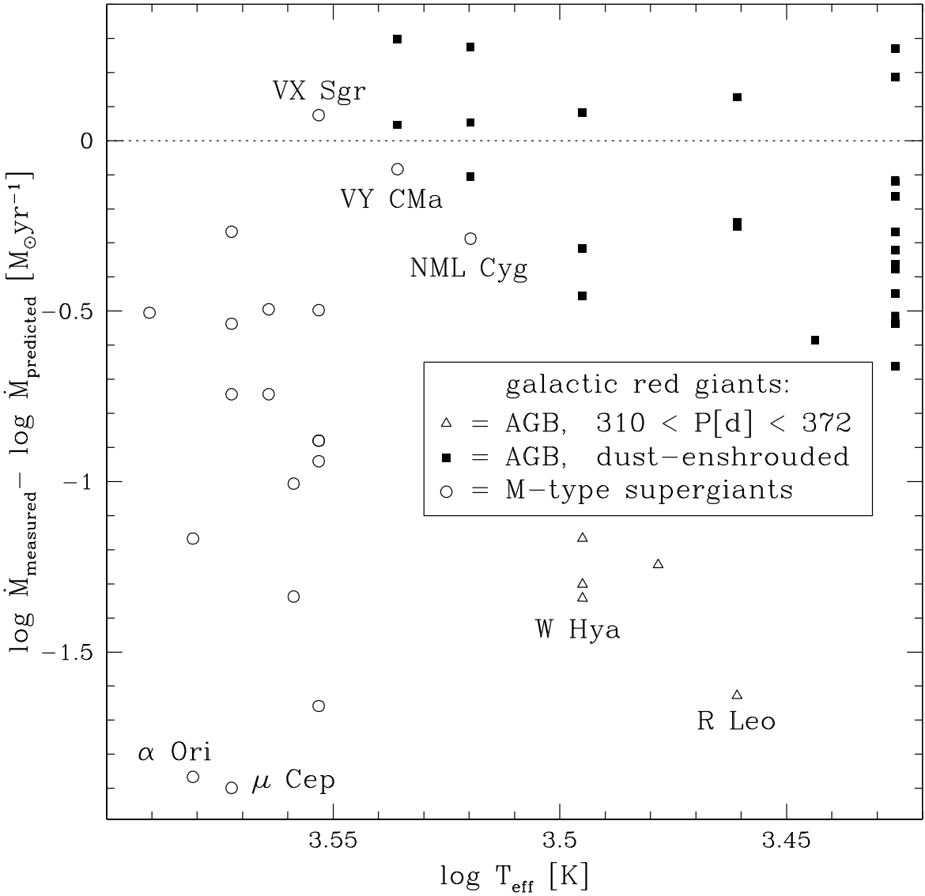
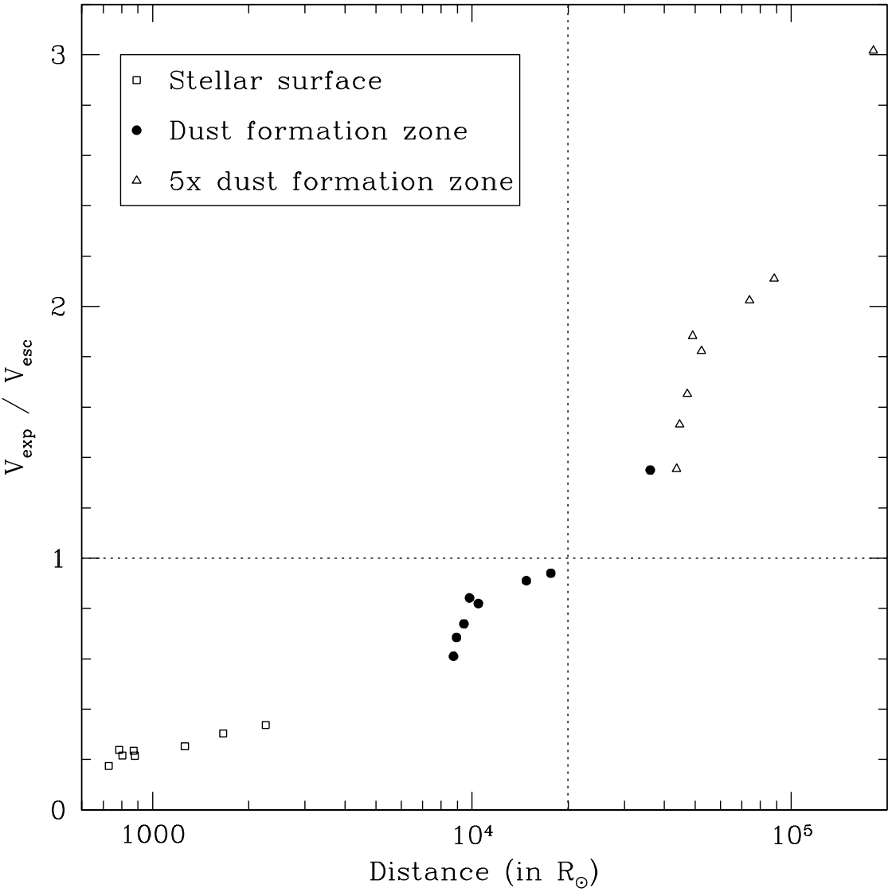
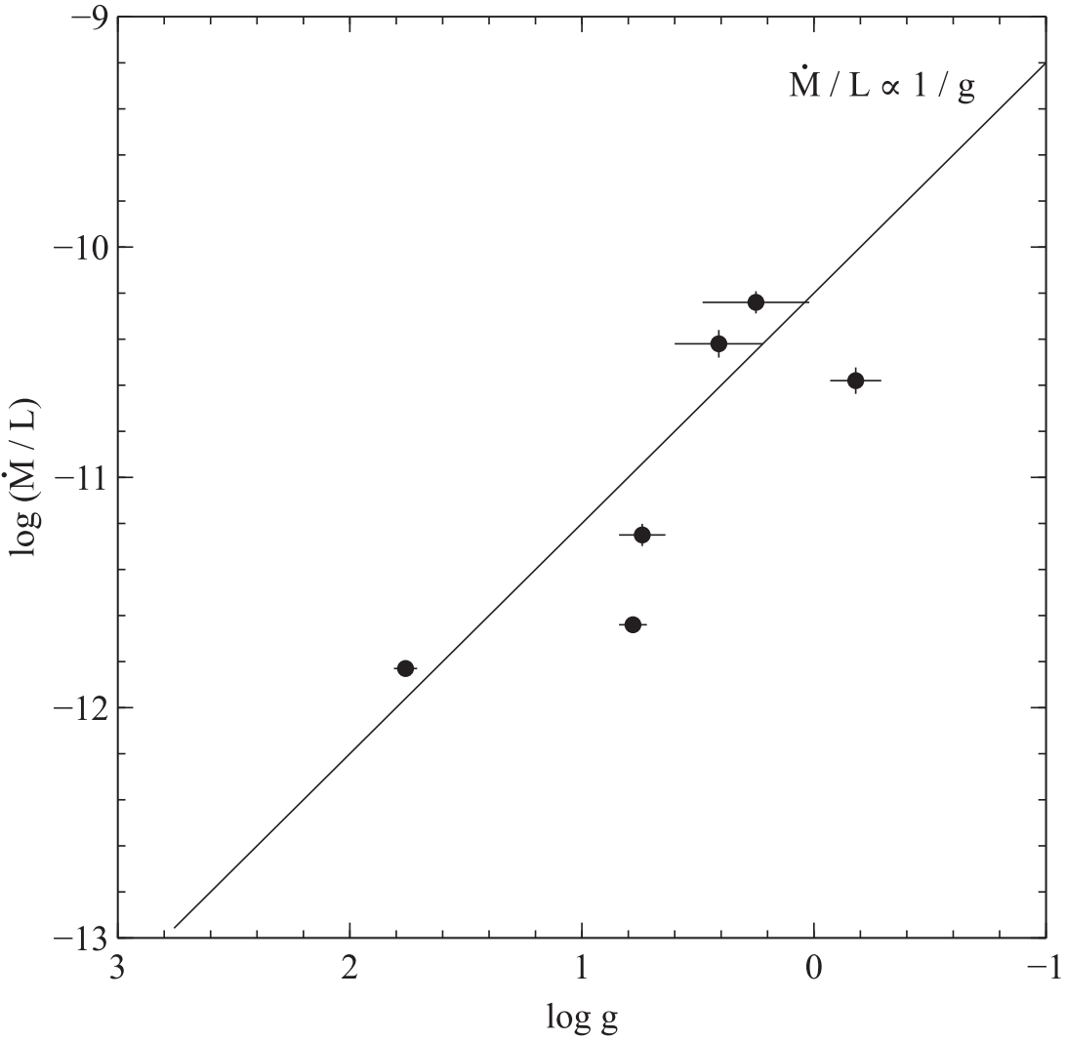
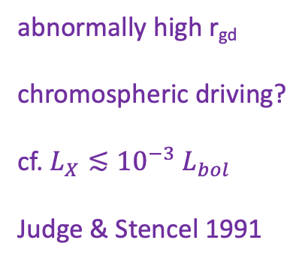

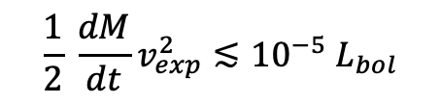

Mass loss from red supergiants – mechanism?
van Loon + 2005
pulsation + dust driven mass loss?
Marshall + 2004
$$\log\left(\frac{dM}{dt}\right)=−5.65+1.05\log\left(\frac{L}{{10}^{4}}\right)−6.3\log\left(\frac{T_{eff}}{3500}\right)$$
$$r_{gd}∝Z^{−1}$$
no direct metallicity dependence
closing remark
abnormally high r_{gd}
chromospheric driving?
cf. $L_{X}≲{10}^{−3} L_{bol}$
Judge & Stencel 1991
Energetically trivial
cf. when gravity does work:
Roche Lobe overflow
Common Envelope
core collapse
$$\frac{1}{2} \frac{dM}{dt}v_{exp}^{2}≲{10}^{−5} L_{bol}$$
Goldman + 2017

Slide 9
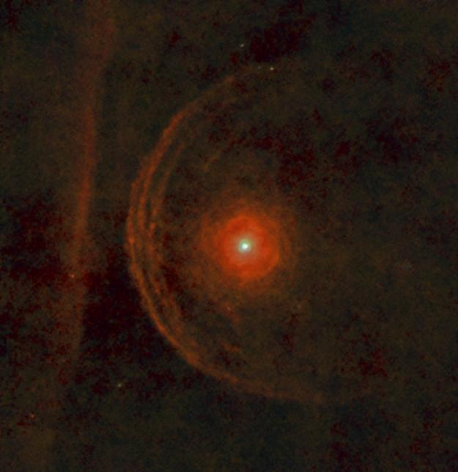
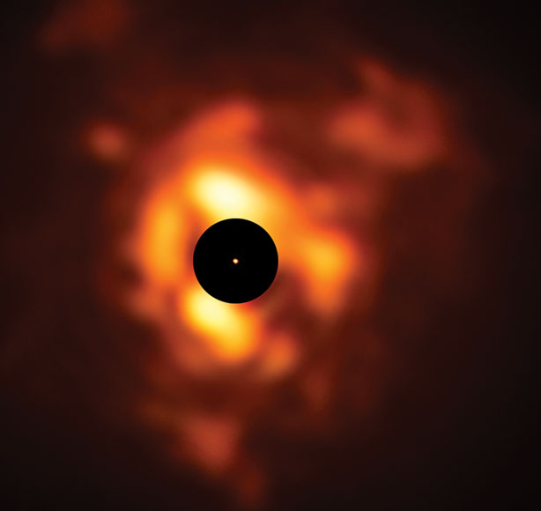

The peculiar (or typical?) case of Betelgeuse
ESO/VISIR – Kervella 2019
runaway (whence?)
fast rotator (15 km/s)
not very dusty
chromosphere
ALMA few au – O’Gorman 2017
Herschel few pc – Decin 2011

Slide 10
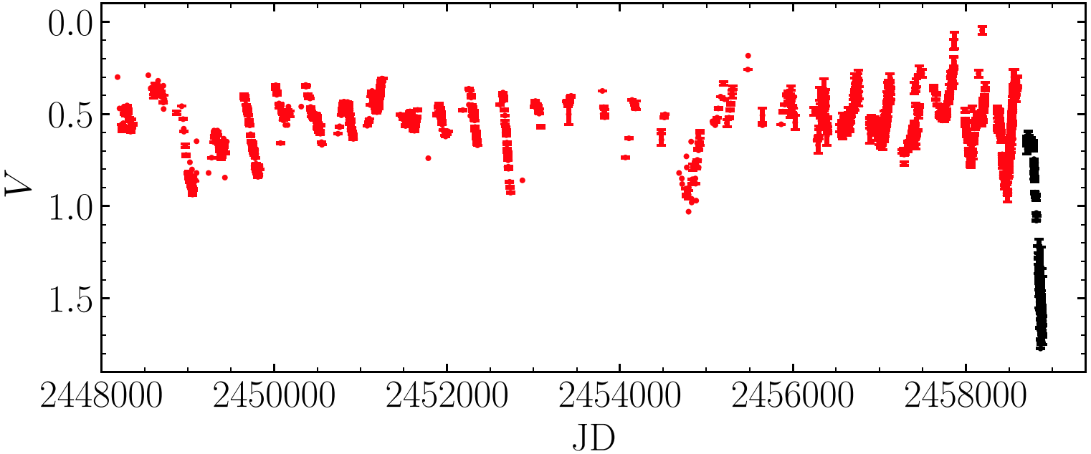
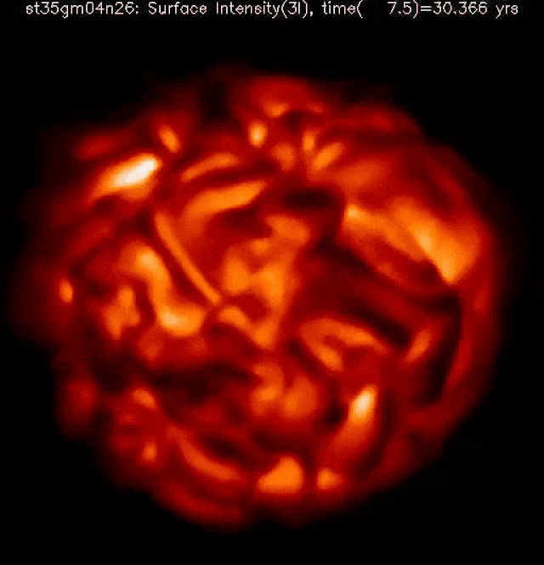
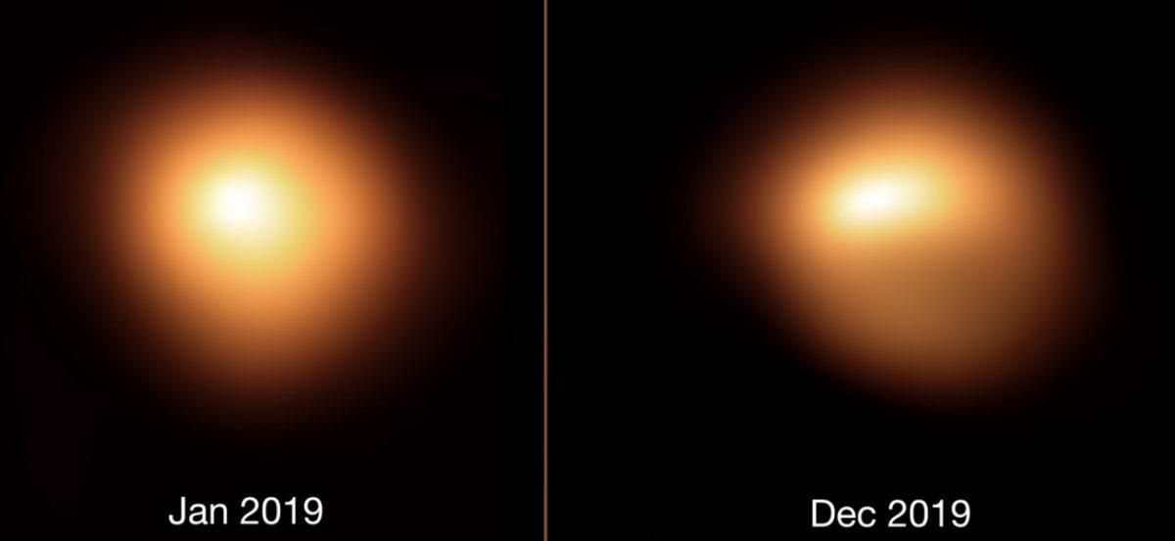
The Great Dimming of Betelgeuse
precursor?
Granulation? (Ren & Jiang 2020)
Dust cloud?
Convection cell?
ESO/SPHERE – Kervella
Freytag

Slide 11
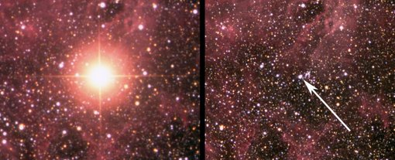
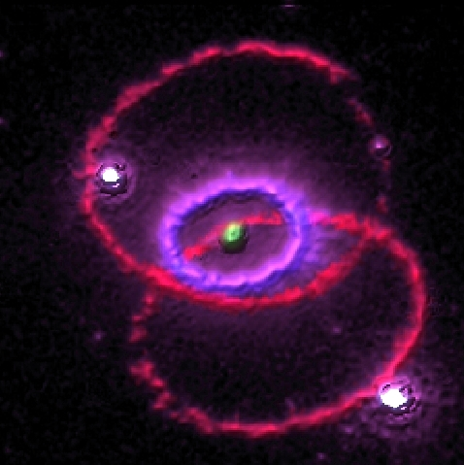
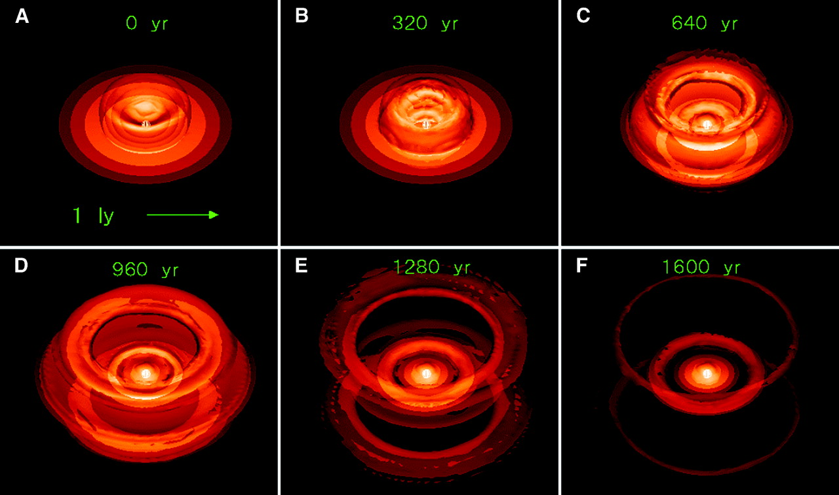
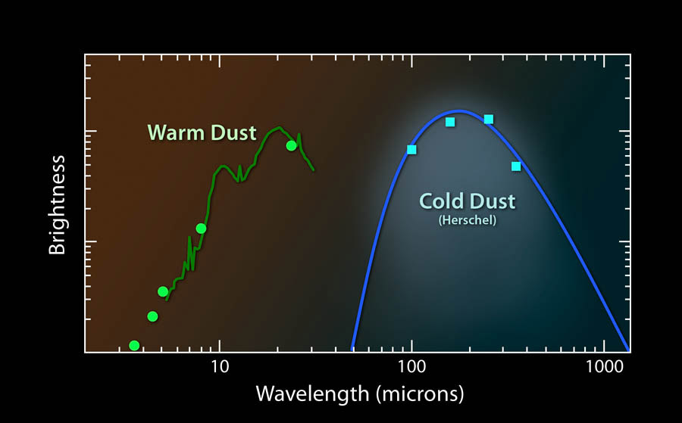
Red supergiants as progenitors of supernovae
1987
before
0.5 pc
Blue Supergiant !?
Sanduleak -69º 202
HST Challis
RSG
SN
Tanaka & Washimi 2002
Matsuura + 2011 / many others
post-red supergiant !

Slide 12
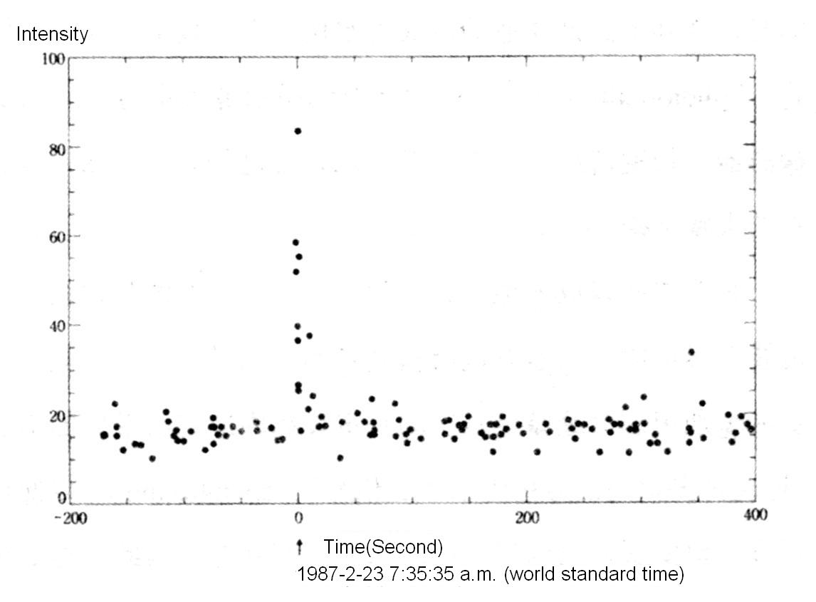
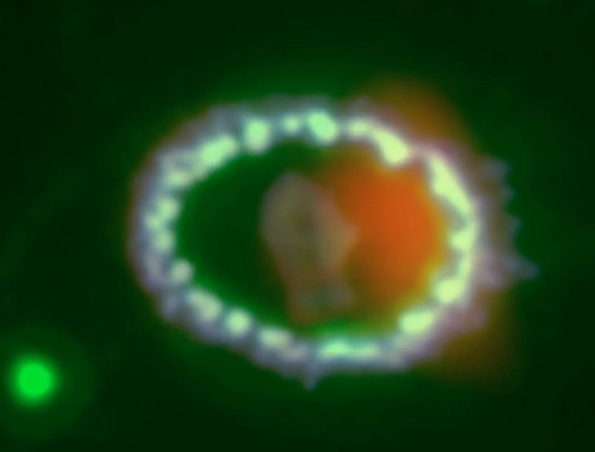
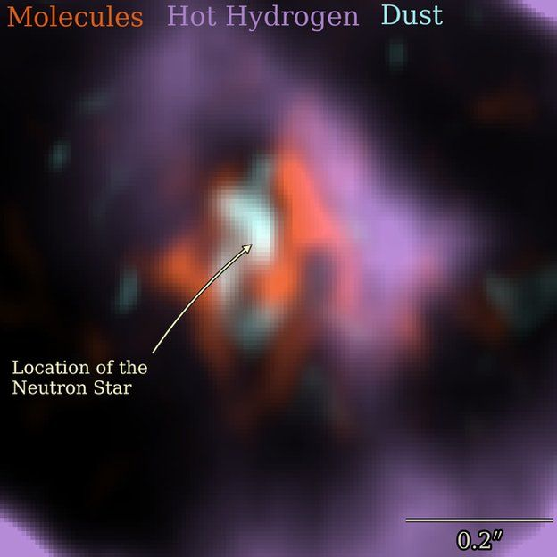
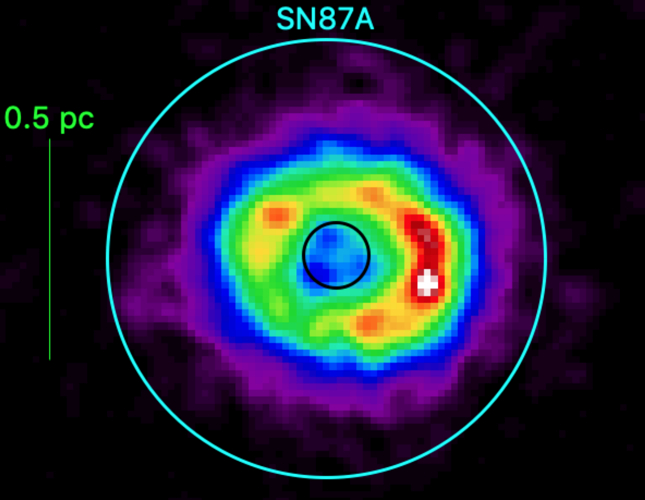
Red supergiants as progenitors of neutron stars
neutrinos
Zanardo + 2014
Hirata + 1987
here?
so: where is the neutron star?
or here?
Greco + 2021
0.1-8 keV
evidence?
neutrinos (black hole?)
source of dust heating
no pulsar detected
?
Cigan + 2019
here!

Slide 13
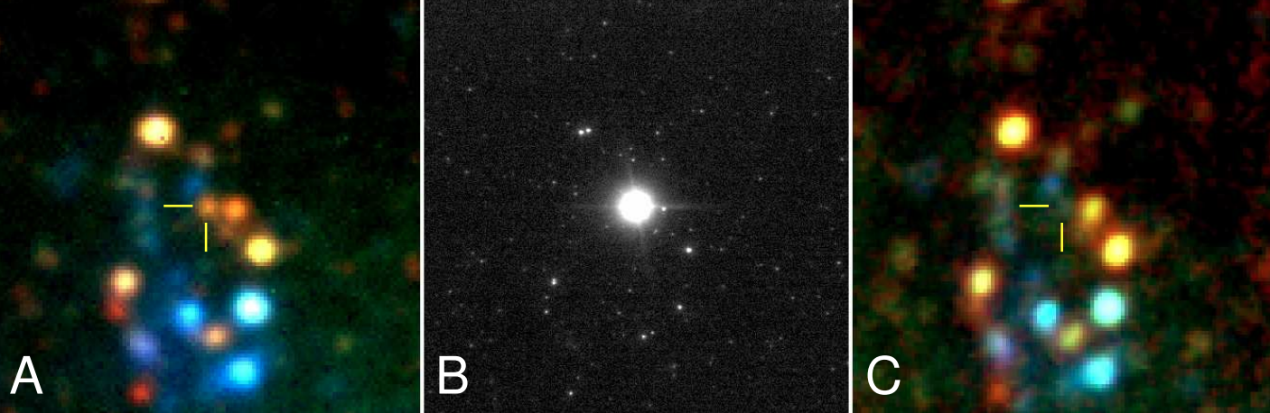
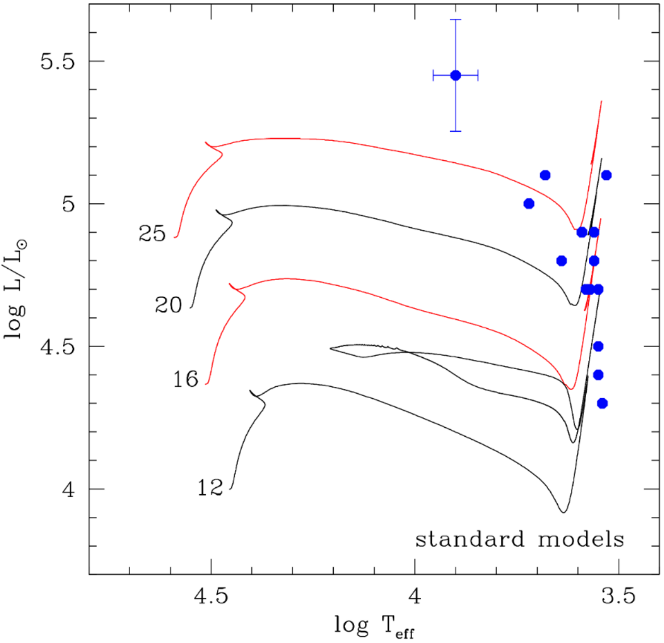
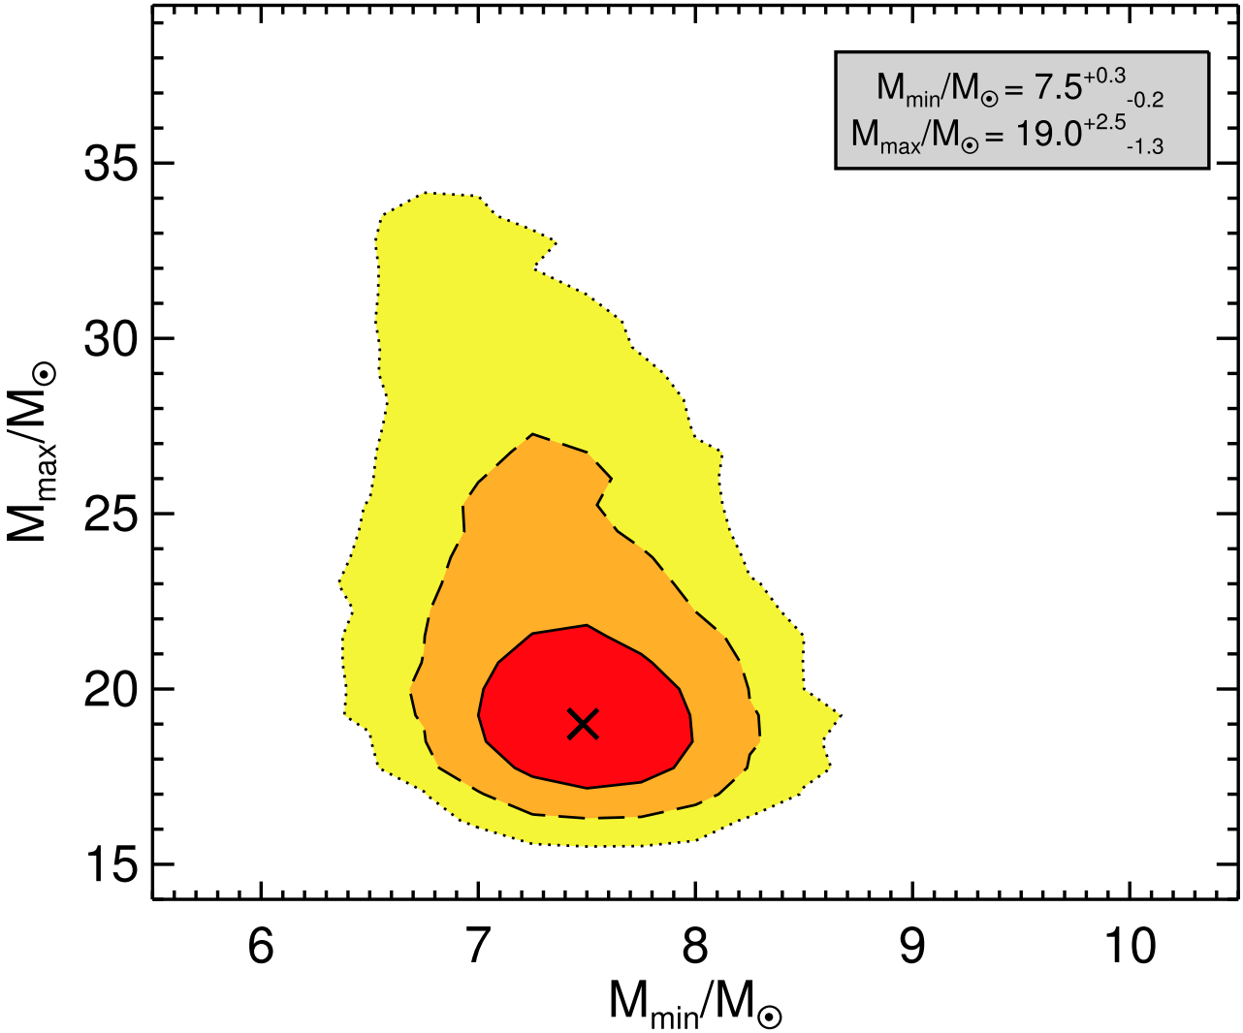
Red supergiants as progenitors of supernovae (and possibly black holes)
SN2008bk: Mattila + 2010
complications
dust (T_{eff}, BC)
matching model
II-L ?
II-b ?
Davies & Beasor 2018
II-P
mass loss
binary interaction
when does it go SN?
II-L ?
II-P
Smartt 2015 data
Straniero 2019

Slide 14
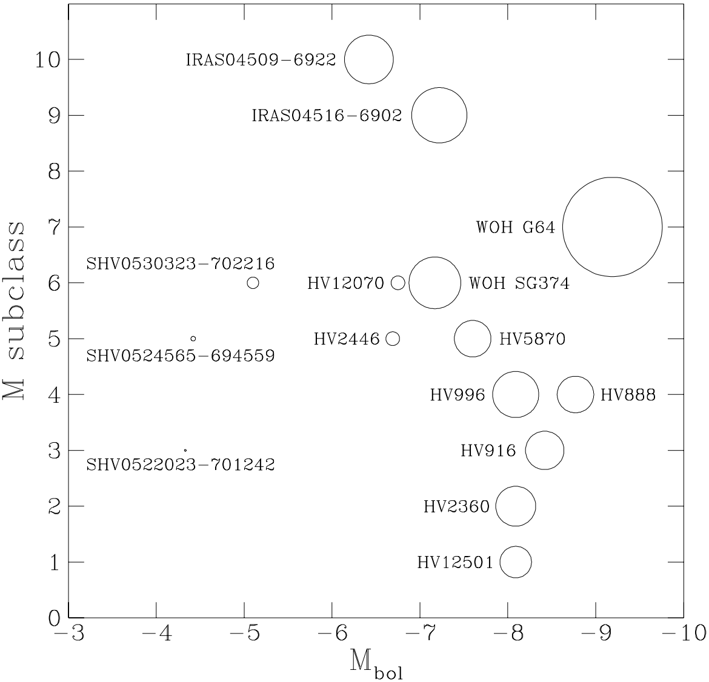
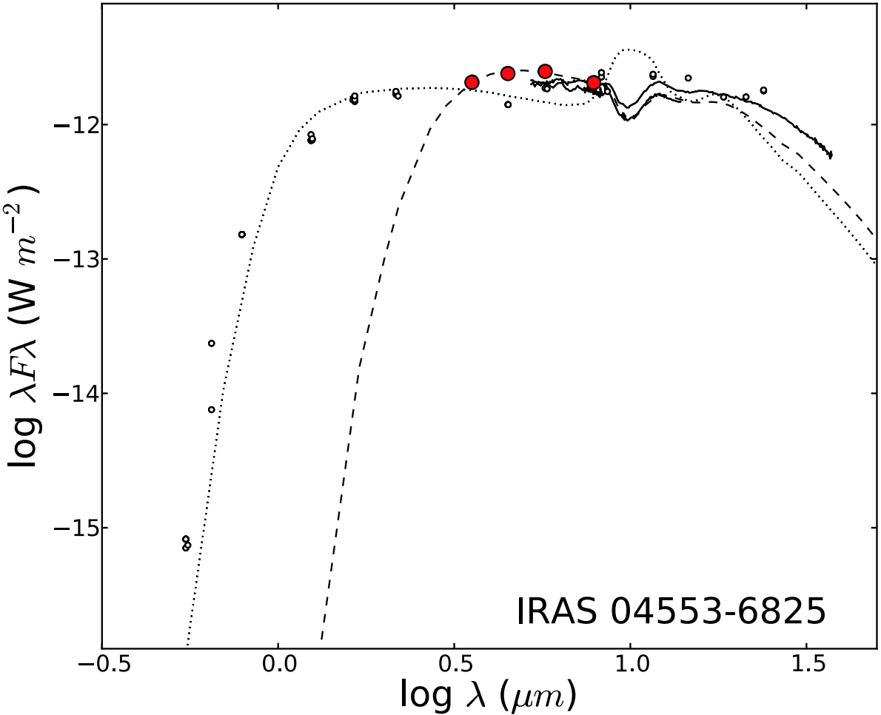
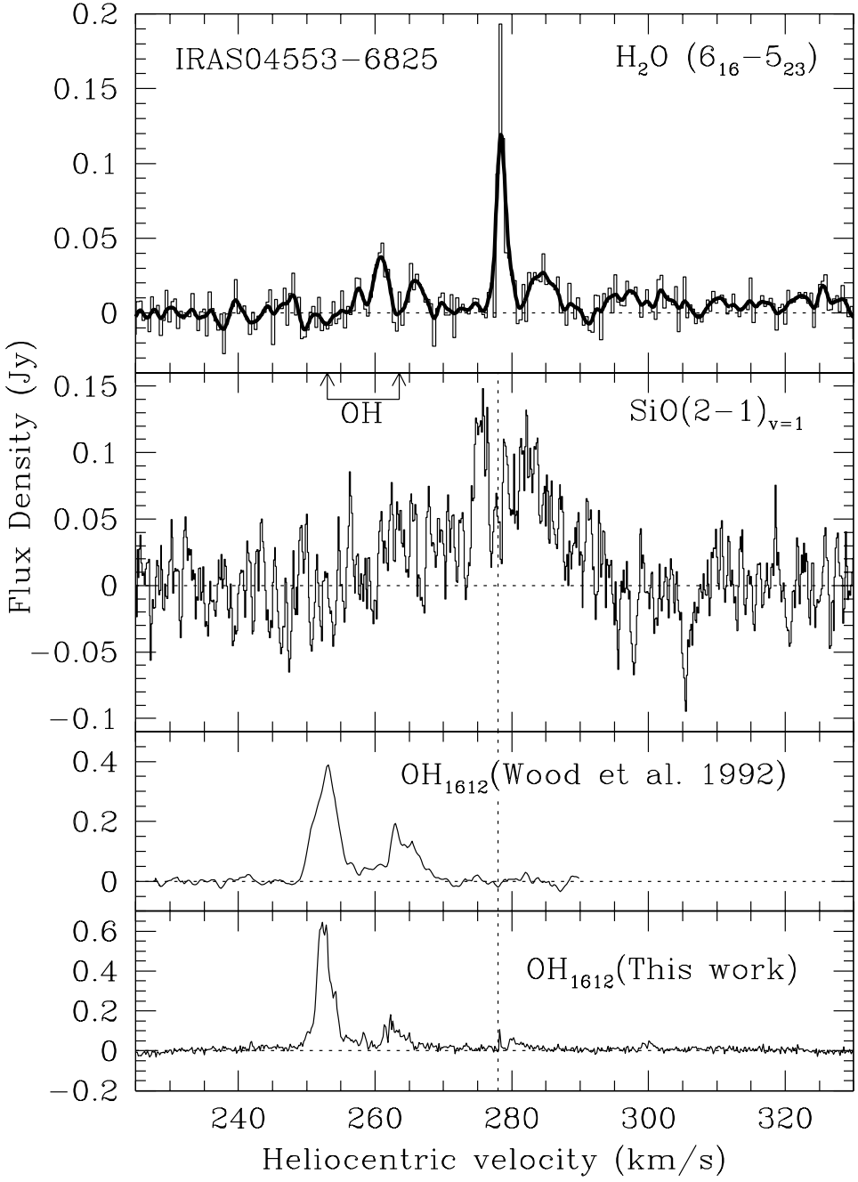
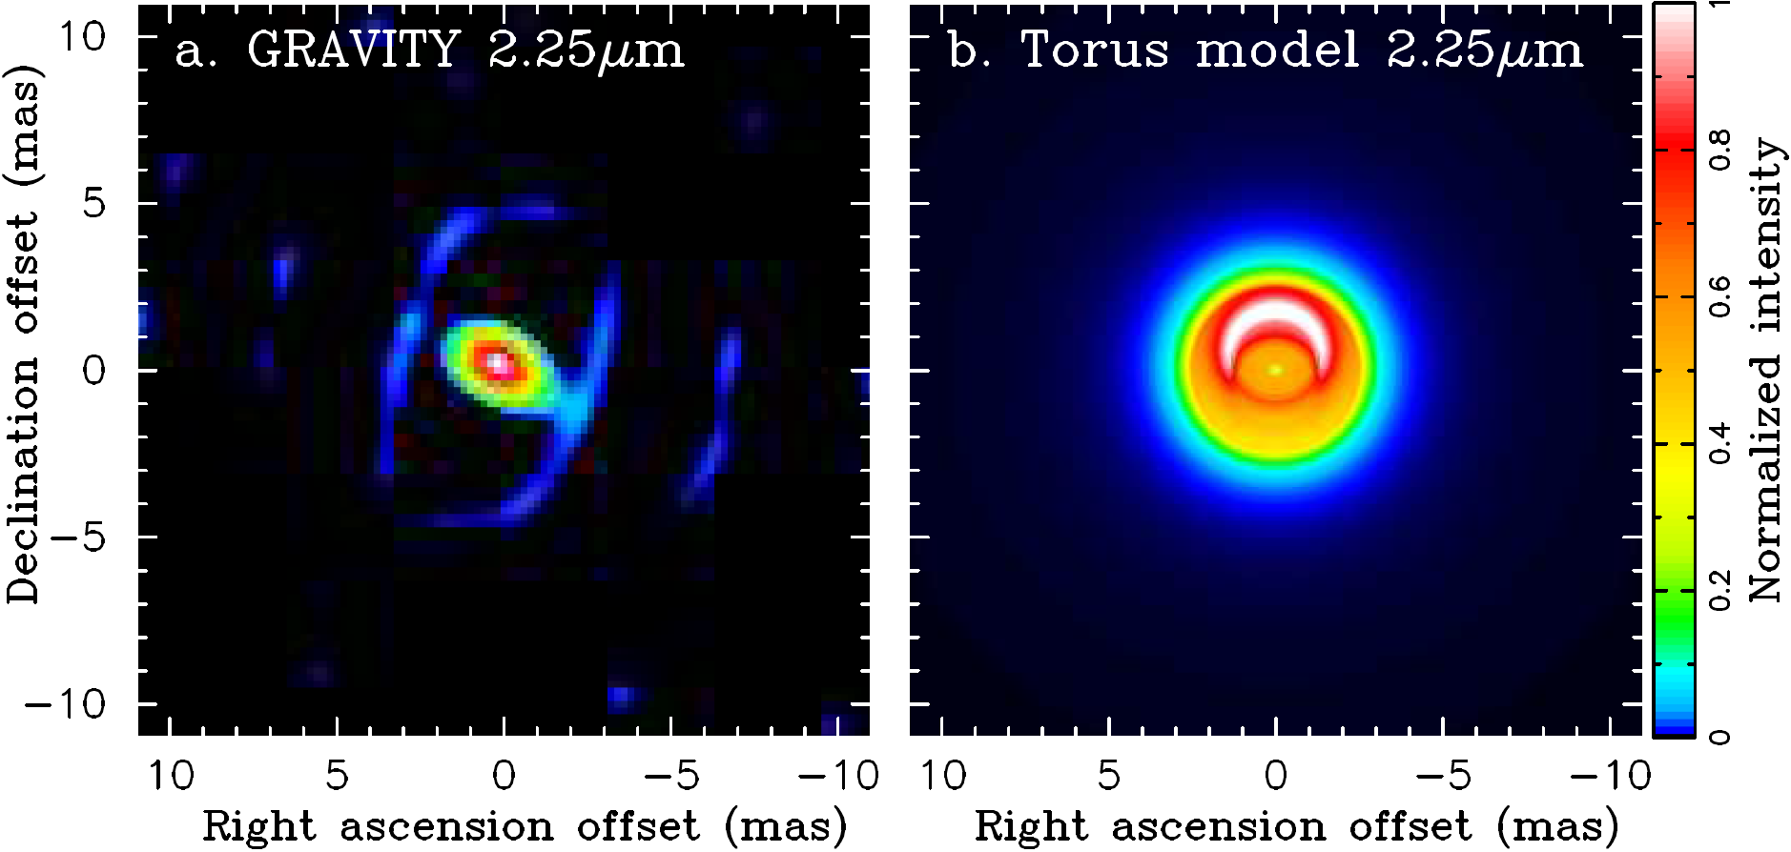
My favourite RSG: WOH G64 in the LMC
van Loon + 1998
how to reconcile?
Goldman + 2017
van Loon + 1999
van Loon + 1996
2000 au
Marshall + 2004
questions
where is the dust?
why is it axisymmetric?
will it mimic SN1987A?
Ohnaka + (in prep)
(Ohnaka + 2008)

Slide 15
Děkuji

