Slide 1
Introduction to the Course:
Contemporary Hunters-Gatherers: Behavior, Ecology, & Change

Slide 2
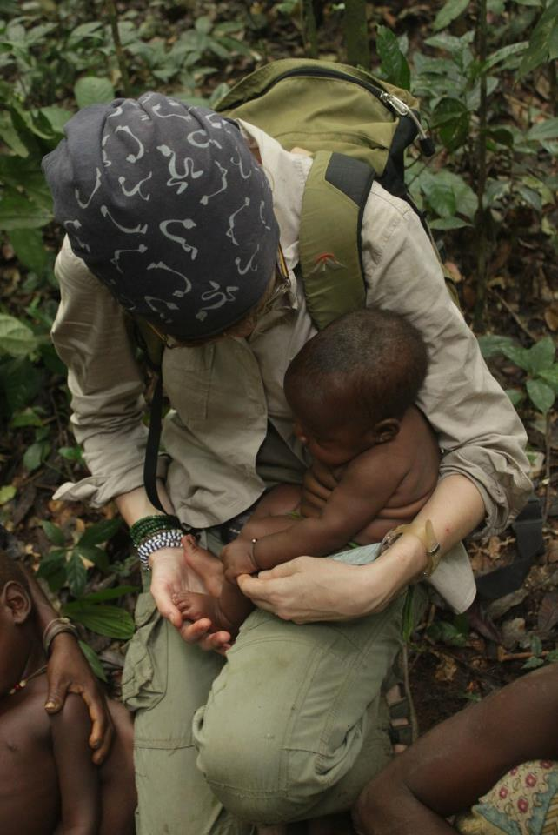
Who am I and how did I start to be interested into hunters-gatherers?

Slide 3


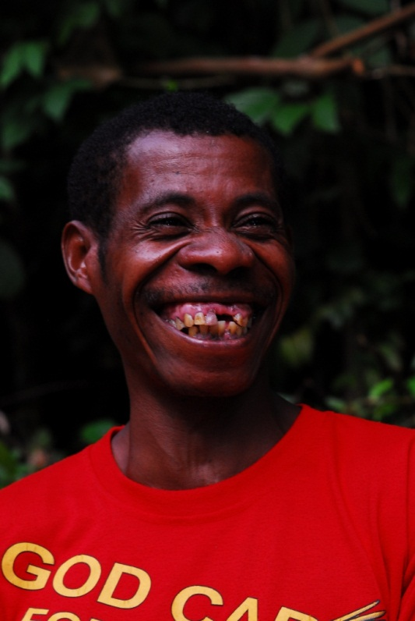



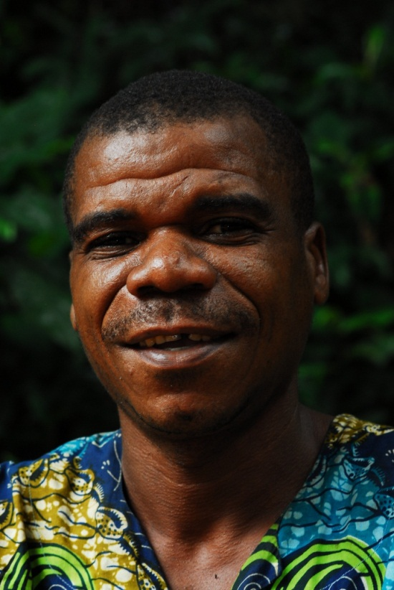

Slide 4
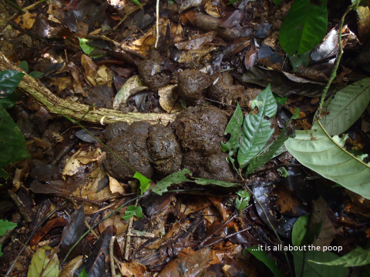


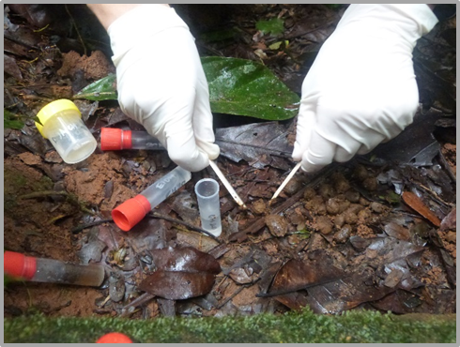
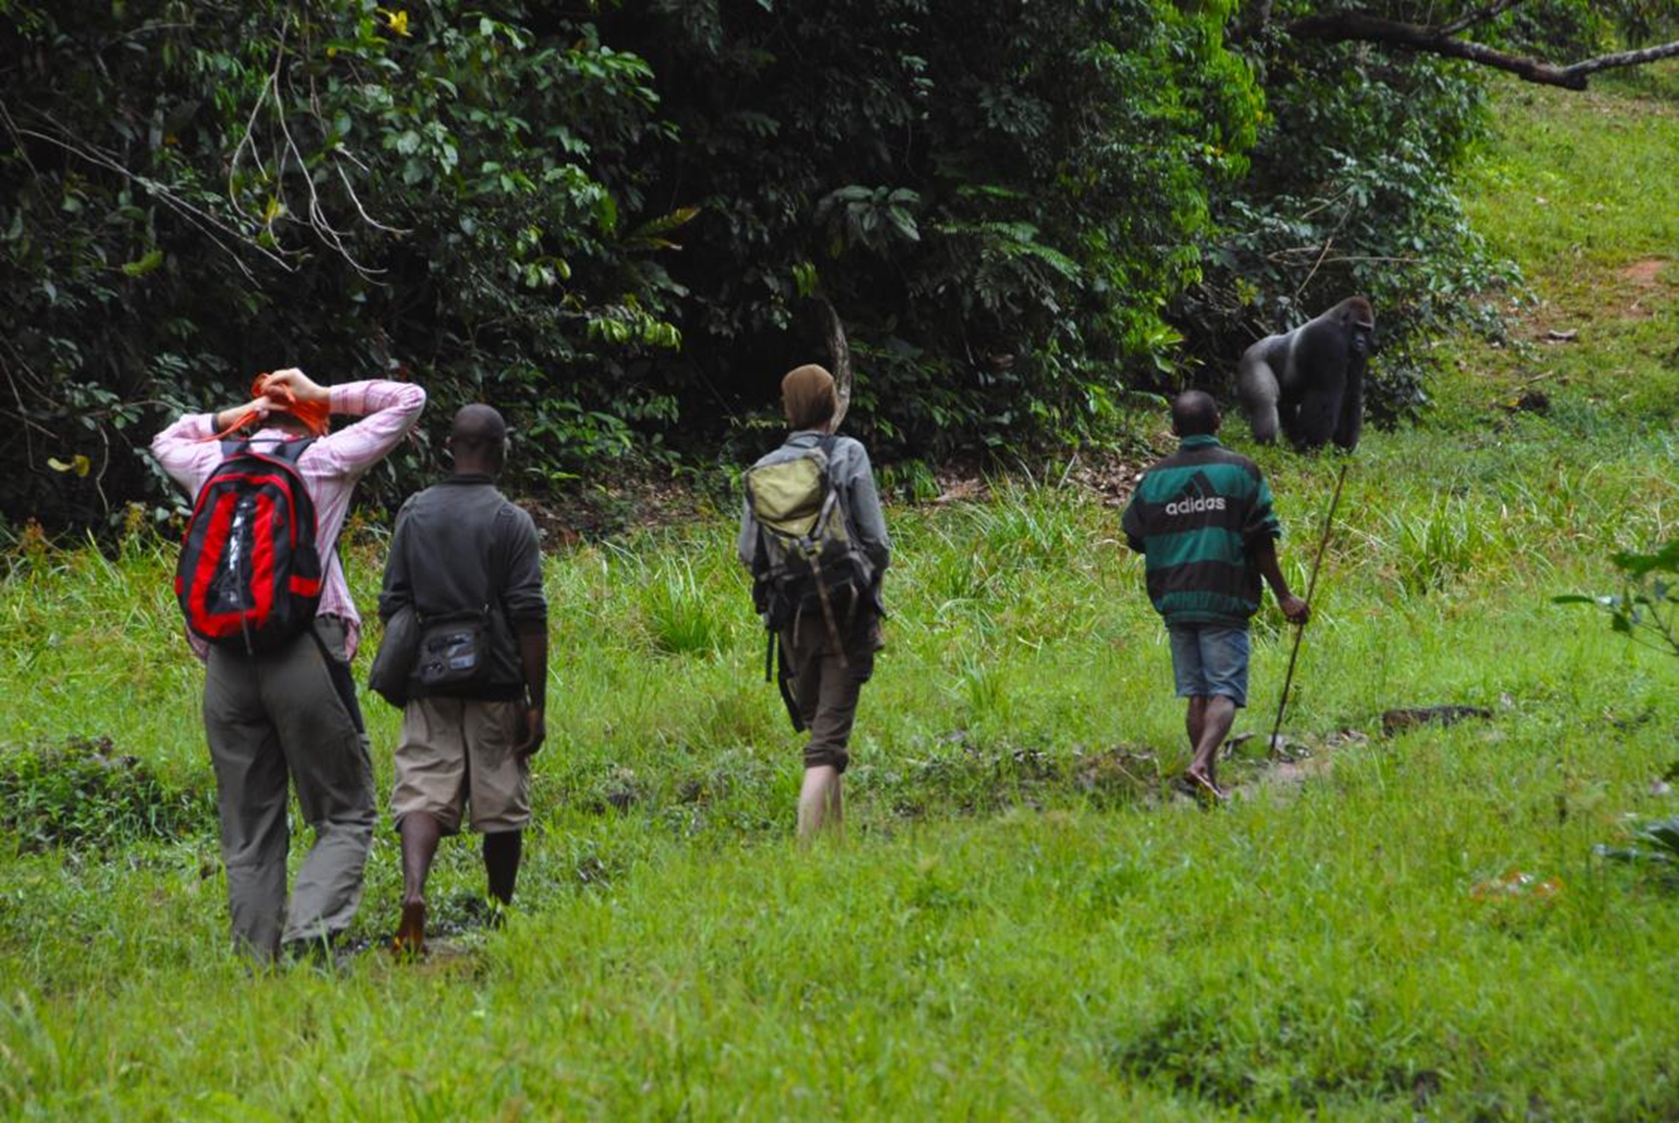
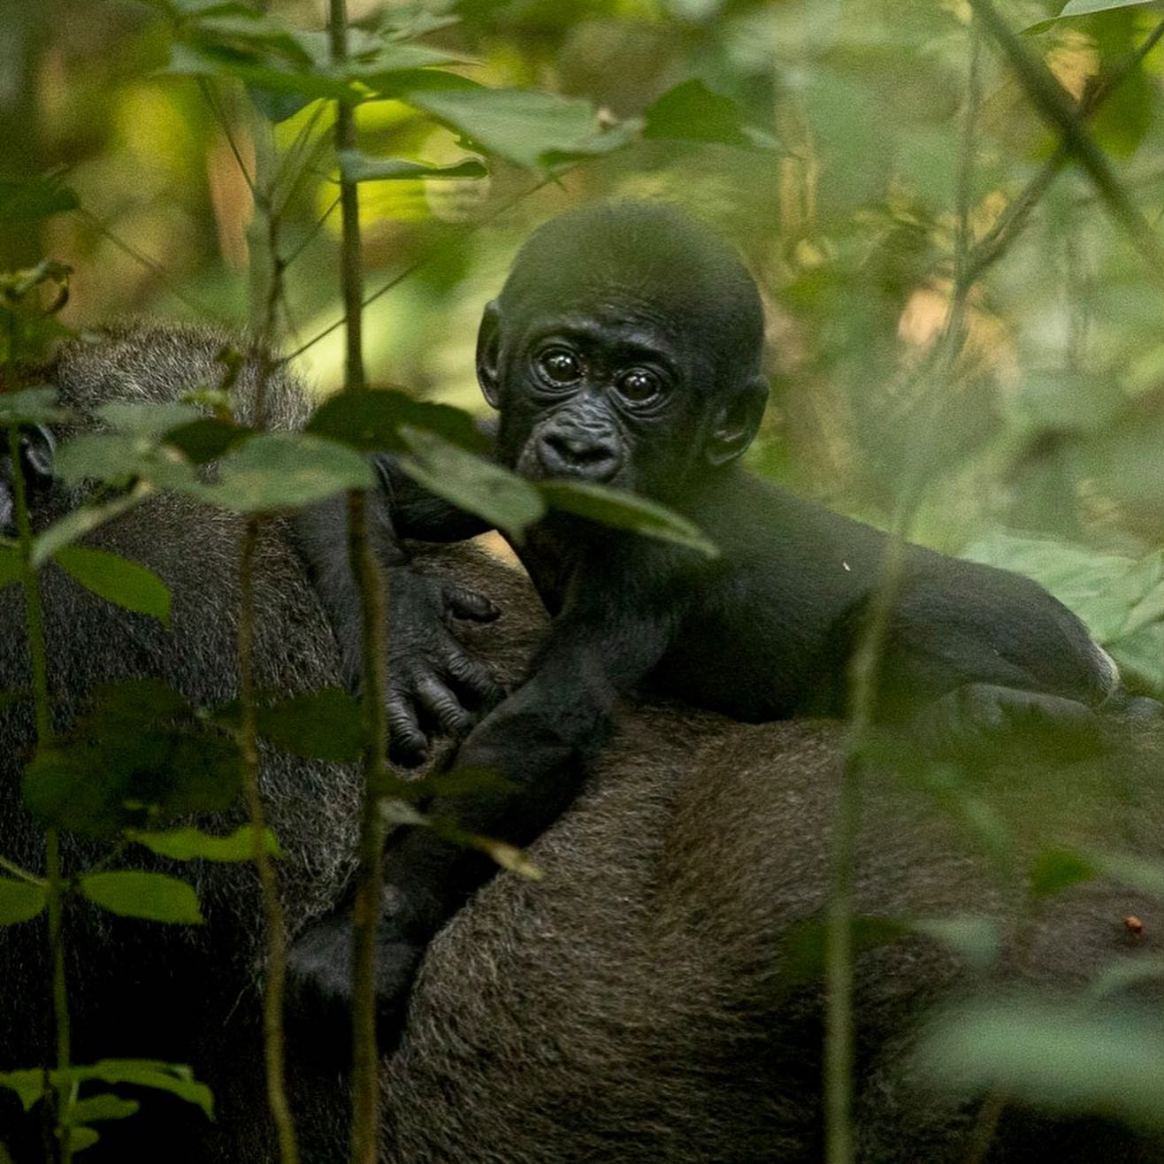
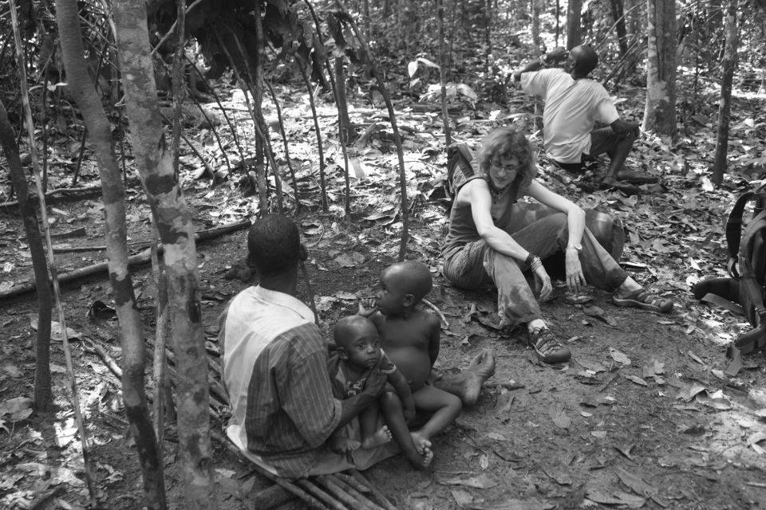
Primate Parasite/Symbiont Ecologist
Microbiology
Zoology/primatology
Parasitology
Conservation Biology
Primate ecology
Symbiont ecology
Human ecology
Medical anthropology
IVB CAS: Primate Symbiont Ecology Research Group

Slide 5
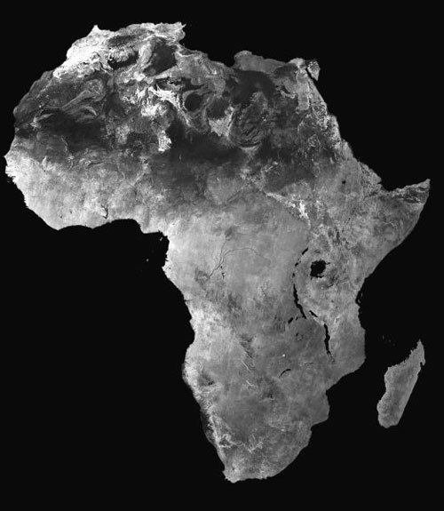


Cantanhez
Sapo
Dzanga Sangha
Dja
Virungas
Campo Ma’an
Kalinzu
Petit Loango
Rubondo
Ugalla

Slide 6

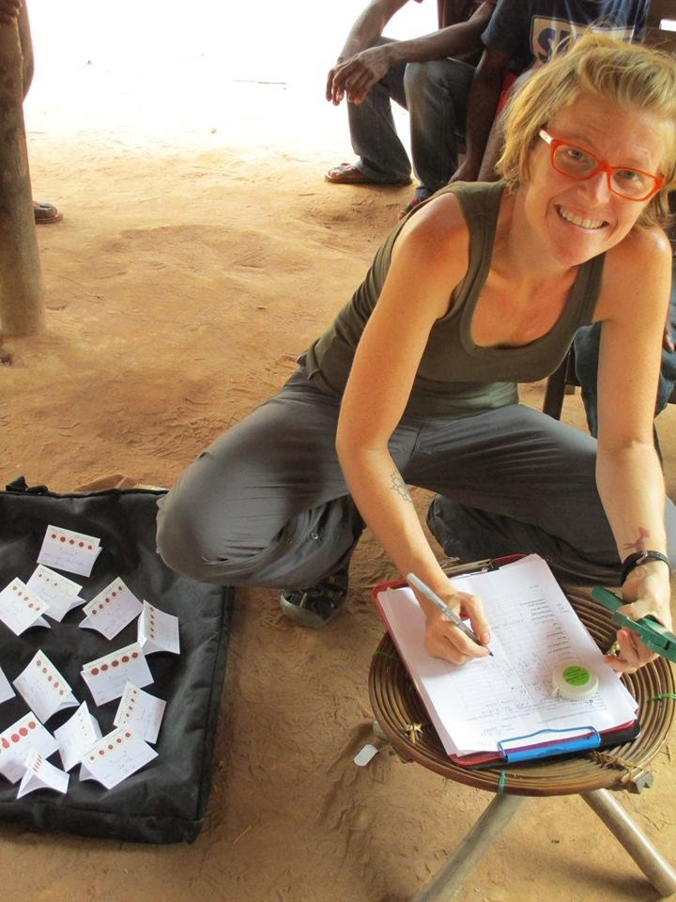
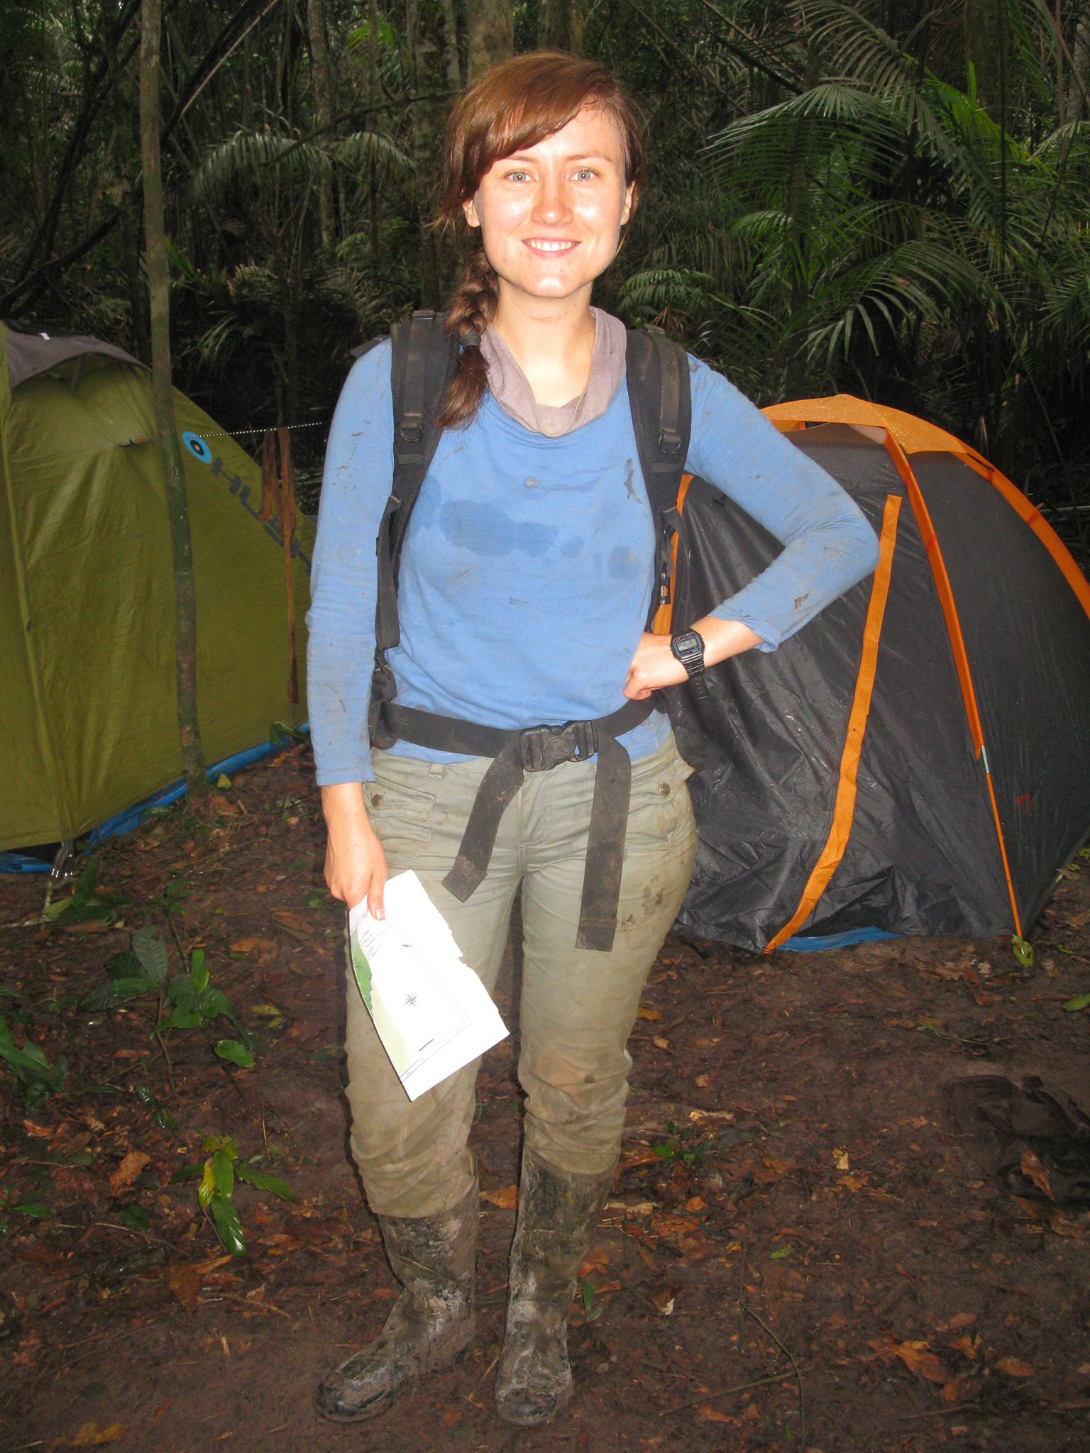

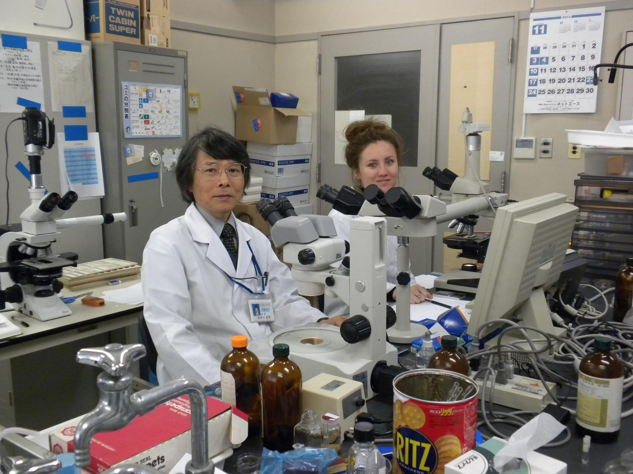
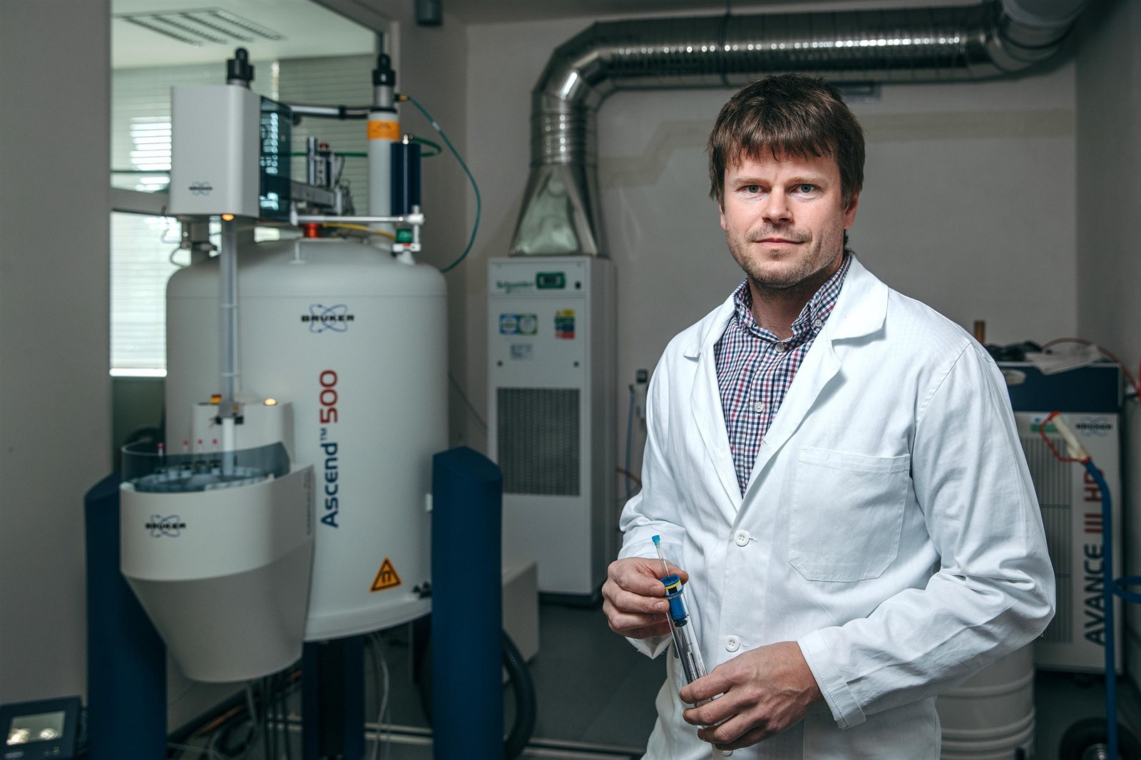
Collaborative Research

Slide 7
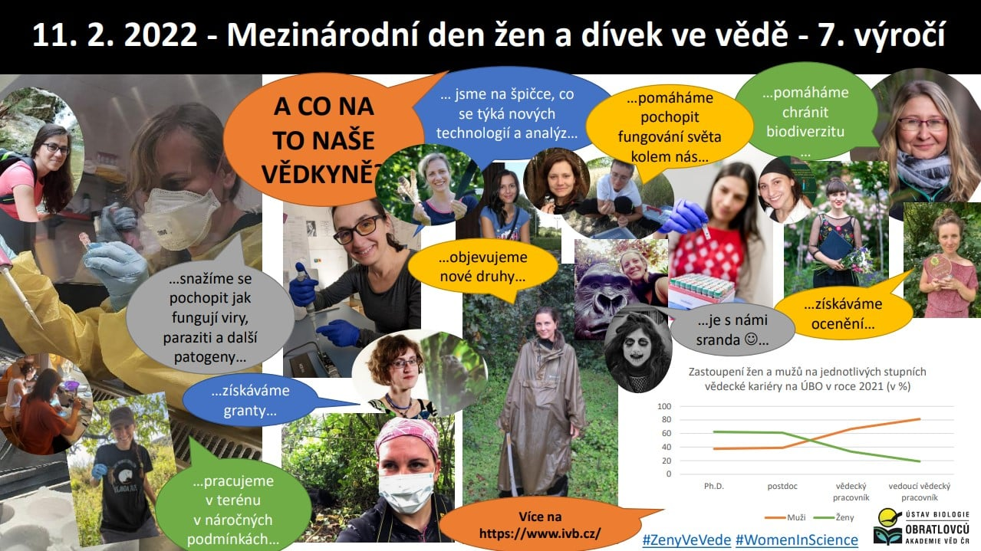

Slide 8
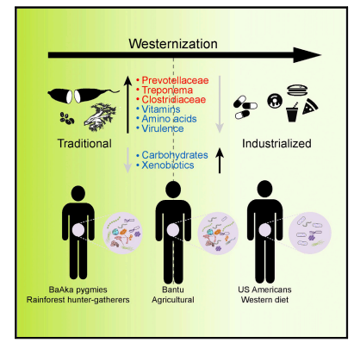
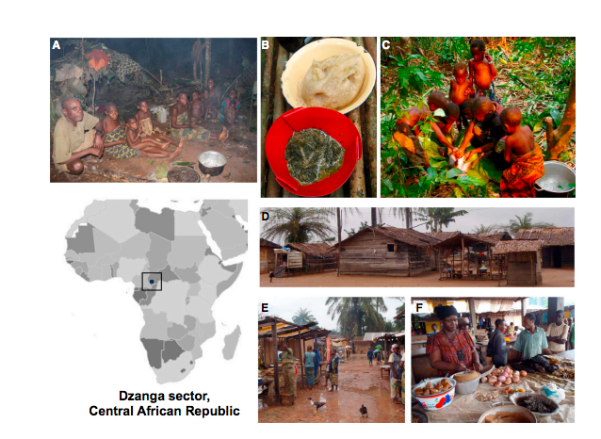
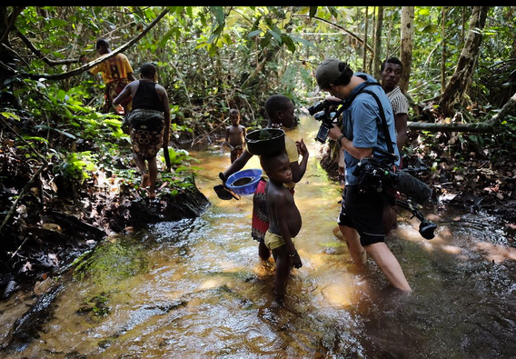
What are we looking at and why does it matter?

Slide 9
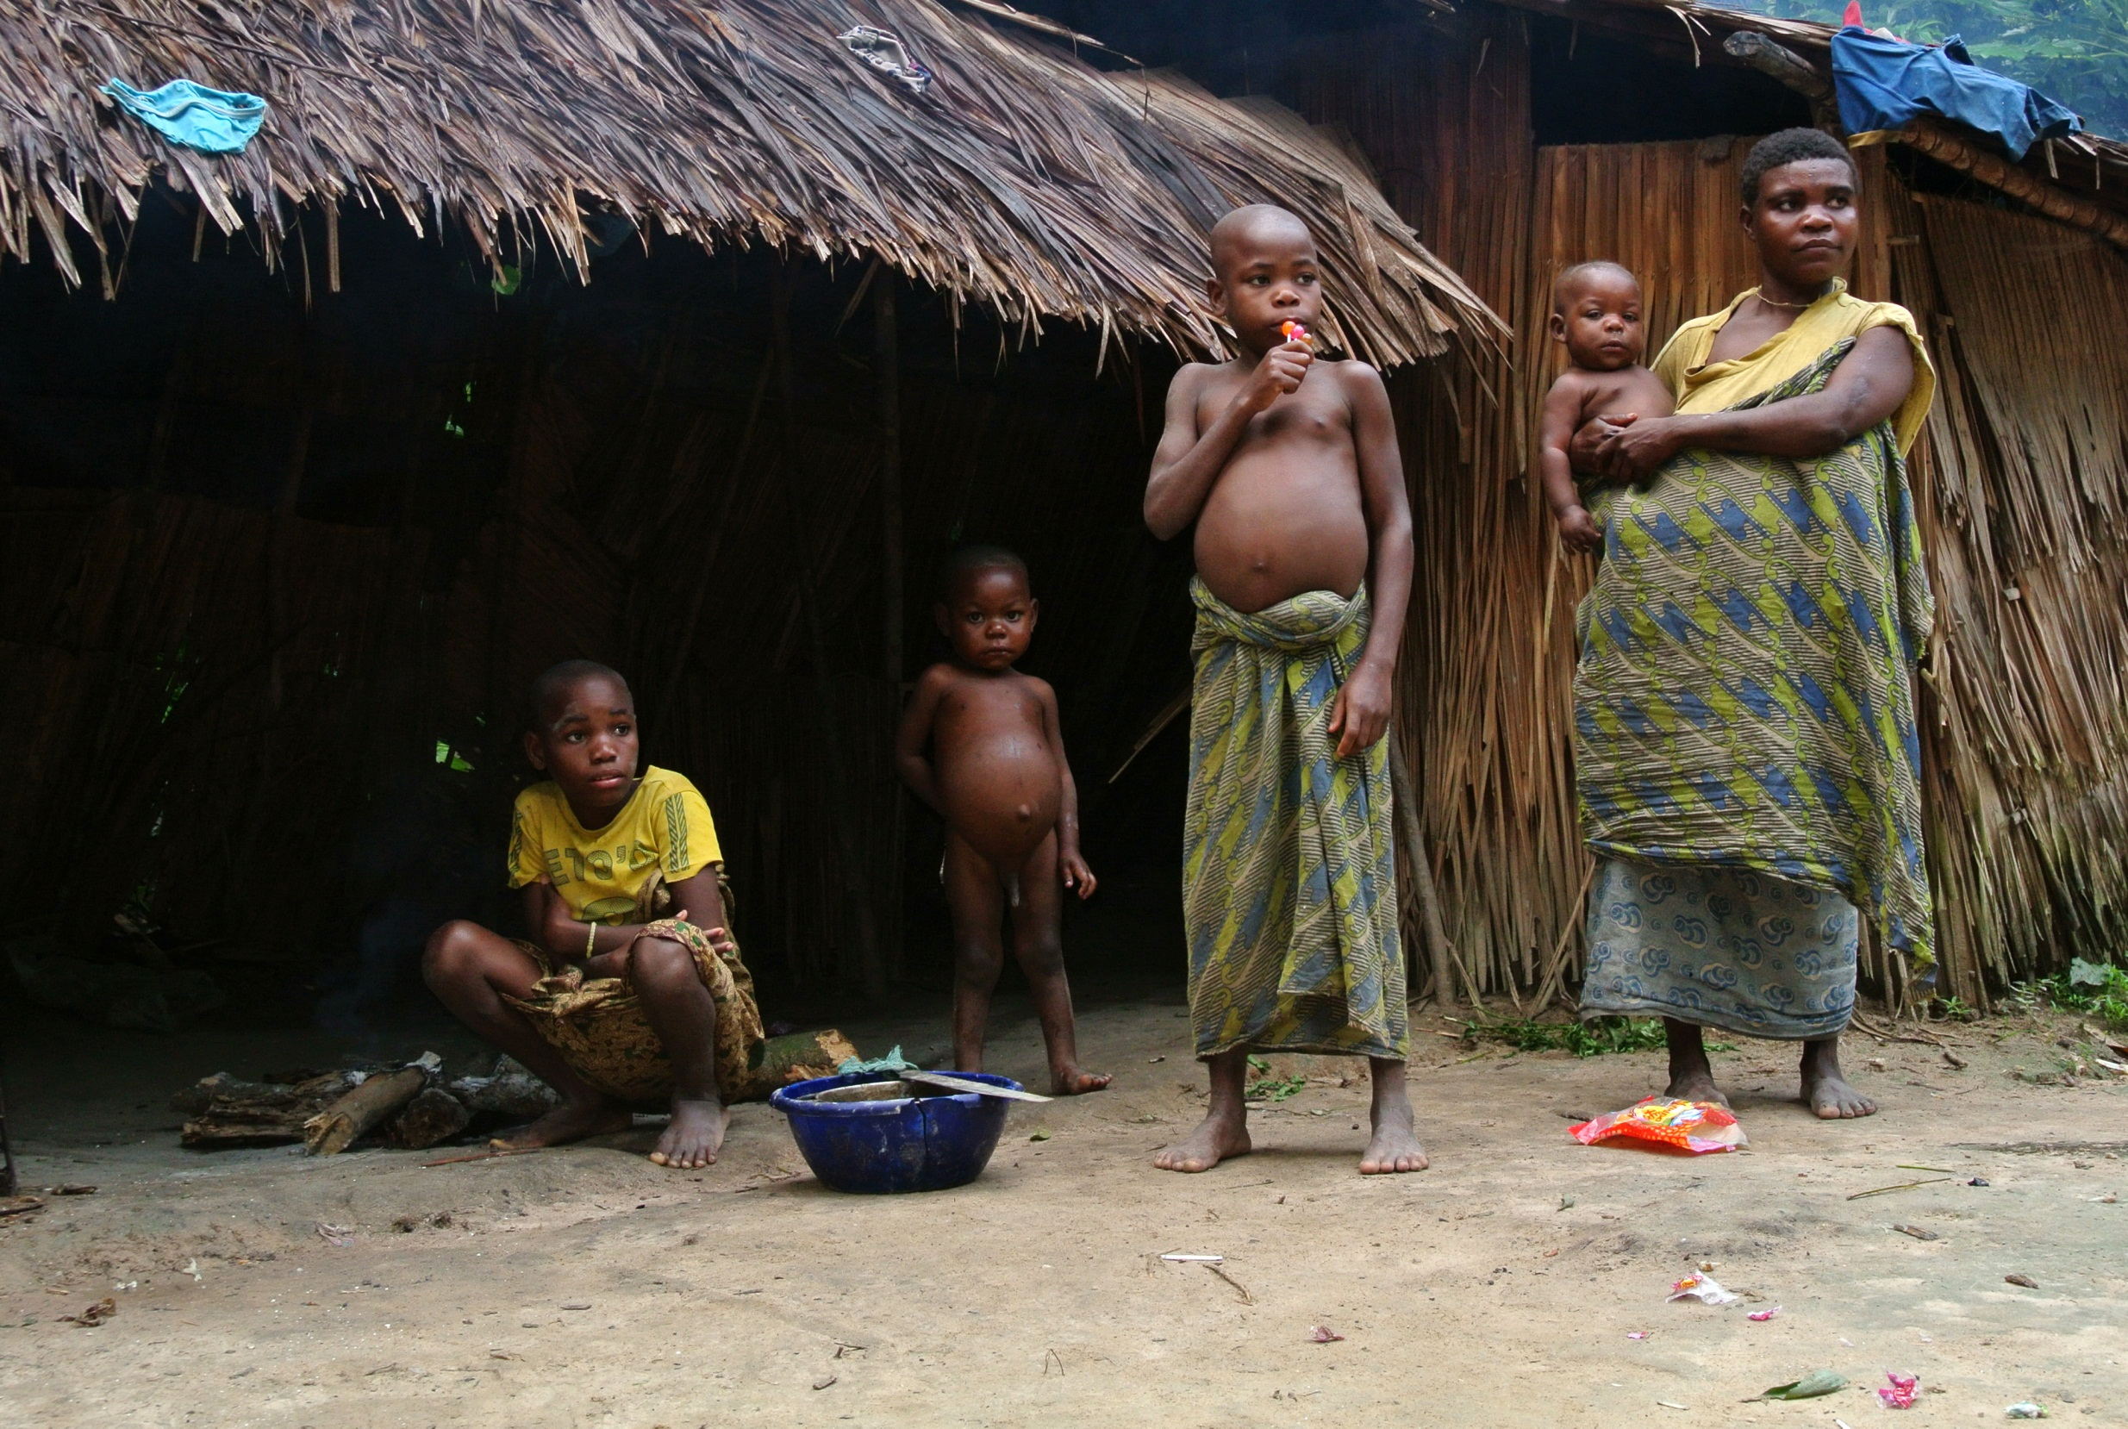



N. americanus
N. gorillae
N. gorillae
?

Slide 10
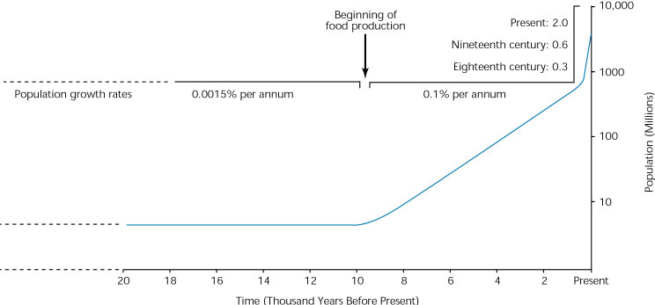
Why study Hunter-Gatherers?

Slide 11
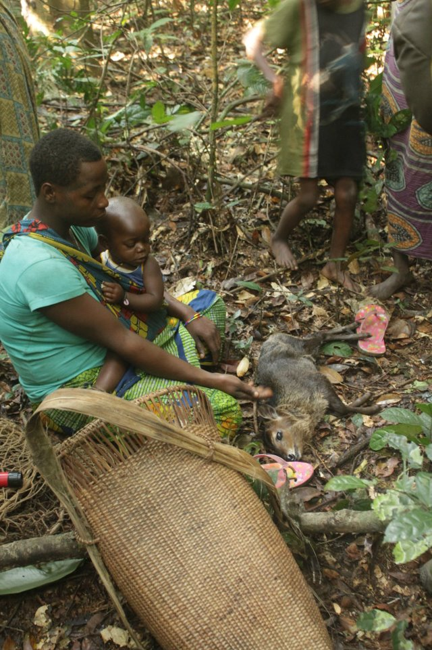
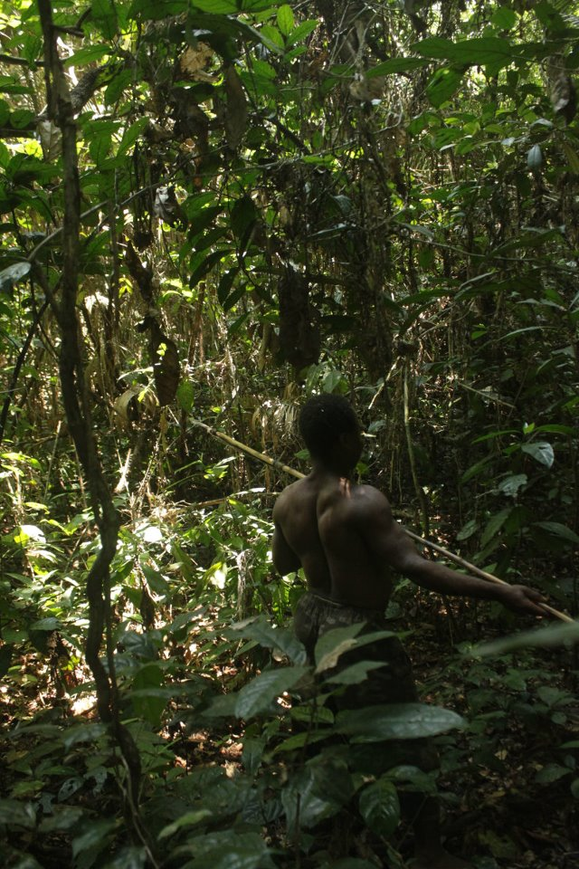
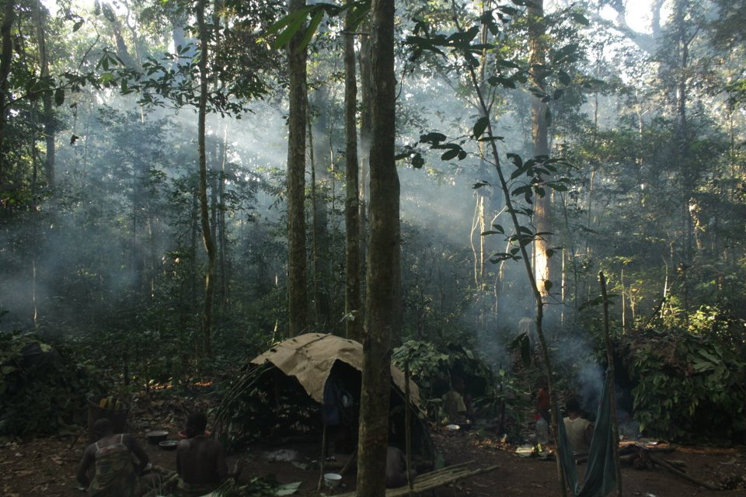
Hunter-Gatherers (Foragers) Defined
Term Pygmy
  widely recognized, but considered derogatory
  not all all hunters- gatherers
  not all live in the forest

Slide 12

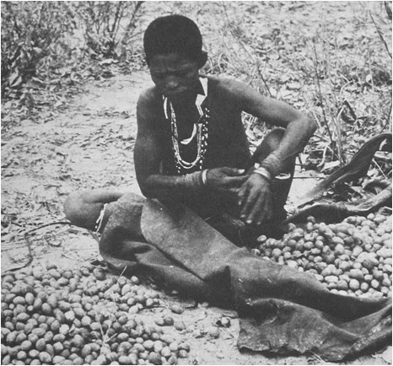
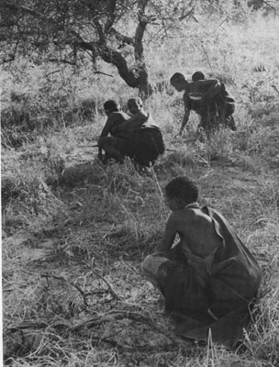
Hunter-Gatherers (Foragers) Defined
Economically – mode of subsistence
  reliance on hunting wild animals, gathering wild plant foods, and fishing
  no domesticated plants and animals (except dogs)

Slide 13
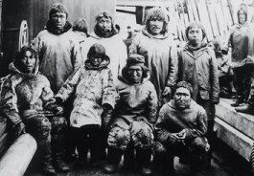
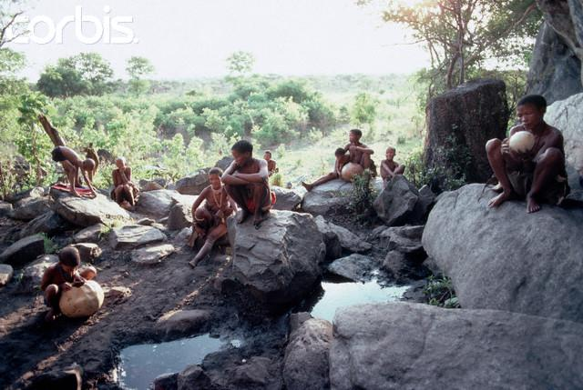
Hunter-Gatherers (Foragers) Defined
Socially – band level societies, live in small groups where membership is flexible and relations are generally egalitarian
Multiple child caregiving

Slide 14
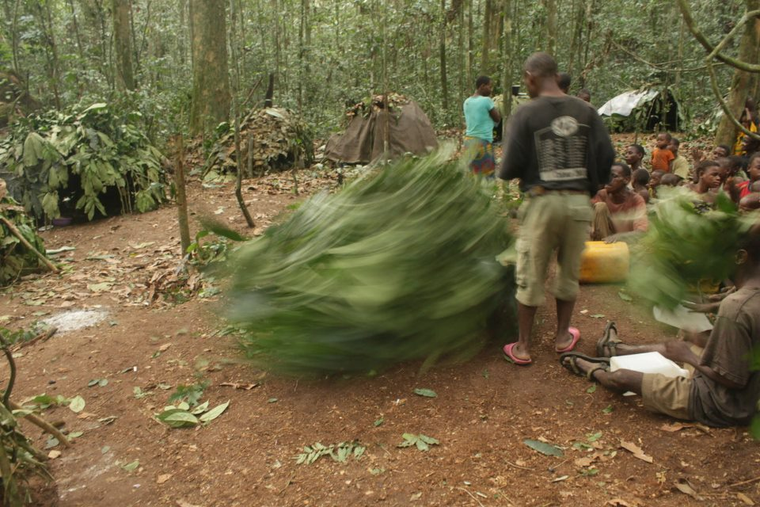
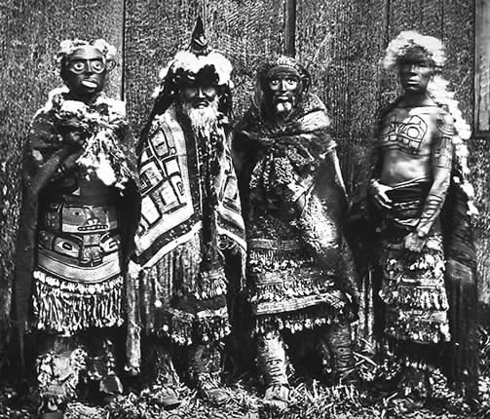
Hunter-Gatherers (Foragers) Defined
Cosmology and world-view
Complex relationships with neighboring farming groups

Slide 15
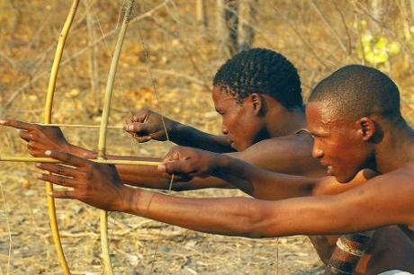
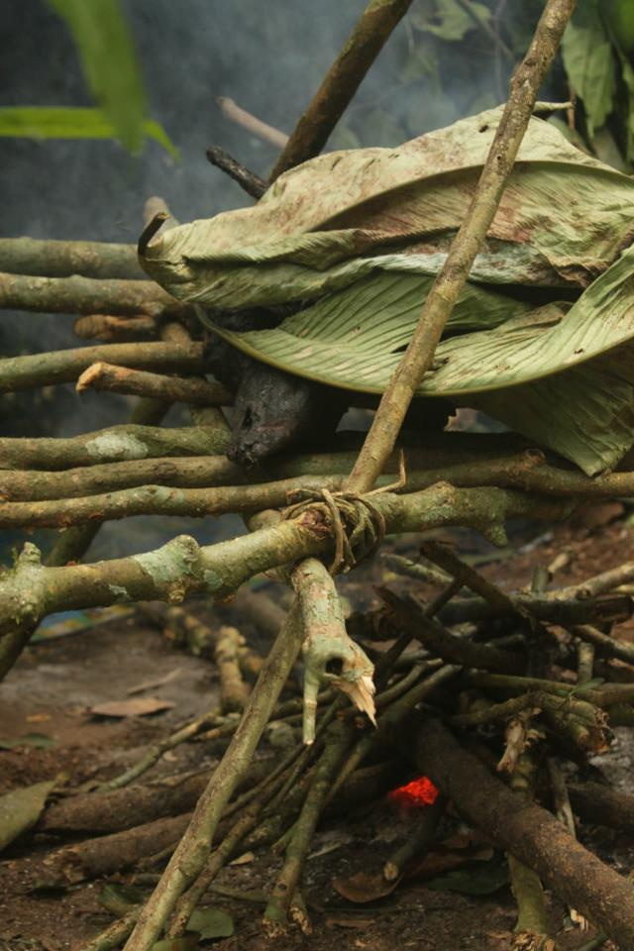
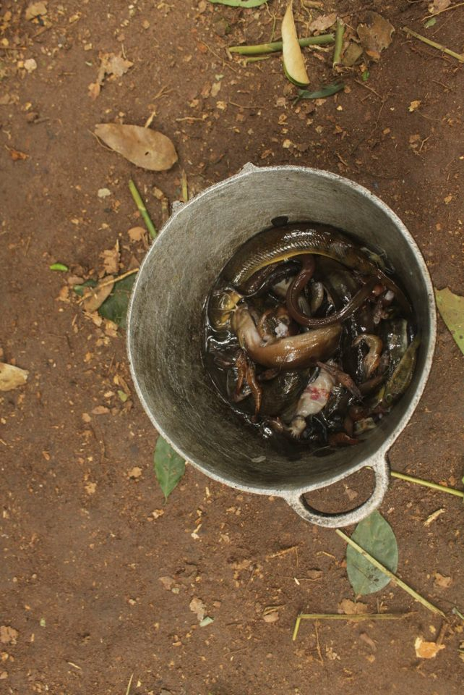
Sharing
Varied patterns
Intricate
  Sharing and permission are not as simple as we think!
Sharing and Reciprocity

Slide 16
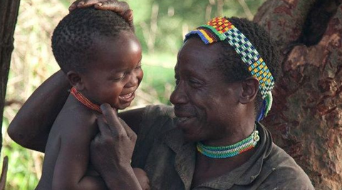
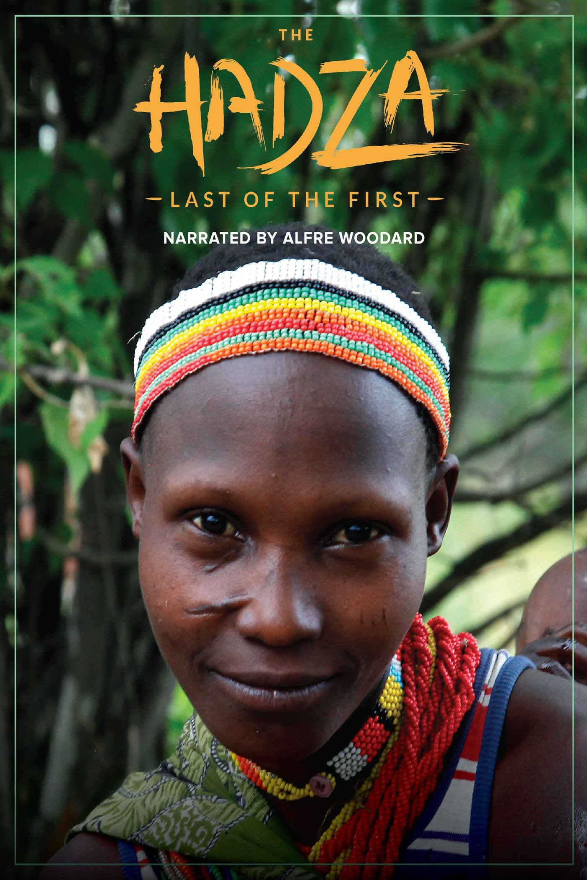
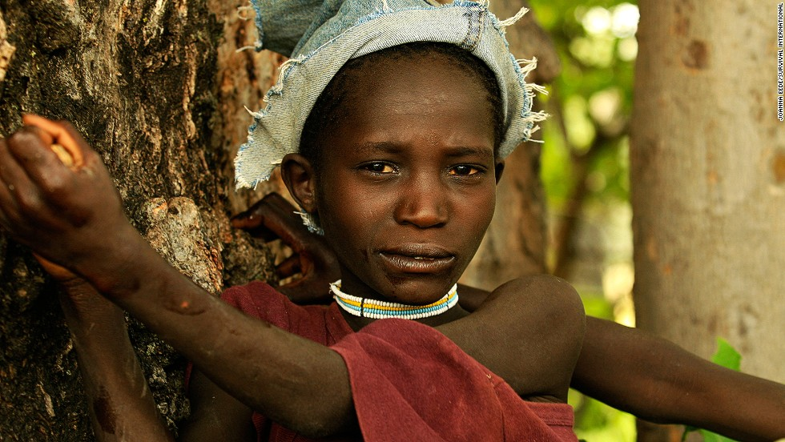
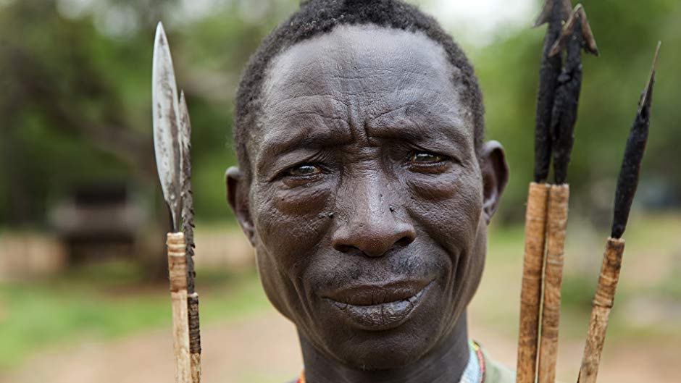
Notes:
https://www.youtube.com/watch?v=AwS7JaWB0x8

