Slide 1
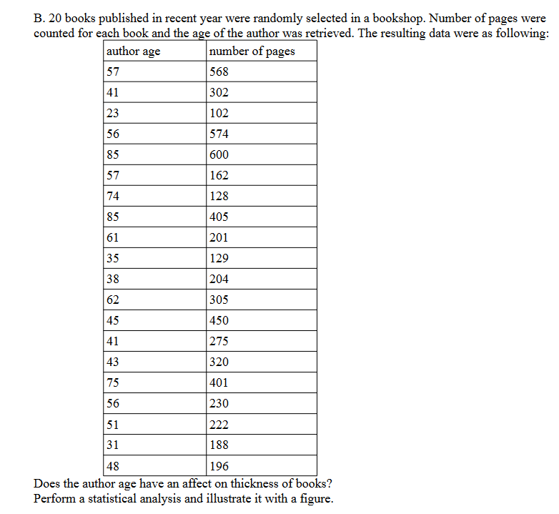

Slide 2
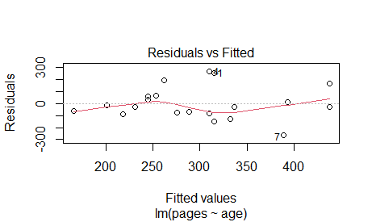
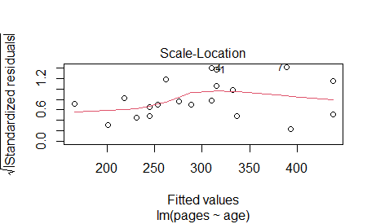
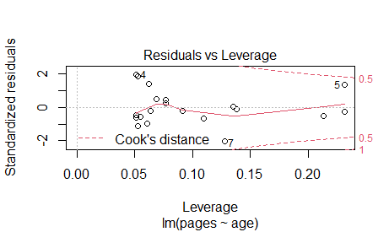
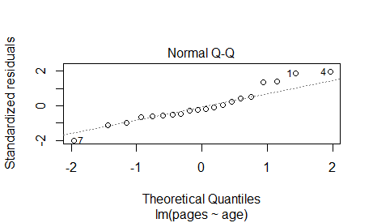
books<-read.delim2("clipboard")
lm.b<-lm(pages~age, data=books)
plot(lm.b)
The null hypothesis – the author’s age does not have an affect on thickness of book

Slide 3
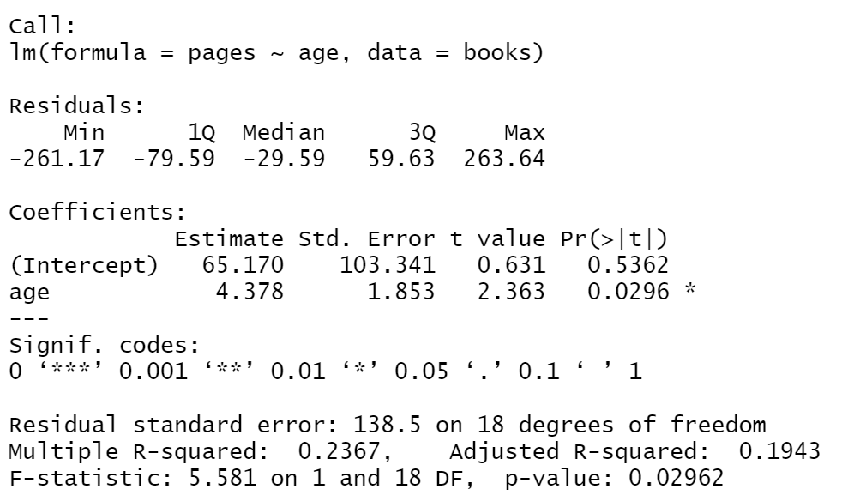
summary(lm.b)
The null hypothesis is rejected = the author’s age does have an affect on thickness of book

Slide 4
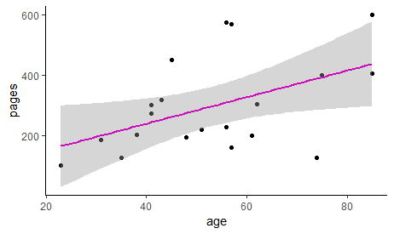
ggplot(books, aes(x=age, y=pages))+geom_point()+geom_smooth(method="lm", colour=6)+theme_classic()

