Slide 1
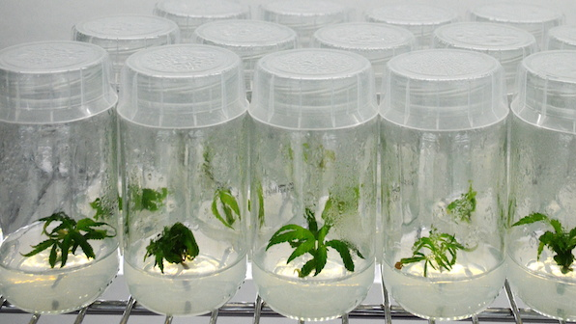
05_Mikropropagace
Množení in vitro
Mgr. Hana Cempírková, Ph.D.
Rostlinné explantáty

Slide 2
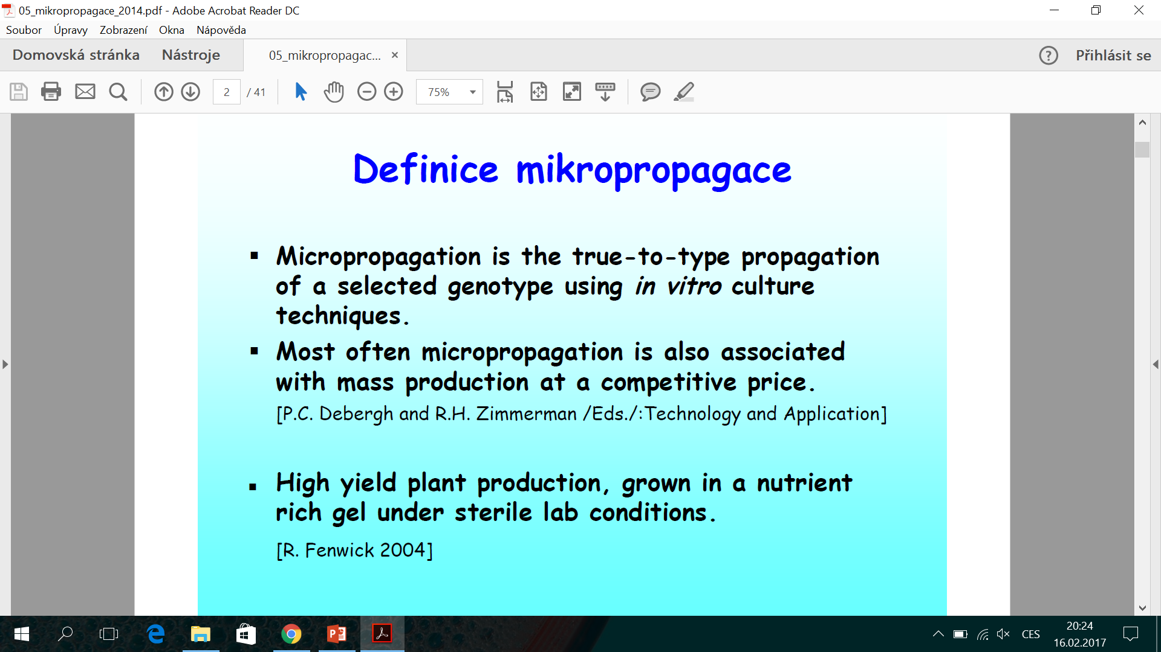
Micropropagation is a method to produce genetically identical plantlets by using tissue culture techniques
Micropropagation is an advanced vegetative propagation technology for producing a large number of genetically superior and pathogen-free transplants in a limited time and space.

Slide 3
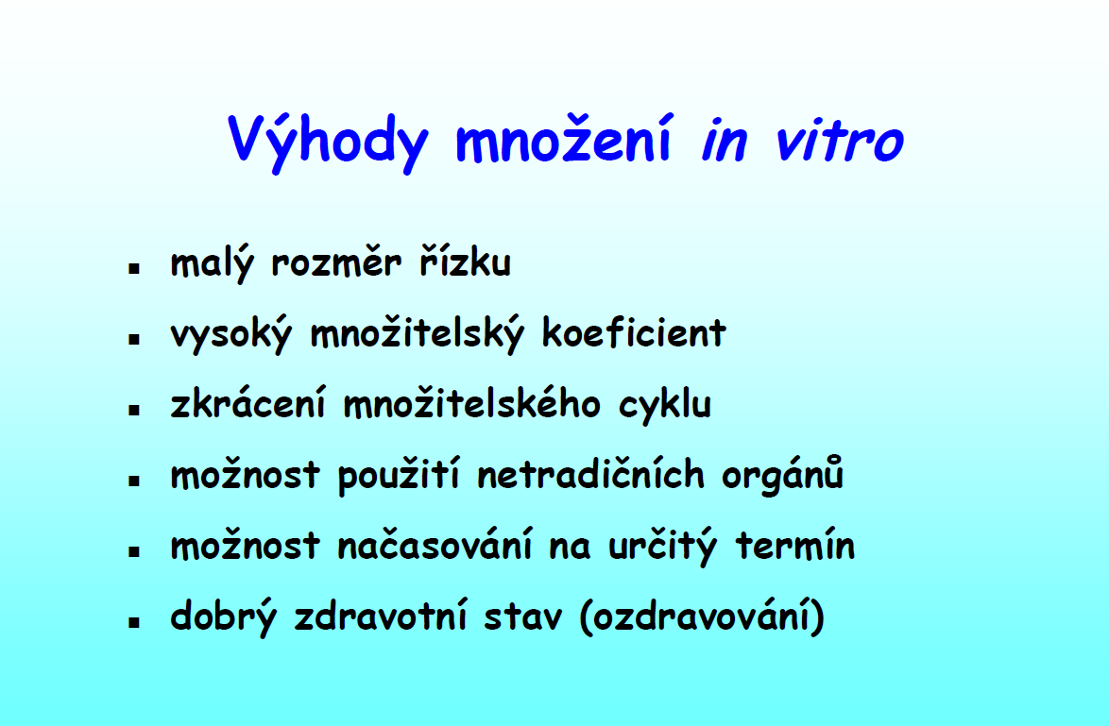

Slide 4
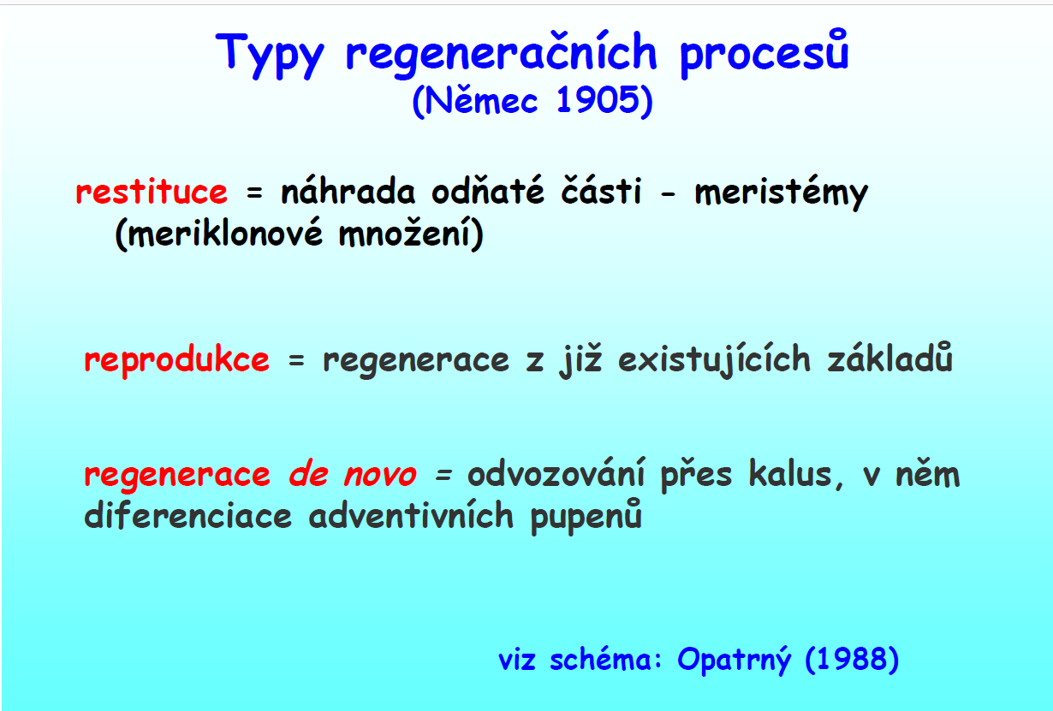

Slide 5
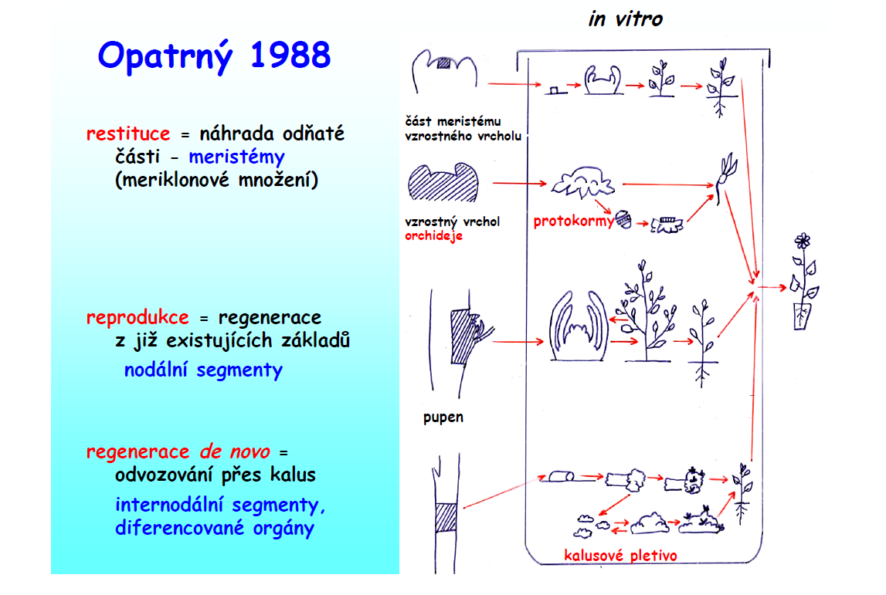

Slide 6
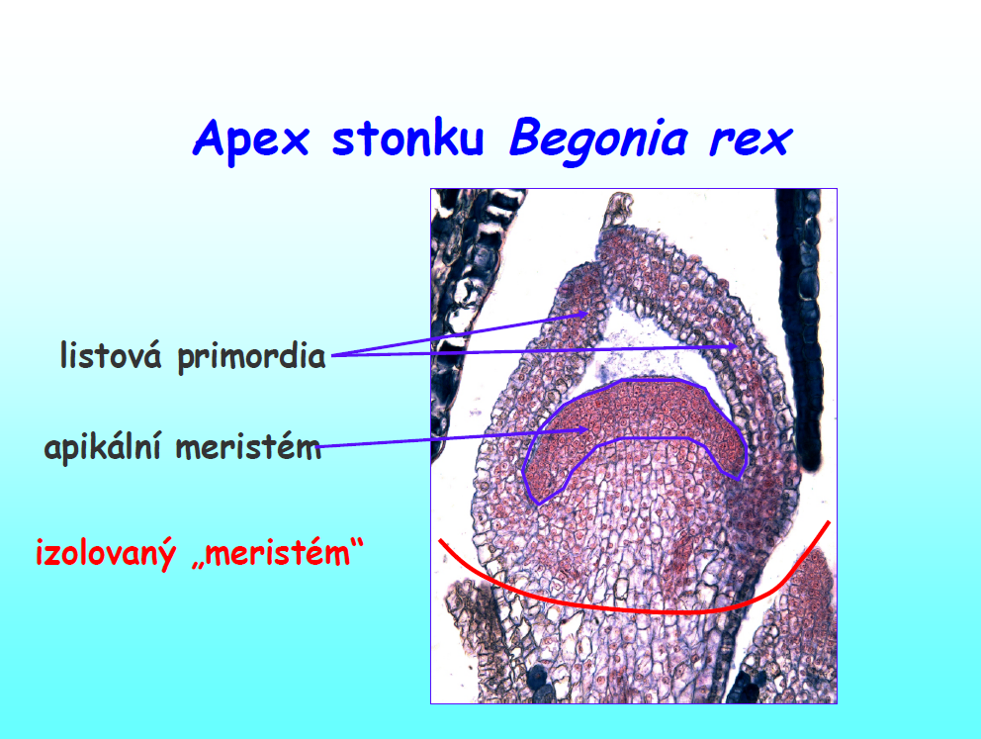
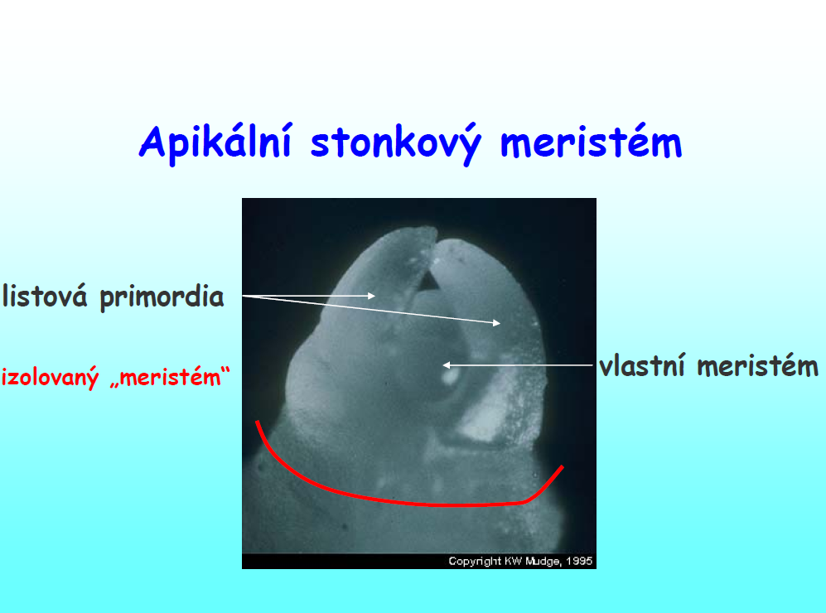

Slide 7
Typy mikropropagace
1) meristémové množení (apikální nebo axilární meristémy)
2) tvorba adventivních prýtů (z již diferencovaných orgánů, např. listy, internodia, listy cibulových hlíz, květenství, dělohy… - přes kalus nebo přímo)
3) kalusové, suspenzní a protoplastové kultury
4) somatická embrya a umělá semena

Slide 8
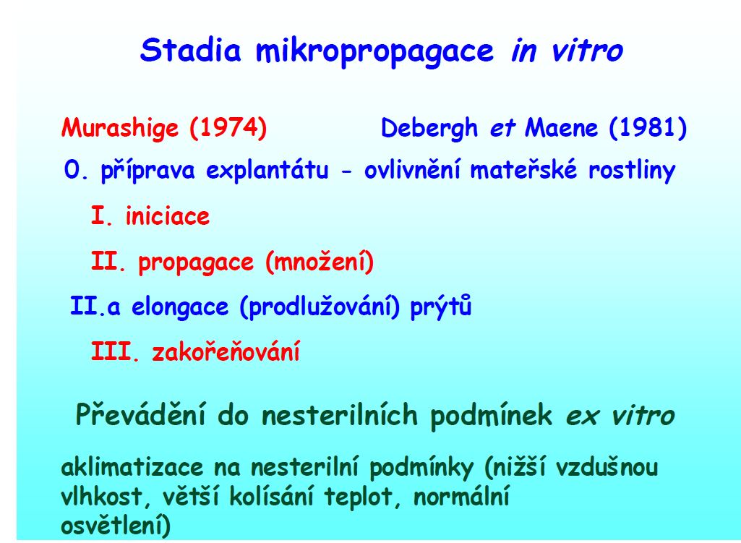
IV.

Slide 9
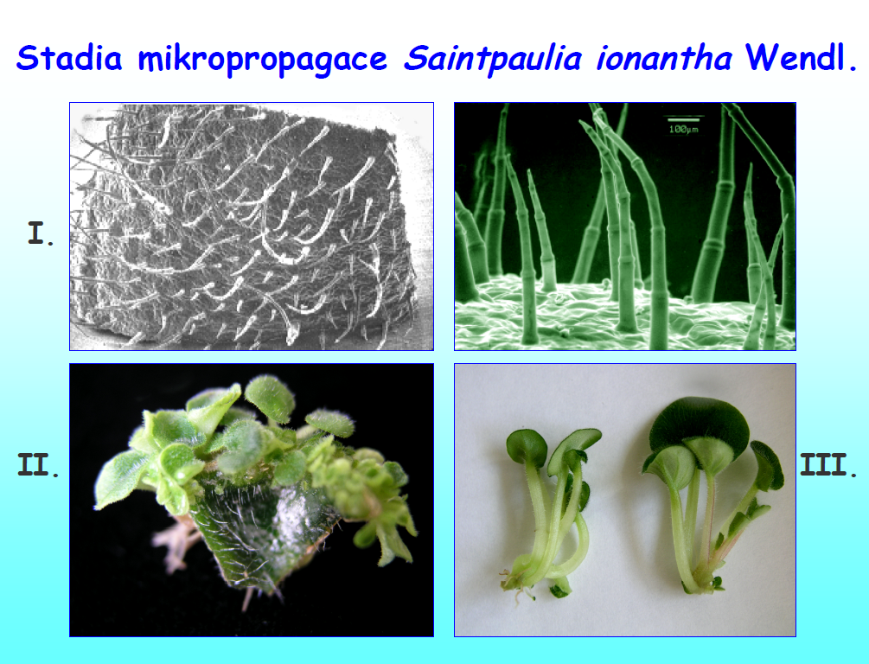

Slide 10
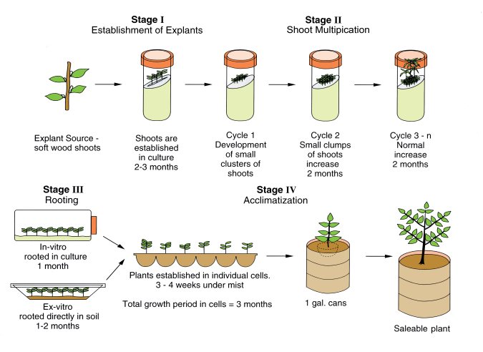
http://irrecenvhort.ifas.ufl.edu/plant-prop-glossary/09-tissue-culture/01-types/04-tctypes-micropropagation.html

Slide 11
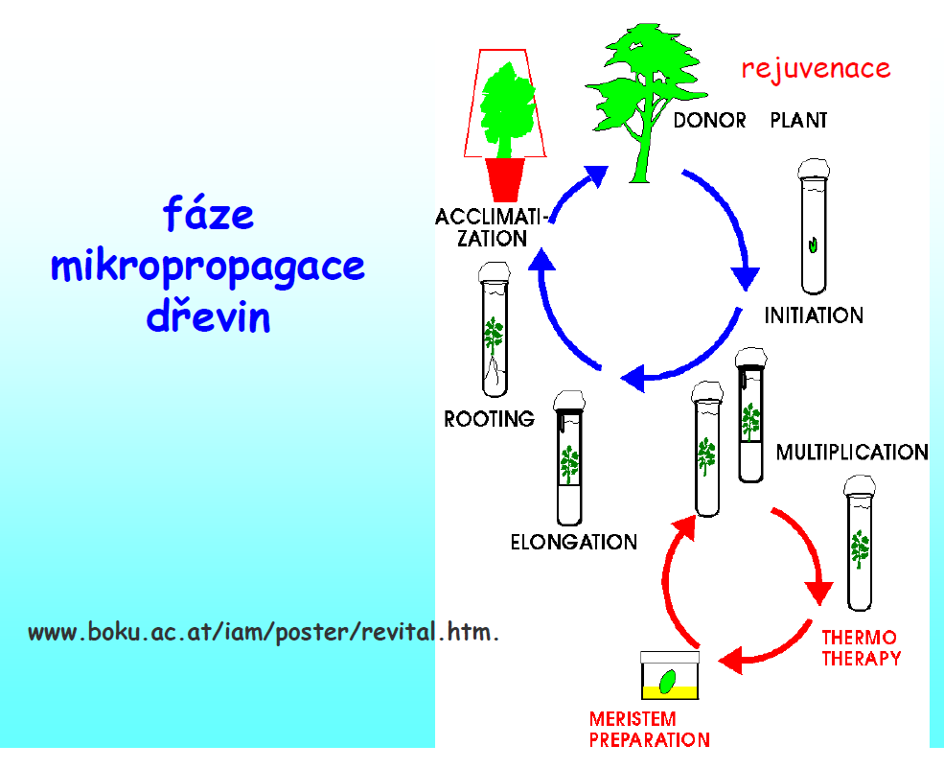

Slide 12
Rejuvenace dřevin
Methods Mol Biol. 2013;11013:383-95. doi: 10.1007/978-1-62703-074-8_30.
In vitro rejuvenation of woody species.
Read PE¹, Bavougian CM.
Author information
Abstract
Juvenility and phase change in woody plant species exert profound impacts on plant morphology and the ability of explants to be successfully propagated in vitro. Morphological characteristics such as leaf shape modifications, thorniness, and the inability to initiate flowers are associated with juvenility. Physiological maturity, that is the ability to reproduce sexually, is reached by many woody species only after many years of juvenile growth. As a result, micropropagation of woody species has historically been difficult with many plant species proving to be exceedingly recalcitrant. The importance of juvenility and its impact on successful vegetative reproduction in vitro has therefore received much research attention. In vitro technologies that have been demonstrated to induce rejuvenation include meristem culture, chemical treatments, pruning and hedging, forcing new growth, and taking advantage of epicormic buds, grafting and micrografting, and somatic embryogenesis. Applications of these technologies are discussed in this chapter.

Slide 13
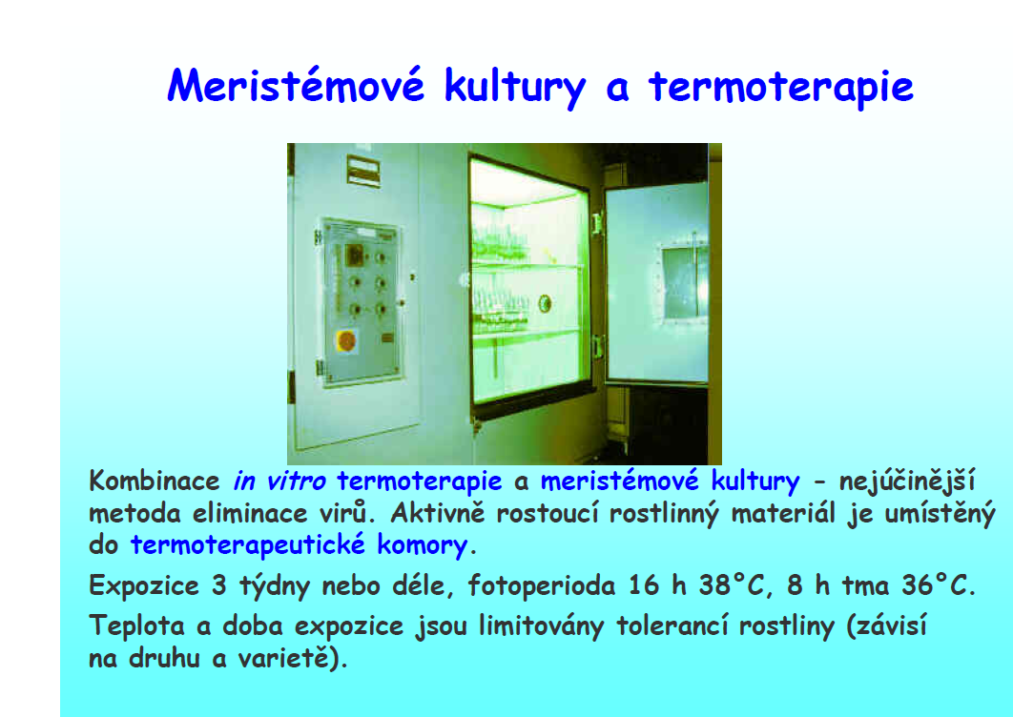

Slide 14
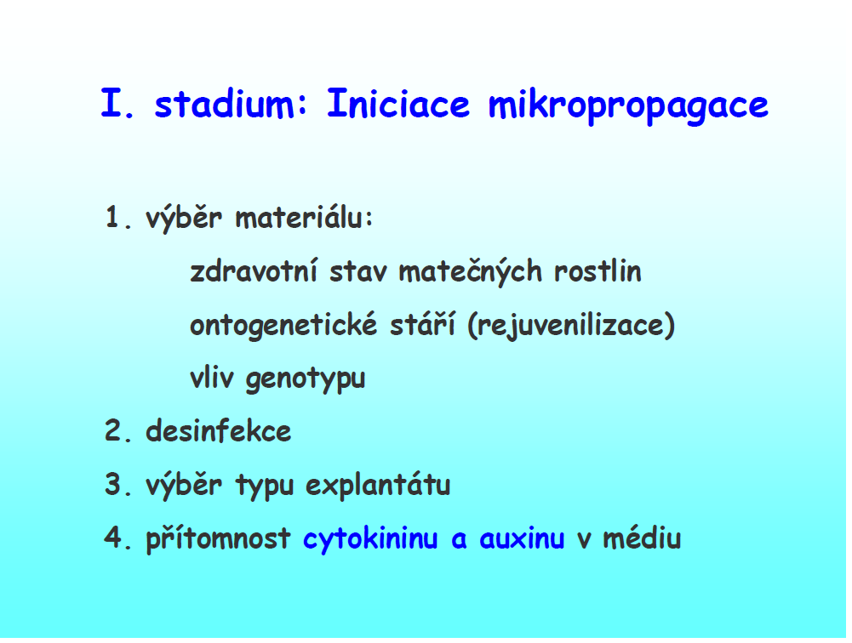

Slide 15

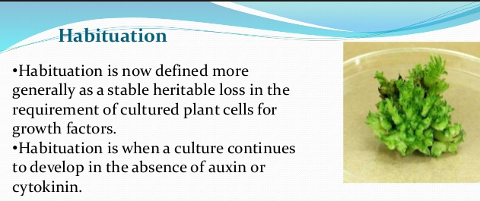
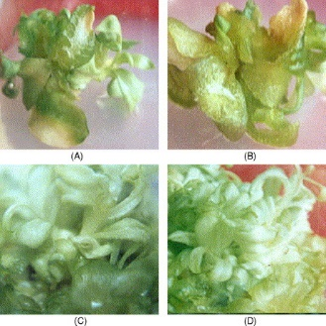
Kultura pokračuje ve vývoji i přes nepřítomnost auxinů nebo cytokininů
(hyperhydratace) – převodnění pletiv

Slide 16
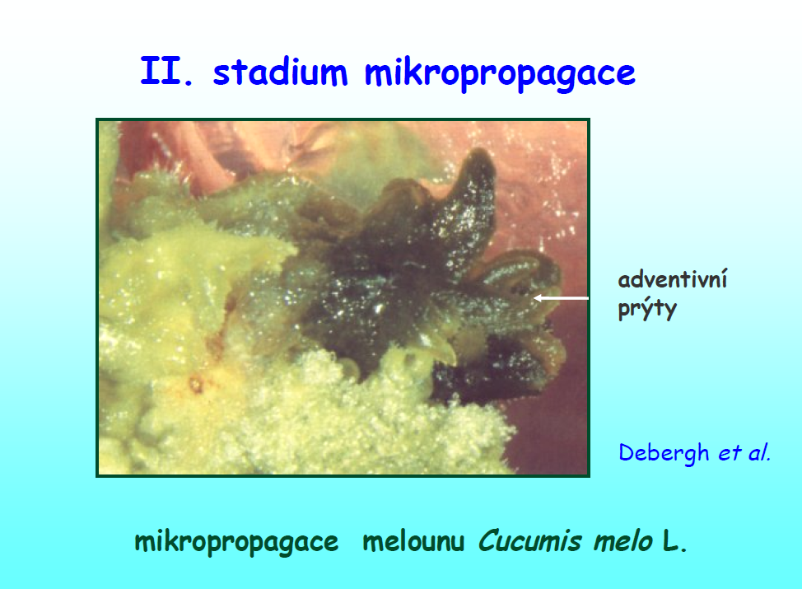
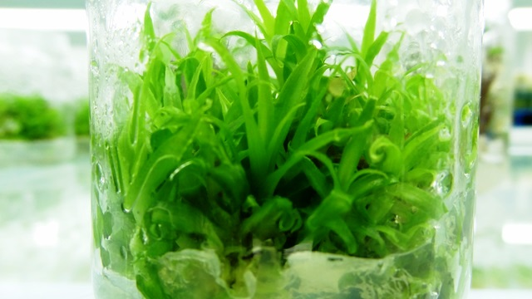
mikropropagace ananasu
http://www.micronesialandgrant.org/in-vitro-mass-scale-disease-free-pineapple-seedling-production-research-and-multiple-demonstrations-on-sustainable-climate-smart-and-organic-commercial-cultivation/

Slide 17
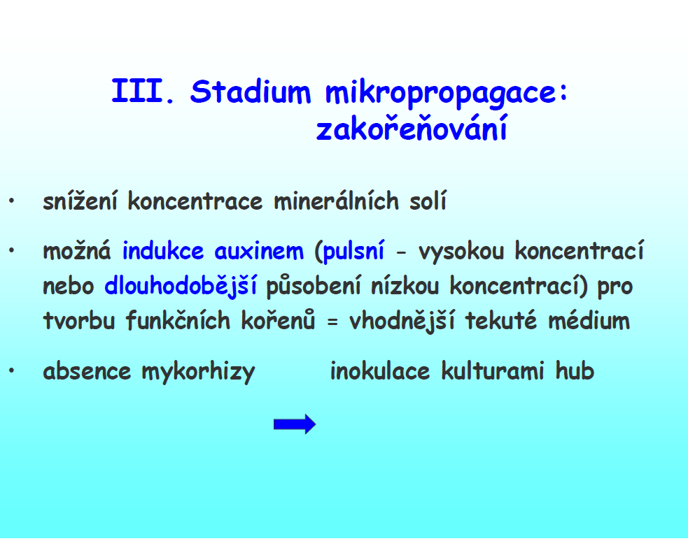

Slide 18
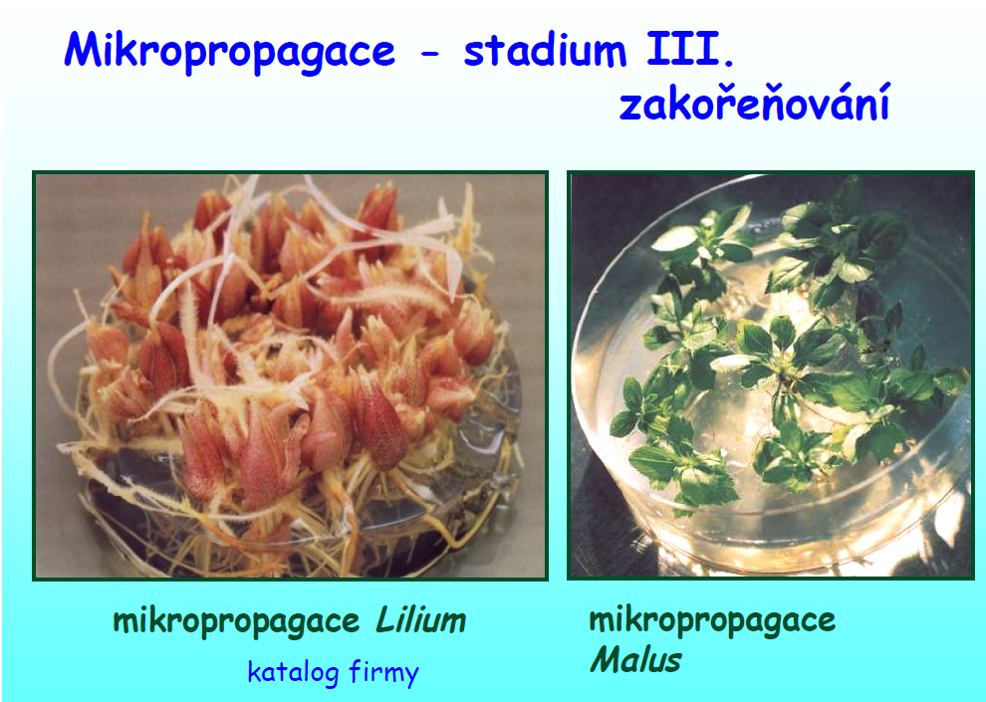

Slide 19
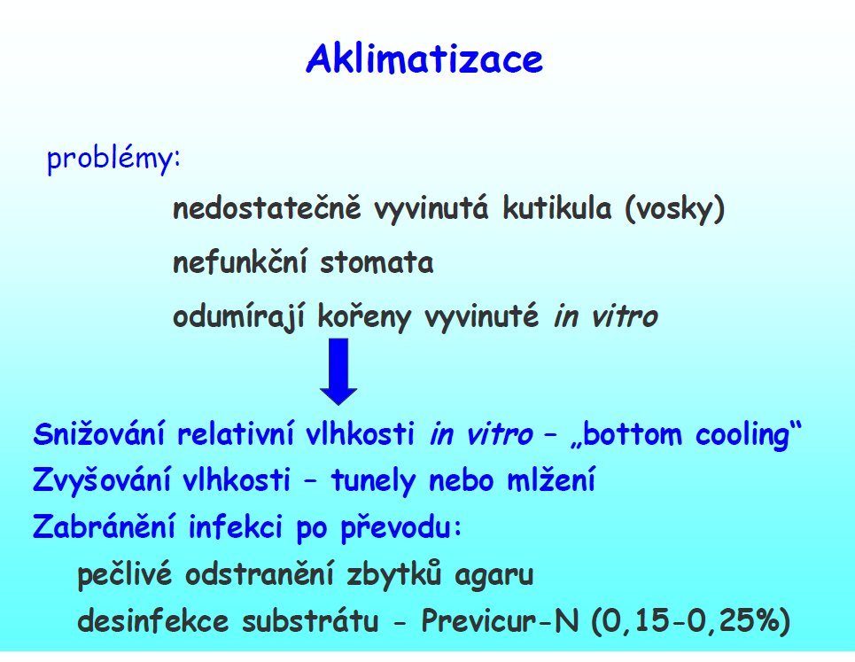

Slide 20
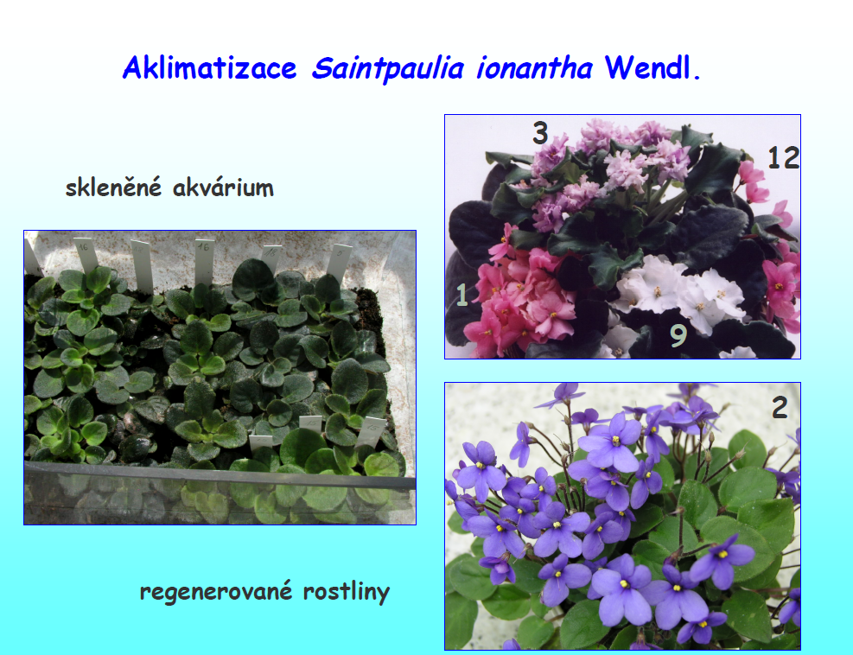

Slide 21
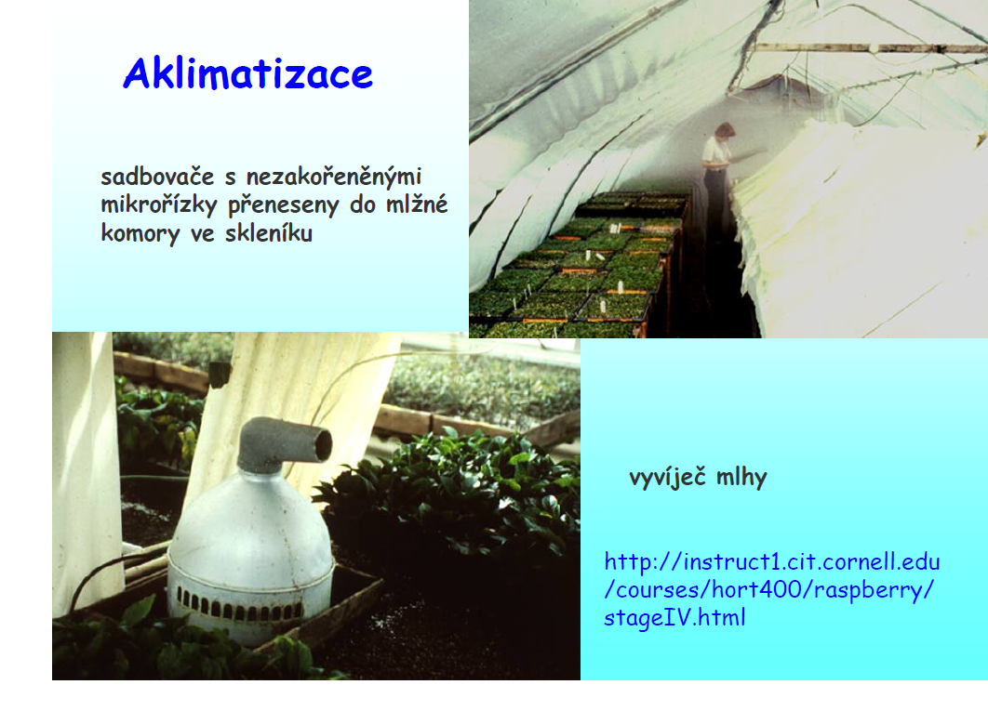

Slide 22
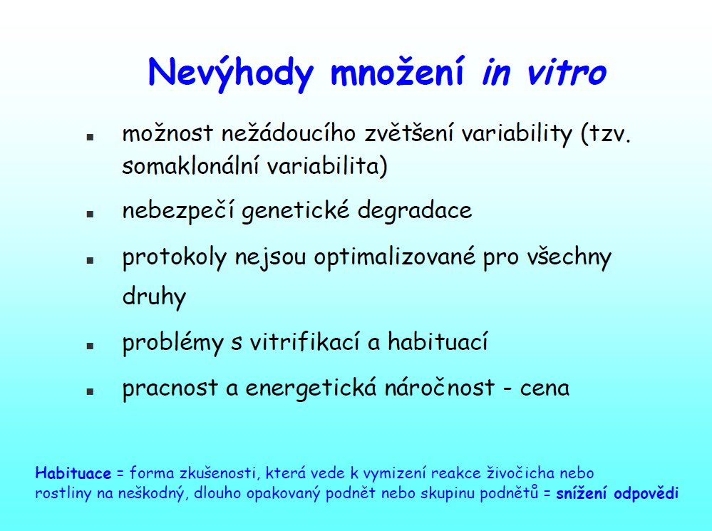

Slide 23
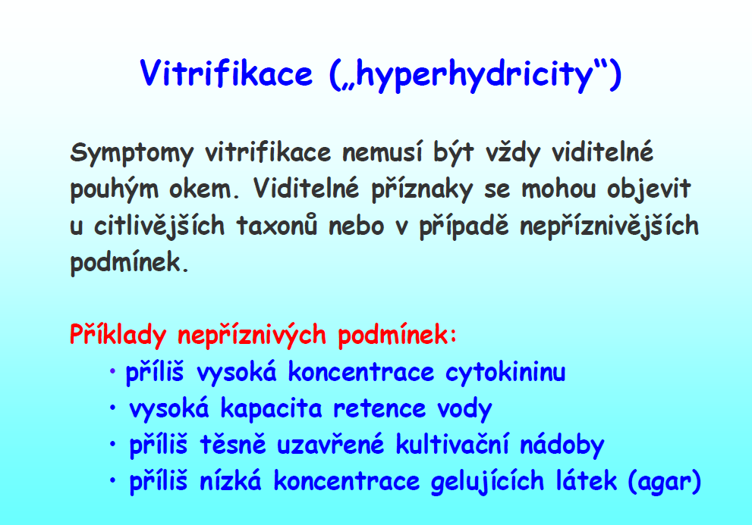

Slide 24
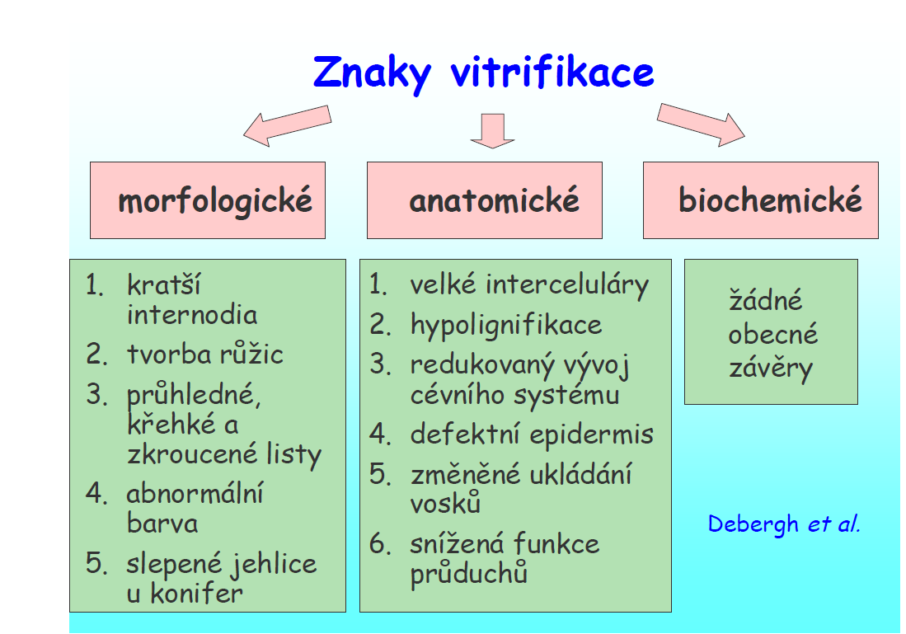

Slide 25
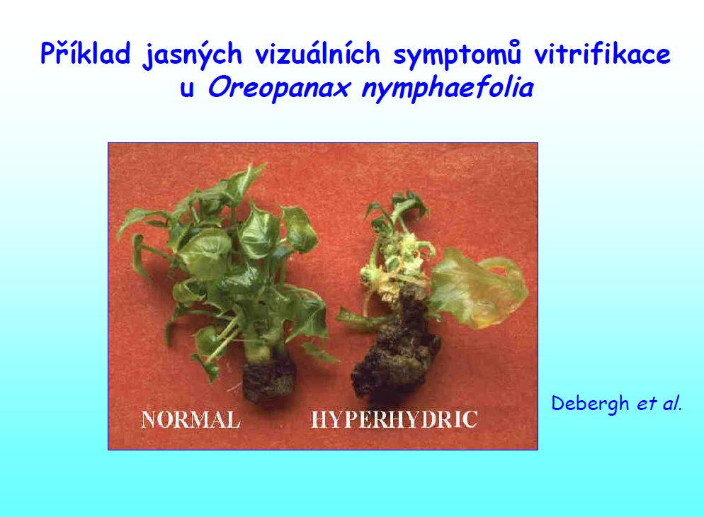

Slide 26
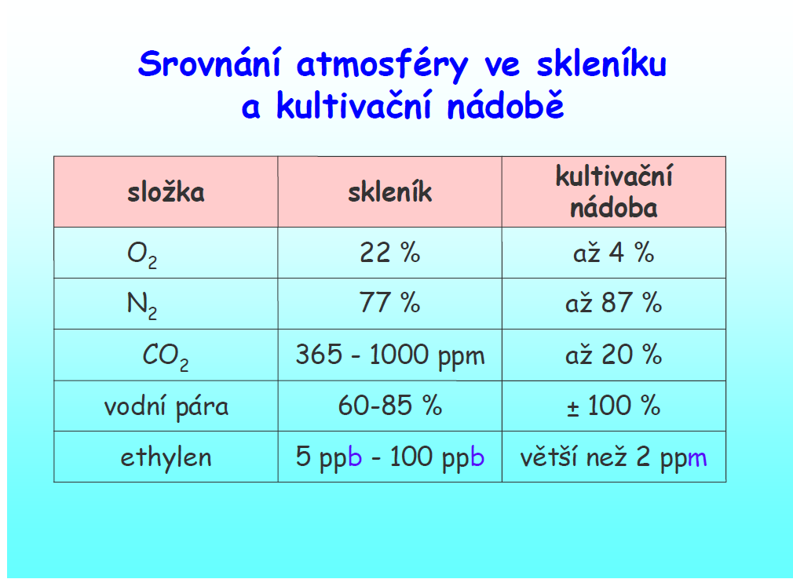

Slide 27
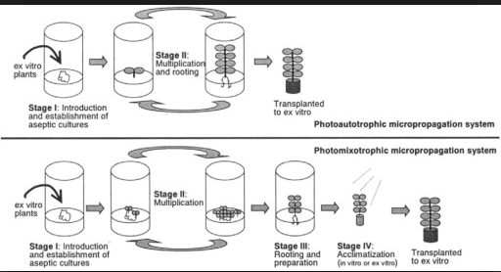
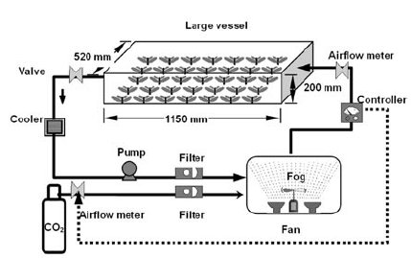
Fotoautotrofní mikropropagace
bez dodání exogenních organických látek (cukry, vitamíny…)
A schematic diagram of the forced ventilation unit for supplying CO 2 -enriched, humidified, and cooled air for photoautotrophic micropropagation.
Growth promotion of Gerbera plantlets in large vessels by using photoautotrophic micropropagation system with forced ventilation, PROPAGATION OF ORNAMENTAL PLANTS 5(4):179-185

Slide 28
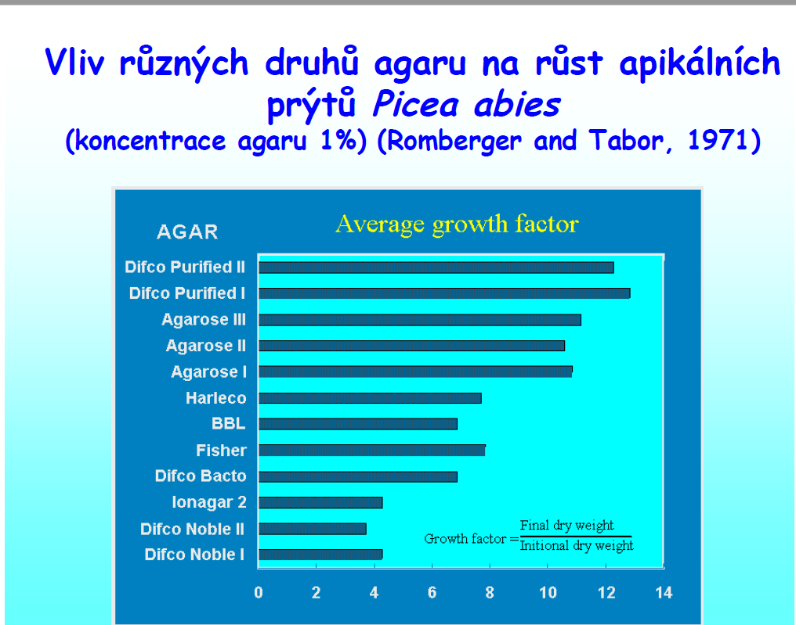

Slide 29
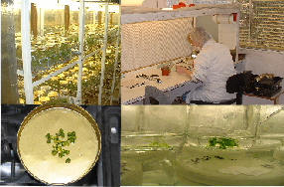

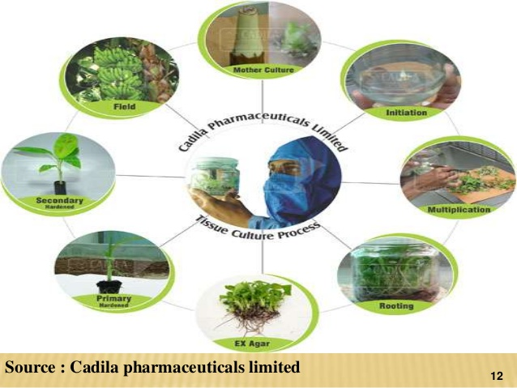
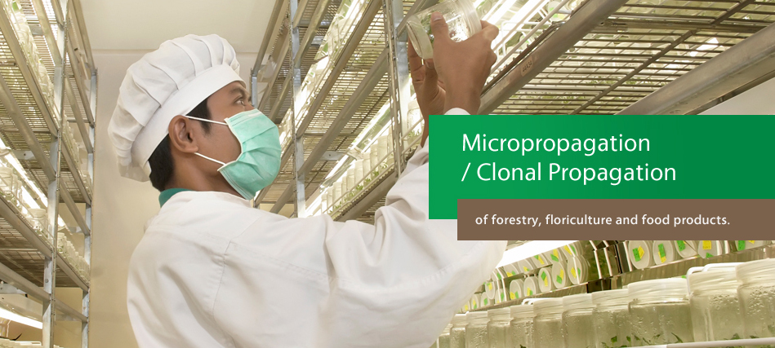
Komerční mikropropagace
http://www.micropropagation-services.co.uk/
http://bestcarnivorousplants.com/dionaea/
http://www.monfori.com/

Slide 30
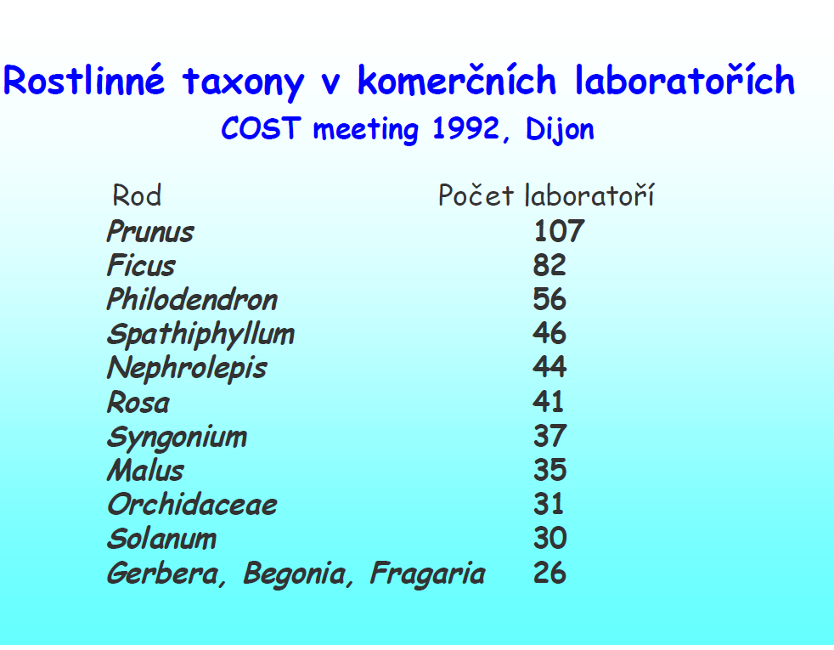

Slide 31
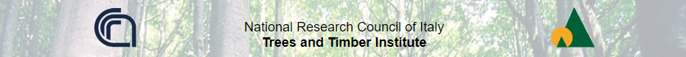
Innovative techniques of micropropagation (= in vitro propagation)
http://www.ivalsa.cnr.it/en/research/innovative-techniques-of-micropropagation-in-vitro-propagation.html
almost 25 millions the plants produced by micropropagation
many fruit species, but also ornamental plants and some vegetables
the optimization of specific microproagation protocols in semi-solid media, and the development of innovative tissue culture systems, such as somatic embryogenesis, the production and regeneration of encapsulated explants (synthetic seeds), the liquid culture in temporary immersion system (TIS)

Slide 32
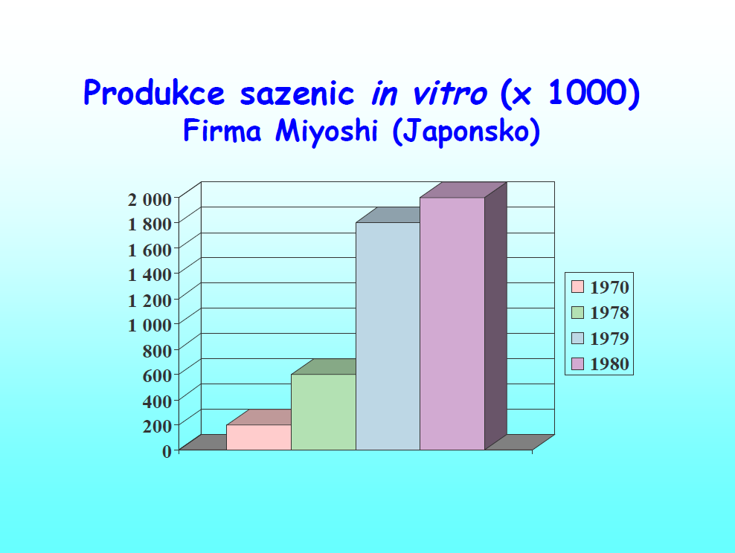

Slide 33
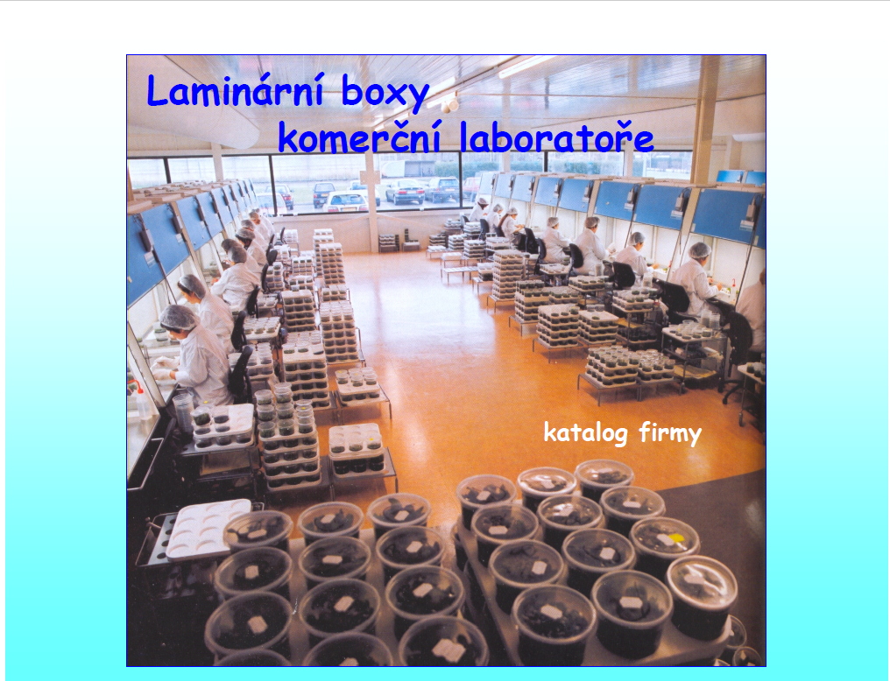

Slide 34
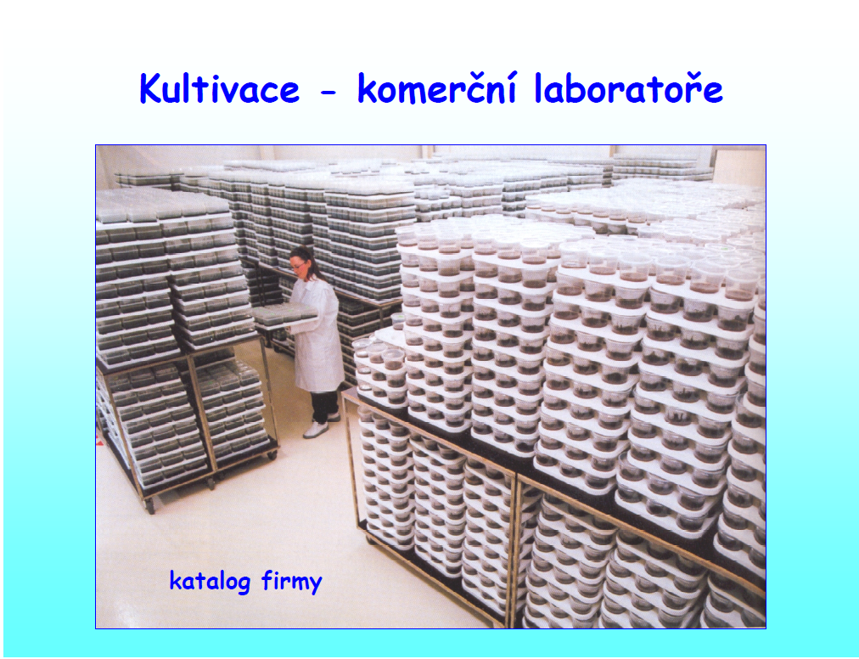

Slide 35
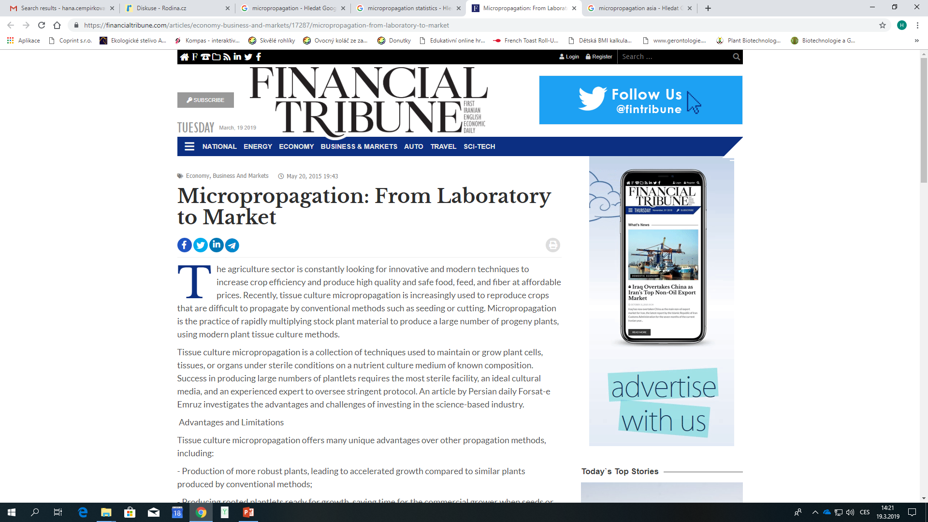
Despite the many advantages, high production costs, labor-intensive process, requirement of sophisticated facilities and skills and the vulnerability of progeny plants to infections are among major limitation in the use of micropropagation.
Unavailability of immediate market for the produced crops and the high cost of export and transportation are among other limitations while considering investment in the sector. Experts believe micropropagation is not economically feasible when practiced in small areas, suggesting the establishment of large-scale micropropagation plants for generating reasonable profits.

Slide 36
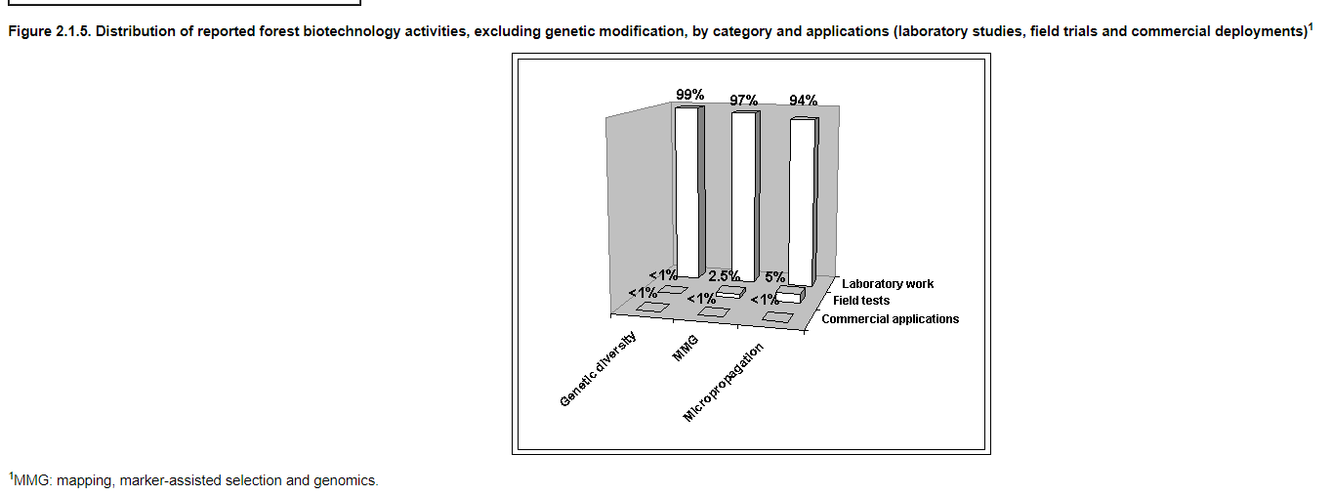
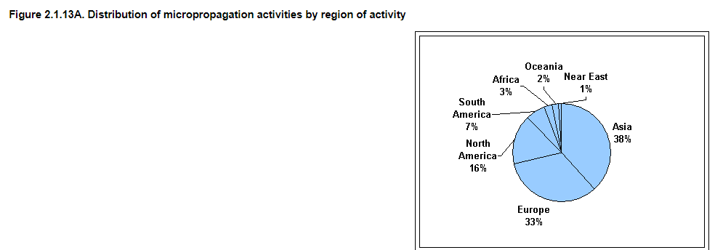
http://www.fao.org/3/ae574e/AE574E06.htm

Slide 37



Slide 38
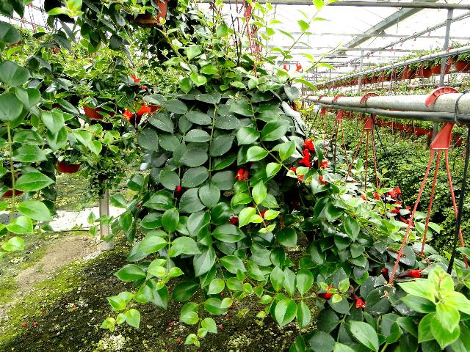
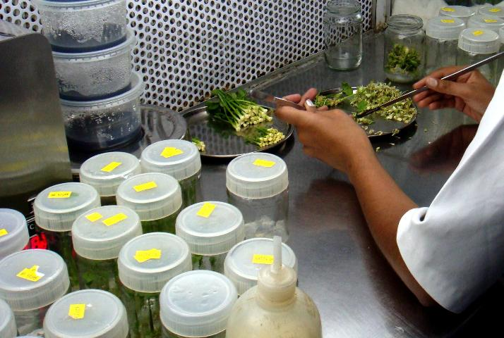
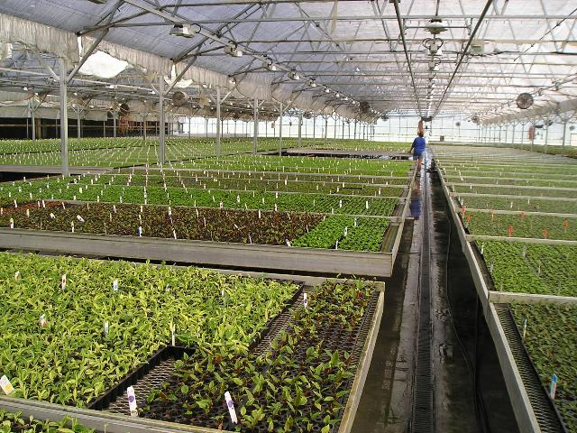
Commercial Production of Ornamental Tropical Foliage Plants: Micropropagation
https://edis.ifas.ufl.edu/ep520

Slide 39

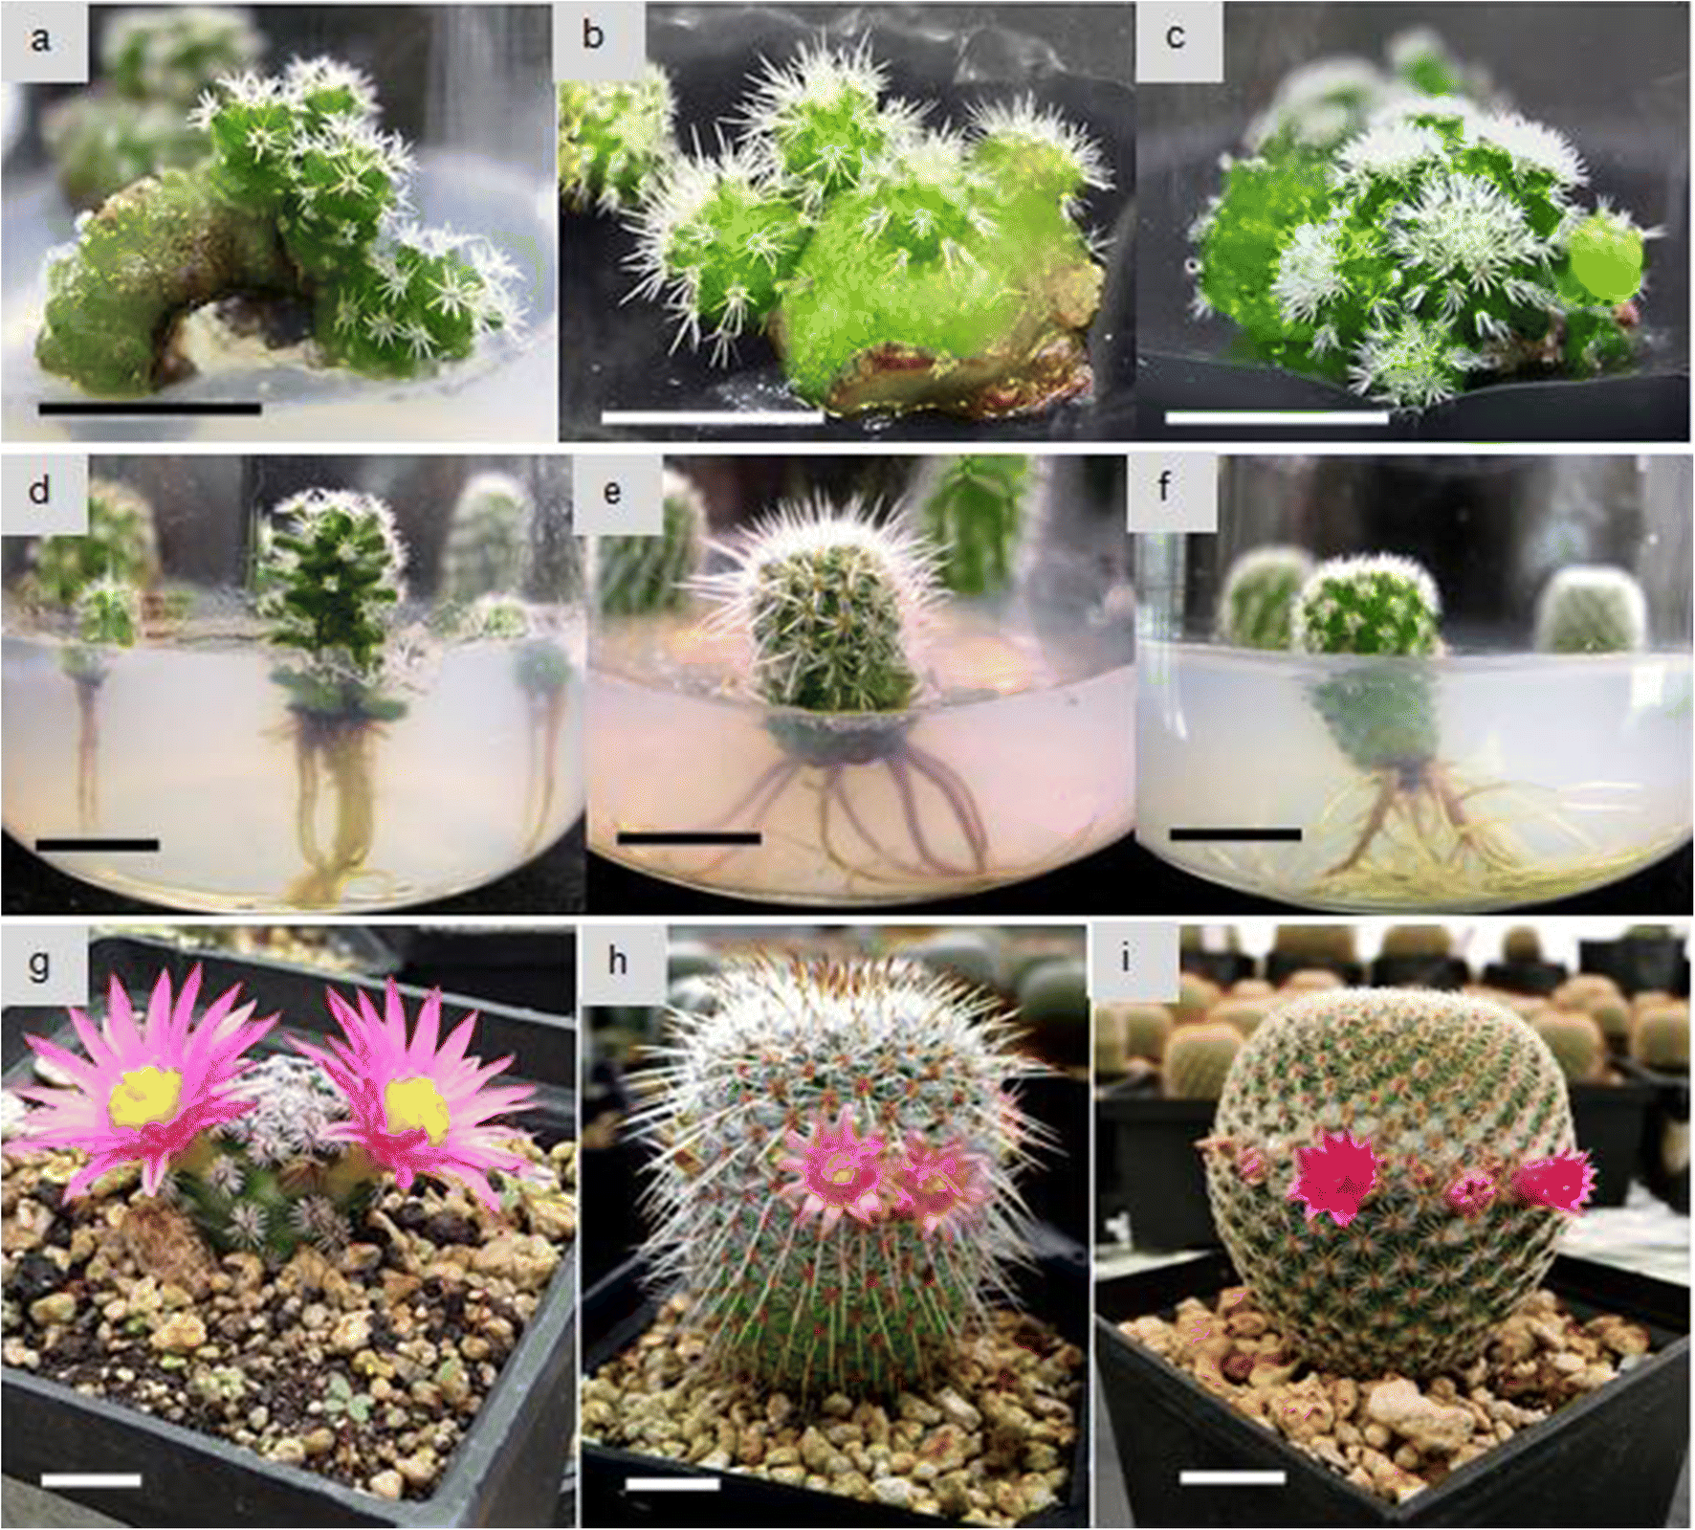
In vitro propagation of endangered Mammillaria genus (Cactaceae) species and genetic stability assessment using SSR markers, In Vitro Cellular & Developmental Biology - Plant
October 2018, Volume 54, Issue 5, pp 518–529
https://www.succulent-tissue-culture.com/EN/home

Slide 40
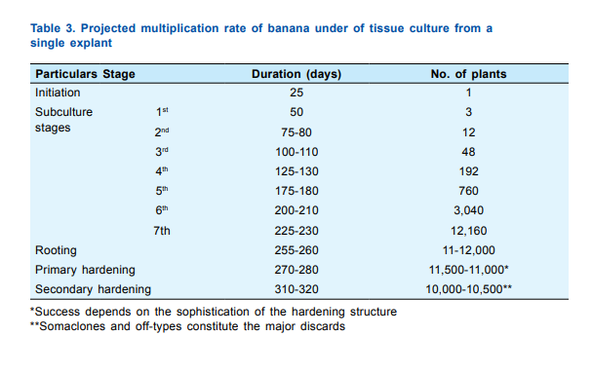

Slide 41
Příklady využití in vitro rostlin v ČR
http://zahradaweb.cz/rozmnozovani-okrasnych-drevin-mikropropagaci/
http://www.janholub.cz
http://www.profiplants.cz/kategorie/akvarijni-rostliny
http://www.lesaktualne.cz/vyzkum/vedci-prispivaji-k-udrzeni-biologicke-rozmanitosti-drevin
http://www.agris.cz/clanek/190191
Plant culture is used commercially
Culturing plants in the laboratory has become common practice, and this technique is used commercially to produce plants for the agricultural and horticultural industries. You may be surprised to learn that most of our native carnivorous plants that can be purchased legally are the products of tissue culture. It is illegal to collect most species in the wild, so producers pay for licenses to collect a limited number of specimens that they then use to establish tissue culture lines. Periodically, some of the descendent cultures from a line are subjected to growth regulators which cause them to develop into young plants that can be sold.
Notes:
Plant culture is used commercially
Culturing plants in the laboratory has become common practice, and this technique is used commercially to produce plants for the agricultural and horticultural industries. You may be surprised to learn that most of our native carnivorous plants that can be purchased legally are the products of tissue culture. It is illegal to collect most species in the wild, so producers pay for licenses to collect a limited number of specimens that they then use to establish tissue culture lines. Periodically, some of the descendent cultures from a line are subjected to growth regulators which cause them to develop into young plants that can be sold.

Slide 42

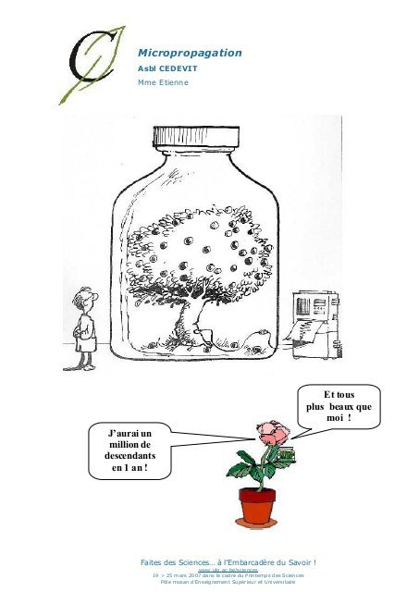
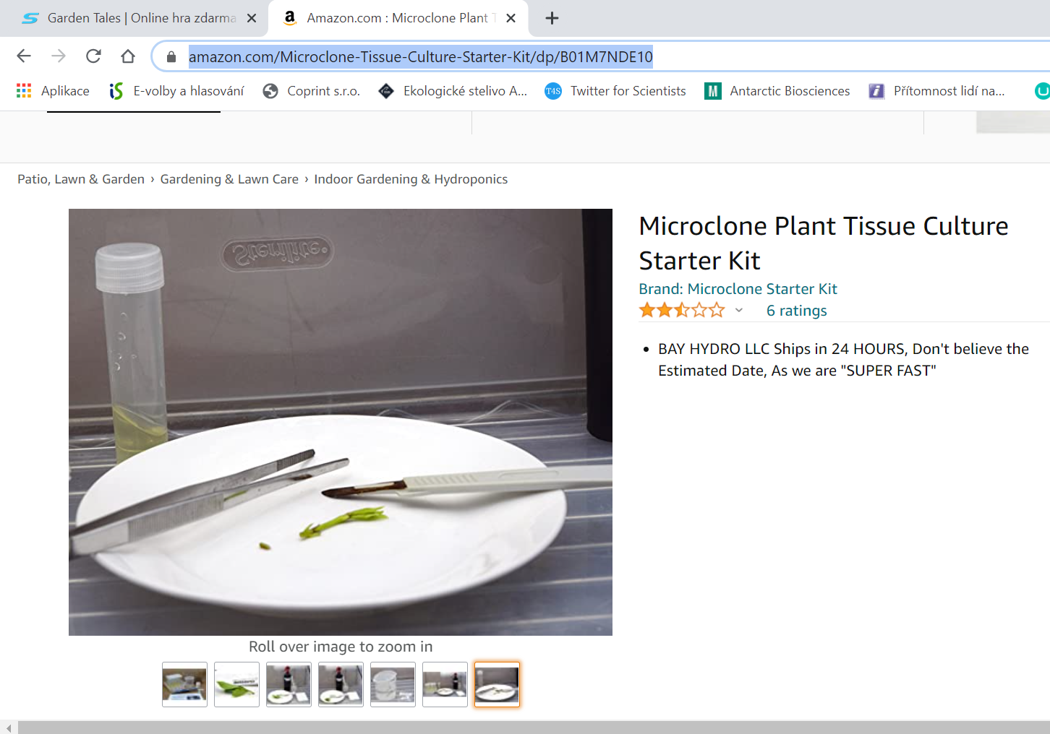
https://www.amazon.com/Microclone-Tissue-Culture-Starter-Kit/dp/B01M7NDE10

