Slide 1
Cílená léčba v onkologii
Vladimír Rak

Slide 2
Prerekvizity ...
Organizmy z buněk
Chování určené proteiny
Proteiny určené geny (DNA)
Nádory z buněk
Změněné chování oproti normálním somatickým buňkám
Změny v DNA (mutace) → nádory
Specifické!

Slide 3
Prerekvizity ...
Nádorové buňky jsou trochu jiné než ostatní somatické buňky protože mají specifické změny v DNA
„Cancers don’t invent new things, they co-opt processes, functions that are used in development in normal homeostasis, but they subvert them for their own purposes“
- Douglas Hanahan

Slide 4
Myšlenka dne
Možná kdybychom ovlivnili specificky ty funkce, kterými se nádorové buňky liší od normálních buněk, tak vyléčíme nádor a nepoškodíme člověka
Proč to dělat?

Slide 5
Proč vůbec potřeba?
Standardní léčba:
Nevyléčí 100% lidí
Toxická

Slide 6
Proč vůbec potřeba?
Standardní léčba:
Nevyléčí 100% lidí
Toxická

Slide 7
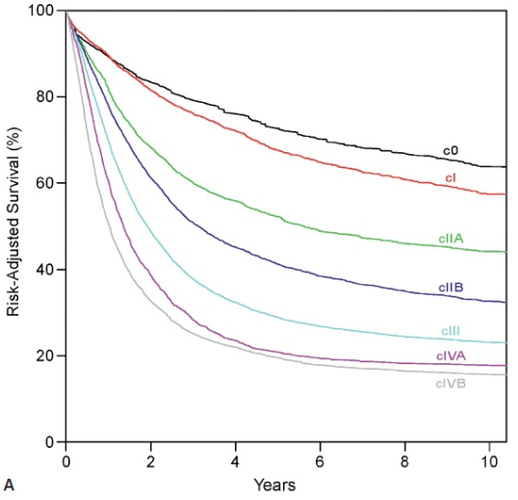
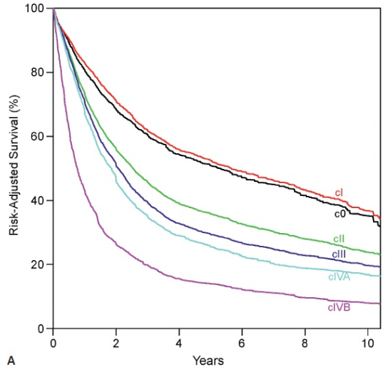
Proč vůbec potřeba?
Nevyléčí 100% lidí – jícen
adenoCa
spinoCa

Slide 8
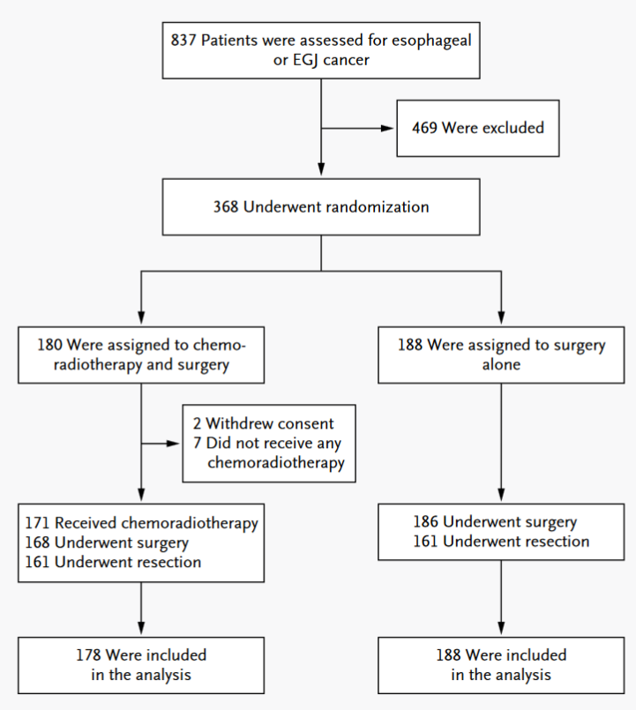
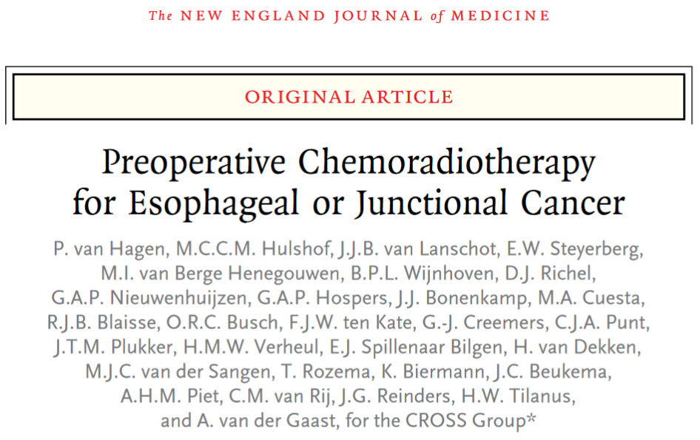
Proč vůbec potřeba?
Nevyléčí 100% lidí – jícen

Slide 9
Proč vůbec potřeba?
Nevyléčí 100% lidí – jícen
ELIGIBILITY CRITERIA:
Patients with histologically confirmed, potentially curable squamous-cell carcinoma, adenocarcinoma, or large-cell undifferentiated carcinoma of the esophagus or esophagogastric junction were eligible for inclusion in the study.
The upper border of the tumor had to be at least 3 cm below the upper esophageal sphincter. Patients who had proximal gastric tumors with minimal invasion of the esophagus were excluded. The length and width of the tumor could not exceed 8 cm and 5 cm, respectively. Only patients with tumors of clinical stage T1N1 or T2-3N0-1 and no clinical evidence of metastatic spread (M0), were enrolled.
Eligible patients were 18 to 75 years of age, had a World Health Organization (WHO) performance status score of 2 or lower and had lost 10% or less of body weight.
Patients also had to have adequate hematologic, renal, hepatic, and pulmonary function, as well as no history of other cancer or previous radiotherapy or chemotherapy.
All patients provided written informed consent.

Slide 10
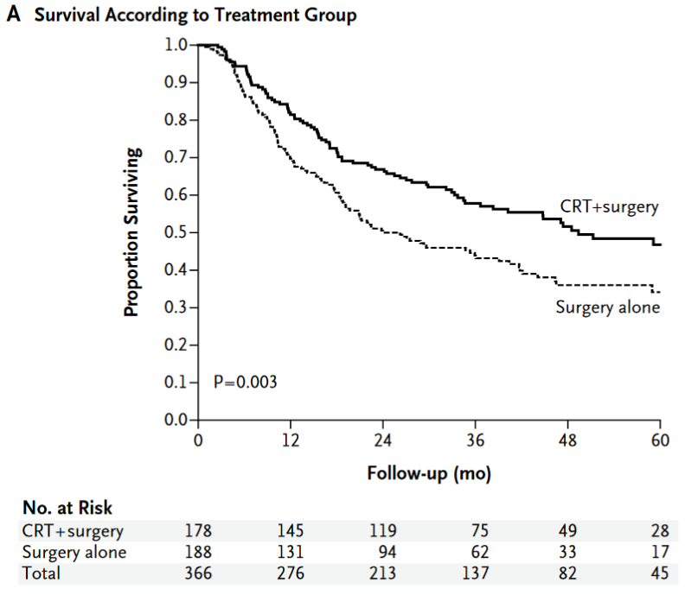
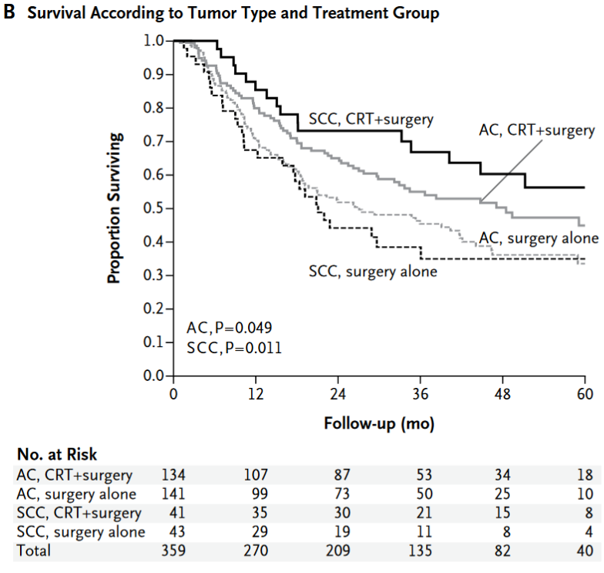
Proč vůbec potřeba?
Nevyléčí 100% lidí – jícen

Slide 11
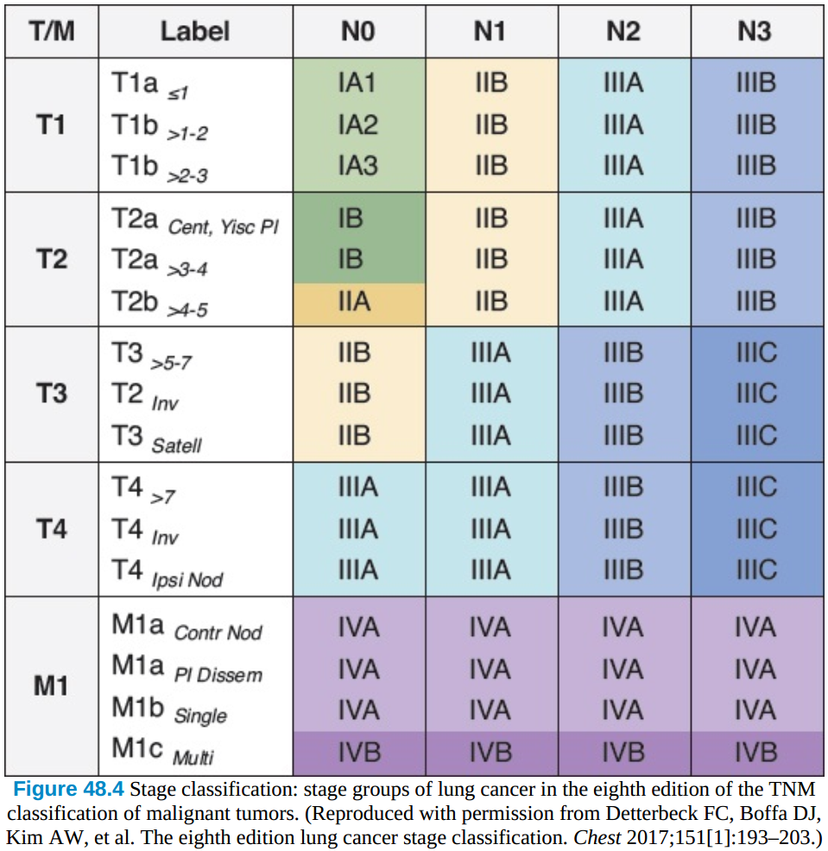
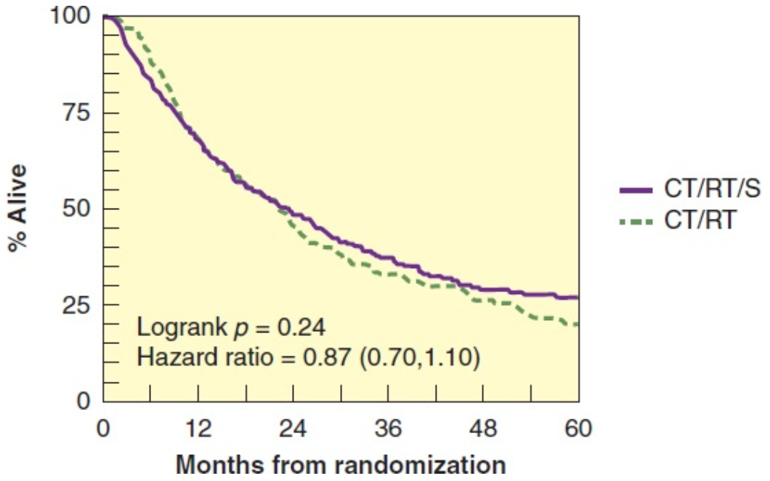
Proč vůbec potřeba?
Nevyléčí 100% lidí – plíce
Stádium | 5-leté přežití
IA1 | 92%
IA2 | 83%
IA3 | 77%
IB | 68%
IIA | 60%
IIB | 53%
Stádium |  | Median OS
IV | CHT | 9-10 měs.
 | Cíl. léčba | ≈ 25 měs.*
N2

Slide 12
Proč vůbec potřeba?
Nevyléčí 100% lidí – krk - tonzila
The length of time from either the date of diagnosis or the start of treatment for a disease, such as cancer, to the date of death from the disease. Patients who die from causes unrelated to the disease are not counted in this measurement. In a clinical trial, measuring the cause-specific survival is one way to see how well a new treatment works. Also called CSS.

Slide 13
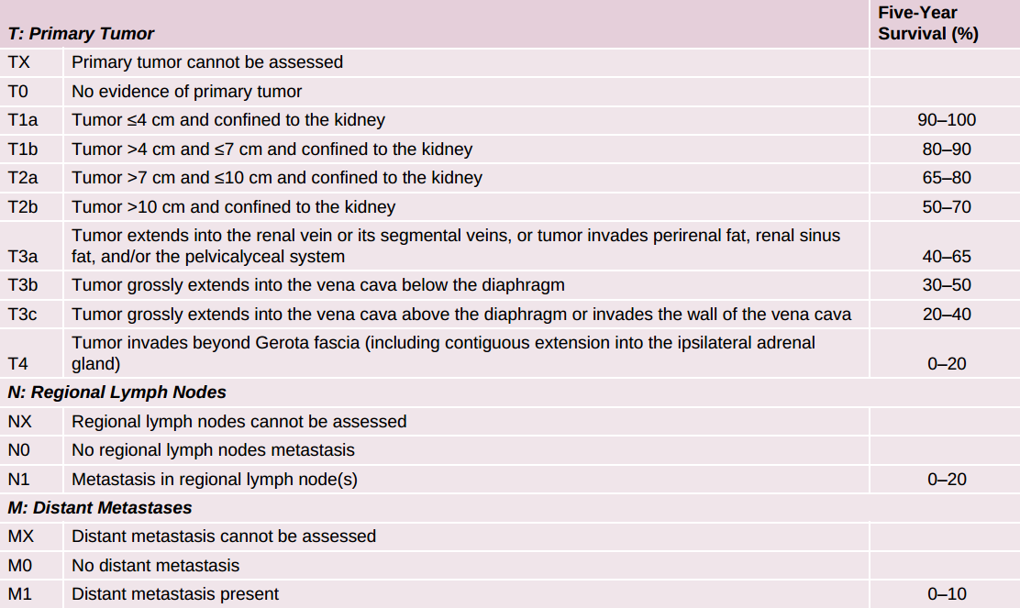
Proč vůbec potřeba?
Nevyléčí 100% lidí – ledvina

Slide 14
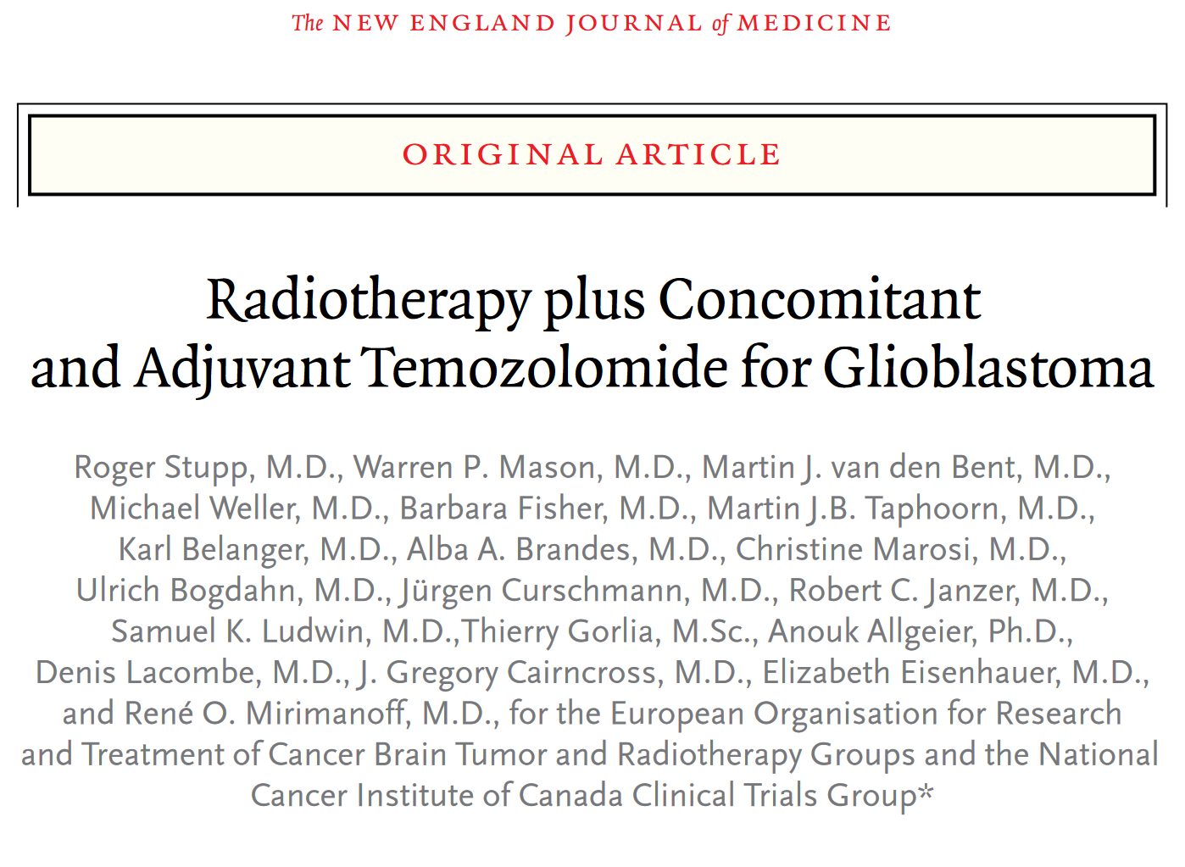
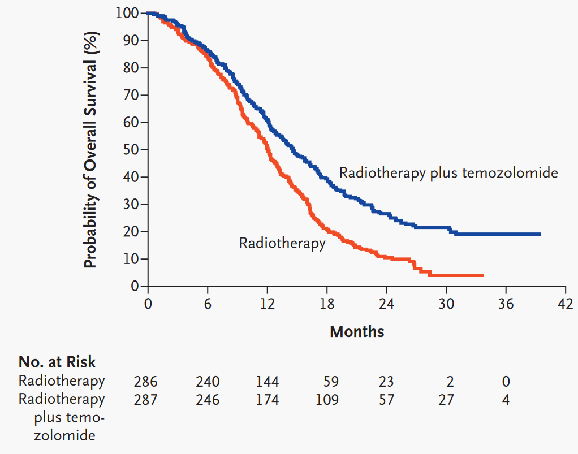
Proč vůbec potřeba?
Nevyléčí 100% lidí – CNS (GBM)

Slide 15
Proč vůbec potřeba?
Standardní léčba:
Nevyléčí 100% lidí
Toxická
Chirurgie
Radioterapie
Chemoterapie

Slide 16
Proč vůbec potřeba?
Toxická
Chirurgie
Radioterapie
Chemoterapie
+ CNS, pankreaty, HNSCC, ...

Slide 17
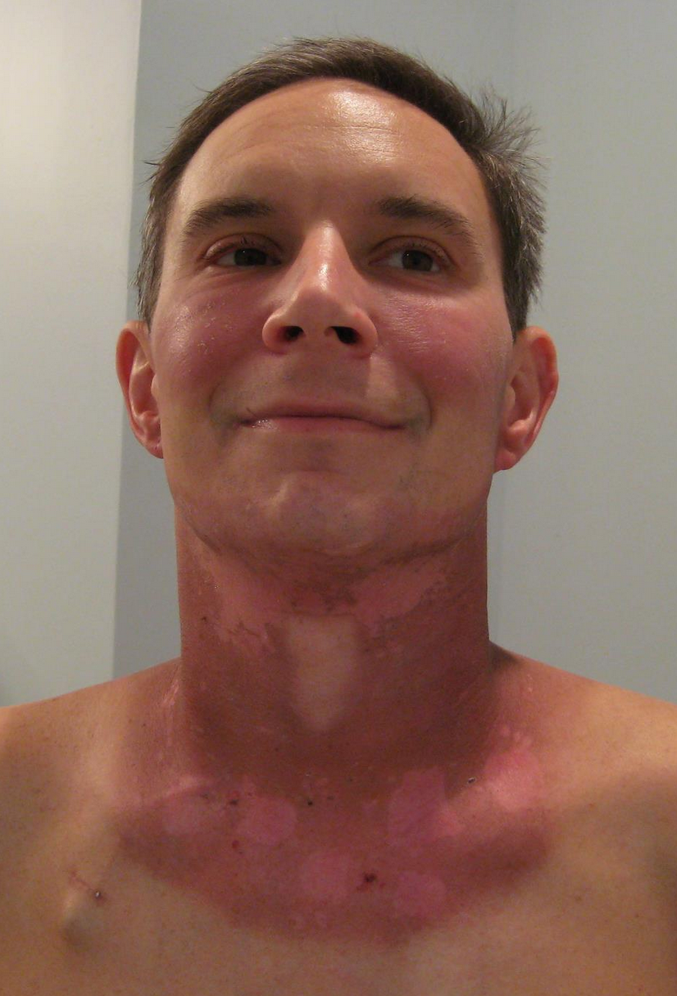
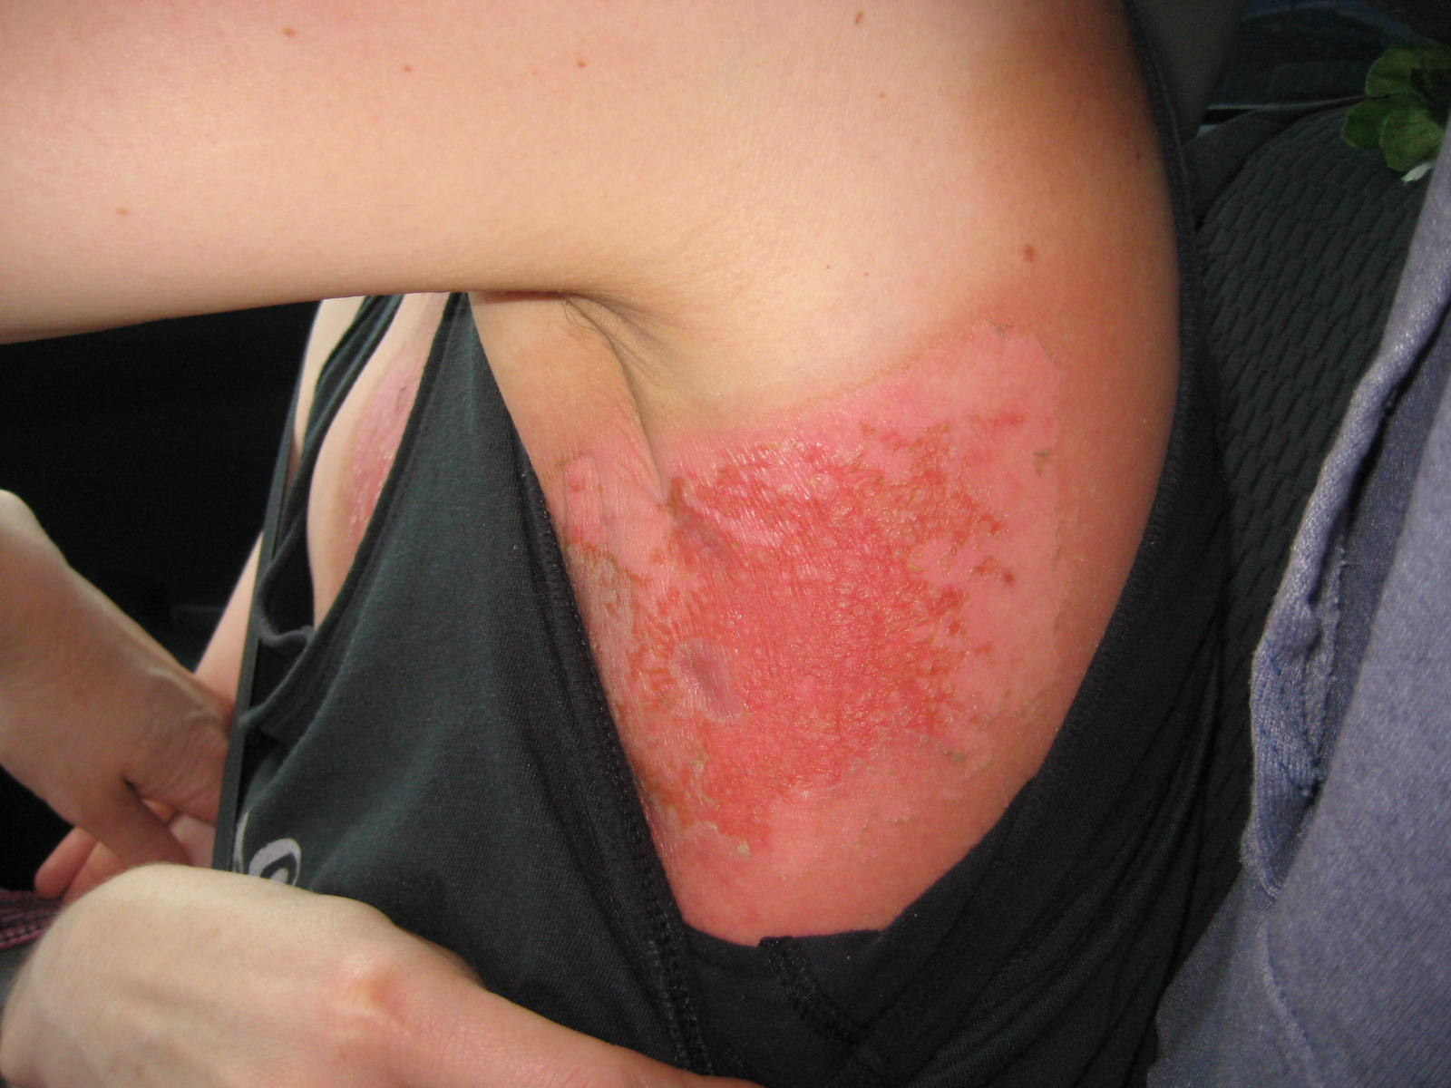
Proč vůbec potřeba?
Toxická
Chirurgie
Radioterapie
Chemoterapie
Akutní / pozdní

Slide 18
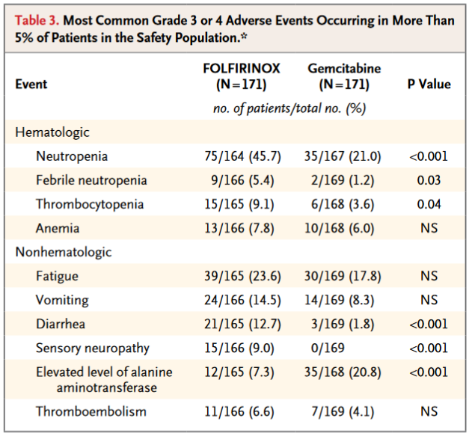
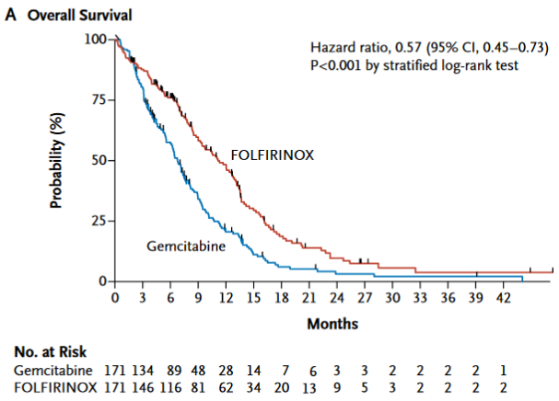
Proč vůbec potřeba?
Toxická
Chirurgie
Radioterapie
Chemoterapie
FOLFIRINOX versus Gemcitabine for Metastatic Pancreatic Cancer

Slide 19
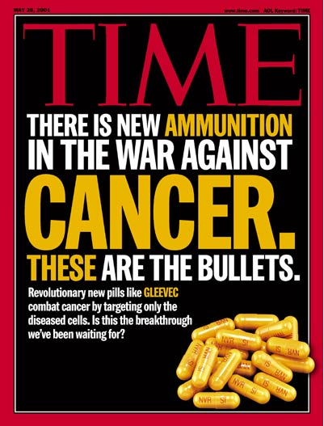
„klasická“ léčba
Toxická
Nedostatečně účinná
Čas ji zahodit a začít používat něco „modernějšího“?

Slide 20
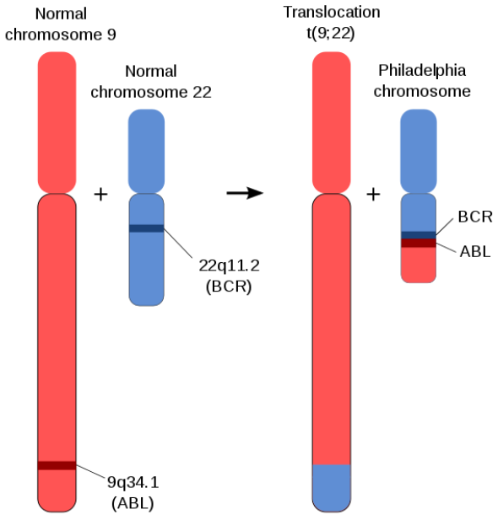
První krůčky
Chronická myeloidní leukemie
U těcho nádorů je častá specifická translokace mezi 9. a 22. chromozomem
Vzniká fůzní gen bcr-abl
Je to příčina tohoto onemocnění
cDNA → retrovirus → myš → CML
ABL – protoonkogen
Tyrosin kináza, buněčná diferenciace, dělení, adheze, odpověď na stres
Pokud spojený s BCR (breakpoint cluster region)
Zvýšená aktivita fůzního genu

Slide 21
První krůčky
Ovlivňuje
RAS
PI3k – Akt/PKB
Jak-STAT
Jun, Myc, ...
...
Pokud ale porušíme tyrosin kinázovou funkci → ztráta maligního chování
První cílený lék – imatinib mesylate (gleevec)
Vážena se na a inaktivuje Bcr - Abl
(relativně specifický – inaktivuje 4 TK)
Skoro vše

Slide 22
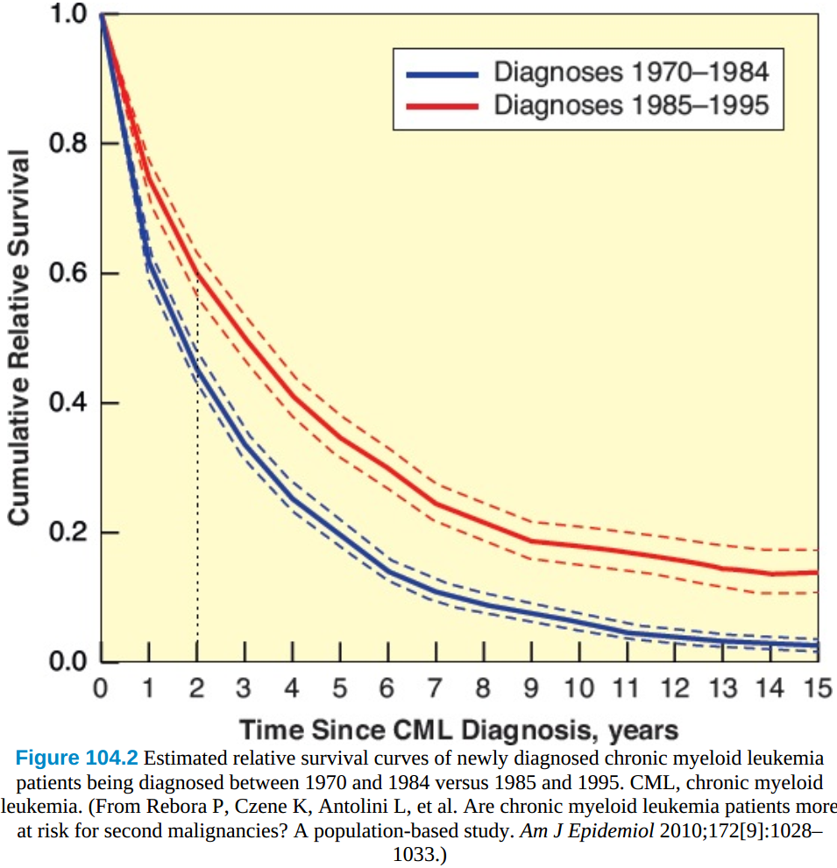
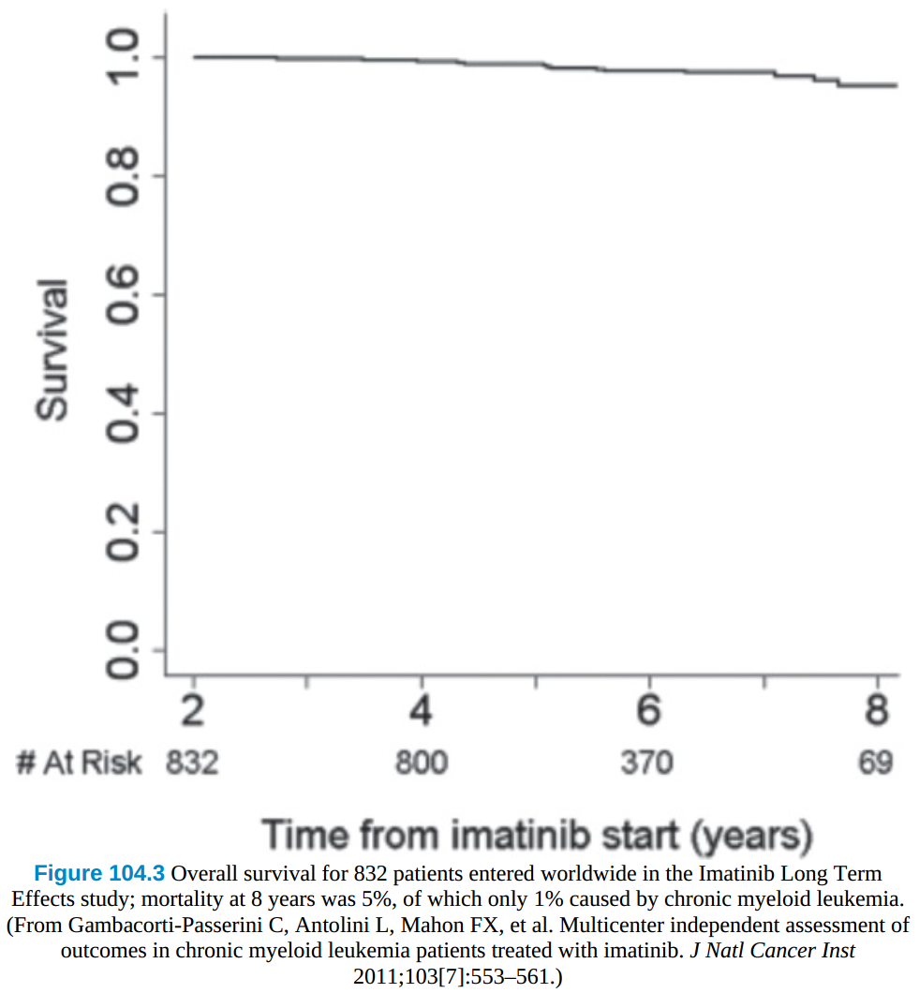
První krůčky

Slide 23
První krůčky
relativně specifický – inaktivuje 4 TK
Kit se vyskytuje u přibližně % GIST
Solidní nádor – horší výsledky (větší genetická heterogenita?)
Další je Kit

Slide 24
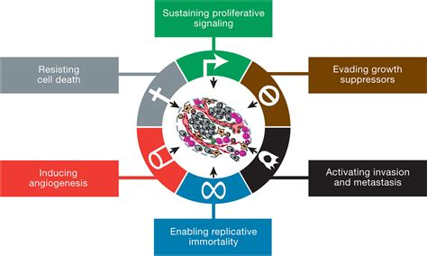
Hallmarks

Slide 25
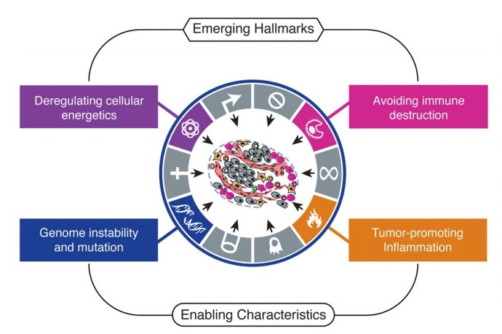
Hallmarks

Slide 26
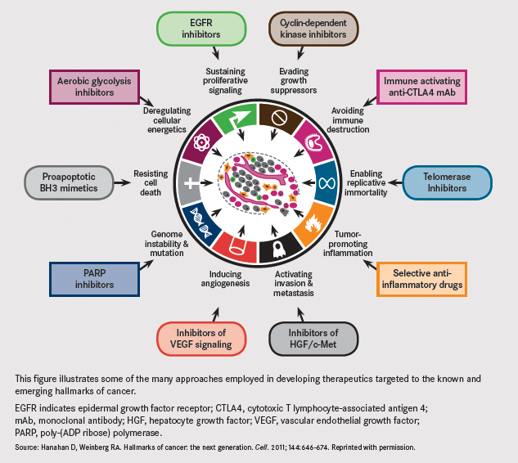
Hallmarks

Slide 27
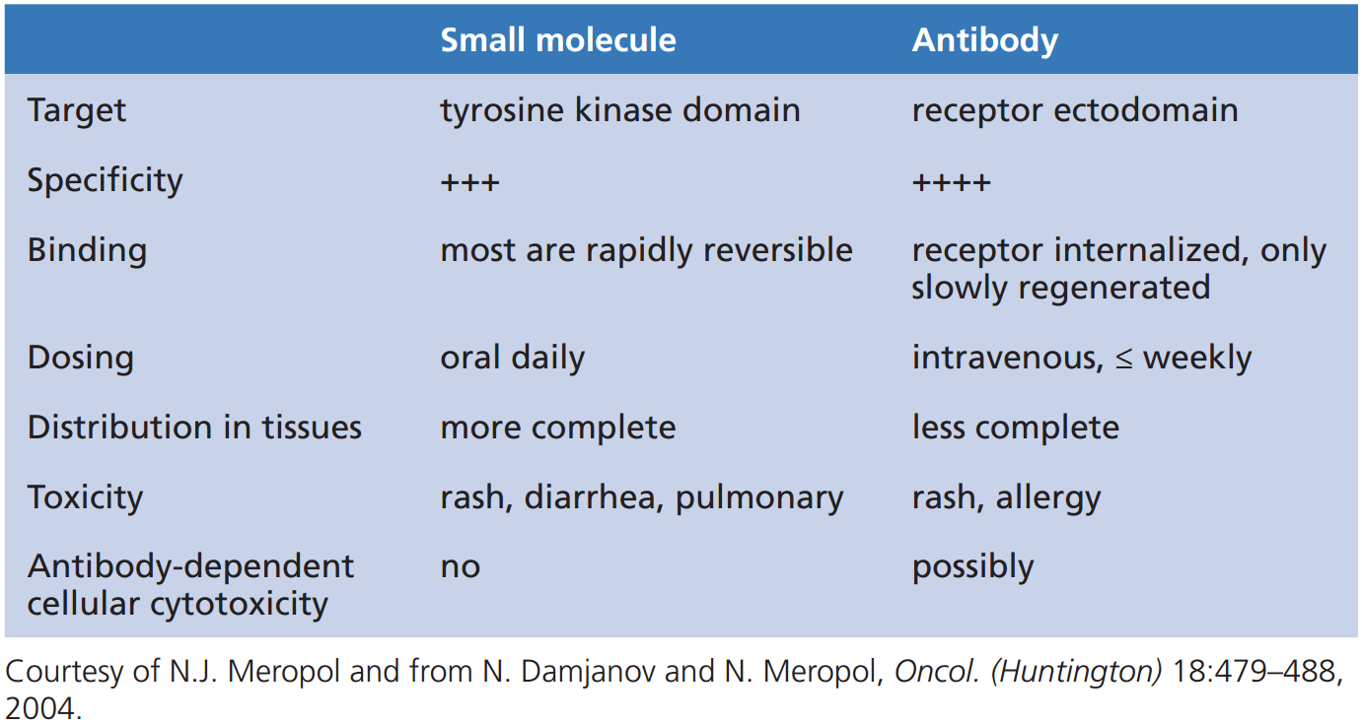
Typy léků

Slide 28
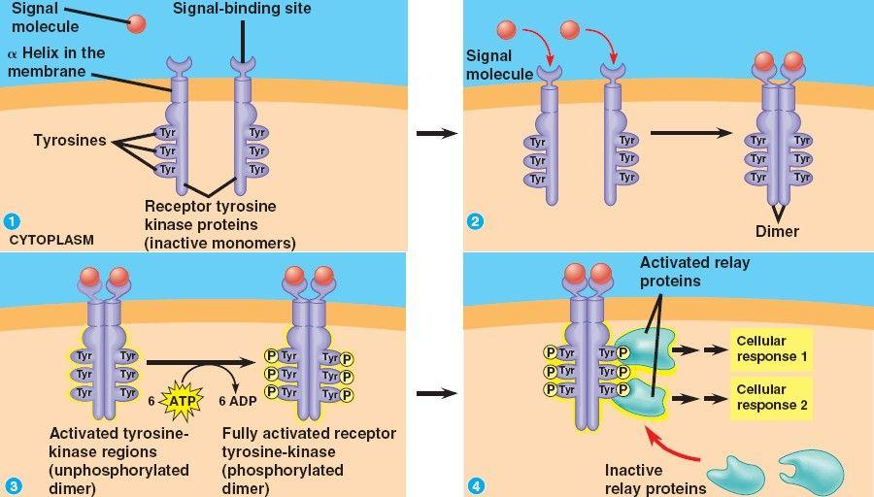
TKIs
Pozice TKs:
Na povrchu (EGFR, )
V cytoplazmě (Raf, )
Uvnitř jádra
Cíle TKs:
Serin/threonin
Tyrozin
... intrinsic and acquired resistance are major clinical challenges that limit the effectiveness of this drug class:
secondary mutations in the kinase that prevent or alter drug binding
co-mutations or adaptive changes involving parallel signaling pathways that reduce dependence on the target kinase

Slide 29
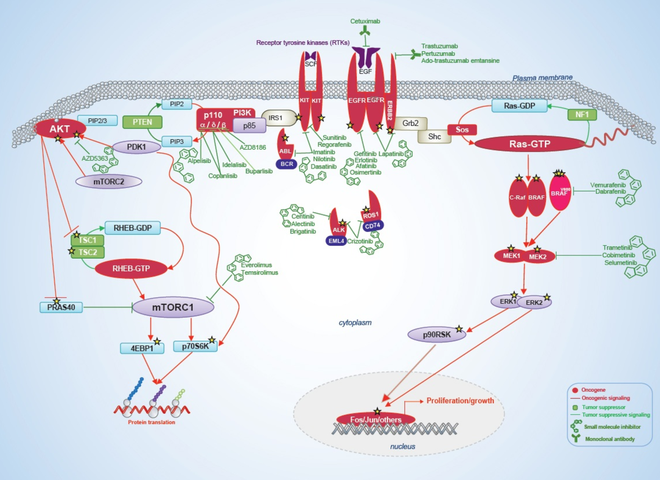
TKIs
Funguje pouze u nádorů co mají danou mutaci / jsou závislé na určité signalizaci (crizotinib, vemurafenib ...)
The mitogen-activated protein kinase and phosphatidylinositol 3-kinase (PI3K) signaling pathways. Major signaling nodes are shown as well as select kinase inhibitors and antireceptor antibodies.

Slide 30
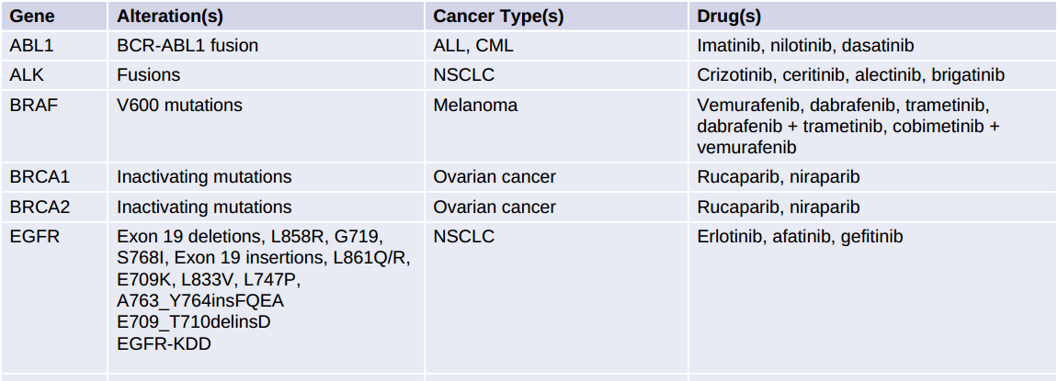
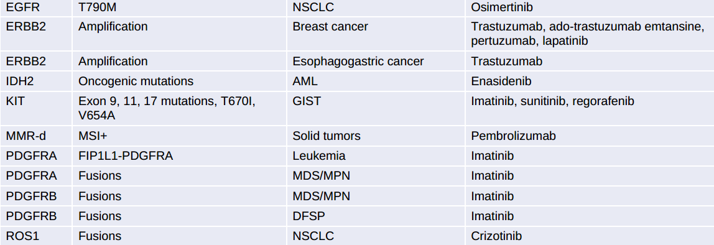
TKIs
OncoKB level 1 mutations represent established FDA-recognized biomarkers of response to an FDA-approved drug being used in the FDA-approved cancer indication
+sorafenib, sunitinib

Slide 31
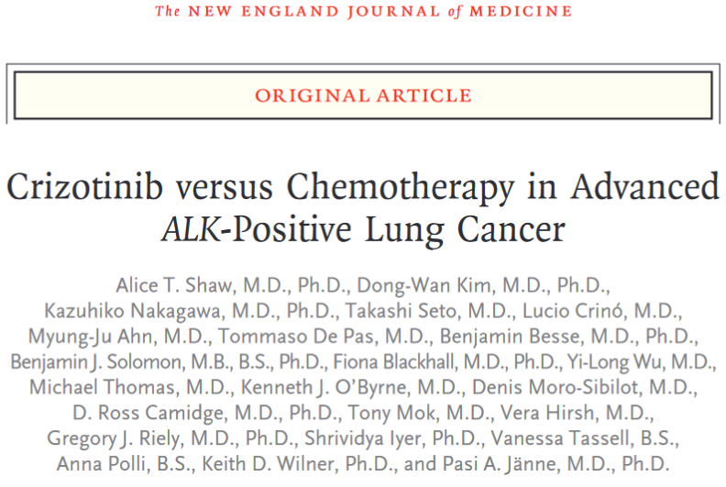
TKIs – ALK (anaplastic lymphoma kinase)
Orphan receptor (insuline kinase family)
Role při vývoje nervového systému
Fúze z jinými geny (EML4) → ligand-nezávislá signalizace
U přibližně 4-5% NSCLC (mladší muži nekuřáci adenoCa)
Nebývá zároveň s EGFR nebo KRAS mutacemi
We conducted a phase 3, open-label trial comparing crizotinib with chemotherapy in 347 patients with locally advanced or metastatic ALK-positive lung cancer...

Slide 32
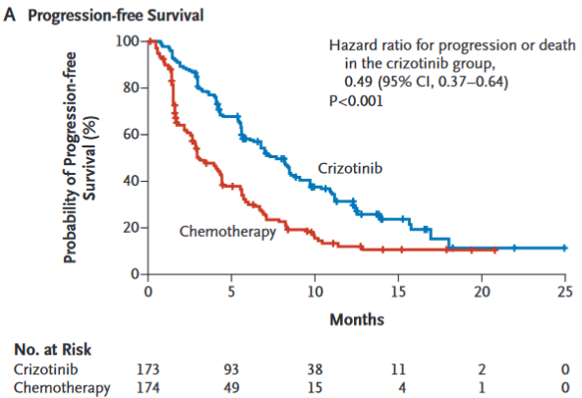
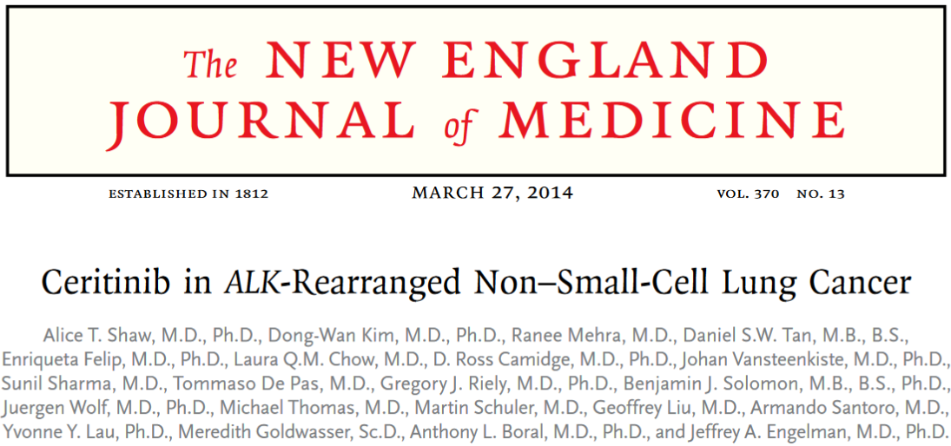
TKIs – ALK (anaplastic lymphoma kinase)
The median progression-free survival was 7.7 months in the crizotinib group and 3.0 months in the chemotherapy group (hazard ratio for progression or death with crizotinib, 0.49; 95% confidence interval [CI], 0.37 to 0.64; P<0.001)
Among 80 patients who had received crizotinib previously, the response rate was 56% (95% CI, 45 to 67). Responses were observed in patients with various resistance mutations in ALK and in patients without detectable mutations. Among patients with NSCLC who received at least 400 mg of ceritinib per day, the median progression-free survival was 7.0 months

Slide 33
TKIs – BRAF V600E (vemurafenib, dabrafenib)
Mutace přítomná u ≈50 - 60% melanomů
Nebývá při mutaci Ras (stejný efekt)
Pokud RAF wt → TKI aktivují (místo inhibice) downstream ERK signální dráhu

Slide 34
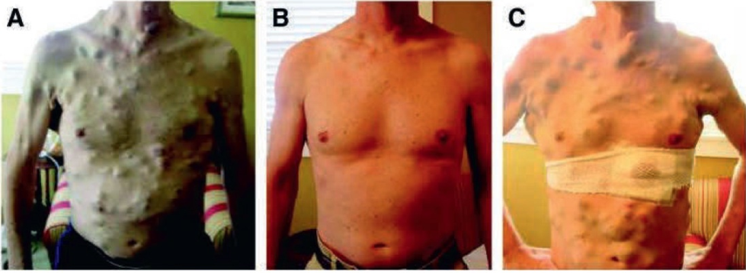
RAF TKI (vemurafenib, dabrafenib)
A 38-year-old man with BRAF-mutant advanced melanoma with widespread subcutaneous tumor nodules.
A: Prior to initiation with vemurafenib.
B: After 15 weeks of therapy with vemurafenib.
C: At progression, after 23 weeks of therapy. A post-progression biopsy was sequenced and revealed a BRAF V600E mutation and a concomitant MEK1 C121S activating resistance mutation. (Reproduced from Wagle N, Emery C, Berger MF, et al. Dissecting therapeutic resistance to RAF inhibition in melanoma by tumor genomic profiling. J Clin Oncol 2011;29[22]:3085–3096.)

Slide 35
Jak moc je v nádoru buněk?

Slide 36
Jak moc je v nádoru buněk?
1buňka ≈10 μm

Slide 37
Jak moc je v nádoru buněk?
1buňka ≈10 μm
1 mm^3 = 100x100x100 buněk = 10^6 buněk
1 cm^3 = 10^9 buněk
Rozlišovací mez zobrazovacích metod je v rámci milimetrů
To že po léčbě není nikde vidět žádný nádor znamená, že v těle může být něco mezi 0 a asi 10^7 buněk

Slide 38
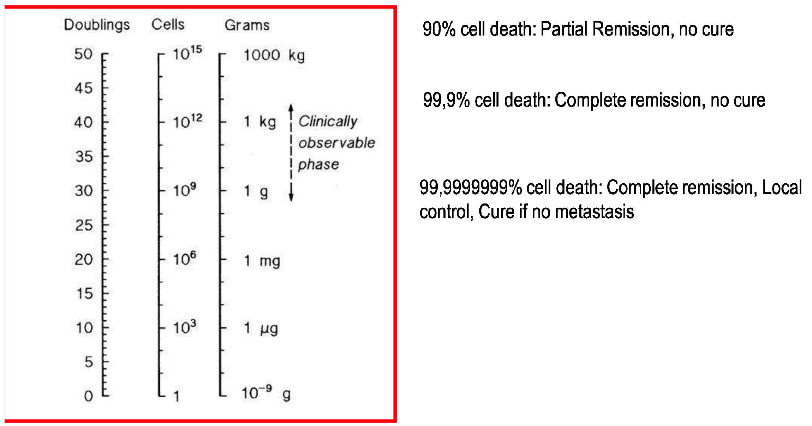

Slide 39
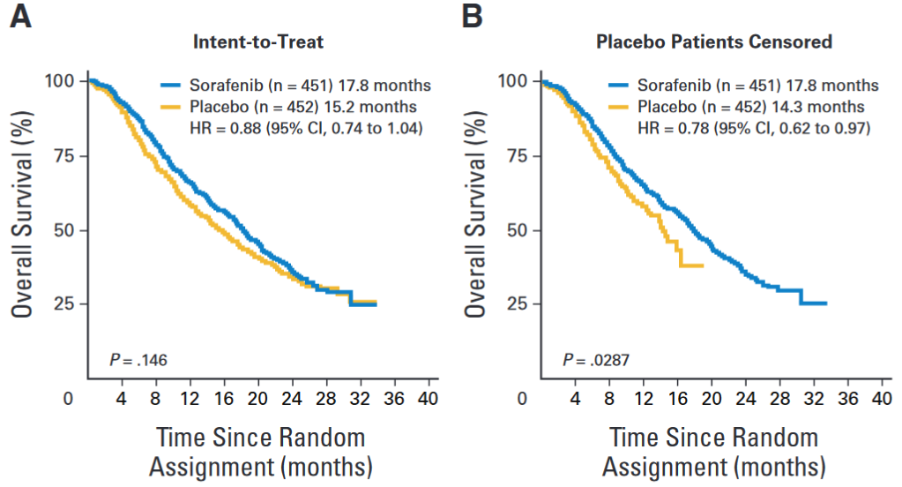
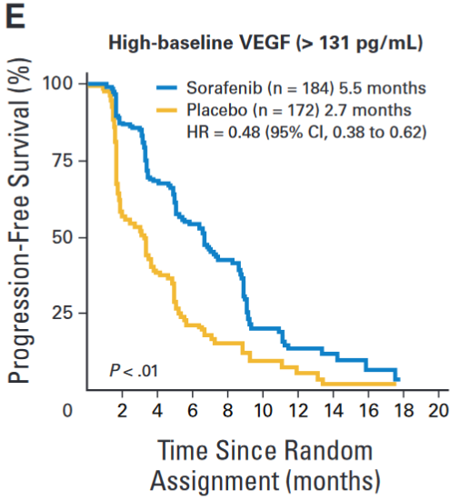
Multi TKIs – sorafenib, sunitinib
Sorafenib
VEGFR, PDGFR, RAF, FLT3, KIT, RET inhibitor

Slide 40
Multi TKIs – sorafenib, sunitinib
Sunitinib
VEGFR, PDGFR, FGFR, FLT3, KIT, RAF, FMS
Pazopanib
VEGFR, PDGFR, KIT
Cabozantinib
VEGFR, AXL, MET, KIT, TIE2, FLT3, RET

Slide 41
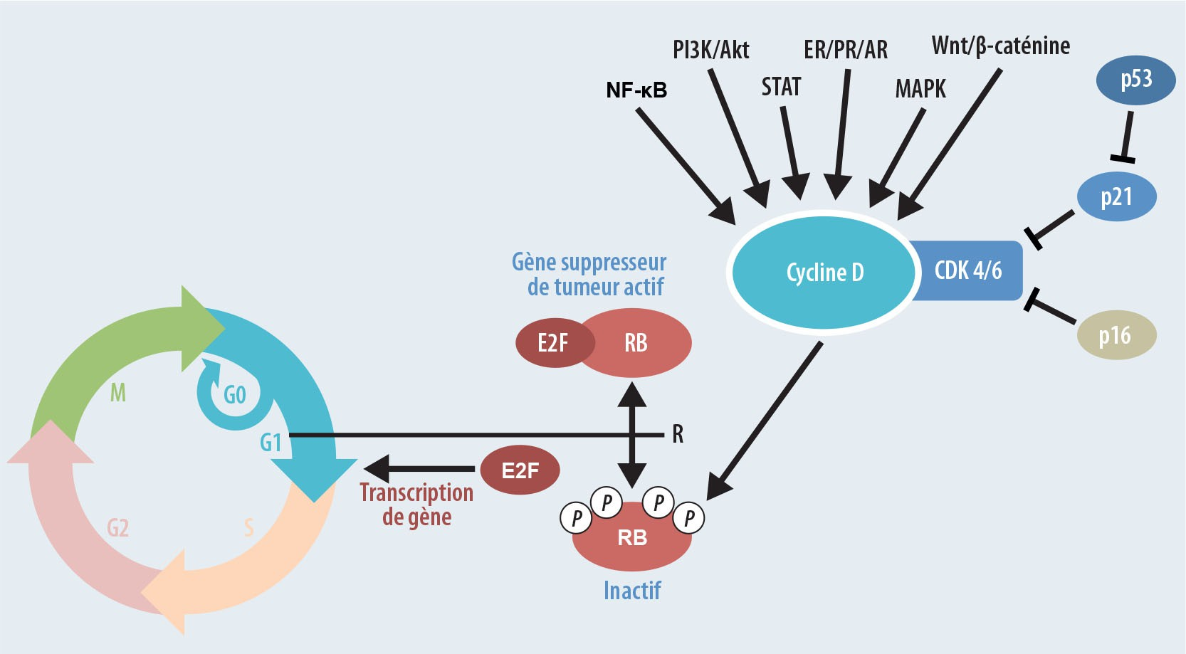
CDK4/6 TKIs (palbociclib, ribociclib, abemaciclib)
Co tuto signalizaci porušuje?

Slide 42
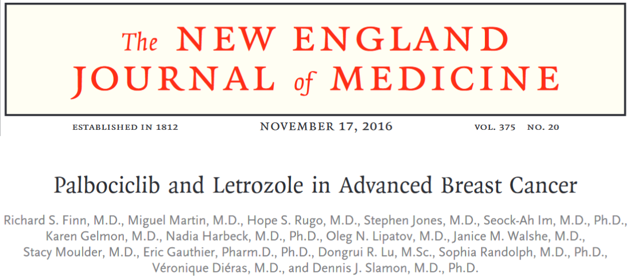
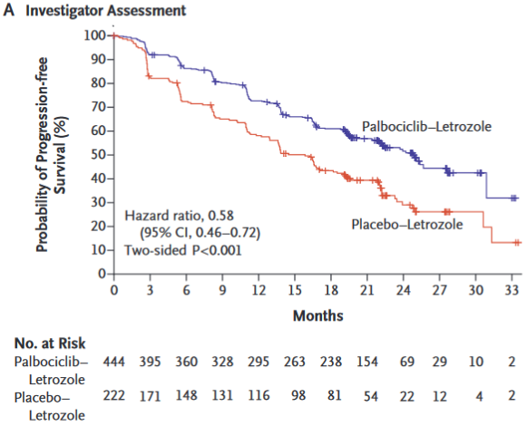
CDK4/6 TKIs (palbociclib, ribociclib, abemaciclib)
In this double-blind study, we randomly assigned, in a 2:1 ratio, 666 postmenopausal women with ER-positive, HER2-negative breast cancer, who had not had prior treatment for advanced disease, to receive palbociclib plus letrozole or placebo plus letrozole.

Slide 43
mTOR inhibitory .....
Součást PIK3, reguluje především růst a přežití buněk
Serin / threonin kináza
Everolimus, sirolimus, ...

Slide 44
TKIs závěr
DeVita 2018:
Although often effective initially, both intrinsic and acquired resistance to kinase inhibitors is the rule rather than the exception. In many cases, resistance is the result of selection for cells with a co-mutation in a second targetable kinase. In others, “adaptive” resistance due to activation of parallel kinase pathways is the basis for treatment failure. Achieving the promise of precision oncology will thus require the development of combination therapies that can prevent or delay the emergence of drug resistance. Such combinations have been difficult to develop to date due to the diversity of co-mutation patterns observed in lung cancer, melanoma, and other common cancer types. The additive toxicity associated with the use of multiple agents is also a hurdle in the development of effective combination regimens. One can, however, envision a future in which broad prospective tumor molecular profiling and the availability of more selective inhibitors will allow for the personalized selection of kinase inhibitor combinations. Achieving this vision will require close collaboration between clinical and laboratory researchers focused on identifying the biologic basis for drug response in parallel with the development of less toxic, more selective kinase inhibitors.

Slide 45
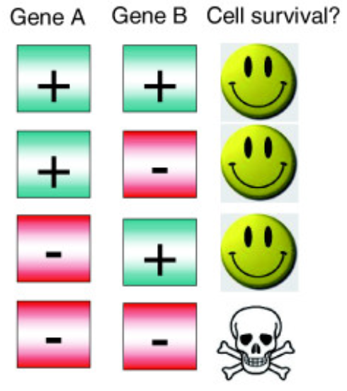
PARPi (olaparib, veliparib, rucaparib, ...)
Oprava SSBs
Pokud porucha DSBs opravy a nárůst SSBs → problém
„BRCAness“
Syntetická letalita
Potenciální otázky:
Proč dojde ke smrti buňky, když NHEJ je pořád funkční? A je NHEJ opravdu tak špatné?

Slide 46
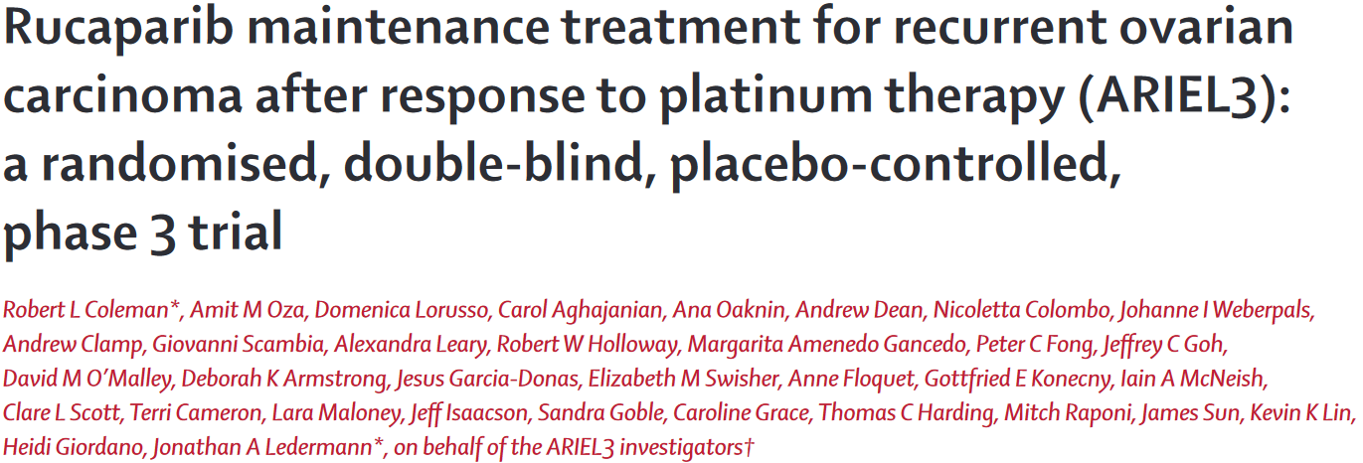
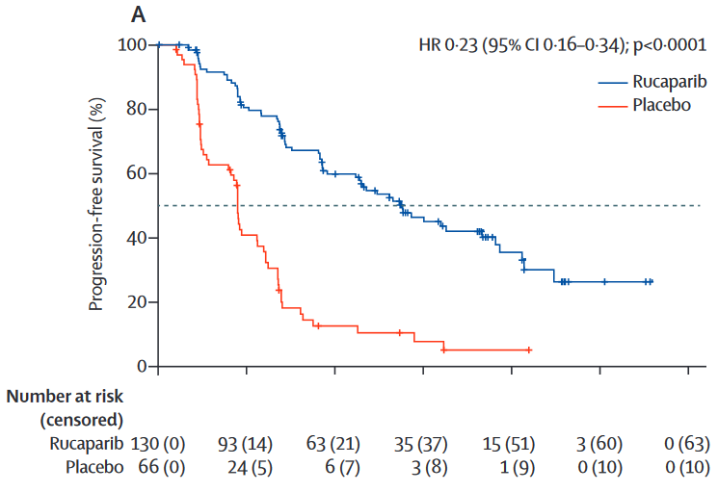
PARPi (olaparib, veliparib, rucaparib, ...)
Between April 7, 2014, and July 19, 2016, we randomly allocated 564 patients: 375 (66%) to rucaparib and 189 (34%) to placebo
Eligible patients were aged 18 years or older, had a platinum-sensitive, high-grade serous or endometrioid ovarian, primary peritoneal, or fallopian tube carcinoma, had received at least two previous platinum-based chemotherapy regimens, had achieved complete or partial response to their last platinum-based regimen, had a cancer antigen 125 concentration of less than the upper limit of normal, had a performance status of 0–1, and had adequate organ function.
6 12 18 24 30 36

Slide 47
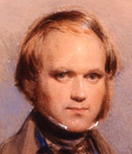
Imunitní systém
Nádory mají neoantigeny (mutované geny), které imunitní systém bere jako cizí
Imunitní dohled – především T lymfocyty a NK buňky
Většinou passenger mutace
„cizí“ epitopy na MHC-1
Málo MHC-1
Neoantigeny
Fetální antigeny
Antigeny ze specif. míst (testis)
CEA
T lymfocyty = CD8+ CTLs

Slide 48
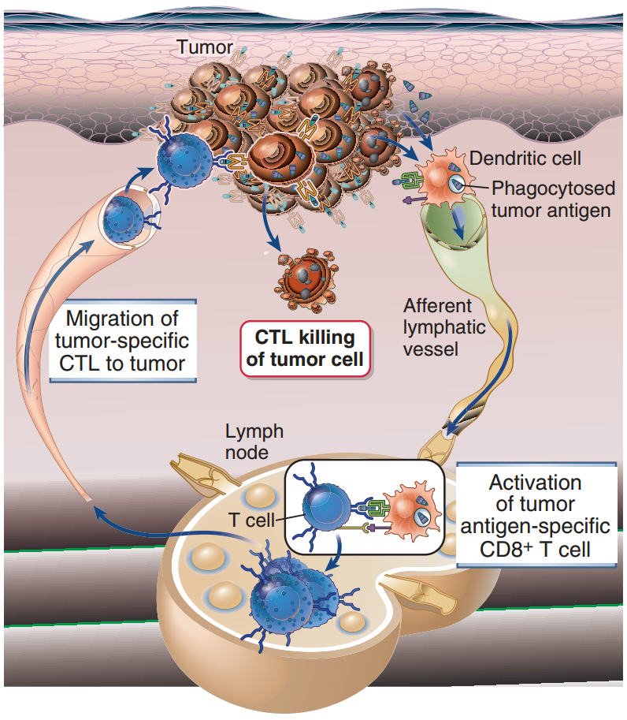
Imunitní systém

Slide 49
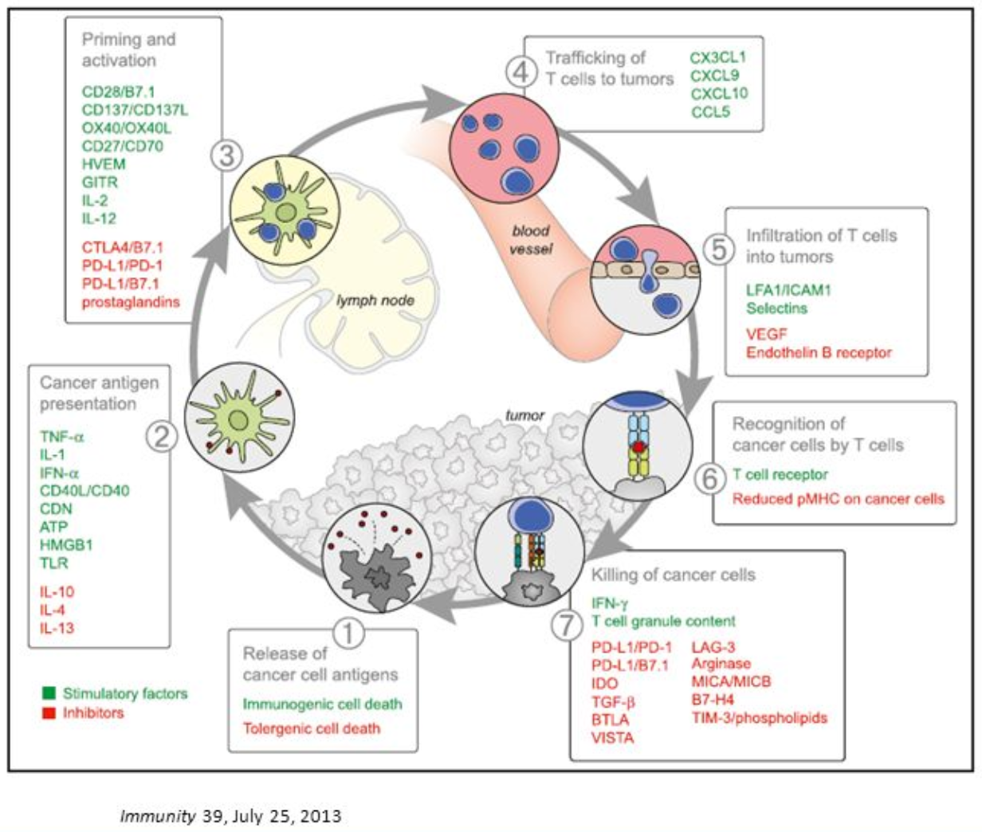
Imunitní systém
„...Immune response in cancer reflects a series of carefully regulated events that may be optimally addressed not singly but as a group.“

Slide 50
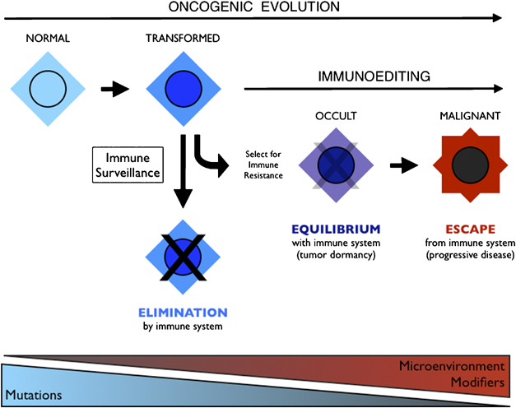
Imunitní systém
Makroskopické nádory se už imunitě úspěšně vyhly

Slide 51
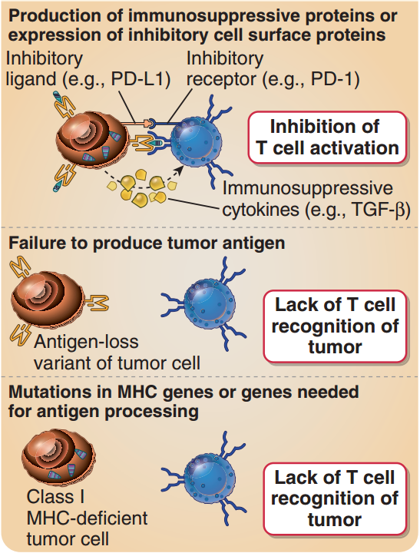
Imunitní systém – obrana nádorů
CTLA-4
PD-1
Blokují aktivaci CTLs
Nenastává u myší s poruchou adaptivní imunity

Slide 52
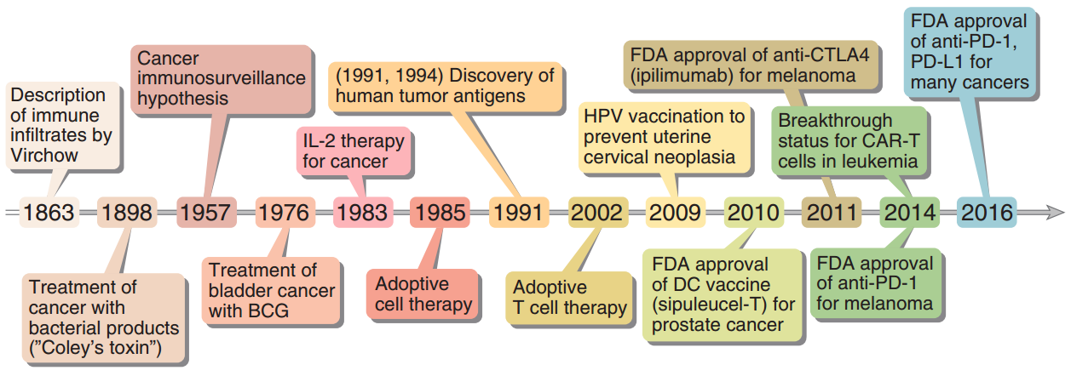
Imunitní systém

Slide 53
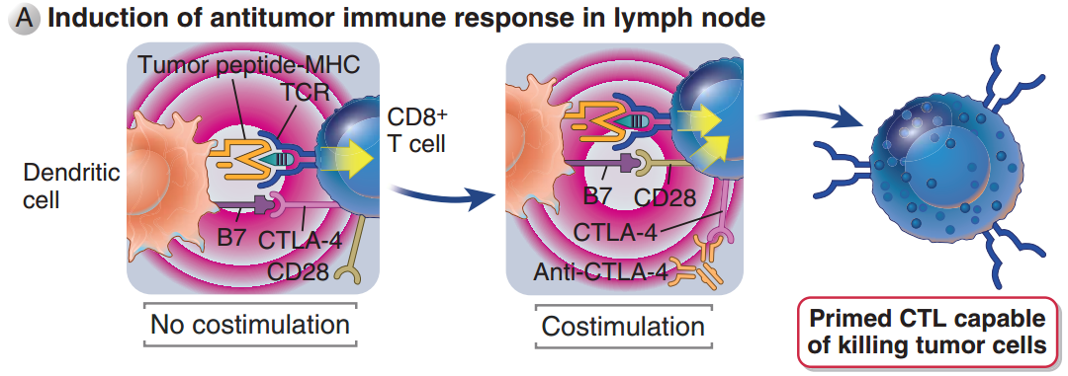
Blokování CTLs
CTLA-4 je inhibiční receptor na povrchu T lymfocytů
Funkce: limitace imunitní reakce
„Chechpoint inhibitory“
(„matoucí“ termín)

Slide 54
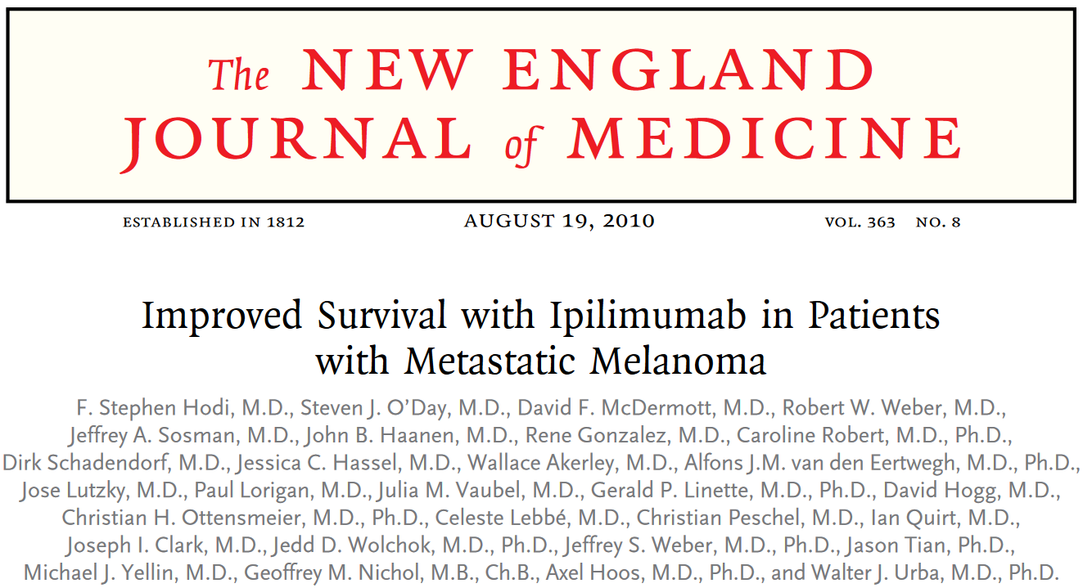
Protilátky proti CTLA-4 (ipilimumab)

Slide 55
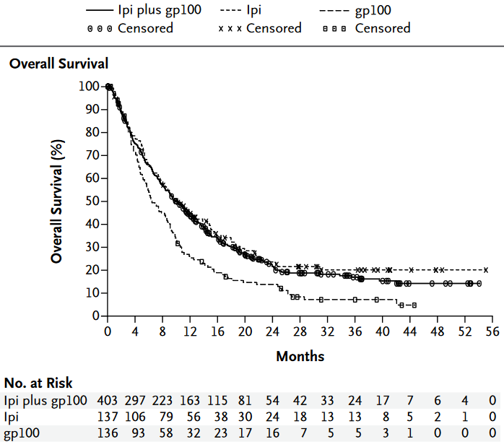
Protilátky proti CTLA-4 (ipilimumab)
A total of 676 patients with unresectable stage III or IV melanoma, whose disease had progressed while they were receiving therapy for metastatic disease, were randomly assigned to ....
The median overall survival was 10.0 months among patients receiving ipilimumab plus gp100, as compared with 6.4 months among patients receiving gp100 alone (hazard ratio for death, 0.68; P<0.001)

Slide 56
Blokování CTLs
PD-1 je inhibiční receptor na povrchu T lymfocytů
„Chechpoint inhibitory“
(„matoucí“ termín)

Slide 57
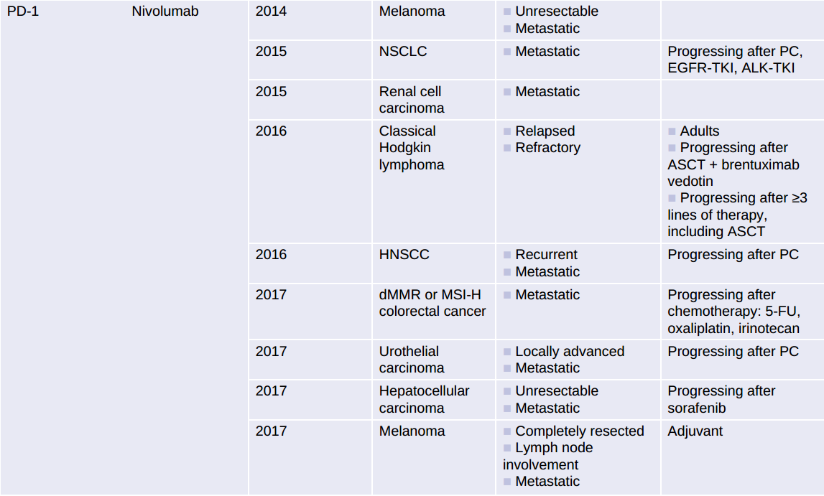
Protilátky proti PD-1 / PD-L1

Slide 58
Protilátky proti PD-1 / PD-L1

Slide 59
Protilátky proti PD-1 / PD-L1

Slide 60
Protilátky proti PD-1 / PD-L1

Slide 61
Protilátky proti PD-1 / PD-L1

Slide 62
Imunoterapie
CTLA-4
PD-1

Slide 63
CAR-T cells (Chimeric Antigen Receptor)
...Upon encountering the antigen of interest,
all necessary costimulation occurs and the T cell can eliminate the encountered cell...
„Choosing the most appropriate antigen is extremely critical, as CARs will essentially kill any cell expressing its target antigen.“

Slide 64
CAR-T cells (Chimeric Antigen Receptor)
Vhodný antigen?
CD19 (B-cell ALL a B lymfomy)
BCMA (mnohočetný myelom)
CD30 (Hodgkin lymphoma)
FLT3 (AML)
„Choosing the most appropriate antigen is extremely critical, as CARs will essentially kill any cell expressing its target antigen.“
„human epidermal growth factor receptor 2 (HER2)-targeted CAR that caused fatal pulmonary toxicity, potentially due to low levels of HER2 expression in the lungs“

Slide 65
CAR-T cells (Chimeric Antigen Receptor)
Large B-cell lymphomas, including diffuse large B-cell lymphoma, primary mediastinal B-cell lymphoma, and transformed follicular lymphoma, are treated with combination chemoimmunotherapy at diagnosis. Patients who have a relapse with chemotherapy-sensitive disease may be treated with high-dose chemotherapy followed by autologous stem-cell transplantation. However, patients who have disease that is resistant to primary or salvage chemoimmunotherapy or who have had a relapse after transplantation have an extremely poor prognosis. Recently, in a large, international, retrospective research study involving patients with non-Hodgkin’s lymphoma (SCHOLAR-1), investigators found an objective response rate of 26%, a complete response rate of 7%, and a median overall survival of 6.3 months with existing therapies among patients who had aggressive B-cell lymphoma that was resistant to chemotherapy or who had a relapse within 12 months after autologous stem-cell transplantation.

Slide 66
CAR-T cells (Chimeric Antigen Receptor)
...objective response rate of 26%, a complete response rate of 7%...

Slide 67
CAR-T cells (Chimeric Antigen Receptor)
...median overall survival of 6.3 months...

Slide 68
CD20
Receptor na povrchu B-lymfomů
Rituximab
induces lymphoma cell lysis through:
complement-mediated cytolysis
Antibody dependent cell cytotoxicity
induction of apoptosis
acts synergistically with chemotherapy
Vývoj a dozrávání B lymfocytů
„CD20 function is not fully understood, although it is known to be involved in the calcium flux. Recent studies suggested that raft-associated CD20 constitutes a component of a store-operated calcium entry pathway activated by BCR“
(2015)

Slide 69
CD20 (rituximab)
Celkové přežití
399 previously untreated patients, age 60 to 80 years, with diffuse large B-cell lymphoma.
Patients received eight cycles of classical CHOP (cyclophosphamide 750 mg/m2, doxorubicin 50 mg/m2, vincristine 1.4 mg/m2, and prednisone40 mg/m2 for 5 days) every 3 weeks.
In R-CHOP, rituximab 375 mg/m2was administered the same day as CHOP. Survivals were analyzed using the intent-to-treat principle.

Slide 70
MABs

Slide 71
MABs

Slide 72
MABs
Substem Indication of the Species on Which the Immunoglobulin Sequence Is Based
-o- Mouse
-xi- Chimeric
-zu- Humanized
-xizu- Chimeric/humanized
-u- Human

Slide 73
ErbB rodina
Receptory na povrchu buněk
Přenos signálu přes buněčnou membránu
Tyrozin-kinázová funkce
Protoonkogeny

Slide 74
HER2
První klinicky používaný MAB
Receptor na povrchu buněk, součástí ErbB rodiny
Tyrozin-kináza
Trastuzumab, pertuzumab, ...
In 1987, amplification of the ERBB2 gene, which encodes the HER2 transmembrane receptor tyrosine kinase, was identified in a subset of breast cancers

Slide 75
HER2
Results: Study patients had advanced metastatic disease
and had received extensive prior therapy. A blinded, independent response evaluation committee identified eight complete and 26 partial responses, for an objective response rate of 15% in the intent-to-treat population (95% confidence interval, 11% to 21%). The median duration of response was 9.1 months; the median duration of survival was 13 months.

Slide 76
HER2

Slide 77
HER2
Methods: This international, multicenter, randomized trial compared one or two years of trastuzumab given every three weeks with observation in patients with HER2-positive andeither node-negative or node-positive breast cancer who had completed locoregionaltherapy and at least four cycles of neoadjuvant or adjuvant chemotherapy.
At the first planned interim analysis (median follow-up ofone year), 347 events (recurrence of breast cancer, contralateral breast cancer, secondnonbreast malignant disease, or death) were observed: 127 events in the trastuzumab group and 220 in the observation group. The unadjusted hazard ratio for an event inthe trastuzumab group, as compared with the observation group, was 0.54

Slide 78
HER2
Methods: This international, multicenter, randomized trial compared one or two years of trastuzumab given every three weeks with observation in patients with HER2-positive andeither node-negative or node-positive breast cancer who had completed locoregionaltherapy and at least four cycles of neoadjuvant or adjuvant chemotherapy.

Slide 79
EGFR
Standardní léčba:
Nevyléčí 100% lidí
Toxická

Slide 80
Realita

Slide 81
Proč vůbec potřeba?
Standardní léčba:
Nevyléčí 100% lidí
Toxická

Slide 82
Problémy
Resistence
Genetická instabilita
Intranádorová heterogenita – obrázek prso geny
Limitace cílů

Slide 83
Problémy
Nature - Vol 458j9 April 2009 doi:10.1038/nature07943

Slide 84
Problémy
Nature - Vol 458j9 April 2009 doi:10.1038/nature07943

Slide 85
The advent of molecularly targeted agents, as discussed in the following sections, has not changed a widespread consensus among drug developers: monotherapies involving either low–molecular-weight drugs or biological molecules are unlikely to cure most types of cancer, and eﬀective multi-agent therapies must be devised if definitive, durable clinical responses are to be achieved in the future.
Biology of cancer 2014, weinberg

