Slide 1
Psychologické a psychosociální faktory
Praktikum

Slide 2
Psychosocial Risk Factors and Cardiovascular Disease and Death in a Population-Based Cohort From 21 Low-, Middle-, and High-Income Countries Ailiana Santosa, MD, MMedSc, PhD¹; et al JAMA Netw Open. 2021;4(12):e2138920. doi:10.1001/jamanetworkopen.2021.38920

Slide 3
Objective To investigate the association of a composite measure of psychosocial stress and the development of CVD events and mortality in a large prospective study involving populations from 21 high-, middle-, and low-income countries across 5 continents. Design, Setting, and Participants This population-based cohort study used data from the Prospective Urban Rural Epidemiology study, collected between January 2003 and March 2021. Participants included individuals aged 35 to 70 years living in 21 low-, middle-, and high-income countries. Data were analyzed from April 8 to June 15, 2021. Results A total of 118 706 participants (mean [SD] age 50.4 [9.6] years; 69 842 [58.8%] women and 48 864 [41.2%] men) without prior CVD and with complete baseline and follow-up data were included. Of these, 8699 participants (7.3%) reported high stress, 21 797 participants (18.4%) reported moderate stress, 34 958 participants (29.4%) reported low stress, and 53 252 participants (44.8%) reported no stress. During a median (IQR) follow-up of 10.2 (8.6-11.9) years, a total of 7248 deaths occurred. During the course of follow-up, there were 5934 CVD events, 4107 CHD events, and 2880 stroke events. Compared with no stress and after adjustment for age, sex, education, marital status, location, abdominal obesity, hypertension, smoking, diabetes, and family history of CVD, as the level of stress increased, there were increases in risk of death (low stress: hazard ratio [HR], 1.09 [95% CI, 1.03-1.16]; high stress: 1.17 [95% CI, 1.06-1.29]) and CHD (low stress: HR, 1.09 [95% CI, 1.01-1.18]; high stress: HR, 1.24 [95% CI, 1.08-1.42]).

Slide 4
Psychological stress
Psychosocial stress was assessed by 2 single-item questions relating to stress at work and home.
Stress was defined as
feeling irritable or filled with anxiety, or
as having sleeping difficulties as a result of conditions at work or home.
For each question, participants were asked to report to what extent they had felt stressed.

Slide 5
Psychosocial factors and CVD
Prospective Urban Rural Epidemiology study
Population-Based Cohort From 21 Low-, Middle-, and High-Income Countries
118 706 participants (mean [SD] age 50.4 [9.6] years; 69 842 [58.8%] women and 48 864 [41.2%] men) without prior CVD and with complete baseline and follow-up data were included.
Santosa A, Rosengren A, Ramasundarahettige C, et al. Psychosocial Risk Factors and Cardiovascular Disease and Death in a Population-Based Cohort From 21 Low-, Middle-, and High-Income Countries. JAMA Netw Open. 2021;4(12):e2138920. doi:10.1001/jamanetworkopen.2021.38920

Slide 6
Otázky 1
Je kohortová studie vhodná pro zkoumání vlivu stresu?
Co si myslíte o metodice měření stresu v této studii? Co myslíte, že tyto otázky měří?
Popiste a vysvetlete numerické výsledky na předešlém obrázku
Jak byste interpretovali výsledky této studie?

Slide 7
Perceived neighbourhood social cohesion and depressive symptom trajectories in older adults: a 12-year prospective cohort study Ruiz M et al, Soc Psychiatry Psychiatr Epidemiol. 2018; 53(10): 1081–1090. 11,037 participants aged 50+ from the English Longitudinal Study of Ageing

Slide 8
Perceived neighbourhood social cohesion (PSC)
How do you feel about your local area, that is everywhere within a 20 min walk or about a mile from your home?
(1) ‘I really feel a part of this area’/‘I feel that I don’t belong in this area;’
(2) ‘Most people in this area can be trusted’/‘Most people in this area can’t be trusted;’
(3) ‘Most people in this area are friendly’/‘Most people in this area are unfriendly;’ and
(4) ‘People in this area will take advantage of you’/‘People in this area will always treat you fairly.’

Slide 9
Depressive symptomatology
8-item version of the Center for Epidemiological Depression (CES-D) scale
3 symptoms on depressed affect
‘I felt depressed,’
‘I felt lonely,’
‘I felt sad’
3 symptoms on somatic and retarded activity
‘I felt that everything I did was an effort,’
‘My sleep was restless,’
‘I could not get “going”’);
Ě symptoms on positive affect
‘I was happy,’
‘I enjoyed life’)
Participants provided yes/no responses to each question.

Slide 10
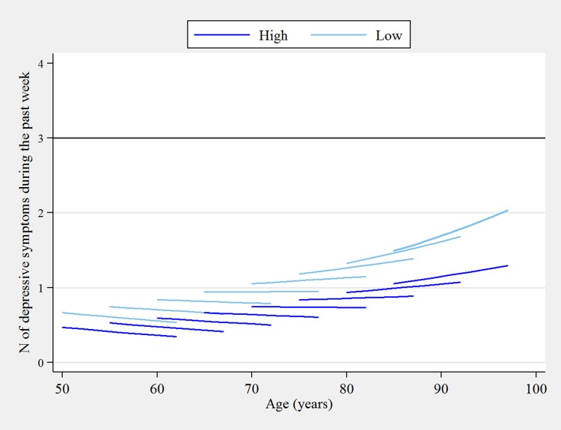
Predicted 12-year ageing vectors of depressive symptoms by high and low perceived social cohesion

Slide 11
Otázky 2
Je tento typ studie vhodný pro zkoumání vlivu sociální soudržnosti?
Co si myslíte o metodice měření sociální soudržnosti v této studii? Co myslíte, že tyto otázky měří?
Co si myslíte o metodice měření symptom deprese?
Popište a vysvětlete numerické výsledky v grafu.
Jak byste interpretovali výsledky této studie?

