Slide 1
English for Physicists IV
Week 6

Slide 2
Outline
Presentation skills
Visuals – how, why, what

Slide 3
a) Why are visuals used in scientific papers and presentations?
b) What visuals do people in your field commonly use to show data? Why?

Slide 4
Visuals
What can be used as a visual? | Why to use visuals? | How to use visuals effectively?

Slide 5
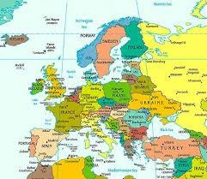
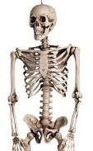
Presentations: VISUALS
WHAT?

Slide 6
Presentations: VISUALS
WHY? – visuals can:
focus the attention (reinforce your main ideas)
help to explain (illustrate points)
help the presenter’s memory
motivate the audience
involve the audience, …

Slide 7
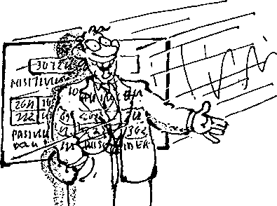
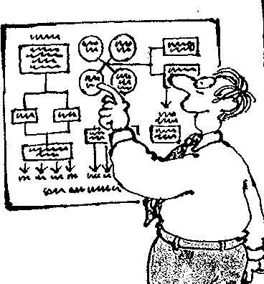
Presentations: VISUALS
HOW?
visuals should be:
visible
simple
interesting
practical
to the point

Slide 8
1 Tables, graphs, etc. are necessary | a be consistent with them.
2 Visual summaries allow | b reduced in size in a paper.
3 Deciding how to present data visually makes you | c show trends; tables to show exact numbers.
4 Visuals need to be clear even when | d the reader to check the data for themselves.
5 Graphs should be used to | e think carefully about what your results mean.
6 Too much information in a visual | f to avoid filling up the text with lists of numbers.
7 Use standard symbols and | g will confuse the reader.

Slide 9
Introducing visuals – useful phrases
OK. Let’s take a look at …..
The first / second / next / final slide is
…..
This shows / illustrates / demonstrates / refers to …..
This is I graph / an organigram which shows …..
As you can see, this is …
As you can see from these figures... Here we can see …..
I'd like you to look at this graph... Let me show you this pie chart... Let's have a look at this model...
Let's turn to this map...
To illustrate my point let’s look at some diagrams...
If you look at these photographs you'll see... If you look at this bar chart you'll notice...
If you look at this histogram you'll appreciate... If you look at this flow chart you'll understand ... If you look at this matrix...
I’d like to draw your attention to …..
One of the most important aspects of this is ….. At first glance it seems ….. but …..

Slide 10
Effective use of captions
1. Should the caption appear above or below the visual it describes?
Why?
2. What kind of information should the caption include?
3. What difficulties might there be when writing a caption in English?

Slide 11
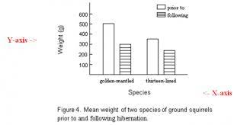

Slide 12
Rewriting captions – noun phrases
a) The table compares the physical and chemical characteristics of the hydrothermal fluids.
The comparison of the physical and chemical…
b) The chart depicts how many students in class speak both English and Spanish.
The number of students…
c) This table lists the names of people who have seen the Loch Ness monster.
Loch Ness monster witnesses
d) The picture illustrates the way in which electromagnetic waves can be categorized.
The categorization of electromagnetic waves
e) The pie chart shows how the percentage of the expenditure incurred is distributed.

Slide 13
Match the types of graphs and their names
1 – an area chart
2 – a stock chart (box plot)
3 – a radar chart
4 – a column chart
5 – a doughnut chart
6 – a line chart
7 – a pie chart
8 – a bubble chart
9 – an XY (scatter ) chart
10 – a surface chart
11 – a bar chart

Slide 14
Sentence transformations
a) A surface chart is useful when you want to find optimum combinations between two sets of data. As in a topographic map, colours and patterns indicate areas that are in the same range of values.
b) Pie charts show the size of items in one data series, proportional to the sum of the items. The data points in this type of chart are displayed as a percentage of the whole chart.
c) Area charts emphasize the magnitude of change over time, and can be used to draw attention to the total value across a trend.
d) Column charts are useful for showing data changes over a period of time or for illustrating comparisons among items.
e) You could use a stock chart to indicate the fluctuation of daily or annual temperatures.
f) Like a pie chart, a doughnut chart shows the relationship of parts to a whole, but it can contain more than one data series.
g) A bar chart is a graphical method of displaying several data series in the form of a two-dimensional chart of three or more quantitative variables represented on axes starting from the same point.

Slide 15
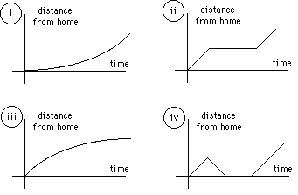
Identify the graph
Flat tire
Late
Books

Slide 16
Language focus - synonyms
to increase:
to decrease:
to stay the same:
an increase:
a decrease:

Slide 17
Language focus - synonyms
to increase:
to grow, climb, rise, surge, soar, leap, rocket, go up, ascend, gain
to decrease:
to go down, fall, decline, plummet, dip, plunge, drop, descend
to stay the same:
to level off, stay/ remain constant/flat
an increase:
growth, a climb, a rise, a surge, a leap, a gain
a decrease
a fall, a decline, a plummet, a dip, a plunge, a drop

Slide 18
TED talk
Watch the extract from a TED talk and comment on the way in which the presenter uses visuals.

