Slide 1
English for Mathematicians II

Slide 2
Lesson 1 - Introduction
syllabus, requirements, exam
meet your classmates – practising questions
university studies vocabulary - revision
theorems in mathematics
exam practice – understanding the text – vocabulary focus

Slide 3
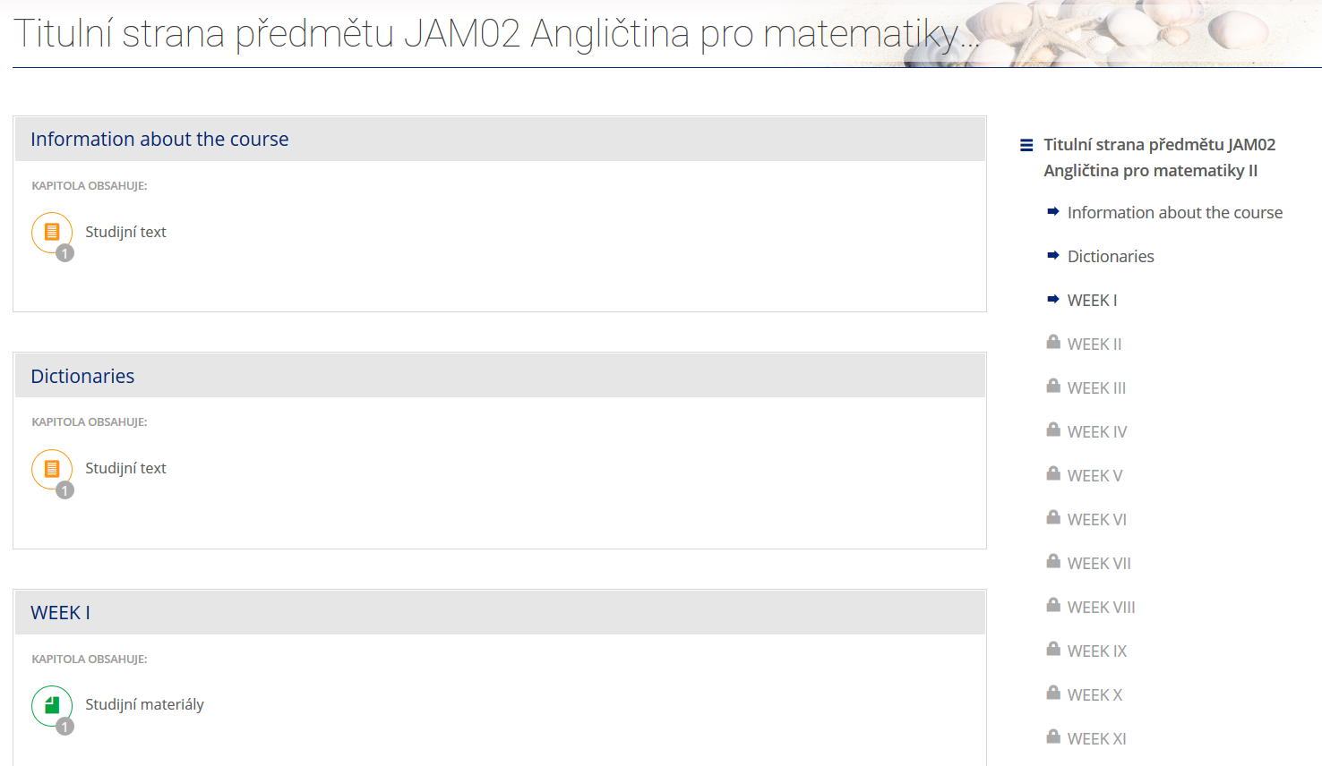
Study materials
https://is.muni.cz/auth/el/sci/jaro2022/JAM02/index.qwarp?prejit=4680091

Slide 4
Requirements
attendance, you can miss max. two seminars
homework is compulsory: helping you prepare for the exam
  project - presenting a (mathematical) topic, preparing follow-up tasks – listening, speaking
  writing emails – written part of the exam
  preparing and presenting a poster (the role of mathematics in your studies/future career) – oral part of the exam
credit test in Week 14, min. 60% correct
Continuous work!!!

Slide 5
Examination
Written part
  Listening (10 questions/gaps)
  Gram-lex: make questions, gap-fill (words given), word formation, sentence transformation
  Reading: parts of sentences into the text, multiple choice
  Writing: academic email
  Summary of a chosen text
Oral part
  one topic + your studies & future career (10 minutes)
“EXAM PRACTICE” tasks in the materials

Slide 6
Unit 1 – Getting to know each other and university studies
Find out information + make correct questions:
Find someone who …
… prefers oral exams to written exams.
… went skiing during the examination period.
… is studying applied mathematics.
… is going to do homework tonight.
… has been using English this year.
… will have to study hard this semester.
… prefers online to face-to face
Do you prefer oral exams to written exams?
Did you go skiing during …. ?
Are you studying applied maths?
Are you going to do homework tonight?
Have you been using English this year?
Will you have to study hard this semester?
rules: hello, small talk -> ask two questions max -> thank you, bye

Slide 7
more vocabulary related to your studies
assignment | lecture | tutorial | examination | assessment | research
library | dormitory | professor | supervisor | degree | Master
Bachelor | dean | scholarship | department | fieldwork | graduate
Sort out the nouns into groups + add more
Which verbs can go with the nouns?

Slide 8
3. Complete these questions
How many exams do you usually _________ within one week?
Have you __________ all your exams so far?
How many assignments do you have to _______________ this term?
Do you prefer exams or continuous _____________?
Do you always __________ all your lectures?
Can good students receive __________ at your faculty?
take / sit
passed
do/complete/write
assessment
attend/ go to
scholarship

Slide 9
Typical Vocab from any Field of Mathematics…
???

Slide 10
The correct number:
1a 2c 3a 4b 5b 6c 7b 8b
a) ¼
b) 15%
c) 1.356
d) 2,905,740
e) 5 x 10⁹
f) -35
g) 10⁶
h) 10,893
i) -57
j) 17 5/8
k) 0.003
l) 5,090,019

Slide 11
What is a theorem in mathematics?
Typical vocabulary?
???

Slide 12
Theorems in mathematics
AXIOMS | PROOFS | PRECISE | DEDUCTIVE | ESTABLISHED | FORMAL
STATEMENT | INTERPRETED | INFORMAL | REASON | CONSEQUENCE
statement
In mathematics, a theorem is a (1)_________________ that has been proved on the basis of previously (2)_________________ statements, such as other theorems, and generally accepted statements, such as (3)_________________. A theorem is a logical (4)_________________ of the axioms. The proof of a mathematical theorem is a logical argument for the theorem statement given in accord with the rules of a deductive system. The proof of a theorem is often (5)_________________ as justification of the truth of the theorem statement. In light of the requirement that theorems must be proved, the concept of a theorem is fundamentally (6)_________________, in contrast to the notion of a scientific law, which is experimental.
To be proved, a theorem must be expressible as a (7)_________________, formal statement. Nevertheless, theorems are usually expressed in natural language rather than in a completely symbolic form, with the intention that the reader can produce a formal statement from the (8)_________________ one.
established
axioms
consequence
interpreted
deductive
precise
informal

Slide 13
Pair/Group work: examples of theorem
in symbolic language
in natural language

Slide 14
Four Colour Theorem – discuss the questions
What does the Four Color Theorem state?
How long did it take to prove this theorem?
When was the theorem solved?
Which famous mathematician was involved with the appearance of the Four Color Problem?
How can this theorem be proven?
Why was the first proof considered controversial?

Slide 15
Four Colour Theorem – video
What does the Four Color Theorem state?
How long did it take to prove this theorem?
When was the theorem solved?
Which famous mathematician was involved with the appearance of the Four Color Problem?
How can this theorem be proven?
Why was the first proof considered controversial?
Every map can be coloured using
four colours so that no two …
125 years
1970’s
Augustus de Morgan
To show that every map can be coloured
using four colours or (disproving it) to find
one example that needs five colours

Slide 16
Four Colour Theorem - Reading
What are adjacent regions?
What kinds of maps need four colors?
When was the five color theorem proven?
How was the four color theorem proven?
Why was the proof unacceptable?
Which methods of proving the theorem were used in 2005?
regions sharing a border segment (not just a point)
e.g. when one region is surrounded by
an odd number of other regions
the late 19th century
using a computer
the computer assisted proof was not possible
to check by a human (this was controversial)
with general purpose theorem proving software

Slide 17
Four Color Theorem – Reading - synonyms
Example: adjacent: contiguous
sufficient …………………..
to be enough …………………
a part ………………………..
at first ………………………..
impossible …………………….
to put to rest …………………….
adequate
suffice
portion
initially
infeasible
dispel

Slide 18
Linking expressions in the text
only if
which
that
however
regardless of
whether
because
additionally
initially

Slide 19
Methods of proof
in mathematics, a proof is an argument which gives evidence for a mathematical statement
Examples of methods:
Direct proof
Proof by mathematical induction
Proof by contradiction
Proof by construction
…

