Slide 1
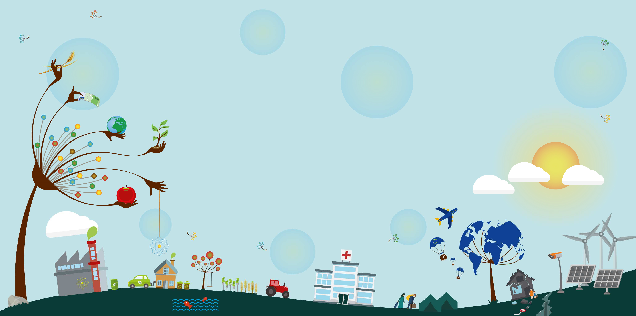

Digital Earth: Future Challenges
Alessandro Annoni
European Commission – Joint Research Centre
ISDE 11, Florence 24-27/09/2019
Joint Research Centre
The European Commission’s science and knowledge service

Slide 2
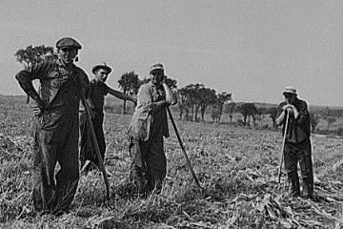
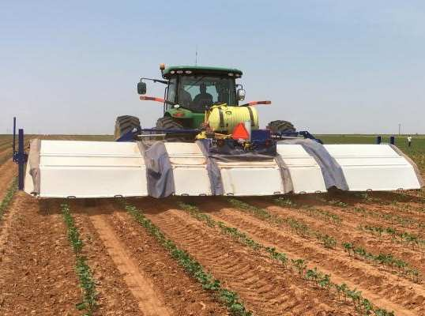
Farm Automation
Courtesy Jerry Kaplan, Stanford University
2

Slide 3
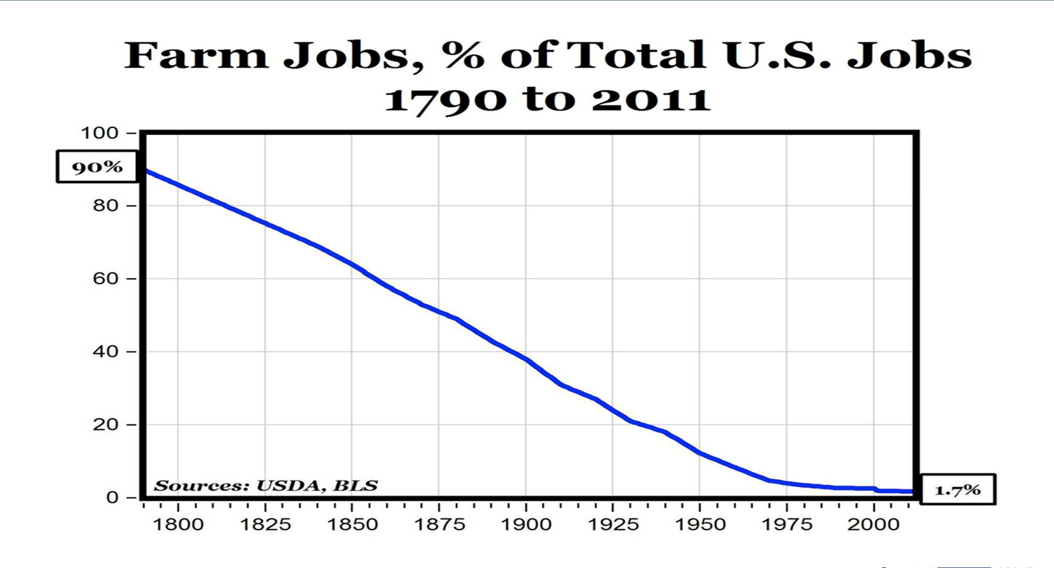
Farm % of Total US Employment
Courtesy Jerry Kaplan, Stanford University
3

Slide 4
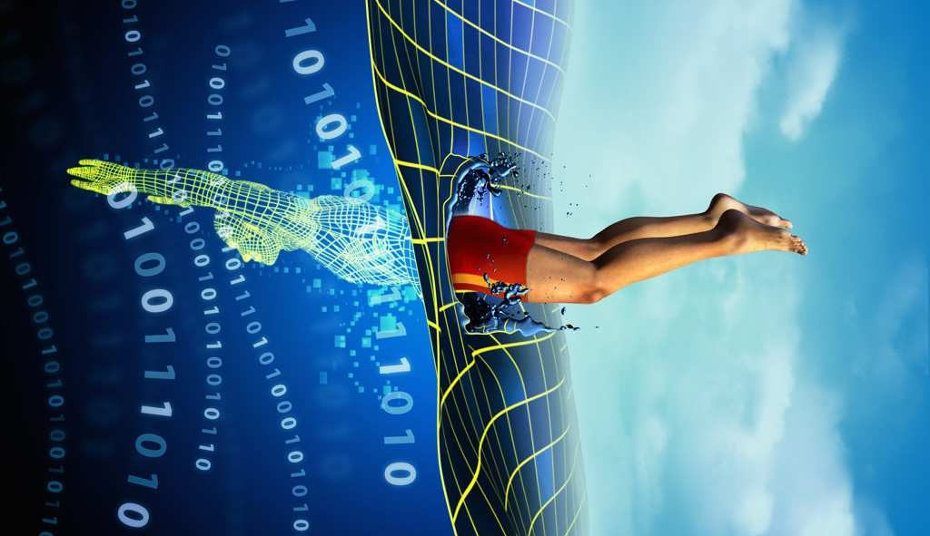
Digital transformation refers to the profound changes taking place in the economy and society as a result of the uptake and integration of digital technologies in every aspect of human life.

Slide 5
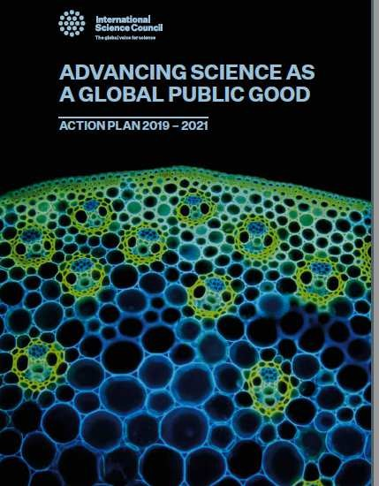
MAJOR CHALLENGES FOR SOCIETY TO WHICH SCIENCE SHOULD RESPOND
International Science Council: Action Plan 2019-2021
Today’s digital technologies are a good example of a ‘general-purpose technology’ that continually transforms itself, progressively penetrating almost all domains of private and public life.
It disrupts existing patterns of behaviour, organization and production and boosts productivity across all sectors and industries because of its cost effectiveness, with profound economic and social implications.
It has ushered in a new era of data driven science, with concomitant pressures for change in the social organization of science.

Slide 6
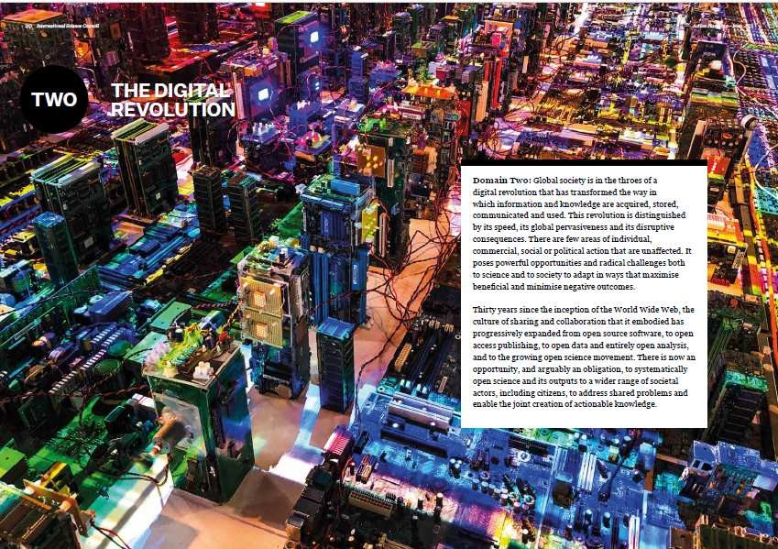
The Digital Revolution
Domain 2 in the ISC Action Plan 2019-21
Global society is in the throes of a digital revolution that has transformed the way in which information and knowledge are acquired, stored, communicated and used.
This revolution is distinguished by its speed, its
global pervasiveness and its disruptive consequences.
There are few areas of individual, commercial, social or political action that are unaffected.
It poses powerful opportunities and radical challenges both to science and to society to
adapt in ways that maximise beneficial and minimise negative outcomes.
Two Projects as priority
Data-driven interdisciplinarity
Global data resources and governance

Slide 7
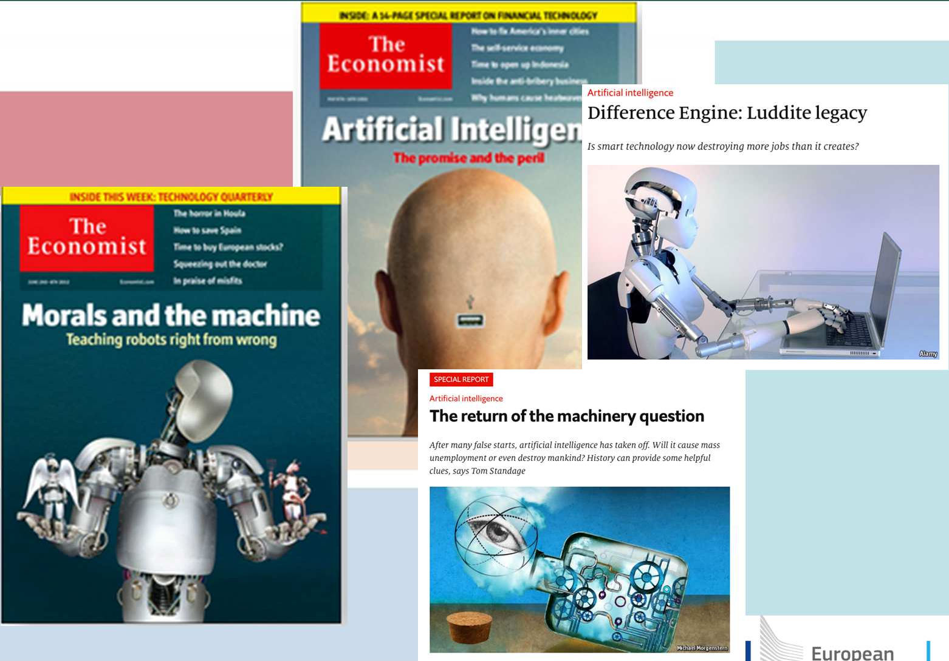
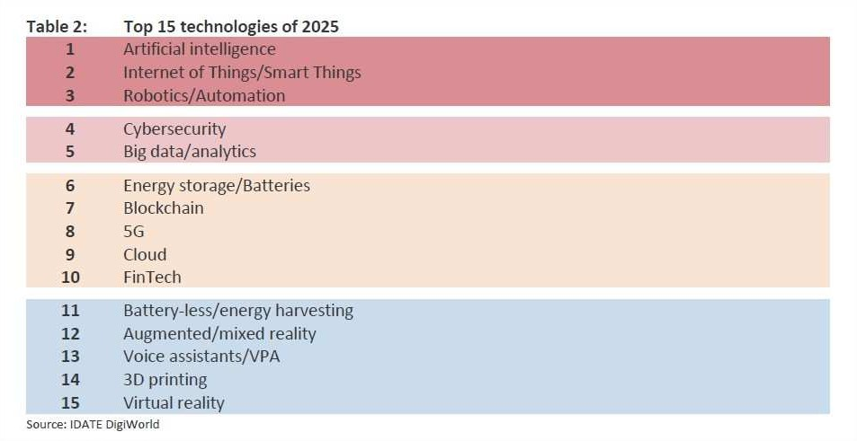
Most important technologies contributing to Digital Transformation

Slide 8
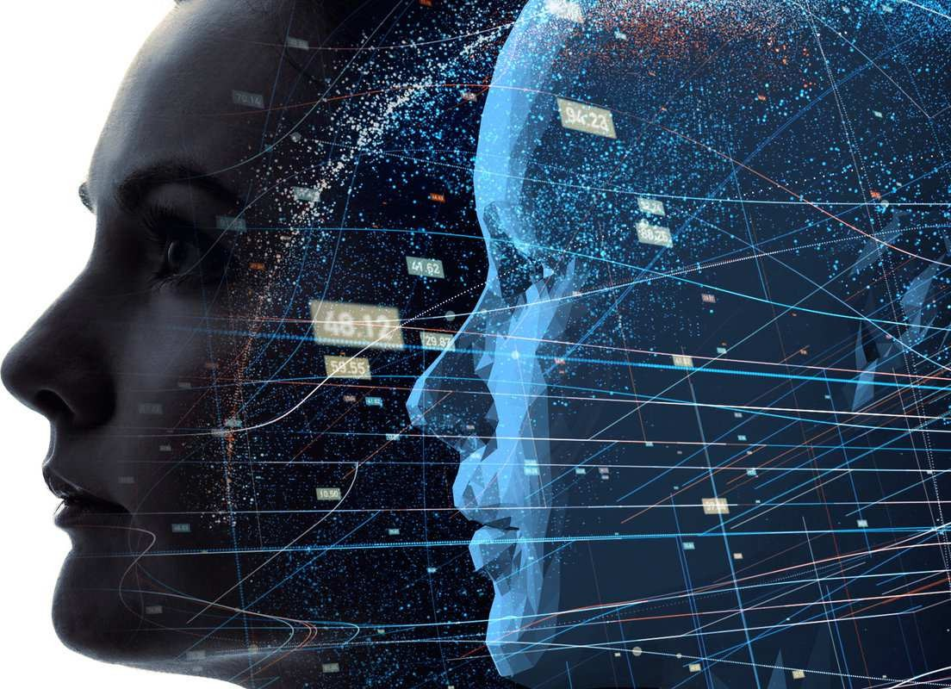
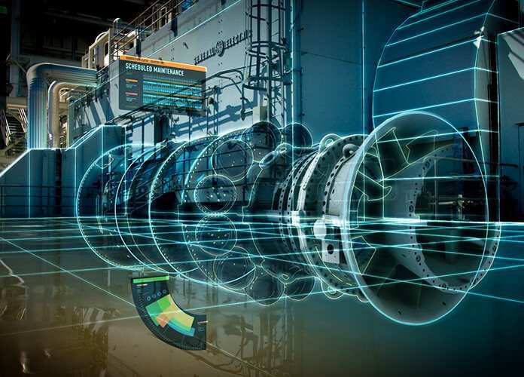
Digital Earth vs Digital Twin
Digital twins are virtual replicas of physical devices that data scientists and IT pros can use to run simulations before actual devices are built and deployed. They are also changing how technologies such as IoT, AI and analytics are optimized.
https://www.networkworld.com/article/3280225/what-is-digital- twin-technology-and-why-it-matters.html
https://blog.eduonix.com/internet-of-things/digital-twin-new- big-strategic-rise-iot/

Slide 9
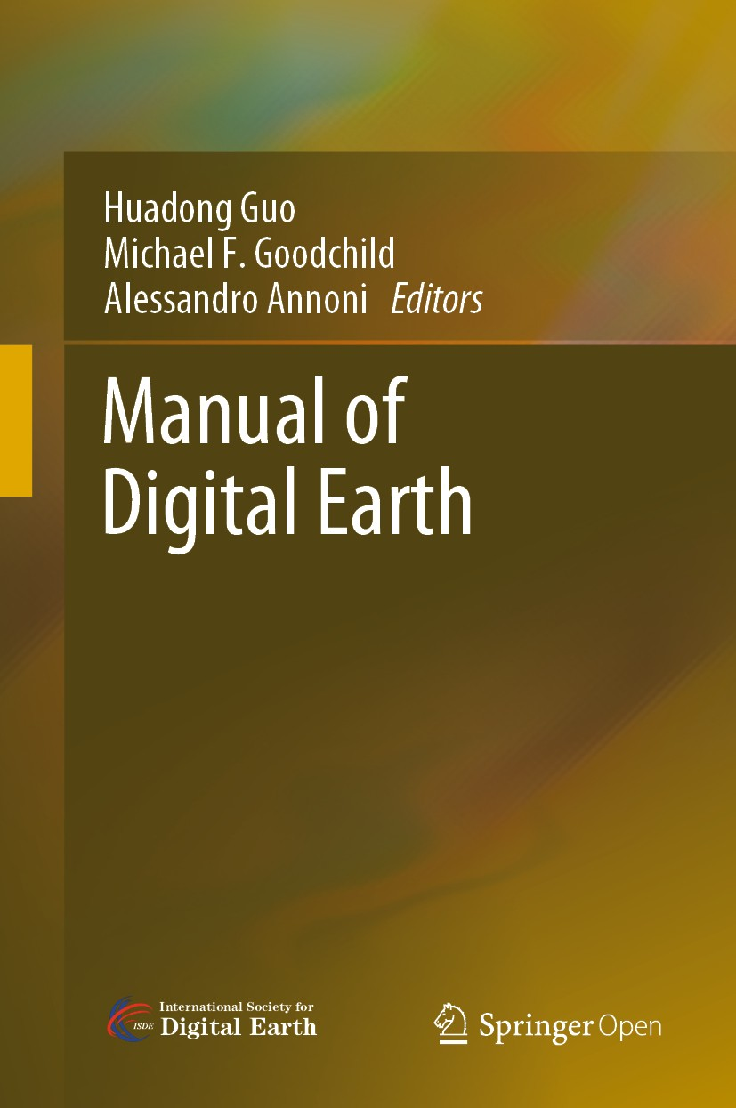
Major Challenges for Digital Earth
Big Data Management
DE Platforms implementation and construction
Developing an Ecosystem for DE
Addressing Social Complexities
Diversified curricula toward DE Education

Slide 10
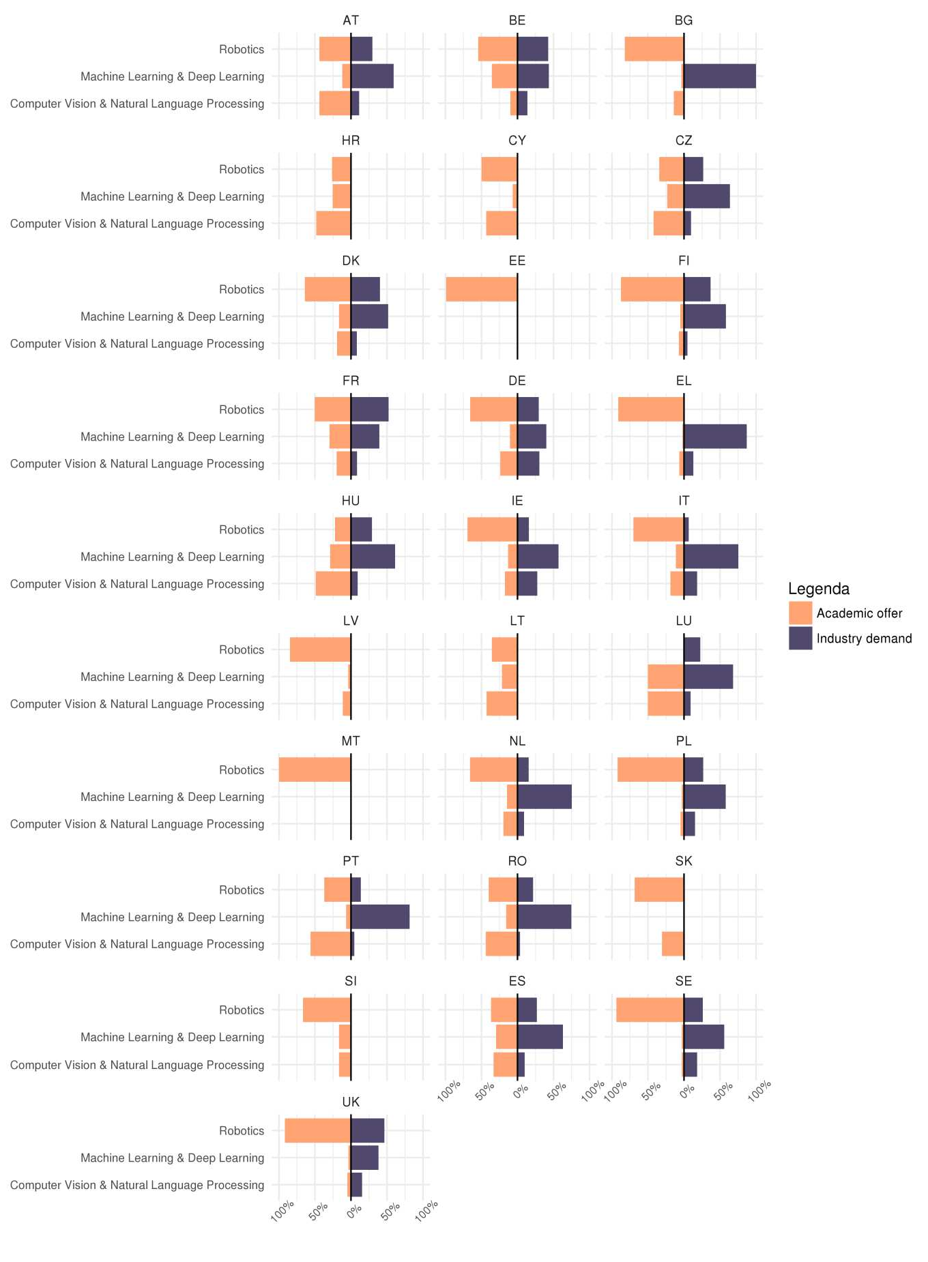
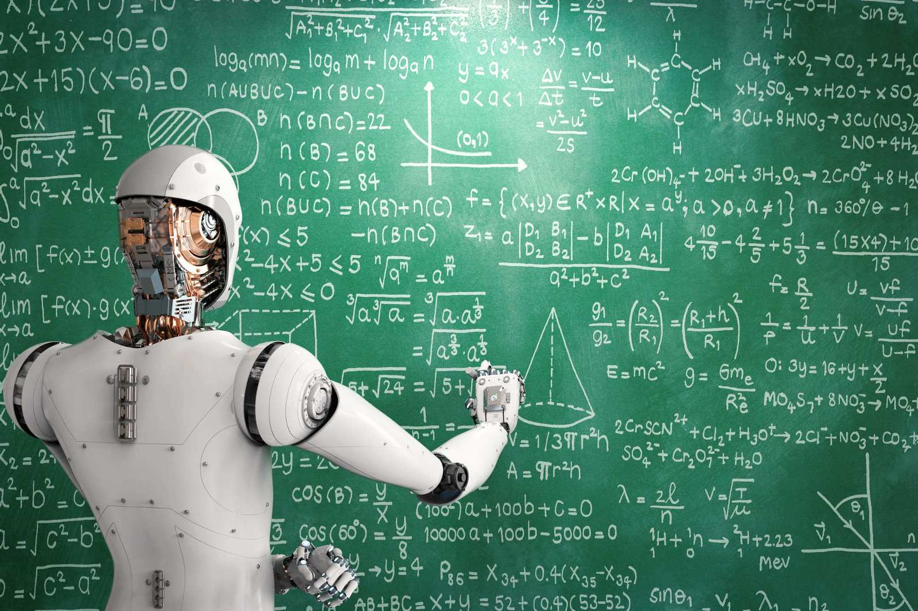
Education
AI Thematic profiles in Job Vacancies and Academic Programs

Slide 11
Technologies relevant for Digital Earth
IoT
Block Chain
Virtual Reality / Augmented Reality
Artificial Intelligence
Hyper Connectivity
5G, Fog/Edge computing
Progress in computing and microelectronics
In memory computing…

Slide 12
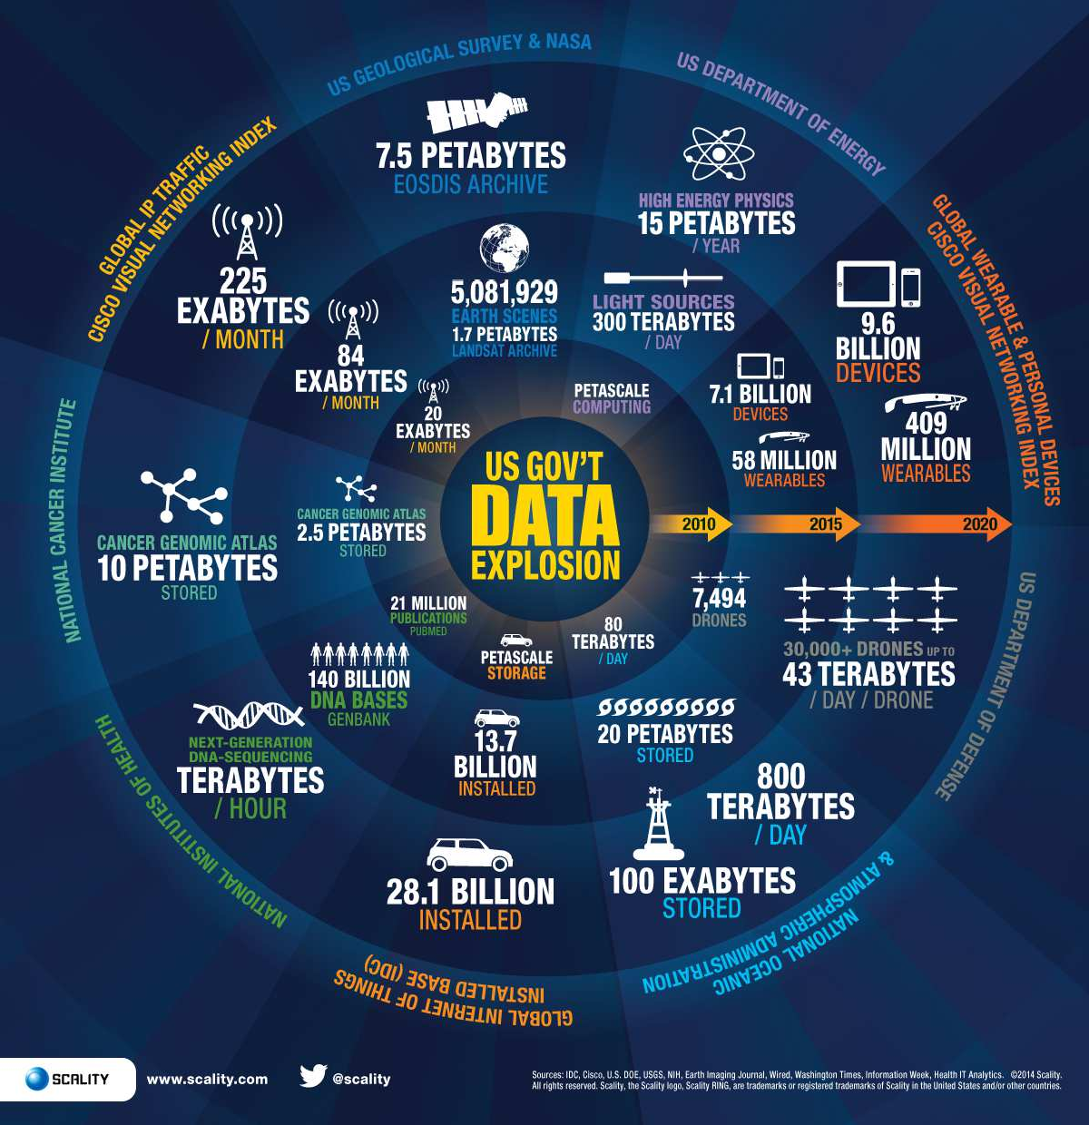
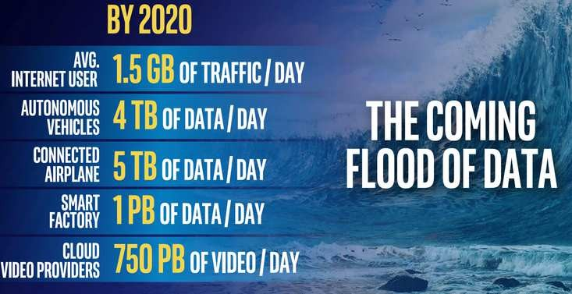
Data Explosion
https://www.semiconwest.org/consumer-industrial-data- explosion-hits-supply-chain

Slide 13

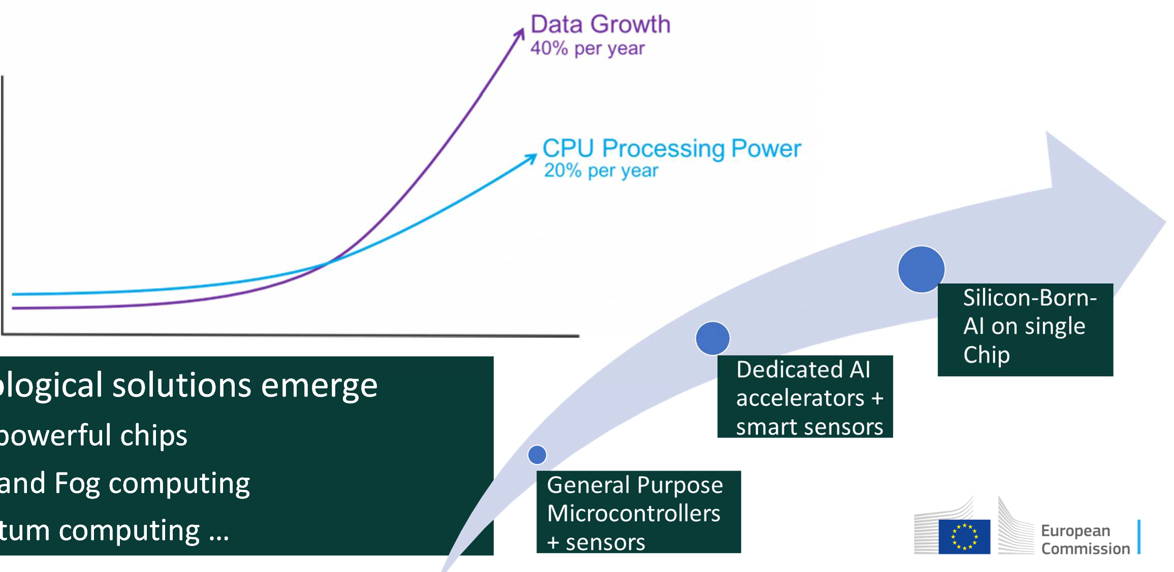
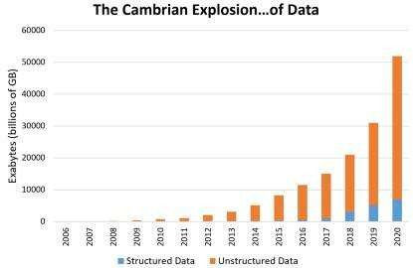
Data Vs Computing Power
COMPUTING
Techn
New
Edge
Quan
ological solutions emerge
powerful chips
and Fog computing tum computing …

Slide 14
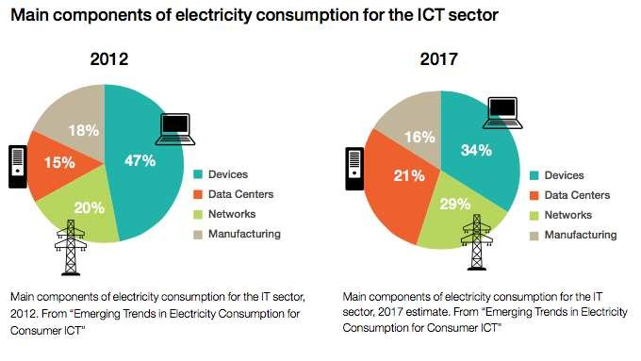
Energy consumption
source: IEEE STC on Sustainable Computing
© Sibelga 2012. All rights reserved.

Slide 15
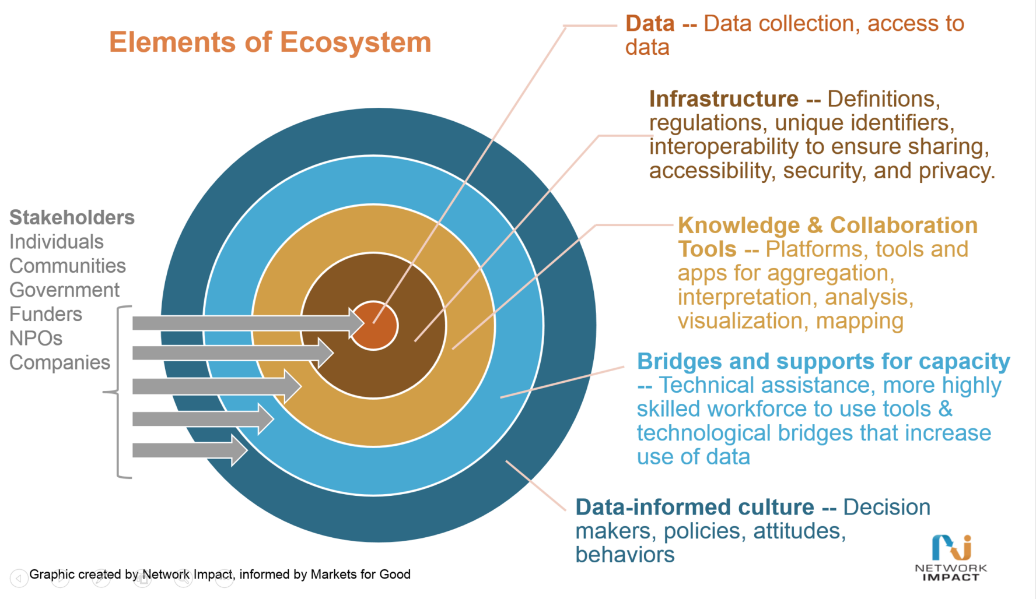
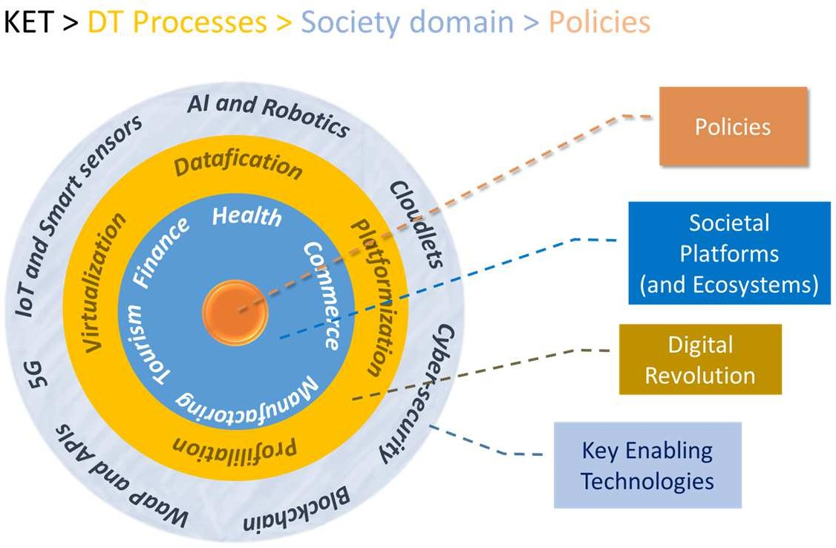
Data ecosystem (economic vs technogical view)

Slide 16
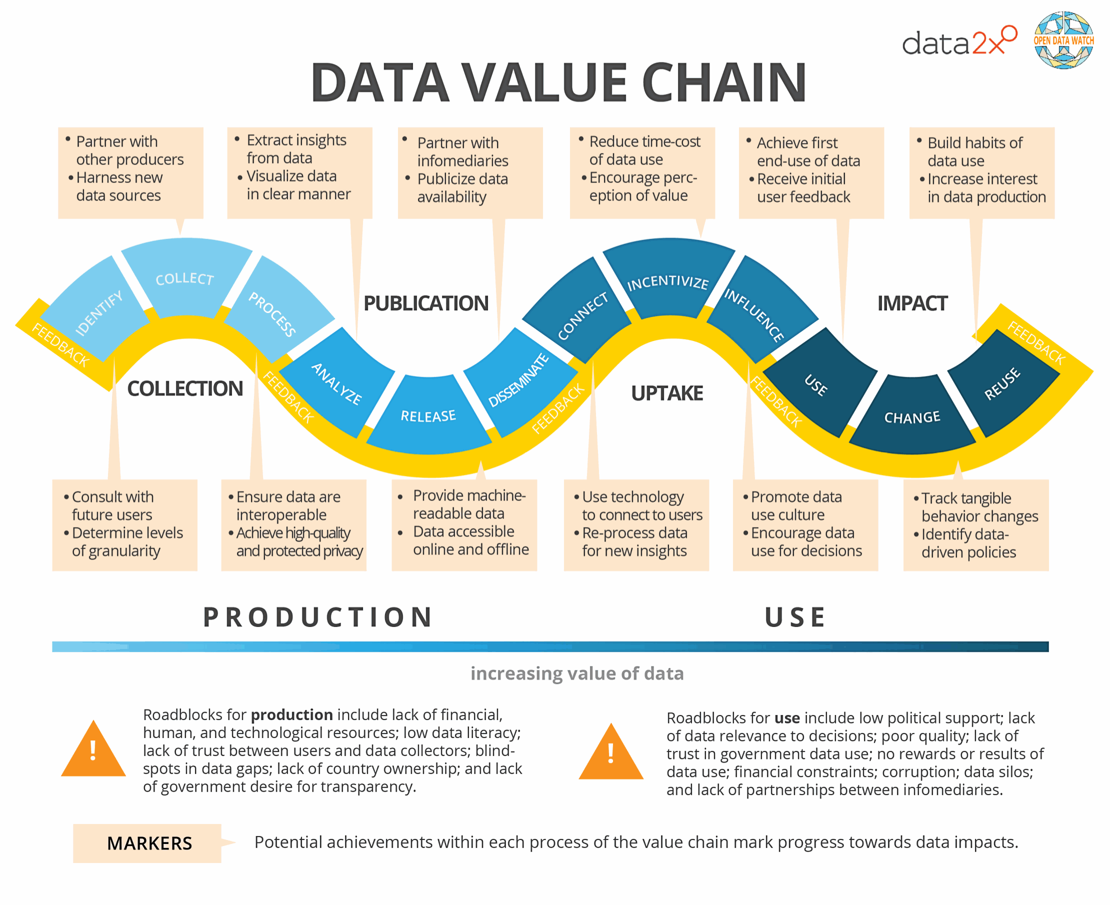
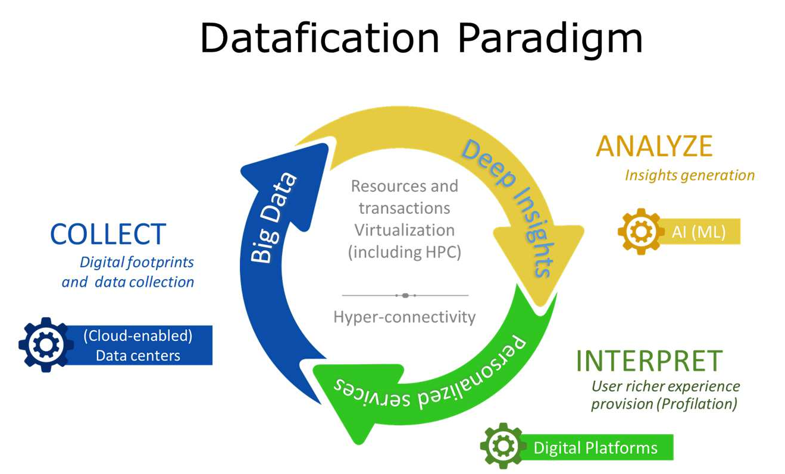
Data value chain vs Datafication paradigm
Source: https://opendatawatch.com/publications/the-data- value-chain-moving-from-production-to-impact/

Slide 17
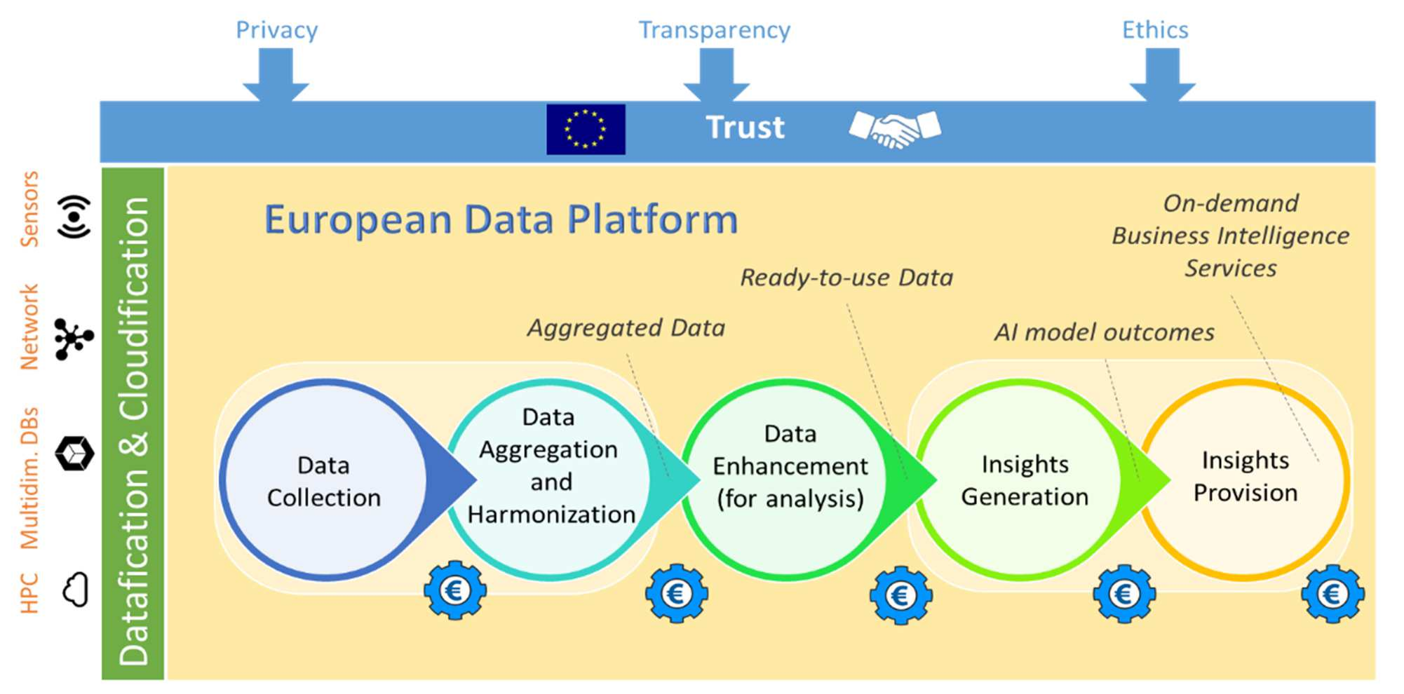
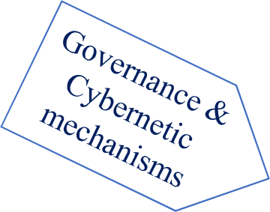






(networked) Supply chain ecosystem
Datafication & Virtualization
DE Platform Ecosystem
Social
Utility Function
Policy

Slide 18

Blockchain
Blockchain — just like data science — is gradually transforming the way several industries operate. And while data science focuses on harnessing data for proper administration, blockchain ensures trust of data by maintaining a decentralized ledger.

Slide 19
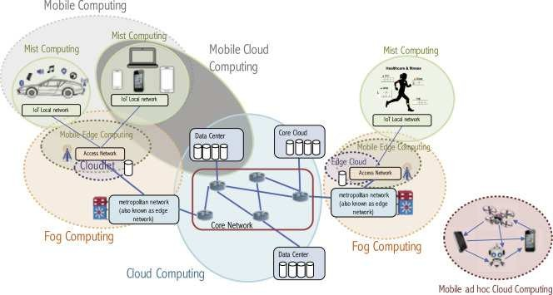
Fog and Edge computing
https://www.sciencedirect.com/science/ article/pii/S1383762118306349

Slide 20
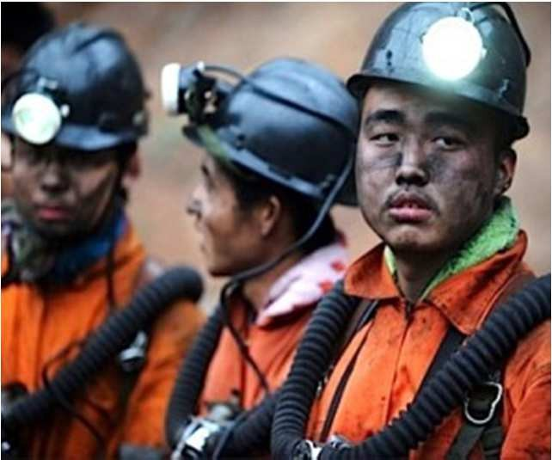
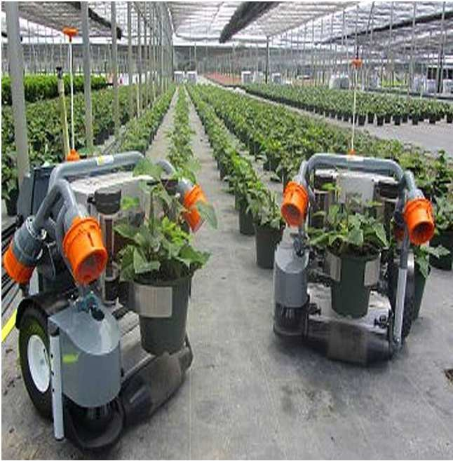
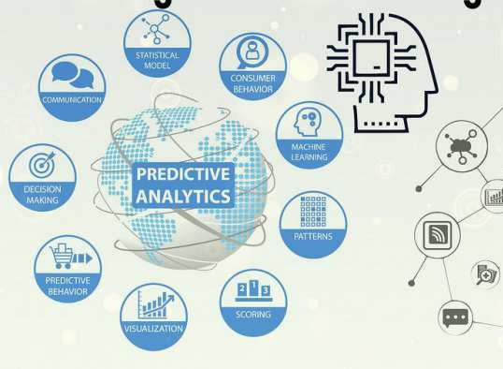
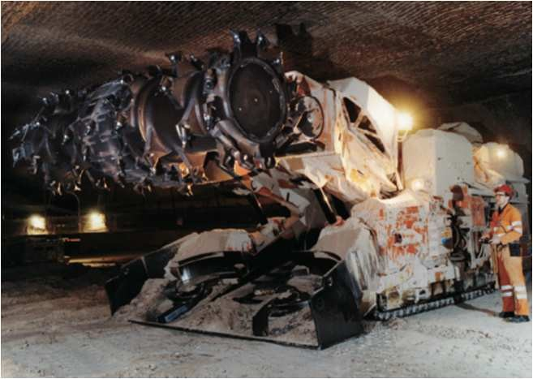
Opportunities: e.g. Artificial Inteligence
AI is automation
Quality of work will improve
Better decision making

Slide 21
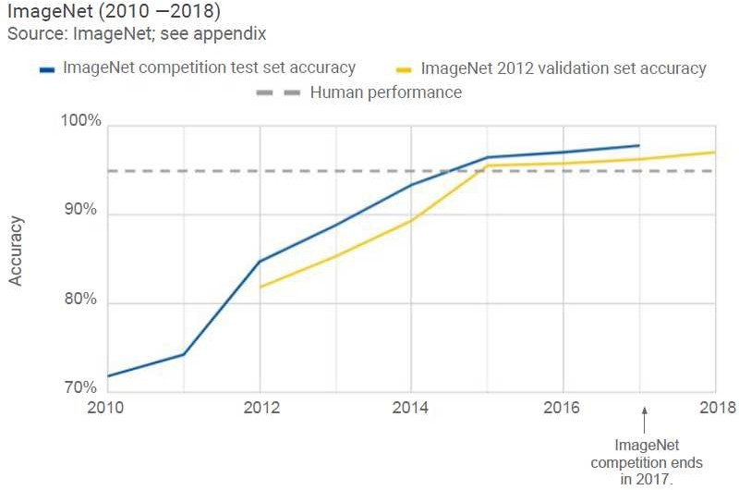

Readiness and Maturity of the technologies

Slide 22
New challenges
Sustainability
Ethics and Security
Digital Governance

Slide 23
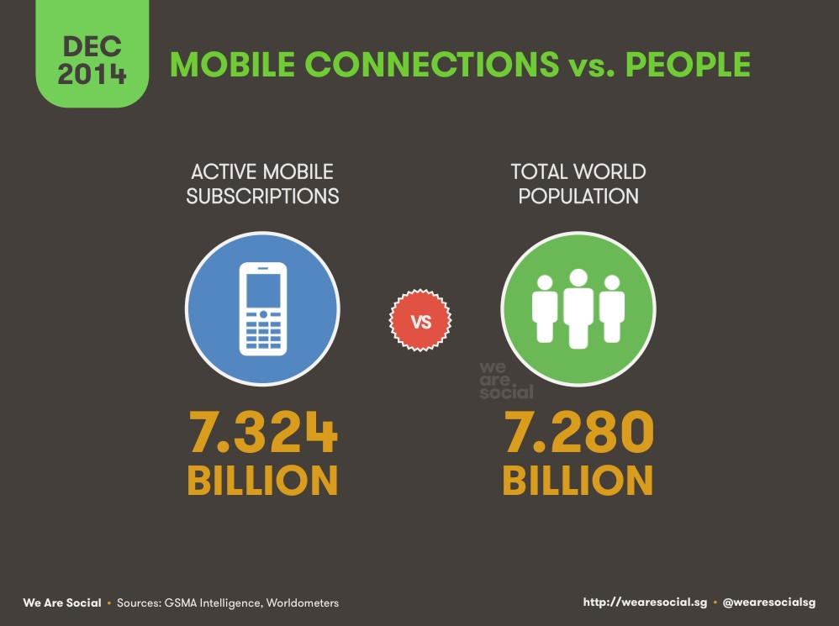
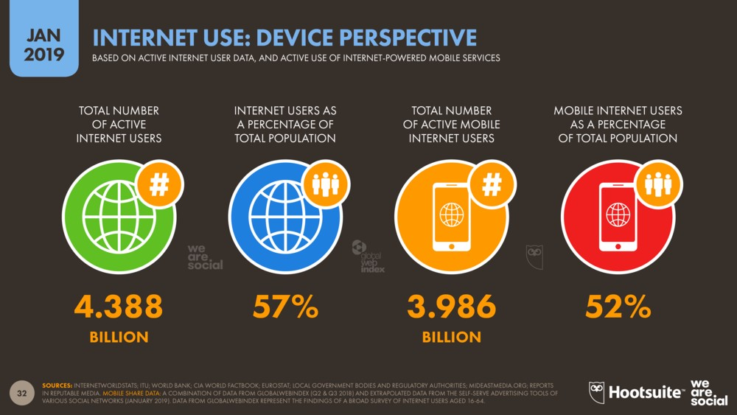
Societal and ethical impact

Slide 24
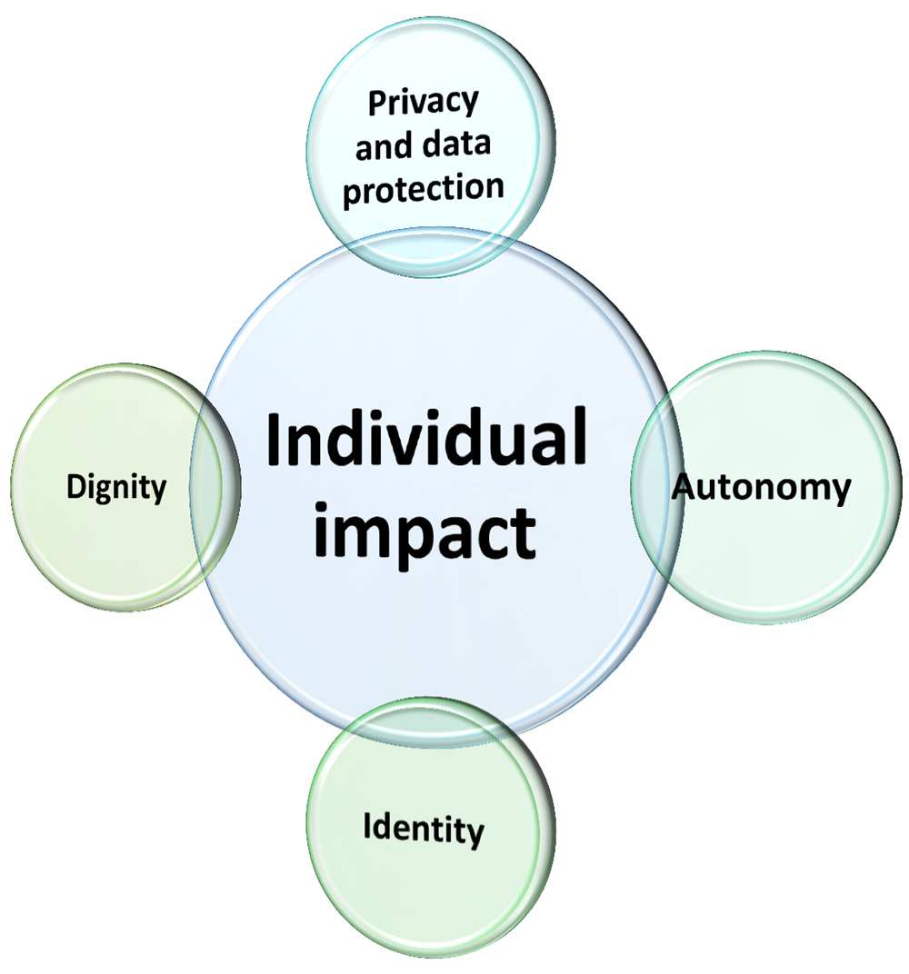
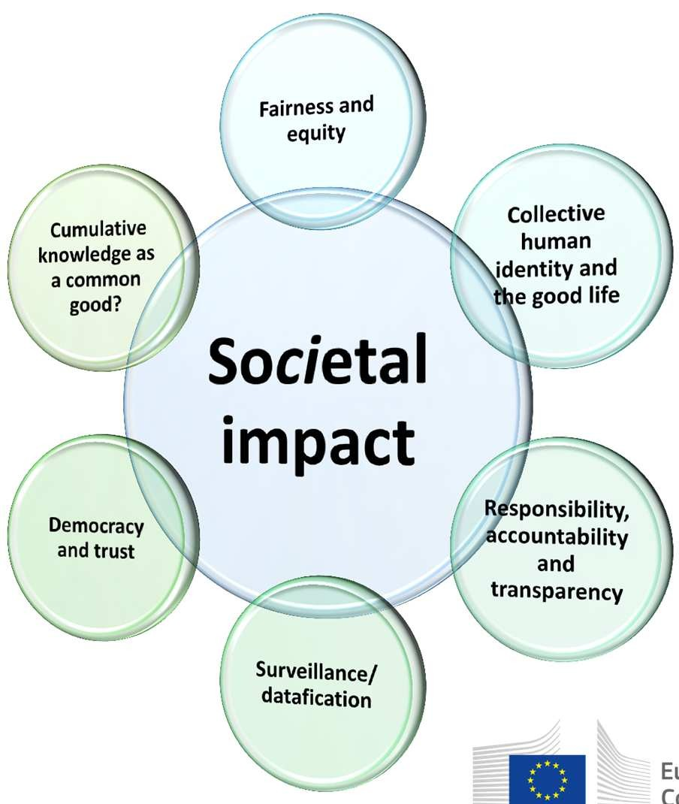
Societal and ethical impact

Slide 25
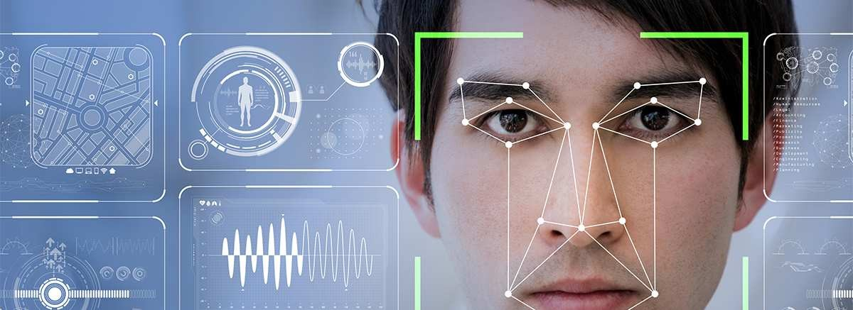
Face Recognition
https://newsroom.cisco.com/feature-content?type=webcontent&articleId=1938827

Slide 26
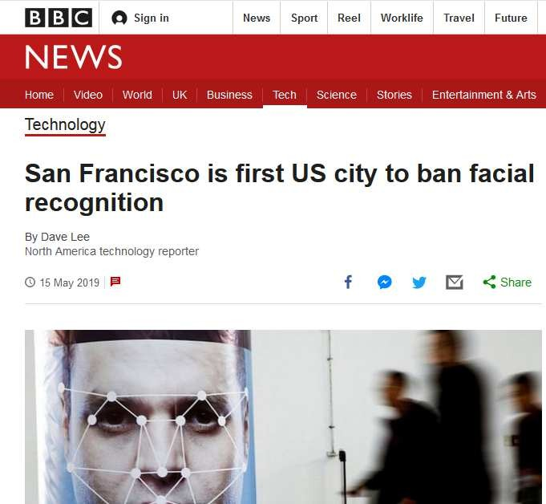
Tecnolgy my raise ethical concern
Legislators in San Francisco have voted to ban the use of facial recognition, the first US city to do so.
The emerging technology will not be allowed to be used by local agencies, such as the city's transport authority, or law enforcement.
With this vote, San Francisco has declared that face surveillance technology is incompatible with a healthy democracy and that residents deserve a voice in decisions about high-tech surveillance,"

Slide 27

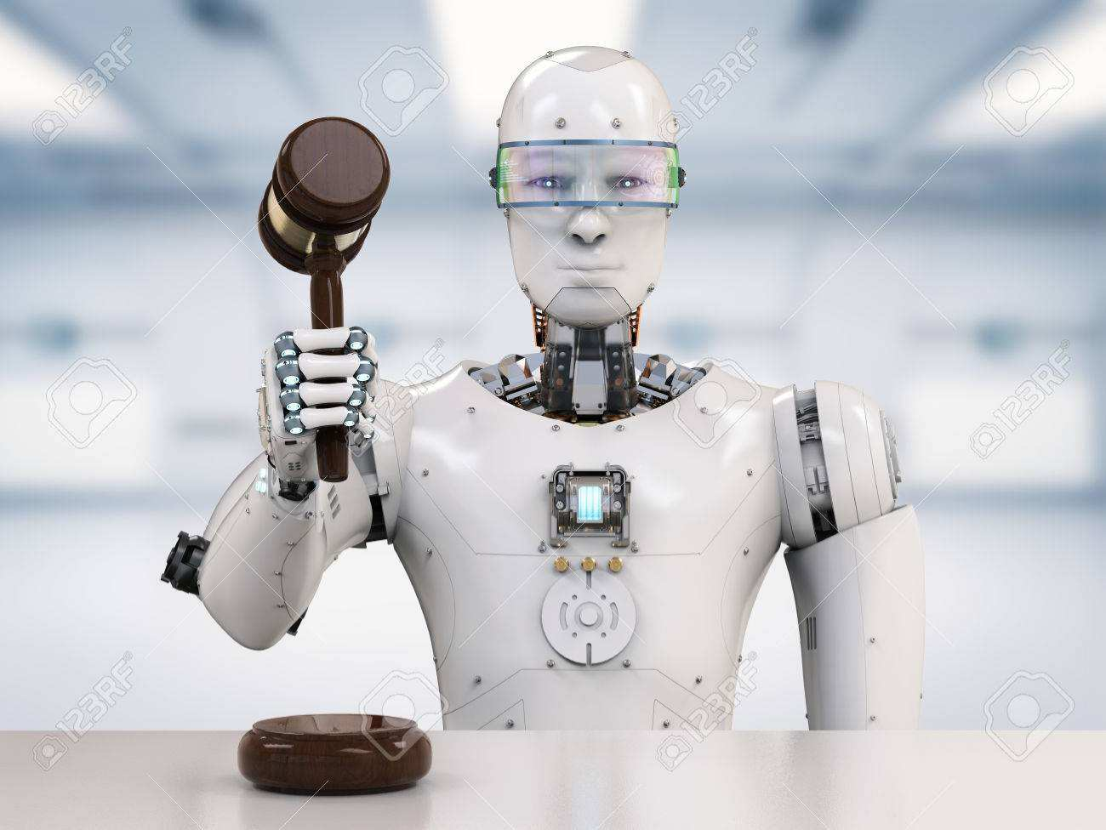
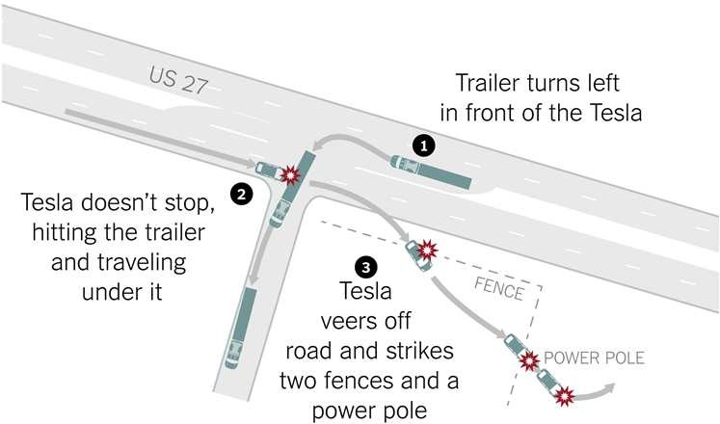
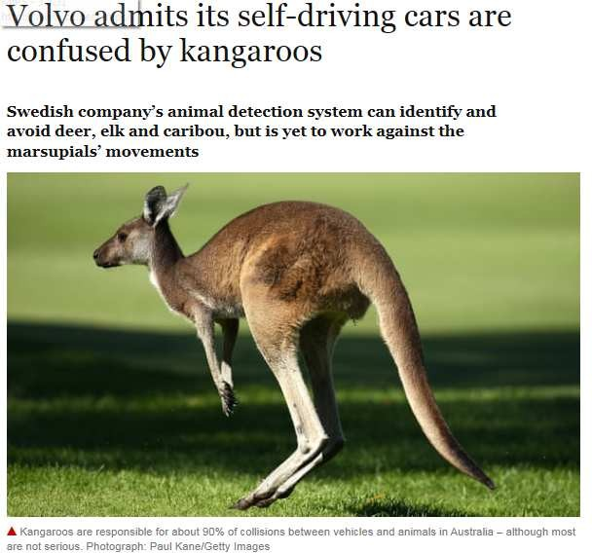
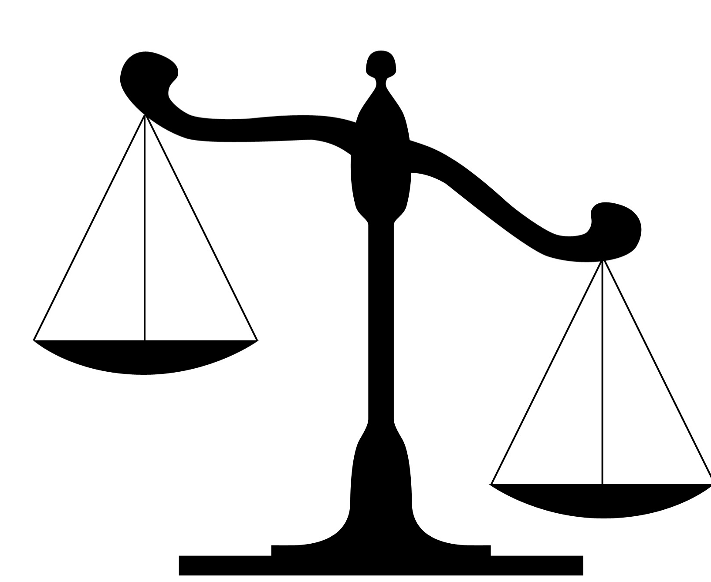
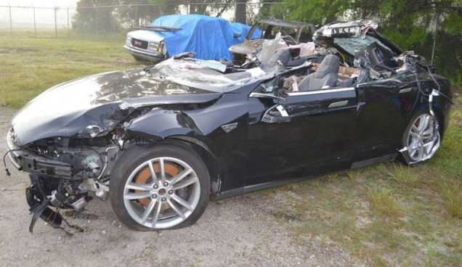
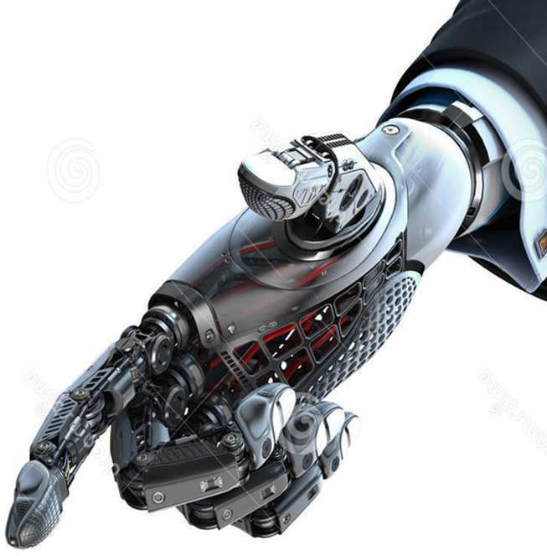
Trust in technologies
Algorithmic Authority
Regulation vs Innovation
and algorithm bias

Slide 28
Technological Determinism: Technological Neutrality
It is one of the commonly held views that the computer, like all pieces of technology is neutral it’s only a tool it might be argued. Or we could rebut this point with the statement that technology is not neutral because it determines the course of society through history. Technological determinism argues that throughout history, technology has been the main cause for changes in society. https://www.scss.tcd.ie/tangney/ComputersAndSociety/99/StdPape rs/P3-Revisited/doc.html

Slide 29


Slide 30
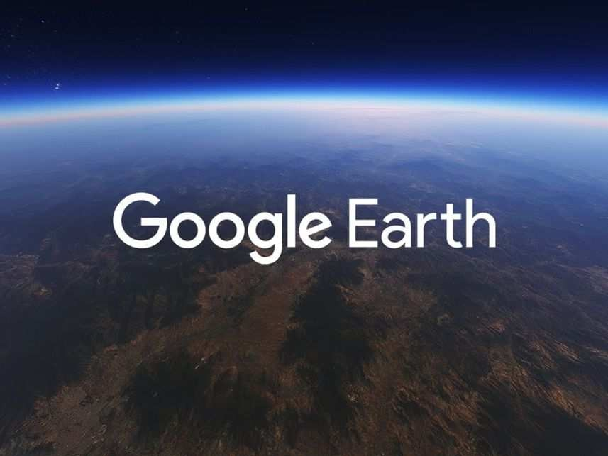
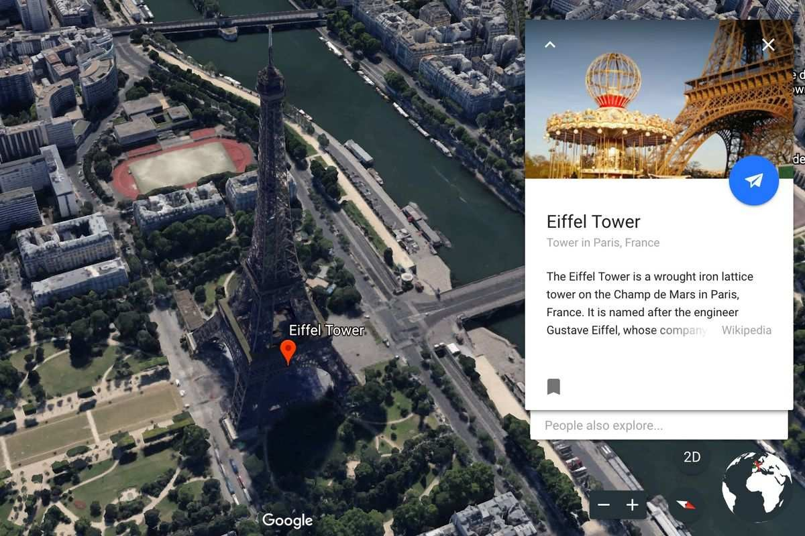
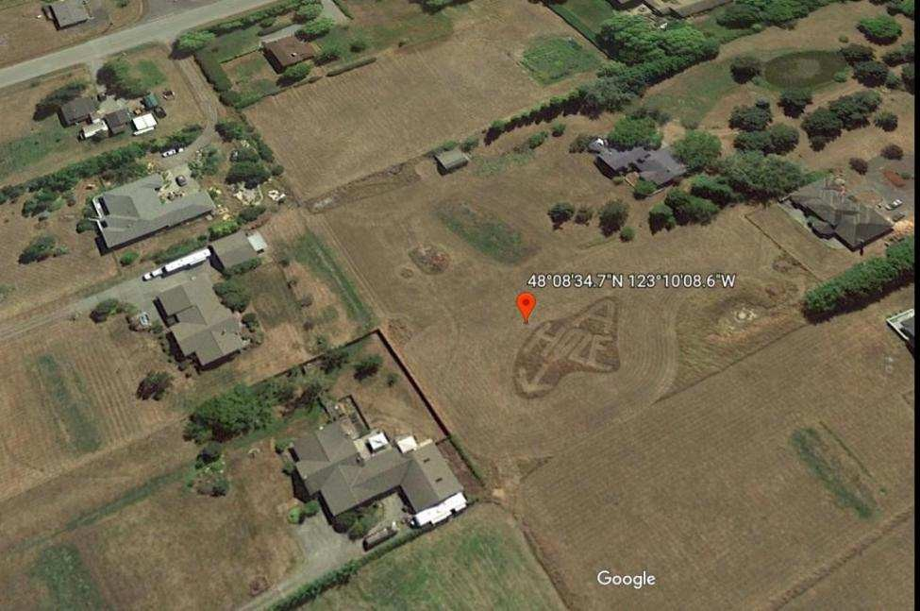
Virtual Reality / Augmented Reality

Slide 31
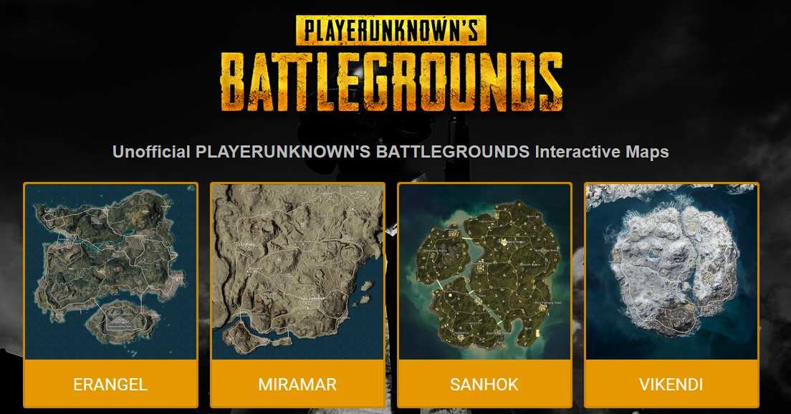
Virtual Reality / Augmented Reality

Slide 32
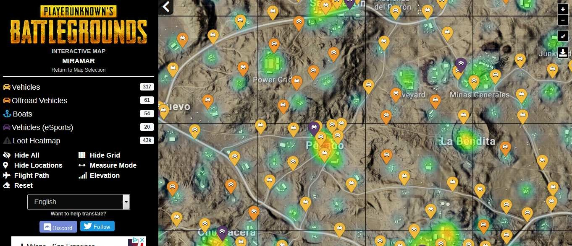

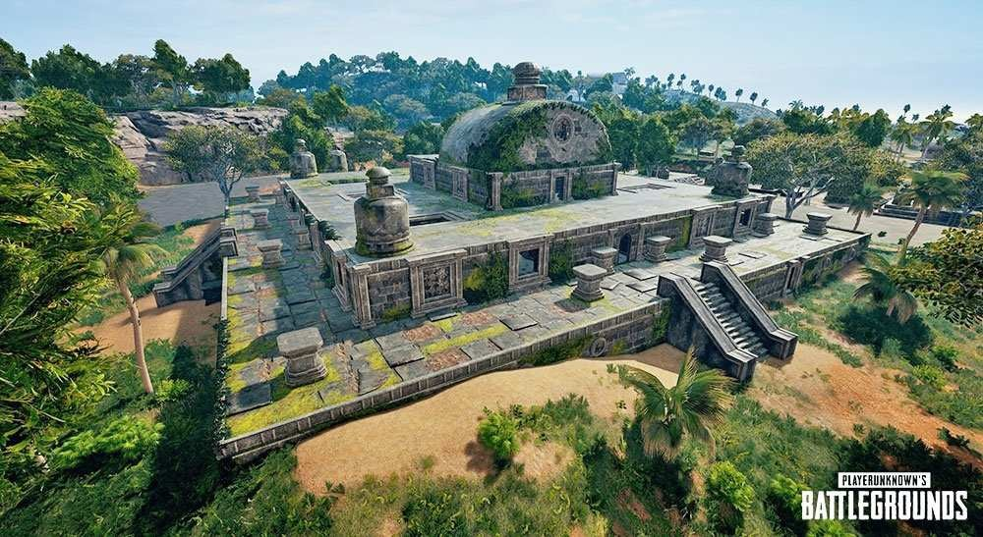
Virtual Reality / Augmented Reality and Collaborative Platform

Slide 33
Big challenges for DE scientists – wrap up
Mastering Technologies and try to use them for good (e.g. to address sustainability issues). Bad examples could be of inspiration (e.g. use of profiles to better target people needs)
Identify and address ethical and security challenges
when they emerge (e.g being ethic and secure by design)
Provide solutions (e.g. platforms) that are Multidisciplinary, Collaborative and Inclusive always considering environmental and socio-economic impacts of human actions
Understand impact of digital transformation and contribute to define the right digital governance

Slide 34
Conclusions
No single definition of Digital Earth. DE is an evolving concept to adapt to social and technological changes
Its main characteristic is to promote the use of digital the technology to study and safeguard our planet and the people that live in
Mastering Technologies, Understanding social changes and Addressing societal challenges should be the raison d'etre of the DE community
Advances in science will be relevant if and only if we can demonstrate their value for big issues of our society

Slide 35






Thanks
EU Science Hub: ec.europa.eu/jrc
Twitter: @EU_ScienceHub
Facebook: EU Science Hub - Joint Research Centre
LinkedIn: Joint Research Centre
YouTube: EU Science Hub

