Slide 1
Development of gastrointestinal system

Slide 2
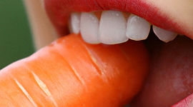
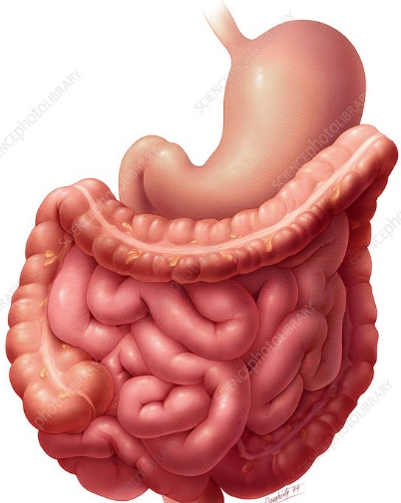
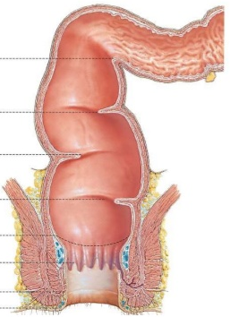
Function of gastrointestinal system
food intake and processing
absorption of nutrients
excretion of waste products

Slide 3
Development of gastrointestinal system in vertebrates
sources of precursor cells of gastrointestinal system
Endoderm:
  pharynx
  esophagus
  stomach
  intestine
Mesoderm:
  vessels
  muscles
Ectoderm:
  oral cavity
  glands
  teeth
  anus
Neural crest:
  teeth
  muscles
  upper and lower jaws
  nerves

Slide 4
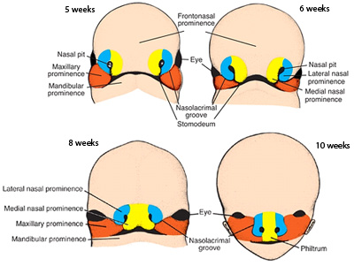
Development of oral cavity
formation of facial prominences – mesenchymal swellings
Cranial neural crest cells migrate to forebrain region, surface facial ectoderm
  Middle part – frontonasal prominence
  lateral – lateral nasal prominences
  medial – medial nasal prominences
Neural crest cells migrate to 1. pharyngeal arch, surface pharyngeal arches ectoderm
  cranially – maxillary part (upper jaw, palate)
  caudally – mandibular part (lower jaw)
Duke Embryology

Slide 5
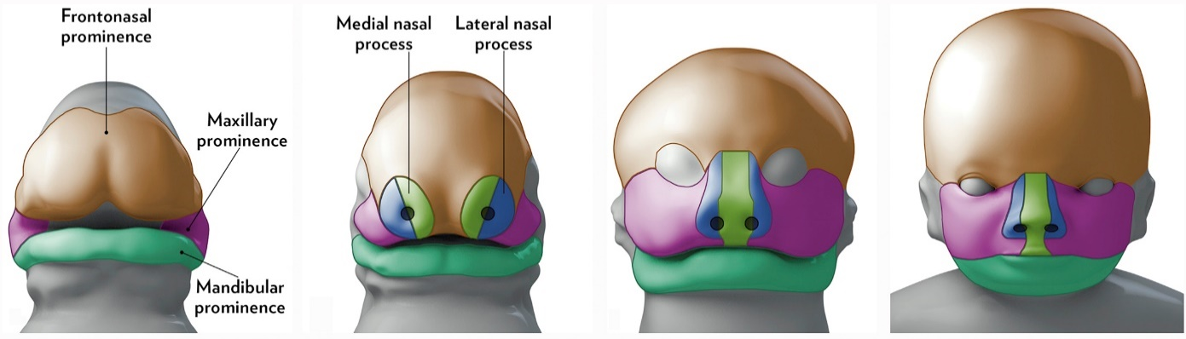

Development of the palate
Palate composes of two parts:
  Primary palate – anterior, frontonasal prominence
  Secondary palate – lateral palatal shelves, maxillary prominence
medial nasal prominences pushed medially by maxillary prominences
  Intermaxillary segment formation – formation of primary palate, philtrum, parts of nose
Maxillary prominences grow medially
  gradual separation of oral and nasal cavivites
  medial fusion in some species
  anterior - hard palate
  posterior – soft palate
  interspecies variability
Worley et al. 2018. Clin Perinat

Slide 6
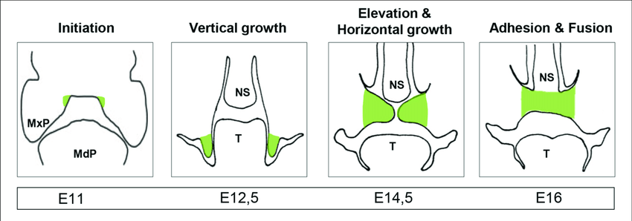
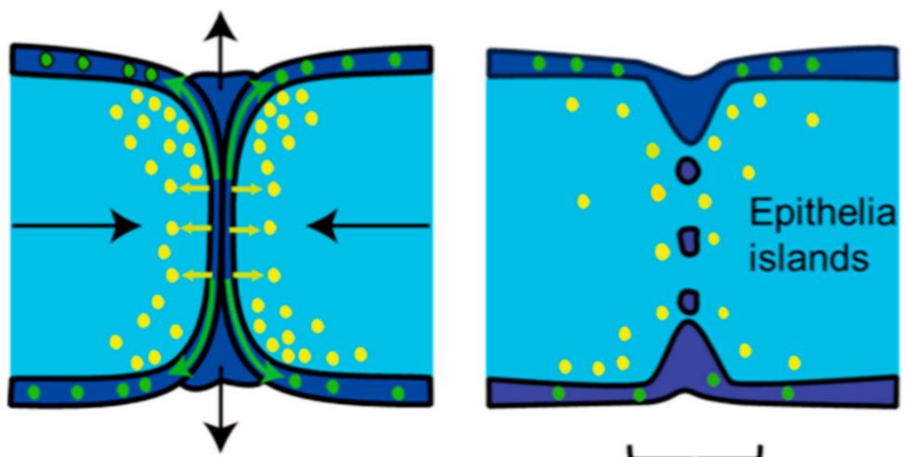
Development of the palatal shelves and secondary palate
palatal shelves medially outgrow from maxillary prominences (mesenchyme from neural crest, stomodeal epithelium from ectoderm)
tongue prevents horizontal growth – vertical growth along the tongue
vertical head elongation, tongue recedes ventrally, palatal shelves reorient into horizontal plane
Schoen et al. 2017. Front Physiol
connection of opposite palatal shelves, formation of epithelial seam
apoptosis
epithelial cells undergo apoptosis and epithelial-mesenchymal transition → fusion and complete palate formation
EMT
Nakajima et al. 2018. Int J Mol Sci

Slide 7
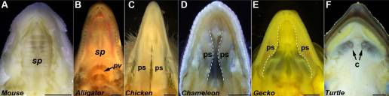
Secondary palate variability
fusion of palatal shelves – complete palate (mouse)
fusion of palatal shelves – complete palate (alligator)
palatal shelves in contact – keratinization, physiological cleft (birds)
palatal shelves not in contact, great variability (chameleon)
rudimentary palatal protrusions (gecko)
palatal shelves not formed
(turtle)
Abramyan and Richman, 2015. Dev Dyn

Slide 8
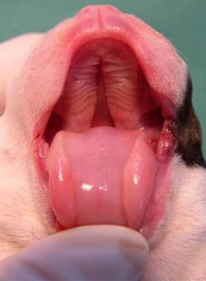
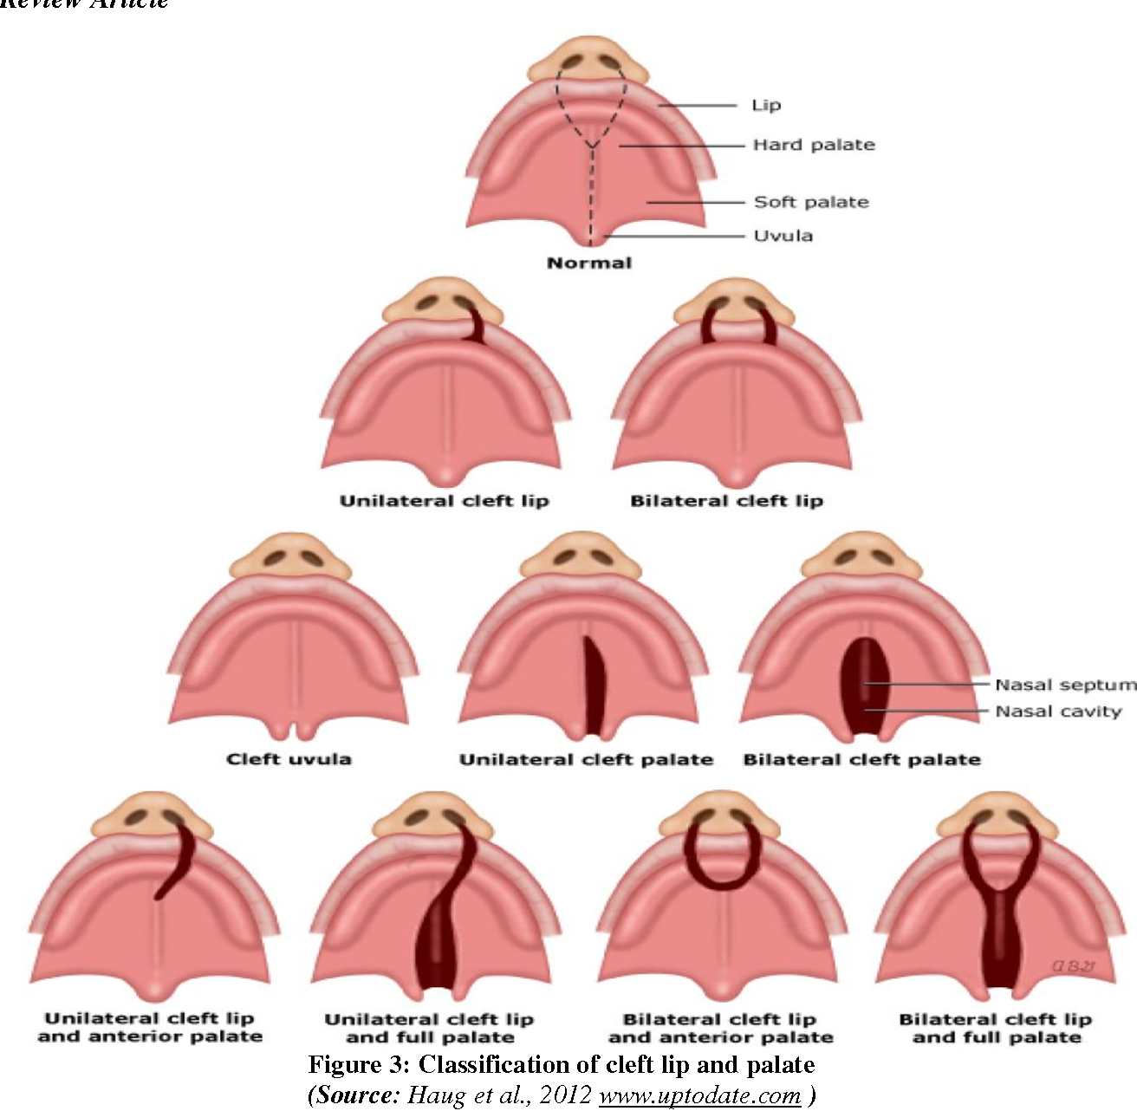
Developmental defects of lip and palate
Cleft lip and/or palate – the most often developmental defects of head and neck (1:500/700)
3 % of all the developmental defects
combined and isolated
unilateral and bilateral
syndromic and non-syndromic clefts

Slide 9
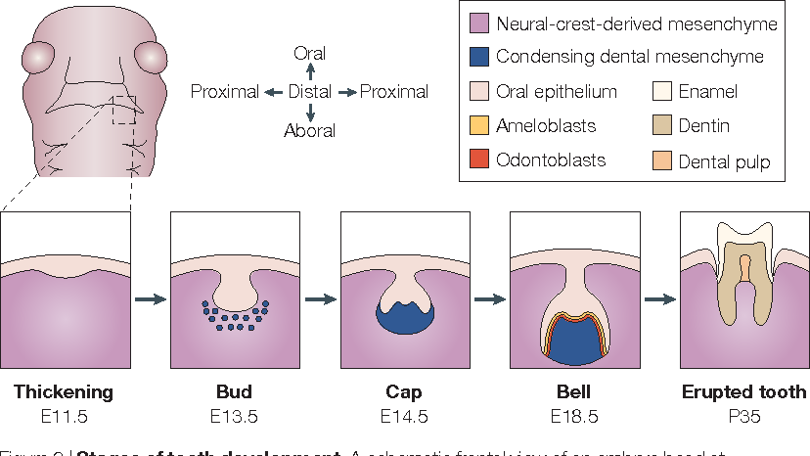
Tooth development
Cooperation between cells of different origin:
  oral cavity ectoderm
  Neural crest mesenchyme
  vessels from mesoderm
oral epithelium (ectoderm)
  ameloblasts
  enamel
mesenchyme (neural crest)
  odontoblasts
  dentin
  cement
  dental pulp
Epithelial thickening
(mouse E11.5)
(human 6.w)
Bud stage
(mouse E13)
(human 8.w)
Cup stage
(mouse E14.5)
(human 11.w)
Bell stage
(mouse E15.5)
(human 14.w)
Erupted tooth
Tucker and Sharpe, 2004. Nat Rev Genet

Slide 10
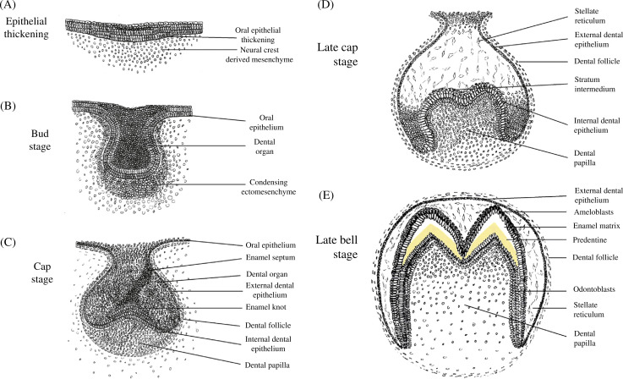
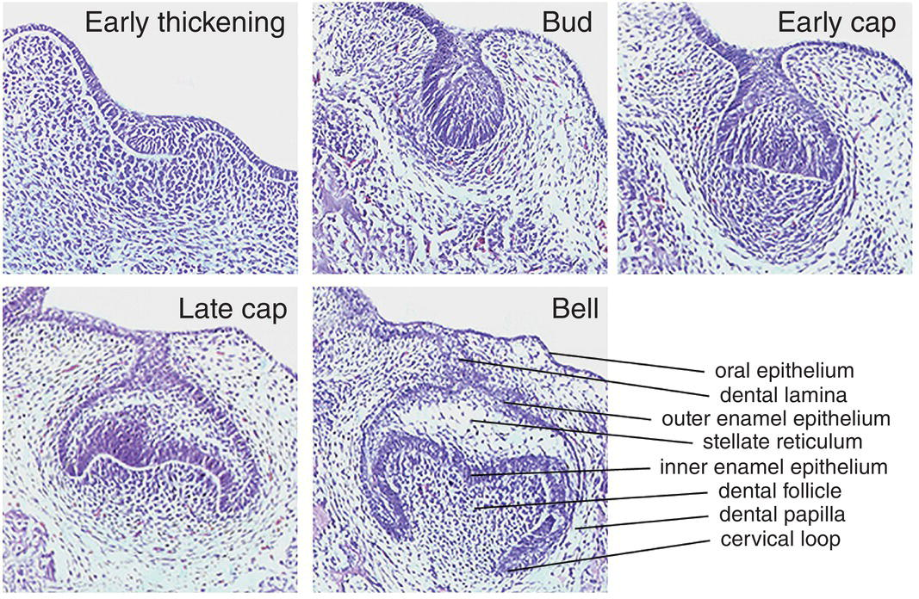
1. Epithelial thickening
oral
in the region of future tooth are proliferating oral epithelial cells – epithelial thickening
epithelial thickening – dental placode
placodal cells proliferate and invaginate into underlying mesenchyme originating in neural crest
aboral
Cobourne and Sharpe. Tooth development. Pocket dentistry

Slide 11
2. Bud stage
epithelium invaginates into mesenchyme, formation of dental organ (epithelium) – epithelial cells are proliferating
oral
mesenchyme starts to condensate around forming epithelial bud – bud stage
aboral
Cobourne and Sharpe. Tooth development. Pocket dentistry

Slide 12
3. Cup stage
epithelial bud growth into mesenchyme, formation of epithelial (enamel) knots
Oral epithelium
Stellate reticulum
External dental epithelium
Dental follicle
oral
Enamel organ
inner and external epithelial cells distinguished, layer of loose reticular cells (stellate reticulum) form layer between them
Inner enamel epithelium
Dental papilla
enamel organ formed from inner enamel epithelium, dental papilla formed from mesenchyme – cup stage
mesenchymal cells form Dental follicle around forming tooth
aboral
Cobourne and Sharpe. Tooth development. Pocket dentistry

Slide 13
4. Bell stage (early Bell)
Tooth cup grows further into jaw mesenchyme, connection with oral epithelium preserved via „string“ of epithelial cells – dental stalk
oral
oral epithelium
diphyodont and polyphyodont species – outgrow of so called dental lamina (next generation teeth source) from dental stalk
dental stalk
External enamel epithelium
Stellate reticulum
Inner enamel epithelium
stellate reticulum cells induce differentiation of inner enamel ep cells – formation of ameloblasts
Dental papilla
mesenchymal cells of dental papilla in contact with differentiating ameloblasts – differentiation into cylindrical cells - odontoblasts
aboral
Cobourne and Sharpe. Tooth development. Pocket dentistry

Slide 14
5. Apposition stage (late Bell)
ameloblasts form enamel
odontoblasts form dentin
External dental epithelium
oral
ameloblasts
forming enamel
ameloblasts produce enamel into space towards odontoblasts, ameoblasts transfered to the tooth surface
forming dentin
dental follicle
odontoblasts
odontoblasts produce dentin into space towards ameloblasts, odontoblasts transfered to the dental cavity
Stellate recitulum
dental papilla
enamel and dentin in direct contact
aboral
dental crown base formed
Cobourne and Sharpe. Tooth development. Pocket dentistry

Slide 15
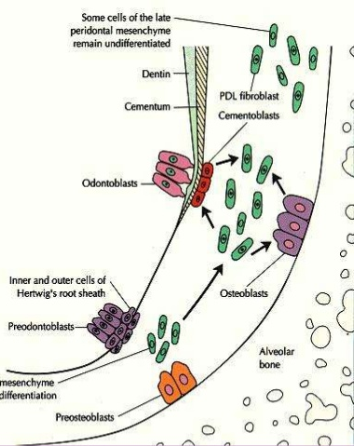
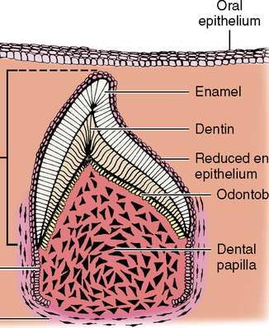
Development of tooth root
enamel organ base – crown and root interface
Oral epithelium
enamel organ base – direct contact of inner and external enamel epithelium, proliferation and migration into mesenchyme → epithelial root sheath (root base)
dentin
enamel
cement
dentin
cementoblasts
crown
sheath induces dental papilla mesenchymal cells to form odontoblasts → connection of crown dentin to root dentin
odontoblasts
odontoblasts
epithelial root sheath
dental papilla
stellate recitulum absence→ epithelial cells do not differentiate into ameloblasts
dental follicle
epithelial sheath
osteoblasts
dental follicle inner cells – cementoblasts (cement – root surface)
Alveolar bone
Periodontal cells
outer cells – osteoblasts (alveolar bone)
middle layer – mesenchymal cells of periodontium, collagen fibers (periodontal ligaments)
1994. Curr Top Periodontol

Slide 16
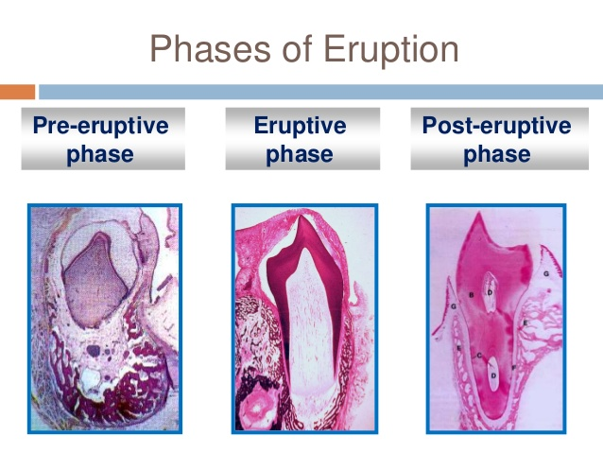
6. Tooth eruption
Pre-eruption phase – preparation for tooth eruption, begins in early bell stage, terminates at the begining of the root formation
Eruption phase – intensive growth of root, tooth supported by formed alveolar bone, oral epithelium rupture, tooth enters oral cavity
Post-eruption phase – further growth of tooth into oral cavity
Bleahid, 2017. Health and Medicine

Slide 17
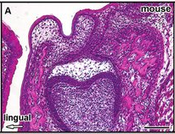
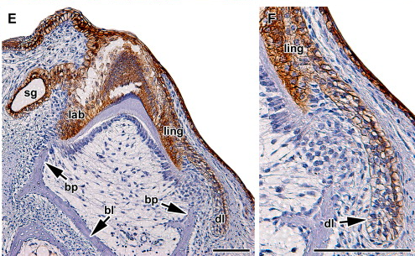
Next generation teeth development
monophyodont species (chameleon, mouse, marsupials, whales, moles) – one generation, dental lamina do not develop
Dental lamina is formed in chameleon – next tooth generation is not formed
chameleon
Buchtova et al. 2012. JDR
Buchtova et al. 2013. Arch Oral Biol

Slide 18
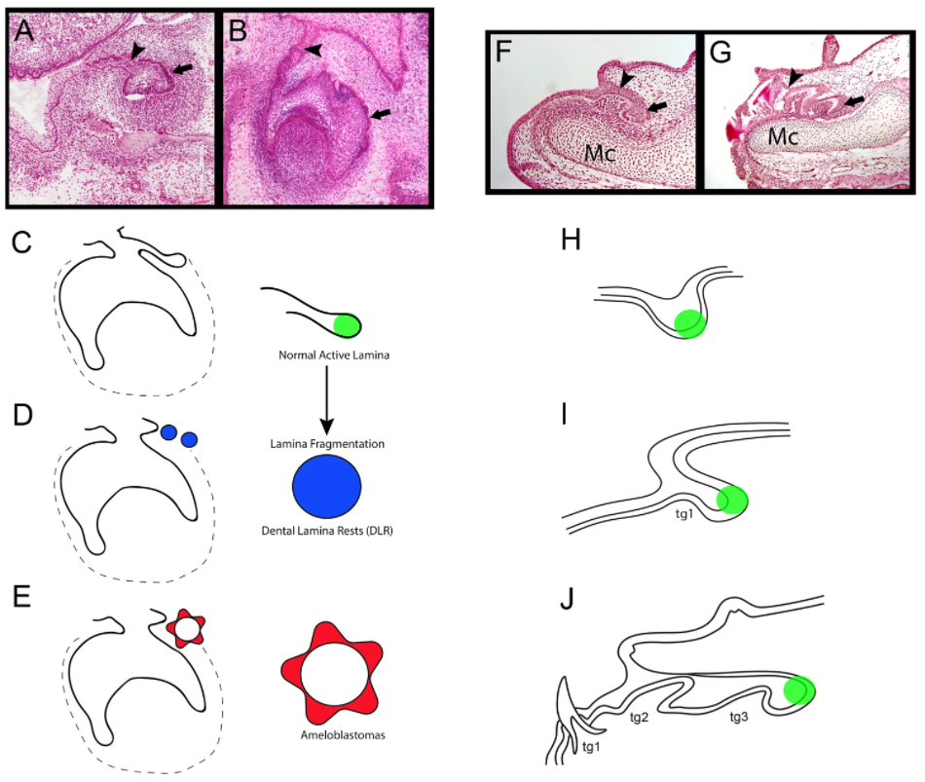
Next generation teeth development
diphyodont species (majority of mammals, human) – second teeth generation, secondary or successional dental lamina
polyphyodont species (sharks, snakes) – more than two teeth generations, lifelong teeth replacement, active dental lamina
Fraser et al. 2019. Sci Rep

Slide 19
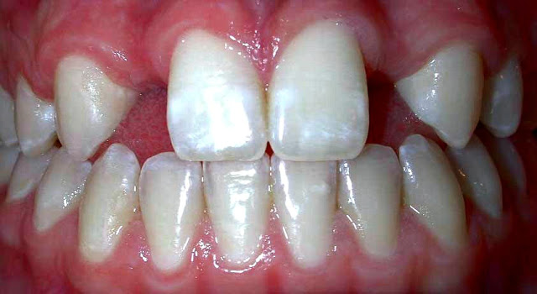
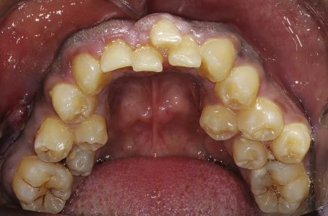
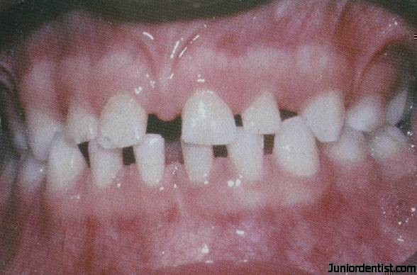
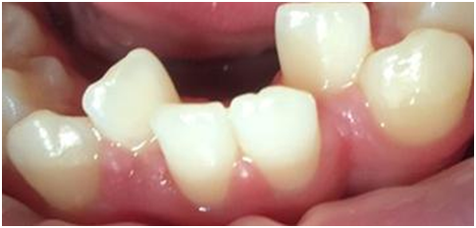
Developmental defects of teeth
Hypodontia – missing one or more teeth
Hyperdontia – excessive teeth
malposition – teeth in atypical positions
microdontia – smaller teeth

Slide 20
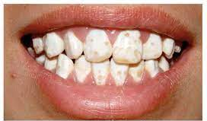
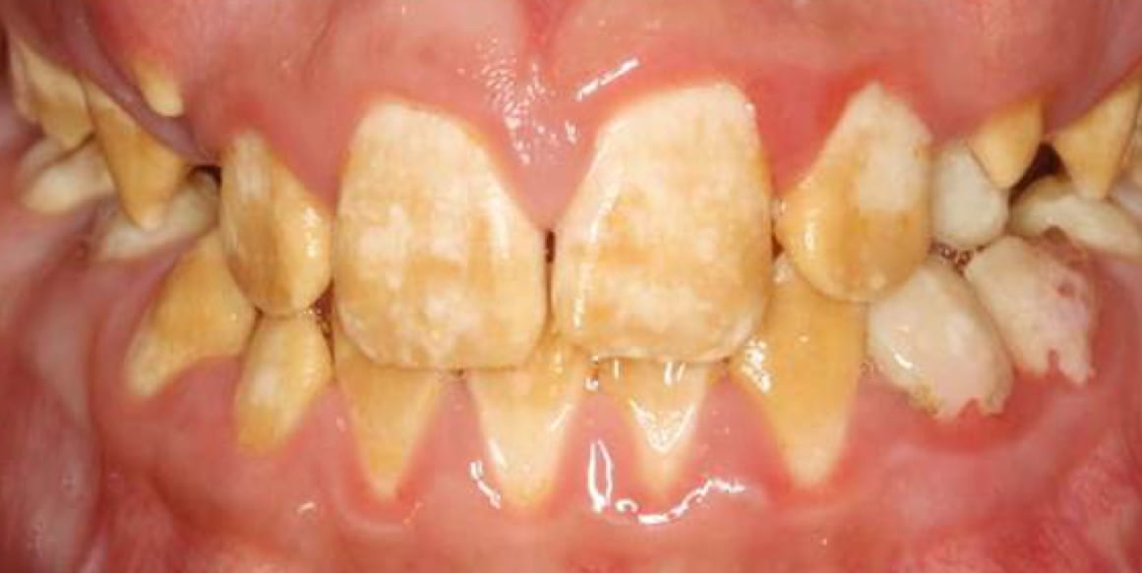
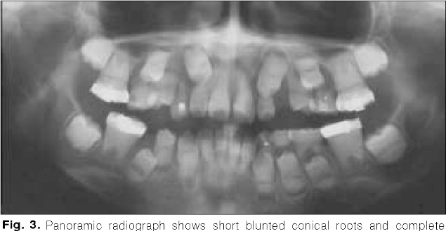
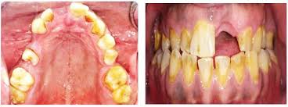
Developmental defects of teeth
Enamel hypoplasia
  insufficient or abnormal enamel development
  Amelogenesis imperfecta – congenital defect, insufficient enamel development
Dentin dysplasia
  Dentin development affected
  1. type – crown dentin not disturbed, missing or rudimentary roots
  2. type – crown dentin development disturbed, altered crown color

Slide 21
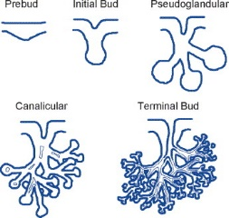
Development of salivary glands
Major salivary glands – ectoderm; minor mucuous glands of the tongue – endoderm; palatal glands – mixed origin
Pseudoglandular phase
proliferation → oral epithelium thickening – formation of epithelial placode (pre-bud stage)
Epithelial placode
Bud stage
ES
invagination of epithelial cells into mesenchyme of 1. pharyngeal arch (neural crest) – formation of bud and epithelial stalk (ES), condensation of mesenchyme
other buds formed from main by branching, onset of cavitation from oral cavity, mesenchymal capsule – pseudoglandular phase
Canalicular phase
Terminal phase
Following branching, cavitation via apoptosis of the inner epithelial cells, luminisation from proximal to distal parts, formation of glandular acini (lobes) – canalicular phase
cavitation ended, differentiation of epithelial cells in ducts (excretory cells) and acini (secretory cells) – terminal phase
Tucker, 2007. Sem Cell Dev Biol
Notes:
Major salivary glands – ectoderm; minor mucuous glands of the tongue – endoderm; palatal glants – mixed ectodermal and endodermal origin

Slide 22
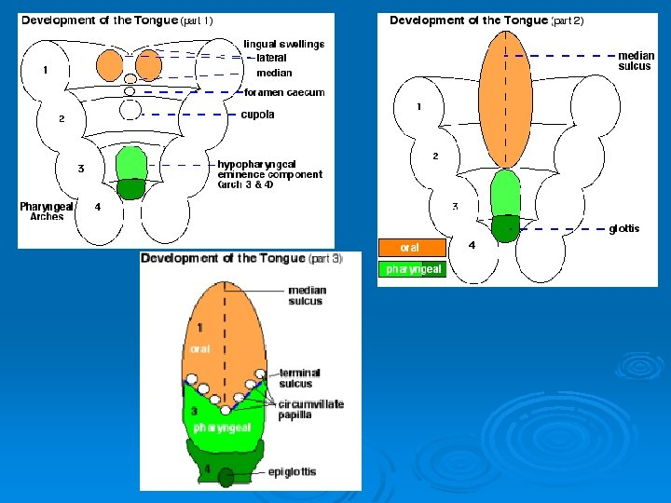
Tongue development
Interaction of cells from two sources:
  connective tissue from neural crest mesenchyme
  muscles from occipital segments (mesoderm)
1. pharyngeal arch – paired lateral and unpaired medial swellings (tubercle), lateral grow and overgrow medial swelling → formation of medial tongue sulcus, covered with epithelium from ectoderm (2/3 anterior part, body of tongue)
2. and 3. pharyngeal arches – formation of ventromedial swelling, called cupola
3. and 4. pharyngeal arch – hypopharyngeal eminence from mesenchyme
Fusion of cupola and hypopharyngeal eminence – root of tongue, covered with epithelium from endoderm
fusion of tongue root and body
Gallatz Katallin

Slide 23
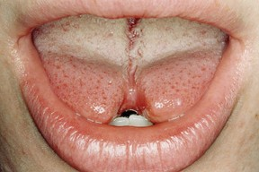
Developmental defects of tongue
Cleft tongue (bifid tongue)
  deffective interaction between medial and lateral swellings
  formation of longitudinal cleft
  surgery
  Mostly syndromic
Fleming and Flood, 2005. British Dental Journal

Slide 24
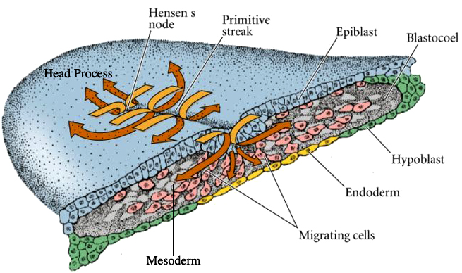
Endoderm formation
Epiblast cells invaginate in primitive streak and Hensen`s node regions
First epiblast cells invaginating through Hensens node – migrate cranially, forming future pharyngeal cells of the primitive gut
hypoblast cells replaced by endoderm cells
Attachment of digestive tube – formation of dorsal and ventral mesentery (hinge) from splanchnic mesoderm
Balinsky, 1975

Slide 25
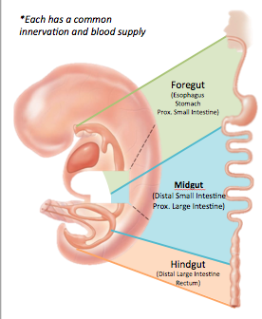
Formation and development of primitive gut
blindly terminated tube of primitive gut connects cranial and caudal parts of the developing individual
Primitive gut divided into three parts:
  foregut – pharynx, esophagus, stomach, cranial part of duodenum
  midgut – from liver bud to transversal colon
  Hindgut – from transversal colon to cloacal membrane
Gut endoderm connected with ectoderm on both sides, formation of two membranes:
  cranial – connection with primitive oral cavity (stomodeum) – oropharyngeal membrane
Hindgut
  caudal – connection with primitive anal opening (proctodeum) – cloacal membrane

Slide 26
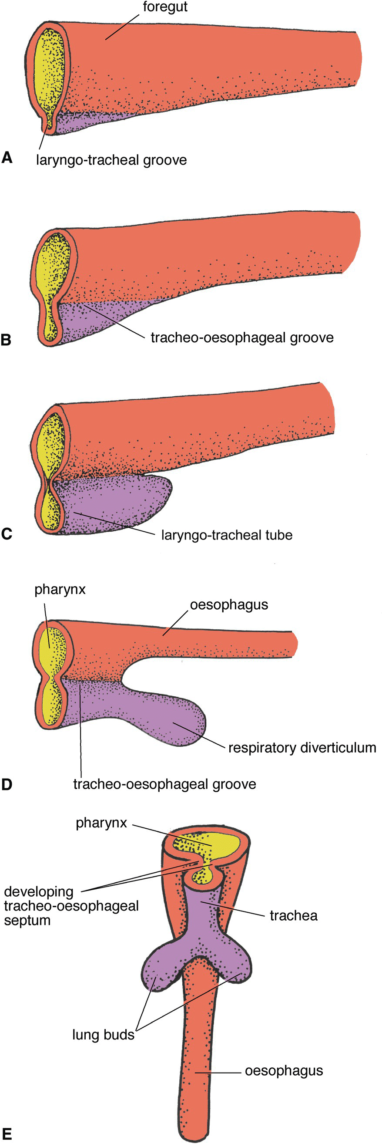
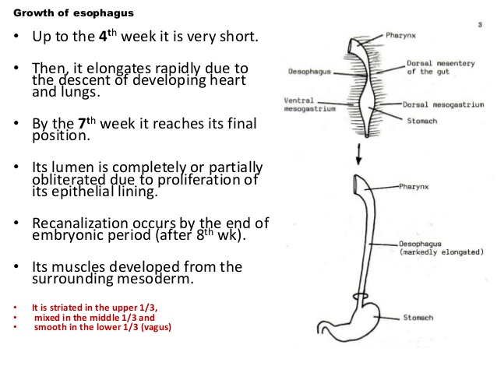
Development of esophagus
Separation of laryngotracheal tube in pharynx region, dorsaly basis of esophagus, ventraly basis of trachea and lung
foregut
Laryngotracheal groove
Tracheoesophageal groove
Embryo grows along cranio-caudal axis – separation of head and neck from thoracic cavity – prolongation of esophagus
Laryngotracheal tube
Veterian Key
Primitive esophagus – multilayered cylindrical epithelium, prolongation, number of layers lovered → proliferation leads to narrowing of esophagus (no temporary encloser) in region of tracheal biffurcation → recanalization
pharynx
pharynx
Esophagus basis
Dorsal
mesentery
Esophagus prolongation
Epithelial cells start to form cilia → gradual replacement with multilayered squamous epithelium, ciliary epithelium preserved only in cranial region of esophagus
Ventral
mesogastrium
Dorsal mesogastrium
stomach
stomach
finally – cylindrical epithelium only in initial and final regions of esophagus
Sahar Hafeez

Slide 27
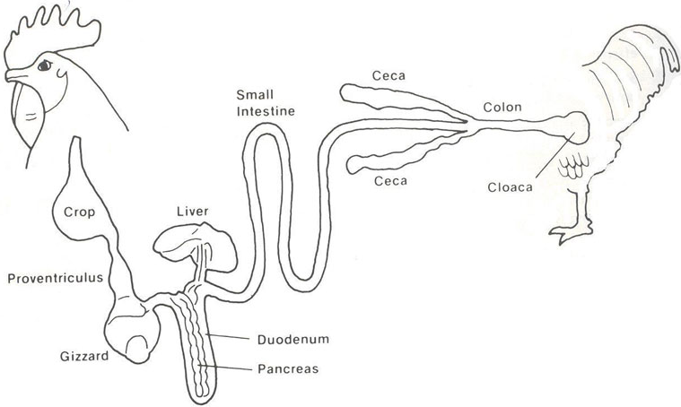
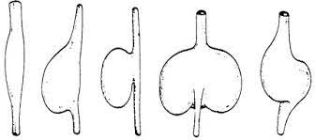
Development of crop in birds
Formation of bag-like extension from ventral side of esophagus in neck region
Extended part of esophagus for food storage
morfology based on species according to type of food

Slide 28
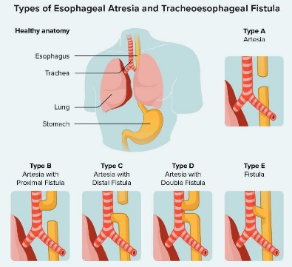
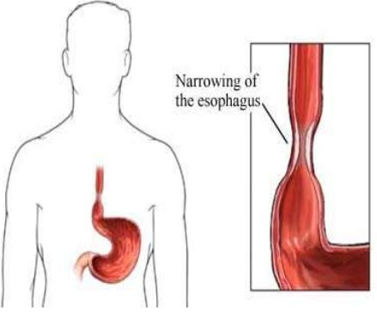
Developmental defects of esophagus
Tracheoesophageal fistula
  Improper division of basis of trachea and esophagus
  Persistent communication between them
Esophageal atresia
  Blindly ended termination of esophagus
  Often connected with tracheoesophageal fistula
Congenital esophageal stenosis
  Narrowing of esophagus
  Insufficient recanalization of esophagus
  Problems in movement of food to stomach
https://www.healthline.com/health/tracheoesophageal-fistula#types

Slide 29
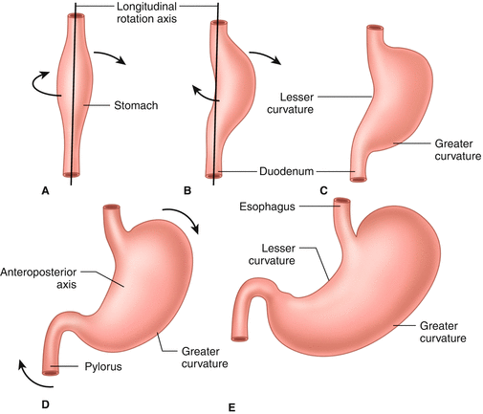
Development of stomach
Develops from front region of primitive gut
Expansion of primitive gut endoderm, formation of larger cavity
Rotation around longitudinal axis:
  left side displaced ventraly
  right side displaced dorsaly
Lesser curvature
duodenum
left cranial side grow faster than the right side → basis for greater curvature on left side, lesser curvature on right side
Further growth results in displacement of former cranial part to the left and caudal to the right
Craniocaudal axis
proliferation of smooth muscle cells precursors (mesoderm) on the interface of stomach and small gut – pyloric sphincter
Thomson, 2017. Embryology of the Stomach

Slide 30
Formation of gastric glands
Formation of depressions in epithelium (invagination) – basis of gastric depressions, 3 layered epithelium
3 layered epithelium
invagination
depression
Epithelium further invaginates (grow) into underlying mesenchyme, formation of cavities in depressions, concurrent growth of mesenchyme to epithelium
cavitation
1 layered epithelium
Rearrangement of cells, from 3 to 1 layered epithelium
depression
growing of mesenchyme to epithelium
Invagination and proliferation of epithelial cells at the bottom of depressions → basis of glands
gland

Slide 31
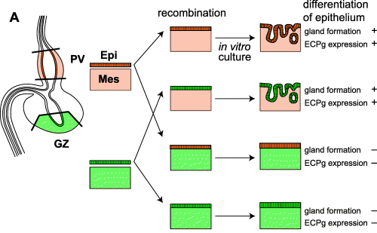
Development of two types of stomach in birds
Two types of stomach:
  cranialy – proventricle (glandular)
  caudaly – muscular stomach
Glandular stomach – invagination of epithelial cells into underlying mesenchyme, onset of glands developemnt, epithelium divided into glandular and covering, production of digestive enzymes
Muscular stomach – formation of thick smooth muscle layer from underlying mesenchyme, epithelial cells differentiate and keratinize
Determining role of mesenchyme – stomach epithelium specifically differentiate based on factors produced in underlying mesenchyme
Takiguchi-Hayashi and Yasugi, 1986 – 1996, experiments

Slide 32
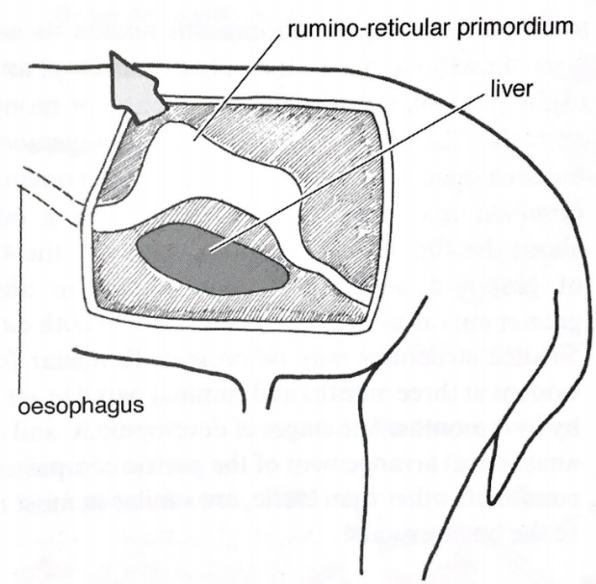
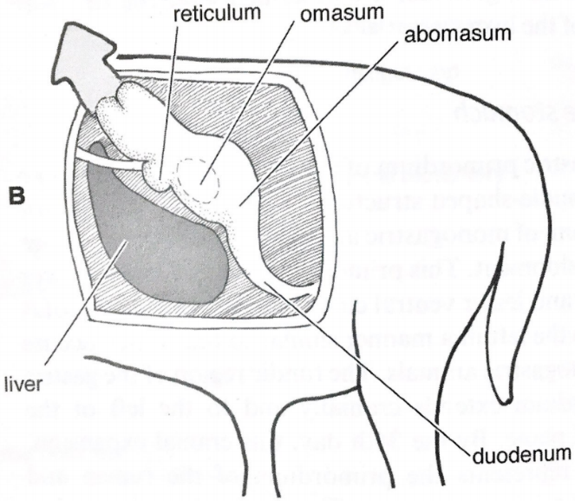
Development of stomachs in ruminants
Three parts of prestomach, one main stomach:
  rumen, reticulum, omasum
  abomasum (stomach glands)
rumino-reticular basis
Reticulum basis
Omasum basis
Abomasum basis
liver
Formation of spindle-shaped dilatation of the caudal region of foregut, dorsaly greater curvature, ventraly lesser curvature
Rumen basis
esophagus
liver
greater curvature – basis for rumen and reticulum
lesser curvature – basis for omasum
Omasum basis
Small intestine
Edited: McGeady et al. Veterinary Embryology. 2009
Rotation around longitudinal axis:
  Dorsal side displaced to the left
  ventral side displaced to the right
left and cranialy – formation of rumen and reticulum basis
right formation of omasum basis
right and caudaly basis of abomasum

Slide 33
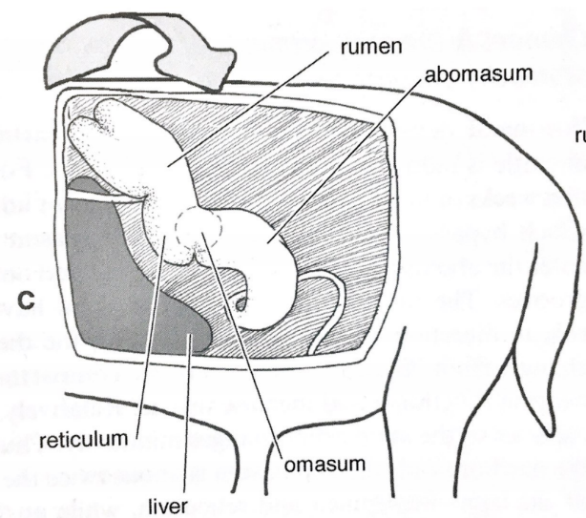
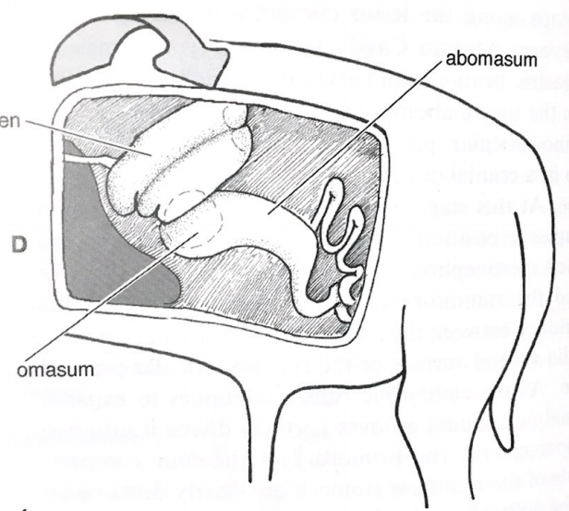
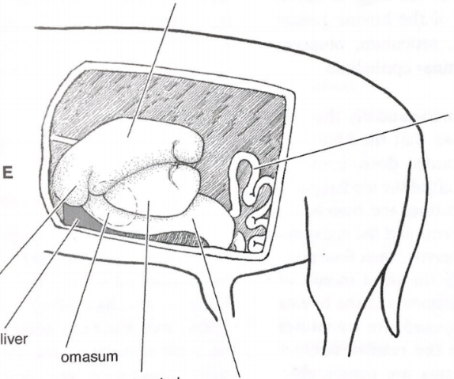
Development of stomachs in ruminants
Growth of rumen and reticulum in cranial direction and to the left, stomach lining formed of cylindrical epithelium
rumen
abomasum
abomasum
rumen
groove divides rumen into two parts and undergo dorsocaudal rotation
  former dorsocranial direction, now caudal and left direction
omasum
rotation of rumen causes displacement of other parts of stomach and gut to the right
reticulum
omasum
liver
Dorsal rumen
accelerated growth of abomasum, other parts grow slowly → doubling the volume compared to other parts
gut
lining:
  rumen, reticulum, omasum – replaced with multilayered squamous epithelium
  abomasum – cylindrical epithelium preserved, formation of glands
reticulum
liver
omasum
Edited: McGeady et al. Veterinary Embryology. 2009
Ventral rumen
abomasum

Slide 34
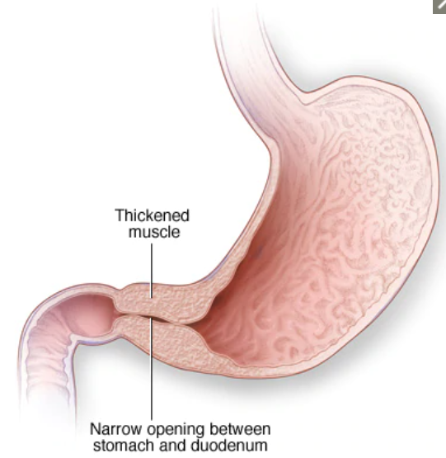
Developmental defects of stomach
Hypertrophic pyloric stenosis
  Partial pyloric blocking of stomach
  Hypertrophy of the pyloric sphincter muscle
  Blockade of digested food transition from stomach to duodenum
Mayo Clinic

Slide 35
Formation and development of primitive gut
blindly terminated tube of primitive gut connects cranial and caudal parts of the developing individual
Primitive gut divided into three parts:
  foregut – pharynx, esophagus, stomach, cranial part of duodenum
  midgut – from liver bud to transversal colon
  Hindgut – from transversal colon to cloacal membrane
Gut endoderm connected with ectoderm on both sides, formation of two membranes:
  cranial – connection with primitive oral cavity (stomodeum) – oropharyngeal membrane
Hindgut
  caudal – connection with primitive anal opening (proctodeum) – cloacal membrane

Slide 36
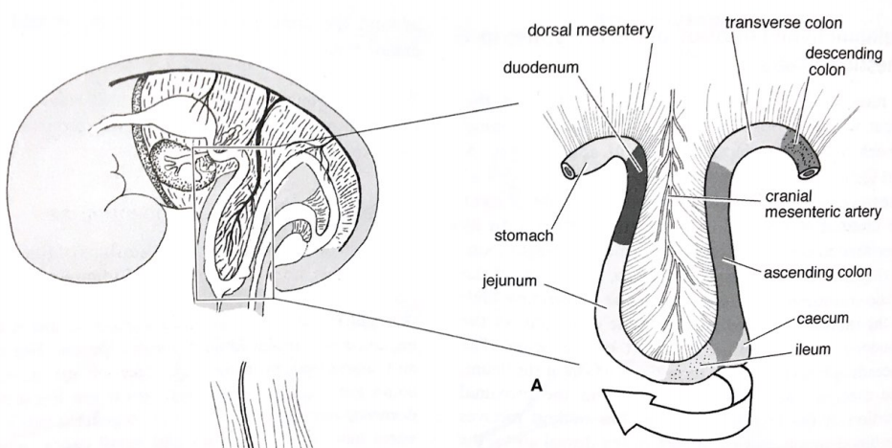
Intestine development
Develops from caudal foregut, midgut and hindgut
Prolongation of midgut – midgut loop formation ventraly (remnants of viteline-intestinal duct in the loop)
descending loop– distal duodenum, jejunum and ileum
ascending loop – distal ileum, caecum, ascending colon, part of transverse colon
ventral
Viteline-intestinal duct
Prolongation of loop – temporary leave of abdominal cavity, located in extraembryonic cavity – physiological umbilical hernia
Edited: McGeady et al. Veterinary Embryology. 2009
Onset of dorso-ventral rotation

Slide 37
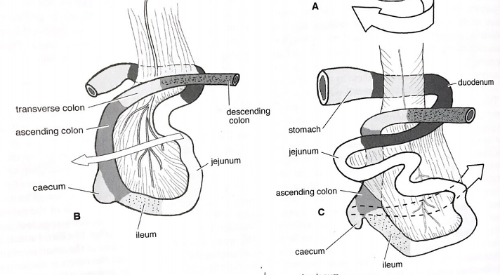
Intestine development
Dorso-ventral rotation –180^{O} transfer of structures
descending loop structures→ caudal
ascending loop structures→ cranial
Prolongation of descending part – formation of coiled loops –small intestine basis
ascending part, basis of colon and caecum, slower growth
cranial
caudal
Further growth– not enough space in extraembryonic cavity – return of descending and ascending parts to abdominal cavity
Edited: McGeady et al. Veterinary Embryology. 2009

Slide 38
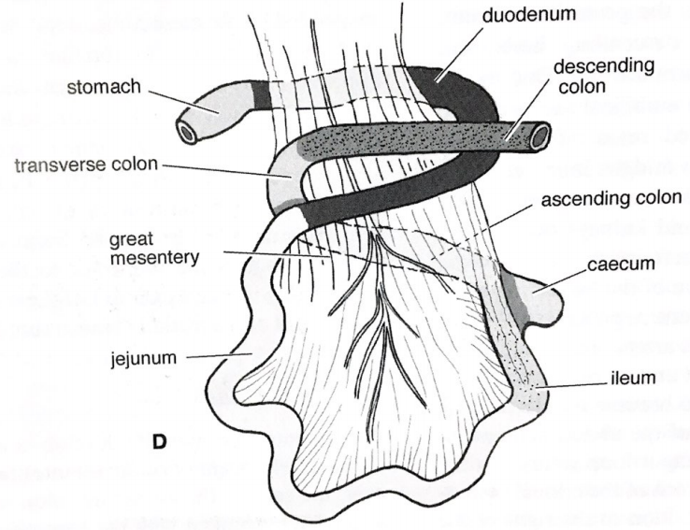
Development of intestine
return of intestine to cavity causes further rotations
Further prolongation of coiled loops in forming small intestine and colon
Structures movement:
  originally descending moved left
  originally ascending moved right
  basis of descending colon left
Edited: McGeady et al. Veterinary Embryology. 2009
Video: https://www.news-medical.net/health/Malrotation-of-the-Gastrointestinal-Tract.aspx

Slide 39
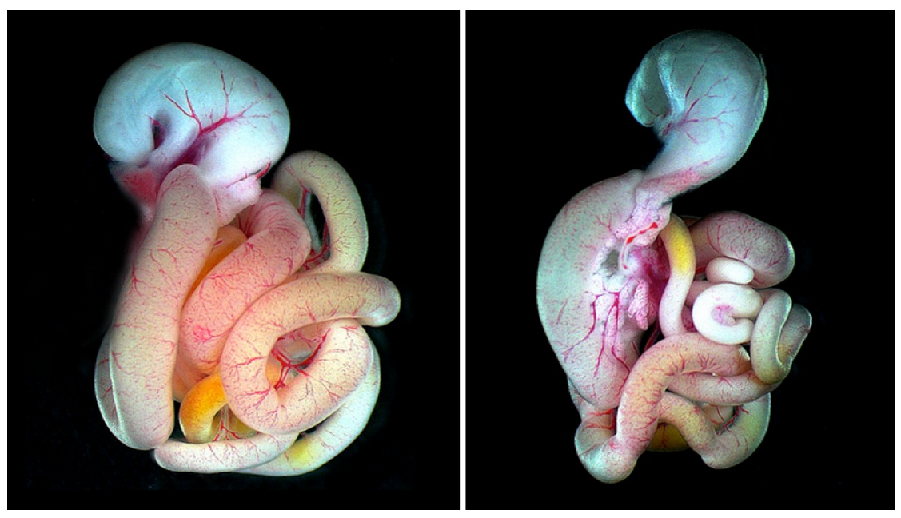
Intestine twisting
Bowl of spaghetti look?
What molecule is responsible for this twisting?
connective tissue molecule hyaluronan
decorated with amino acids chains – only on right side of the gut
accumulation of modified hyaluronan on right side
  right side expansion
  tilting the intestine leftward
  triggering rotation
WT embryo
Embyro mut
Kurpios et al. 2018. Nature

Slide 40

Intestine development
endoderm – intestine lining
mesoderm – vessels, muscular layer, connective layer
endodermal cells differentiate → growth, thickening and diffentiation of mesoderm to smooth muscle cells
Formation of specific intestinal mucosa – crypts and villi
Teach me Physiology

Slide 41


Small intestine development
intensive proliferation leads to partial or complete blocking of intestinal lumen– recanalization via vacuoli formation and their fusion
Cylindrical single layer
First villi formed in duodenum – proliferation and infiltration of mesenchymal cells into multilayered epithelium, villi start to form in duodenum and follow to ileum
Multilayered epithelium
Intervillar zone
Epithelium transformed from multilayered into single layered
formation of intervillar zone –intensively proliferating cells
Epithelium of villus – differentiation to enterocytes, Goblet cells, enteroendocrine cells
Zhang et al. 2019. MDPI Animals
Notes:
Enterocyt – nejhojnější buněčný typ tenkého střeva, absorpční funkce
Pohárková buňka – žlázová buňka tvořicí mucin
Enteroendokrynní buňka – chemosenzorické buňky, v závislosti na senzorické funkci detekují stav ve střevě a regulují tvorbu trávicích enzymů

Slide 42


Crypt formation
Intervillar zone – onset of invagination, so called apical constriction
mesenchyme
mesenchyme
cells proliferate and invaginate into underlying mesenchyme
invagination
Sumigray et al. 2018. Dev Biol
Formation of crypts – progenitor cells supply
Three cell types:
  Stem cells – source of immature progenitors
  Transit-amplifying cells
  Paneth cells
Zhang et al. 2019. MDPI Animals
Notes:
Panethovy buňky – tvorba a sekrece antimikrobiálních peptidů, tvorba imunomodulačních proteinů
Přechodně se dělicí buňky -

Slide 43

Development of colon
Develops from mid and hindgut
villi and crypts form at the same time (compared to small intestine) from endoderm, migration of mesenchymal cells to forming villi
Thickening of apical parts of villi during development
flattening and transformation of villi in width – villi specific for small intestine disappear
  Enterocytes
  Enteroendocrine cell
  Goblet cells
villus
Spaces between villi spaces develop into permanent crypts
  Stem cell
  Paneth cells
crypt
Kostorous et al. 2020. Int J Mol Med

Slide 44


Developmental defects of intestine
Intestinal atresia
  Insufficient growth or recanalization
  Often in duodenum
  Results in vomiting, intestinal obstruction
  Surgery
Altered intestinal rotation with volvulus
  often connected with missing mesentery
  Caused by mislocalization of intestine during migration back to abdominal cavity and altered rotation
  Knotting of intestinal mesentery and obstruction
  surgery

Slide 45

Development of rectum and anal canal
terminal part of digestive tube
rectum
Partly from endoderm of hindgut
Partly from ectoderm, so called proctodeum (primitive anal opening)
hindgut
Connection between endoderm and ectoderm – cloacal membrane, rupture and formation of opening between digestive system and external environment
Anal canal
Cloacal membrane
proctodeum
Anal sphincters develop from mesoderm

Slide 46

Developmental defects of rectum and anal canal
Displaced development of anus
  Insufficient development and blindly terminated rectum
  Formation of fistula to other developing structures (urethra, bladder, penis, vagina)
  Anus developed ectopically
  Narrowing of anal canal
  Cloacal membrane is not perfored
UCSF. Dep Surgery

Slide 47


Liver – structure overview
Blood
Bile
http://www.biologymad.com

Slide 48



Liver location induced by cardiac mesoderm
K.S. Zaret, Nature Reviews Genetics 3, 499-512, 2002
Notes:
The ventral foregut endoderm gains the competence to develop into various tissues as a result of the expression of transcription factors in the endoderm. These include Foxa proteins, as well as signals that affect the endoderm, including bone morphogenetic proteins (Bmps) that emanate from the adjacent cells of septum transversum mesenchyme (STM). b | During tissue specification, fibroblast growth factor (Fgf) signals from the cardiogenic mesoderm, perhaps in conjunction with Bmp signals from the STM, initiate the liver gene programme in proximal endoderm, as well as blocking that for pancreas. Ventral endoderm cells sufficiently distal to the cardiogenic mesoderm escape the latter inhibitory effect and initiate the pancreatic gene programme. Ventral foregut explants were found to initiate liver gene expression, if exposed to cardiogenic mesoderm or Fgfs, or initiate pancreatic gene expression in the absence of such effectors70. The ventral endoderm explant studies therefore indicate that the pancreatic programme is the default state for this domain of endoderm.
After the hepatic endoderm has been specified, it begins to extend towards the midgut. This process is abetted by turning of the embryo from the 'gut out' position (see figure in Box 1) to the inward curve shown by the typical fetus. At the same time, the hepatic endoderm cells become columnar in shape. These transitions seem to be elicited by signals that specify the endoderm (Fig. 2). Cells such as septum transversum mesenchyme (STM) cells and primitive endothelial cells, signalling molecules (such as Bmp, Hgf and Vegfr2) and transcription factors (such as Hex, Prox1, Hlx and c-Met) are essential to promote the morphogenesis of the liver bud itself (see b). b | Liver-bud morphogenesis is marked by the formation of the rostral diverticulum of the gut, remodelling of the extracellular matrix around the hepatoblasts and of E-cadherin-based connections between the cells, and proliferation and migration into the surrounding STM (beige). So, the hepatic endoderm (green) makes a transition from an epithelium to a non-polarized cell type during this period. Primitive endothelial cells, or angioblasts, appear near the hepatoblasts (a) and also promote outgrowth of the latter into the STM. During the outgrowth, the endothelial cells coalesce around spaces in the loose STM and create vesicles that fuse to form blood vessels (not shown). Haematopoietic cells then invade the growing liver and the organ becomes distinct from the gut epithelium. Bmp, bone morphogenetic protein; c-Met, HGF receptor; Hgf, hepatocyte growth factor; Vegfr2, vascular endothelial growth factor receptor 2.

Slide 49

Development of liver
Interface between foregut and midgut
Yolk sac detaches from intestine
transversal septum region (basis for diphragma)
dorsal mesogastrium (splanchnic mesoderm)
Interaction between endoderm of primitive gut and mesenchyme from splanchnic mesoderm
ventral side of caudal area of foregut – formation of liver diverticle → basis for liver and gallbladder
dorsal
Basis for liver – pars hepatica (larger part cranialy)
Basis for gallbladder – pars cystica (smaller part caudally)
ventral
Liver bud
Gallbladder bud
Edited: McGeady et al. Veterinary Embryology. 2009

Slide 50

Development of liver
endodermal liver basis grow cranio-ventraly into ventral mesogastrium (splanch. mesoderm) and reaches the transversal septum
Stomach basis
Epithelial cells proliferate (endoderm) – differentiate into hepatoblasts (liver cells) – furter growth into mesenchyme of transversal septum
Transversal septum
Liver beams
hepatoblasts form liver beams
Ventral mesogastrium
Stomach basis
Formation of liver sinusoids (capillaries) from mesoderm
Part of former diverticle between basis of liver and primitive gut – main bile duct
diaphragma
Main bile duct
From septum mesenchyme capsule is formed
Liver beams
Forming capsule
Edited: McGeady et al. Veterinary Embryology. 2009

Slide 51

Development of liver
Lining of bud formed from endodermal cells - hepatoblasts
Pseudostratified epithelium
Condensation of endothelial cells – vessels formation
Transformation from cylindrical cells to pseudostratified epithelium
Epithelio-mesenchymal transition (EMT) – hepatoblasts leave liver beams, migrate and settle mesenchyme of transversal septum
endothelial cells intercalate to migrating hepatoblasts – formation of liver sinusoids (exchange of metabolites between capilaries and hepatoblasts)
Endothelial cells
EMT
Lemaigre, 2009. Rev Basic Clinic Gastroenter

Slide 52

Developmental defects of liver
Liver agenesis
  Complete liver absence
  lethal
Absence or liver lobes hypoplasia
  One or more parts of liver do not develop
  Insufficient development of liver
  Often connected with free gallbladder
Main bile duct agenesis
  Excretion directly to gallbladder
  Excretion through gallbladder to duodenum
  Very rare

Slide 53

Development of gallbladder
Liver part
stomach
ventral of the caudal foregut – formation of liver diverticle → basis for liver and gallbladder
Main bile duct
stalk
(Gallbladder duct)
gallbladder
gallbladder
Gallbladder basis is getting bigger and prolonged, formation of gallbladder duct (stalk)
Gallbladder duct
Gallbladder duct first hollow tube – proliferation leads to solid structure– recanalization by formation of vacuoles in endodermal cells
gallbladder
Embryonic atrophy of gallbladder – horse, rat, whale
Cardinale et al. 2012. Nat Rev Gastroenterol Hepatol

Slide 54

Developmental defects of gallbladder
Gallbladder agenesis
  Complete absence of gallbladder
  Gallbladder does not outgrow from liver diverticle (pars cystica)
Gallbladder hypoplasia
  Insufficient growth of gallbladder
  Only small basis of gallbladder
Gallbladder cleft
  Gallbladder basis split into two basis during development (diverticulum)

Slide 55


Development of pancreas
Two basis from foregut endoderm:
  dorsal – develops earlier
  ventral – later from liver diverticle
Formation of basis
rotation
fusion
Main bile duct
stomach
rotation of stomach and intestine – ventral part moves and contacts dorsal part
Dorsal part
Ventral part duct
Ventral part
fusion of parts – formation of one structure
Dorsal part duct
ventral part duct – main pancreatic duct conects to main bile duct, together form larger duodenal papilla (LDP)
dorsal part duct – additional pancreatic duct, forms smaller duodenal papilla (SDP)
SDP
LDP
Gorelick et al. 2003. Gastrointestinal Teaching Project

Slide 56

Development of pancreas
invagination of epithelial (endoderm) bud into surrounding mesenchyme (splanchnic mesoderm)
Epithelial cells proliferate, branching to mesenchyme
Onset of differentiation of cells
  Cells of ducts – form excretory canals
  acinar cells – exocrine pancreas
  Cells of islets – endocrine pancreas
Epithelial bud
branching
Forming islets
acinar cells – formation of secretory parts connected to ducts leading to duodenum, exocrine cells
Acinar precursors
Cells of islets – epithelial-mesenchymal transition, migration into mesenchyme, differentiation to endocrine cells, vesseles formation
ducts
Islet precursors
Secretory parts
differentiation
maturation
O´Dowd and Stocker, 2013. Front Physiol

Slide 57

Zebrafish diffuse pankreas

Slide 58

https://www.ncbi.nlm.nih.gov/pmc/articles/PMC2990215
Zonula occludens1 –
polarita buněk, tvorba lumen
Non-polarized
cells
polarizované
Polarized cells
https://embryology.med.unsw.edu.au/embryology/index.php/Endocrine_-_Pancreas_Development#Developing_Pancreatic_Islets

Slide 59



Developmental defects of pancreas
Pancreas divisum
  Dorsal duct do not fuse with bile duct
  Larger dorsal part drain pancreatic products through smaller duct
  smaller ventral part drain to main bile duct
  Insufficient drainage – inflammation of pancreas
  4 – 14 % population
Anular pancreas
  The most often congenital defect of pancreas
  Defect in rotation of ventral part
  Formation of ring of panreatic tissue around duodenum
  In majority of patients leads to partial or complete blockade of duodenum

Slide 60

Git in danio rerio
https://www.sciencedirect.com/science/article/pii/S1566070210001840?via%3Dihub
- Swimbladder
- Functions – buoyanc (in teleosts), secretion of ions
- Dorsal outgrowth of foregut
- pneumatic duct degenerates in teleosts (inflating by oxygen from the circulation)
Typical features of GIT:
- cannot distinguish esophagus and pharynx
- doesn´t have stomach and acidification of chyme
- has anterior intestinal bulb, midle intesine, posterior intestine.

Slide 61
Development of respiratory system

Slide 62


Functions of respiratory system
sounds creation
gas exchange between individual and external environment
breathing
talking
lung
diaphragm

Slide 63





Various respiratory systems
difussion – gas exchange not dependent on specialized organ, through cuticle or skin
Tracheal system – system of piping leading to terminal tissues
gills – gas exchange in aquatic environment
lung – system of bronchi, bronchioles and alveoli, gas exchange in terrestrial and aquatic environments

Slide 64


Development of respiratory system in aquatic vertebrates
pharynx and gills
vessels
oxygenated water enters the pharynx
  mouth
  spiracle
septum (cartilage/bone)
pharynx
partial septum
mouth or spiracle is closed
Gill fibers
missing septum
pharynx pumps water through gills via gill openings outside
nerves
Comparative Anatomy. University of the Cumberlands

Slide 65

Development of gills – Pharyngeal arches
Neural crest cells migrating to region of developing head and neck into the space between surface ectoderm and gut endoderm → 6 pairs of pharyngeal arches
Pharyngeal clefts
  surface depression of ectoderm
Pharyngeal pouches
  primitive gut endodermal protrusions
Pharyngeal membrane – connection of primitive gut endoderm with surface ectoderm
Pharyngeal slits – pharyngeal membrane broken, formation of gills opening
McGeady et al. Veterinary Embryology. 2009

Slide 66

Formation of the gill (pharyngeal) slits
Pharyngeal pouches endoderm (pp) reaches the surface ectoderm (arrow), fusion → gill slit
rostral
ectoderm
caudal
Endodermal cells gradually cover majority of the pharyngeal arches surface
Pharygeal arches give rise to:
  Gill fibers (gf) – contain vessels (mesoderm) for gas exchange, both anterior and posterior sides
  cartilage or bone – gill support (neural crest)
endoderm
Internal gills – majority of fish and cartilaginous fish
External gills – some amphibians, larval stages of amphibians, some larval stages of fish
Gillis and Tidswell, 2017. Current Biol

Slide 67

Parts of the respiratory system
Conductive
  nasal cavity and nasopharynx
  larynx, trachea, bronchi
Respiratory
  bronchioles
  alveolar ducts, alveolar sacs, alveoli
Harkema, Nikula and Haschek. Respiratory System. Hanbook of Tox and Path

Slide 68
Development of the conductive respiratory system
formation of the facial prominences
Neural crest cells migrate to forebrain region, covered by facial ectoderm
  Middle part – frontonasal prominence
  laterally – lateral nasal prominences
  medially – medial nasal prominences
Neural crest cells migrate to 1. pharyngeal arch, covered by pharyngeal arches ectoderm
  cranially – maxillary part (upper jaw, palate)
  caudally – mandibular part (lower jaw)
Duke Embryology

Slide 69


Development of nasal cavity
formation of nasal placodes – ectodermal thickening, epithelium growth and mesenchymal proliferation around placodes
Medial nasal processes
Placode deepening – formation of nasal pit, lateral nasal processes on sides, medial nasal processes are formed later
deepening and extension of nasal pit – nasal groove
deepening of nasal groove, approaching stomodeum – formation of nasal sac
Som and Naidich, 2013. Am J Neurorad

Slide 70


Separation of primitive nasal and oral cavities
maxillary prominences grow medially – nasal sacs are pushed medially
medial nasal prominence form intermaxillary segment
closing space between maxillary and medial nasal prominences – buconasal groove disappears → closing of the nasal sac lower part
primitive nasal and oral cavities separated
Som and Naidich, 2013. Am J Neurorad

Slide 71

Formation of nasal and oral cavities
primitive nasal cavity epithelium grows to underlying mesenchyme – formation of oronasal membrane (connection of primitive nasal and oral epithelium)
differentiation of the olfactory epithelium dorsally
brain epithelium
oral cavity
oronasal membrane breakdown
communication between oral and nasal cavitites through primitive choana
secondary palate formed from maxillary prominences, definitive choana formed caudally
McGraw-Hill, 2006

Slide 72

Development of nasopharynx (nasal part of pharynx)
nasopharynx connects nasal cavity with larynx and trachea through oropharynx
formation – breakdown of oronasal membrane and secondary palate formation→ connection between nasal cavity (ectoderm) and pharynx (endoderm)
ectoderm
endoderm
Eustachean tube opening – from the 1. pharyngeal arch pouch
endoderm
ectoderm
Anterior – extension of the nasal cavity
  similar microscopic anatomy to nasal cavity
  pseudostratified cylindrical epithelium
  vascularized tissue with lymphatic tissue
Posterior – extension of pharynx
  similar microscopic anatomy to oropharynx
  stratified squamous epithelium

Slide 73

Development of oropharynx (oral part of pharynx)
connects oral cavity with larynx
caudally from oral cavity
formation – connects oral cavity (ectoderm) with pharynx (endoderm)
region of oropharyngeal (buccopharyngeal) membrane breakdown – separation of primitive oral cavity (stomodeum) from pharynx
Anterior – extension of the oral cavity
Oropharyngeal membrane
Posterior – extends to larynx

Slide 74

Development of larynx
connection of pharynx and trachea
Epiglottis (laryngeal flap) located in larynx
sounds creation – vocal cords (vocal folds, VF)
epithelial lining and glands from endoderm
Endoderm proliferation – transitional closure of larynx (epithelial lamina, EL) → growth and expansion laryngeal walls, epithelial cells apoptosis → recanalization
cartilage and muscles
  mesenchyme of 4. a 6. pharyngeal arches
  cartilage – neural crest/mesoderm (somites)
  muscles - somites
Lungova et al. 2018. Dev

Slide 75

Epiglottis development
separates respiratory and digestive systems
Epiglottis swelling (basis) develops on ventral laryngeal side:
  epithelial lining from cranial endoderm
  mesenchyme and cartilage from 3. a 4. pharyngeal arches
laryngeal basis of vocal folds
Embryology of the respiratory system

Slide 76

Origin of lung tissue
Endoderm
  basis for laryngotracheal (respiratory) tube
  lung epithelial lining
Paraxial mesoderm and lateral plate mesoderm
  mesenchyme of lung buds
  smooth muscle cells
  fibroblasts
  cartilage
  vessels
  lymphatic system

Slide 77

Lung development
5 stages:
1. Embryonic – separation from primitive gut
2. Pseudoglandular – branching, onset of differentiation
3. Canalicular – onset of pneumocyte differentiation,
expansion of vessels
4. Sacular – functional pneumocytes, expansion of vessels
5. Alveolar – formation of alveoli

Slide 78

1. Embryonic – separation of respiratory endoderm from foregut endoderm
digestive tube goes along the whole body
buds formation – development of liver, gallbladder, pancreas
onset of respiratory system development – outgrowth from the digestive tube in the primitive foregut
place of separation – caudally from pharynx
human: 3. – 7. week

Slide 79
Lung bud formation
Laryngotracheal groove
  ventral foregut side
  4. pharyngeal arch region
foregut
Laryngotracheal groove
Tracheoesophageal groove
Deepening of groove
  formation of tracheoesophageal groove on both sides
  separation from foregut
pharynx
esophagus
growth in caudal direction – formation of basis of laryngotracheal tube
Lung diverticle
Laryngotracheal tube
Tracheoesophageal groove
pharynx
dorsally – esophageal base
ventrally – basis of laryngotracheal tube
Tracheoesophageal septum
cranially from tracheoesophageal septum – pharynx develops from foregut
Lung buds
esophagus
Veterian Key

Slide 80

2. Pseudoglandular phase
Bronchial buds start to grow into mesenchyme (6. – 16. week in human)
main right bronchus
trachea
main left bronchus
penetration of epithelial organ to mesenchyme reminds exocrine gland formation – pseudoglandular
bronchial buds
all main bronchial branches are formed – epithelial lining originates in endoderm
Differentiation
  ciliated epithelial cells (endoderm)
  cartilage (mesoderm)
  submucosal glands (endoderm)
  smooth muscles (mesoderm)
  endothelium – onset of vascularization (mesoderm)
  lymphatic cells (mesoderm)
left secondary bronchus
right secondary bronchus
Moore and Persaud, 2008. The Developing Human

Slide 81

3. Canalicular phase
cavities of bronchi and bronchioles enlarged
respiratory bronchioles formed from terminal bronchioles – cubic epithelium
from respiratory bronchioles – alveolar tube with terminal sacs – epithelial flattening
around bronchiolar branching - formation of vessels – close surrounding of epithelial cells
onset of epithelial cells differentiation in respiratory bronchioles:
  1. type Pneumocytes
  2. type Pneumocytes
human: 16. – 28. week
Rubarth and Quinn, 2015. Neonat Net, Springer.

Slide 82
4. Sacular phase
differentiating pneumocytes partly functional
  1. type pneumocytes – structural alveolar cells, „membrane“ for gas exchange
  2. type pneumocytes – formation of lamelar bodies, surfactant production
immature sacs
gas exchange can tak place (1. type P)
surfactant is slightly produced (2. type P)
web of blood and lymphatic vessels enlarged
human: 24. – 38. week
Rubarth and Quinn, 2015. Neonat Net, Springer.

Slide 83

5. Alveolar phase
Alveologenesis – alveoli development (36. w. - 3 years in human)
formation of secondary septae → higher number of alveolar tubes and alveoli
more effective gas exchange by formation of septae (larger surface)
induced from mesenchyme – septae formation by alveolal myofibroblasts and lipofibroblasts
pneumocytes on the surface, vessels and mesenchyme inside
Alveologenesis
  human – prenatal and postanal development
  mouse – postnatal development
Chao et al., 2016. Mol Cell Pediatr

Slide 84

Development of respiratory system muscles
intercostal muscles
proliferation and migration of myotomal cells – muscle progenitor cells formed - myoblasts
Hypaxial muscles:
  intercostal muscles – muscle connective tissue originates in somites
    intercostal muscles don`t fuse
Sefton and Kardon, 2019. Curr Top Dev Biol

Slide 85

Development of respiratory system muscles
diaphragm
main muscle for inspiration phase, separating thoracal and abdominal cavity
diaphragm:
  myoblasts – somites (cervical area)
  muscle connective tissue (MCT) – lateral plate mesoderm
migration of precursor cells from lateral plate mesoderm to pleuroperitoneal fold (PPF) region
myoblasts from somites migrate to pleuroperitoneal region – asociation with MCT
crural diaphragm – respiration, esophageal sphincter
costal diaphragm - respiration
Sefton and Kardon, 2019. Curr Top Dev Biol
Notes:
Pleural cavity – space between the lining on the lung surface and lining of the trunk wall
Peritoneal cavity – space between parietal peritoneum (peritoneum surrounding abdominal wall) and visceral peritoneum (peritoneum surrounding the internal organ)

Slide 86

FBMs = fetal breathing-like movements
movements resembling the breathing – crucial for lung development
stimulation of production of PDGFs, IGFs, TTF1
affect development and function of pneumocytes
  pneumocytes typeI. – no FBMS = non-efective gasses exchange
  pneumocytes type II. – no FBMS = no surfactant
Induction of labor
S.F. Gilbert, Developmental biology 2006
Notes:
86
Surfaktant je komplexní povrchově aktivní substance, skládající se z lipidů a proteinů, lemující povrch terminálních bronchiolů a alveolů savčích plic. Zajišťuje základní biofyzikální a imunologické funkce umožňující normální funkci plicní tkáně. Při řadě patologických procesů dochází k postižení surfaktantu, a tím i k poruše plicních funkcí. Tento fakt je znám přibližně 50 let a téměř tak dlouho se datuje snaha vědců o výrobu a využití léků na bázi přírodního či syntetického surfaktantu. Indikace podání surfaktantu jsou zatím stanoveny a všeobecně akceptovány pouze u novorozenců. U dospělých pacientů jsou největší zkušenosti s jeho podáním u ARDS (Acute Respiratory Distress Syndrome), nicméně s velmi rozporuplnými výsledky. V poslední době se objevují nové, užší indikace k užití surfaktantu s prvními dílčími úspěchy.

Slide 87


Developmental defects of respiratory system
developmental defects – specific for developmental stages of lung
1. embryonic
Tracheoesophageal fistula
  incomplete separation of trachea and esophagus
  communication between respiratory and digestive systems
  surgery soon after delivery
Pulmonary agenesis
  lung development stopped at primitive stage
  unilateral or bilateral defects
  rare defect, often lethal
Serrado et al. 2016. ECR 2016

Slide 88


Developmental defects of respiratory system
2. pseudoglandular phase
Congenital diaphragmatic hernia
  insufficient development of diaphragm
  organs from abdominal cavity move to thoracal cavity
  defective lung development – lung hypoplasia, high lethality (50%)
Tracheal atresia
  congenital absence of trachea
  mostly lethal
Texas Children Fetal Center
Pulmonary hypoplasia
  insufficient development of lung
  small number of bronchopulmonary and alveoli segments
  often secondary phenotype manifestation to other defects
St. Louis Fetal Care Institute

Slide 89

Developmental defects of respiratory system
3. canalicular phase
Respiratory insufficiency
  insufficient gas exchange
  not enough bronchioles
  insufficient vascularization of lung
4. sacular phase
Acute respiratory distress syndrome
  lung not well developed
  lung produce not enough surfactant
  blue lips, fingers, toes
  rapid breathing

Slide 90

Developmental defects of respiratory system
5. alveolar phase
Bronchopulmonary dysplasia
  insufficiently or abnormally developed lung
  less alveoli with thicker walls
  insufficient gas exchange
  may be caused by premature birth
  insufficient development of lung lymphatic tissue - inflammation

Slide 91

Developmental defects of respiratory system
Laryngeal atresia
  complete or partial blockage of laryngeal tube
  caused by insufficient recanalization
  dilatation of the lower respiratory truct
  surgical removal

Slide 92
Fun facts
1. How long is the small intestine?
2. How many bacteria live in the colon?
3. What is the area of the whole intestine?
4. How many cells comprises the Langerhanz island in one pankreas?
Notes:
3fold of your lenght
100 Trillion Microbes
250 m2
1 milion
¨

