Slide 1
Summer school
„From gametes to organisms“
Part II.
Dr. Jiřina Medalová
Organogenesis illustrated by histologic slides

Slide 2
Musculoskeletal system

Slide 3
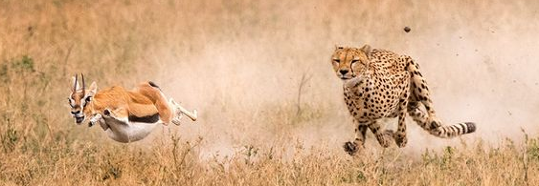
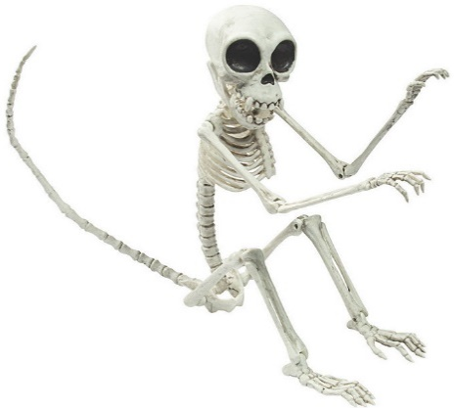
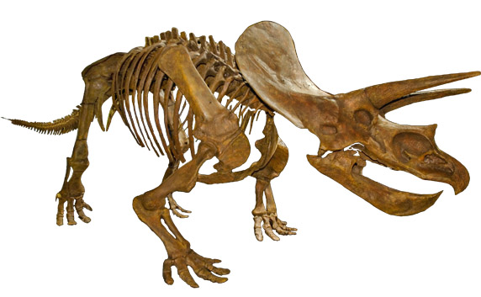

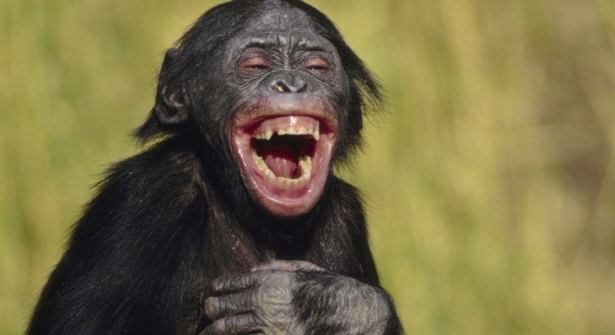
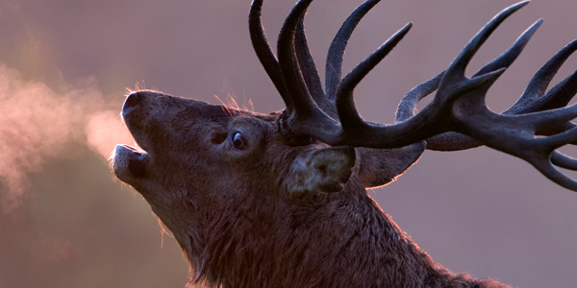
Musculoskeletal system´s functions
locomotion
support
body shape
voice
mimic
breathing

Slide 4
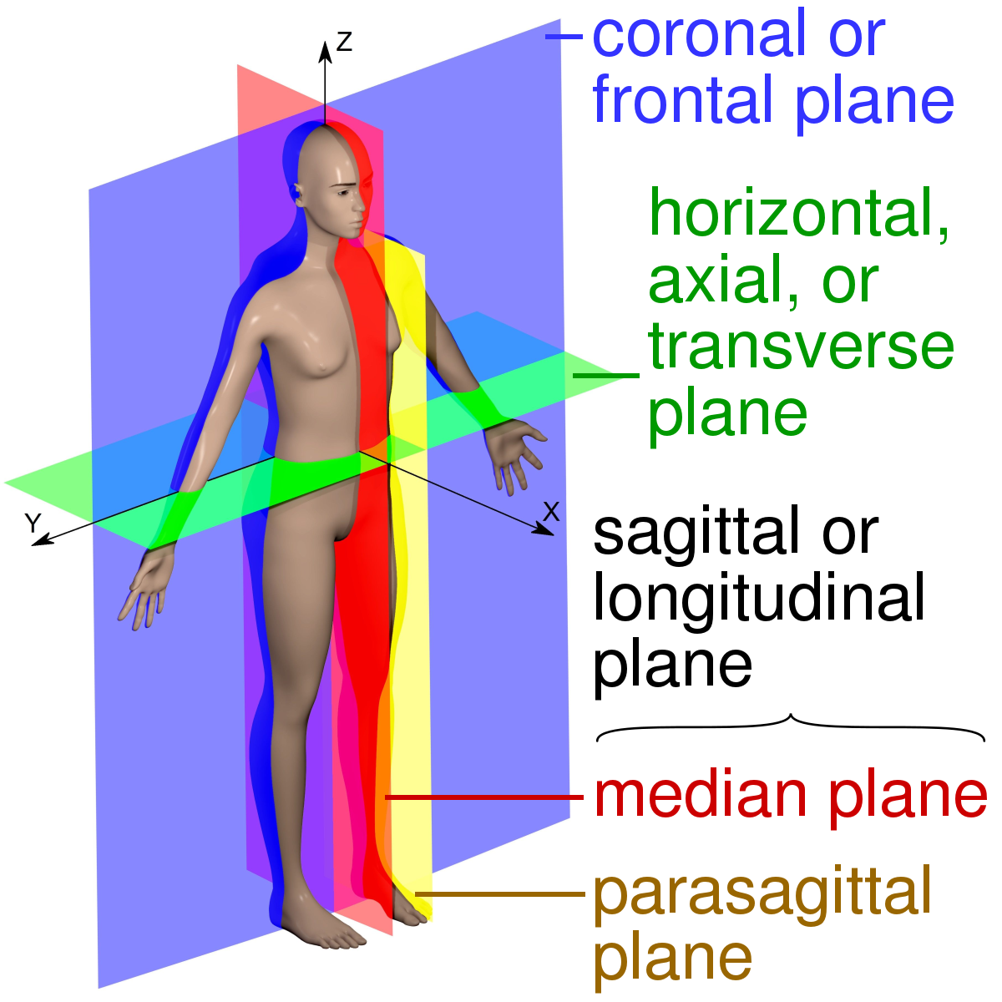
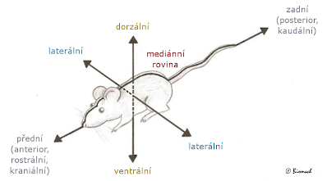
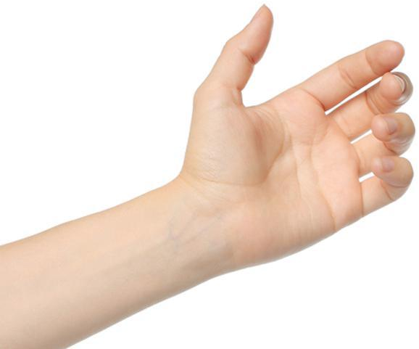
Body axes
Ascent Descent
Afferent Efferent
Hind (posterior/caudal)
dorsal
lateral
Frontal (anterior/rostral/cranial)
lateral
ventral
anterior
distal
dorsal
ventral
proximal
posterior

Slide 5
Video time
GASTRULATION – three laminar embryo body https://www.youtube.com/watch?v=ADlYn0ImTNg
NOTOCHORD FORMATION - first axis
https://www.youtube.com/watch?v=73k0k8qXAow
NEURULATION – neural tube and crest formation
https://www.youtube.com/watch?v=lGLexQR9xGs
EMBRYO FOLDING – final shape of embryo
https://www.youtube.com/watch?v=4lGq4DkTNko

Slide 6
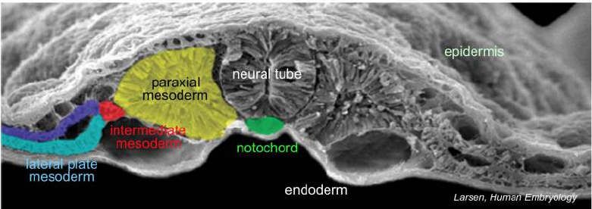
Sources of cells for bones
Bones formed from 3 sources:
paraxial mesoderm – trunk bones, some head bones
lateral plate mesoderm – long bones, sternum
Cranial neural crest – head bones
Muscles formed from 3 sources:
paraxial mesoderm – trunk and limb muscles, head muscles
lateral plate mesoderm – muscle connective tissue
Cranial neural crest – head muscles

Slide 7
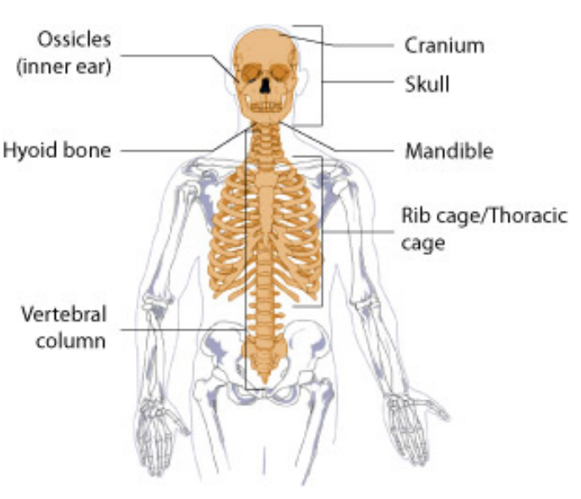
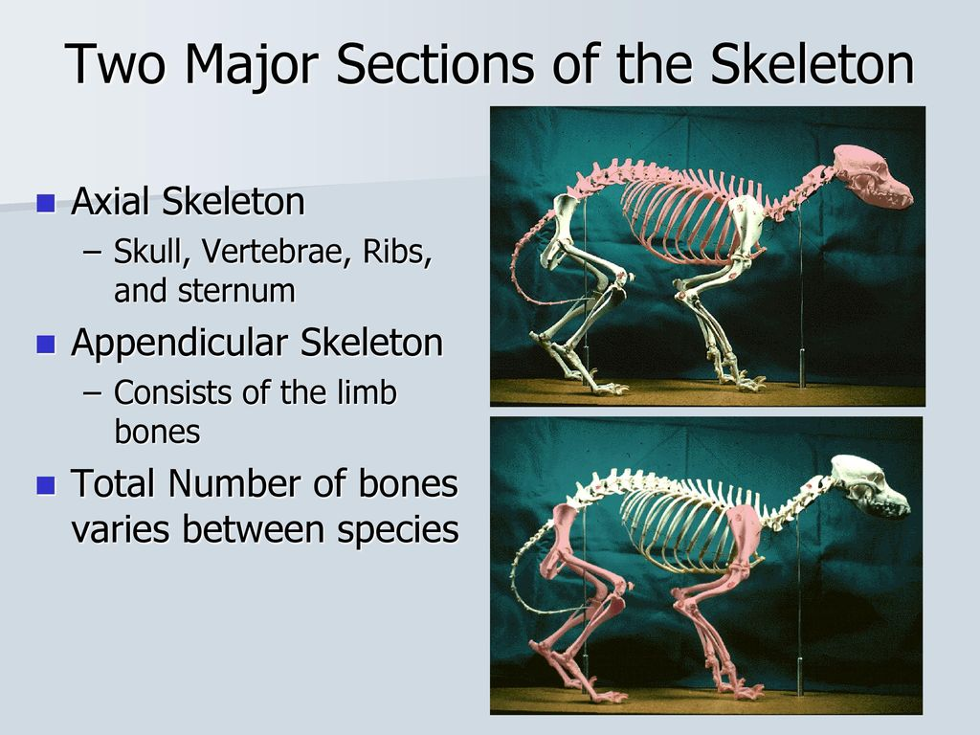
Development of the axial skeleton
Bone development:
  mesoderm, development of somites
Trunk bones
  development
  defects
Head bones
  development
  defects
  Ossification
  Membraneous
  Endochondral

Slide 8
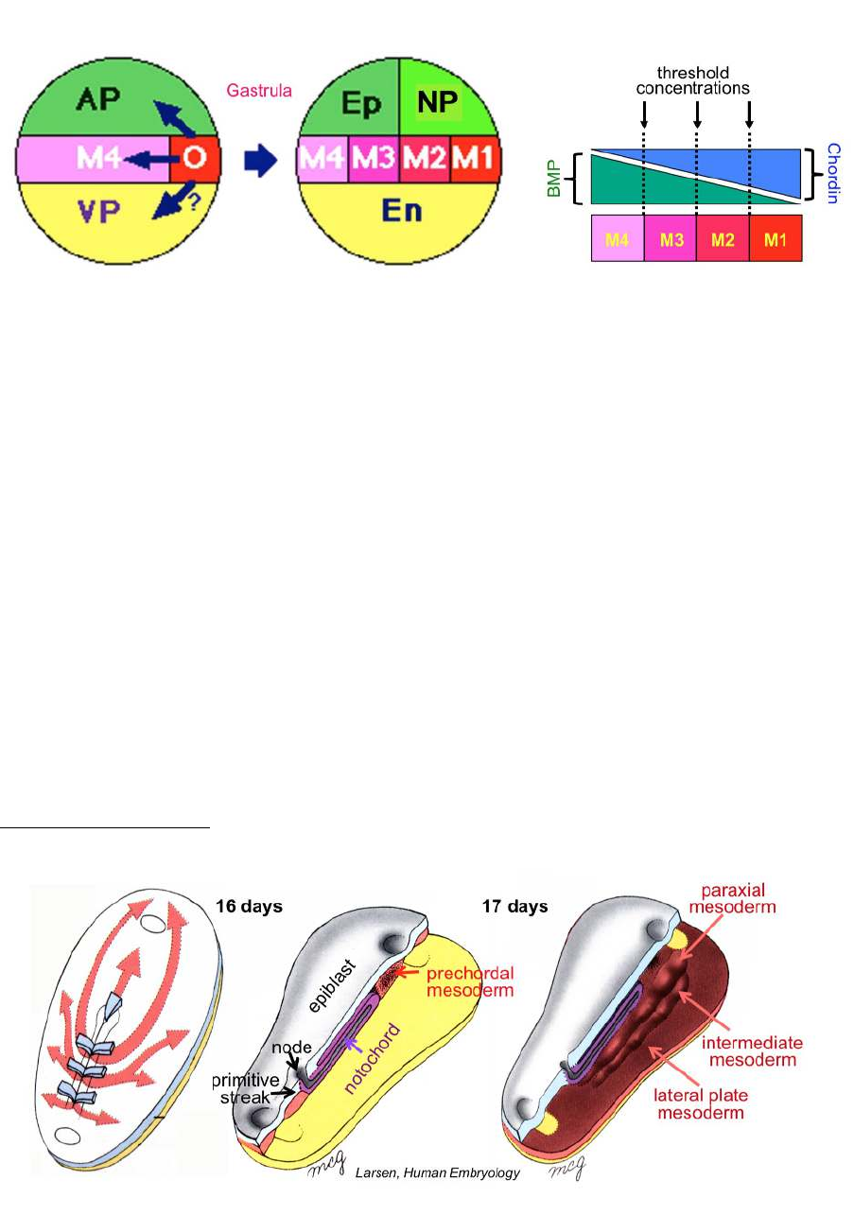
Axial mesoderm – Notochord formation
Notochord is formed from axial mesoderm
Formation: epiblast cells emigrate from node between epiblast and endoderm and form notochord and prechordal mesoderm
Rod-shaped rigid unit stretching along the rostro-caudal embryonic axis
notochord neighbours dorsaly with neural tube and lateraly with paraxial mesoderm
Larsen, Human Embryology

Slide 9
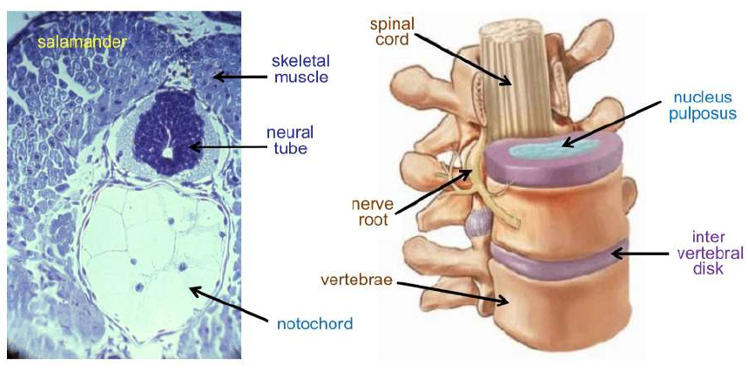
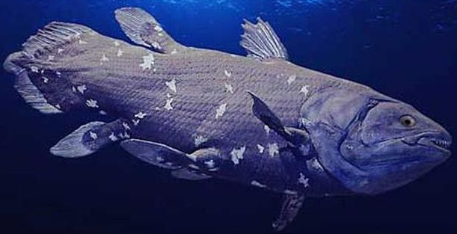
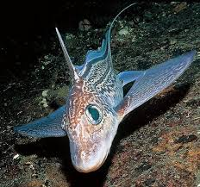
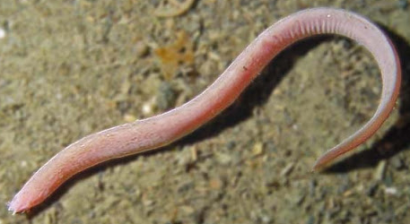
Notochord – interspecies comparison
fish and amphibians – formed from cells with big vacuoles, covered by collagen fibers sheath, rigid and flexible structure enabling support and movement
reptiles, birds, mammals – small and thin notochord, no supportive function
majority of notochord degrades during development replaced by axial skeleton, notochordal residues form nucleus pulposus of the developing intervertebral discs
Introduction to Anatomy and Development, University College London
Notes:
Notochord u ryb a paryb – majority only in larval stage, in some primitive fish (latimerie,chimera) is preserved and function as a backbone, also in hagfish

Slide 10
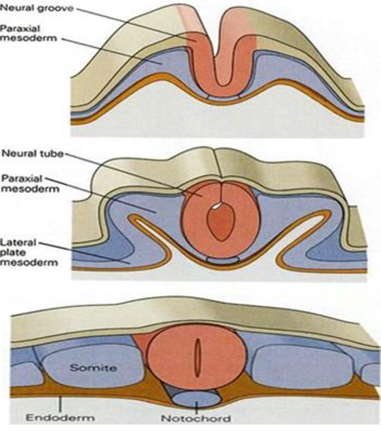
Development of axial skeleton structures
Axial skeleton is formed from 4 sources:
paraxial mesoderm – trunk bones, some head bones
lateral plate mesoderm – sternum
axial mesoderm - notochord
Cranial neural crest – some head bones
Neural groove
Paraxial mesoderm
Neural tube
Paraxial mesoderm
Lateral plate mesoderm
Neural crest
somit
notochord
Edited: Russell, 2018. Chemistry

Slide 11
Paraxial mesoderm
para – alongside, axial - axis
mesoderm developing on both sides along the longitudinal body axis (neural tube)
Epiblast cells emigrate from the primitive streak to area between epiblast and endoderm, migrate rostraly (towards the head) and lateraly (to the sides)
Mesodermal cells adjacent to the neural tube condenstate and form paraxial mesoderm – basis for somites
Larsen, Human Embryology

Slide 12
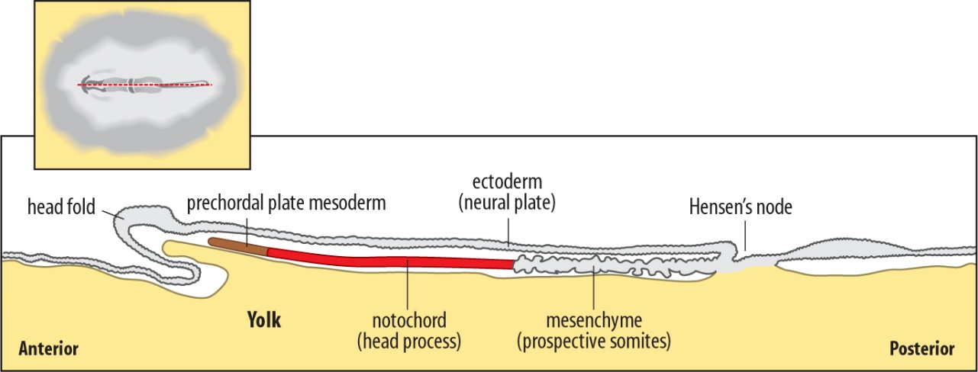
Axial mesoderm – formation of prechordal mesoderm
Formation: epiblast cells emigrate from node between epiblast and endoderm, migrate rostraly along the central axis and form prechordal mesoderm
cluster of cells rostraly from notochord
basis for thicker prechordal plate - mesenchymal head tissues and rostral cranial mesoderm
different names among species – premandibular mesoderm (lamprey, shark), prechordal mesoderm (xenopus, crocodile, chicken), frontal axial mesoderm (zebrafish), ventral cranial mesoderm (mouse)
Dr. Staveley, Memorial University Newfoundland

Slide 13
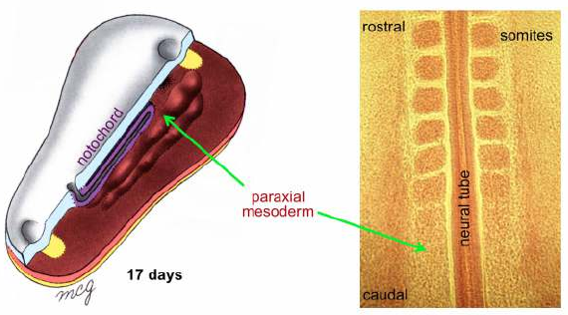
Formation of somites - somitogenesis
segmentation of the paraxial mesoderm – formation of paired somites
Basis for bones, cartilage, muscles, tendons, dermis
segmentation begins on cranial end and runs towards the caudal end
Cranial paraxial mesoderm – not segmented, basis for facial and neck muscles
Somites form in periodic intervals – used for embryo staging
Different number of somites among species
Introduction to Anatomy and Development, University College London

Slide 14
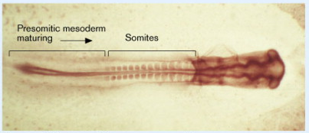
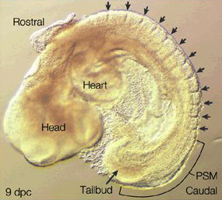
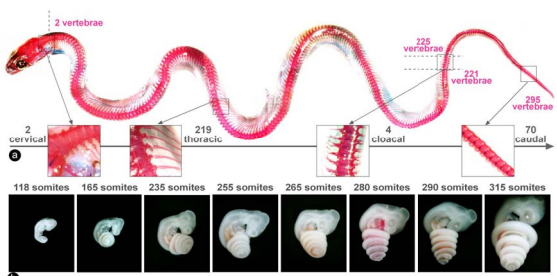
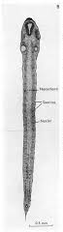
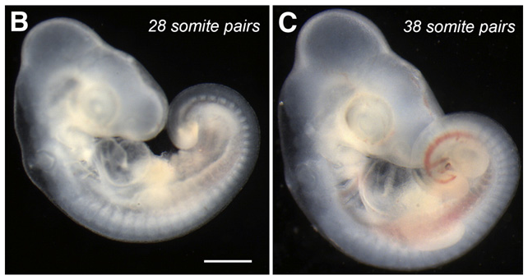
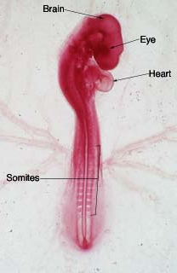
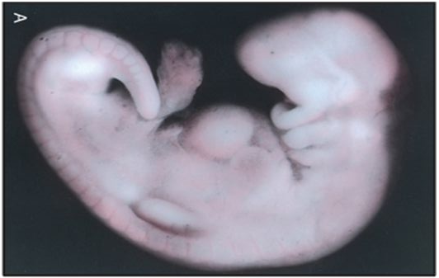
Somitogenesis – interspecies comparison
fish (zebrafish): 32
Jian et al. 1998. Curr Biol
mammals (mouse): 65
Indiana Uni
reptiles (grass snake): 315
Gomez et al. 2008. Nature
reptiles (anolis): 72-73
Eckalbar et al. 2011. Dev Biol
birds (chicken): 55
Cebra-Thomas. Dev Biol
mammals (human): 44
The Developing Human 8th edition
amphibians (xenopus): 42
Hamilton, 1969

Slide 15
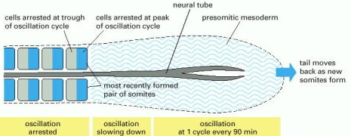
Clock and wavefront model
https://www.youtube.com/watch?v=9wrBROwoRSk
FGF is produced by the Hensen´s node cells
Retinoic acid is produced by the somitic cells
FGF and RA are antagonists and their expression determines the wavefront
Clock are the negative feedbackloops - transient expression of EphrinA4
http://www.ncbi.nlm.nih.gov/books/NBK26863/figure/A3943/?report=objectonly

Slide 16
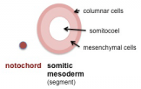
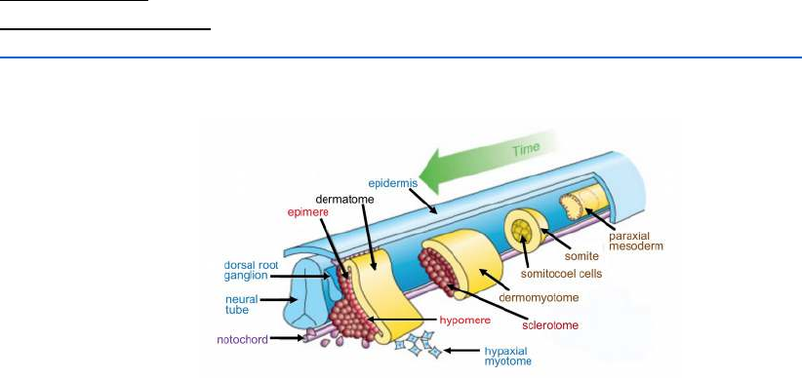
Segmentation of somites - part 1
Paraxial mesoderm formed of mesenchymal cell mass
Dr. Hill. Uni New South Wales
rostraly – gradual separation and somite formation → rostral somites more differentiated than caudal
Formation of spherical somites, epithelial sheath, mesenchymal core, somitocoel cavity in early somites
Segmentation of somites – sclerotome and dermomyotome
Introduction to Anatomy and Development, University College London
Notes:
Diferenciace buněk somitů: jakmile se oddělí somit od paraxiálního mezodermu, jakákoliv z buněk v somitu je schopná dát vzniknout jakékoliv struktuře, která se vyvine ze somitu (chrupavky obratlů a žeber, svaly hrudního koše, končetin, svaly břišního lisu, zad a jazyka, šlachy, dermis, vaskulární buňky, které tvoří aortu a meziobratlové cévy, obaly míchy).
Tyto buňky jsou multipontentní, do které tkáně budou diferencovat záleží na tom, kde se v somitu nacházejí a tím jak dochází k ovlivnění jejich diferenciaci faktory okolních tkání (neurální trubice, notochord, epidermis, intermediární mezoderm)

Slide 17
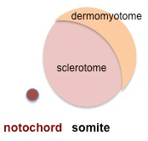
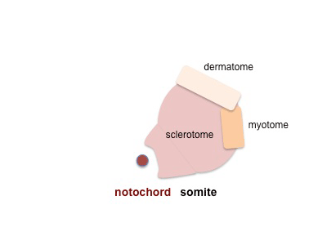
Segmentation of somites – part 2
Dermomyotome + Sclerotome
dermomyotome → dermatome and myotome
dorsal
dermatom
(dermis)
dorsolateral
dermomyotome
ventromedial
sclerotome
vertebral bodies, intervertebral discs, ribs
ventrolateral
myotom
(skeletal muscles)
dorsal
medial
lateral
ventral
Dr. Hill. Uni New South Wales

Slide 18
Development of sclerotome – part 1
NT
NT
S
Sclerotome cells (S) undergo epithelial -mesenchymal transition (EMT)
S
NC
NC
Migrate to notochord (NC) and neural tube (NT) areas
NT
NC
S
Scott Gilbert. Developmental Biology 10th edition

Slide 19
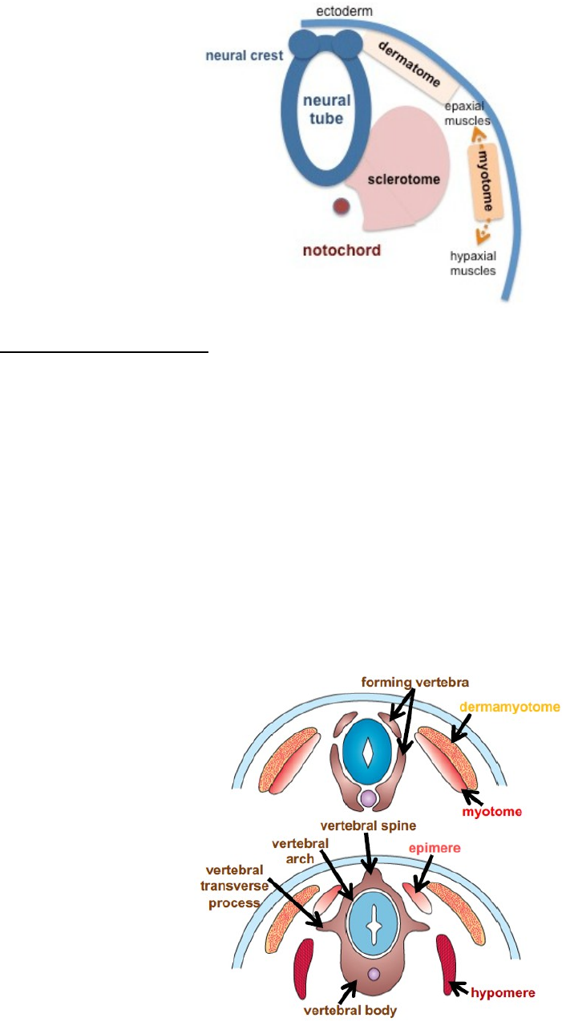
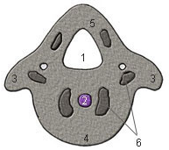
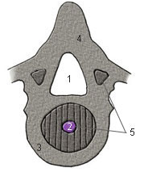
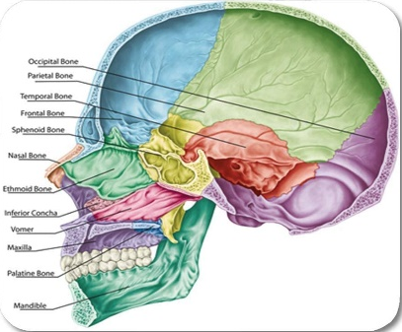
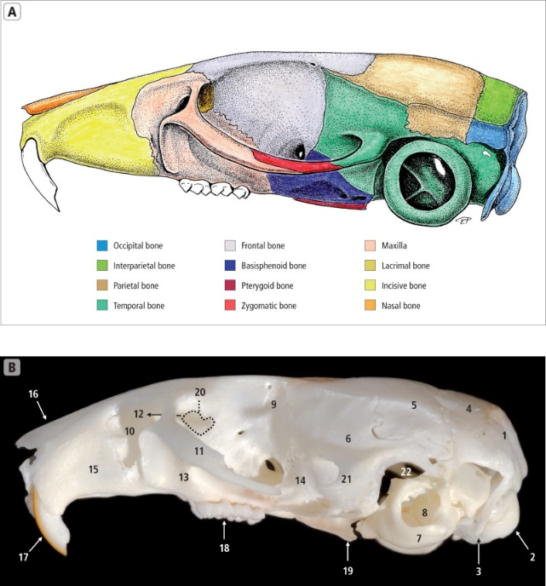
Development of sclerotome – part 2
Sclerotome cells around notochord → vertebral body
Sclerotome cells around neural tube → vertebral transversal processes, arch, vertebral spine and ribs
Vertebral ossification centers
rostraly formation of the occipital bone at the skull base
Introduction to Anatomy and Development, University College London

Slide 20
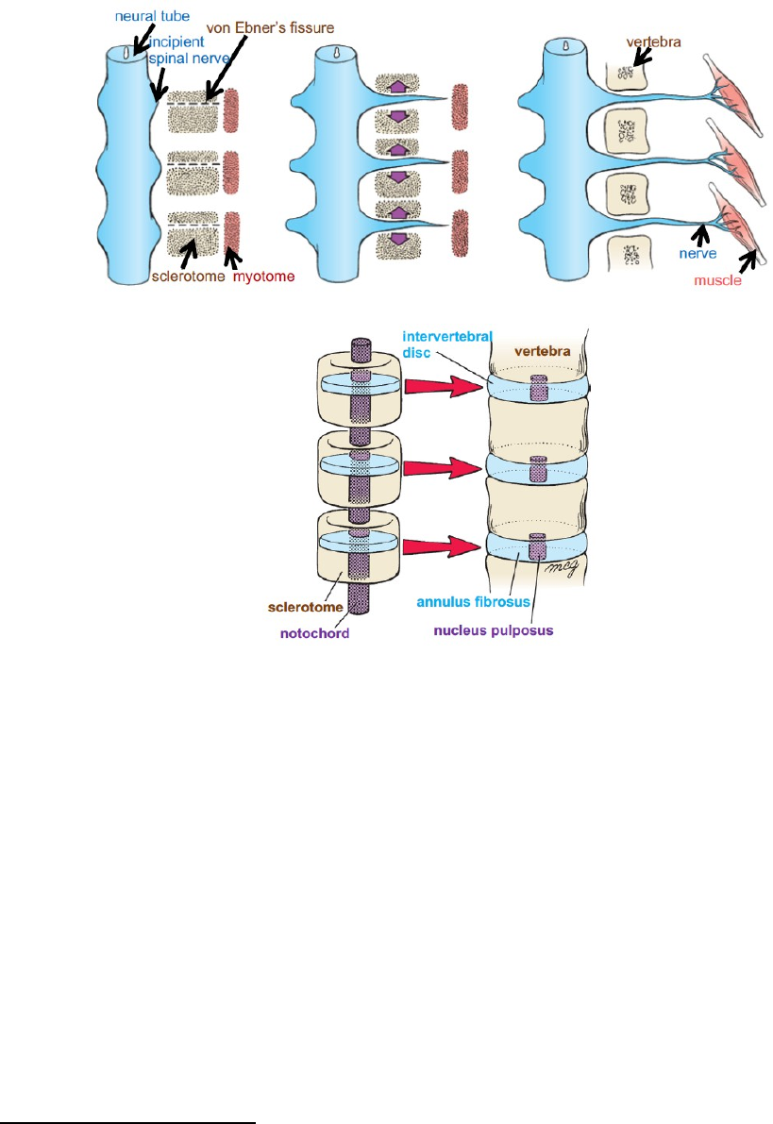
Cranial and caudal sclerotome – part 1
Sclerotome compartmentalization along the cranio-caudal body axis
higher cells density and proliferation rate in caudal sclerotome than in cranial – important for neural crest cells migration and motoric neurons axon growth
Place of cranial and caudal sclerotome division – von Ebner`s fissure (transversally oriented cells)
caudal end of first sclerotome fuses with cranial end of the following sclerotome
formation of vertebra from two neighbouring sclerotomes
Introduction to Anatomy and Development, University College London

Slide 21
Cranial and caudal sclerotome – part 2
formation of vertebra from two neighbouring sclerotomes
vertebral mesenchyme encapsulate notochord
formation of cartilaginous vertebral deposits → compression of notochord followed by dissapperance with following ossification
notochord remnants – soft central parts of intervetebral discs (nuclei pulposi)
Introduction to Anatomy and Development, University College London

Slide 22
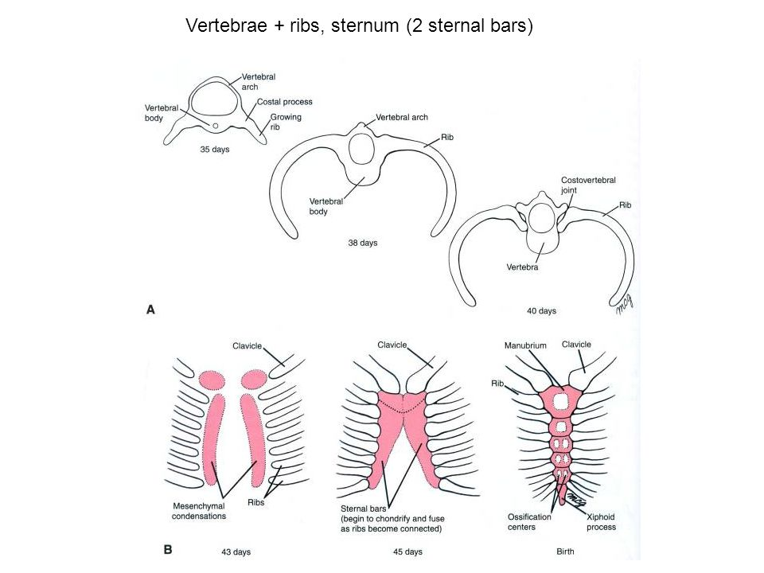
Ribs development
ribs develop from the transversal processes of the thoracic vertebrae
mesenchymal cells permeate between hypomers (myotome part) and differentiate into cartilage
later cartilage ossifies through endochondral ossification, distal cartilage does not ossify – rib cartilage (connection between ribs and sternum)
Development of the Vertebral Column. Dr. Károly Altdorfer

Slide 23
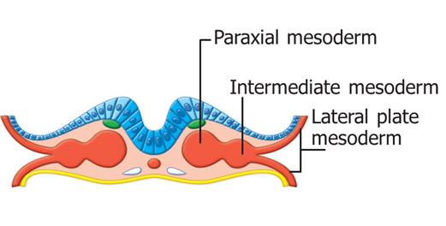
Development of sternum
sternum originates from lateral plate mesoderm→ somatic mesoderm (somatopleura)
cells migrate ventrally
two mesenchymal condensation form on ventral side – cartilage differentiation
Somatic mesoderm
medial fusion – begins cranially, formation of cartilaginous basis of sternum
after fusion – ossification centers formation – endochondral ossification
Marieb et al. Human Anatomy. 7th edition

Slide 24
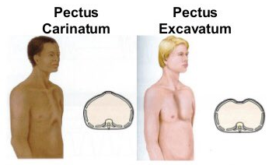
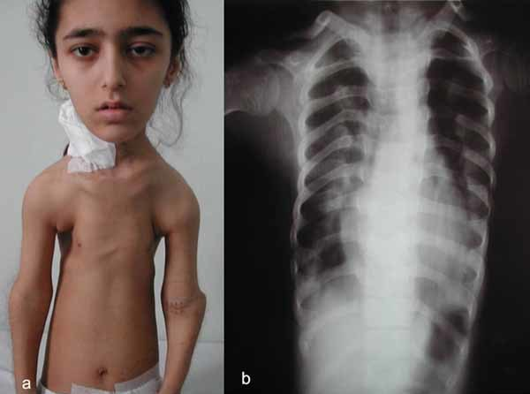
Developmental defects of trunk bones
Pectus excavatum – sunken chest caused by uneven development of ribs and sternum, 90 % of all congenital chest defects
Pectus carinatum – „Bird`s chest“, abnormal growth of rib cartilages cause sternum elevation
Jeune syndrome – trunk dystrophy, mutations in wide spectrum of genes, small chest, short risb, short limb bones
Sternal cleft – insufficient fusion between sternal basis in the midline
Tüysüzet al. 2009. AJMG
Notes:
Pectus excavatum – 1:500, původ není znám, symptomy: bolest na hrudi, srdeční vady, dušnost, řešeno plastickou chirurgií, projevuje se po narození a posléze více v pubertě
Pectus carinatum – 1:400, abnormální růst chrupavek, způsobuje utlačování plic a srdce, dýchací problémy
Jeunův syndrom – 1:130000, ciliopatie, krátké kosti, polydaktylie, velmi málo pacientů přežije
Rozštěp sterna – 1:50000

Slide 25
Development of head bones
Bones and cartilages of head develop from two sources:
  mesoderm
  neural crest
Neural crest
neurocranium
mesoderm
viscerocranium
endochondral
Bones of head form two parts:
  neurocranium – surrounds brain
  viscerocranium – surrounds oral cavity and pharynx
Bones of head are formed by two types of ossification:
  membraneous – from mesenchyme
  endochondral – from cartilage
membraneous

Slide 26
Neurocranium vs. viscerocranium
Neurocranium
Surrounds brain
Viscerocranium
Surrounds oral cavity and pharynx
Membraneous ossification
Endochondral ossification
Membraneous ossification
Endochondral ossification
membraneous neurocranium
cartilaginous neurocranium
membraneous viscerocranium
cartilaginous viscerocranium
nasal capsule cartilage
frontal
parietal
nasal
ethmoid
occipital
ear ossicles
premaxilla
vomer
zygomatic
sphenoid
temporal
occipital
maxilla
palatine
mandible

Slide 27
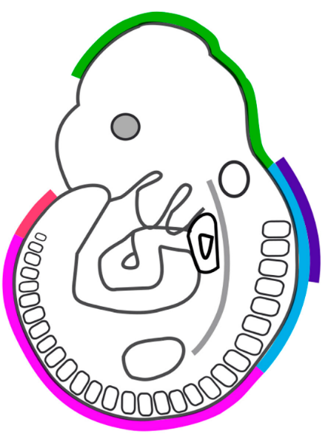
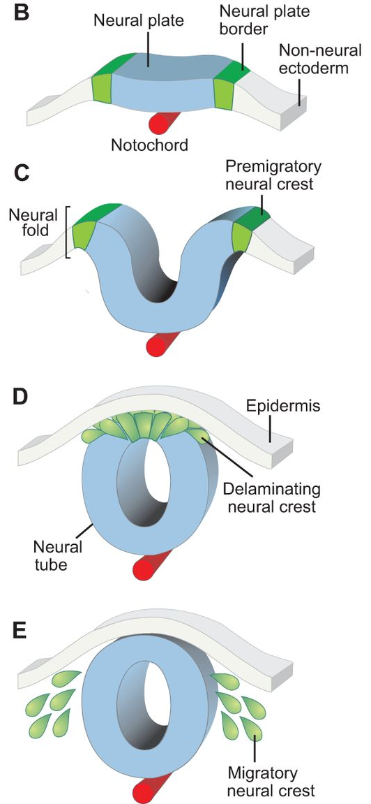

Neural crest
Neural crest– forms from ectoderm, from neural fold in developing neural tube
Neural crest cells – transform from epithelial to mesenchymal (epithelial-mesenchymal transition - EMT) → migration
Migration to final destinations – different cell types and tissues
Regions of the neural crest:
  cranial + cardiac
  vagal
  truncal
  sacral
Green et al. 2015. Nature
Notes:
Neurální lišta – neuroektoderm, často nazývaná čtvrtý zárodečný list

Slide 28
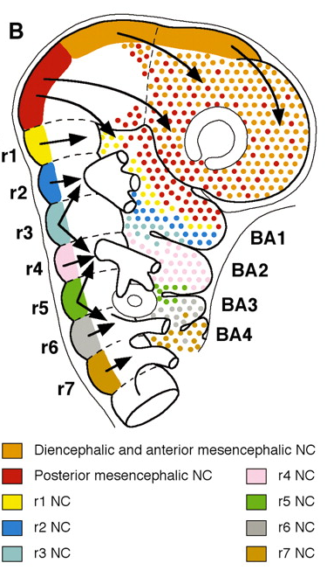
Cranial neural crest
regions of developing prosencephalon (forebrain), mesencephalon (midbrain) a rhombencephalon (hindbrain)
mesencephalic cells and cells from frontal segments of rhombencephalon migrate into prosencephalon → frontal bone, parts of temporal, sphenoid and occipital bones
mesencephalic cells and first three rhombencephalic regions cells (R1,2,3) → migrate to frontonasal prominence and first pharyngeal (branchyal) arch → form bones and cartilage of nasal capsule, maxila and mandible, ear ossicles
prosencephalon
mesencephalon
rhombencephalon
Notes:
Neurální lišta – neuroektoderm, často nazývaná čtvrtý zárodečný list
Kosti středního ucha 1. faryngeální oblouk – malleus (kladívko) a incus (kovadlinka) se vyvíjejí z Meckelovy chrupavky, endochondrální osifikace
Kosti středního ucha 2. faryngeální oblouk – stapes (třmínek) se vyvíjí z Reichertovy chrupavky, enchondrální osifikace

Slide 29
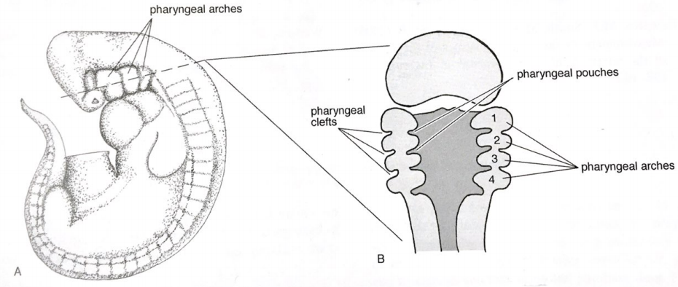
Pharyngeal arches
neural crest cells migrate to regions of developing head and neck between surface ectoderm and primitive gut endoderm → 6 pairs of pharyngeal arches
pharyngeal clefts
  surface depression of ectoderm
  external auditory canal
pharyngeal pouches
  primitive gut endodermal protrusions
  Eustachian tube
  lymphatic system (palatal tonsils)
  endocrine system (parathyroid glands, thymus)
Pharyngeal membrane – broken in fish, communication between oral (pharyngeal) cavity and external environment
McGeady et al. Veterinary Embryology. 2009

Slide 30
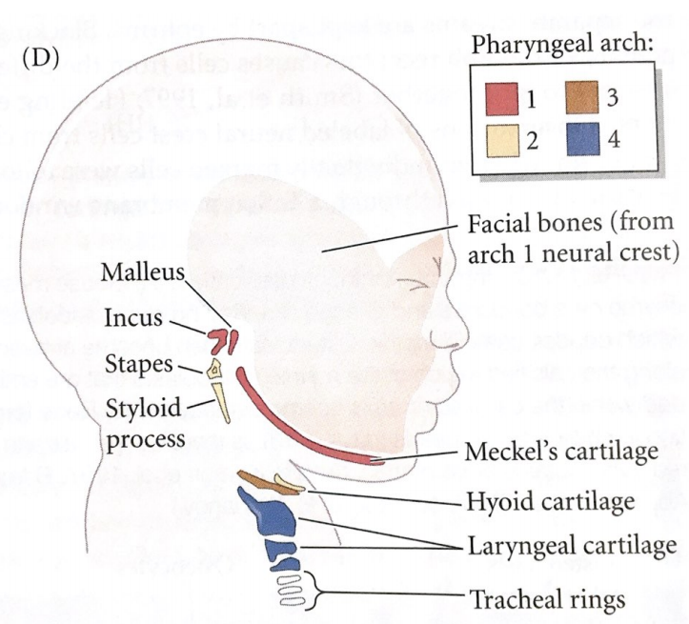
Bony and cartilaginous derivatives of pharyngeal arches
different structures of head and neck develop from mesenchyme of each arch
1. arch
  bones: maxila (Mx), premaxila (p), mandible (Mn), zygomatic (Z), temporal (t)
  cartilage: Meckel`s, malleus, incus
2. arch
  bones: styloid proces of temporal bone (t)
  cartilage: stapes, part of hyoid bone (cartilage)
t
Z
Mx
p
3. arch
  part of hyoid bone (cartilage)
Mn
4. arch
  Laryngeal cartilage
Scott Gilbert. Developmental Biology 10th edition
Notes:
Processus styloideus – výběžek kosti spánkové

Slide 31
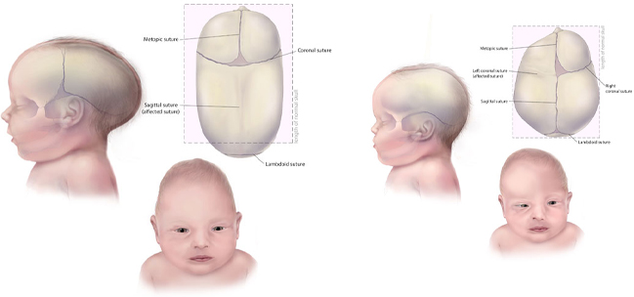
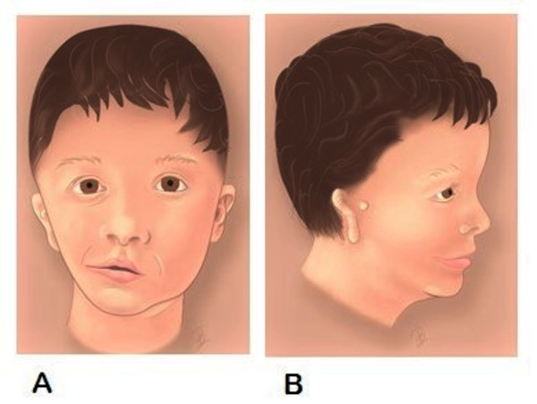
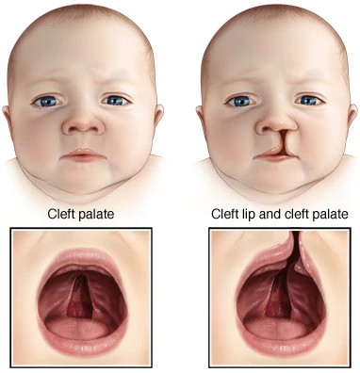
Developmental defects of head
Craniosynostosis – premature ossification of cranial sutures (head deformities, brain and eye defects)
Hemifacial microsomy – one part of face incompletely developed (eye, ear, facial bones and muscles)
Cleft lip and/or palate – the most often developmental defects of head, isolated or combined
Centers for Disease Control and Prevention
Mayo Clinic Family Healt Book, 5th Edition
Notes:
Kraniosynostóza – předčasný srůst lebečních kostí, cca 1:2500, nejčastěji způsobeno mutací v genech fibroblastových růstových faktorů a jejich receptorů, popsáno více než 50 genů způsobující kraniosynostózy, syndromové i nesyndromové
Hemifaciální mikrosomie – druhá nejčastější vývojová vada hlavy po rozštěpových vadách, jiný název: Syndrom prvního a druhého faryngeálního oblouku, Goldenhar syndrom

Slide 32
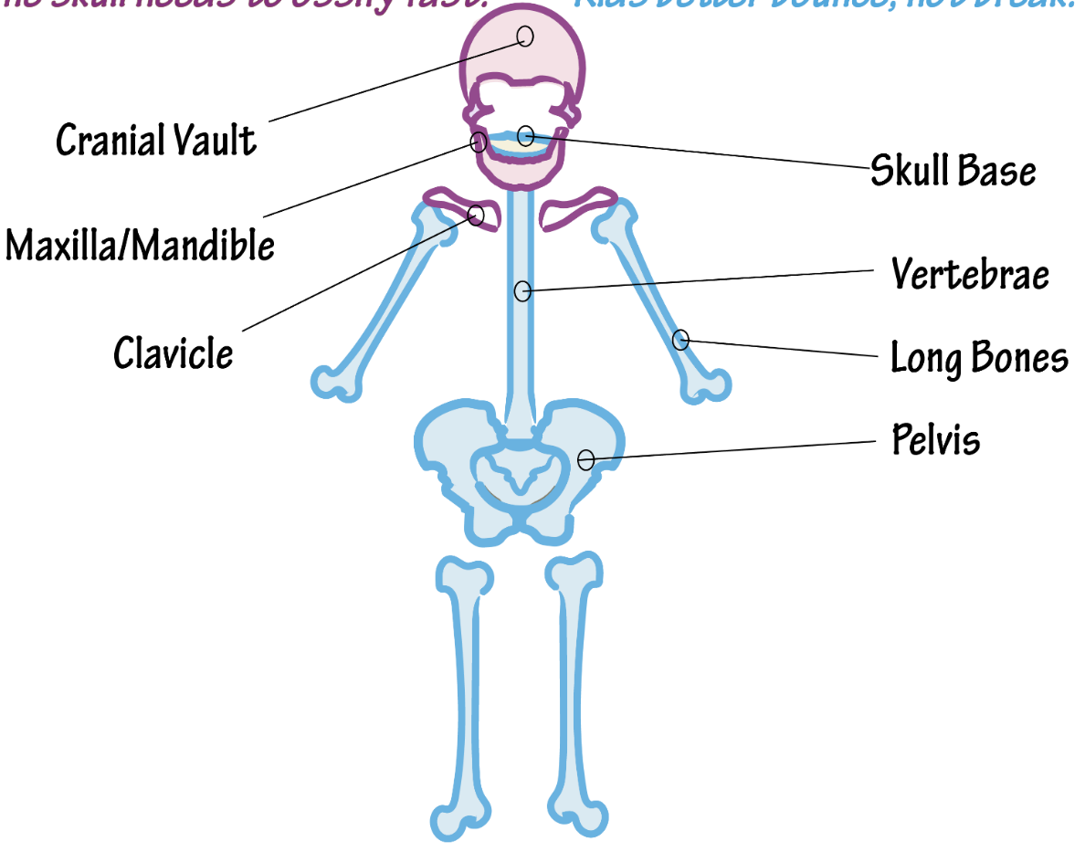
Formation of bones
Membraneous ossification
  Bone forms directly from mesenchyme
cranial vault
skull base
facial bones
vertebra
clavicles
long bones
Endochondral ossification
  Cartilage is formed and than replaced by bone
pelvis
sternum
ribs

Slide 33

Membraneous ossification
Bone develops from mesenchyme
mesenchymal cells condensation
  differentiation - osteoblasts
  ossification center formation
osteoblasts produce minerals
osteoblasts differentiate in ossification center - osteocytes
edges of ossification center – osteogenic progenitors differentiate into osteoblasts
inside – trabecular/spongy bones (osteocytes)
surface – compact bone (periosteum, osteoblasts)
Bone formation and development. Oregon State University

Slide 34

Endochondral ossification – part 1
Hyaline cartilage transforms into bone
mesenchymal cells condensation - chondroblasts
chondroblasts produce matrix - chondrocytes
cartilage is not vascularized – supplied from perichondrium
osteoblasts migrate through vessels in perichondrium to the edge of cartilage – bone is produced in diaphysis - bone collar
bone collar prevents penetration of material to cartilage – chondrocytes are dying and cartilage degrades
space for vessels – region settled by osteoblasts, formation of primary ossification center
Bone formation and development. Oregon State University

Slide 35

Endochondral ossification – part 2
Longitudinal growth of bone - cartilage grows on both ends (future epiphysis),
concurrently is replaced by bone in diaphysis
Primary ossification terminated – diaphysis ossified, epiphysis cartilaginous
Epiphysal cartilage – ossified later, formation of secondary ossification center
during development, cartilage remains between epiphysis and diaphysis in form of epiphyseal/growth plate
Bone formation and development. Oregon State University

Slide 36

Growth plate
Reserve zone
  chondrocytes
  Matrix production
Proliferative zone
  chondrocytes grow
  chondrocytes proliferate (mitosis)
Hypertrophic zone
  chondrocytes grow
  chondrocytes maturation
Calcification zone
  calcification of matrix
  chondrocytes dying
Ossification zone
  vascularization
  osteoblasts form bone
Bone formation and development. Oregon State University

Slide 37


Growth defects
Achondroplasia
  dwarfism
  reduced proliferation of chondrocytes in growth plate
  growth plate disorganized
  short bones, macrocephaly
Thanatophoric dysplasia
  more severe form, usually lethal
  short limbs
  narrow chest
  macrocephaly, brain defects
Carrol et al. 2020. Pal Med Rep
Ornitz and Legeai-Mallet, 2017. Dev Dyn

Slide 38

Development of apendicular skeleton
Limb bones
  development
  defects

Slide 39

Formation and development of limbs
formation of limb buds:
mesenchyme (mesoderm) covered with epithelium (ectoderm)
Hamburger and Hamilton, 1951.

Slide 40

Embryonic origin of limbs
Epaxial myotome
dermatome
hypaxial
myotome
Muscles and dermis – paraxial mesoderm
  myotome – hypaxial part
  dermatome
limb muscle cells precursors
Limb bud
bones and cartilage – lateral plate mesoderm, somatopleura
limb skeletal precursors
endoderm
lateral plate mesoderm
Marieb et al. Human Anatomy. 7th edition

Slide 41

Syndetome
junction between muscles and bones – tendons formation
originates in paraxial mesoderm – somites
dorsal part of sclerotome - syndetome
Nakamichi and Asahara, 2021. Bone

Slide 42



Beginning of limb development
limb field – lateral plate mesoderm cells and paraxial mesoderm cells migrate from limb field
cells accumulate under the ectoderm – formation of limb bud
Stocum and Fallon, 1982
Science Photo Library
Apical ectodermal ridge (AER) formation
  thickening of surface ectoderm in distal part of limb bud
  production of growth factors → mesenchymal cells stimulated (proliferation, migration, differentiation)
Sadler, 2010.

Slide 43


Zone of polarizing activity (ZPA)
mesenchyme in posterior part of limb bud
production of growth factors
mutual influence with apical ectodermal ridge cells
determines differentiation of limb along the anterio-posterior axis

Slide 44

Signaling
AER
Shh is specific for the zone of polarizing activity (ZPA)
En-1 expression blocks development of dorsal part (Wnt7) in ventral part of hand
AER (source of FGF) is formed on the edge of cells producing and not producing r-fng
ZPA
http://www.evol.nw.ru/
Notes:
Upper Scheme: Mechanisms of D/V Patterning and AER Positioning (A) Gene expression along the limb bud D/V axis. The member of Wnt family Wnt-7a and Radical fringe (r-Fng), which encode secreted factors, are expressed in the dorsal ectoderm. The homeodomain-containing factors encoded by Lmx-1 and Engrailed-1 (En-1) localize to the dorsal mesoderm and ventral ectoderm, respectively.
(B) Genetic interactions involved in AER formation and specification of dorsal pattern. En-1 expression in the ventral ectoderm restricts the expression of r-Fng and Wnt-7a to the dorsal ectoderm. Interaction between r-Fng-expressing and r-Fng-nonexpressing cells leads to the specification of the AER. Wnt-7a instructs the dorsal mesoderm to adopt dorsal characteristics, such as Lmx-1 expression, which in turn specifies dorsal pattern. En-1 has a dual function in AER positioning and dorsal specification and hence acts to coordinate the two processes.
Lower Scheme: Three Axes and Three Signals: Shh, FGFs, and Wnt-7a Orchestrate Limb Pattern
(C) Schematic of a limb bud viewed from the posterior-dorsal aspect showing the localization of Shh to the ZPA, FGFs to the AER, and Wnt-7a to the dorsal ectoderm.
(D) Codependence of Shh, FGF, and Wnt-7a signaling and axial patterning. While each secreted factor can be associated with patterning along a single axis, affecting the expression of any single factor will lead to modulation of the other two. For example, reduction of Wnt-7a signaling will lead directly to dorsal patterning defects, but indirectly to posterior defects through a diminution of Shh signaling, and to proliferation defects via a subsequent effect on FGF expression.
Primary Signalling Molecules

Slide 45


Growth and differentiation of limb bud
Progressive zone model – faith and differentiation of mesenchymal cells determined by time they stay in progressive zone
Early specification model – faith and differentiation of mesenchymal cells is already determined by formation of three different cell groups in progressive zone
McGeady et al. Veterinary Embryology. 2009

Slide 46

Bones and cartilage of limb
variation of the same building plan of vertebral limbs
3 zones on developing limb:
  stylopodium (proximal) – humerus, resp. femur
  zeugopodium (middle) – radius, ulna, resp. tibia, fibula
  autopodium (distal) – metacarpal bones and finger bones
stylopodium zeugopodium autopodium

Slide 47





Source of limb cells
http://www.cmrb.eu/media/upload/imatges/
centre-investigacio/linies_treball/6_1_limb.jpg
http://www.utm.utoronto.ca/

Slide 48



Developmental defects of limb bones
Syndactyly – connection between two or more fingers
Polydactyly – more than five fingers formed on one limb
Phocomelia – missing proximal part of limb
Kapoor and Johnson, 2011.
N Eng J Med
J Integr Health Sci

Slide 49

Development of trunk skeletal muscles
trunk muscles have two origins:
  Paraxial mesoderm (somites)
  Lateral plate mesoderm
  somites differentiate into sclerotome and dermamyotome
  dermamyotome differentiates into dermatome and myotome
  myotome is divided into:
    Epaxial myotome:
      some trunk muscles (dorsal)
    Hypaxial myotome:
  some trunk muscles (ventral)
  limb muscles

Slide 50

Epaxial and hypaxial trunk muscles
proliferation and migration of myotome cells– muscle cell progenitors formation - myoblasts
Epaxial muscles:
  back (dorsal) muscles formation – muscle connective tissue from somites
  muscle segments are fusing
Hypaxial muscles:
  intercostal muscles – muscle connective tissue from somites, muscle do not fuse
  abdominal (ventral) muscles – muscle connective tissue from lateral plate mesoderm, muscles fuse
Sefton and Kardon, 2019. Curr Top Dev Biol

Slide 51

Development of limb muscles
Hypaxial myotome – source of myoblasts for limb muscles
myoblasts emigrate from myotome in the limb field to developing limb bud
Hypaxial myotome
Deries and Thorsteinsdóttir, 2016. Cell Mol Life Sci

Slide 52


Head muscles
Head muscles develop from 3 sources:
  nonsegmented cranial mesoderm (CM)
  Paraxial mesoderm - somites (PM)
  Cranial neural crest (CNC)
3 groups:
  extraocular muscles– CM, CNC
  muscles originating in pharyngeal arch - CM, CNC
    Facial muscles, jaw muscles, neck muscles
  tongue muscles – PM, CNC
Randolph and Pavlath, 2015
Sefton and Kardon, 2019. Curr Top Dev Biol

Slide 53


Differentiation of skeletal muscle cells
Myotome cells
Multinuclear myotubules
Muscle fiber
myoblasts
myocytes
myotubules
mitosis
extension connection
fusion differentiation
maturation
maturation
Growth and renewal of muscles – progenitor and muscle stem cells - satellite muscle cells

Slide 54


Developmental defects of muscles and muscle dystrophy
Duchene muscle dystrophy –
the most often muscle dystrophy, gradual loose of muscles, mutation in gene for dystrophin – stabilization of muscles
Becker`s muscle dystrophy – less severe form of Duchene dystrophy
Poland syndrome – missing one side of breast muscles, often connected with scapula hypoplasia and other limb bones on the same side
Shahi et al. 2020. Cureus

Slide 55

Fun facts
How many bones are in the adult human body?
How many bones has the newborn?
And the skull?
What is the smalest bone?
https://www.bioexplorer.net/skeletal-system-fun-facts.html/
Notes:
How many bones are in the adult human body? 206
How many bones has the newborn? 270
And the skull? 22 – grow together
What is the smalest bone? Staples

Slide 56

Information sources
Comparison of human and mouse embryo (21 d)
https://embryology.med.unsw.edu.au/embryology/index.php/Category:Mouse_E12
Atlas of mouse embryo
http://www.emouseatlas.org/eAtlasViewer_ema/application/ema/kaufman/plate_25a.php
Chick embryo developmental stages (21 d)
https://embryology.med.unsw.edu.au/embryology/index.php/Hamburger_Hamilton_Stages
European mole developmental stages (talpa europea) (28 d)
https://www.researchgate.net/publication/250068036_Developmental_Stages_and_Growth_Rate_of_the_Mole_Talpa_occidentals_Insectivora_Mammalia
Atlas of danio rerio development (3 d till the egg is hatching)
https://bio-atlas.psu.edu/

Slide 57


Slide 58
Samples
Homo Sapiens Sapiens
H.S.S. embryos 6th – 22nd week iud (46 weeks)
Mus Musculus (mouse)
M.M. E12 = 5-6th week iud H.S.S. (21 days)
M.M. E14,5 = 7.-8. week iud H.S.S.
Gallus Gallus (chicken)
G.G. HH10 (1,5 d) = 3rd week iud H.S.S. (21 days)
G.G. HH20 (3,5 d) = 5th week iud H.S.S.
G.G. HH24 (4,5 d) = 6th week iud H.S.S.
G.G. HH26 (5D) = 6,5th week iud H.S.S.
G.G. Hh28 (5,5-6D) = 7th week iud H.S.S.
Talpa Europea (Mole)
T.E. 16D = beginning of organogenesis (29 days)
T.E. 27d = just before the birth
Mesocricetus Auratus (hamster)
M.A. 13,5D= 6. týden iuv H.S.S. (17days)
M.A. 15D= just before the birth
Danio Rerio (zebrafish)
Zebrafish 5 days – larval stadium (hatching of embryo in 3rd day)

