Slide 1
Papers ETC.
2nd batch of embryologic papers

Slide 2
List of papers
Tarazi 2022 - Post-gastrulation synthetic embryos generated ex utero from mouse naive ESCs Filippo
experimental manuscript, differentiation factors, molecular biology
Shindo 2022 - Versatile roles for histones in early development
  review, molecular biology Lana
Paloviita 2021 - The non-coding genome in early human development
  review, molecular biology Jorge
Noli 2016 - Potential of human twin embryos generated by embryo splitting in assisted reproduction and research Denise
  review, interesting embryo manipulation
Hoekzema 2017 - Pregnancy leads to long-lasting changes in human brain structure
  experimental manuscript, NMR Brina

Slide 3
List of papers
Graves 2013 - Newborn Transition
review, medical Ximena
Einspieler 2021- Fetal movements: the origin of human behavior
review, medical Kun
Cavaliere 2017 - A 14-day limit for bioethics: the debate over human embryo research
  review, ethical
  Ayala 2015 - Cloning humans? Biological, ethical, and social considerations review, ethical

Slide 4
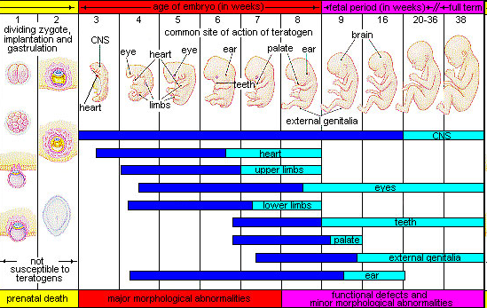
Timing
http://php.med.unsw.edu.au/embryology/index.php?title=File:Human-critical_periods.jpg

Slide 5
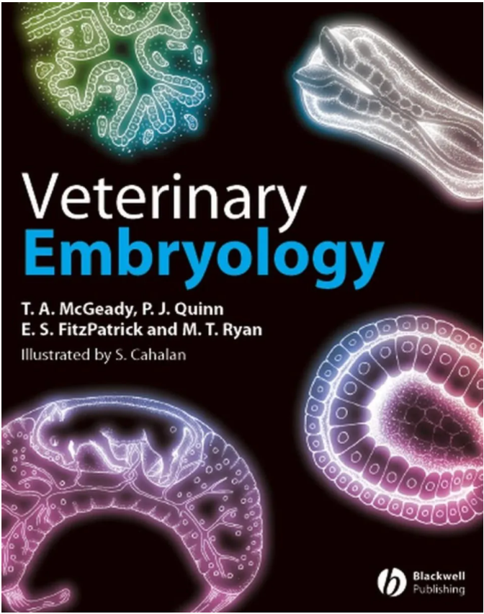
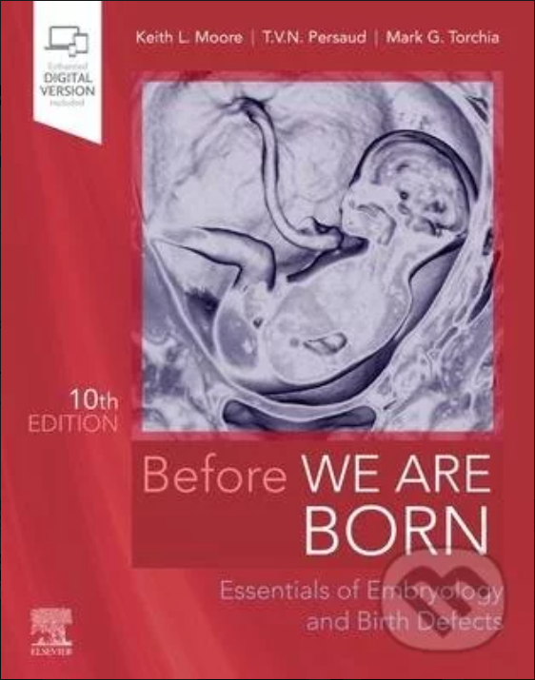
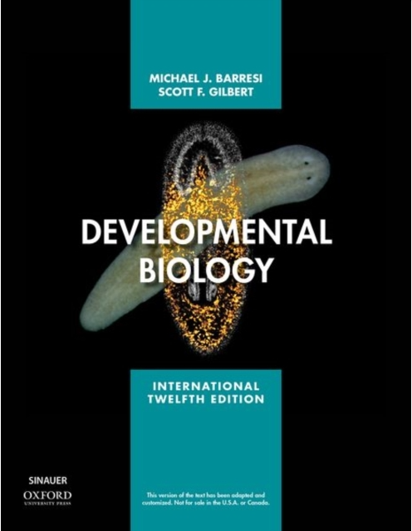
Books

Slide 6

Information sources
Comparison of human and mouse embryo (21 d)
https://embryology.med.unsw.edu.au/embryology/index.php/Category:Mouse_E12
Atlas of mouse embryo
http://www.emouseatlas.org/eAtlasViewer_ema/application/ema/kaufman/plate_25a.php
Chick embryo developmental stages (21 d)
https://embryology.med.unsw.edu.au/embryology/index.php/Hamburger_Hamilton_Stages
European mole developmental stages (talpa europea) (28 d)
https://www.researchgate.net/publication/250068036_Developmental_Stages_and_Growth_Rate_of_the_Mole_Talpa_occidentals_Insectivora_Mammalia
Atlas of danio rerio development (3 d till the egg is hatching)
https://bio-atlas.psu.edu/

Slide 7
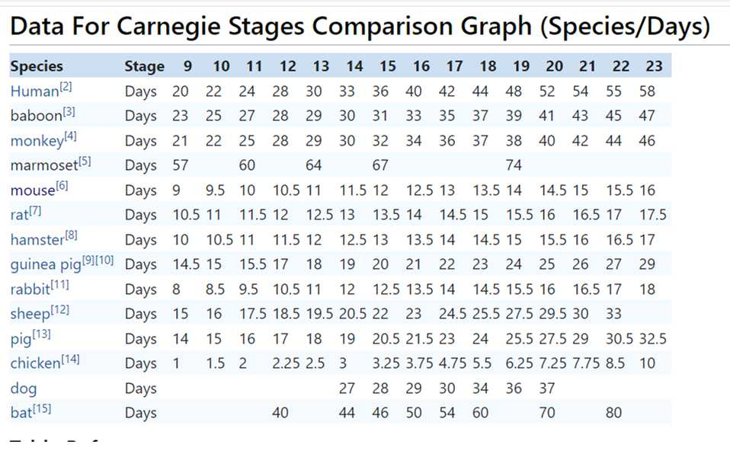

Slide 8
Samples
Homo Sapiens Sapiens
H.S.S. embryos 6th – 22nd week iud (46 weeks)
Mus Musculus (mouse)
M.M. E12 = 5-6th week iud H.S.S. (21 days)
M.M. E14,5 = 7.-8. week iud H.S.S.
Gallus Gallus (chicken)
G.G. HH10 (1,5 d) = 3rd week iud H.S.S. (21 days)
G.G. HH20 (3,5 d) = 5th week iud H.S.S.
G.G. HH24 (4,5 d) = 6th week iud H.S.S.
G.G. HH26 (5D) = 6,5th week iud H.S.S.
G.G. Hh28 (5,5-6D) = 7th week iud H.S.S.
Talpa Europea (Mole)
T.E. 16D = beginning of organogenesis (29 days)
T.E. 27d = just before the birth
Mesocricetus Auratus (hamster)
M.A. 13,5D= 6. týden iuv H.S.S. (17days)
M.A. 15D= just before the birth
Danio Rerio (zebrafish)
Zebrafish 5 days – larval stadium (hatching of embryo in 3rd day)

