Slide 1
Dependence of THC concentration in blood on the amount of cannabis smoked was analyzed in one person who smoked different amounts of dried cannabis of the same source. The intervals between measurements were long enough to decrease of THC concentration to 0 before each trial.
Does THC concentration in blood depend on the amount of cannabis smoked?
Perform a statistical analysis and illustrate it with a figure.
THC DW
10.1 5.3
3 1.2
8.7 3.8
12.3 8.5
20.8 9.1
5.9 3.1
10.1 4.5
12.3 8.5
5.9 6.5
10.1 7.8

Slide 2
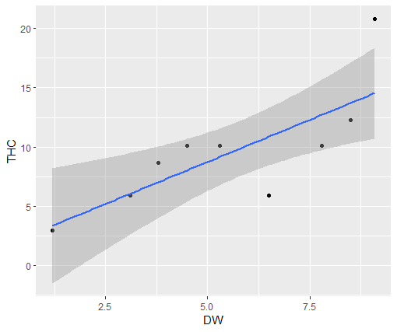
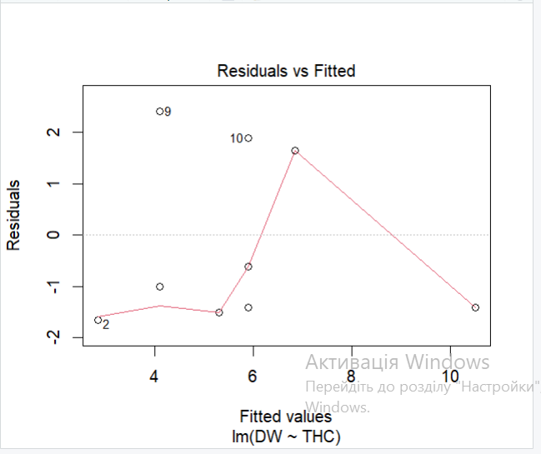
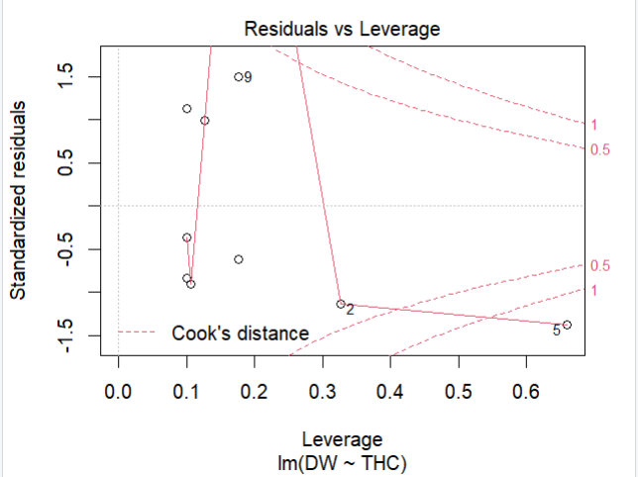
Results:
Response: DW
Df Sum Sq Mean Sq F value Pr(>F)
THC 1 39.244 39.244 12.509 0.007655 **
Residuals 8 25.097 3.137

