Slide 1
Practical 9
Task B

Slide 2
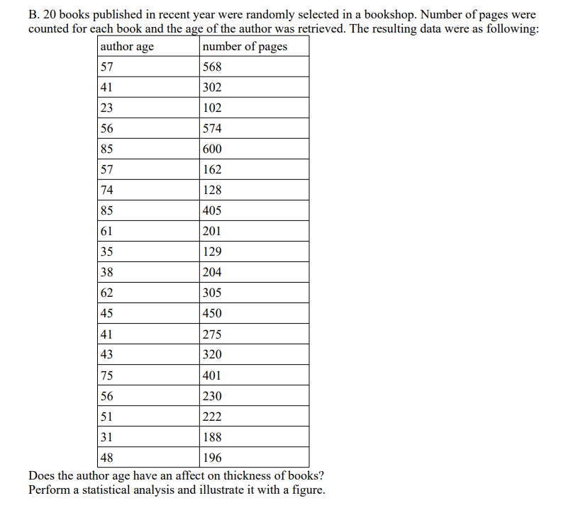

Slide 3
Codes for analysis
Books<-read.delim2("clipboard")
summary(Books)
cor.test(Books$age,Books$pages)
summary(lm(Books$age~Books$pages))
ggplot(Books, aes(x=age, y=pages))+geom_point()+ geom_smooth(method="lm", col=1)+theme_classic()

Slide 4
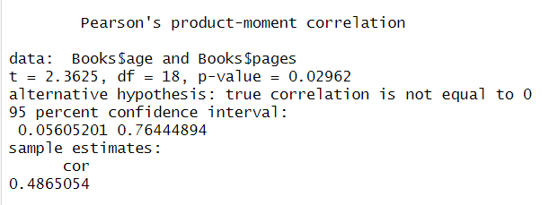
Correlation

Slide 5
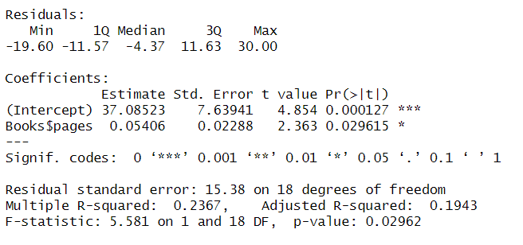
Correlation using Linear Regression

Slide 6
