Slide 1
Oogenesis
Helena nejezchlebová

Slide 2
How to successfully complete the course?
1) the attendance is compulsory. If you are absent, find a solution of this situation with the teacher individually
2) all protocols accepted by the teacher; always hand over your protocols regularly at the beginning of the next lesson
3) homework at the end of the semester: add labels to unlabelled schemes ☺

Slide 3
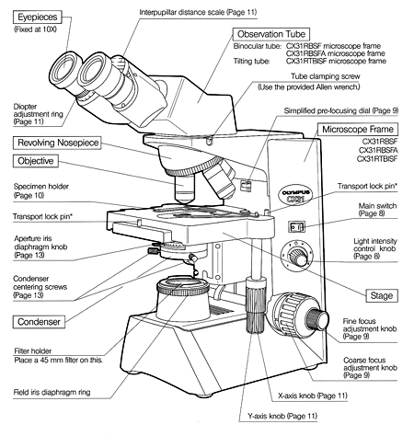
Place the microscope slide with the specimen within the stage clips on the fixed stage
Rotate the lowest power lens into position. While watching from the side to insure that the lens doesn't touch the specimen, turn the coarse focus knob to move the stage as close as it can get to the lens without touching the lens. (Always watch from the side whenever you move a specimen towards any objective lens to make sure the lens doesn't crash through the specimen and get damaged!)
Now, while looking through the ocular lens, turn the coarse focus knob carefully, and slowly move the stage away from the lens until the specimen comes into focus. Then, use the fine focus knob to bring the specimen into sharp focus.
Routinely adjust the light source for optimum illumination for each new slide and for each change in magnification.
Once you have brought the specimen into sharp focus with the first 3 lenses (from low-power to high-power), preparation may be made for visualizing the specimen under oil immersion. Place a drop of oil on the slide directly over the area to be viewed. Rotate the nosepiece until the oil-immersion objective locks into position. Care should be taken not to allow the high-power objective to touch the drop of oil. The slide is observed from the side as the objective is rotated slowly into position. This will ensure that the objective will be properly immersed in the oil. The fine-adjustment knob is readjusted to bring the image into sharp focus.

Slide 4
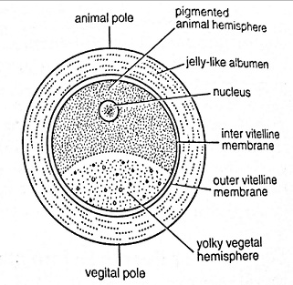
Oocytes
ova (plural, lat.), ovum (singular, lat.)
unicellular formations that contain genetic information and nutrition material for the early stages of embryo development
spherical, with an asymmetric internal structure
during oogenesis, animal-vegetal polarity arises, the animal pole contains germinal vesicle; vegetal pole is rich in yolk
the amount of yolk (proteins, lipids and glycogen to nourish the embryo) correlates with the duration of development reguired before the individual can feed itself after hatching or before placental attachement with mother is established
the envelopes: membrana vitellina (vitelline envelope), albumen („egg white“), shell membranes, calcium shell; zona pellucida in mammals;
the plasma membrane of an egg is covered by a glycoprotein layer in mammals (=zona pellucida) and generally referred to as vitelline envelope which plays an important role in fertilization. Eggs deposited on land (reptiles, birds) have hard shells. Eg. the yolky chicken egg is surrounded initially by a vitelline envelope. Above this envelope, “egg white” is deposited + shell membranes are added.
quantity of yolk and its distribution in the eggs → different types of cleavage after fertilization
fertilization → holoblastic (total) cleavage (sea urchins, amphibians,…)
→ meroblastic (partial) cleavage (superficial; insects, disc-shaped in fish, reptiles and birds)
when an egg develops in the presence of follicular cells, the oocyte is surrounded by one or more layers of epithelially arranged cells that are not its sister cells. These are somatic cells and form a follicle around the oocyte. We encounter this development, for example, in insects, reptiles, birds and mammals, incl. humans.

Slide 5
Eggs based on yolk quantity and its distribution
Holoblastic (oligolecital) eggs
alecital: without yolk
isolecital: even distribution of yolk, total cleavage → equally large blastomeres, equal cleavage (mammals, echinoderms)
heterolecital: moderate yolk at vegetative pole (amphibians)
Meroblastic (polylecital) eggs
telolecital: most vertebrates (fishes, reptiles, birds), yolk accumulated at the vegetative pole (heavier), the opposite animal pole contains the nucleus of the oocyte → inequal cleavage: animal pole → micromers, vegetative pole → macromers; special type: discoidal cleavage
centrolecial: arthropods, superficial cleavage
Note: humans - oligolecital, isolecital oocytes, total and equal cleavage
accordint to Knoz J., 1979

Slide 6
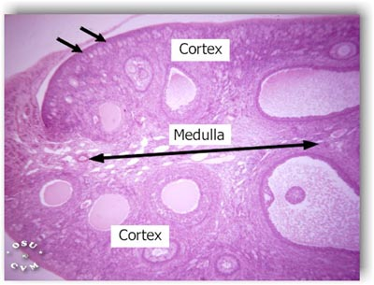
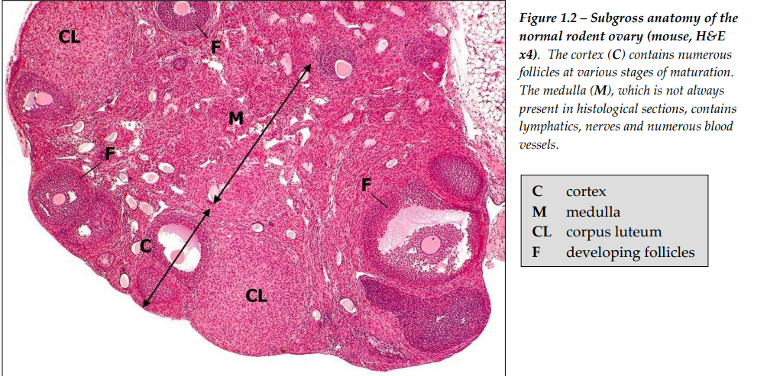
Mammalian ovary
almond shaped organs, covered by ovarian surface epithelium and a thick connective tissue = the tunica albuginea
an outer cortex: the follicles with oocytes
inner medulla: fibrous tissue, rich blood supply, lymphatic ducts, nerves
http://legacy.owensboro.kctcs.edu/gcaplan/anat2/notes/APIINotes2%20female%20reproductive%20anatomy.htm

Slide 7
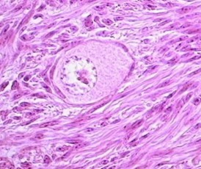
A) Primordial follicles
the earliest stage of follicular development
they form during early fetal development
located within the peripheral cortex (beneath the tunica albuginea)
a large oocyte + a layer of flattened follicular cells
arrested in prophase I
http://sprojects.mmi.mcgill.ca/menstrualcycle/primordialfollicle.html

Slide 8
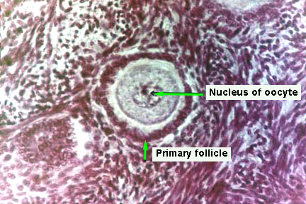
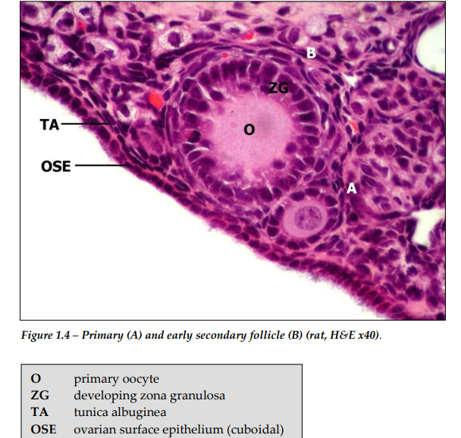
B) Primary follicles
a oocyte + a layer of cuboidal follicular cells
the zona pellucida (clear zone around the oocyte in the photo) covers the oocyte and separates it from the cuboidal follicular cells
http://legacy.owensboro.kctcs.edu/gcaplan/anat2/notes/APIINotes2%20female%20reproductive%20anatomy.htm

Slide 9
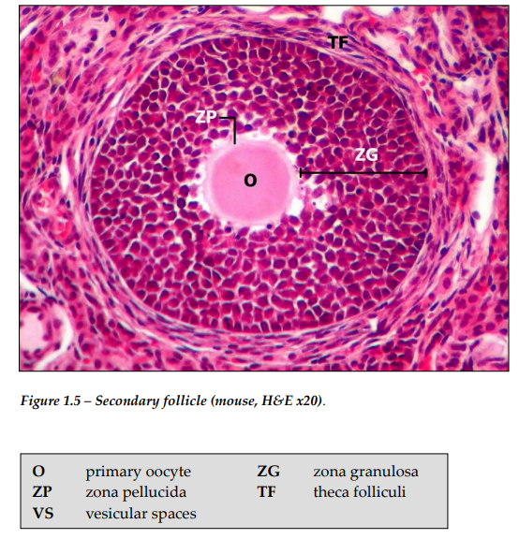
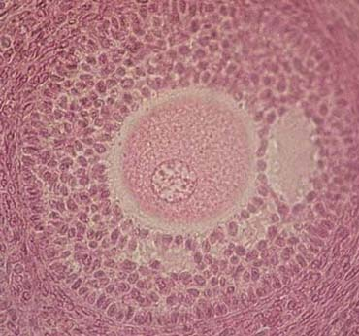
B) Secondary follicles
the stratified granulosa cells there are large with lacunae (later → follicular antrhum - antrum folliculi)
the stromal cells around the follicle → an inner layer (theca interna, cells → steroids + an outer layer (theca externa, concentrically arranged stromal cells = a support for the developing follicle)

Slide 10
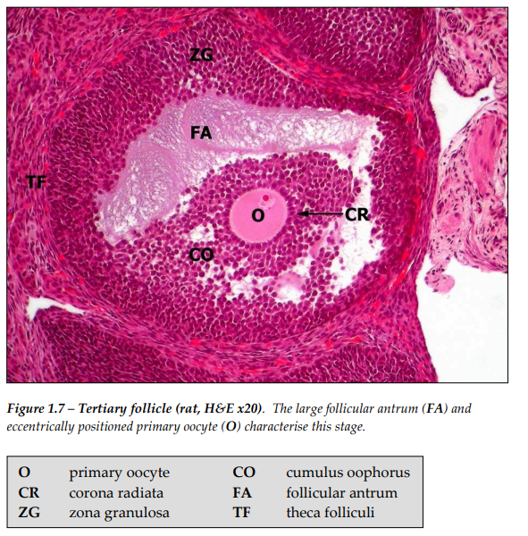
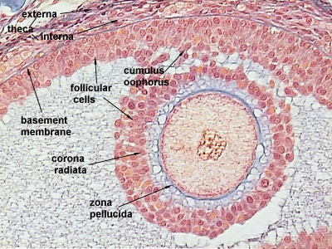
C) Graafian /ovulatory /mature f.
a large anthrum folliculi surrounded by many layers of cuboidal granulosa (follicular) cells
the oocyte is situated eccentricaly within the follicle in a small hillock (cumulus oophorus which protrudes into the antrum)
the oocyte is of its full size, ready for ovulation
the zona pellucida is covered by a layer of follicular cells (corona radiata)
the theca interna is separated from the follicle by a basement membrane and has a rich vascular supply
the spindle-shaped cells in the theca externa are densely packed and is blend with the theca interna cells
http://legacy.owensboro.kctcs.edu/gcaplan/anat2/notes/APIINotes2%20female%20reproductive%20anatomy.htm

Slide 11
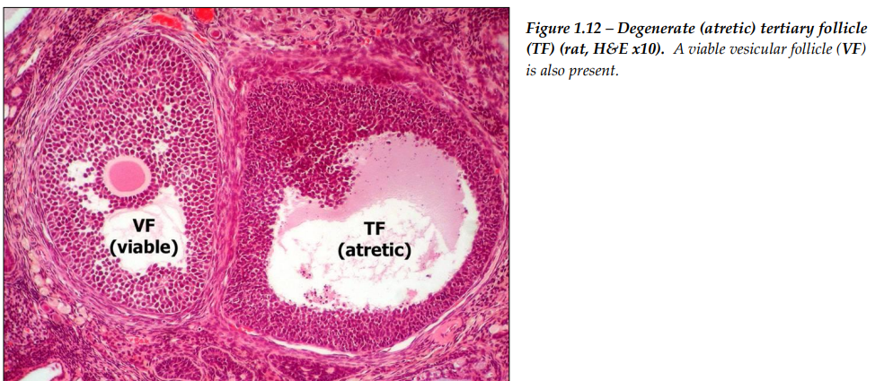
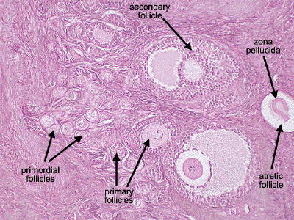
Atresia
may begin at any stage in follicular development
shrinkage and lysis of the cytoplasm of the oocyte and granulosa/follicular cells

Slide 12
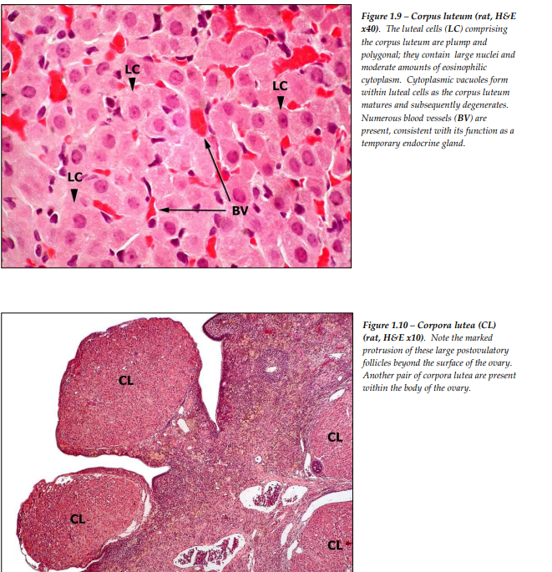
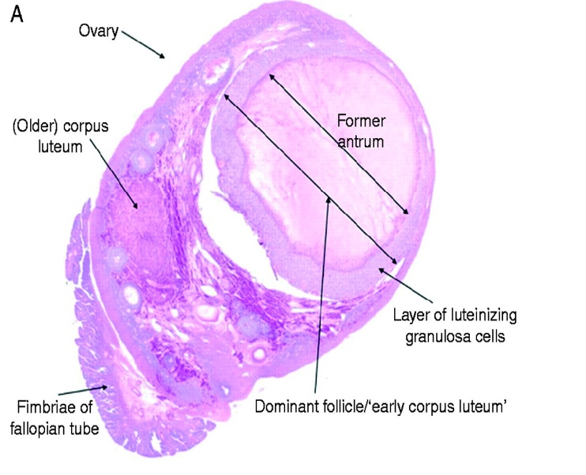
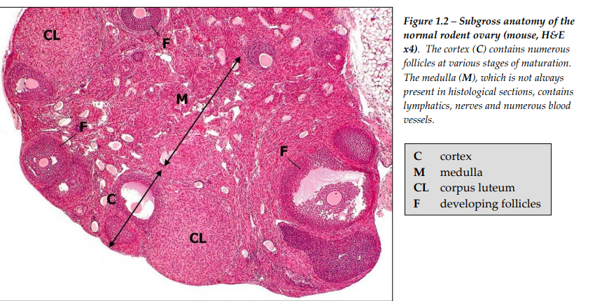
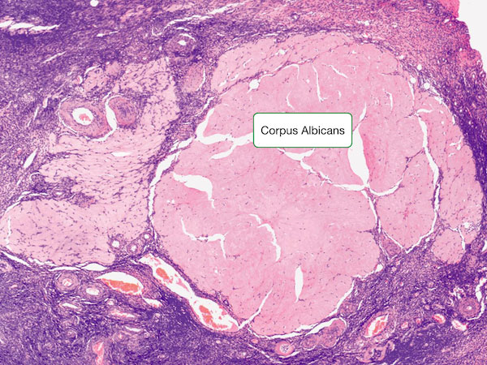
After ovulation
after ovulation, the Graffian follicle collapses, becomes infolded and invaded by blood vessels → corpus luteum (yellow body)
during the luteinisation, the granulosa and thecal cells undergo hypertrophy, this is accompanied by degeneration of the basement membrane separating the theca interna and granulosa cells, and infiltration of the postovulatory follicle by blood vessels from the theca interna).
if the egg is fertilized: the corpus luteum → corpus luteum of pregnancy (supported by hCG)
if the egg is not fertilized: the corpus luteum degenerates, is infiltrated with collagen (and a few fibroblasts) → the corpus albicans (white body, fibrous structure)

Slide 13
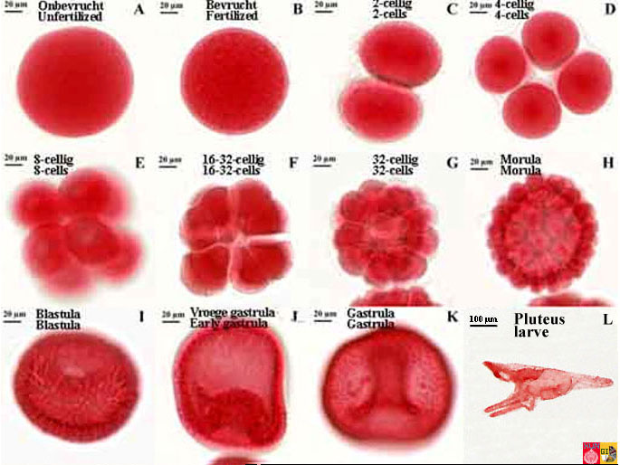
Example of a fertilized isolecal egg - a sea urchin
sea urchin = a model for studying the cleavage of isolecithal eggs
unfertilized egg coated with vitelline membrane (A)
after fertilization: fertilization membrane, formed immediately after fertilization and prevents the penetration of other sperm (B)

Slide 14
Used and recommended literature
B. M. Carlson: Human embryology and developmental biology. 4th edition, 2009. ISBN 978-323-05385-3.
R. Hodge: Developmental Biology : from a Cell to an Organism. 1st edition, 2010. ISBN 978-0-8160-6683-4.
L. C. Junqueira, J. Carneiro,R. Kelly R. Základy histologie. H+H, Jinočany. 1997, 502 s.
R. Lüllmann-Rauch- Histologie. Překlad 3. vydání. Grada, Praha. 2012, 556 s.
K. L. Moore, T. V.N Persaud: The developing human. Clinically oriented embryology. 8th edition, 2008. ISBN 978-0-8089-2387-9.
J. M. W Slack: Essential developmental biology. 2nd edition, 2006. ISBN 978-4051-2216-0.
Z. Vacek: Embryologie. 2006. ISBN 978 -80-247-1267-3.
www.sci.muni.cz/ptacek
https://www.oecd.org/chemicalsafety/testing/40581066.pdf
http://medcell.med.yale.edu/histology/ovary_follicle.php
http://histol.narod.ru/atlas-en/female-01-en.htm
http://www.reproduction-online.org/content/142/6/893/F10.large.jpg
www.sci.muni.cz/ptacek
https://histology.medicine.umich.edu/resources/female-reproductive-systém
https://www.oecd.org/chemicalsafety/testing/40581066.pdf
https://zoomify.luc.edu/female/dms174/popup.html
http://legacy.owensboro.kctcs.edu/gcaplan/anat2/notes/APIINotes2%20female%20reproductive%20anatomy.htm
http://sprojects.mmi.mcgill.ca/menstrualcycle/primordialfollicle.html
https://www.vcbio.science.ru.nl/en/virtuallessons/embryology/seaurchinstage/
https://www2.hawaii.edu/~johnb/micro/m140/syllabus/week/handouts/m140.2.4.html

