Slide 1
SPERMATOGENESIS
helena nejezchlebová

Slide 2
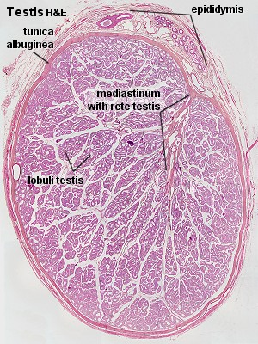
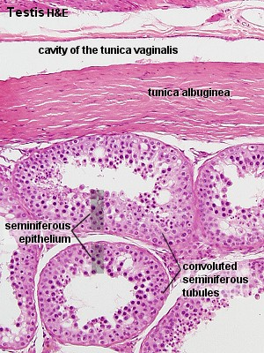
Testis
→ sperm and hormonal production (→ hormones – androgens – testosterone: stimulates the accessory male sexual organs, influences the development of the masculine extragenital characteristics)
the testis is surrounded by a thick capsule (tunica albuginea), externally covered by a serosa
from the tunica albuginea, a mass of connective tissue (mediastinum testis), projects into the testis ; further delicate fibrous septa divide the parenchyma of the testis into lobuli testis
lobules contain convoluted seminiferous tubules, each seminiferous tubule continues near the mediastinum into a straight tubule (tubulus rectus). The straight tubules continue into rete testis (system of cavities in the mediastinum).
interstitial tissue between the convoluted tubules = loose vascular connective tissue, blood vessels, nerves, Leydig cells → testosterone
Ledig cells are present in clusters , the cytoplasm is acidophilic and finely granular; the large round nucleus is eccentricly in the cell
Bi6140c Embryologie-cvičení

Slide 3
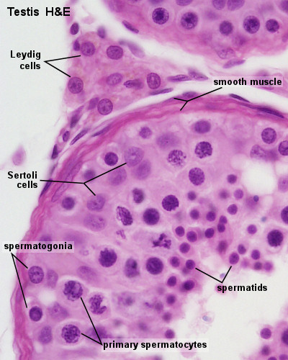
Seminiferous tubules
the tubules are surrounded by a thick basal lamina, externally covered by cca 3 layers of smooth muscle cells (or myoid cells). The insides of the tubules are lined
seminiferous epithelium = spermatogenic cells + Sertoli cells.
Sertoli cells:
nutritive function, mechanical support for the spermatogenic cells
evenly distributed between spermatogenic cells
far less numerous than the spermatogenic cells and are evenly distributed between them
irregular/columnar shape, they extend from the basement membrane to the luminal space
ovoid/anguar large, lightly stained nucleus with a large nocleolus; a fold in the nuclear membrane is characteristic for Sertoli cells but not always visible in the LM
Sertoli cells are a laterally connected by tight junctions= basis for the blood-testis barrier
http://www.lab.anhb.uwa.edu.au/mb140/corepages/malerepro/malerepro.htm
Bi6140c Embryologie-cvičení

Slide 4
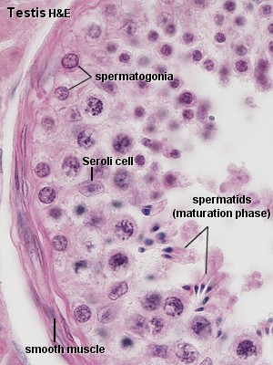
Seminiferous tubules
spermatogonia and primary spermatocytes: in the basal compartment
other cellular stages: in the adluminal compartment
Bi6140c Embryologie-cvičení

Slide 5
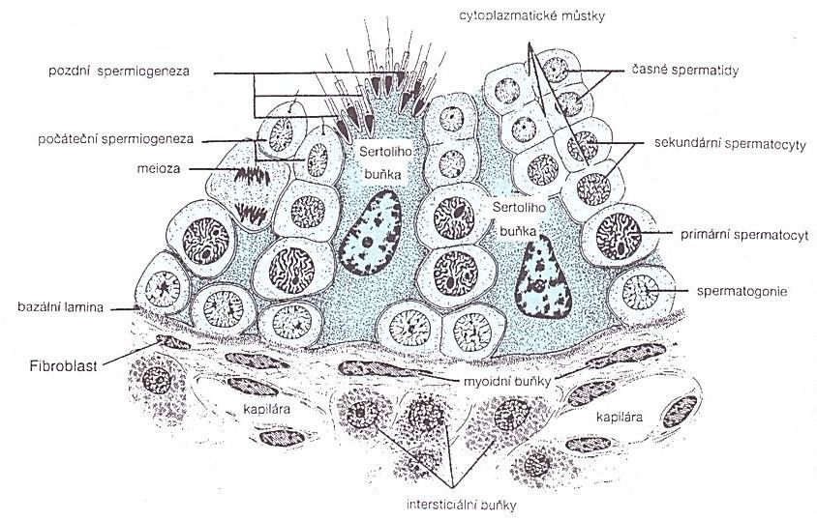
Spermatogenesis
Spermatogonia: dormant until puberty, always in contact with the basal lamina of the tubule;
type A spermatogonia: stem cells → new generations of type A and type B spermatogonia; rounded nucleus with fine chromatin grains, 1-2 nucleoli. b) type B spermatogonia: rounded nuclei with chromatin granules of variable size, 1 nucleolus; theydo not function as stem cells → final mitosis →
Primary spermatocyty: lie in the cell layer luminal to the spermatogonia. They appear larger than spermatogonia. They immediately enter the prophase of the first meiotic division, which is extremely prolonged (about 22 days!). A large number of primary spermatocytes is always visible in cross-sections through seminiferous tubules. Cell divisions, from the formation of primary spermatocytes and onwards, to the production of the spermatocytes, are incomplete - the cells remain connected by bridges of cytoplasm. The completion of the first meiotic division →
Secondary spermatocytes: smaler, seldom seen in histological slides (rapidly enter and complete the second meiotic division) →
Spermatids: in the luminal part of the seminiferous tubules, small (10 µm in diameter), initially very light (eccentric) nukleus; the chromatin condenses during the maturation into spermatozoa → the smaller and darker nucleus; →
Jungueira a kol, 1997
Bi6140c Embryologie-cvičení

Slide 6
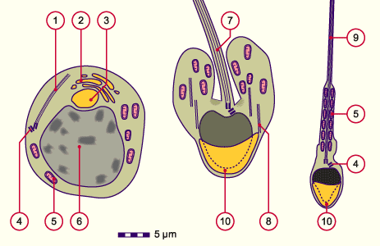
Spermatozoa
head, neck, tail
the head: flattened, the nucleus with condensed chromatin; cca 2/3 of the nucleus covered by the acrosome (enzymes important tor fertilization).
the neck: short (cca 1 µm)
the tail = middle piece + principal piece + end piece;
the middle piece: axonema (arrangement of microtubules), a sheath of mitochondria.
the principal piece: axonema
 | 1 Axonemal structure,first flagellar primordium 2 Golgi complex 3 Acrosomal vesicle 4 Pair of centrioles (distal and proximal) 5 Mitochondrion 6 Nucleus 7 Flagellar primordium 8 Microtubules 9 Sperm cells tail 10 Acrosomal cap
anonymus (2)
Bi6140c Embryologie-cvičení

Slide 7
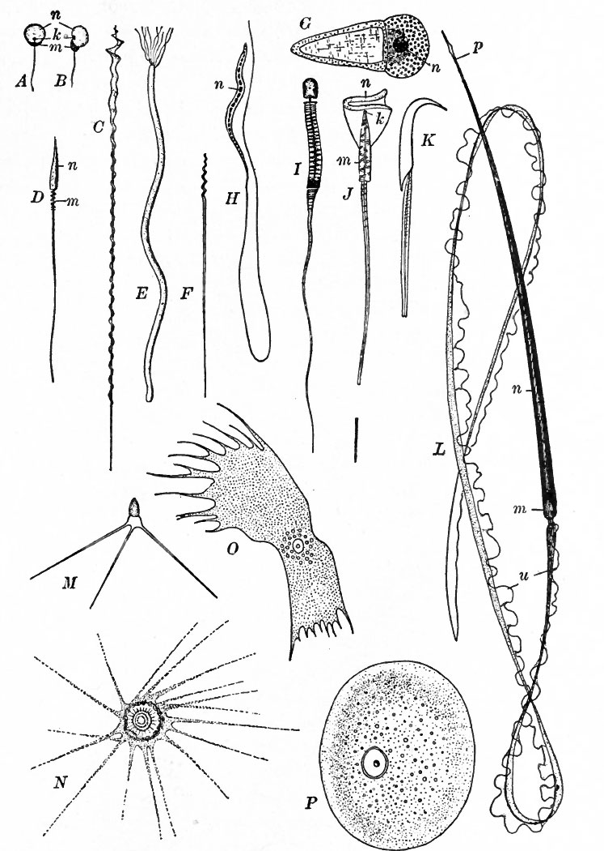
Sperm of different animal species
Sperm of different animals: A, B fish; C, D birds; E, F snakes; G Nematoda - Ascaris; H bats; K rodents; L newt; M, N, O, P crustaceans; u: undulating membrane
in most cases: with flagellum
Bi6140c Embryologie-cvičení

Slide 8
Used and recommended literature
B. M. Carlson: Human embryology and developmental biology. 4th edition, 2009. ISBN 978-323-05385-3.
R. Hodge: Developmental Biology : from a Cell to an Organism. 1st edition, 2010. ISBN 978-0-8160-6683-4.
L. C. Junqueira, J. Carneiro,R. Kelly R. Základy histologie. H+H, Jinočany. 1997, 502 s.
R. Lüllmann-Rauch- Histologie. Překlad 3. vydání. Grada, Praha. 2012, 556 s.
K. L. Moore, T. V.N Persaud: The developing human. Clinically oriented embryology. 8th edition, 2008. ISBN 978-0-8089-2387-9.
J. M. W Slack: Essential developmental biology. 2nd edition, 2006. ISBN 978-4051-2216-0.
Z. Vacek: Embryologie. 2006. ISBN 978 -80-247-1267-3.
www.sci.muni.cz/ptacek
http://lecannabiculteur.free.fr/SITES/UNIV%20W.AUSTRALIA/mb140/CorePages/MaleRepro/male.htm
http://www.lab.anhb.uwa.edu.au/mb140/corepages/malerepro/malerepro.htm
Bi6140c Embryologie-cvičení

