Slide 1
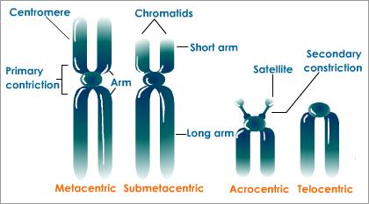
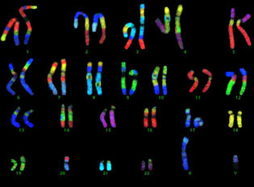
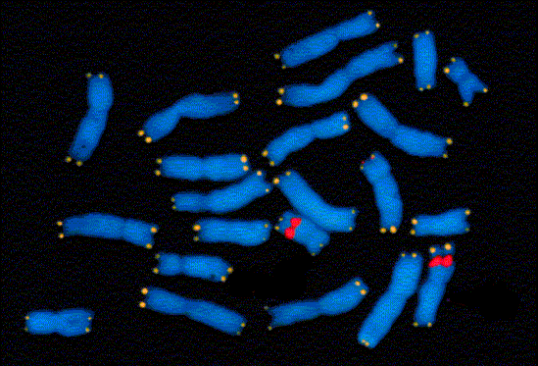
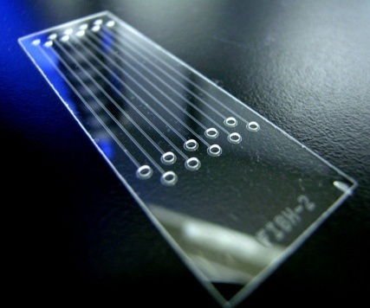
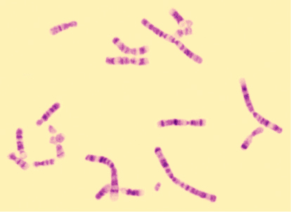
MODULARIZACE VÝUKY EVOLUČNÍ A EKOLOGICKÉ BIOLOGIE
CZ.1.07/2.2.00/15.0204
CYTOGENETIC METHODS

Slide 2
analysis of chromosome microscopic structure
the term „chromosome“ – 1888 Wilhelm Waldeyer
chromosomal theory of heredity: 1st half of 20th century – Theodore Boveri, Walter S. Sutton, Thomas H. Morgan
study of chromosomes: karyology, cytogenetics
karyotype = arranged set of chromosomes in a cell

Slide 3
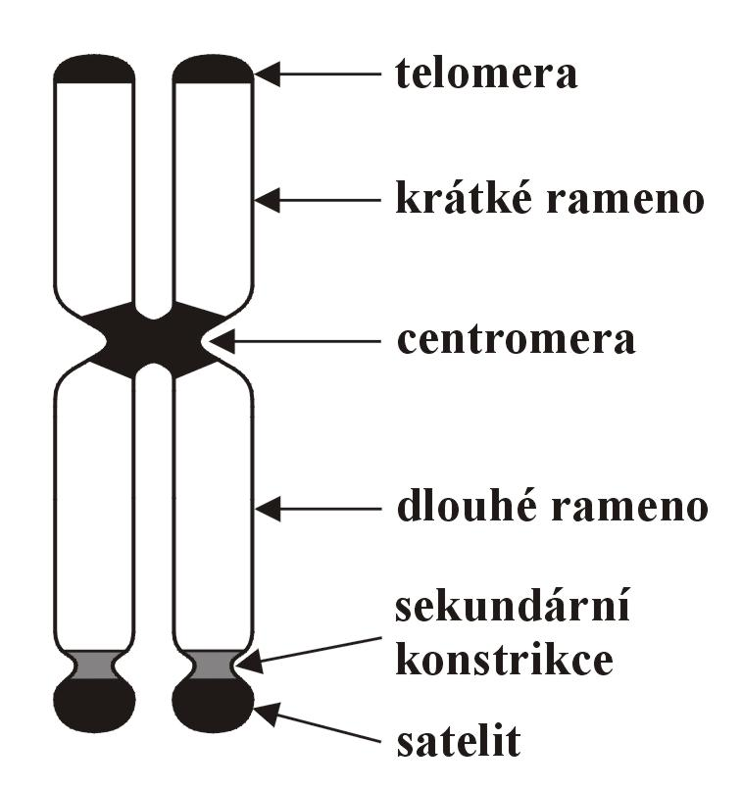
Structure of metaphase chromosome
telomere
short arm
centromere
long arm
secondary constriction
satellite

Slide 4
Classification of chromosomes according to position
of centromere:
metacentric
submetacentric
(subtelocentric)
acrocentric
telocentric

Slide 5
History of cytogenetics
Role of key technological innovations – 4-5 breakthroughs in the modern era:
1. Discovery of hypotonic treatment → spread of metaphase chromosomes
2. Cultivation of peripheral blood (leucocytes) and fibroblasts
3. Chromozome banding techniques
4. In situ hybridization (ISH)
5. Immunochemical methods used along with ISH → non-radioisotopic detection of hybridized probes (NISH) using different fluorochromes („chromosome painting“)

Slide 6
Mitotic preparations
1. Choice of tissue with high mitotic activity
root cap, embryos, larvae, regenerating tissues
adult vertebrates: bone marrow, kidney, spleen, gonads, interstitial epithelium, corneal epithelium
sometimes subcutaneous stimulation, or intraperitoneal injection of phytohemagglutinin, pokeweed (Phytolacca americana), or active yeast suspension

Slide 7
Mitotic preparations
2. Discontinuation of mitotic divisions in vivo or in vitro
cytostatic: colchicine, colcemid, vinblastine
in vivo: advantage: cheaper, simpler
disadvantage: necessary to sacrifice
in vitro: peripheral blood cultivation (short-term) and fibroblasts (long-term)
advantage: possibility to synchronize cell divisions → reduction of variation in chromosome condensation, increased quality, reduced consumption of cytostatic
disadvantage: more laborious, expensive, time-consuming, fewer chromosomes

Slide 8
Mitotic preparations
3. Hypotonization of cells
0,075 M KCl solution, distilled water also possible
4. Fixation
Carnoy mixture = methanol : acetic acid (glacial) 3:1
multiple changes
(in squash preparations: ethanol instead of methanol)

Slide 9
Mitotic preparations
5. Slide preparation
2 basic techniques:
„squash“ (rozmačkání): maceration or gentle grinding of tissue pieces on a slide and squashing with silicone cover slip
„splash“ (nakapání): cell suspension is poured in drops onto a cover slip using Pasteur pipette → chromosome spread due to surface tension; after dripping either „air-drying“, or „flame-drying“

Slide 10
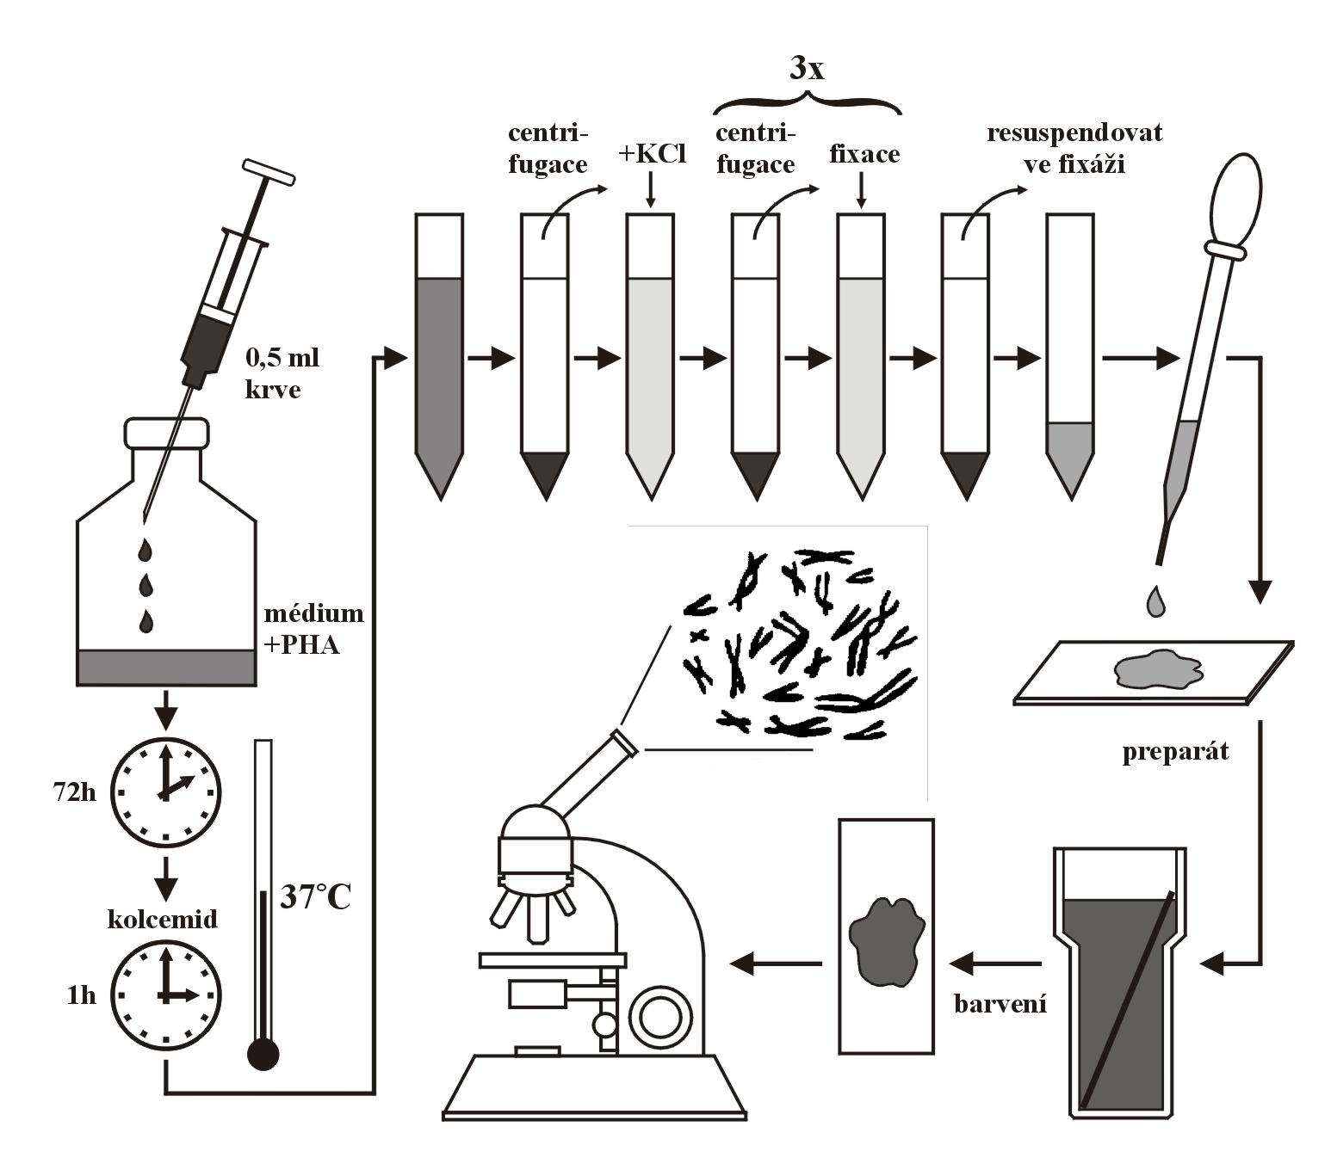
Blood cultivation

Slide 11
Meiotic preparations
testes, pollen mother cells
hypotonization with sodium citrate, procedure similar to mitotic preparation
meiotic progress and importance of particular stages; synaptonemal complexes (SC), lampbrush chromosomes

Slide 12
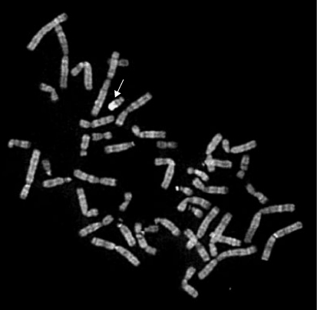
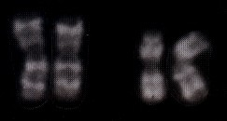
Differential staining - chromosome banding
Q-banding (quinacrine):
differential fluorochrome excitation and extinction depending on presence of AT bases
quinacrine staining, UV ⇒ short period of visibility

Slide 13
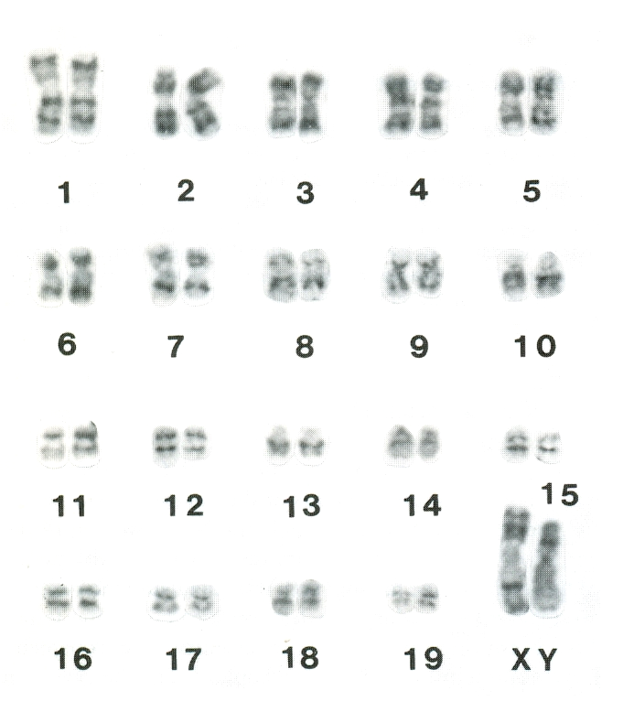
Differential staining - chromosome banding
G-banding (Giemsa, GTG-banding):
effect of denaturation agents on stability of protein and nucleic chromatin constituents
positive (dark) bands ≈ areas rich of AT bases (isochores)
effect of trypsin (chymotrypsin, NaOH)
Giemsa staining
rypoš obří
(Fukomys mechowi)

Slide 14
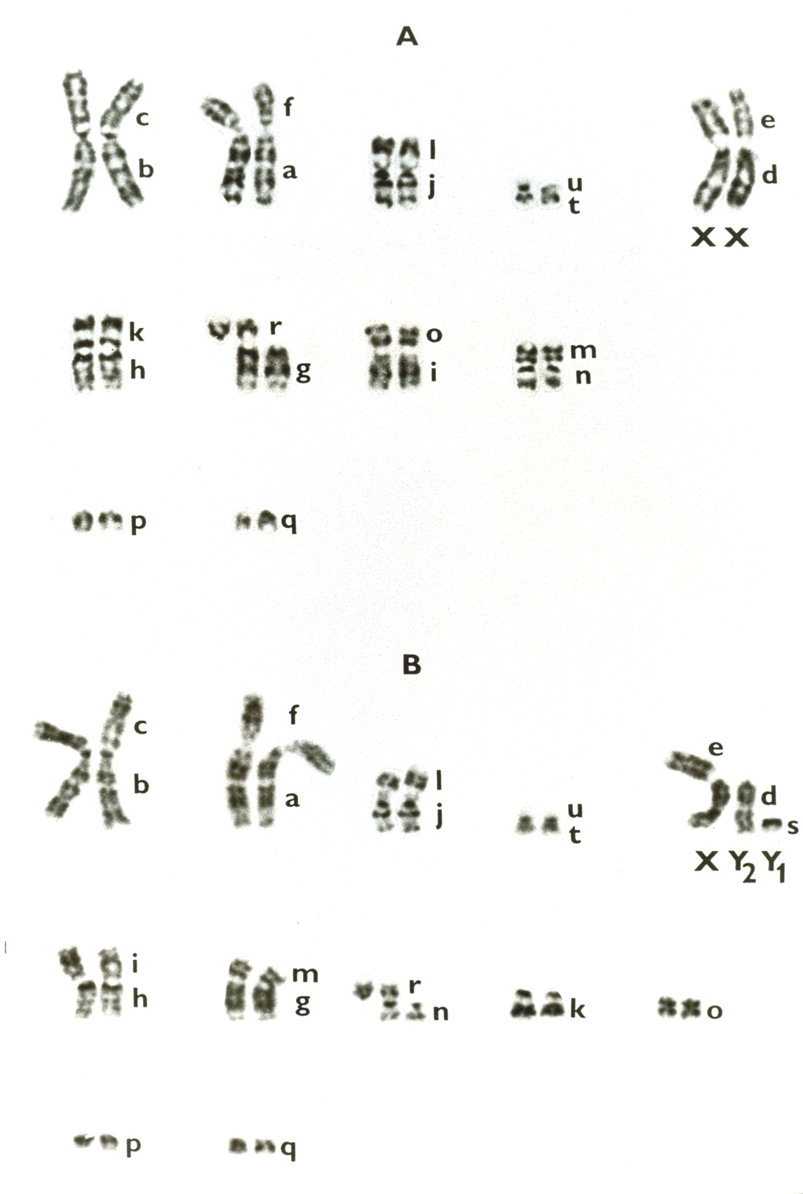
rejsek obecný
(Sorex araneus)

Slide 15
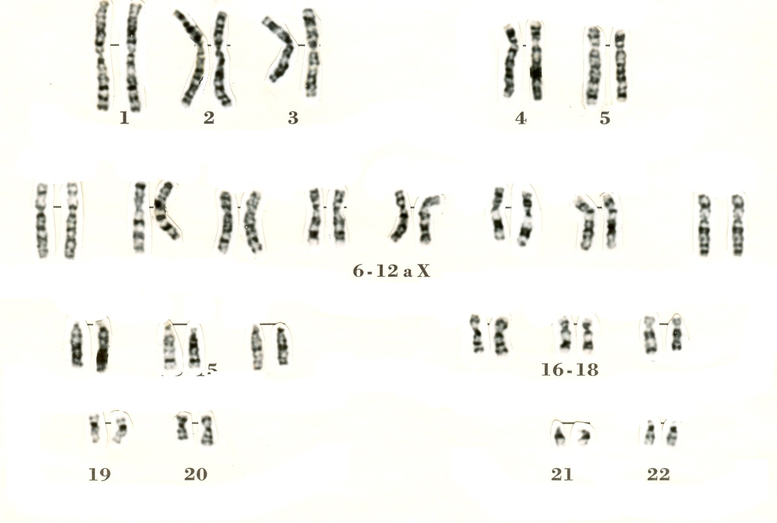
Homo sapiens

Slide 16
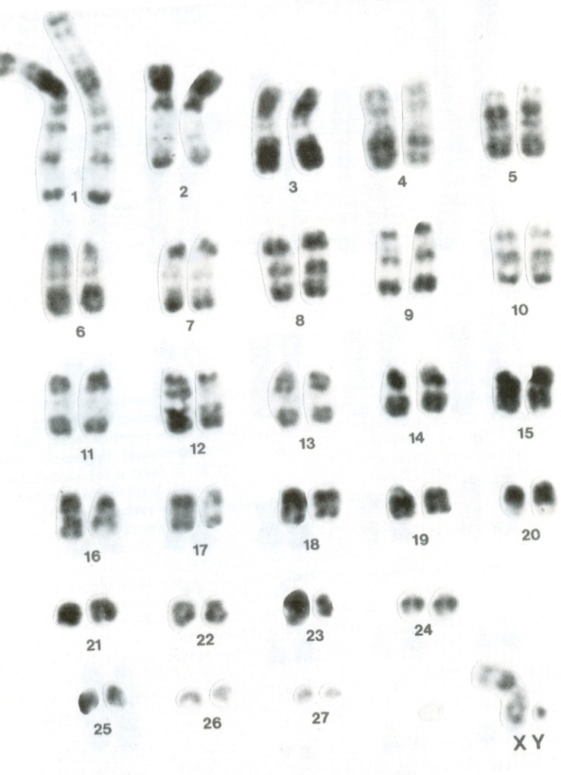
Differential staining - chromosome banding
R-banding (reverse banding):
denaturation by alcaline treatment at high temperature (80–90°C) followed by DNA renaturation
dark bands ≈ isochores rich of GC bases
Giemsa or acridine orange staining
Lemur catta

Slide 17
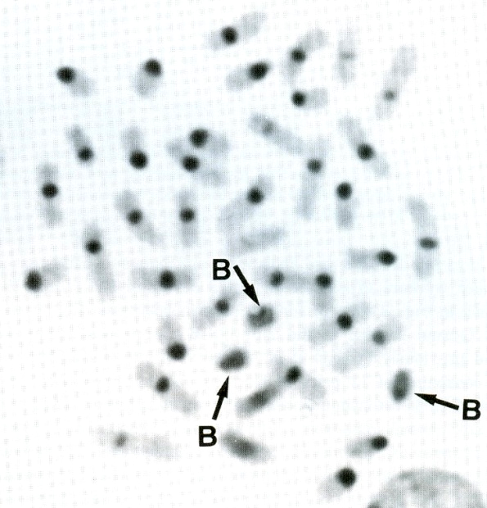
Differential staining - chromosome banding
C-banding (constitutive heterochromatin):
treatment first with strong acid (1M HCl), followed by alcaline (Ba(OH)₂) and heterochromatin renaturation in saline buffer (2×SSC) at high temperature (60°C)
euchromatin dissolving
Giemsa staining (visualization of satellite DNA)
psík mývalovitý
(Nyctereutes procyonides)

Slide 18
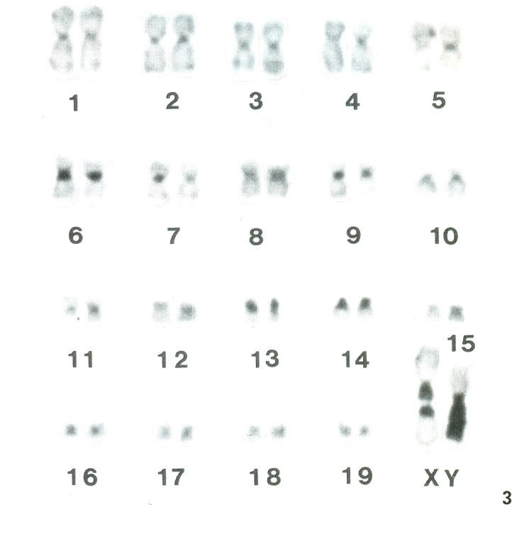
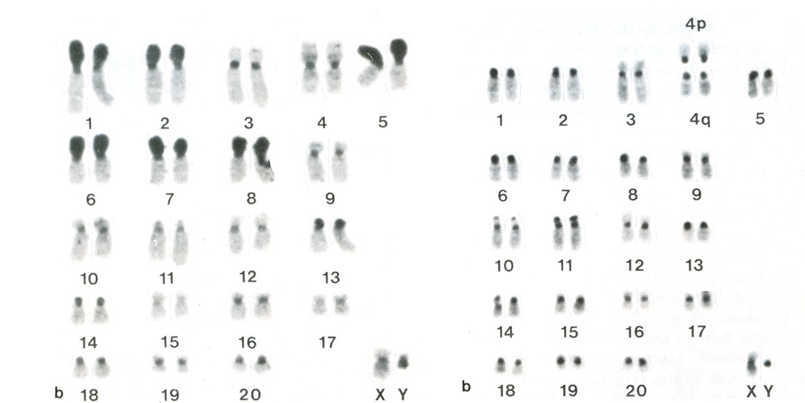
rypoš obří
(Fukomys mechowi)
kolčava a hranostaj

Slide 19
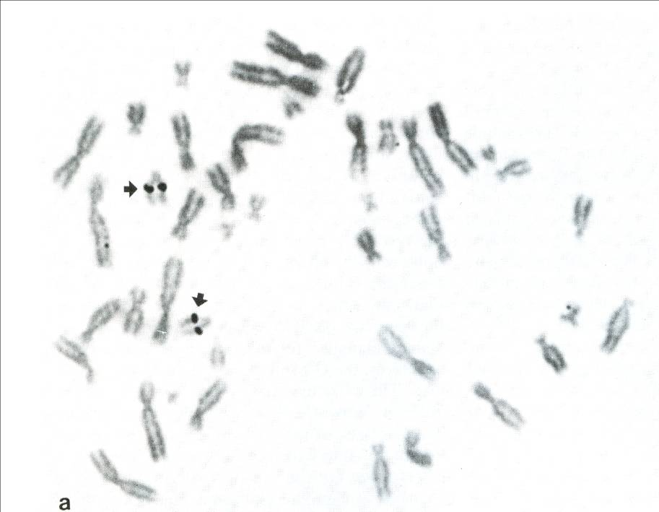
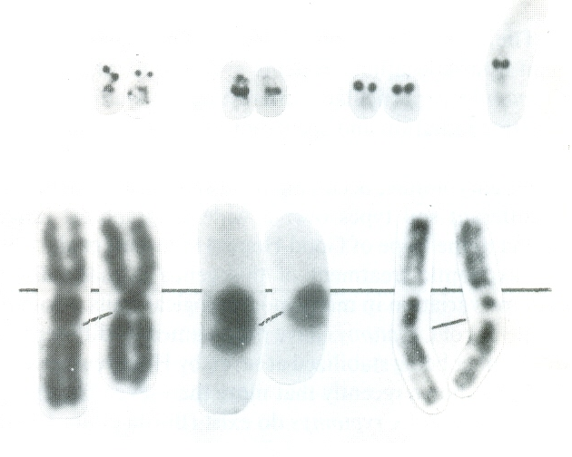
Differential staining - chromosome banding
Ag-NOR:
gelatine + formic acid, AgNO₃ staining
nucleolus organizer visualization (only active NORs)
rypoš obří
(Fukomys mechowi)
kolčava

Slide 20
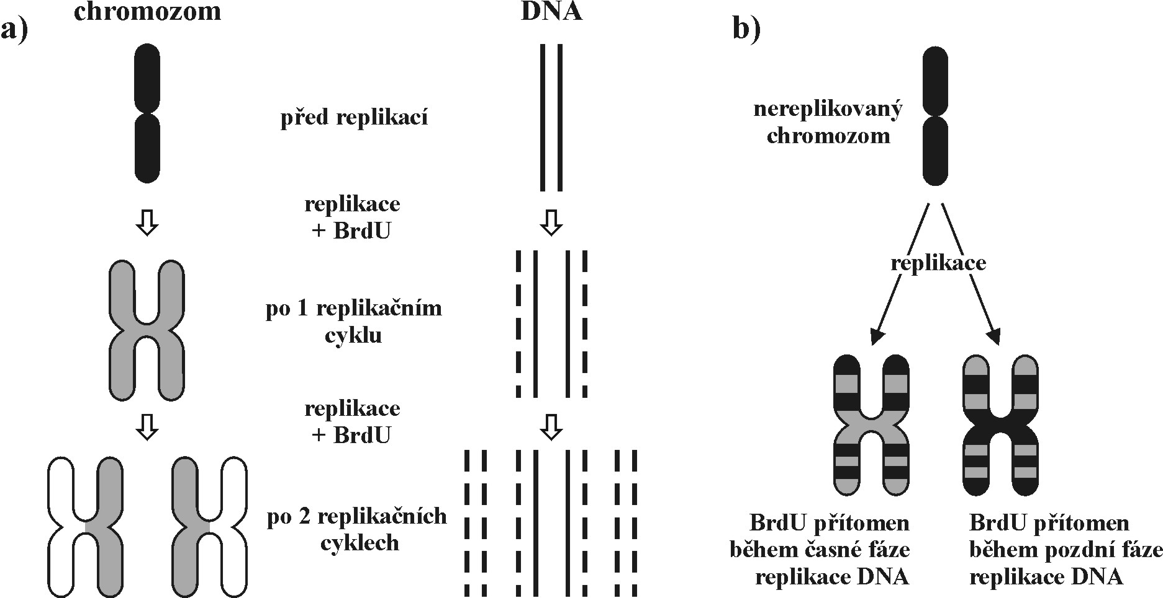
Differential staining - chromosome banding
BrdU:
replication with artificial precursor (5-bromo-2´-deoxyuridine) → visualization of sister chromatid interchanges

Slide 21
Fluorescent in situ hybridization (FISH)
in situ hybridization of chromosomes with flurescently labelled probe
possibility of simultaneous application of several probes
visualization: antibodies specific for biotin (avidin, streptavidin) are conjugated either with fluorochrome (e.g. fluoresceine isothiocyanate, FITC), or enzymes (e.g. alcaline phosphatase, peroxidase), reaction with specific substrate

Slide 22
Fluorescent in situ hybridization (FISH)
CISS, chromosome in situ supression hybridization
PRINS, primed in situ labelling
GISH, whole genome in situ hybridization
FACS, fluorescence activated cell sorting
„chromosome painting“

Slide 23
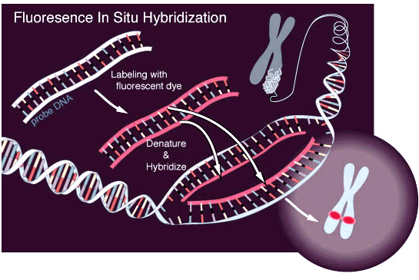
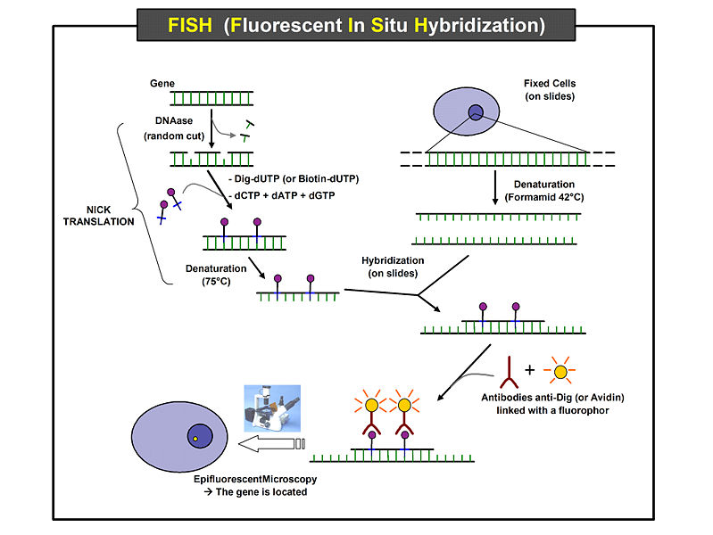

Slide 24
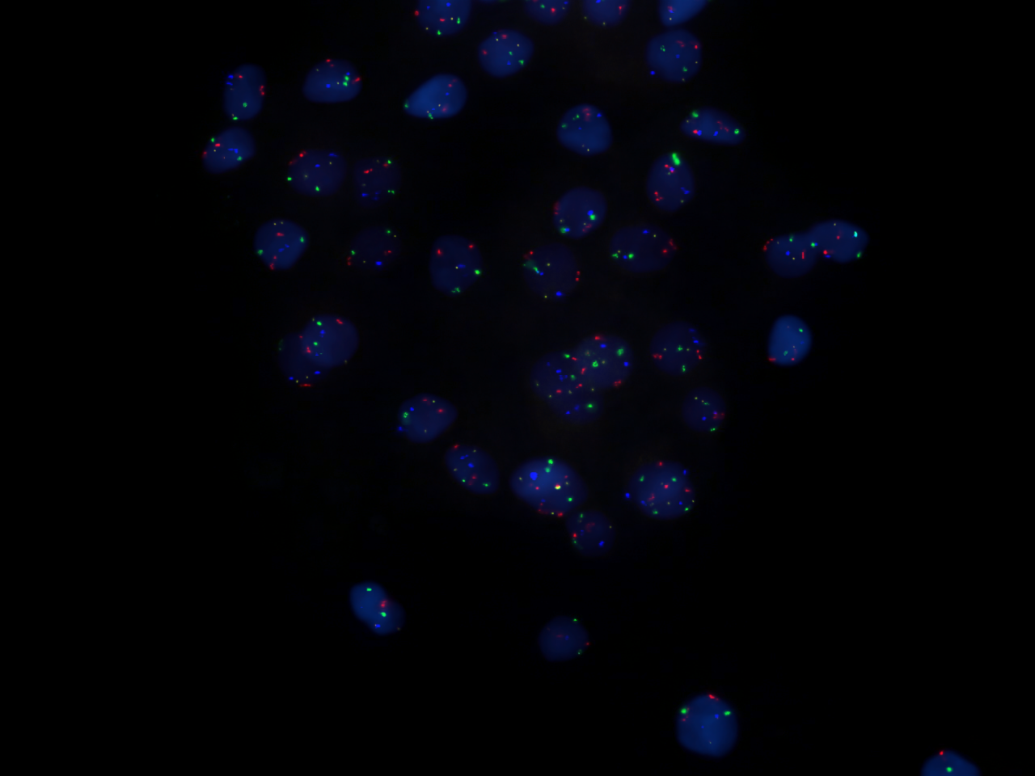
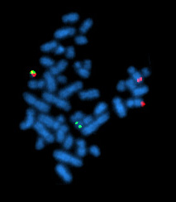
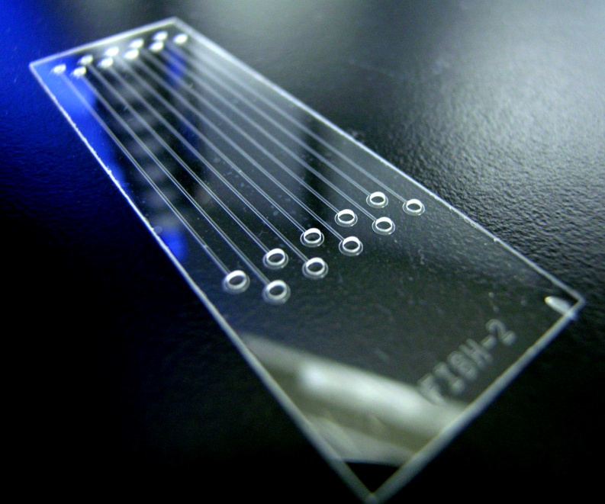

Slide 25
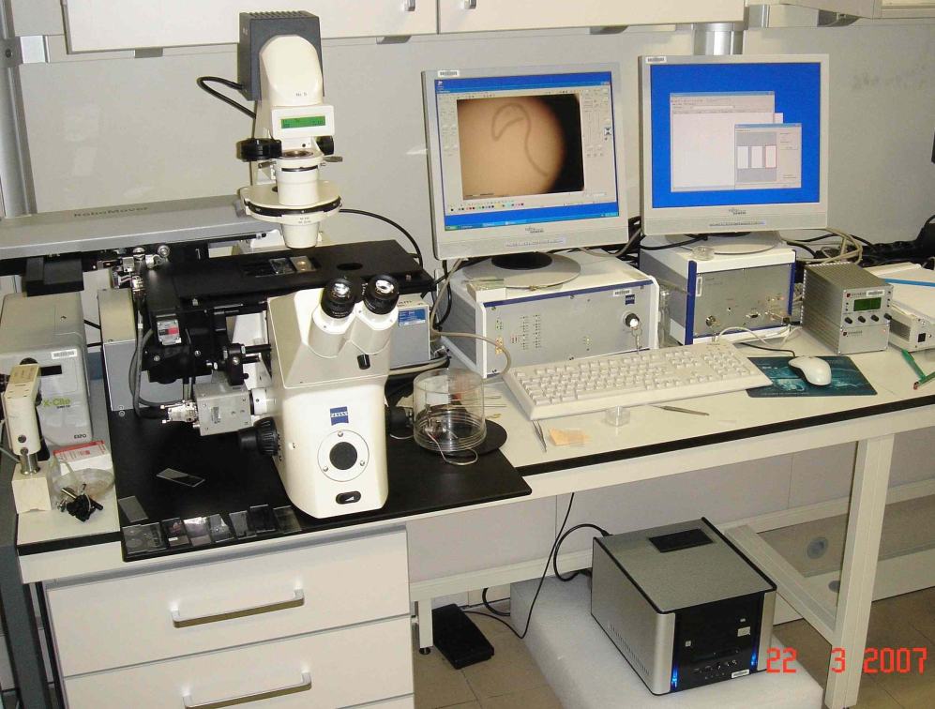
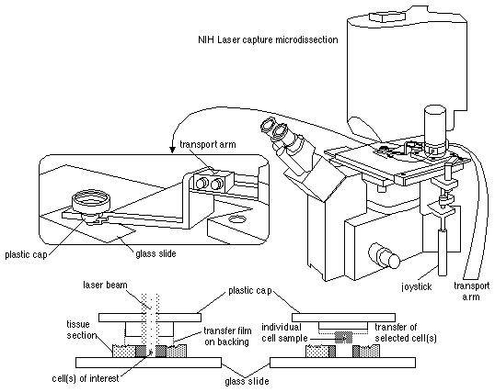
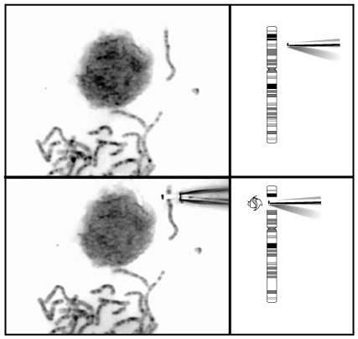
Microdissection

Slide 26
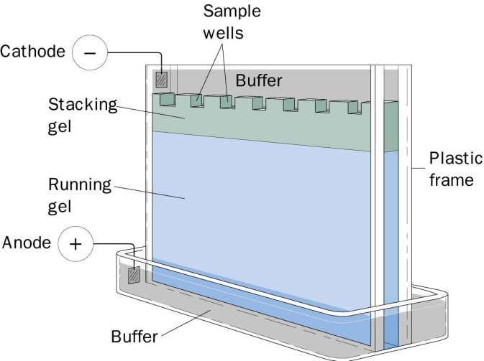
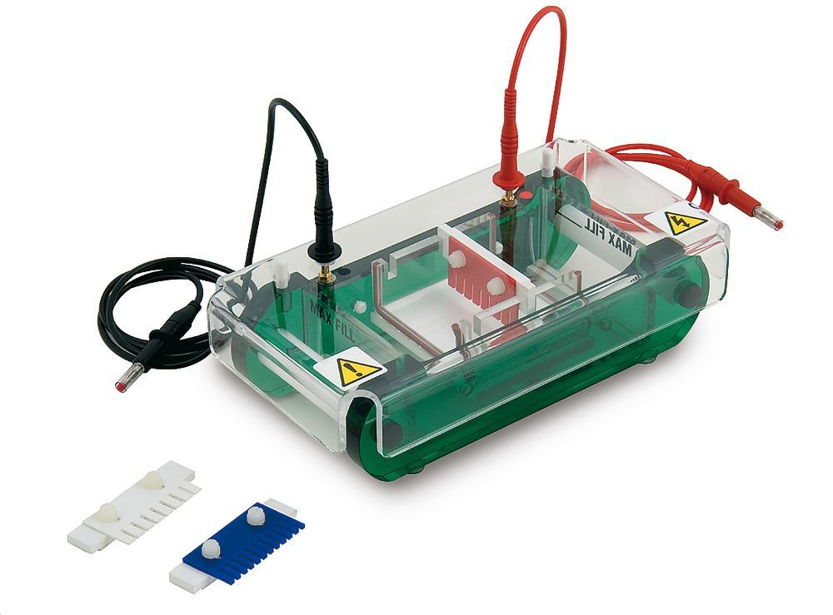
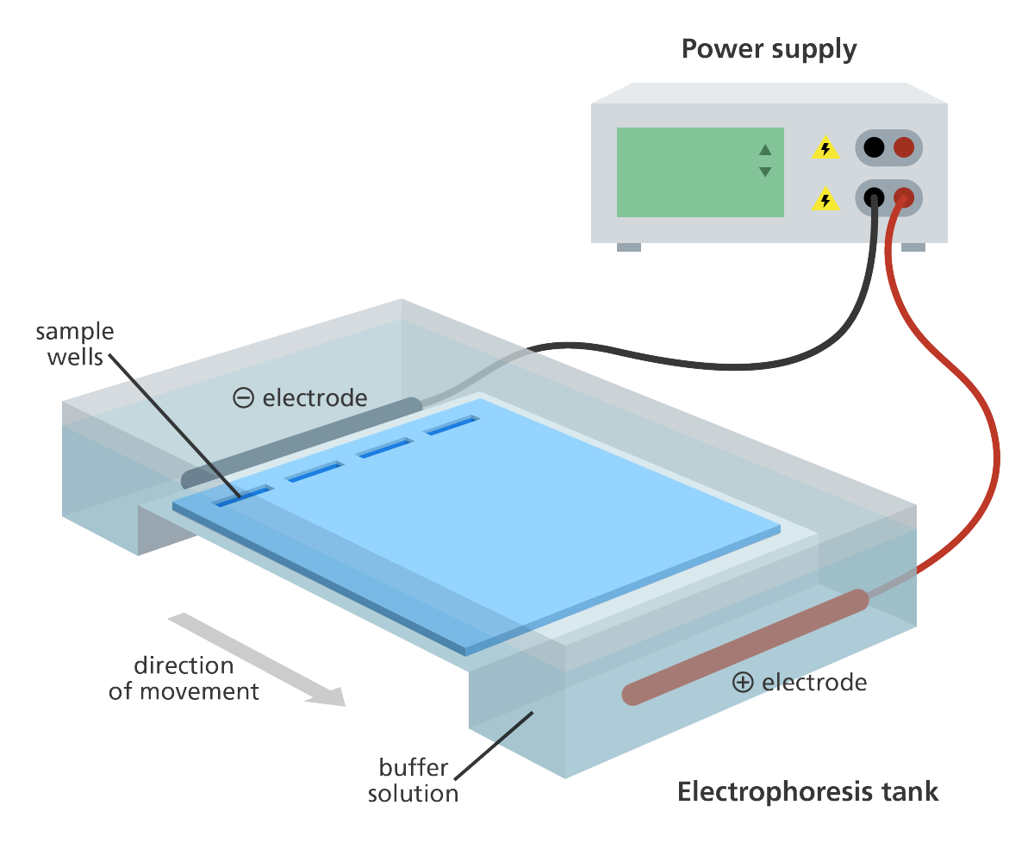
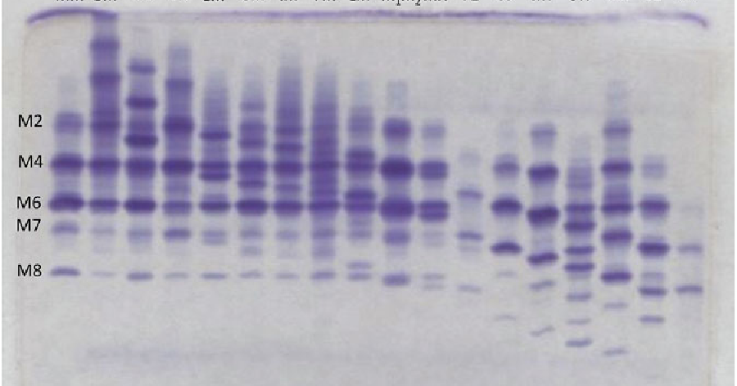
ELECTROPHORESIS
of enzymes and other proteins

Slide 27
electrophoresis: from Greek, "to bear electrons" = motion of particles under influence of electric field
until end of 1950’s, studies of genetic variation in natural populations only based on Mendelian morphological traits or polytene chromosomes → To what extent these traits represent real genetic variability in nature?
amino acid substitutions can be detected by sequencing – if this is impossible, we can use protein electrophoresis

Slide 28
of 20 AA, 3 bear positive charge (Arg, Lys, His), 2 negative charge (Asp, Glu)
besides charge, also macromolecule size and conformation (-S-S- bridges, van der Waals forces, hydrogen bonds, electrostatic forces); buffer pH
electric charge stabilization → specific buffer of high ionic strength and pH as different from given protein’s pI^{*)} as possible: pH 3–10, most often pH 6,5–9,5
charge of most proteins at pH 8–9 negative → migration to anode
*) isoelectric point

Slide 29
Principle of electrophoresis known since end of the 19th century
1937 – Thisselius: “moving boundary” method
1949 – Linus Pauling: filter paper – abnormal Hb (sickle cell anemia)
1955 – Oliver Smithies: starch
1957 – Hunter & Moeller: employment of catalytical abilities of enzymes (histochemical staining)
1966 – application on natural populations: Harry Harris (humans), Richard Lewontin & John Hubby (fruit fly)

Slide 30
Media (gels):
starch (SGE): molecule size + charge
cellulose acetate (CAGE): charge
agar, agarose (AGE): charge
polyacrylamide (PAGE): molecule size + charge

Slide 31
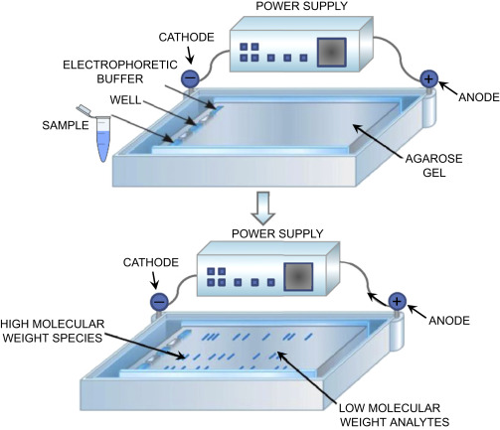
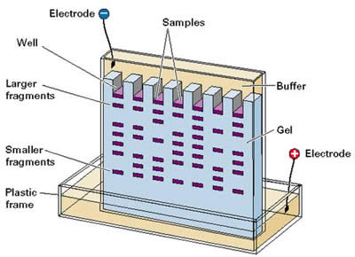
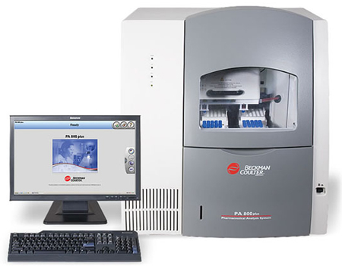
Electrophoretic methods
horizontal
vertical
capillary

Slide 32
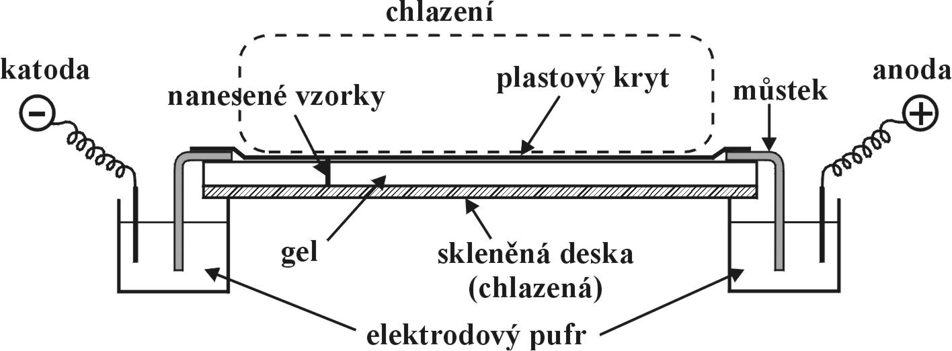
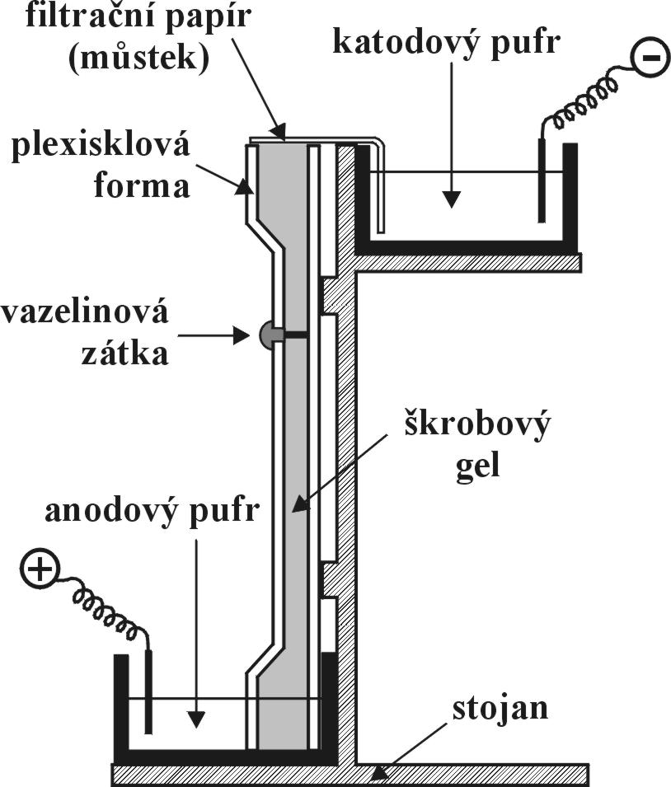
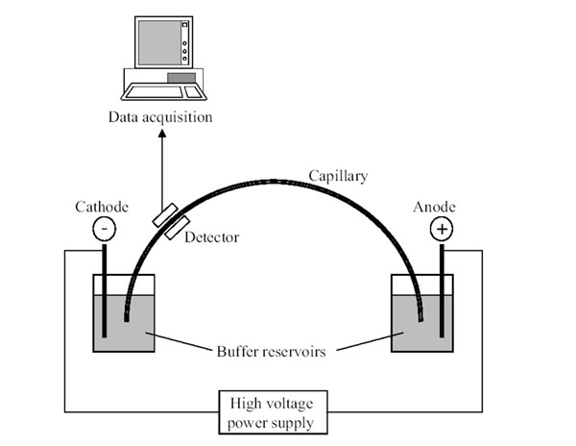

Slide 33
Electrophoretic methods
1. ELFO in continuous buffer
2. ELFO in discontinuous buffer (multiphasic ELFO):
2 gels of different concentrations - concentrating and separating gels
protein „sandwiching“ on boundary between „leading“ a „dragged“ ions; on its own = isotachophoresis

Slide 34
3. Isoelectric focusing, IEF:
= separation of molecules by differences in their isoelectric points
solution of ampholytes (syntetic polyamino polycarbonates) with a range of pI put in gel; in electric field → stable pH gradient; ampholytes kept in gel by strong acid at anode and strong alcali at cathode
molecules stop where zero charge (pI point)

Slide 35
4. urea and SDS ELFO:
SDS = sodium dodecyl sulphate (= anion detergent):
can dissolve some proteins and cleave some polymers
SDS brings about strong charge of proteins, migration only based on molecular weight
urea: similar to SDS, but protein charge normal – migration based on total charge
(likewise, proteins can be denatured by increased teperature → ELFO)
5. Two-dimensional (2-D) ELFO:
electric field applied first in one direction and then perpendicularly
e.g. 1. stage = IEF, 2. stage = SDS ELFO – combination of pI and molecular weight

Slide 36
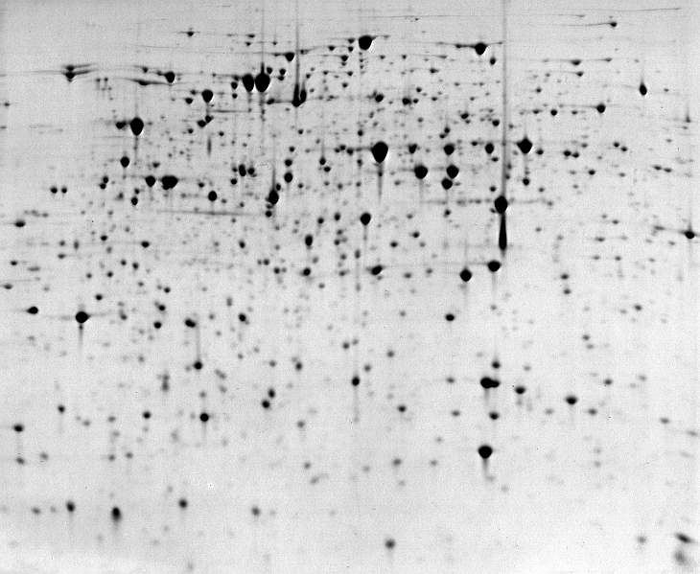
Electrophoretic methods
Ability to separate blood plasma proteins:
CAGE: 5 bands
SGE: 15 bands
PAGE: 19 bands
IEF > 30 bands
2-D ELFO ~300 spots ≈75-100 polypeptides

Slide 37
Protein detection
non-specific: amido black, Coomassie Brilliant Blue R
specific: dyes for glycoproteins, lipoproteins histochemical staining of enzymes: catalysis of specific substrate processing connected with staining reaction - nitro tetrazolic salts (MTT, NBT) + PMS (phenazine methosulphate); Fast Blue RR; Fast Garnett GBC, Fast Black K - reduction of NAD⁺, NADP⁺ - sometimes necessary to add other enzymes

Slide 39
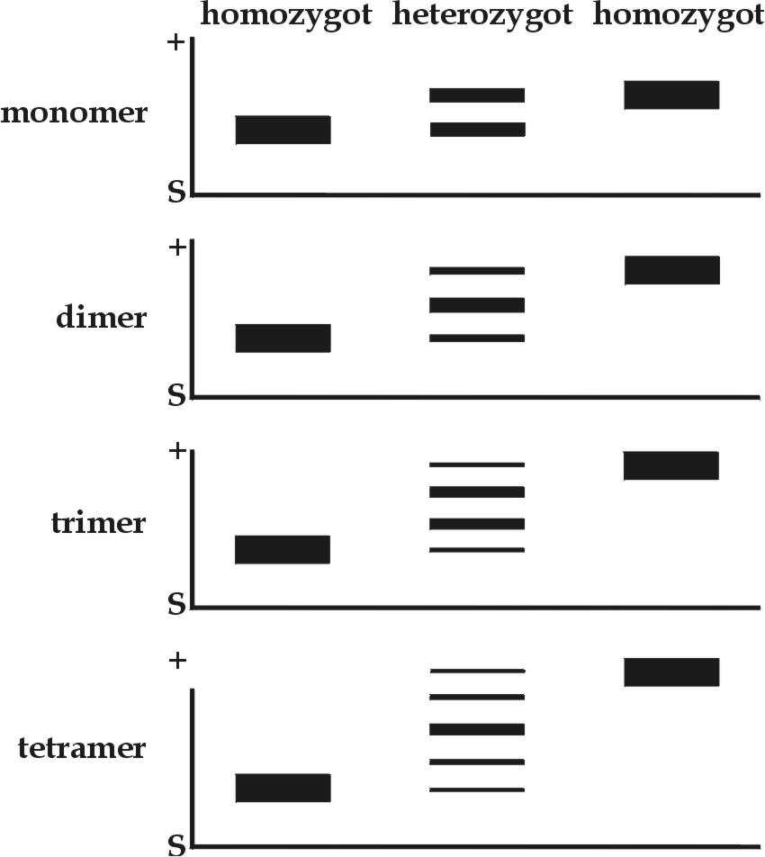
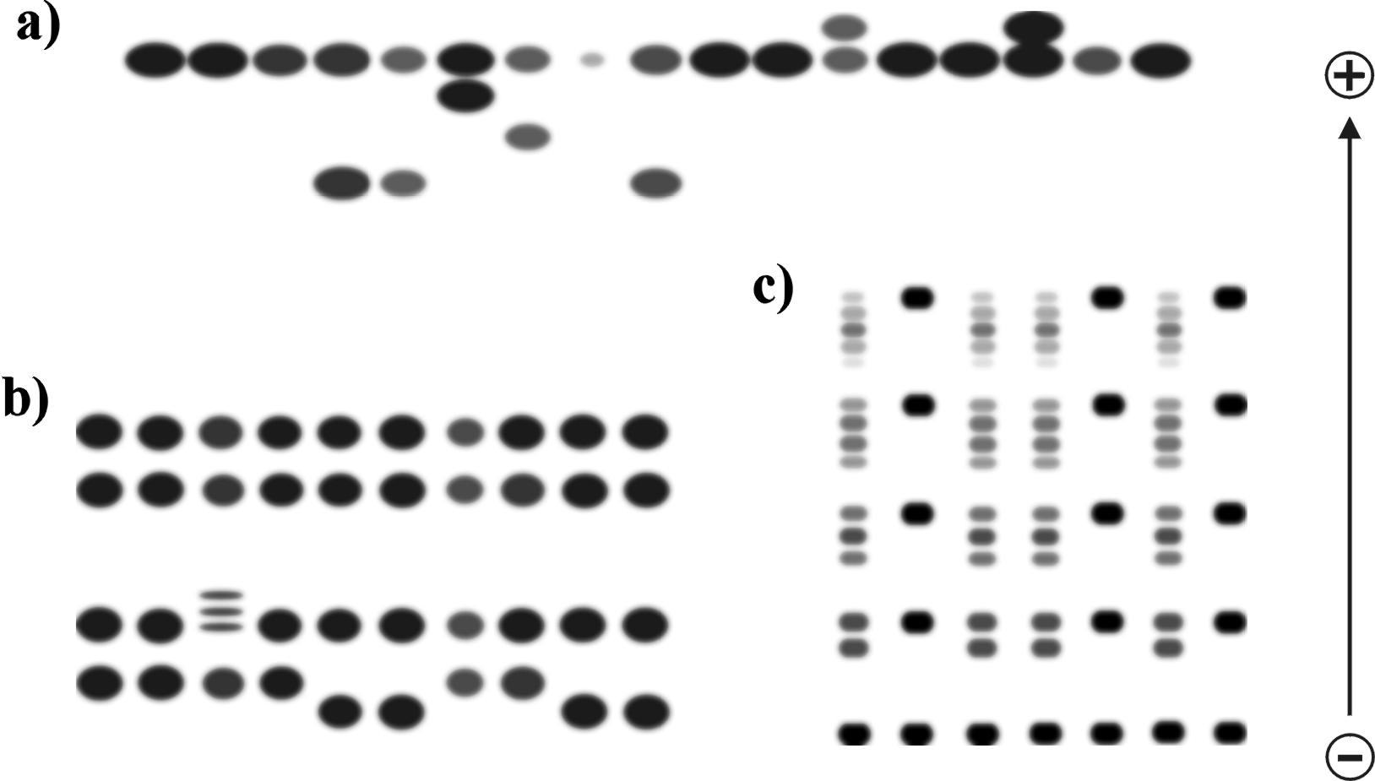
stained gel = in general electrophoretogram, if enzymes specifically stained = zymogram (enzymogram)
bands = „electromorphs“, „alelles“, „alellomorphs“
isozymes, allozymes

