Slide 1
PRACTICAL CONSIDERATIONS DIFFERENCES BETWEEN LABORATORY AND LARGER SCALE PROCESSES
Petr Beňovský

Slide 2
DIFFERENCES BETWEEN ACADEMIC AND PROCESS CHEMISTRIES
Academic – Discovers, reveals, disputes, confirms, brings new knowledge.
Small amount of material.
Process – Selects, optimizes, seeks for efficiency, defines control points, considers efficiency and environment (also safety).
Role of chemical engineers.
Relatively large amount of material.

Slide 3
BASIC CONSIDERATIONS
Laboratory (medicinal) chemistry (mg – g) has to be diverse and flexible; chromatography is very common;
Can be done by a synthetic chemist only;
Process (up-scaled) pathway (kg – 1000 kg) must provide reliable results, the procedure is expected to be robust, repeatable, simple, economic, focuses on safety (both operators and patients); chromatography is to be avoided;
Must be done in mutual cooperation of a synthetic chemist (thinks in steps) and a chemical engineer (thinks in unit operations)

Slide 4
BASIC CONSIDERATIONS
What is scale-up?
Transferring a lab-scale chemical process to pilot or commercial equipment with:
same yield
same selectivity
same quality
Scale-up is NOT a simple linear increase in geometric dimensions

Slide 5
BASIC CONSIDERATIONS
What is scale-up?
MORE
understanding of critical parameters
how to control them
ability to predict performance at any scale

Slide 6
BASIC CONSIDERATIONS
Laird, T. – How to Minimise Scale Up Difficulties
Appropriate conditions
Correct dosing time
Hazards
Mass transfer issues
Solvent extractions
Optimising using statistical methods
Laird, T. Chemical Industry Digest, p. 51, July 2010

Slide 7
BASIC CONSIDERATIONS
The best way to minimize the scale-up problems is by important data gathering and detailed process understanding.

Slide 8
DIMENSIONAL ANALYSIS
Ideally, dimensions in geometry, velocities of the components, forces on the system, temperatures and concentrations should be kept constant between different scales
Surface area per volume ratio (serious consequences for heat removal and heat input during process scale-up);
Kinematic similarity – they exists when two systems have the same shape and the ratios of the velocities between corresponding places are also equal; Fluid dynamics – the Reynolds number (Re) – it increases during scale-up at a constant stirrer speed as the diameter of the stirrer increases;
Hydrodynamic similarity – they exists when the ratios of forces between corresponding places are also equal in both systems;

Slide 9
DIMENSIONAL ANALYSIS
Thermal similarity – temperature differences between corresponding places in a system have a constant ratio with one another (temperature profile, heat transfer area);
Chemical similarity – concentration differences between corresponding places in two systems have a constant ratio to one another (ratio between the chemical conversion rate, rate of molecular diffusion).

Slide 10
DIMENSIONAL ANALYSIS
Maintaining geometrical similarities for various scales is not practical in batch processing as the jacket heat-exchange area per unit reduces significantly with a scale
 | Reactor Size [L] | Surface Area [m²] | Surface Area / Volume [m²/L] | Factor
Lab Scale | 0.5 | 0.02 | 0.04 | 28.6
 | 10 | 0.20 | 0.02 | 14.3
Pilot Plant Scale | 380 | 2.32 | 0.0061 | 4.4
Large Production | 38 000 | 53.0 | 0.0014 | 1

Slide 11
DIMENSIONAL ANALYSIS
Reynolds number
- gives a measure of the degree of turbulence or the ratio of inertial force to viscous force (the higher Reynolds number the higher turbulence of the system)
R_{e} = ND² ρ/μ (mostly for homogeneous systems)
R_{e} … Reynolds number
N … rotational speed (revolutions per second)
D … diameter of the stirrer (m)
μ/ρ … kinematic viscosity (m²/s)

Slide 12
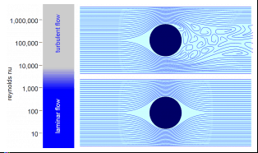
LAMINAR VS. TURBULENT FLOW
Laminar flow – is characterized by smooth or regular paths of fluid particles. The fluid flows in parallel layers with minimal lateral mixing.
Turbulent flow – is characterized by irregular movement of particles. Lateral mixing is very high.

Slide 13
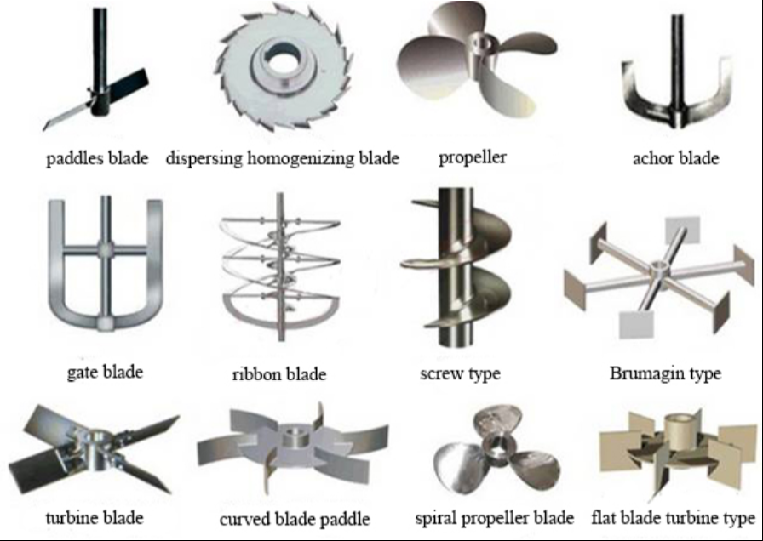
MIXING

Slide 14
DIMENSIONAL ANALYSIS
Maintaining total similarity of all possible scale-up parameters on different scales cannot be established and, in fact, is almost impossible;
A reliable batch process scale-up cannot be simulated in generally applicable mathematical models without a clear understanding of all process and reaction mechanisms;
Regime analysis – significance/trade-off of particular similarities – can be done in an early stage of process development;

Slide 15
DIMENSIONAL ANALYSIS
Regime analysis can be done in an early stage of the process development:
If heat effects are relative small, then the thermal similarity will be easily maintained;
If reaction rate is slow compared to the mixing time, a turbulent regime is not that relevant anymore;
For very rapid reactions any limitation in diffusion might be the rate-controlling step and the chemical reaction is a subject to a hydrodynamic regime and the energy input should get priority;
if in a heterogeneous reaction the particle size and, therefore, the dissolution rate is an important process parameter, the chemical regime might dictate a stirrer rate on large scale where all particles are free from bottom of the reactor;

Slide 16
DIMENSIONAL ANALYSIS
Stirrer rate and diameter of the stirrer are important parameters to play with in the early stages of process development and that in any realistic process scale-up the larger scale-reactor will always represent higher tip speed and longer circulating and mixing times than on the smaller scale. For heterogeneous processes this fact might have serious consequences.

Slide 17
DIMENSIONAL ANALYSIS
Widely used scale-up rule is the equal power per unit of volume criterion and has given accurate results in many cases. This rule has been concluded to be the best in almost any scale-up problem.
For non-laminar flow (high Reynolds number), with constant geometry and the same stirrer type
P/V = P₀ x ρ x N³ x D² = constant
P₀ … power number of the stirrer
ρ … density
N … stirrer speed
D … diameter of the stirrer

Slide 18
DIMENSIONAL ANALYSIS
Table represents effects of various scale-up strategies from 1 L to 1000 L
Parameter | Power | P/V | Q/V | Tip Speed | Reynolds number
Equal P | 1.0 | 10⁻³ | 0.0215 | 0.215 | 2.15
Equal P/V | 10³ | 1.0 | 0.215 | 2.15 | 21.5
Equal N | 10⁵ | 10² | 1.0 | 10 | 10²
Equal Tip Speed | 10² | 0.1 | 0.1 | 1.0 | 10
Equal Reynolds number | 0.1 | 10⁻⁴ | 10⁻² | 0.1 | 1.0
Q/V … the liquid pumping capacity of the stirrer per volume

Slide 19
BASIC CONSIDERATIONS
Why is scale-up so difficult?
There are no standard approaches for doing quantitative process scale-up;
Textbooks on scale-up are limited;
Scale-up practice largely depends upon individual experience;
There is a shortage of people with the right experience;
The success of process scale-up depends to a great extent on the communication and transfer of information between the chemists and the chemical engineers;
There are no systematic ways for a chemical engineer to ask a chemist what information is required for process scale-up and vice versa;
Companies and chemical engineering community are not learning from the success and failures that are occuring on a daily basis throughout the industry;
There is a gap between how chemical engineers and chemists want the process to run in the plant and how the operators actually run it, due to lack of training or involvement.

Slide 20
BASIC CONSIDERATIONS
Process development should be defined as the process of converting a synthetic route into an optimum, robust, safe and economic process for manufacturing the chemical of desired quality at the desired ultimate scale within a reasonably desired period of time;

Slide 21
BASIC CONSIDERATIONS
SAFETY
TEMPERATURE CONTROL
TEMPERATURE RANGE
MOBILE (TRANSFERABLE) STREAMS
INCREASE EFFECTIVITY (MINIMIZE SOLVENTS, INCREASE CONCENTRATION WHERE POSSIBLE)
STABILITY OF COMPONENTS DURING REACTION AND HOLD ONS
SIMULATE LARGE SCALE CONDITIONS IN LABORATORY (prolonged additions, heat accumulation, stability of reactants and products, etc.)
GET INFORMATION ABOUT PROPERTIES (solubilities, pH tolerance, …)

Slide 22
BASIC CONSIDERATIONS
DETERMINE CONTROL POINTS (in process controls)
KEEP IT SIMPLE
ANTICIPATE FATE OF VOLATILE REAGENTS
DEVELOP EFFICIENT AND STRAIGHTFORWARD WORK UP PROCEDURE
CONSIDER INERT ATMOSPHERE TO AVOID THE PRESENCE OF MOISTURE AND OXYGEN
ASSUME SCRUBBING FOR ANNOYING OR TOXIC OFF-GASES
SUGGEST RESISTANT MATERIAL

Slide 23
CHARGING
Weighing of reagents (differential, reactors mounted on a load cell);
Charging of liquids (by weight or by volume) – use the same approach in the laboratory – density of liquids will change slightly with temperature;
Recommended accuracy (tolerance) - volumes + 5%, weights + 2%;
Different transfer times considering a laboratory scale and the production (large) scale;

Slide 24
SOLVENT CONSIDERATIONS
Watch out hydrocarbon solvents with even number of carbons (toxicity, electrostatic buildup);
Classification of solvents – ICH Harmonised Guideline Q3C – Impurities: Guideline for Residual Solvents
Class 1 – solvents to be avoided (known human carcinogens, strongly suspected human carcinogens, and/or environmental hazards, e.g. carbon tetrachloride (concentration limit 4 ppm), 1,2-dichloroethane (5 ppm), 1,1,1-trichloroethane (1500 ppm), benzene (2 ppm))
Class 2 – solvents to be limited (non-genotoxic animal carcinogens, agents of irreversible toxicity, e.g. acetonitrile (410 ppm), chlorobenzene (360 ppm), chloroform (60 ppm), N,N-dimethylformamide (880 ppm), hexane (290 ppm), methanol (3000 ppm), N-methylpyrrolidone (530 ppm), toluene (890 ppm))
Class 3 – solvents with low toxic potential (permissible daily exposure 50 mg or more per day, e.g. acetic acid, acetone, ethyl acetate, heptane, 2-propanol, triethylamine)
Solvents for which no adequate toxicological data was found – a manufacturer is asked to supply justification for residual levels of these solvents (e.g. diisopropyl ether, petroleum ether, trifluoroacetic acid)

Slide 25
WORK UP
IN PROCESS CONTROLS (IPCs)
Off-line analysis
In-line analysis
On-line analysis
WORK UP
Efficiency – e.g. crystallization directly from the reaction mixture;
– labor cost is very important;
Extractions are generally preferred over filtration to remove impurities;
Column chromatography is rare and very expensive;

Slide 26
WORK UP
Includes operations after the reaction was declared complete;
Such operations include quenching the reaction both to remove impurities and facilitate product isolation and to allow safe handling of process streams, even after product isolation.
Quenching reactive species
pH adjustment
Filtration
Precipitation
Extractions
Concentration (including azeotropic distillation)
(Chromatography)

Slide 27
WORK UP
Typical time and money saving technique
TELESCOPING
The reaction proceeds further without full isolation of an intermediate, with advantage even without any quench;
Pushing a reaction to completion – removal of side products

Slide 28
WORK UP
Gallou, F. et al J. Org. Chem. 70, 6960 (2005)

Slide 29
WORK UP
QUENCHING REACTIONS
Safe decomposition of excessive reagents stops a reaction

Slide 30
WORK UP
QUENCHING REACTIONS
VERY CAREFUL
Recent issue with the formation of nitrosamines (e.g. limit in Valsartan (320 mg dose) will be 0.03 ppm in 2021
Careful with halogenated solvents (e.g. dichloromethane) in the presence of azides (diazidomethane !!)

Slide 31
WORK UP
EXTRACTIONS
Used to separate neutral compounds from water soluble components;
Solid Phase Extraction (SPE) – separate compounds of significant different polarity;
Solubility or miscibility of organic solvents with water;
Separation of layers
pH value adjustment – extra opportunities;
Ionic strength;
Solubility at higher temperatures;

Slide 32
WORK UP
EXTRACTIONS
Zegar, S. et al Org. Process Res. Dev. 11, 747 (2007)

Slide 33
WORK UP
EXTRACTIONS
Convenient Aqueous Solutions for Extractions
Solvent | pH of 0.1 N solution | Relative Solubility in Organic Solvents | Comments
HCl | 1.1 | High | Corrosive, volatile
H₂SO₄ | 1.2 | Low
AcOH | 2.9 | High | Weak acid
Na₂HPO₄ | 8.5 | Low
NaHCO₃ | 8.4 | Low
NH₃ | 11.1 | Moderate | Volatile
Na₂CO₃ | 11.6 | Low
Na₃PO₄ | 12.0 | Low

Slide 34
WORK UP
FILTRATION
Polish Filtration – an operation to remove trace amounts of insoluble impurities before other operations – passing a process stream through in-line filters with different porosity;
Very important for crystallizations, avoiding emulsions;
Ultrafiltration – protein separation through membranes;

Slide 35
WORK UP
PERVAPORATION
Pervaporation through membranes – specific for some solvents – a processing method for the separation of the mixtures of liquids by partial vaporization through a nonporous or porous membranes;
Separation of components is based on a difference on a transport rate of individual components through the membrane;
Pervaporation is effective for solutions containing traces or minor amounts of the component to be removed;
Hydrophilic membranes for dehydration of alcohols containing small amount of water, hydrophobic membranes for removal of traces of organic compounds from aqueous solutions;

Slide 36
WORK UP
PERVAPORATION
Hydrophilic membranes – commercially most successful membranes are formed from polyvinyl alcohol or polyimides;
Hydrophobic membranes – based on polydimethylsiloxane
PRINCIPAL
The pressure difference on sides of a membrane (usually atmospheric vs. vacuum), permeate goes through a membrane, retentate does not go through and thus it is separated.

Slide 37
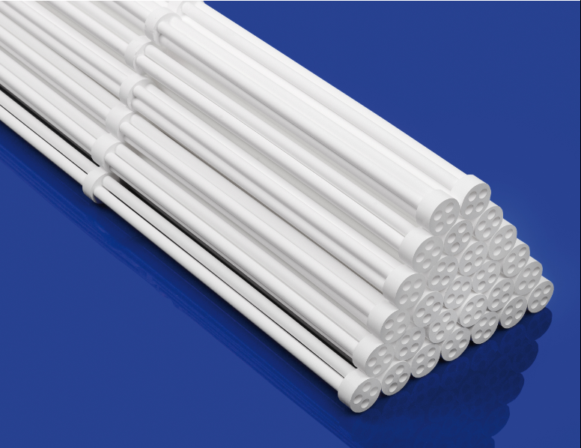
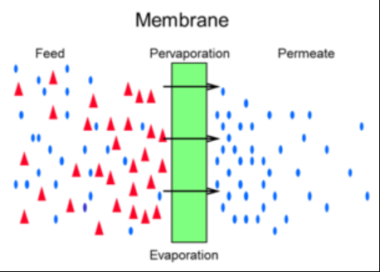
WORK UP
PERVAPORATION

Slide 38
WORK UP
CHROMATOGRAPHY
Best to avoid, technically difficult and expensive on large-scale, but still used in special cases (preparative chromatography);
Solid Phase Extraction
Simulated Moving Bed Chromatography
https://www.youtube.com/watch?v=Harx2khTuEc

Slide 39
EFFICIENT PROCESS DEVELOPMENT
Anticipate and avoid problems
Do experiments at minimum and maximum ranges to confirm robustness/sensitivity in cases where a particular parameter is significant
Identify critical impurities within the whole process and their fate
Get maximum allowed level of critical impurities
How to proceed if the specification criteria in IPCs are not met?
Pay attention to details, observe unusual changes
Avoid systematic errors
Take into account future process validation

Slide 40
PROCESS VALIDATION
The cumulative effort to demonstrate reliable processing and product quality;
The fruition of the labor of process chemists and engineers, the ultimate tests of how well one understands the process;
Before 1970s little attention has been paid to efficient process development;
1987 – FDA – Guideline on General Principles of Process Validation (validation is defined as establishing documented evidence which provides a high degree of assurance that a specific process will consistently produce a product meeting its predetermined specifications and quality attributes);
2008 – FDA – process validation is the collection and evaluation of data, from the process design stage throughout production, which establishes scientific evidence that a process is capable of consistently delivering quality products; the quality is built up into the product through process understanding and cannot be tested in batches – quality by design (QbD)
Anderson, N.G. et al Org.Process Res.Dev. 15, 162 (2011)

