Slide 1
SOLVENT SELECTION
Petr Beňovský

Slide 2
IMPORTANCE OF SOLVENTS
Reaction medium (transport, combine, separate)
Dissolution
(In)solubility
Kinetics
Health
Safety
Environmental aspects
Course of the reaction
Cost (purchase, recycle, dispose)

Slide 3
PERSPECTIVE ON SOLVENT SELECTION
ASPECT | COMMENT
Safety | Avoid solvents that are toxic or highly flammable
Promote high-yielding reactions | Compatible with desired chemistry; Can isolate product in good yield?
Convenient (minimize processing operations) | Isolate product from reaction solvent? Operate at high concentrations?
Water miscibility | Azeotroping ability Control amount of water
Cost of bulk and recoverability | More important at the end of development cycle
Environmental | Ethics, and cost of recovery and non-compliance
Long-term availability
Acceptability for human use
Water as solvent | But, recovery of product from aqueous layer can be costly, plus cost of disposal
Neat reactions
Ionic liquids

Slide 4
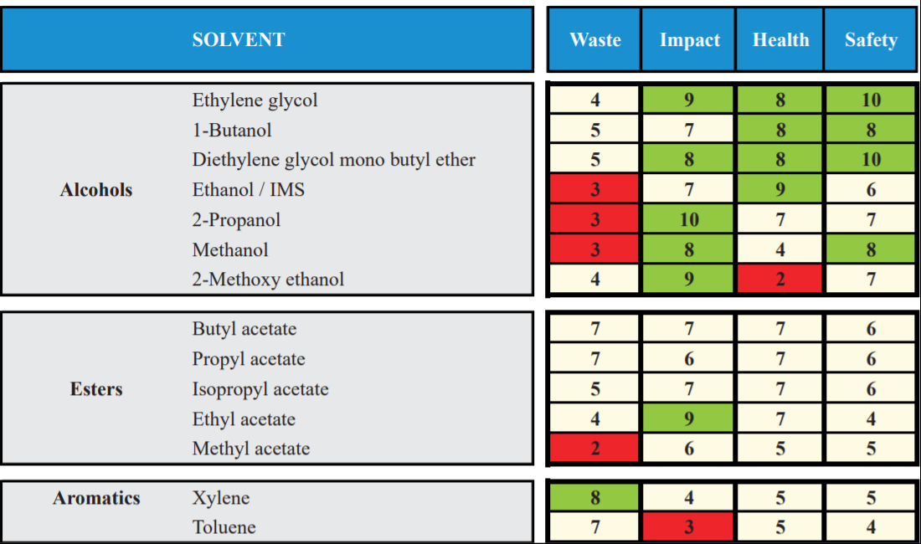
SOLVENT SELECTION GUIDES
Almost every company created specific solvent guide
SmithKline Beecham – Curzons, A.D. et al Clean Products and Processes 1, 82 (1999)

Slide 5
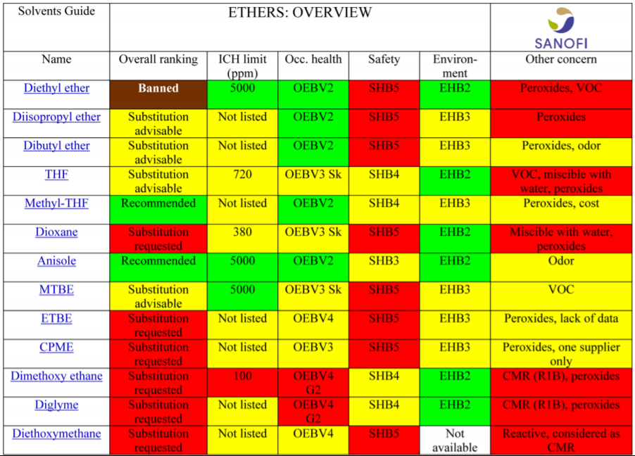
SOLVENT SELECTION GUIDES
Sanofi – Prat D. et al Org.Process Res. Dev. 17, 1517 (2013)

Slide 6
SOLVENT SELECTION GUIDES
GlaxoSmithKline – Henderson, R.K. et al Green Chemistry 13, 854 (2011)

Slide 7
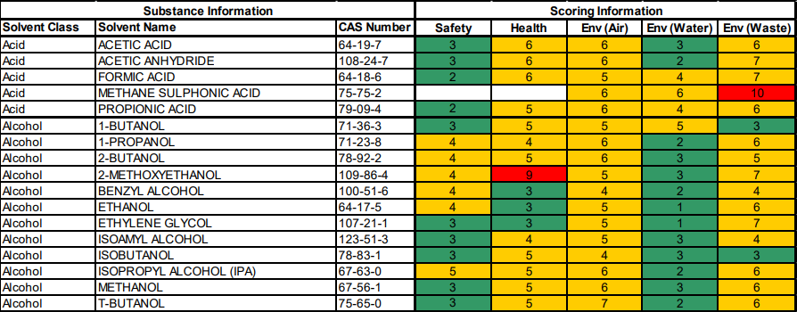
SOLVENT SELECTION GUIDES
ACS Green Chemistry Institute® Roundtable Solvent Selection Guide, March 2011

Slide 8
SOLVENT CONSIDERATIONS
Watch out hydrocarbon solvents with even number of carbons (toxicity, electrostatic buildup);
Classification of solvents – ICH Harmonised Guideline Q3C – Impurities: Guideline for Residual Solvents
Class 1 – solvents to be avoided (known human carcinogens, strongly suspected human carcinogens, and/or environmental hazards, e.g. carbon tetrachloride (concentration limit 4 ppm), 1,2-dichloroethane (5 ppm), 1,1,1-trichloroethane (1500 ppm), benzene (2 ppm))
Class 2 – solvents to be limited (non-genotoxic animal carcinogens, agents of irreversible toxicity, e.g. acetonitrile (410 ppm), chlorobenzene (360 ppm), chloroform (60 ppm), N,N-dimethylformamide (880 ppm), hexane (290 ppm), methanol (3000 ppm), N-methylpyrrolidone (530 ppm), toluene (890 ppm))
Class 3 – solvents with low toxic potential (permissible daily exposure 50 mg or more per day, e.g. acetic acid, acetone, ethyl acetate, heptane, 2-propanol, triethylamine)
Solvents for which no adequate toxicological data was found – a manufacturer is asked to supply justification for residual levels of these solvents (e.g. diisopropyl ether, petroleum ether, trifluoroacetic acid)

Slide 9
SOLVENT CONSIDERATIONS
The best reaction solvent is the one that crystallizes the product directly from the reaction;
Novartis – the Dimroth rearrangement – temperature and solubility turned out to be the most important – the product simply precipitated from the reaction mixture;
Fischer, R.W. Org.Process Res. Dev.5, 581 (2001)

Slide 10
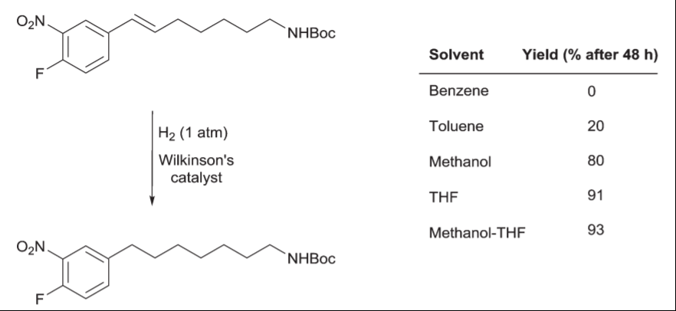
SOLVENT CONSIDERATIONS
Dyson, P.J.; Jessop, P.G. Catal.Sci.Technol.6, 3302 (2016)

Slide 11
SOLVENT CONSIDERATIONS
Homogeneous vs. Heterogeneous
Reactions using gases
Insolubility is sometimes advantageous (the Schotten-Baumann reaction, the Finkelstein reaction)
Menshutkin (1890)
The reaction rate of the reaction of triethylamine with alkyl halides providing quaternary ammonium salts strongly depends on a solvent (hexane 1, acetone 338, benzyl alcohol 739)
Solvents commonly used in academia are not often welcomed for industrial applications
Safety first !

Slide 12
SOLVENT CONSIDERATIONS
The Finkelstein reaction
The reaction driven to completion by exploiting the different solubility of used and formed halides

Slide 13
SOLVENT CONSIDERATIONS
The Halex reaction

Slide 14
MIXING OF HETEROGENEOUS MIXTURES
Anderson, N.G. Practical Process Research and Development, A guide for organic chemists, 2nd Edition, Elsevier 2000

Slide 15
SOLVENT CONSIDERATIONS
Solvent | TWA (ppm)
Acetone | 500
EtOAc | 400
MeOH | 200
t-BuOH | 100
MTBE | 50
MeCN | 20
DMF | 10
Pyridine | 1
2-Methoxyethanol | 0.1
TWA = Time-Weighted Average shift for five days for nearly safe exposure over an 8 h shift for five days for nearly all workers

Slide 16
SOLVENT CONSIDERATIONS
Also, always consider physical-chemical properties like
Flash point
Flammability
Boiling point
Melting point
Electrostatic charge accumulation
Recycling potential
Cost of solvent
Environmental aspects
Cost of disposal
Polarity

Slide 17
SOLVENT CONSIDERATIONS
Solvents rarely used in the pharmaceutical industry
Solvent | Disadvantage | Alternative replacement
Diethylether | Flammable | MTBE
Diisopropylether | Peroxide formation | MTBE
Hexane | Electrostatic charge Neurological toxicity | Heptanes, i-octane
Chloroform | Mutagenicity, environmental aspects, toxicity | Dichloromethane, 2-MeTHF, toluene
Benzene | Toxicity | Toluene
Ethylene glycol | Toxicity | 1,2-Propandiol
Acetonitrile | Animal teratogen, potential acetamide generation (genotoxic) | 2-propanol, acetone - water

Slide 18
SOLVENT CONSIDERATIONS
Solvents preferred for process development (Pfizer)
Preferred | Usable | Undesirable
Water | Cyclohexane | Pentane
Acetone | Heptane | Hexanes
Ethanol | Toluene | Diisopropyl ether
2-Propanol | Methyl cyclohexane | Diethyl ether
Ethyl acetate | MTBE | Dichloroethane
i-Propyl acetate | i-Octane | Dichloromethane
Methanol | 2-MeTHF | Chloroform
Methyl ethyl ketone | DMSO | DMF
n-Butanol | AcOH | NMP
t-Butanol | Ethylene glycol | 1,4-Dioxane
 |  | Benzene
 |  | Carbon tetrachloride

Slide 19
SOLVENT CONSIDERATIONS
Polarity of solvents
Hughes-Ingold rules ((de)stabilization of transition state)
Aliphatic nucleophilic substitution and elimination reactions;
Considering pure electrostatic interactions between ions or dipolar molecules and solvent molecules in initial and transition states;

Slide 20
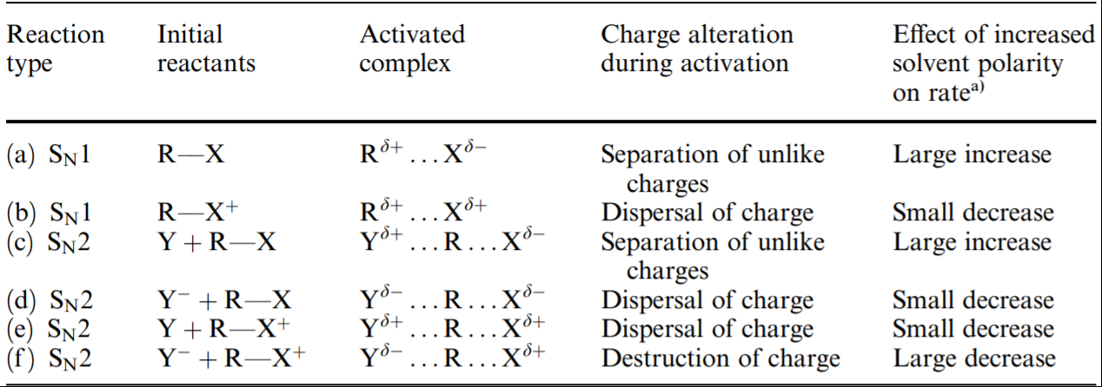
SOLVENT CONSIDERATIONS
Hughes-Ingold rules

Slide 21
SOLVENT CONSIDERATIONS
Hughes-Ingold rules
An increase in solvent polarity results in an increase in the rates of those reactions in which the charge density is greater in the activated complex than in the initial reactant molecules;
An increase in solvent polarity results in a decrease in the rates of those reactions in which the charge density is lower than in the initial reactant molecules;
A change in solvent polarity will have negligible effect on the rates of those reactions that involve little or no change in the charge density from reactants to the activated complex.

Slide 22
SOLVENT CONSIDERATIONS
Polarity of solvents
Reichardt, C. Pure Appl.Chem 76, 1903 (2004)
Reichardt, C. Solvents and Solvent Effects in Organic Chemistry,
3 rd Ed., Wiley-VCH, 2003

Slide 23
SOLVENT CONSIDERATIONS
Polarity of solvents
E_{T}(30) = h . c . N_{A} . ν_{max} [kcal . mol⁻¹]
Could be used even in solid rare gas matrices to establish polarity of rare gases (Xe → Kr → Ar → Ne decreasing polarizability)
E_{T}(30) recommended and used for monitoring of a quality of desinfection solutions of alcohol/water in order to prevent SARS-CoV 2 infections

Slide 24
SOLVENT CONSIDERATIONS
Polarity of solvents
E_{T}^{N} parameter – the negative solvatochromism of the π → π∗ shifts of solutions of the betaine dye – more polar solvents stabilize the ground energy of the polar dye, producing thus greater shift in the position of π → π∗ absorption relative to that found for solutions of the dye in tetramethylsilane.
Colors of this dye in a solvent are indicative of the polarities of the solvent and solvent combination used to dissolve it.

Slide 25
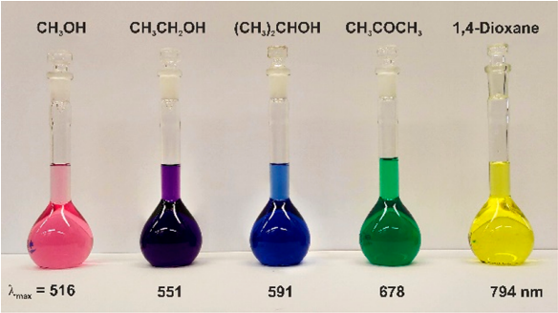
SOLVENT CONSIDERATIONS
Reichardt, C. J.Org.Chem 87, 1616 (2022)

Slide 26
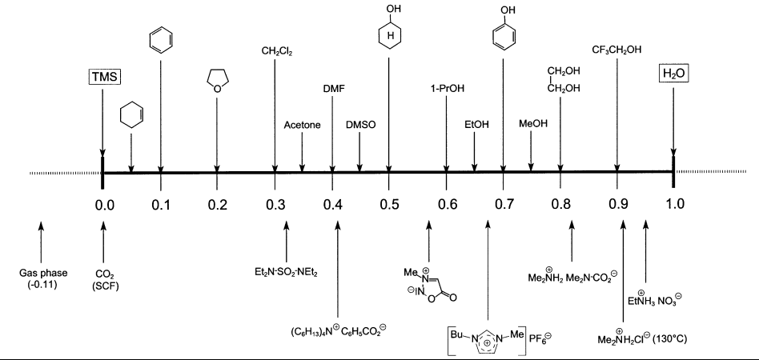
SOLVENT CONSIDERATIONS
Reichardt, C. Pure Appl. Chem.76, 1903 (2004)

Slide 27
SOLVENT CONSIDERATIONS
Polarity of solvents
Solvent | Polarity E_{T}^{N} | Solubility in water (wt%) | Bp of water-solvent azeotrope | wt% of water removed by azeotrope | ICH solvent class
Water | 1.000 | - | None | None
EtOH | 0.654 | ∞ | 78 °C | 4.0 | 3
AcOH | 0.648 | ∞ | 77 °C | 97 | 3
DMF | 0.404 | ∞ | None | None | 2
Acetone | 0.355 | ∞ | None | None | 3
CH₂Cl₂ | 0.309 | 1.3 | 38 °C | 1.5 | 2
Toluene | 0.099 | 0.06 | 84 °C | 13.5 | 2
Et₃N | 0.043 | 5.5 | 75 °C | 10 | 3
Heptane(s) | 0.012 | 0.0004 | 79 °C | 12.9 | 3
Cyclohexane | 0.006 | 0.006 | 69 °C | 9 | 2

Slide 28
SOLVENT CONSIDERATIONS
Polarity of solvent mixtures
Solvent | Polarity E_{T}^{N} | Solvent mixture | Calculated E_{T}^{N}
MeOH | 0.762 | EtOH:H₂O = 6.9:3.1 | 0.762
EtOH | 0.654 | Acetone:H₂O = 4.6:5.4 | 0.654
H₂O:CH₂Cl₂ = 0.2:99.8 | 0.310 | H₂O:MIBK = 1.9:98.1 | 0.283
H₂O:CH₂Cl₂ = 0.2:99.8 | 0.310 | H₂O:EtOAc = 3.3:96.7 | 0.253
H₂O:CH₂Cl₂ = 0.2:99.8 | 0.310 | H₂O:2-MeTHF = 5.3:94.7 | 0.223
i-PrOAc | 0.210 | Heptanes:EtOAc = 0.8:9.2 | 0.210
MeOH:H₂O = 7:1 | 0.792 | EtOH:H₂O = 5:3 | 0.783

Slide 29
SOLVENT CONSIDERATIONS
Tendency of solvents to form azeotropes with water is considered advantageous (it is not practical and economical to dry solvents using drying agents on large scale);
Be careful – dependence on pressure (breaking the azeotrope)
Effect of reducing distillation pressure on EtOAc – water:
Pressure (mm) | Bp (°C) | Water in azeotrope (wt%)
760 | 70.4 | 8.5
250 | 42.6 | 6.3
25 | 1.9 | 3.6

Slide 30
IMPURITIES IN SOLVENTS
Absolute solvents are rather expensive, common solvents contains some amount of water, for certain operations they should be dried (azeotropic distillation, molecular sieves, use of an excess of cheap reagent);
Denatured solvents (ethanol)
Stabilizers (e.g. BHT in THF)
Tendency to form (hydrogen)peroxides (diisopropyl ether, butadiene, acetaldehyde, 1,4-dioxane, styrene, acrylonitrile, 2-butanol, benzyl alcohol, THF, MIBK, 2-propyl alcohol)

Slide 31
IMPURITIES IN SOLVENTS
Degradation of solvents (ethyl acetate, DMF)
Side reactions (reesterifications, reaction with dichloromethane)
Avoid unwanted formation of esters of sulfonic acids (potentially mutagenic)

Slide 32
SACRIFICIAL SOLVENTS
About 50 eq. of 98% H₂SO₄ at 50 ºC for 3 h followed by an aqueous quench provided ring sulfonation in the product;
5-6 eq. of 98% H₂SO₄ in toluene at 70 ºC for 2 h – sulfonation of the product was significantly diminished.
Harrington, P.J. et al Org. Process Res. Dev. 10, 1157 (2006)

Slide 33
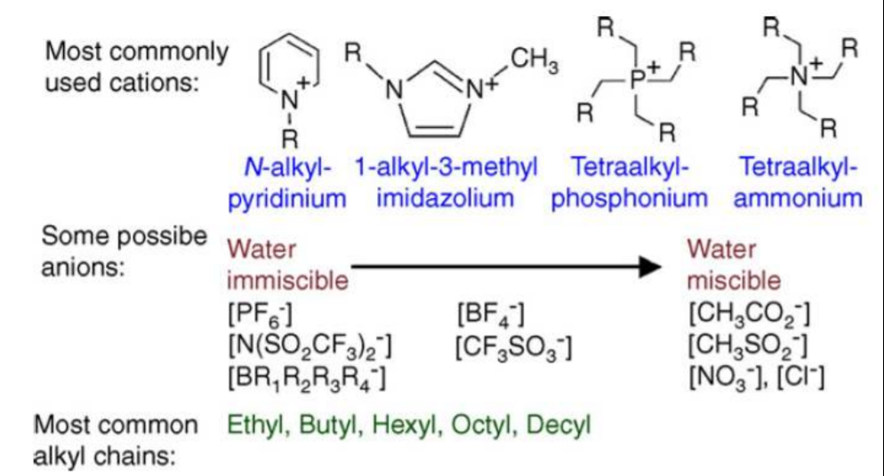
IONIC LIQUIDS
Ionic liquids are ionic compounds (salts) which are liquids below 100 ºC. More commonly, ionic liquids have melting points below room temperature.

Slide 34
IONIC LIQUIDS

Slide 35
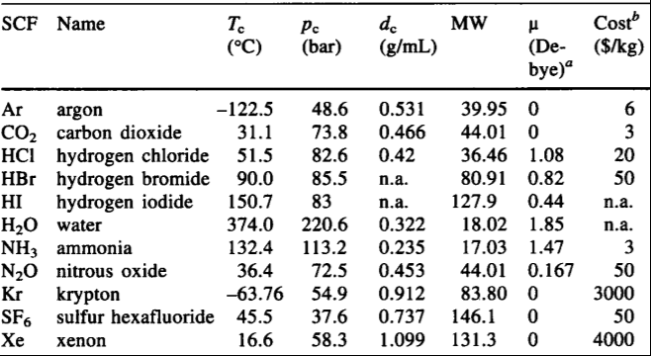
SUPERCRITICAL FLUIDS
Jessop, P.G.; Leitner, W. Chemical Synthesis Using Supercritical Fluids, Wiley-VCH 1999

Slide 36
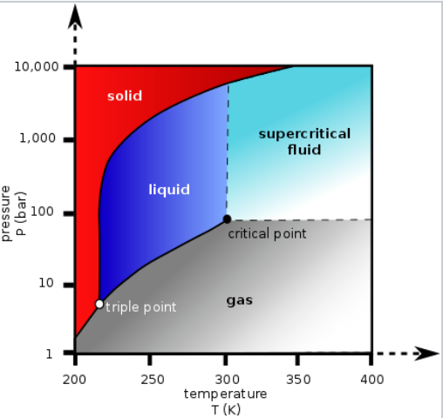
SUPERCRITICAL CARBON DIOXIDE
Peach, J.; Eastoe, J. Beilstein J.Org.Chem. 10, 1878 (2014)
Beckman, E.J. J.Supercritical Fluids 28, 121 (2004)

Slide 37
SUPERCRITICAL CARBON DIOXIDE
FOOD INDUSTRY
Coffee decaffeination
Tea decaffeination
Fatty acids from spent barley
Vitamin E, hops, spices extraction
Nicotine extraction
Natural insecticide/pesticide extraction

Slide 38
SUPERCRITICAL CARBON DIOXIDE
Thomas Swan & Co., Ltd.
Licence, P. et al Green Chem. 5, 99 (2003)

Slide 39
GAS EXPANDED LIQUIDS (GXLs)
Combination of a classical solvent and supercritical solvent (usually scCO₂) – adjustable polarity;

