Slide 1
E2020 – SOFT SKILLS II Citation Tools
Consuelo Quispe

Slide 2
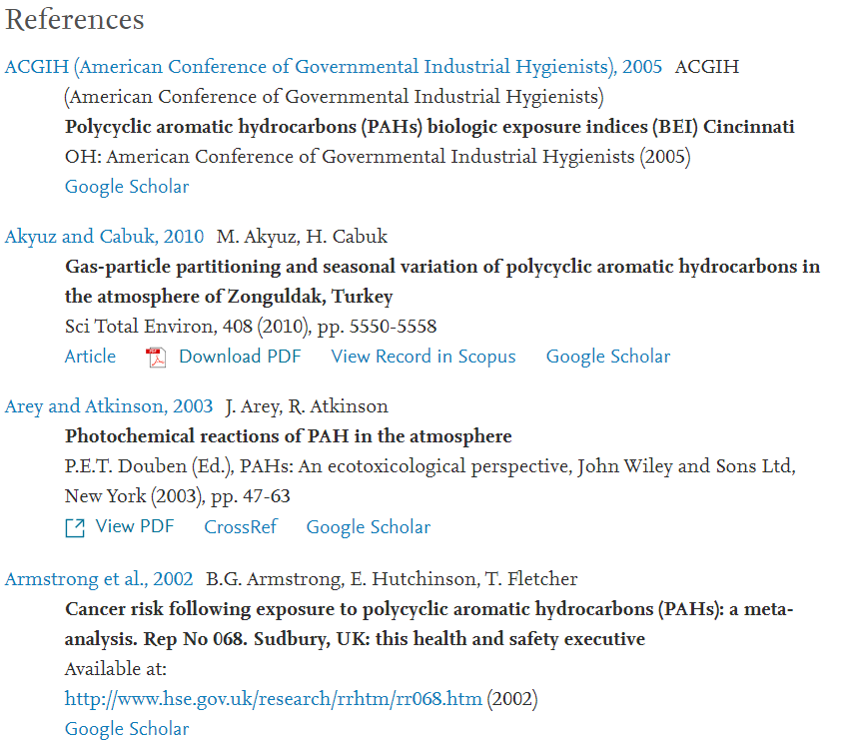
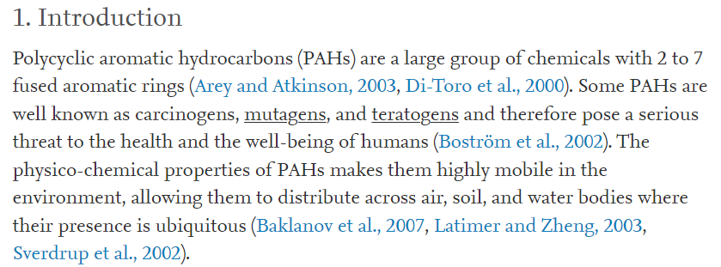

Slide 3
Why?
Plagiarism is presenting someone else’s work or ideas as your own, with or without their consent, by incorporating it into your work without full acknowledgement. All published and unpublished material, whether in manuscript, printed or electronic form, is covered under this definition.

Slide 4
Citation
Ambiguous terms quote & paraphrase
Quote = direct citation
In quotation marks
Not more than 10% of the text
Rarely (practically never) in scientific works
Paraphrase = indirect citation
The text must be understood
It is not enough to replace words with synonyms
In scientific works almost exclusively
In science: Citation = reference to the original source

Slide 5
What to cite?
DDT is one of the oldest and best-known organic insecticides.
In laboratory mice, an LD50 = 135 mg/g was found for oral administration of DDT.
Due to long-distance atmospheric transport, DDT can also be found in remote parts of the world.
DDT bioaccumulates in food chains, which is mostly found in predator tissues.

Slide 6
What to cite?
DDT is one of the oldest and best-known organic insecticides.
In laboratory mice, an LD50 = 135 mg/g was found for oral administration of DDT.
Due to long-distance atmospheric transport, DDT can also be found in remote parts of the world.
DDT bioaccumulates in food chains, which is mostly found in predator tissues, as Rachel Carson pointed out in 1962.

Slide 7
What NOT to cite?
Information considered as basic knowledge
What most people know
What a cultural or national group knows
What people in the field of study know
Depends on the
Target group (who reads it?)
Required level of knowledge
Expectations

Slide 8
What does the citation look like?
The basis is determined by ISO 690: 2021 https://www.iso.org/standard/72642.html
Does not specify citation style, only content!
Contains:
Author, other creators (e.g. translators)
Title, sometimes subtitles
Edition, publishing information (publisher, place, date)
Name and number of the edition, volume, magazine
ISBN, DOI
Availability (online)
…

Slide 9
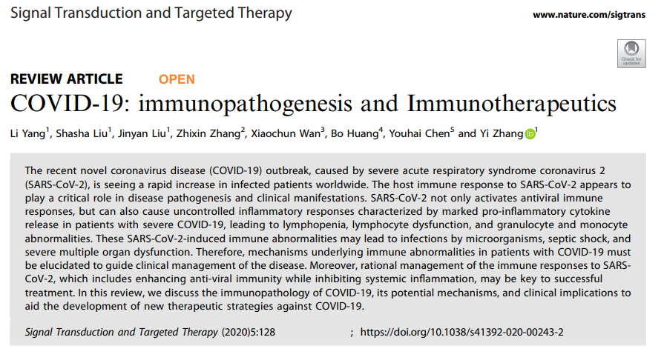
Yang, L., Liu, S., Liu, J. et al. COVID-19: immunopathogenesis and Immunotherapeutics. Sig Transduct Target Ther 5, 128 (2020). https://doi.org/10.1038/s41392-020-00243-2

Slide 10
Yang, L., Liu, S., Liu, J. et al. COVID-19: immunopathogenesis and Immunotherapeutics. Sig Transduct Target Ther 5, 128 (2020). https://doi.org/10.1038/s41392-020-00243-2

Slide 11
Author
In the beginning, before the title
Other creators (not authors!) after the title
It can also be an organization
Example:
Adamovský, O., Kopp, R., Hilscherová, K., Babica, P., Palíková, M., Pašková, V., ... & Bláha, L. (2007). Microcystin kinetics (bioaccumulation and elimination) and biochemical responses in common carp (Cyprinus carpio) and silver carp (Hypophthalmichthys molitrix) exposed to toxic cyanobacterial blooms. Environmental Toxicology and Chemistry: An International Journal, 26(12), 2687-2693.
Notes:
journal, volume, issue, page numbers

Slide 12
Title
Books = title page
Article = title
Long names can be abbreviated
Part of a larger whole (chapter in the book) -> preposition "In"
Example:
POTUŽÁK, Tomáš. Postponed traffic flow characteristics transfer in distributed simulation of road traffic. In: Software Engineering Techniques in Progress. Wroclaw: Oficyna Wydawnicza Politechniki Wroclawskiej, 2008, pp. 245–258. ISBN 978-83-7493-421-3

Slide 13
Edition, publisher, date
Edition - often abbreviated:
Second supplemented edition = 2nd suppl. ed.
Third edition = 3rd ed.
Also publisher:
John Wiley & Sons, Inc. = Wiley
List of allowed abbreviations according to the national library (cz):
https://www.nkp.cz/o-knihovne/odborne-cinnosti/zpracovani-fondu/schvalene-materialy/def-zkra

Slide 14
Edition, volume, magazine
Examples:
vol. 10, s. 148-155.
sv. 9, č. 2, s. 29-33.
For texts in Czech, part type is stated in original (here English, „vol.“ as in „volume“), but pages are in Czech (stránky), therefore „s.“ English version would be „pp.“
Part type can be omitted in serial publications:
10, 148-155
9 (2), 29-33
Magazine titles are abbreviated:
"Environmental Science and Pollution Research" = Environ. Sci. Pollut. Res.

Slide 15
ISBN, DOI
These are standard identifiers
ISSN = international standard serial number
ISBN = international standard book number
… Similarly, ISMN (music), ISAN (audiovisual),…
DOI = digital object identifier
Each online article currently has an assigned DOI
Easy to trace, sometimes straight hyperlink

Slide 16
Availability
For online sources
"Available from:"
Source can change in time - state the date of citation [cit. 4/12/2021]
Example:
DAVIES, Lorraine, FORD-GILBOE, Marilyn and HAMMERTON, Joanne. Gender Inequality and Patterns of Abuse Post Leaving. Journal of Family Violence [online]. Springer. Jan 2009, 24 (1), 27-39 [cited. 6/13/2011]. DOI: 10.1007 / s10896-008-9204-5.

Slide 17
APA 7TH
Ritchie, H. (2022, January 25). Around one-in-three children globally suffer from lead poisoning. What can we do to reduce this? Our World in Data. https://ourworldindata.org/reducing-lead-poisoning
VANCOUVER
Ritchie H. Around one-in-three children globally suffer from lead poisoning. What can we do to reduce this? [Internet]. Our World in Data. 2022 [cited 2022 Feb 24]. Available from: https://ourworldindata.org/reducing-lead-poisoning

Slide 18
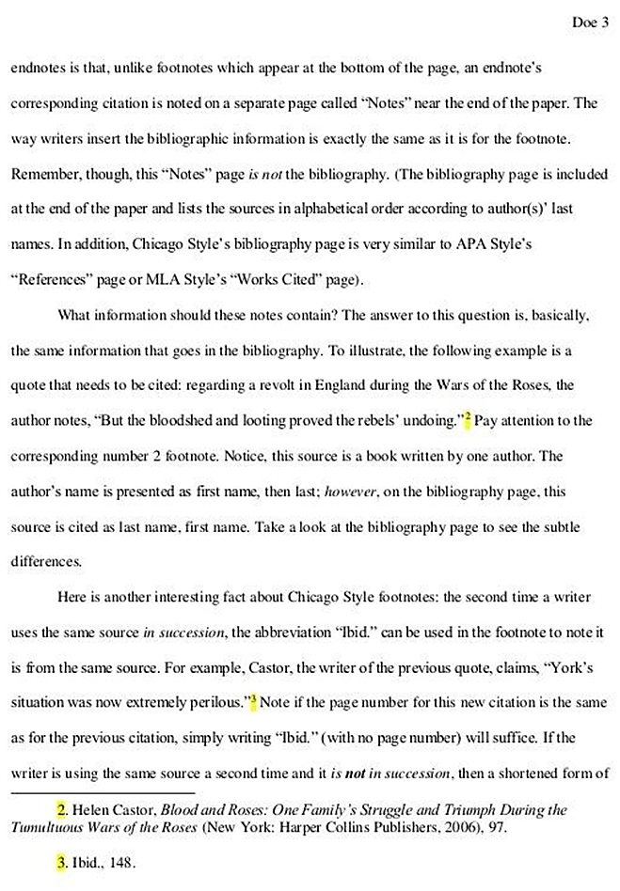
Styles
Where can you find a full quote?
Footnotes
Quotes at the bottom of the page
Footer
Atypical for scientific publications
Endnotes
Citation at the end of the document
All quotes together
Common for scientific publications

Slide 19
Styles
(Smedes, 2019)
(Urík and Vrana, 2019)
(Booij et al., 2016)
(Okeme et al., 2018; Rusina et al., 2007; 2010)
…as suggested by Urík et al. (2020).
(Turner, 1998a) … (Turner, 1998b)
This is a reference (1) followed by another two references (2, 3).
This is also a reference¹, followed by another
two references^{2,3}.
What does the citation link look like?
Harvard system
Author and year in parentheses
Omit the name when it is already in the text
Max 2 names, otherwise only the first author et al.
List of citations in alphabetical order
Vancouver system (numerical)
Numeric reference
Brackets or exponent
List of citations sorted by order of occurrence

Slide 20
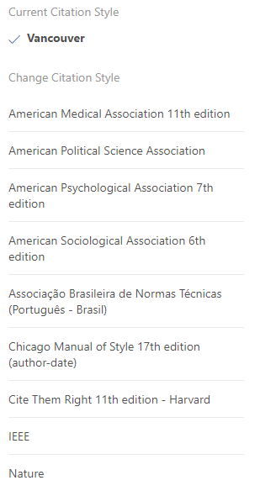
Styles
Which system to choose? And what does the overall quote look like?
Each magazine has its own rules
Can be found in the "Guide for authors" on the magazine pages
Examples
Nature:
Urík, J., Paschke, A. & Vrana, B. Diffusion coefficients of polar organic compounds in agarose hydrogel and water and their use for estimating uptake in passive samplers. Chemosphere 249, 126183 (2020).
Chemosphere:
Urík, J., Paschke, A., Vrana, B., 2020. Diffusion coefficients of polar organic compounds in agarose hydrogel and water and their use for estimating uptake in passive samplers. Chemosphere 249, 126183. doi:10.1016/j.chemosphere.2020.126183
ACS:
Urík, J.; Paschke, A.; Vrana, B. Diffusion coefficients of polar organic compounds in agarose hydrogel and water and their use for estimating uptake in passive samplers. Chemosphere 2020, 249, 126183.

Slide 23
Which system to choose? And what does the overall quote look like?
The citation manager will help

